Slide 1
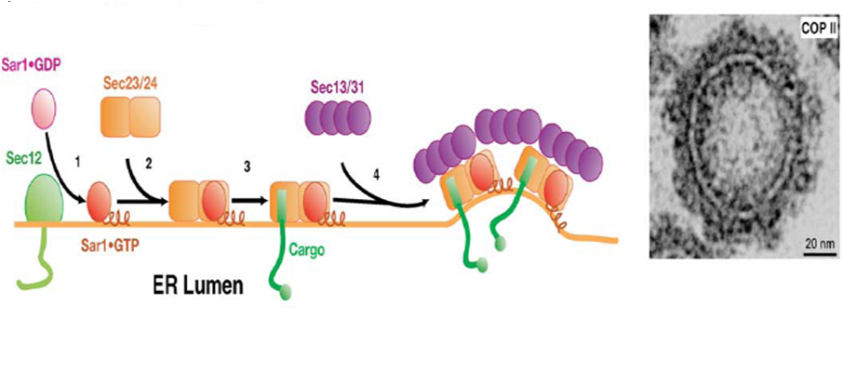
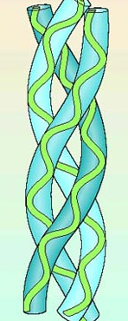
How does a COPII vesicle accommodate large cargo?
60-70 nm
Procollagen (soluble cargo)
300 nm
Lee et al., Annu. Rev. Cell Dev Biol. 2004.20:87-123

Slide 2
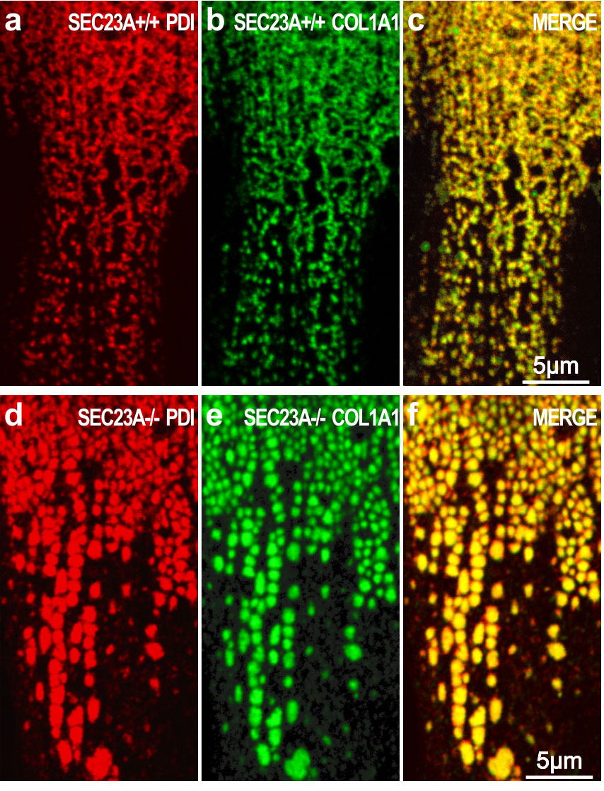
Collagen accumulates in the ER in CLSD mutant fibroblasts

Slide 3
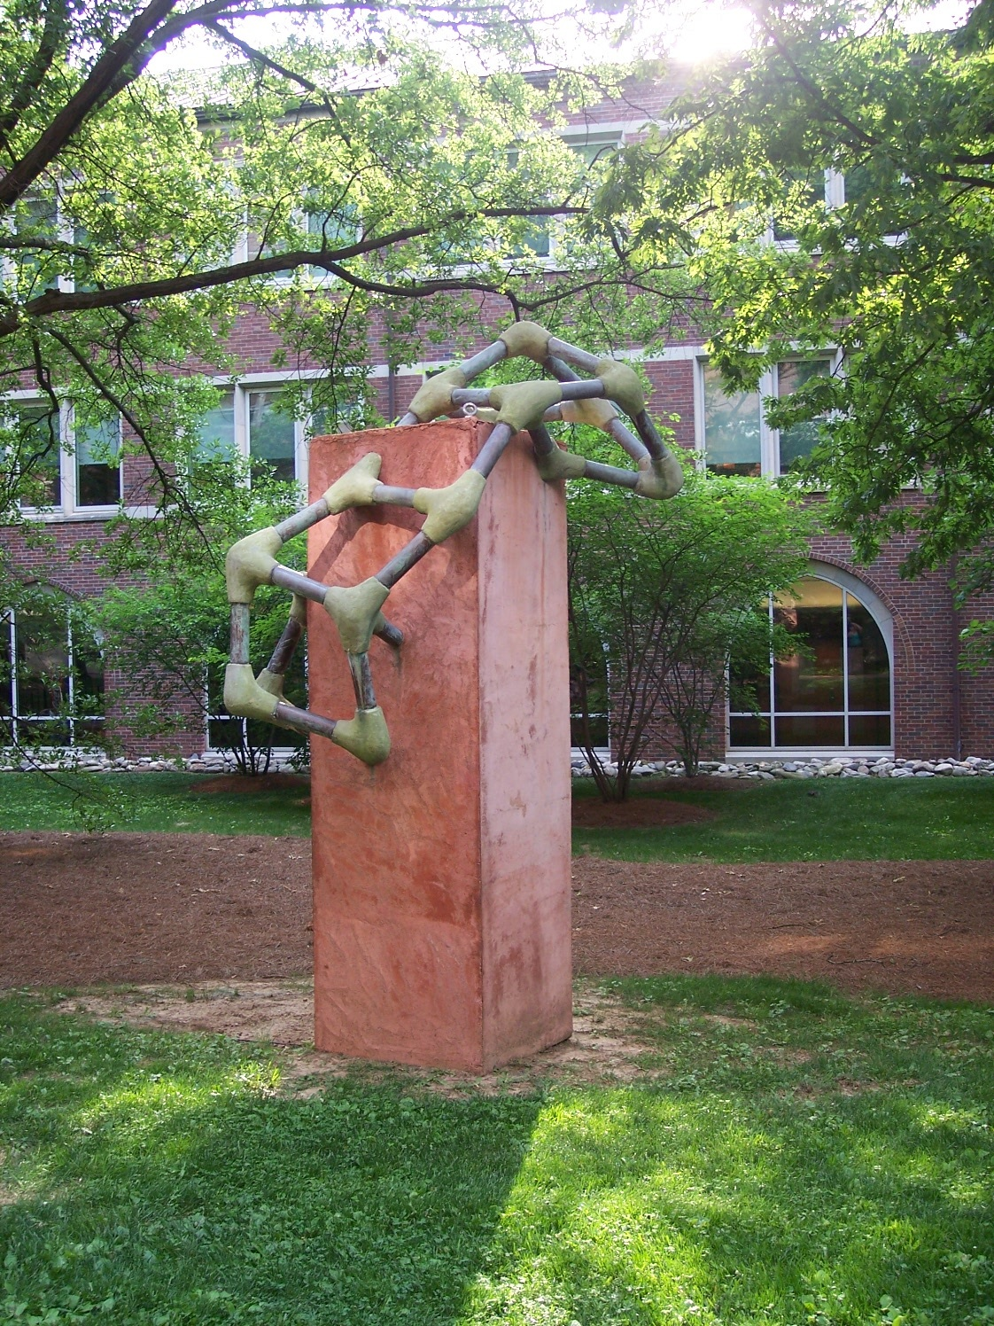

Slide 4
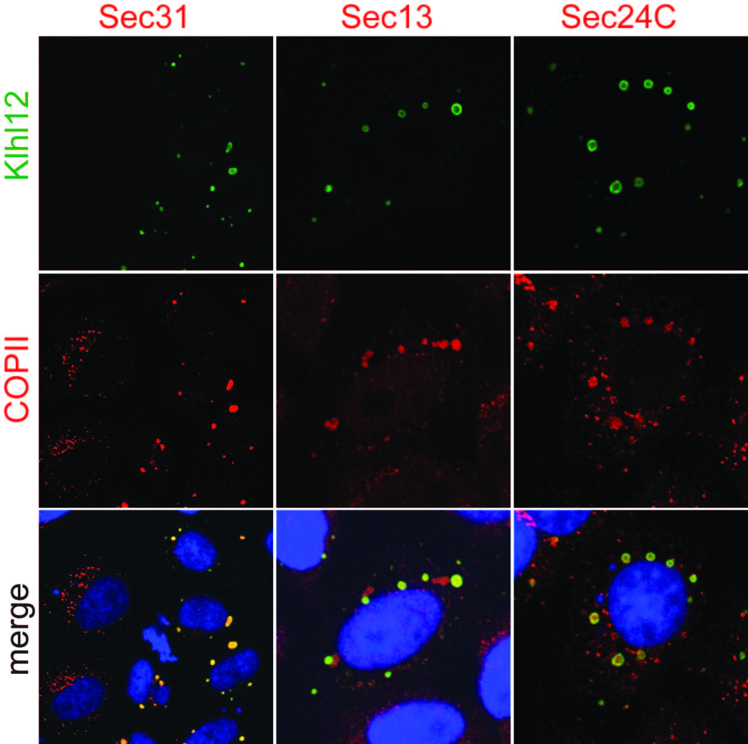
Cul3^{Klhl12} increases the size of COPII vesicles

Slide 5
Overexpression of wt but not mutant Klhl12 promotes collagen secretion
Klhl12 Empty FG289 (mutant Klhl12)
L M L M L M L M L M L M
PC-1
Tubulin
L, lysate ; M, media

Slide 6
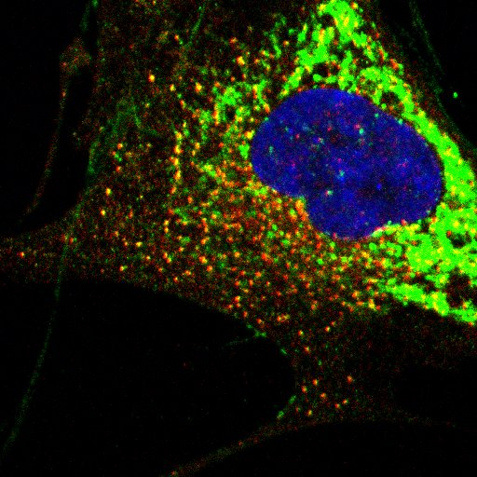
Sec 31
PC-1
Sec31/PC-1 co-localization in IMR90
fibroblasts
Overlay

Slide 7
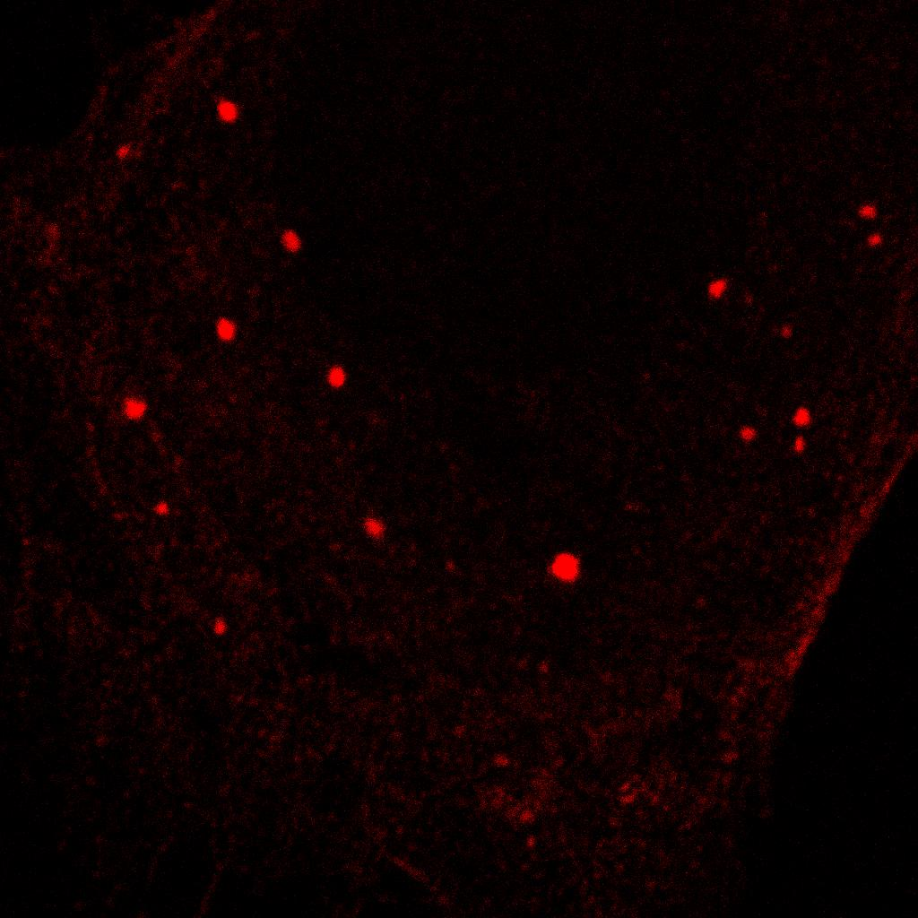
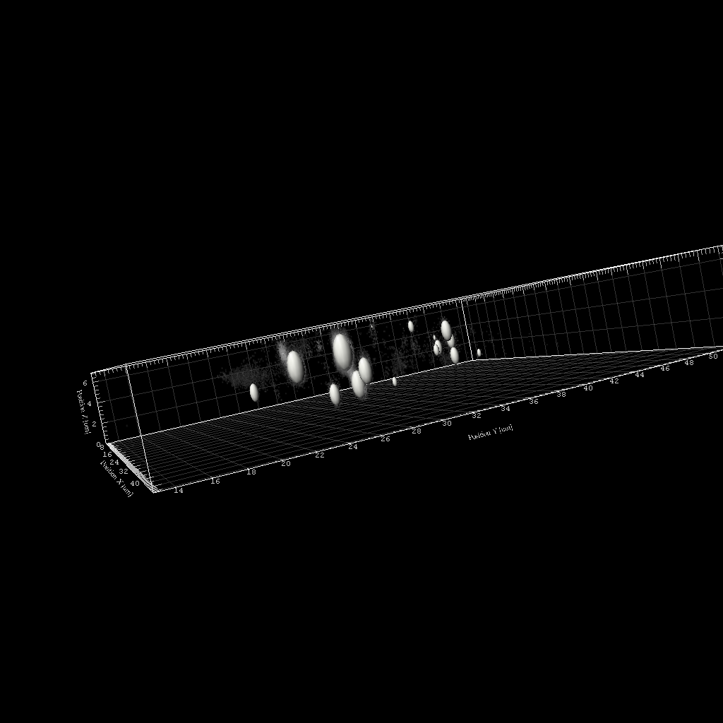
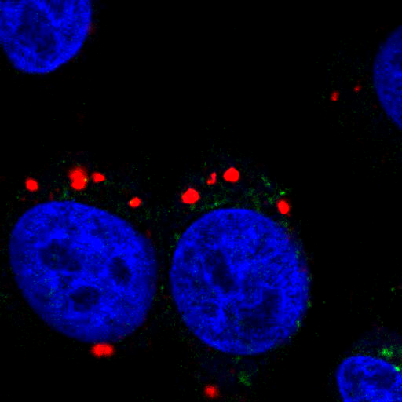
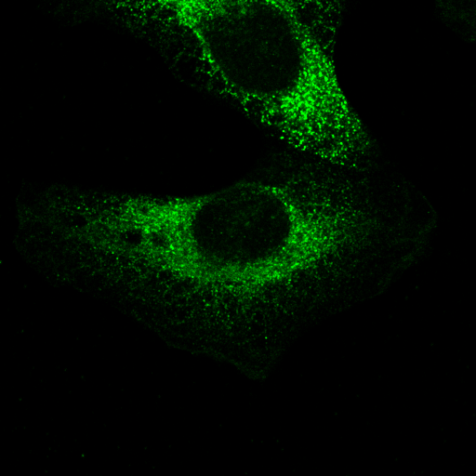
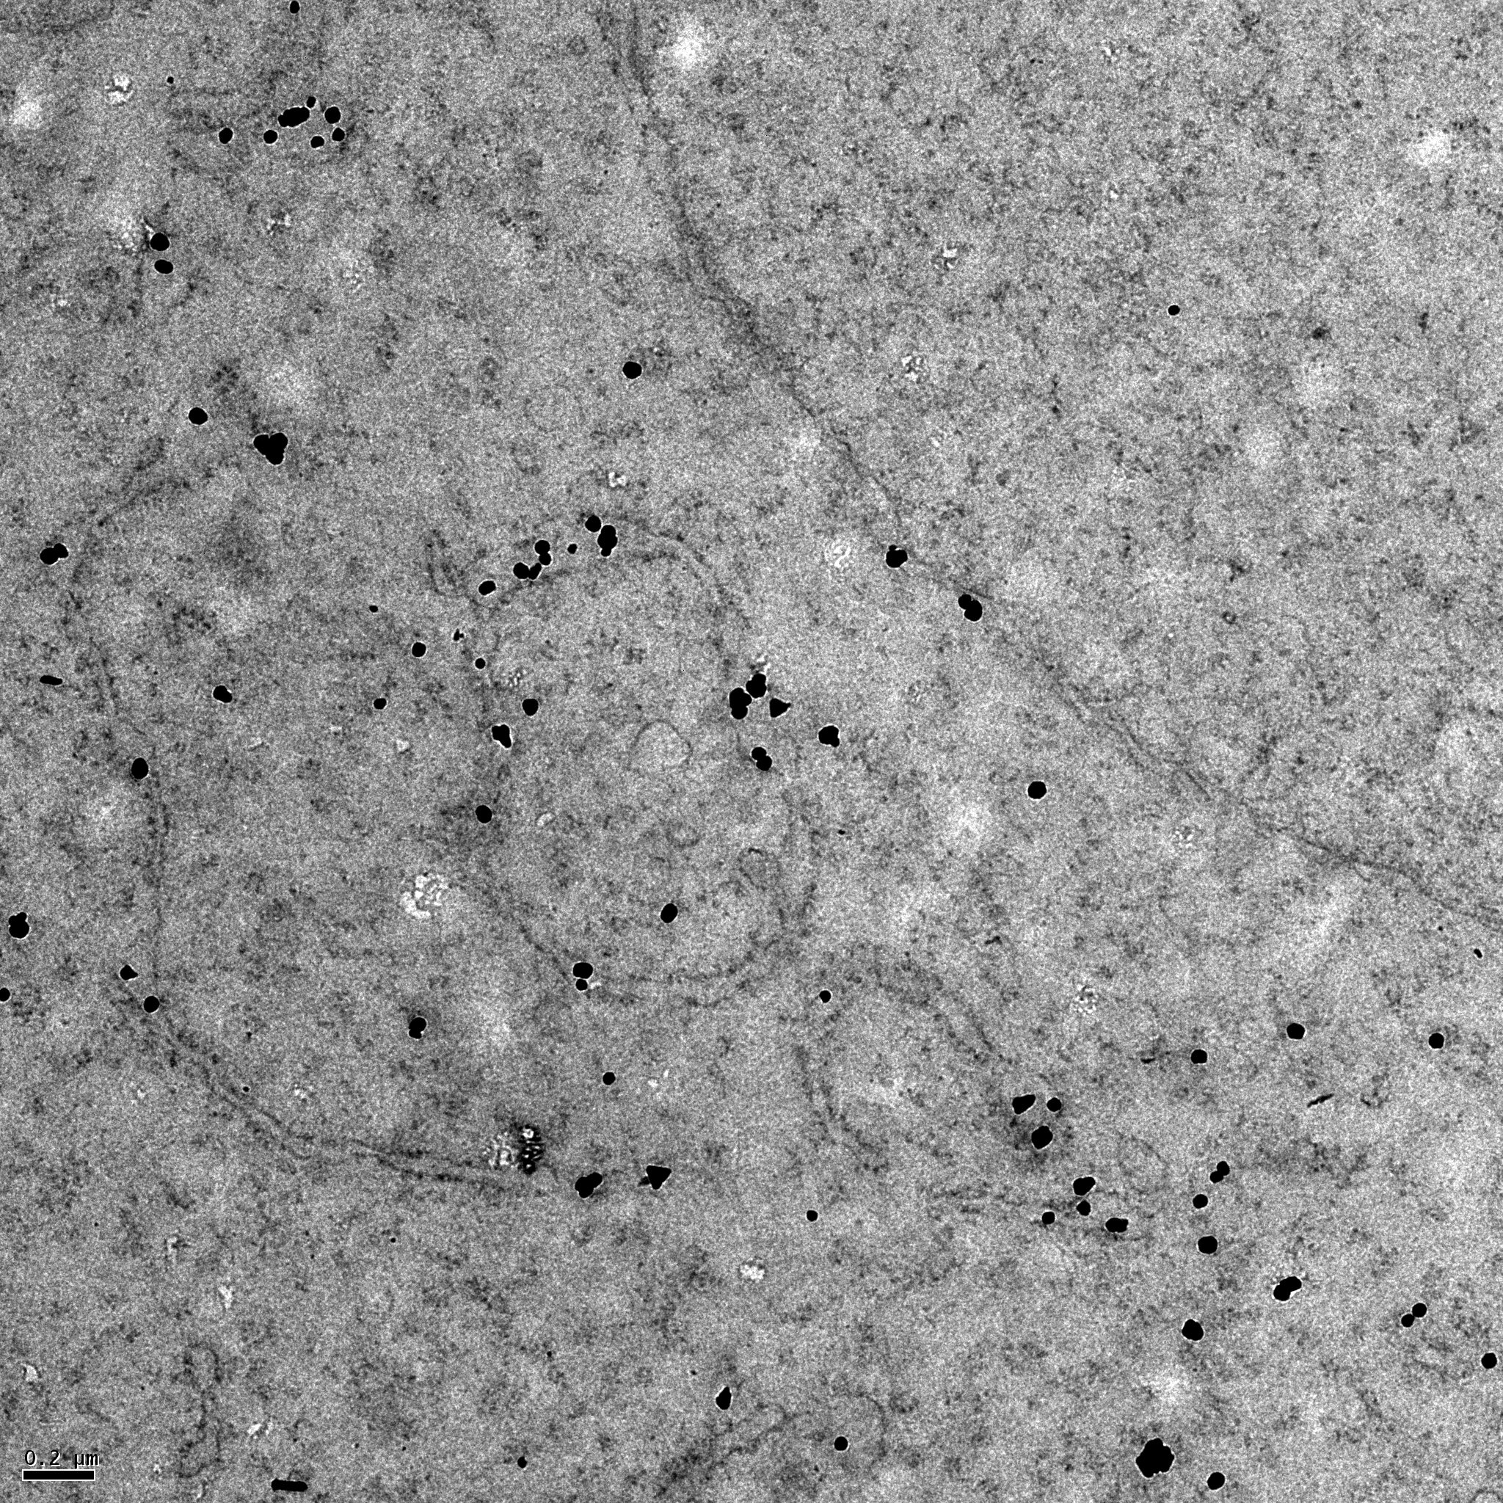
Generation of doxycycline inducible Human Fibrosarcoma (HTPC KI) cell line
stably transfected with PC-1 for structure/function analysis of COPII megacarriers
7.5 hrs
Size distribution
24 hrs
a
b
c
PC-1
d
d
e
f
Notes:
(a) KLHL12 positive structures at 7.5 hours of induction. The structures range in z diameter of 0.3 to 1 μm (b) and upto 2μm (x-y) after 24 hours induction (c). D. Procollagen 1 (PC-1) labeling in parent cell line HT1080 showing no labeling while a uniform reticular pattern in the ER is seen in the stable cell line (e) confirmed ultrastructurally by pre-embedding immunogold labeling (f)

Slide 8
Double Immunofluorescence labeling showing co-localization of klhl12/PC-1
Notes:
Cell line : HTPC KI-6 stable cell line
Time of induction: 7.5 hours
Primary: Rabbit anti-Flag/Mouse monoclonal PC-1
(QED Biosciences Inc)
Secondary: Rabbit 568 / Mouse 488

Slide 9
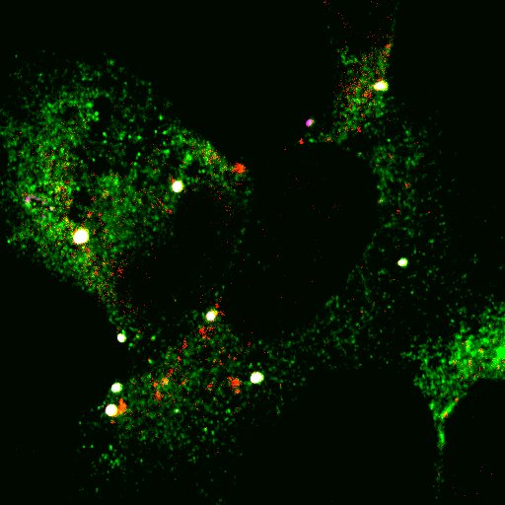
Triple Immunofluorescence labeling showing
co-localization of klhl12/PC-1/Sec31
Goat FLAG (klhl12)
Rabbit Sec 31
Mouse PC-1
overlay
3 um
Notes:
Cell line : HTPC KI-6 stable cell line
Time of induction: 7.5 hours
Primary: Goat anti-Flag/Mouse monoclonal PC-1/Rabbit Sec31
Secondary: Rabbit 568 / Mouse 488 / Goat 647

Slide 10
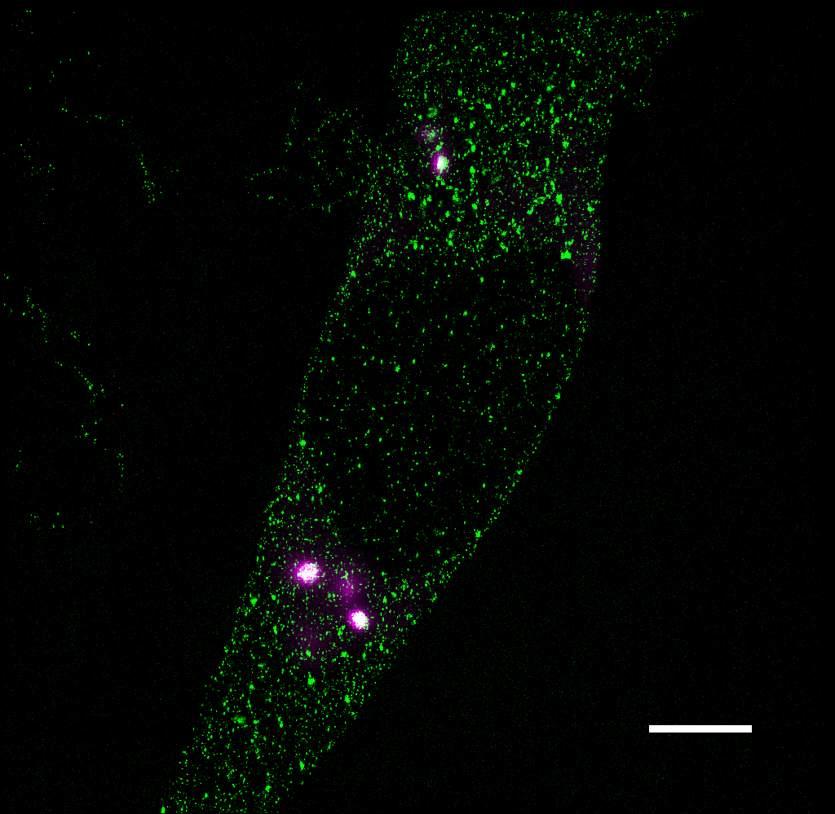
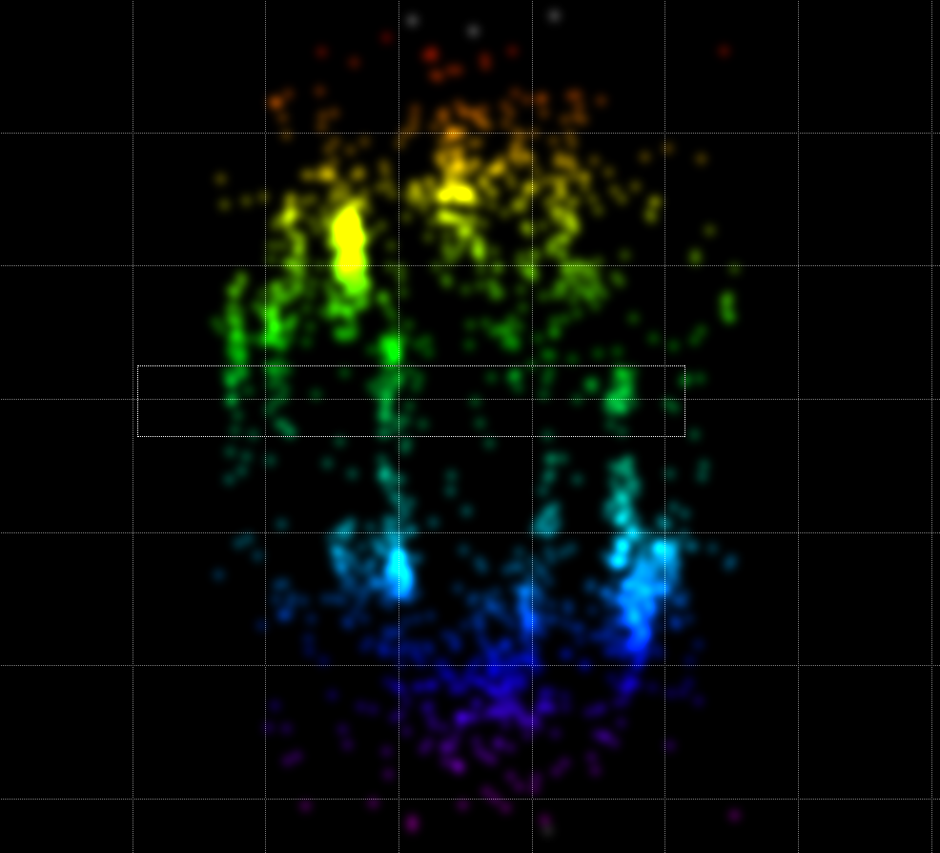
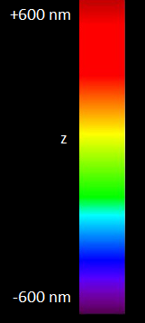
SUPER-RESOLUTION 3D STORM IMAGING OF ENLARGED COPII VESICLES
Green=Sec31 647
Magenta=FLAG 488
Scale bar: 5 μm
200 nm
Ke Xu Lab
Dept. of Chemistry, UC Berkeley

Slide 11
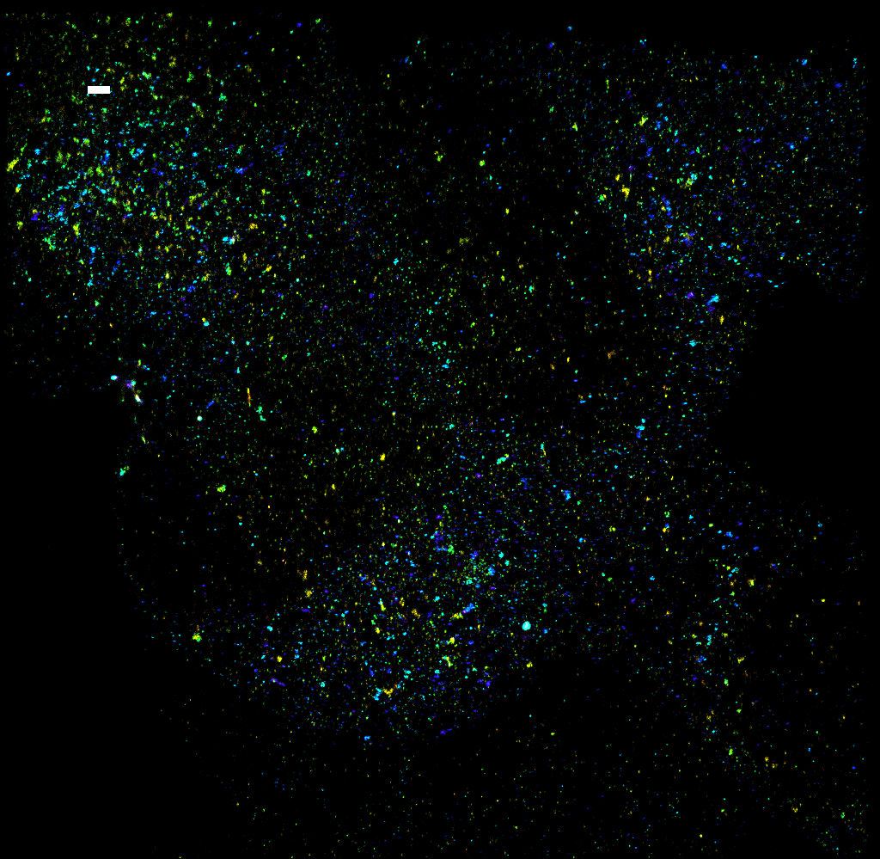
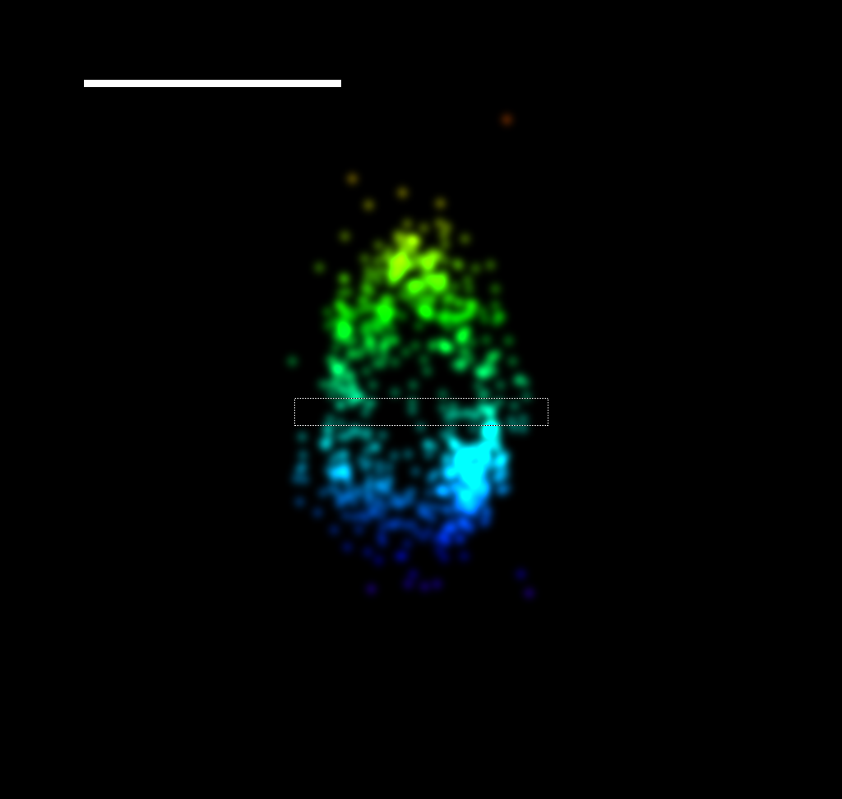
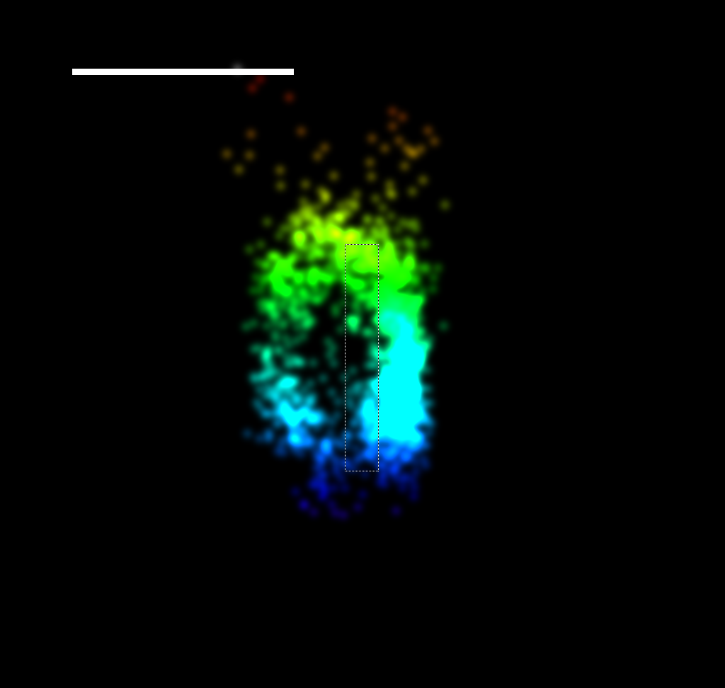
SUPER-RESOLUTION 3D STORM IMAGING REVEALS A HOLLOW CAGE
500 nm
500 nm
x
Y
Z
Z

Slide 12
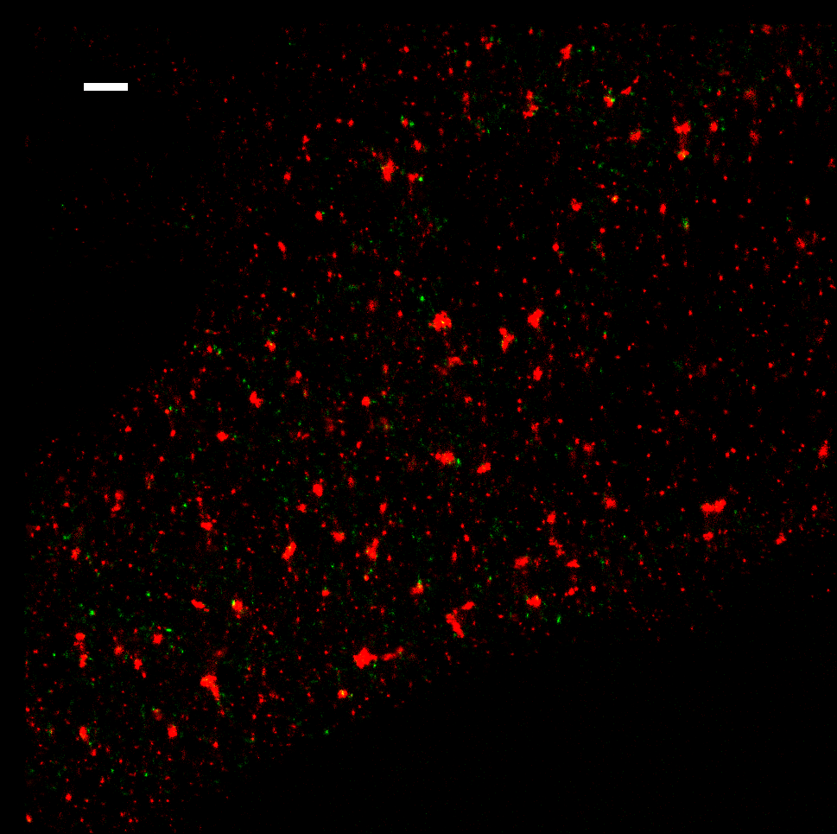
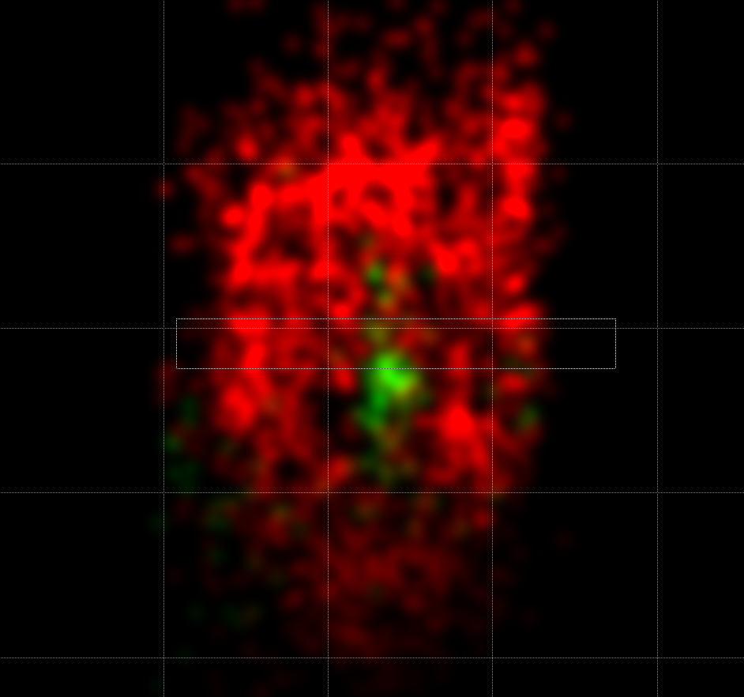
2 COLOR 3D STORM IMAGING REVEALS A CAGE ENCAPSULATING PROCOLLAGEN
xz view of a selected xy area
Sec31 (647)
PC1 (Cy3b)
Grid: 200 nm x 200 nm
Sec31 (647)
PC1 (Cy3b)
Notes:
STORM 4/13/14

Slide 13
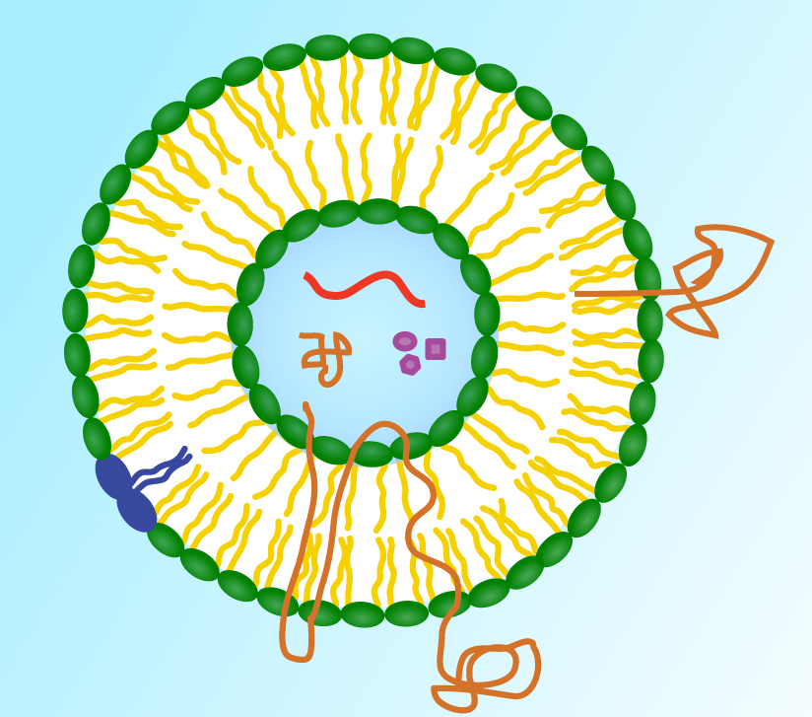
Extracellular vesicles as carriers of unconventional signals
Anchored membrane proteins
RNA
Cytoplasmic proteins
Small molecules
Lipids
Transmembrane proteins

Slide 14
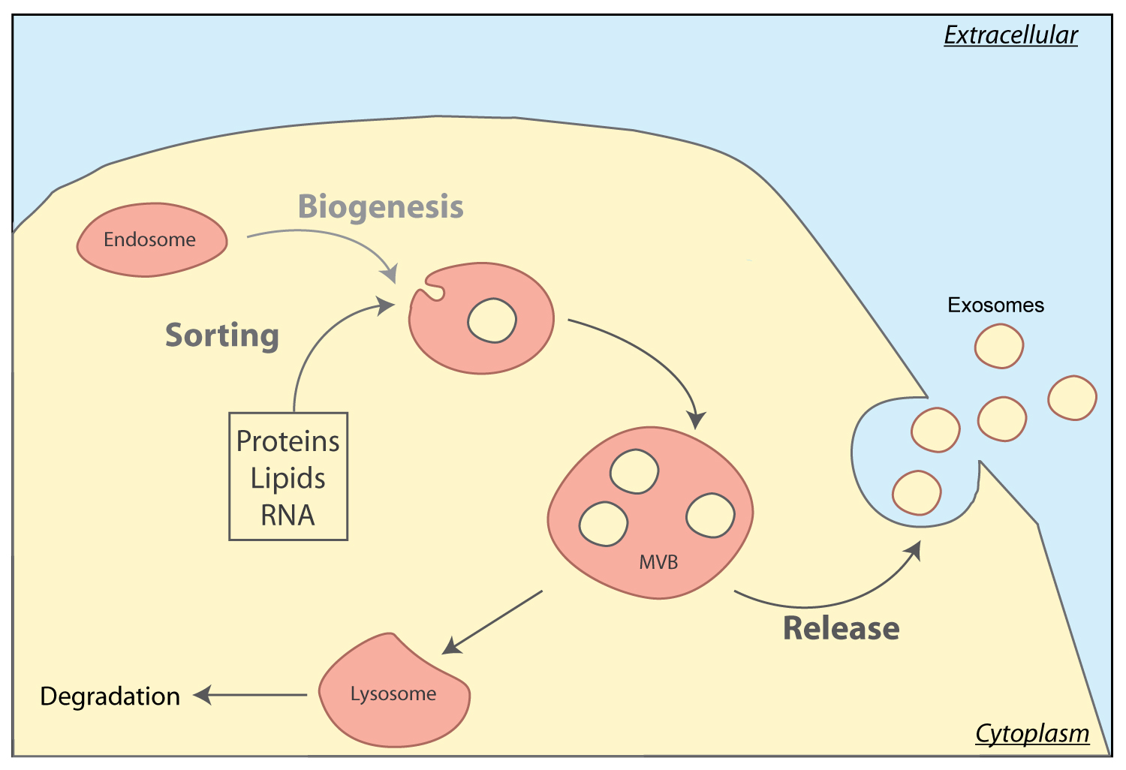
Origin and secretion of exosomes

Slide 15
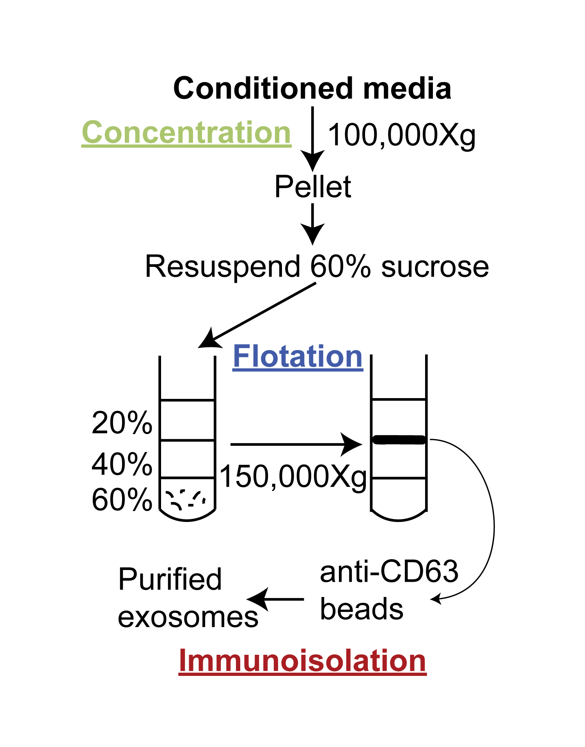
Purification of CD63 exosomes

Slide 16
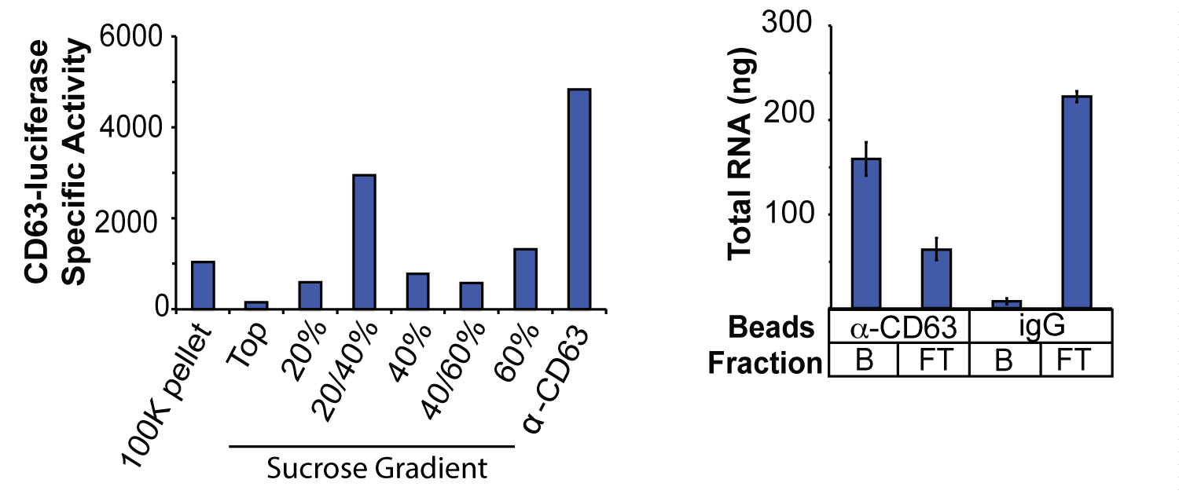
CD63-luciferase and RNA in purified exosomes

Slide 17
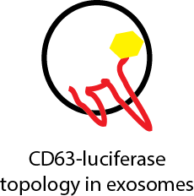
Luciferase latent in CD63 exosomes

Slide 18
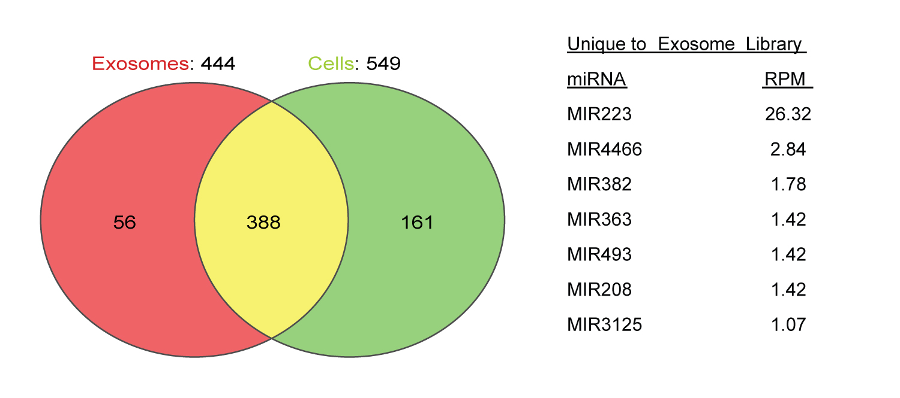
Distribution of miRNAs in exosomes and cells

Slide 19
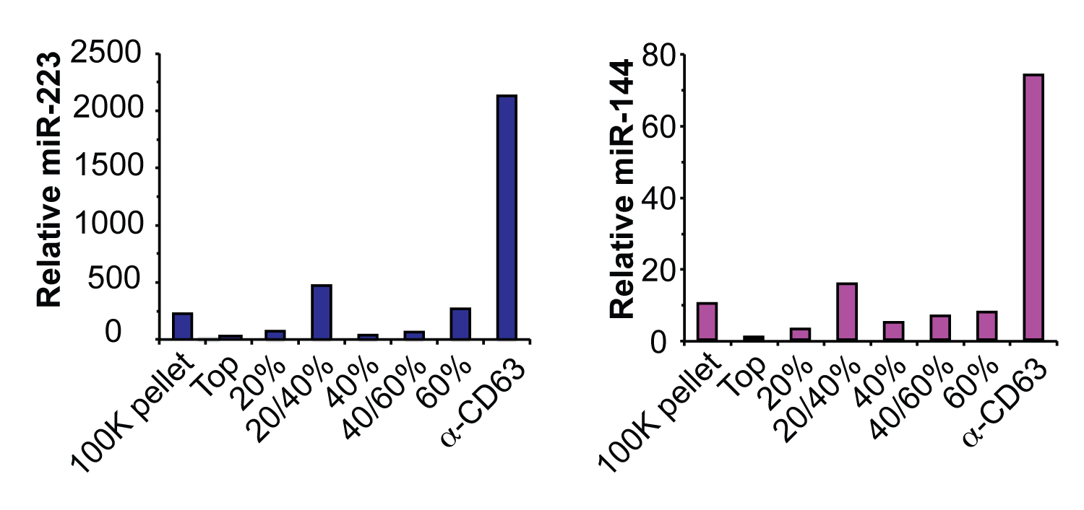
Co-purification of CD63 and miRNAs

Slide 20
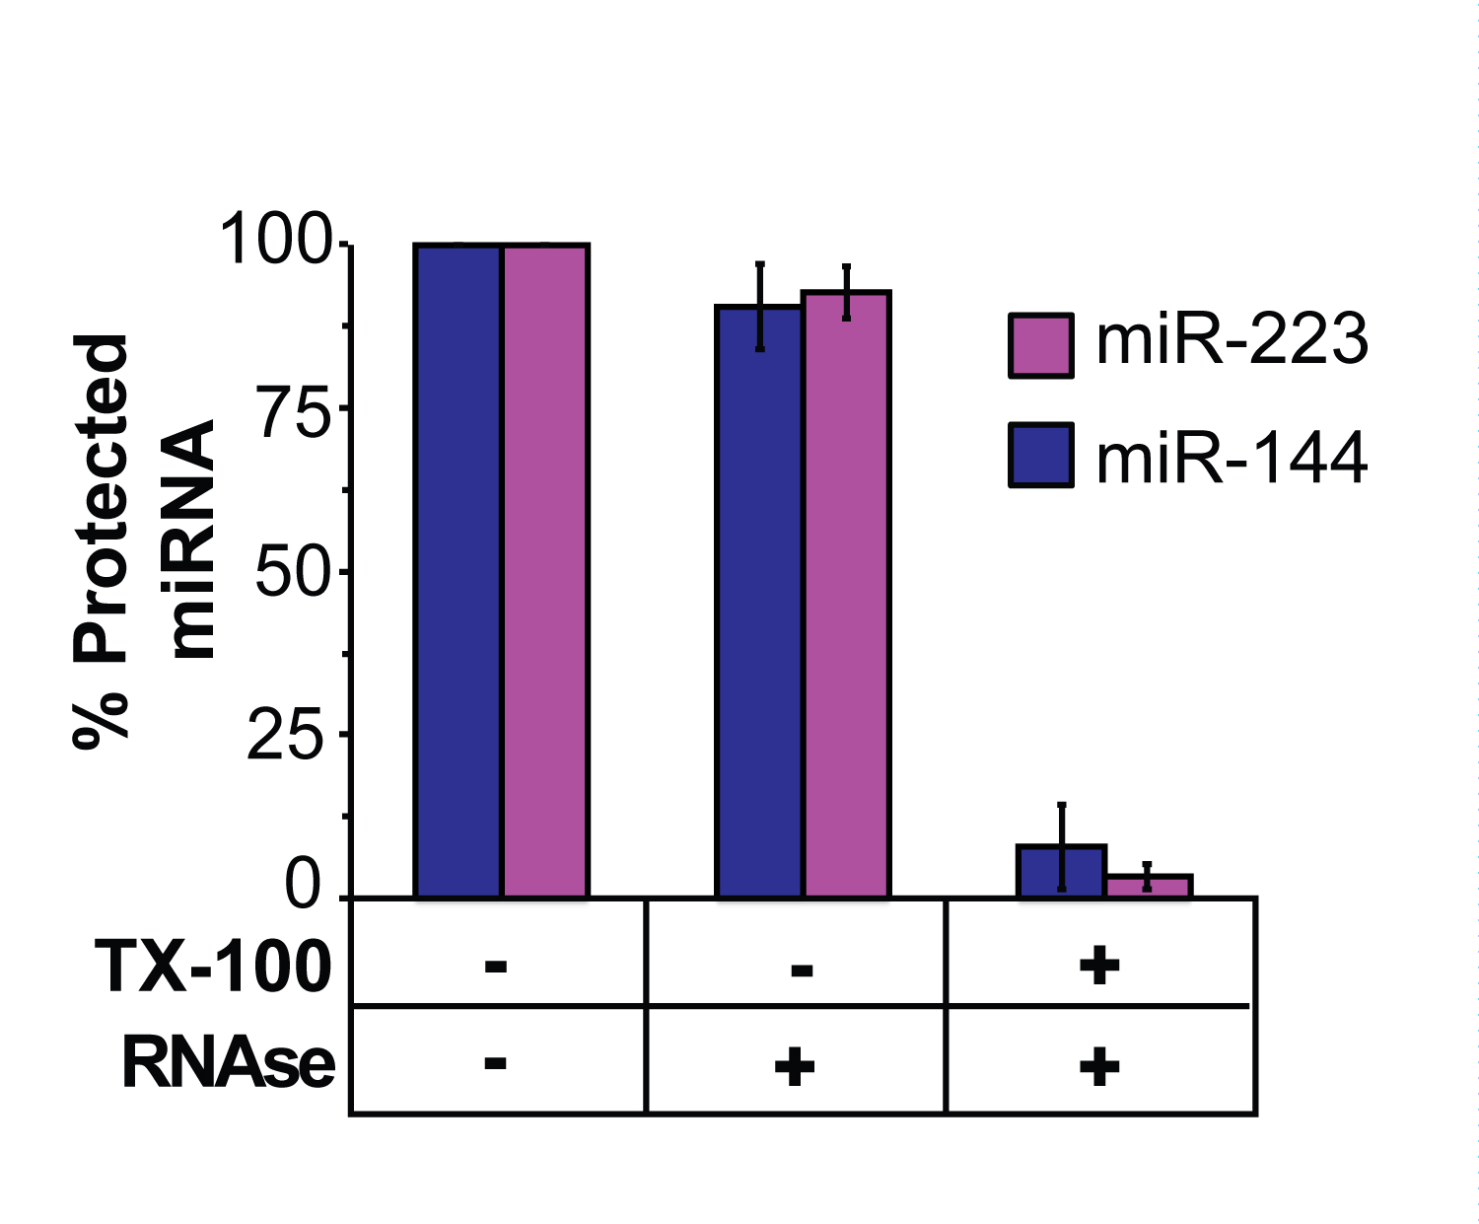
miRNAs in detergent-sensitive vesicles

Slide 21
Cell-free exosome biogenesis
Notes:
Membranes (CD63-luc)

Slide 22
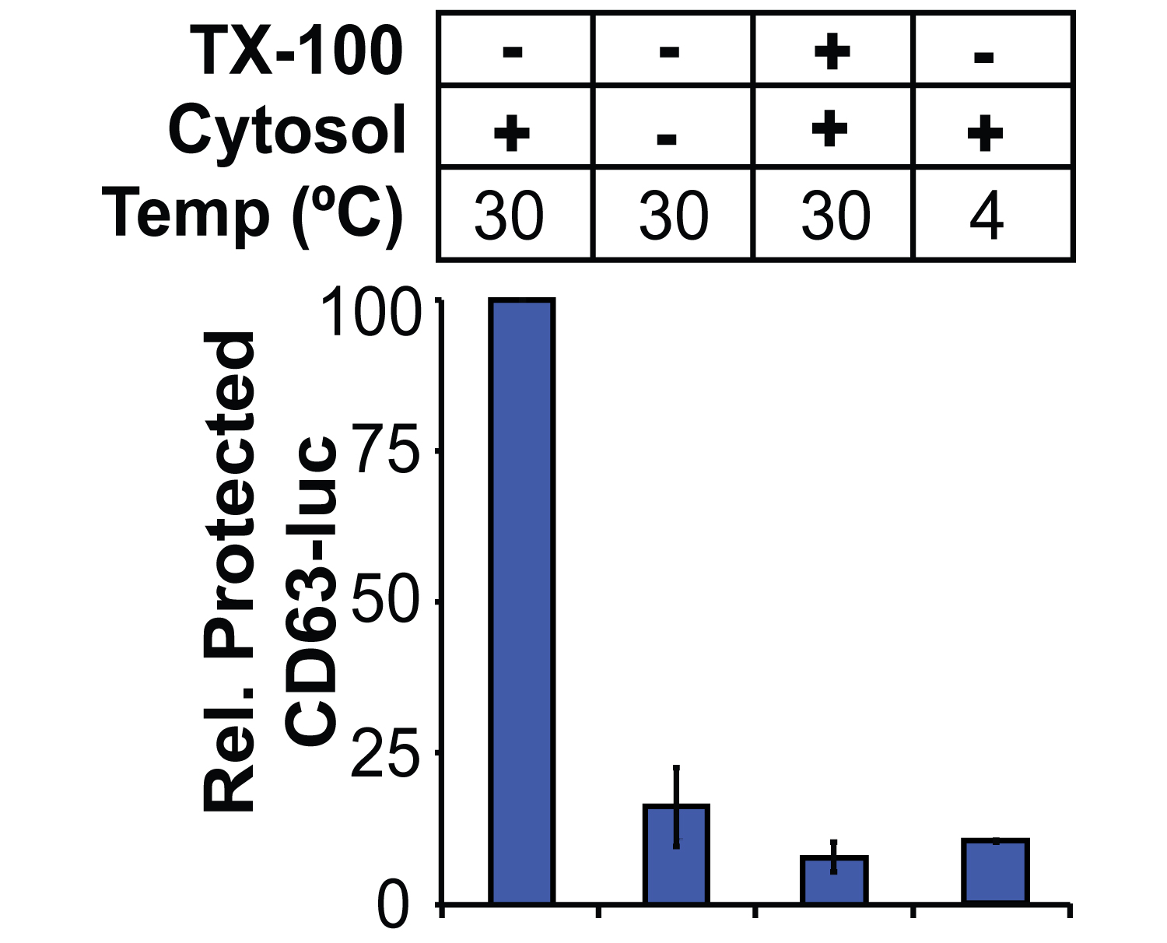
Exosome biogenesis requires cytosol and incubation at 30C

Slide 23
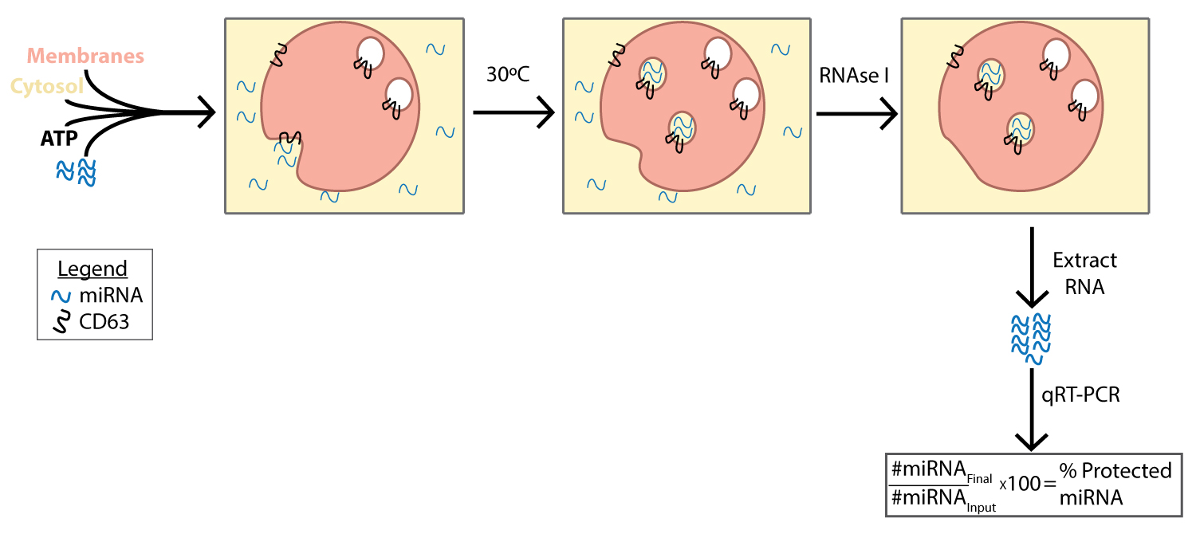
Cell-free miRNA packaging into exosomes

Slide 24
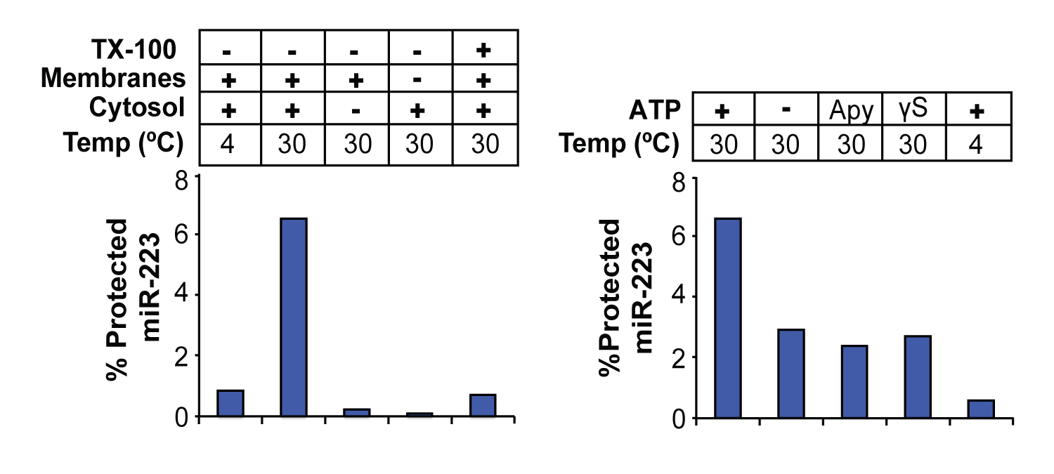
miRNA packaging stimulated by cytosol, incubation at 30C and ATP

Slide 25
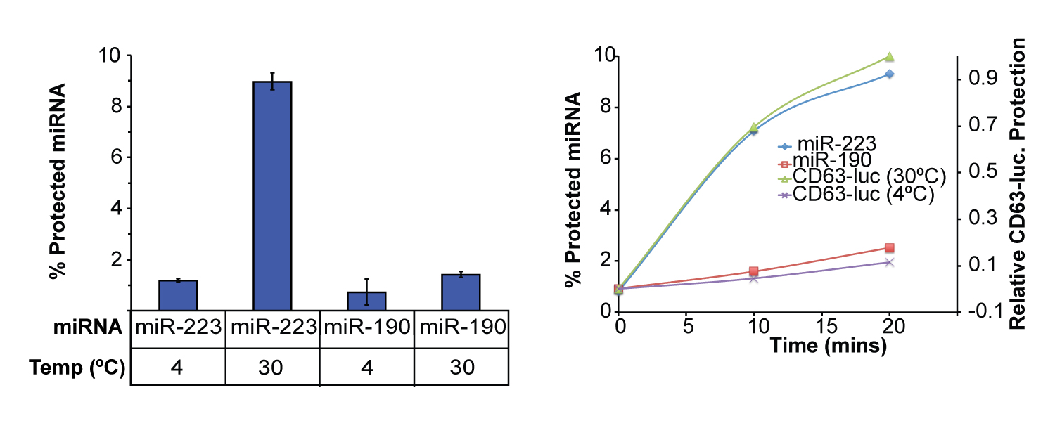
miRNA packaging selective

Slide 26
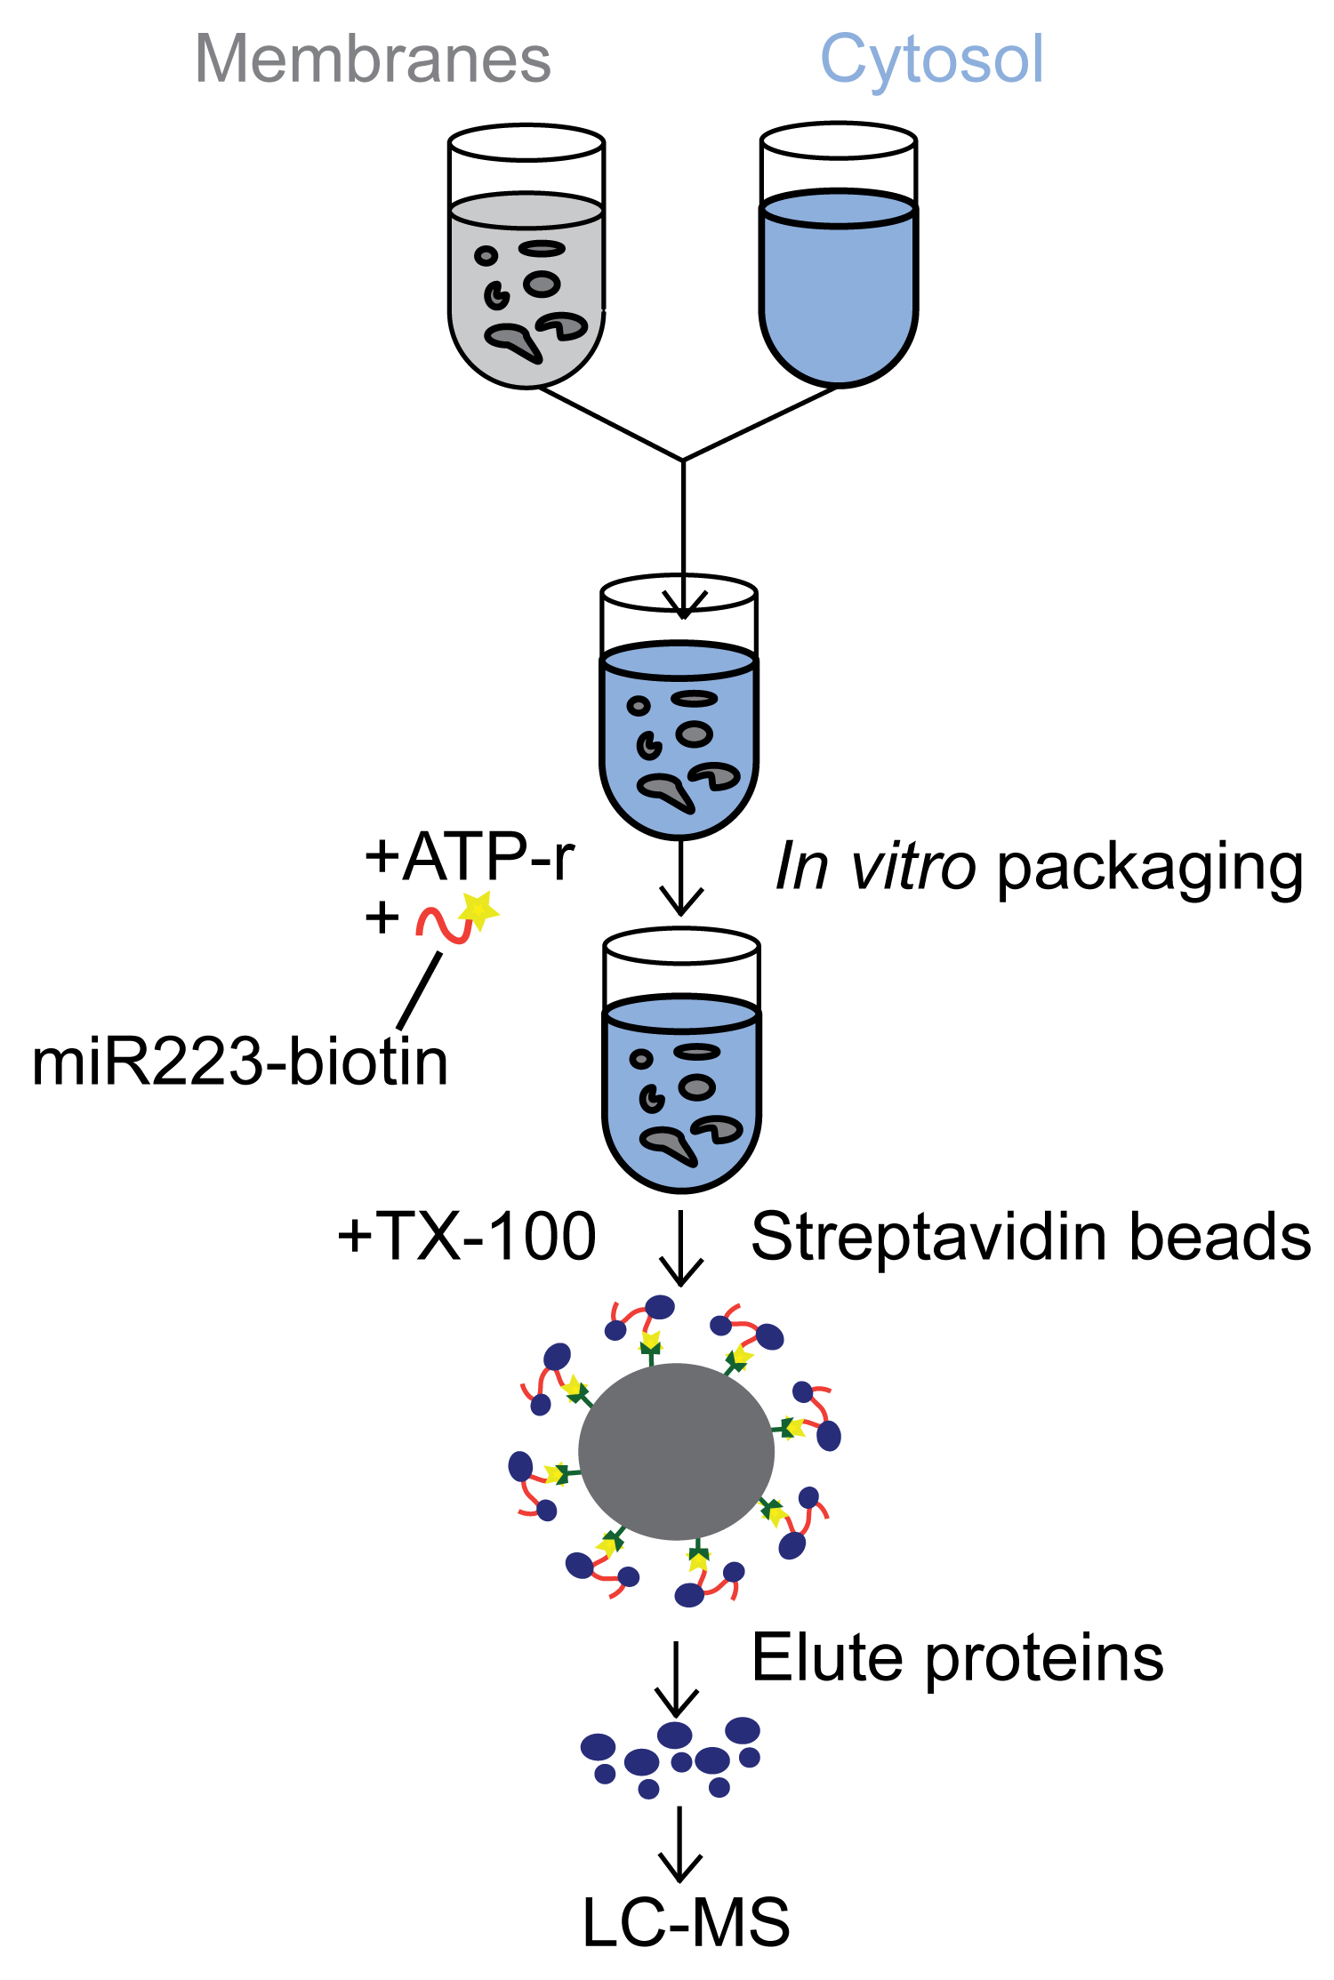
Isolation of miRNA-protein complexes

Slide 27
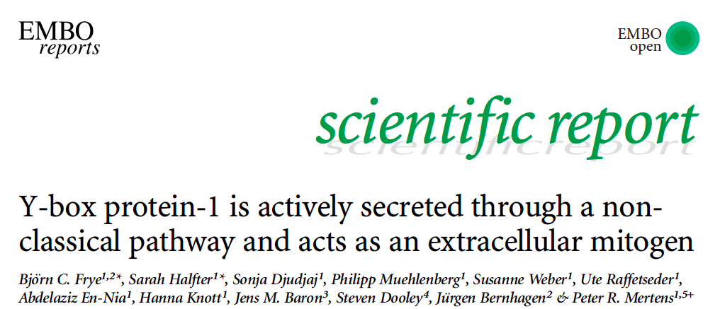
-Secreted YBX1 is protease protected
-Protease protection is detergent sensitive
Suggests it is secreted in a vesicle

Slide 28
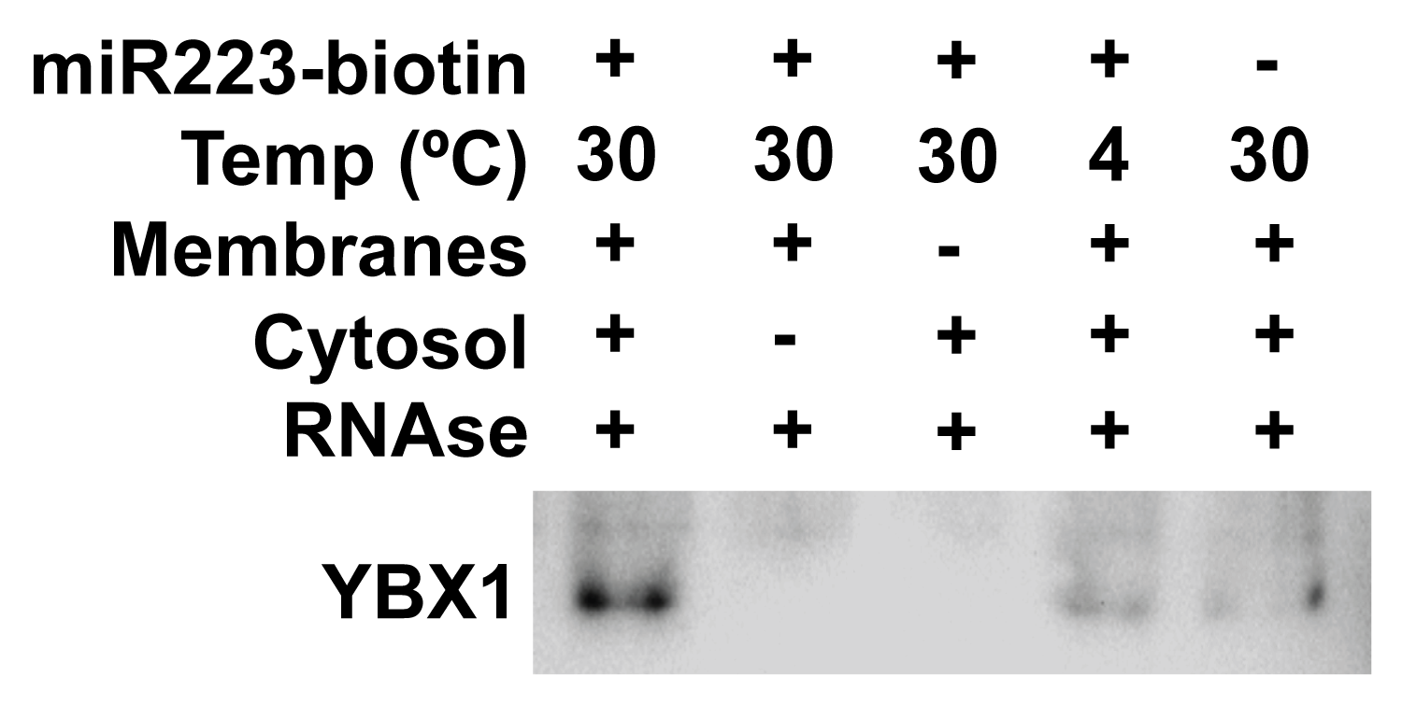
YBX1 packaging stimulated by miR223, cytosol, membranes and incubation at 30C

Slide 29
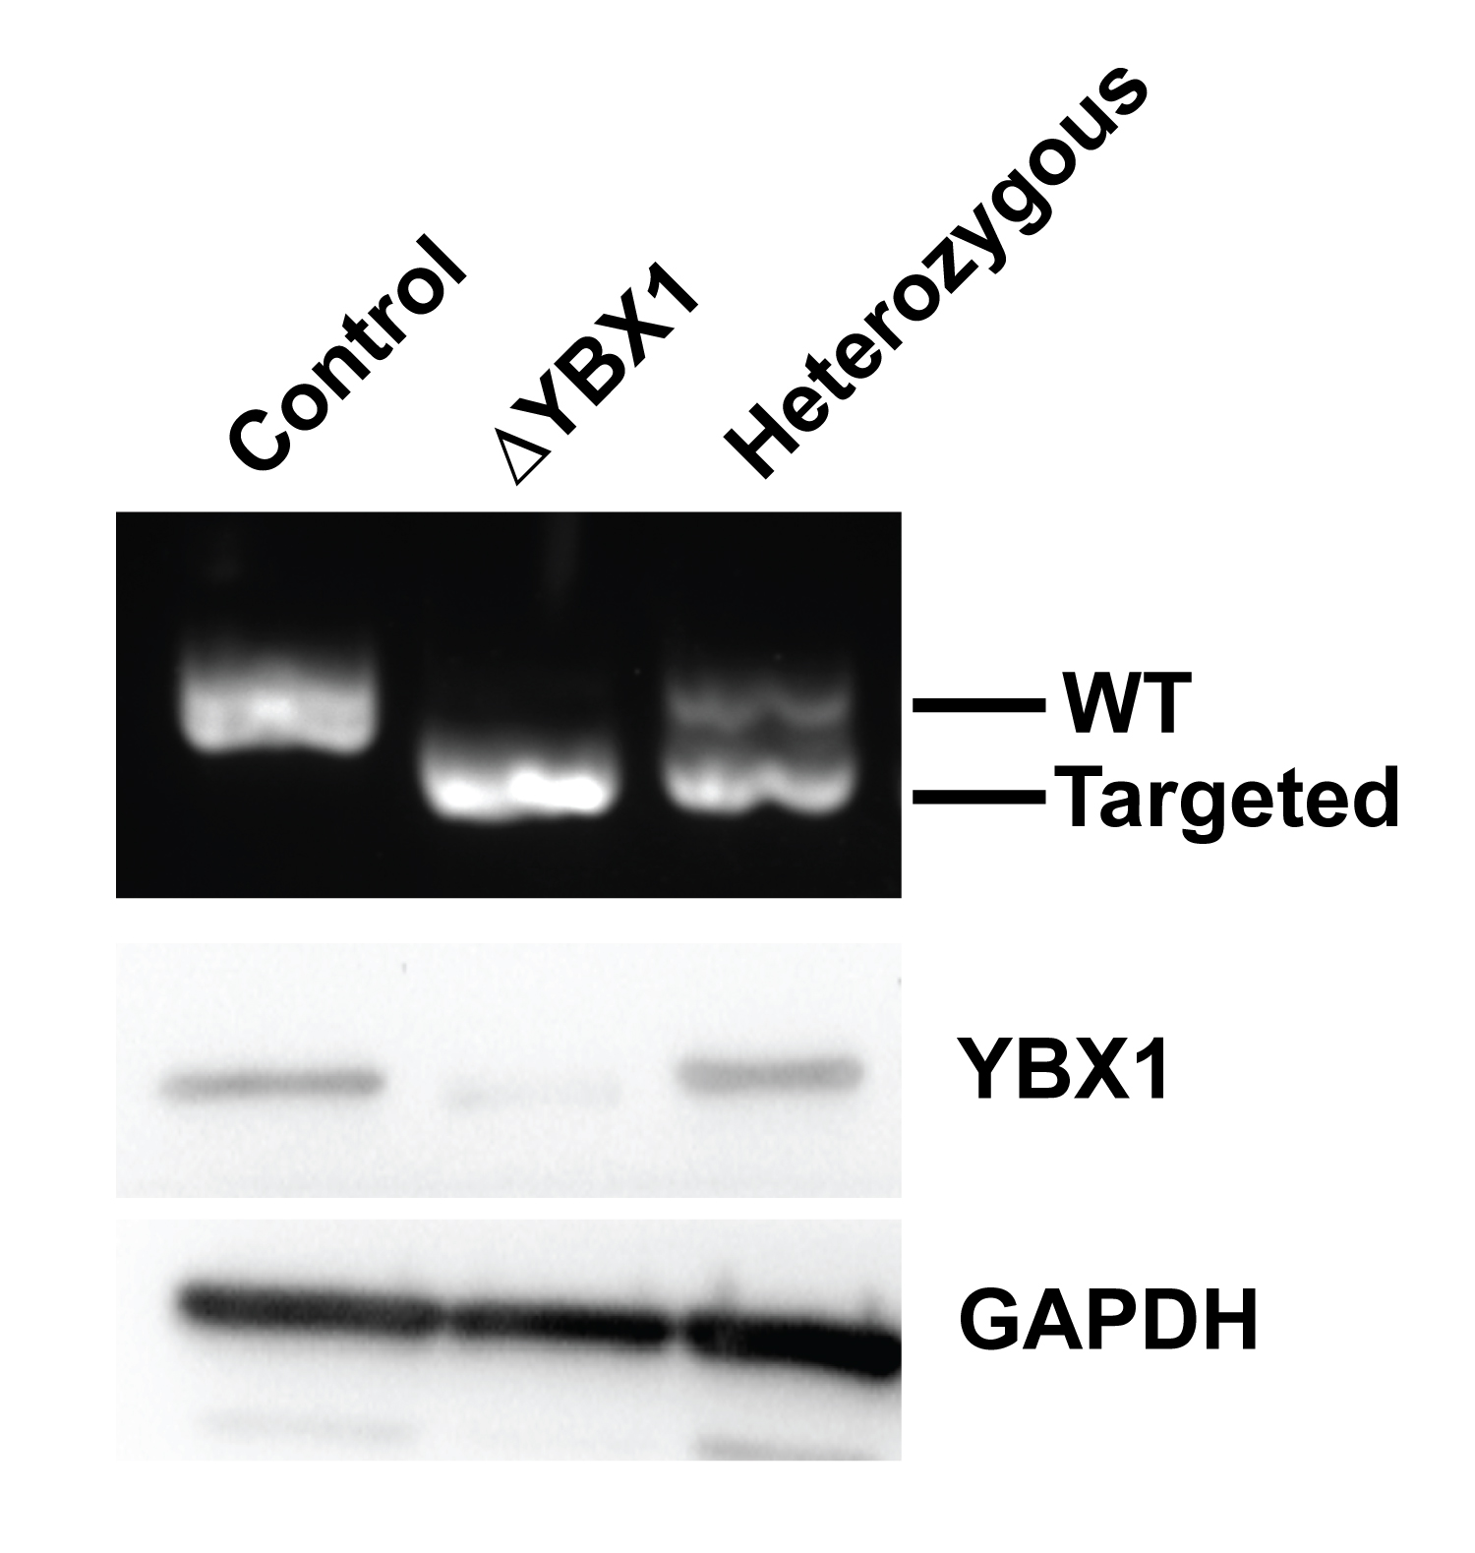
Knockout of YBX1

Slide 30
YBX1 required for packaging of miR-223 but not of CD63-luciferase

Slide 31
Upregulation of YBX2 mRNA in ΔYBX1 cells

Slide 32
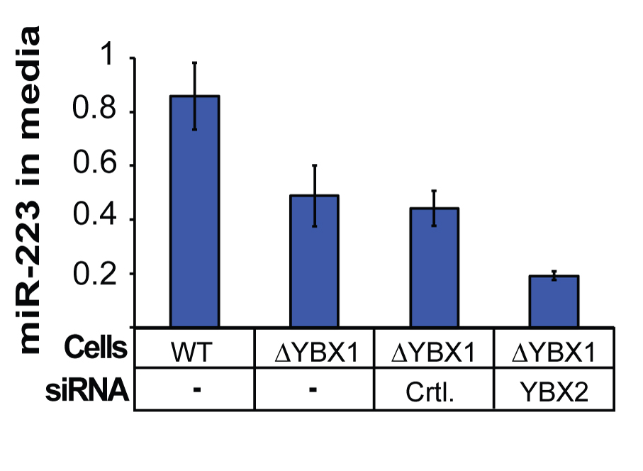
Y-box proteins control miRNA secretion in vivo

Slide 33
MicroRNA Packaging into Exosomes
What is the primary
membrane source?
How is YBX1:RNA
captured?
How is miRNA
cargo recognized?

Slide 34
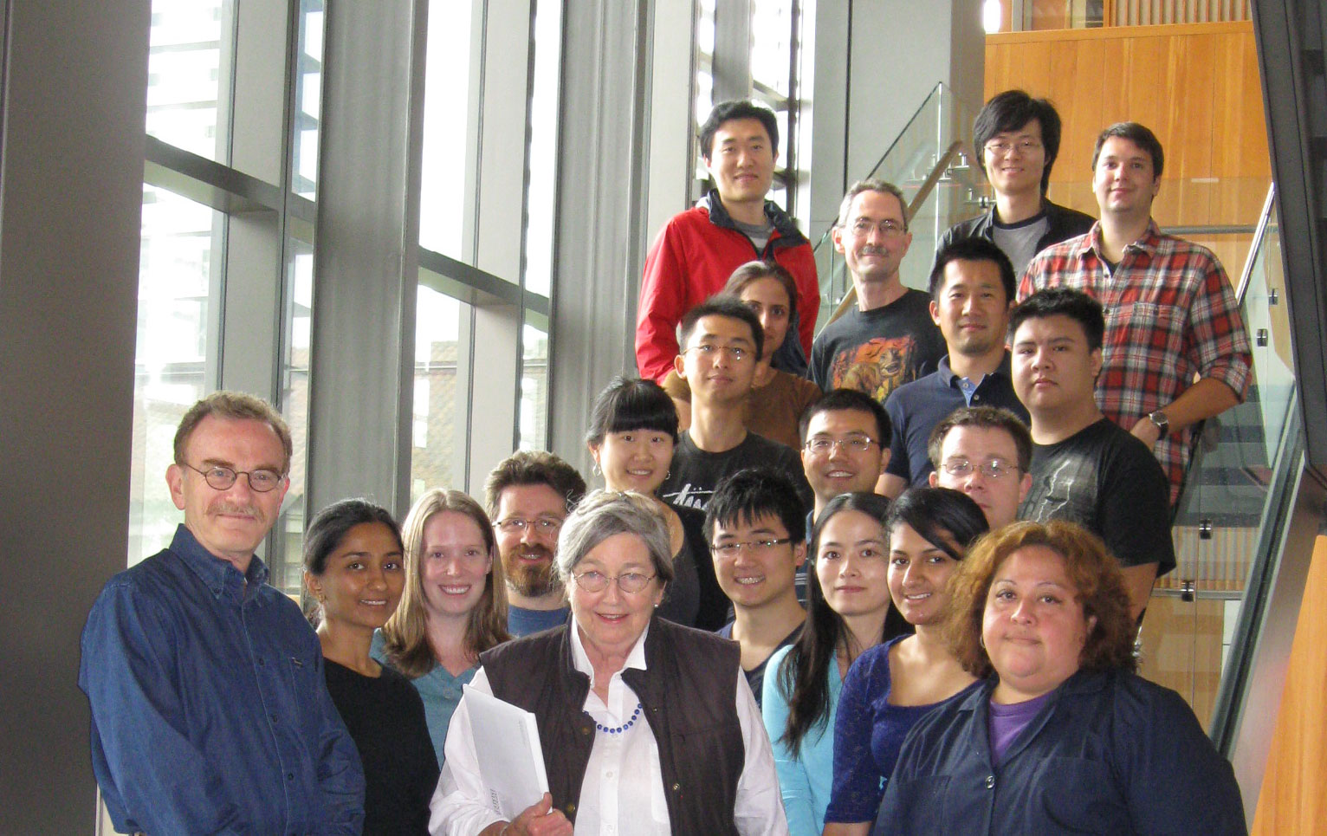

Slide 35
Notes:
eLife is a new initiative in research communication
The initial goal is to launch an outstanding new journal
Longer term, the vision is to catalyse fundamental change in research communication

Slide 38
Institutions with the most papers accepted by eLife, up to March 2015
University of California, Berkeley | 50
UT Southwestern | 28
University of California, San Francisco | 27
University of Oxford | 24
Stanford University | 23
Harvard University | 19
Harvard Medical School | 19
University of Cambridge | 17
Yale University | 17
Medical Research Council Laboratory of Molecular Biology | 14

Slide 39
Acceptances by eLife,
June 2012–August 2014
 | Acceptances | Submissions | % Accepted
UC Berkeley | 37 | 210 | 18%
UT Southwestern | 25 | 156 | 16%
UC San Francisco | 22 | 125 | 18%
Oxford University | 19 | 147 | 13%
Stanford University | 19 | 130 | 15%

Slide 40
I hate the editors of these journals more than
I hate Republicans.
—James Watson, of double-helix fame, speaking
about recent rejections from several journals

