Slide 1
NSF Engines Development Award: Advancing biosecurity, biodefense, and biomanufacturing technologies (KS, MO)
Award number 2303495
PI: Beth A. Montelone, Ph.D.
bethmont@k-state.edu

Slide 2
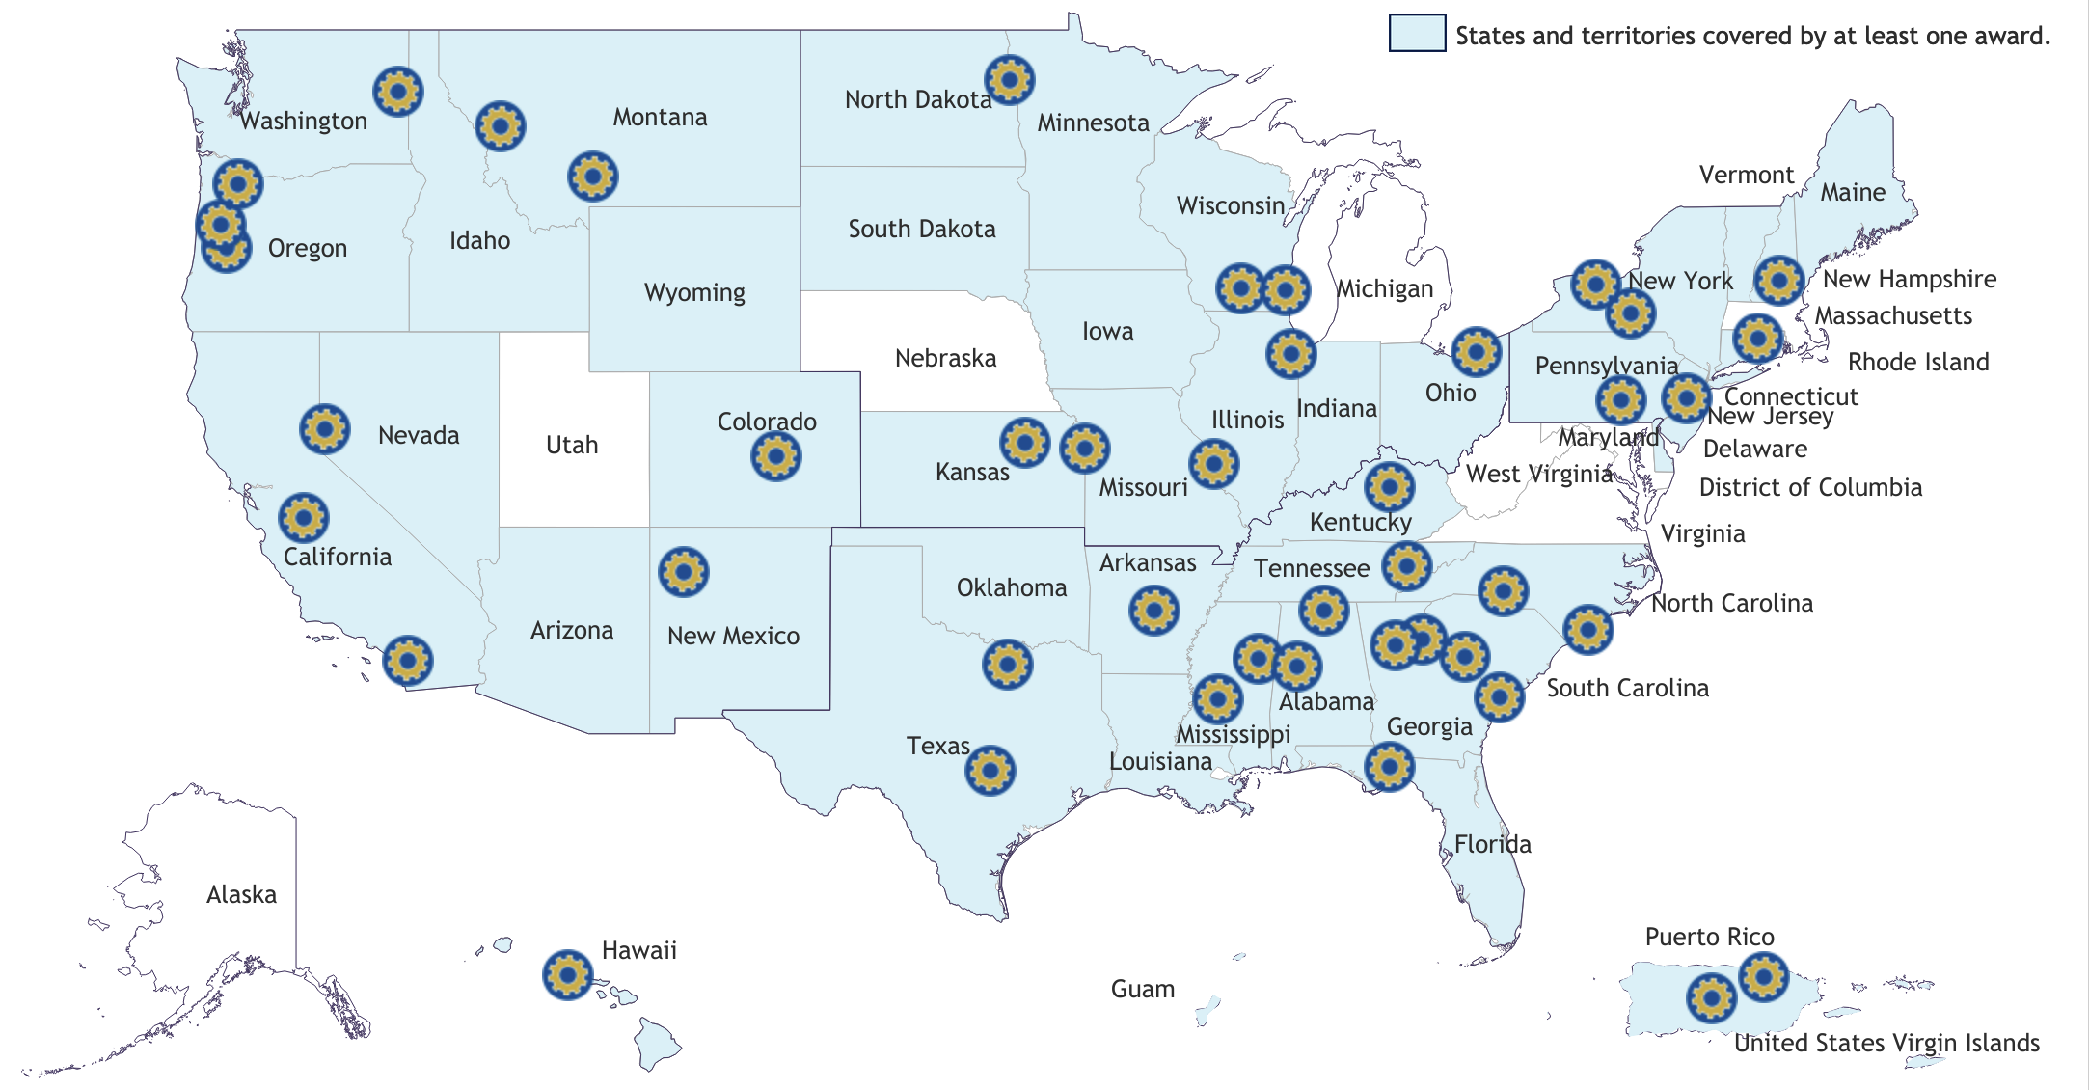
NSF Regional Innovation Engines program
Signature program of TIP Directorate
Intended to foster diverse regional coalitions to stimulate R&D and economic growth
Researchers
Institutions
Private sector
Communities
44 Development Awards (two-year planning grants) announced in May
Potential to lead to full Engine award (ten years, $160M)

Slide 3
Project leadership
Beth A. Montelone, Kansas State University
James Genandt, Manhattan Area Technical College
Sonia Hall, BioKansas
Rebecca Robinson, K-State Innovation Partners
Daryn Soldan, Manhattan Area Chamber of Commerce
Stacy Hutchinson, Kansas State University

Slide 4
Award description
Anticipated outcomes
Build on existing academic, government, and private sector activity in biosecurity, biodefense, biomanufacturing
Increase use-inspired research
Increase capacity for commercialization and manufacturing by increasing availability of venture capital in region
Lay groundwork for sustainable bio-engine
Coordinate regional workforce development efforts with appropriate and accessible entry and exit points
Recruit populations underrepresented in BS/BD/BM workforce
Lay foundation for attraction and creation of companies and capital to the region

Slide 5
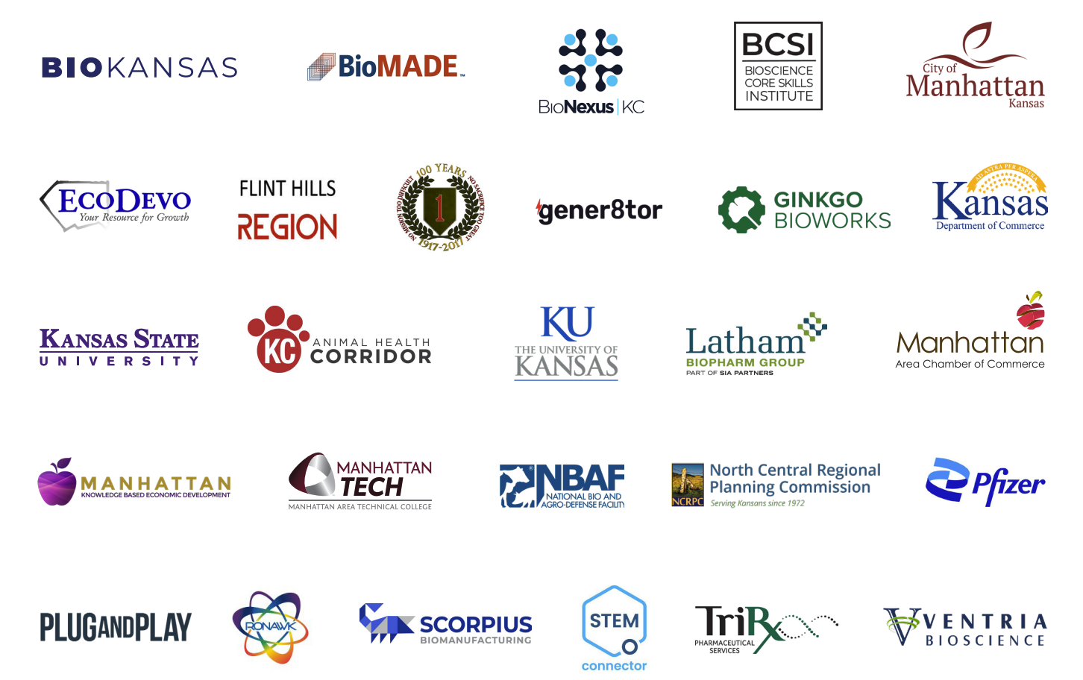
Current Partners
Partner organizations
Kansas State University
The University of Kansas
KU Innovation Park
Manhattan Area Technical College
K-State Innovation Partners
BioKansas
BioNexus KC
Manhattan Area Chamber of Commerce
Kansas Department of Commerce
Flint Hills Regional Council
North Central Regional Planning Commission
Pottawatomie County Economic Development
Plug & Play
BioMADE
Pfizer
Scorpius Biomanufacturing
TriRx Pharmaceutical Services
Ventria Bioscience
Ronawk
Ginkgo BioWorks
Gener8tor
Latham BioPharm Group
Kansas City Animal Health Corridor
Fort Riley
National Bio- and Agro-defense Facility
Bioscience Core Skills Institute
Knowledge Based Economic Development

Slide 6
Region of Service: NE KS and NW MO

Slide 7
Project Goals
Use-inspired research goal
Create tangible economic value by addressing BS/BD/BM challenges and advancing interests of regional companies
Translation of innovation to practice goal
Increase transitional velocity of products into the marketplace
Workforce development goal
Identify and align existing programs, adapt and create new programs to fill gaps in workforce needs and grow and diversity the talent pipeline
Overall goal: build a robust ecosystem to successfully compete for a Type II Innovation Engine award in two years

Slide 8
Activities to be conducted
Foster use-inspired research challenges in BS/BD/BM
Existing Global Food Systems Seed Grant program
New Game-Changing Research Innovation program
NSF Advancing Research Translation proposal submitted 5/ 23
University of Kansas internal research support programs
Biomanufacturing education programs under development at K-State and MATC; educational programs conducted by BioKansas
Increase commercialization and entrepreneurship capacity in the region
Identify gaps in the ecosystem and increase coordination

Slide 9
How to engage with us
This short-term project lays the foundation for potential long-term funding and development of the Engine. Over the next two years, we are looking for partners who can help by:
Attending events and convenings
Providing information on regional ecosystem capabilities
Identifying opportunities or gaps
Helping us create programs to support BS/BD/BM
Collaborating and helping us cultivate new partnerships
https://www.k-state.edu/bio-engine/
Email: bio-dev-engine@k-state.edu

