Slide 1
K-State Concert Band Clinic Director Luncheon
Information and Events
K-State Bands

Slide 2
Spring 2017 - Concerts
March 5th Wind Ensemble/Wind Symphony AFC 7:30pm
March 6th Concert Band/University Bands AFC 7:30pm
April 30th Wind Ensemble/Wind Symphony AFC 3:30pm
April 30th Concert Band/University Bands AFC 7:30pm
May 1st Woodwind/Brass Ensemble Concert AFC 7:30pm

Slide 3
Spring 2017 – School of Music
MUSIC SCHOLARSHIP AWARD DAYS
Friday, March 3, 2017, Saturday, March 4, 2017
Please contact the School of Music, Theatre, and Dance at:
(785) 532-3800 or mus@ksu.edu
If these dates do not work, contact us anyway if you have students interested in a Music Major or Music Minor
Future Music Educators Day (for Sophomores and Juniors) - March 10

Slide 4
Spring 2017 – Percussion and Auxiliary
Color Guard workshops – 4/8, 4/22 – 11:30 – 3pm
Classy Cat workshops – 3/5, 3/2, 4/9 – 11:30 – 3pm
Drumline Mini Camp – May 6th (Free)
Auxiliary Auditions (Twirlers, Classy Cats, Guard) – May 6th
Drumline Auditions – June 3rd – McCain Auditorium

Slide 5
Summer with the K-State Band
Summer Graduate Level Classes
Earn your Master’s Degree in just three summers
2017 Courses Start June 9th and continue through July 11th
For more information regarding summer course and workshop offerings, email ftracz@ksu.edu or call (785) 532-3816

Slide 6
Summer with the K-State Band
7th Annual MPS Golf Tournament
Saturday, May 20th
11:30 am Lunch, 1pm Start
Colbert Hills Golf Course
All proceeds go to the Marching Pride Scholars Program
Need Golfers, Hole Sponsors, Food and Cart Sponsors

Slide 7
Summer with the K-State Band
Summer Music Camp
June 11 – 15
For Winds and Percussion currently in grades 5 – 12
Dr. Gilbert and Dr. Blocher
Summer Leadership and Auxiliary Camp
July 9 – 12
Drum Majors, Section Leaders, Percussion, Color Guard in Grade 9 – 12
Any student interested in leadership in band may register for Section Leader Track
Almost 100 Drum Majors last year!! Almost 160 Total in the camp!
Perfect for young and beginning Guard members as well!
Registration for both camps now available at ksu.edu/band

Slide 8
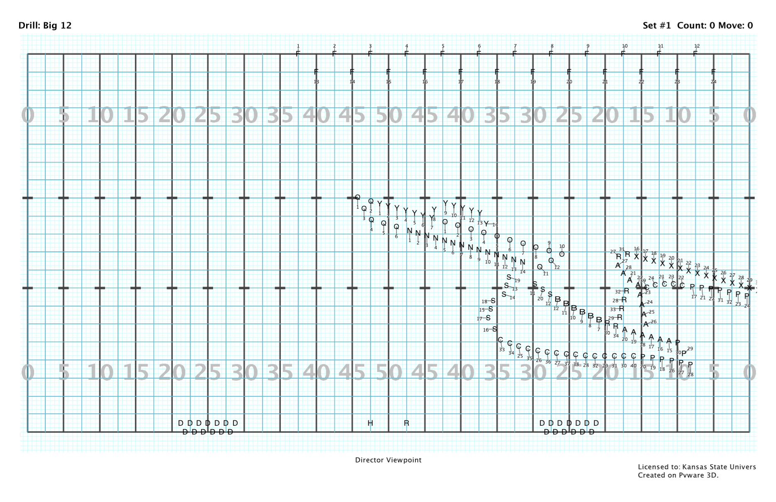
(CENSORED)
Insert Mascot Here

Slide 9
KSUMB BAND CAMP!!!
Band Camp begins August 13th
Make sure your seniors fill out a prospective member information form before May. Form can be found online
A summer newsletter will be mailed in May with information detailing the audition process and a Membership Confirmation form.
The Membership Confirmation and newsletter will also be available online
Wind Auditions for New members will be held on the 13th – Winds will be tested on Pregame music.
Have and Seniors and Juniors schedule a campus visit and meeting with the band office.

Slide 10
Special Events in the Fall
Band Director Day – September 2nd
Band Day/Options – September 9th
Major Announcements and Changes coming very soon!
Alumni Band Day – September 9th
Central States Marching Festival – October 7th

Slide 11
Special Events in the Fall
Trombone Day – November 11th (Tentative)
I need your opinions on dates
Marching Band Concert – November 26th
Marching Band Banquet – December 10th

Slide 12
GO CATS!!!!!!!!!!
2017 K-State Football Schedule/Performances
Apr. 22 – Spring Game
Sep. 2 – Central Arkansas
Sep. 9 – Charlotte 49ers
SEP. 16 – at VANDERBILT (Possible AWAY)
SEP. 30 – Baylor
Oct. 7 - Central States
Oct. 14 – TCU
Oct. 21 – Oklahoma
Oct. 28 – At KU (AWAY)
Nov. 11 – West Virginia
Nov. 25 – Iowa State
Dec. 2 – Big 12 Championship, Arlington, TX

