Slide 1
Burn Your Boats: Create Great Habitudes
Form Your Leadership Habits and Attitudes
Dr. Frank Tracz

Slide 2
Before…
Life’s Mountains (pleasures)
Life’s Valleys (tough times)

Slide 3
We must…
Successfully navigate the journey
Have/Learn/Appreciate/Understand – GRIT!

Slide 4
Experts Explain “GRIT”
A clear goal
Determination over other’s doubts
Self-confidence to figure it out
Humility, It don’t come easy!
Persistence despite fear
Patience to handle obstacles
Code of ethics to live by
Flexibility facing road blocks
Capacity for human connection and collaboration
Accept help is not weakness
Focus and appreciate each step
Loyalty never sacrificing connections
Inner strength to propel you to your goal!

Slide 5

Images to Make You Think
Windshield and Rearview Mirrors
Image One
Purpose of each
Forward, backward
Gazing us, glancing

Slide 6
Where Does Your Energy Come From?
Past?
Future?

Slide 7
Peace of Mind
(Influential Factors)(Mental Stability)
Refusing to live in the past
Absence of suspense, resentment, and regret
Not wasting time and energy fighting conditions you can not change
Forcing yourself to get involved in the world around you
Refuse to indulge in self pity

Slide 8
Remedy
Replace comfort with curiosity
Reject being a victim of your circumstances
Renew your commitment to embrace opportunities
Relinquish the past and create new memories

Slide 9
“The longer you wait for the future, the shorter it will be.”

Slide 10

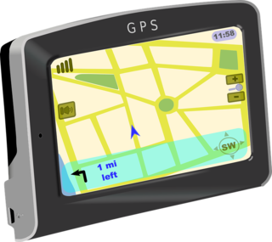
A Compass or a GPS
GPS = Paved Roads
Compass = Unpaved/uncharted Areas
Image Two

Slide 11
A Compass:
Is a set of Personal Values
Identify the values in your life
Include those values in your decisions
Implement your values in your routines
How will/do you do THIS?

Slide 12
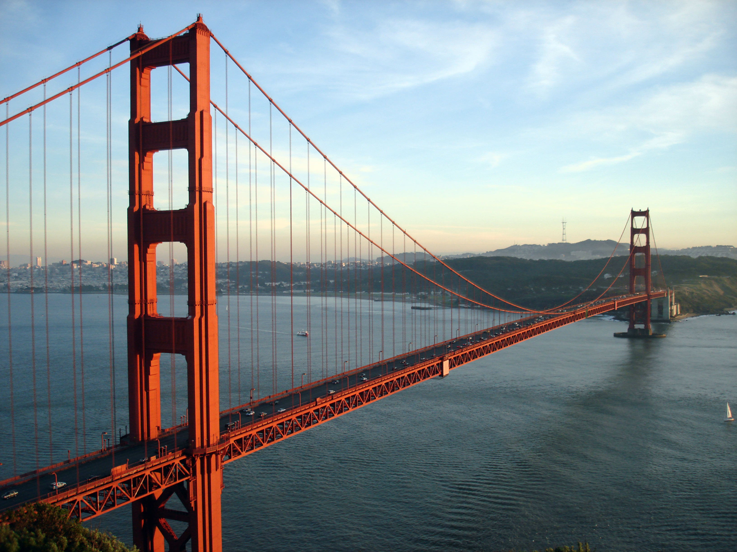
A bridge, not a wall
Image Three
We see differences
We then put up a wall

Slide 13
Why?
We hang around with similar people
We are attracted/prone to those who are like us
We pre-judge those who are not like us
We shy away from those who are different

Slide 14
Be the Bridge, Expand your Horizons
We need others to “stretch” us
We need them to be close enough to provide accountability and balance
We must build build bridges of relationships with others that can bear the weight of truth

Slide 15
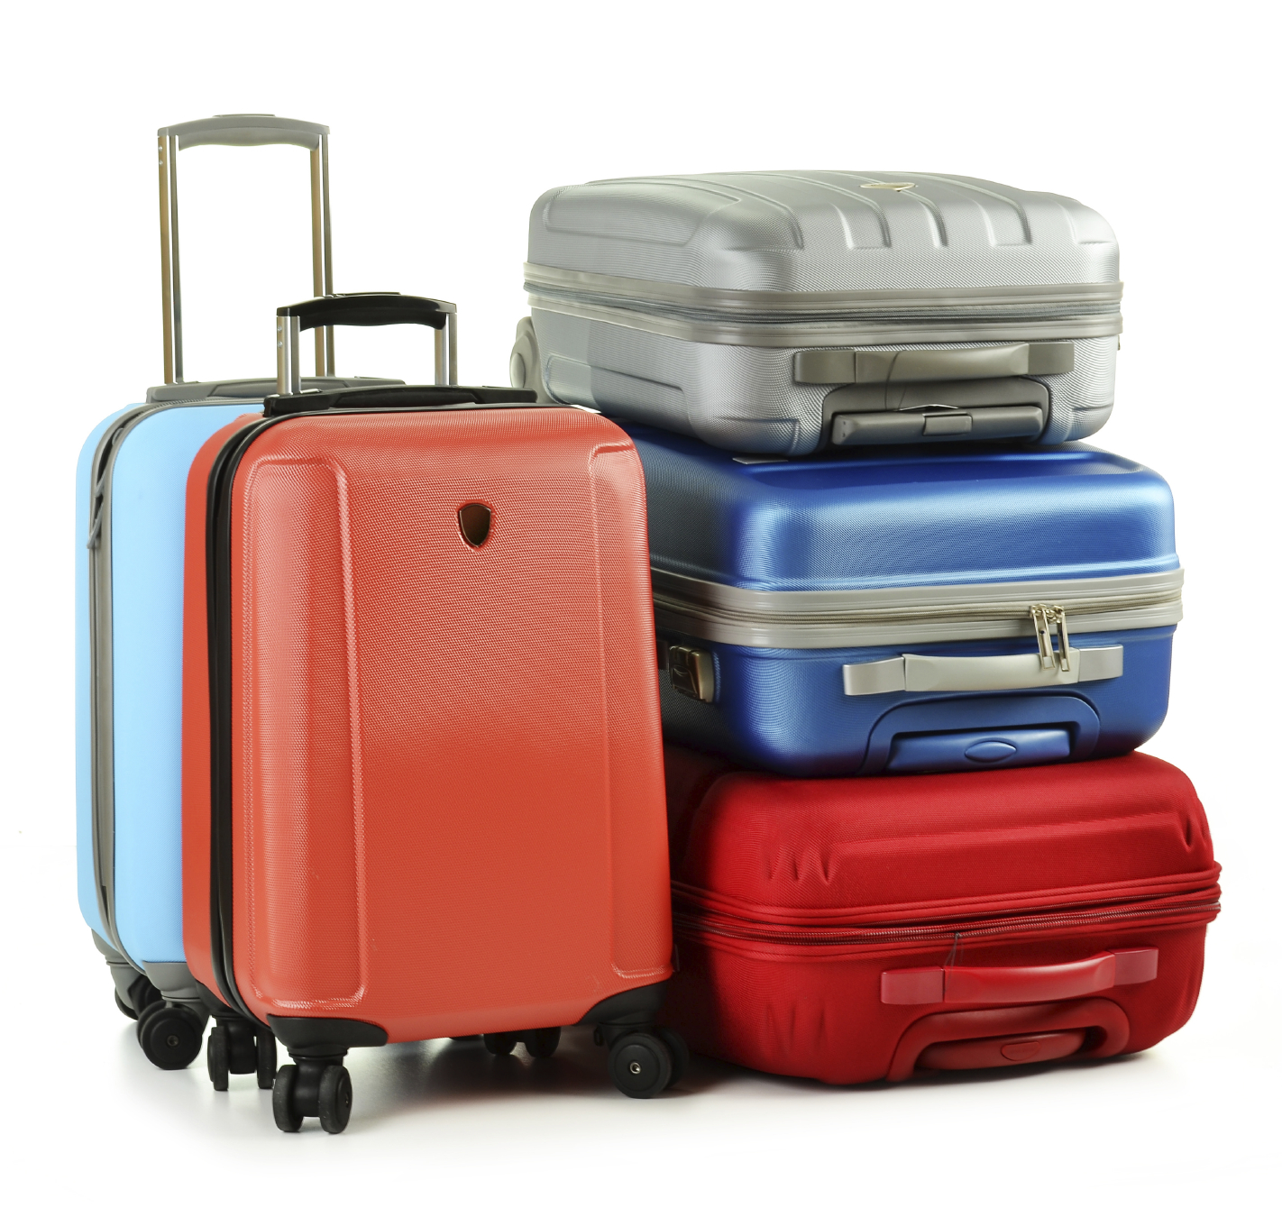
Baggage Fees
Image Four
Baggage on the Trip in a Small Car!
Made drive crowded and chaotic
Made travel slower and difficult
Made trip more expensive
*The more “baggage” we
brought, the more bagged
down we become.

Slide 16
What is the “Price” of Baggage?
”Physical” bags are easily discarded
“Emotional” bags take time

Slide 17
How Do We Break Free?
“Identification then Freedom”
Step One – Talk it Over
Are you alone – NO!
Culture Distraction
Most baggage involves relationships

Slide 18
Step Two: Assess Yourself
Identify YOUR Performance Traps
a. Comparison (compare to others)
b. Communication (judge others)
c. Control (validate worth)
d. Compulsion (people pleaser)
e. Compensation (victim)
f. Competition (self-centered)

Slide 19
Step Three: Try it Out!
Review (reflect on why and how?)
Recall (one instance…)
Release (Let go!)
Reconcile (talk to someone, again)
Request (ask for help)
Refuse (To be victim)
Respond (serve from gratitude, not guilt)

Slide 20
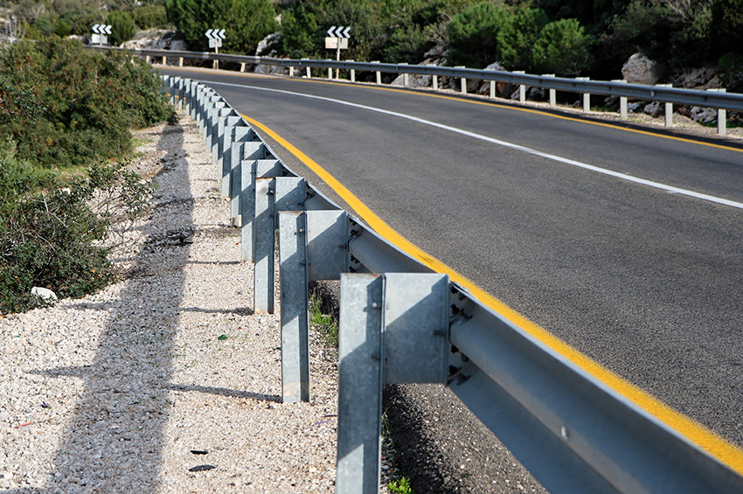
Sturdy Guard Rails
Image Five
Structure to keep us on the road
Offer us:
  Support
  Guidance
  Accountability

Slide 21
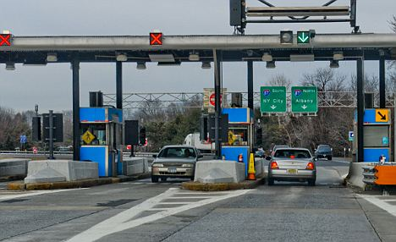
Tollbooths on Road Blocks
Image Six
Challenges will happen
Which version do you see!
Do you know the difference?
”Pay the price or fail!”

Slide 22

Flight Delay
Image Seven
Season of transition…
Manage expectations…
Adaptability is required…
Illusion to disillusion

Slide 23
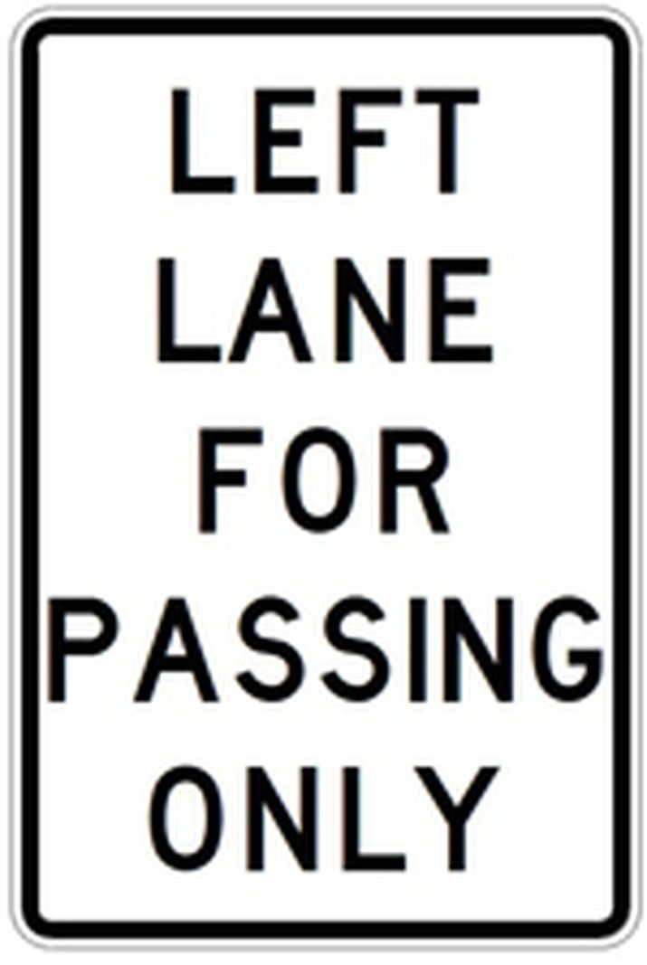
Pass on the Left
Don’t burn bridges!!
Image Eight

Slide 24
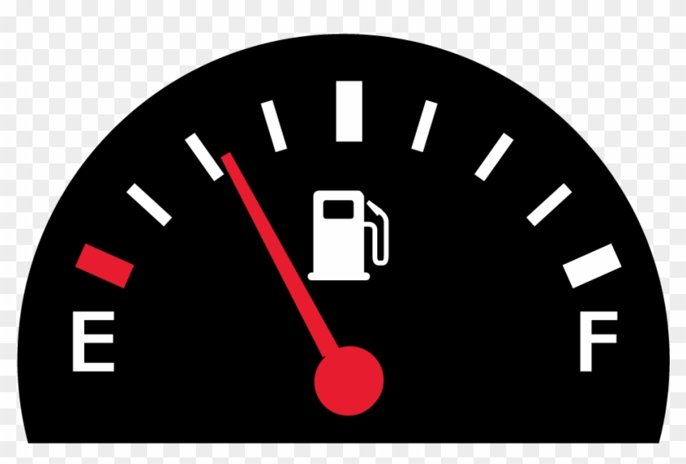
Tank Half Full or Empty
Image Nine
Being content with “you”
Being dissatisfied and strive to grow
A combination of both is healthy

Slide 25


Travel Agents or Tour Guides
Image Ten
One goes with you
The other only tells you where to go!
Mentorship is the answer!

Slide 26

Backseat Drivers
Image Eleven
No one likes them!
Know what you have control over…
…and what you don’t!

Slide 27

Shortcut or Second Mile
We all “live” for shortcuts
More with less
First Mile
You have to
Do the minimum
Duty
Satisfy
Me
Second Mile
You want to
Do the max
Devotion
Serve
Us
Image Twelve

Slide 28
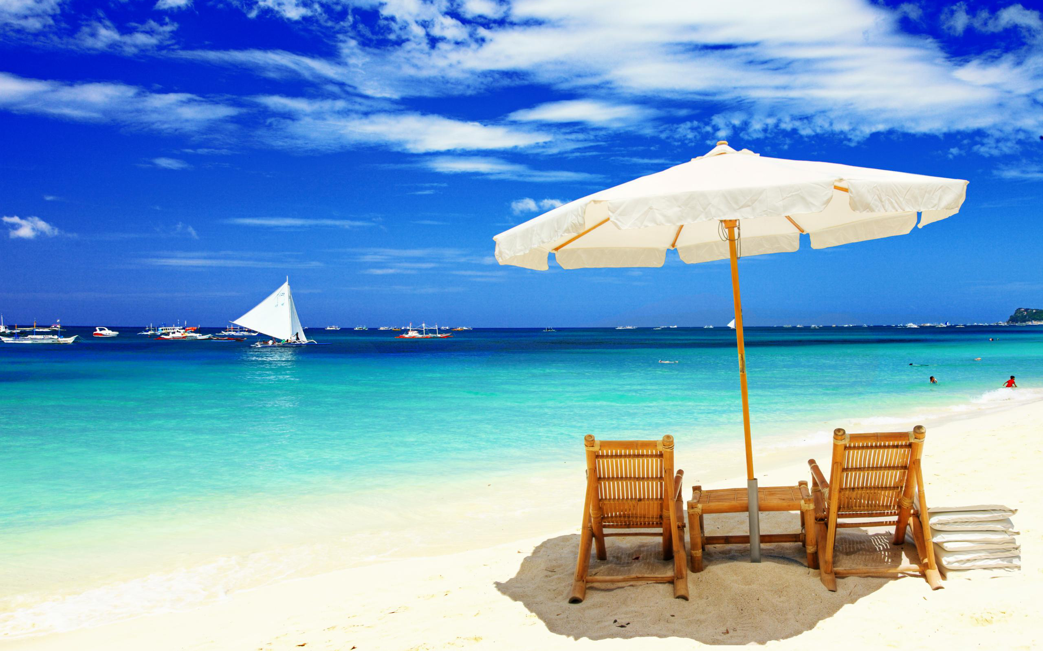
Destination vs. Trip
Reach a Goal
Or
Enjoy the Journey

Slide 29
What is your Destination?
Goal Setting Tips:
S – Specific
M – Measurable
A – Attainable
R – Relevant
T – Timely

Slide 30
Burn Your Boats
Greek Battles Motivation Technique
“The quality of a person’s life is in direct proportion to their commitment to excellence, regardless of their chosen field of their chosen field of endeavor.”
- Vince Lombardi

Slide 31
Credit Given:
“Habitudes”
Dr. Tim Elmore

Slide 32
Dr. Frank Tracz
Kansas State University
Direct or Bands
785-532-3818
ftracz@ksu.edu
ksu.edu/band

