Slide 1

GUTS, GRIT, and GRATITUDE!
LET’S START…
AGAIN!
Dr. Frank Tracz
Director of Bands
Kansas State University

Slide 2
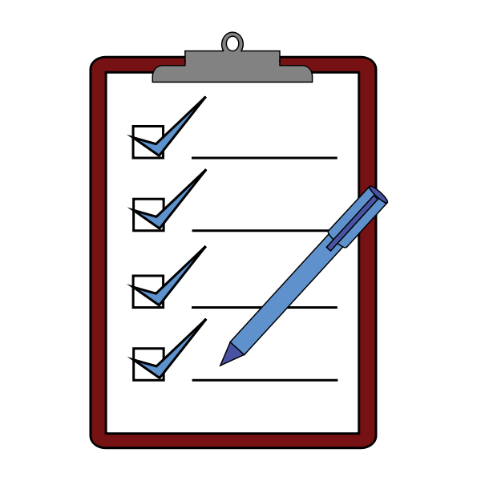
AND IN THE BEGINNING…
We have:
Planned
Recruited
Rehearsed
Connected
Remembered
Dreamed

Slide 3

WHAT’S NEXT?
ME?
YOU?
US?

Slide 4
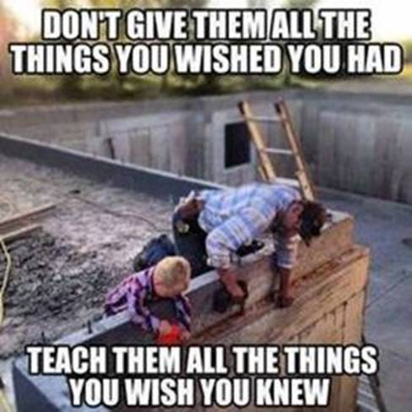
GUTS, GRIT, GRATITUDE
”We are all dreamers; there needs to be more action!”

Slide 5

“GUTS” - WHAT IS THIS?
Ideas in motion
Confidence in doing
Right is right, wrong is wrong
“A chance not taken is a loss for all.”

Slide 6

DO YOU HAVE GUTS?
To find yourself, to create yourself?
Suffer temporarily to succeed long term?
Develop YOUR guts and help others with theirs?

Slide 7


PATHWAY TO “GUTS”
Act your way to correct thinking
Create new habits
Take steps forward, no matter how small
Initiate desired changes in your life
Open up, take risks, ask for help
Never give up on yourself

Slide 8

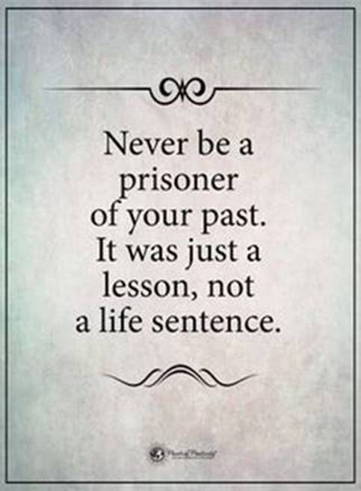

Slide 9

REMEMBER:
Thoughts lead to action...
And action leads to thoughts.
This Photo by Unknown Author is licensed under CC BY

Slide 10

NEXT: “GRIT”
What is it?
Where does it come from?
Where did you get it?
Did you get it?
Did you earn it?

Slide 11
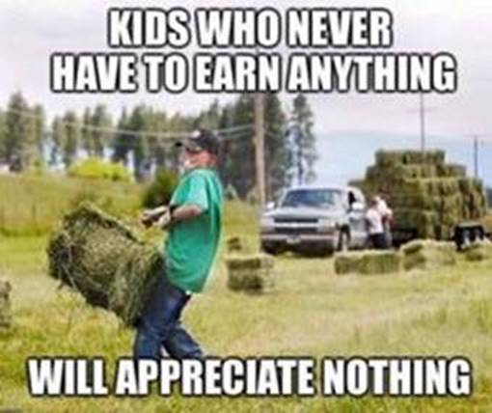
GRIT:
“Willingness to commit to long term goals and to persist in the face of difficulty.”

Slide 12

GRATITUDE…
is a habit of:
Perception
Attitude
Responding
Action

Slide 13
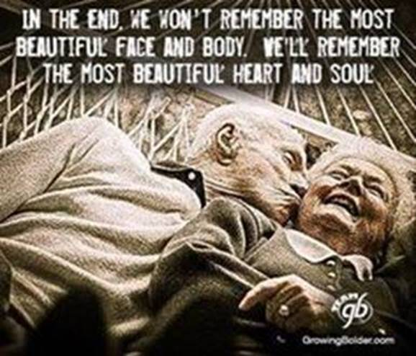
GRATITUDE IS
An attitude
A learned behavior
A remedy
A developed skill/trait

Slide 14
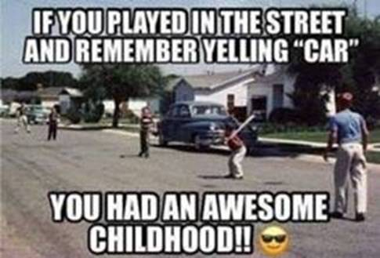
GRATITUDE IS
Looking back and respecting it
Being present and respecting it
Looking ahead and respecting it

Slide 15
GRATITUDE ACTION TIPS
Live it EVERYDAY!
Give it, expect it, earn it!
L.I.B.T.Y.F.I.

Slide 16
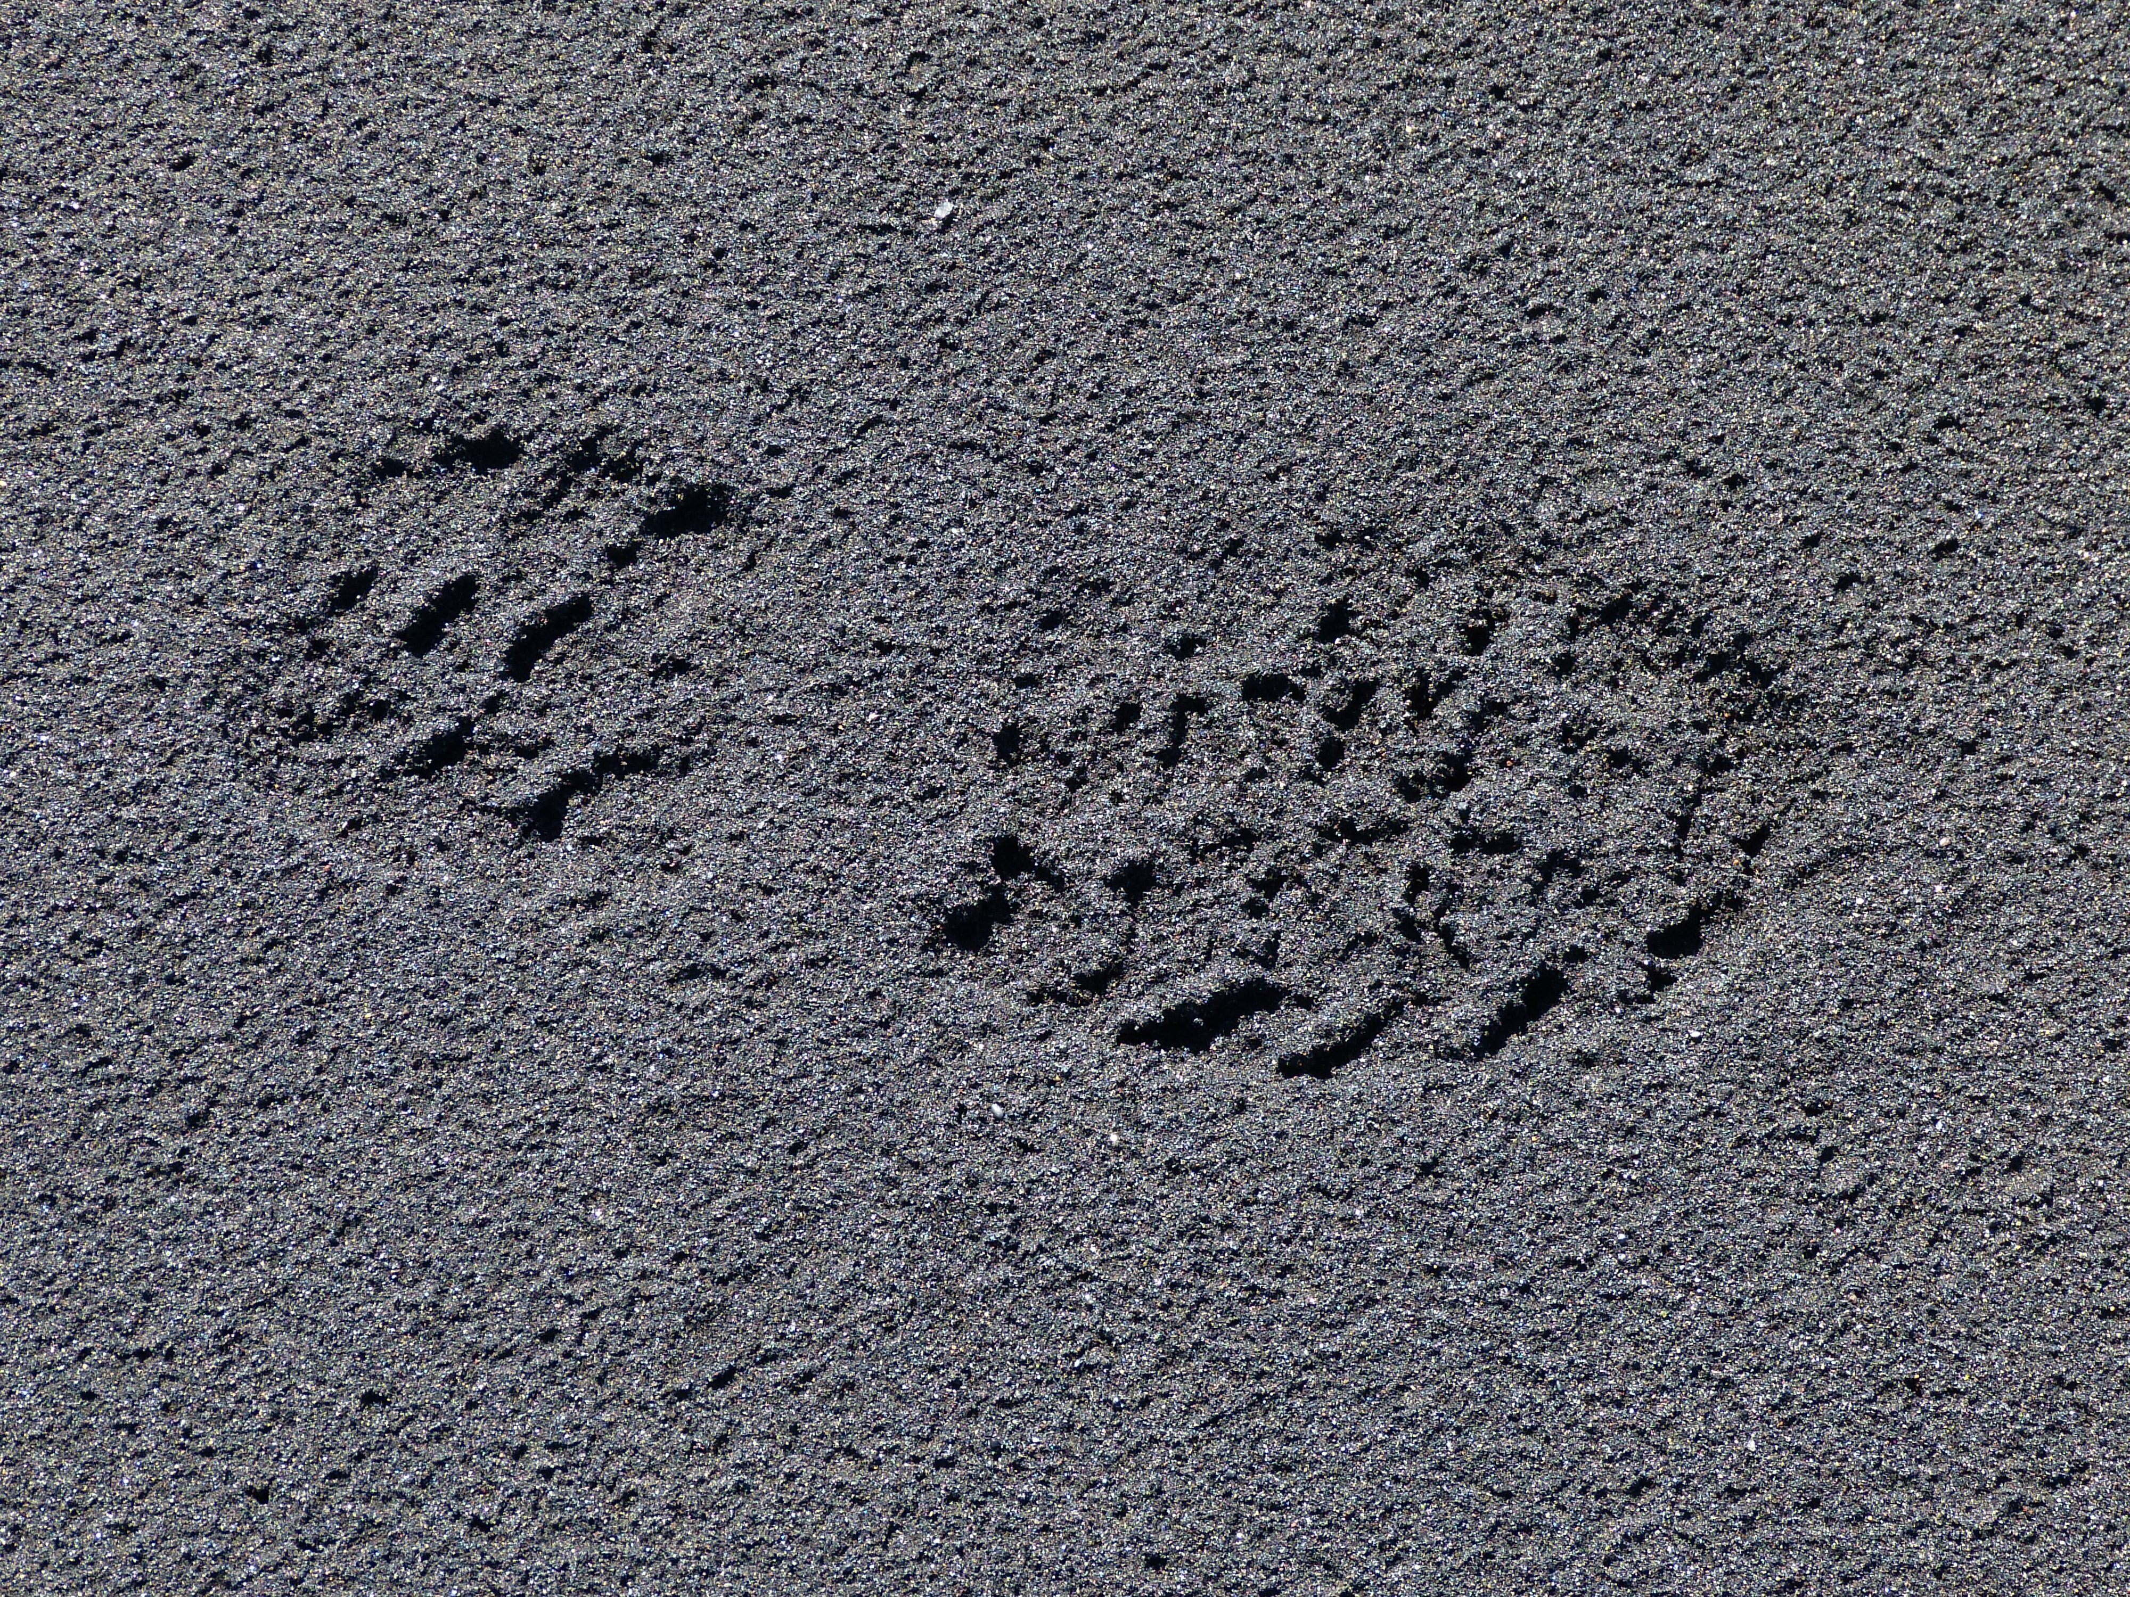
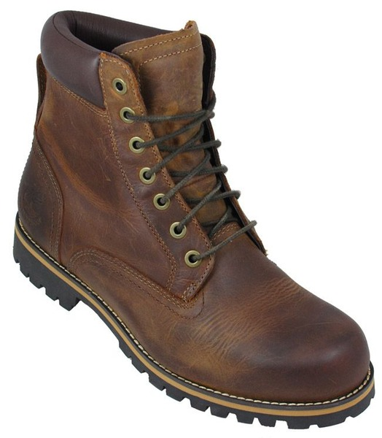
“If you want to leave footprints in the sands of time,
wear work boots!”

Slide 17
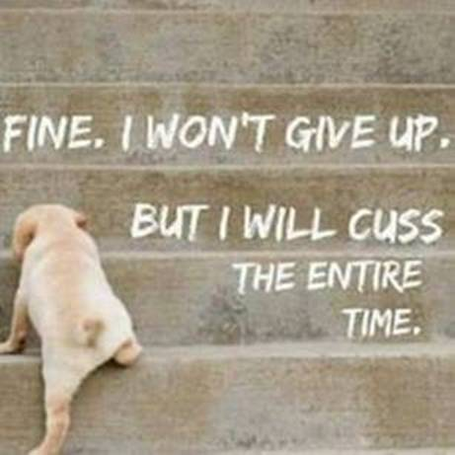
Finally, I won’t give up…
and I won’t let you either.
Dr. Frank Tracz
Director of Bands
Kansas State University
ftracz@ksu.edu

