Slide 1
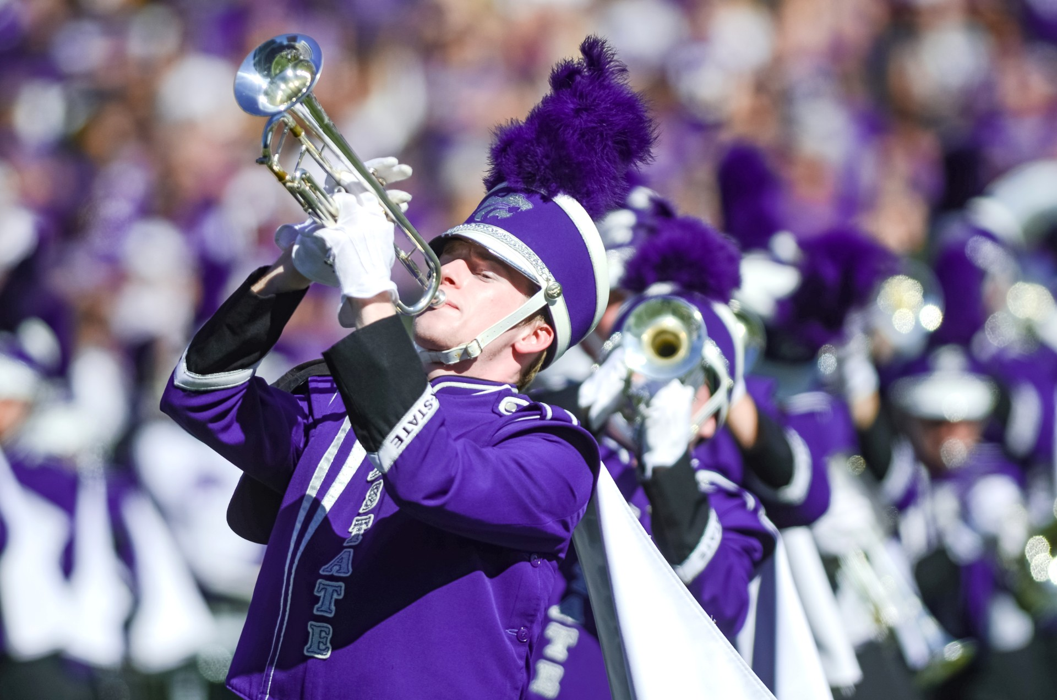
Fundraising: The Professional Necessity
Dr. Frank Tracz
Director of Bands
Kansas State University

Slide 2
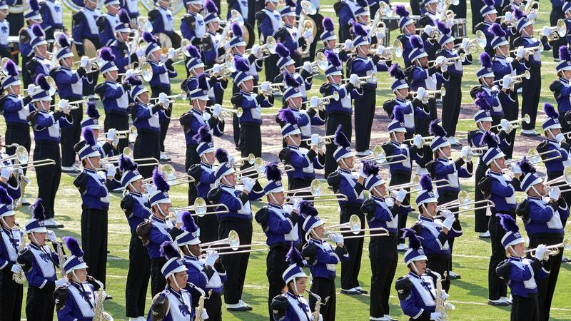
The Problem
Budget Cuts
Rising Prices
Program Needs
More Time Demands on You

Slide 3
The Solution
Take a Deep Breath
Part of our World
Long Term Plan to Success

Slide 4
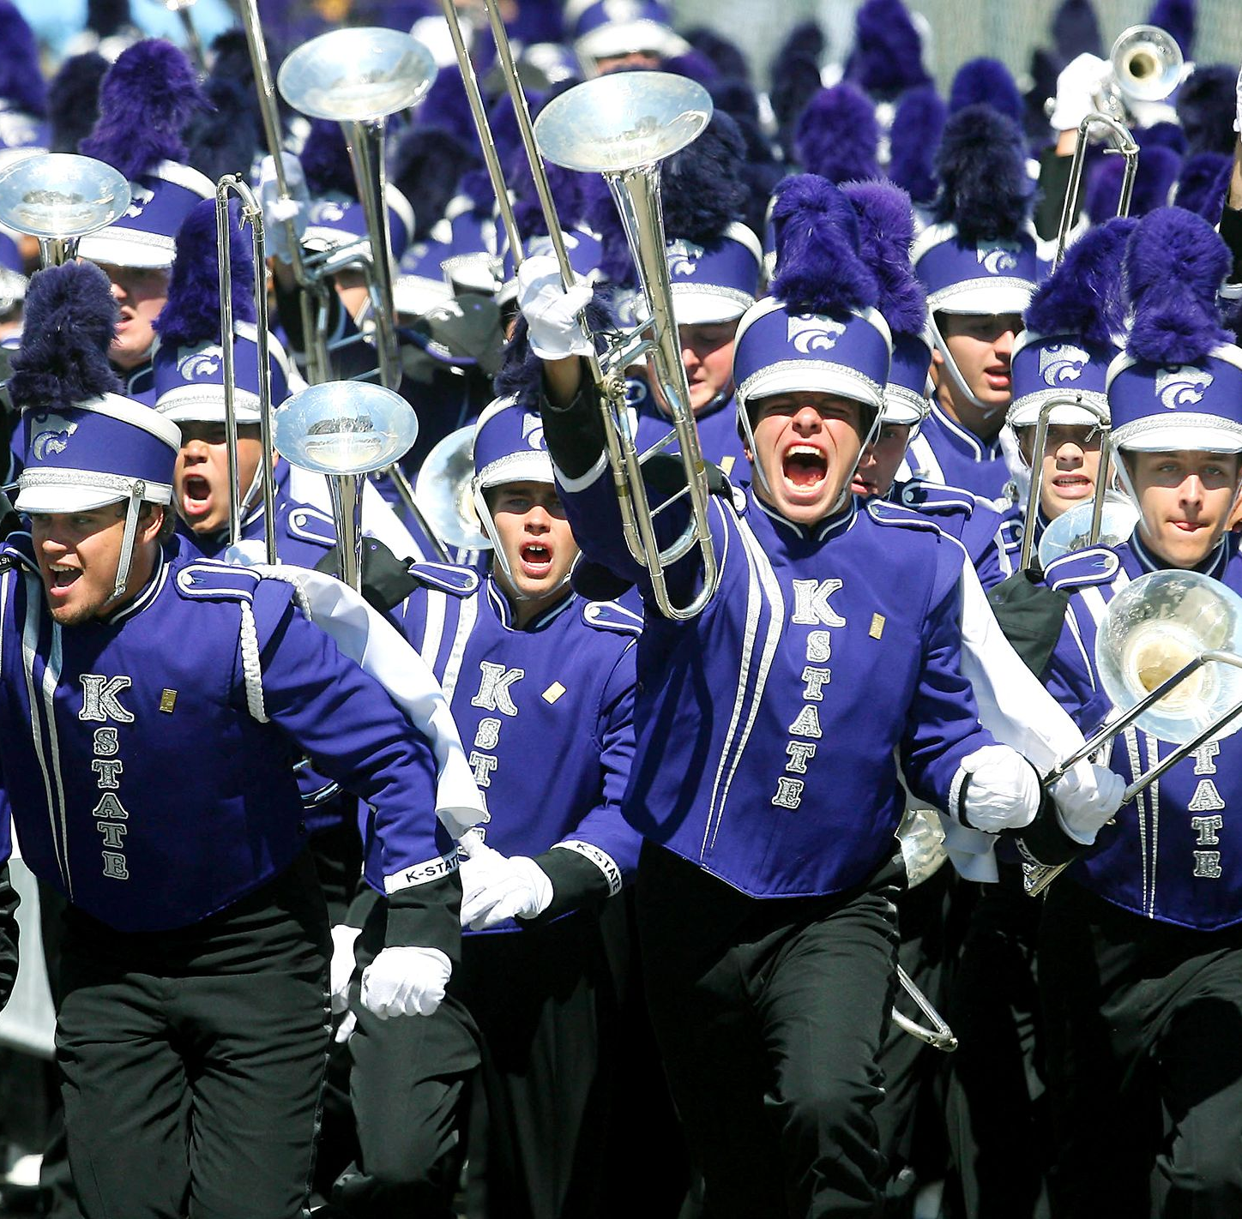
It’s About . . .
You
Them
Us
IT!

Slide 5
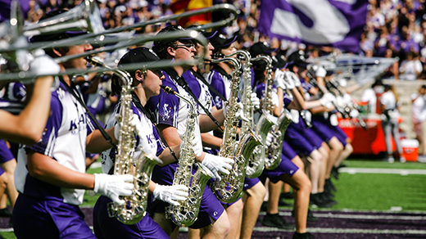
My Experiences
K-State Bands
What is, What Could Be

Slide 6
Organize to Succeed
Needs
Reason/Justification
End Result Desired
Purpose
Benefits

Slide 7
“System”
Identify Need
Timeline
“Players” Involved
Marketing
Identify Sources/Methods/Donors

Slide 8
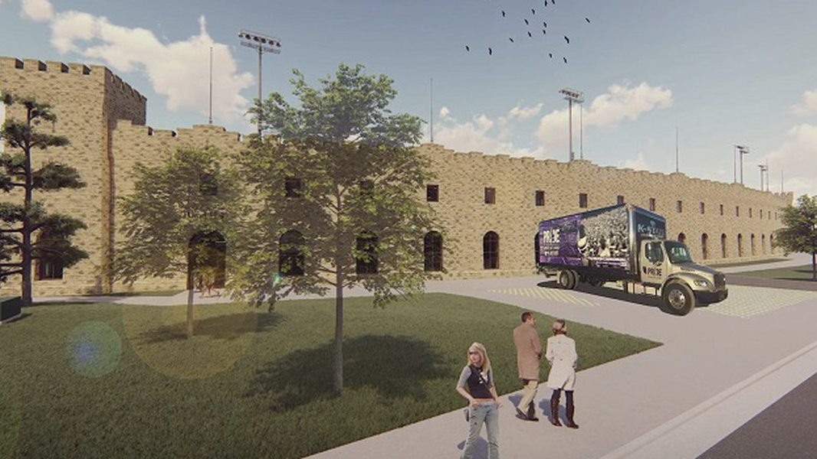
Example
Tracz Family Band Hall

Slide 9
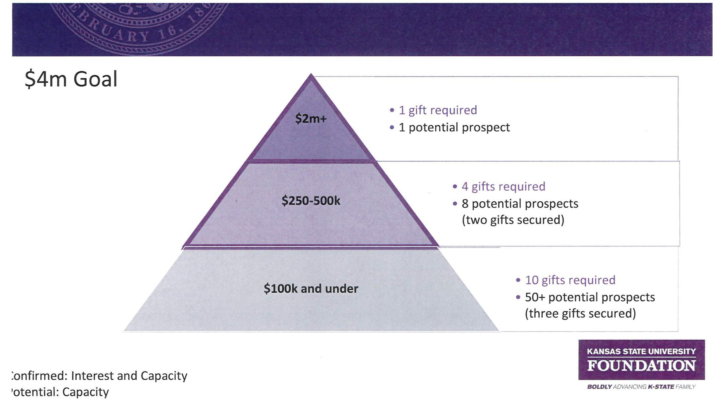
Donor Pyramid

Slide 10
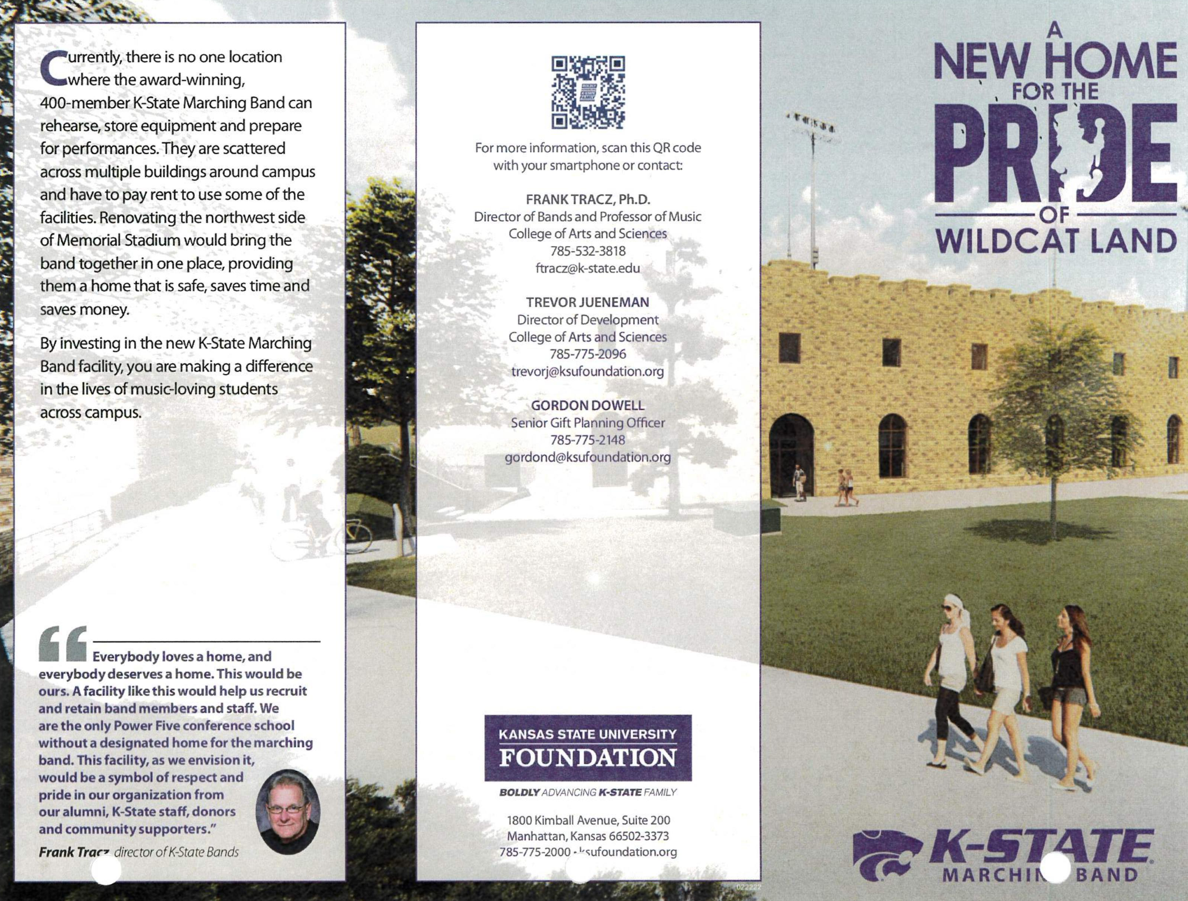
TFBH
Brochure

Slide 11
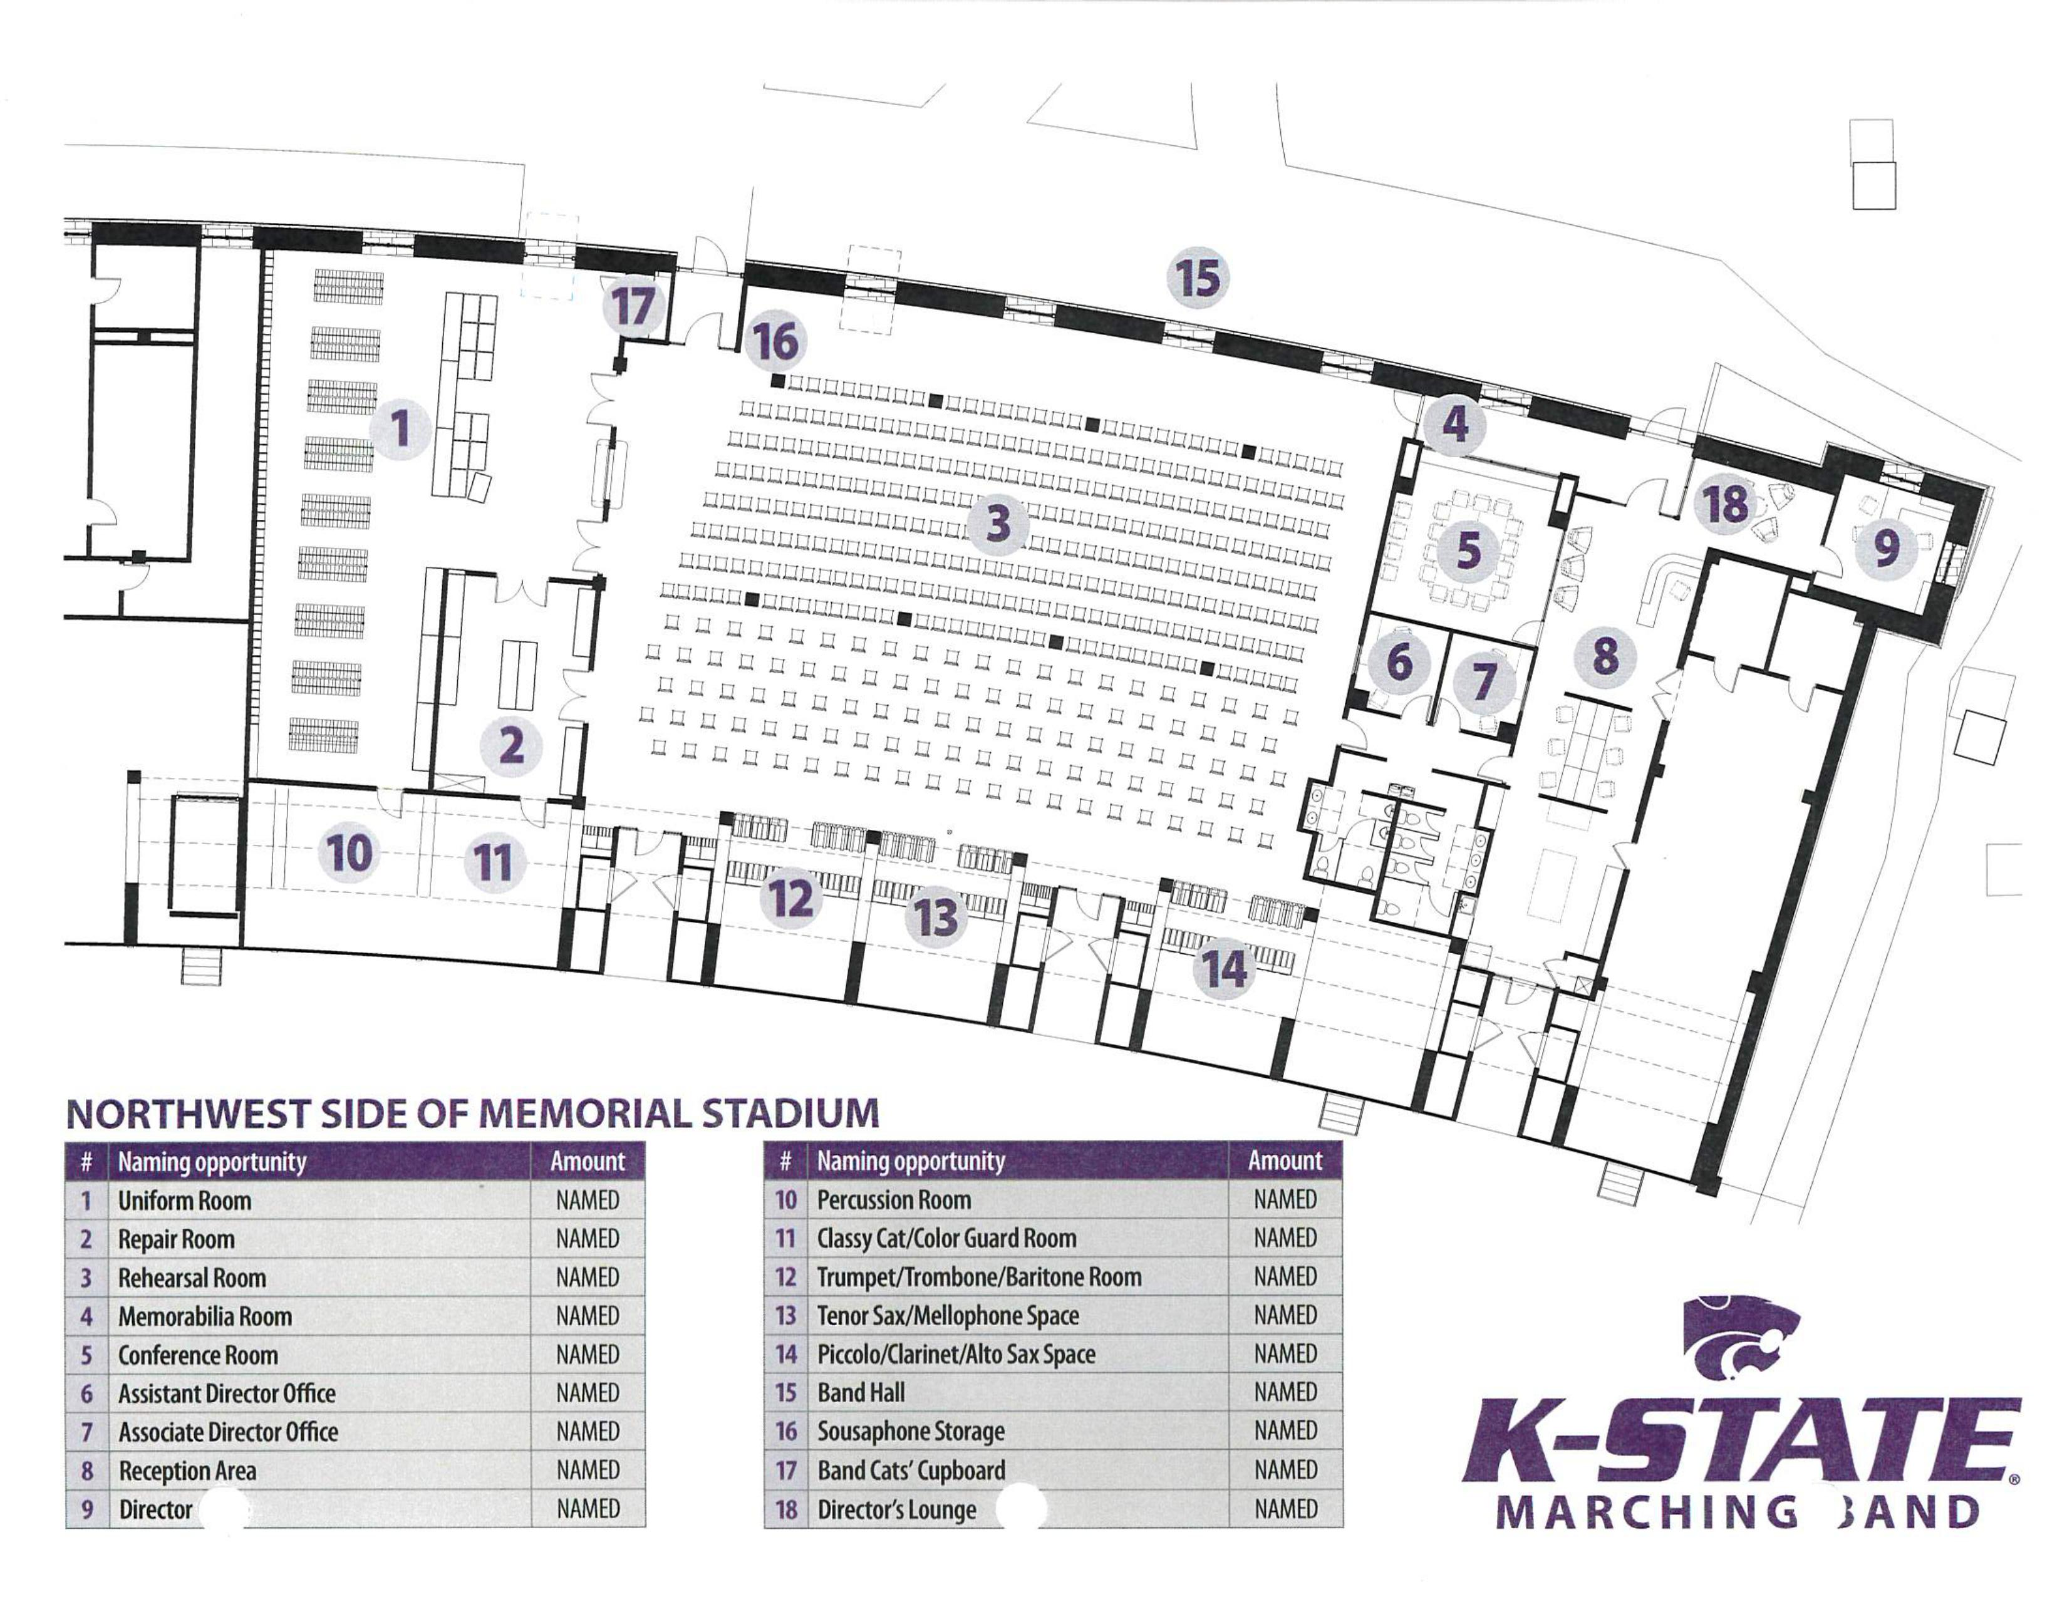

Slide 12
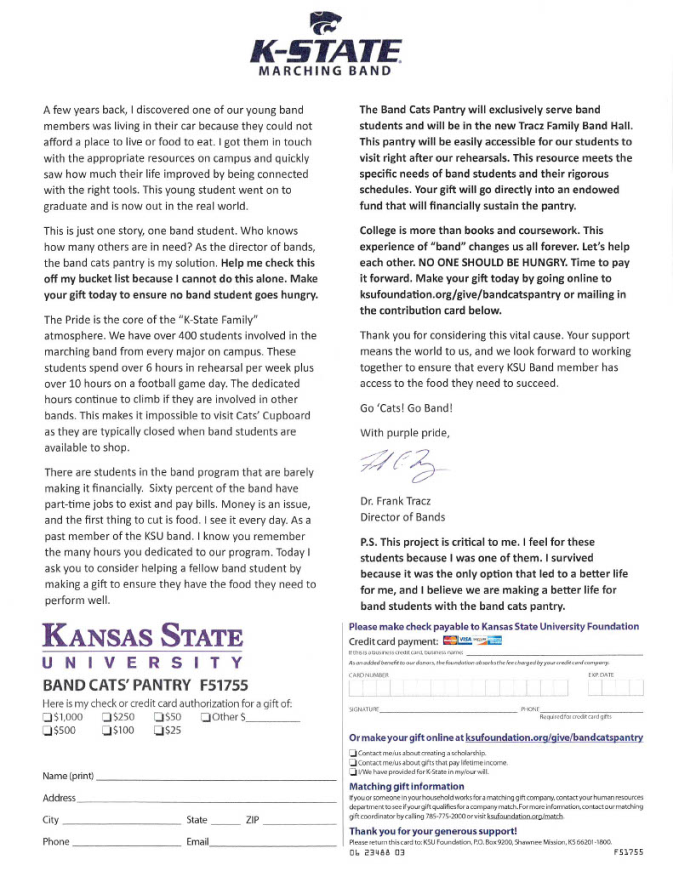
Band Cats’ Pantry
Reason

Slide 13
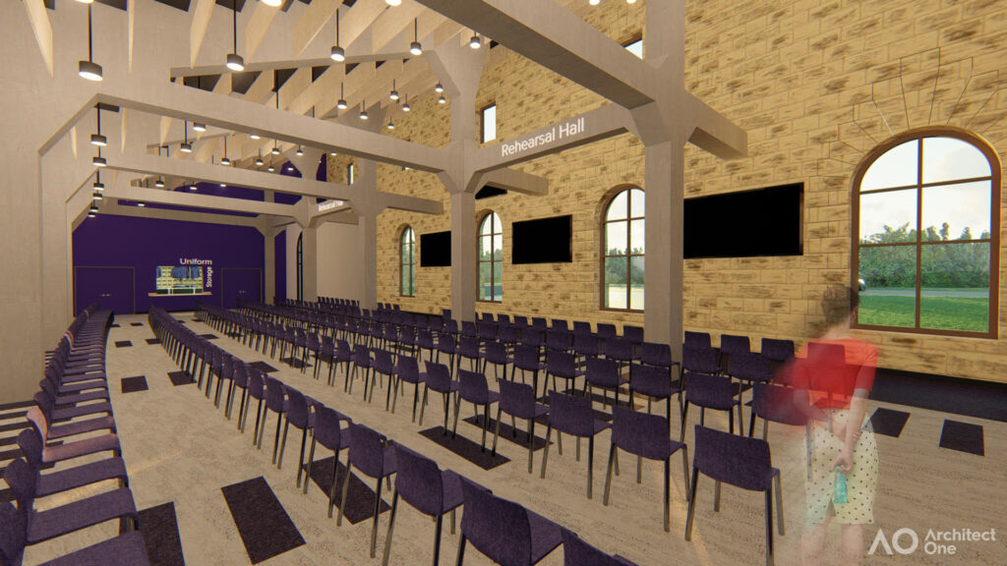
Band Cats’ Pantry Video

Slide 14
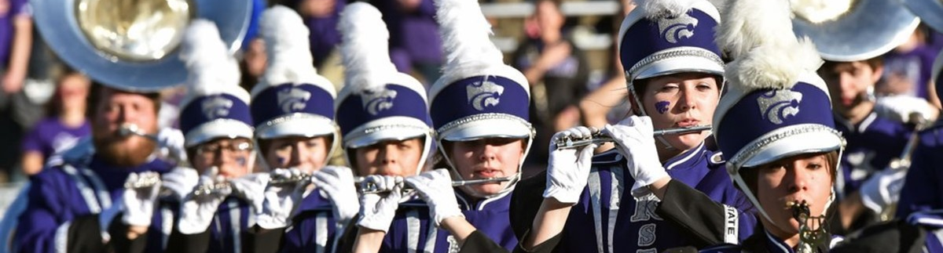
Results
Tracz Family Band Hall – $5.3 Million
Band Cats’ Pantry – Endowed $125,000

Slide 15
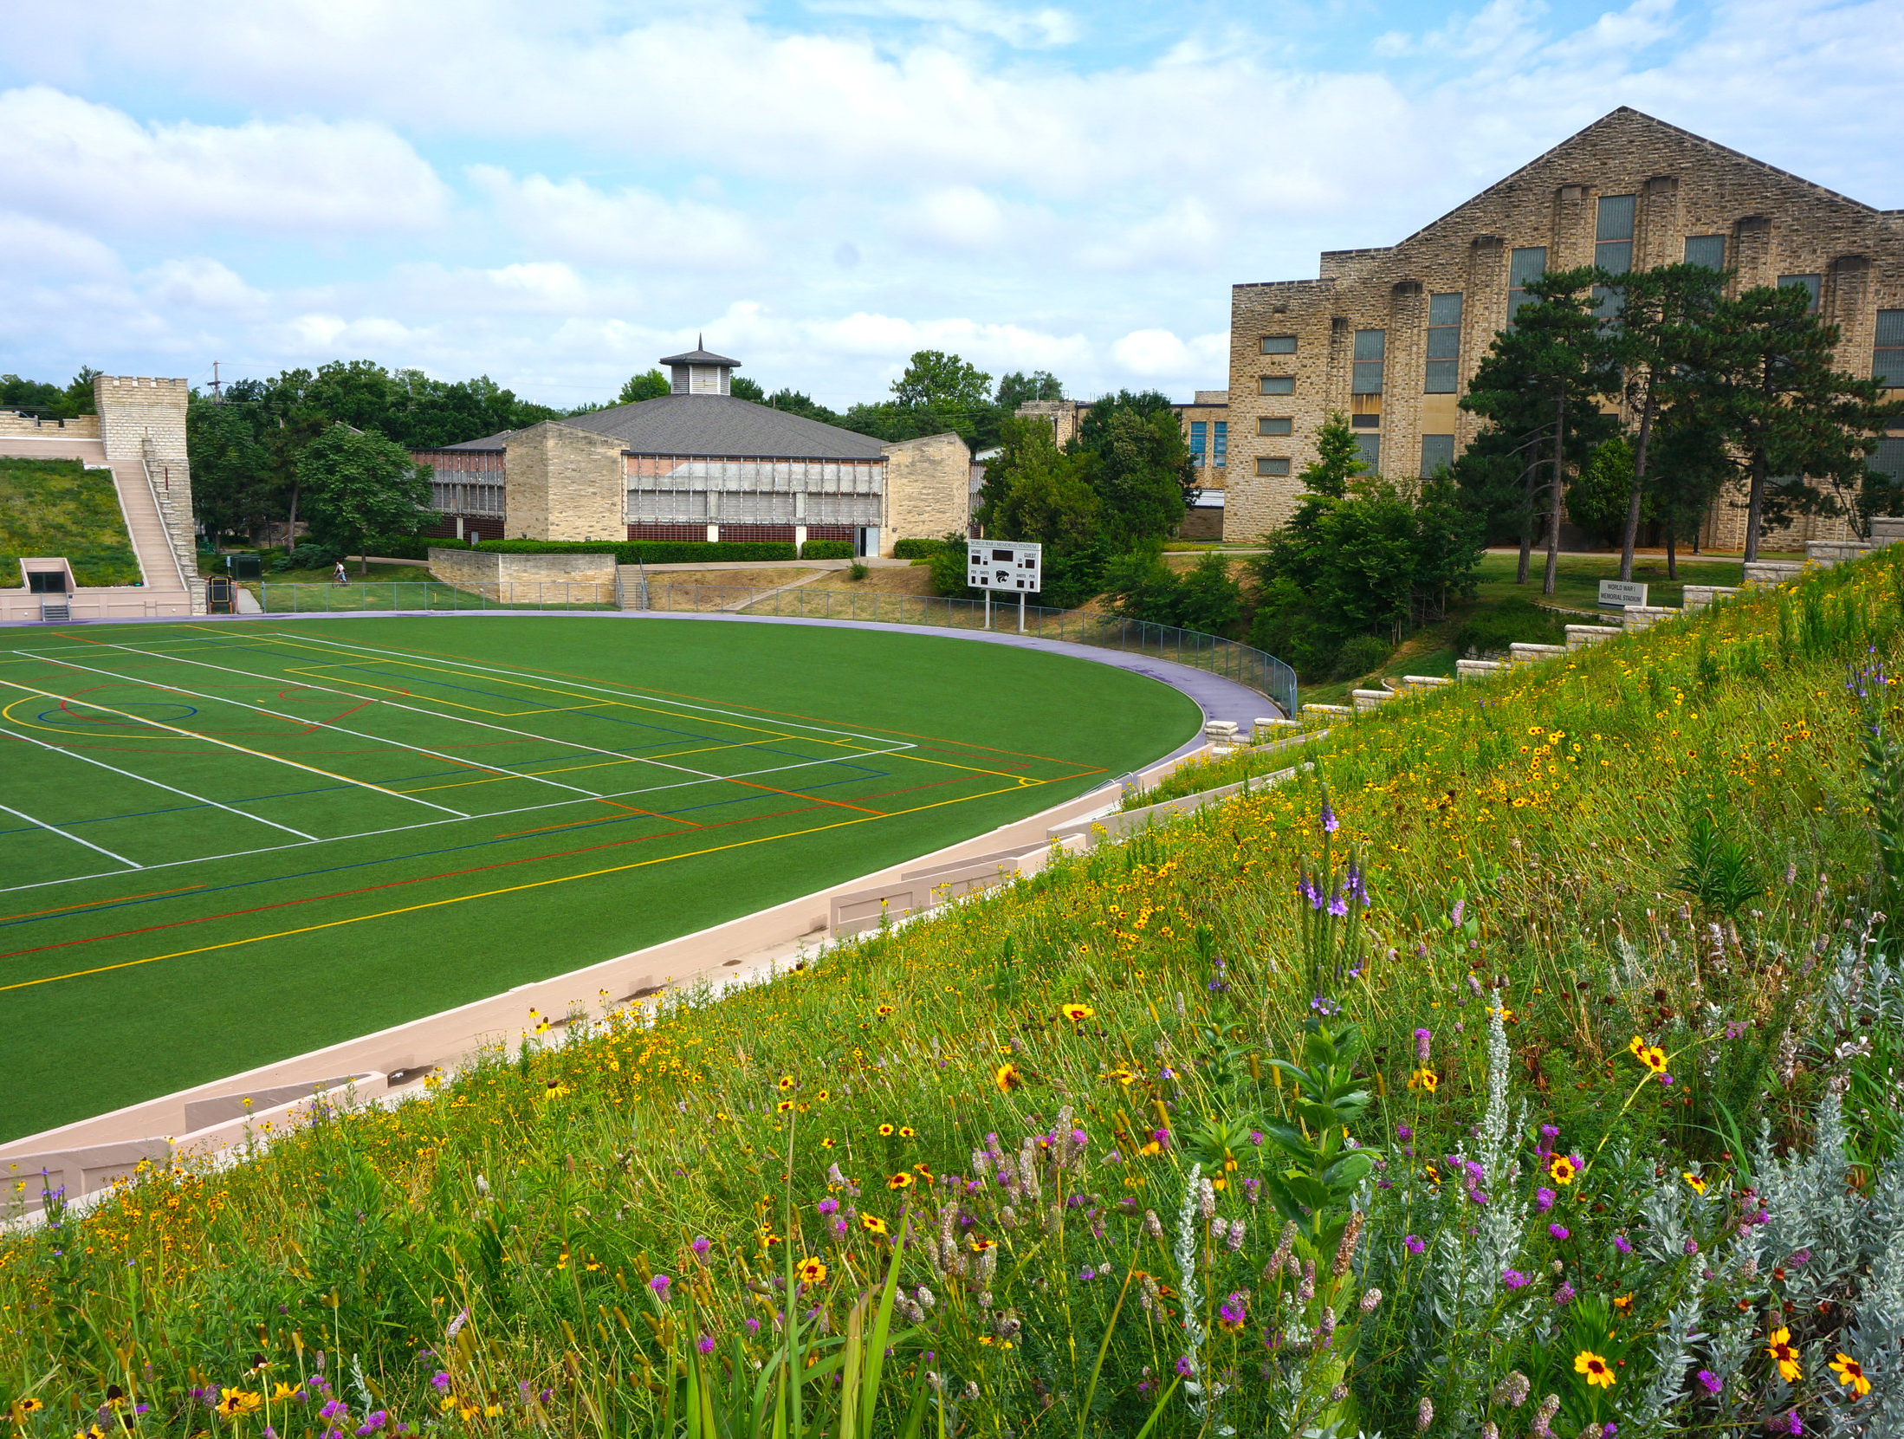
SUmmary
I Knew Nothing
I Learned
Longevity Pays Forward
L.I.B.T.Y.F.I.

Slide 16
Dr. Frank Tracz
Director of Bands
Kansas State University ftracz@ksu.edu

