Slide 1
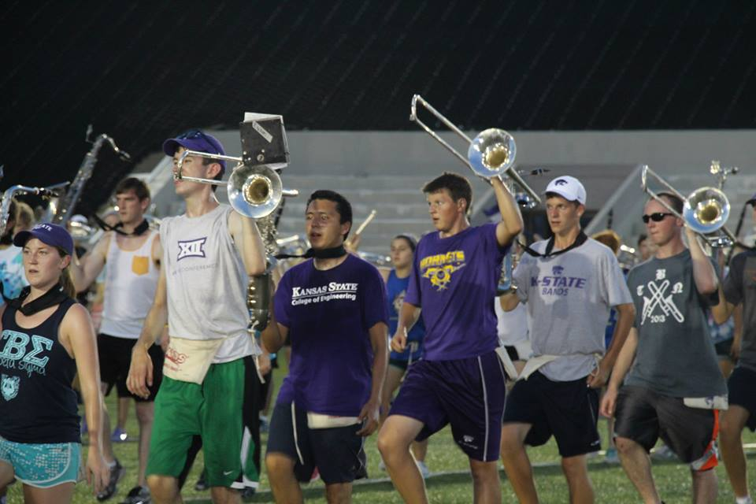
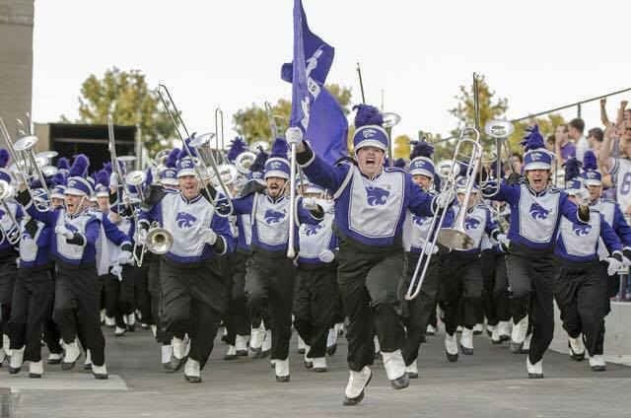
”What is…..What Could Be”
Dr. Frank Tracz
Director of Bands, Kansas State University
Professor of Music

Slide 2
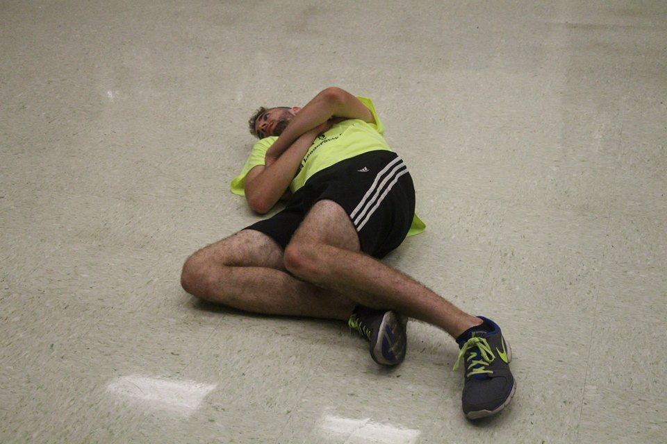
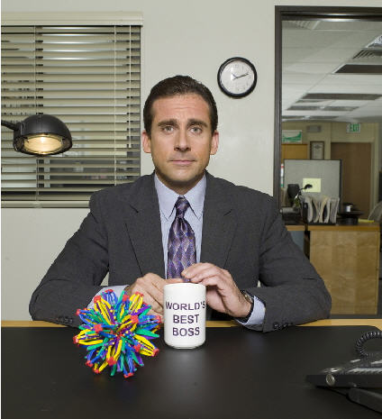
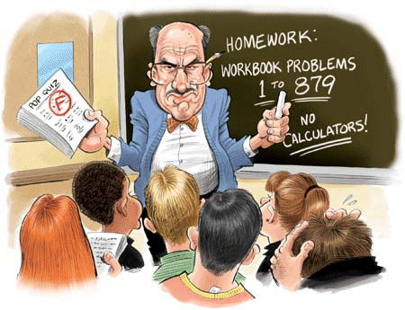
”What is…..What Could Be”
“They Come From…..”
Class
Work
Napping!
Home/Apartment

Slide 3
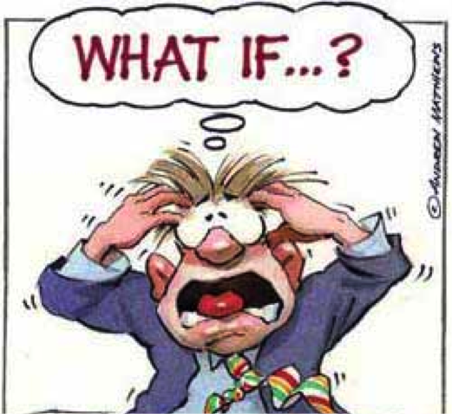
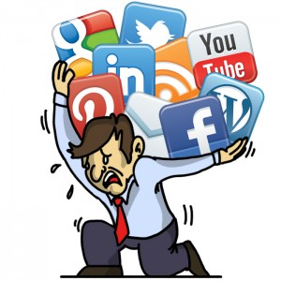
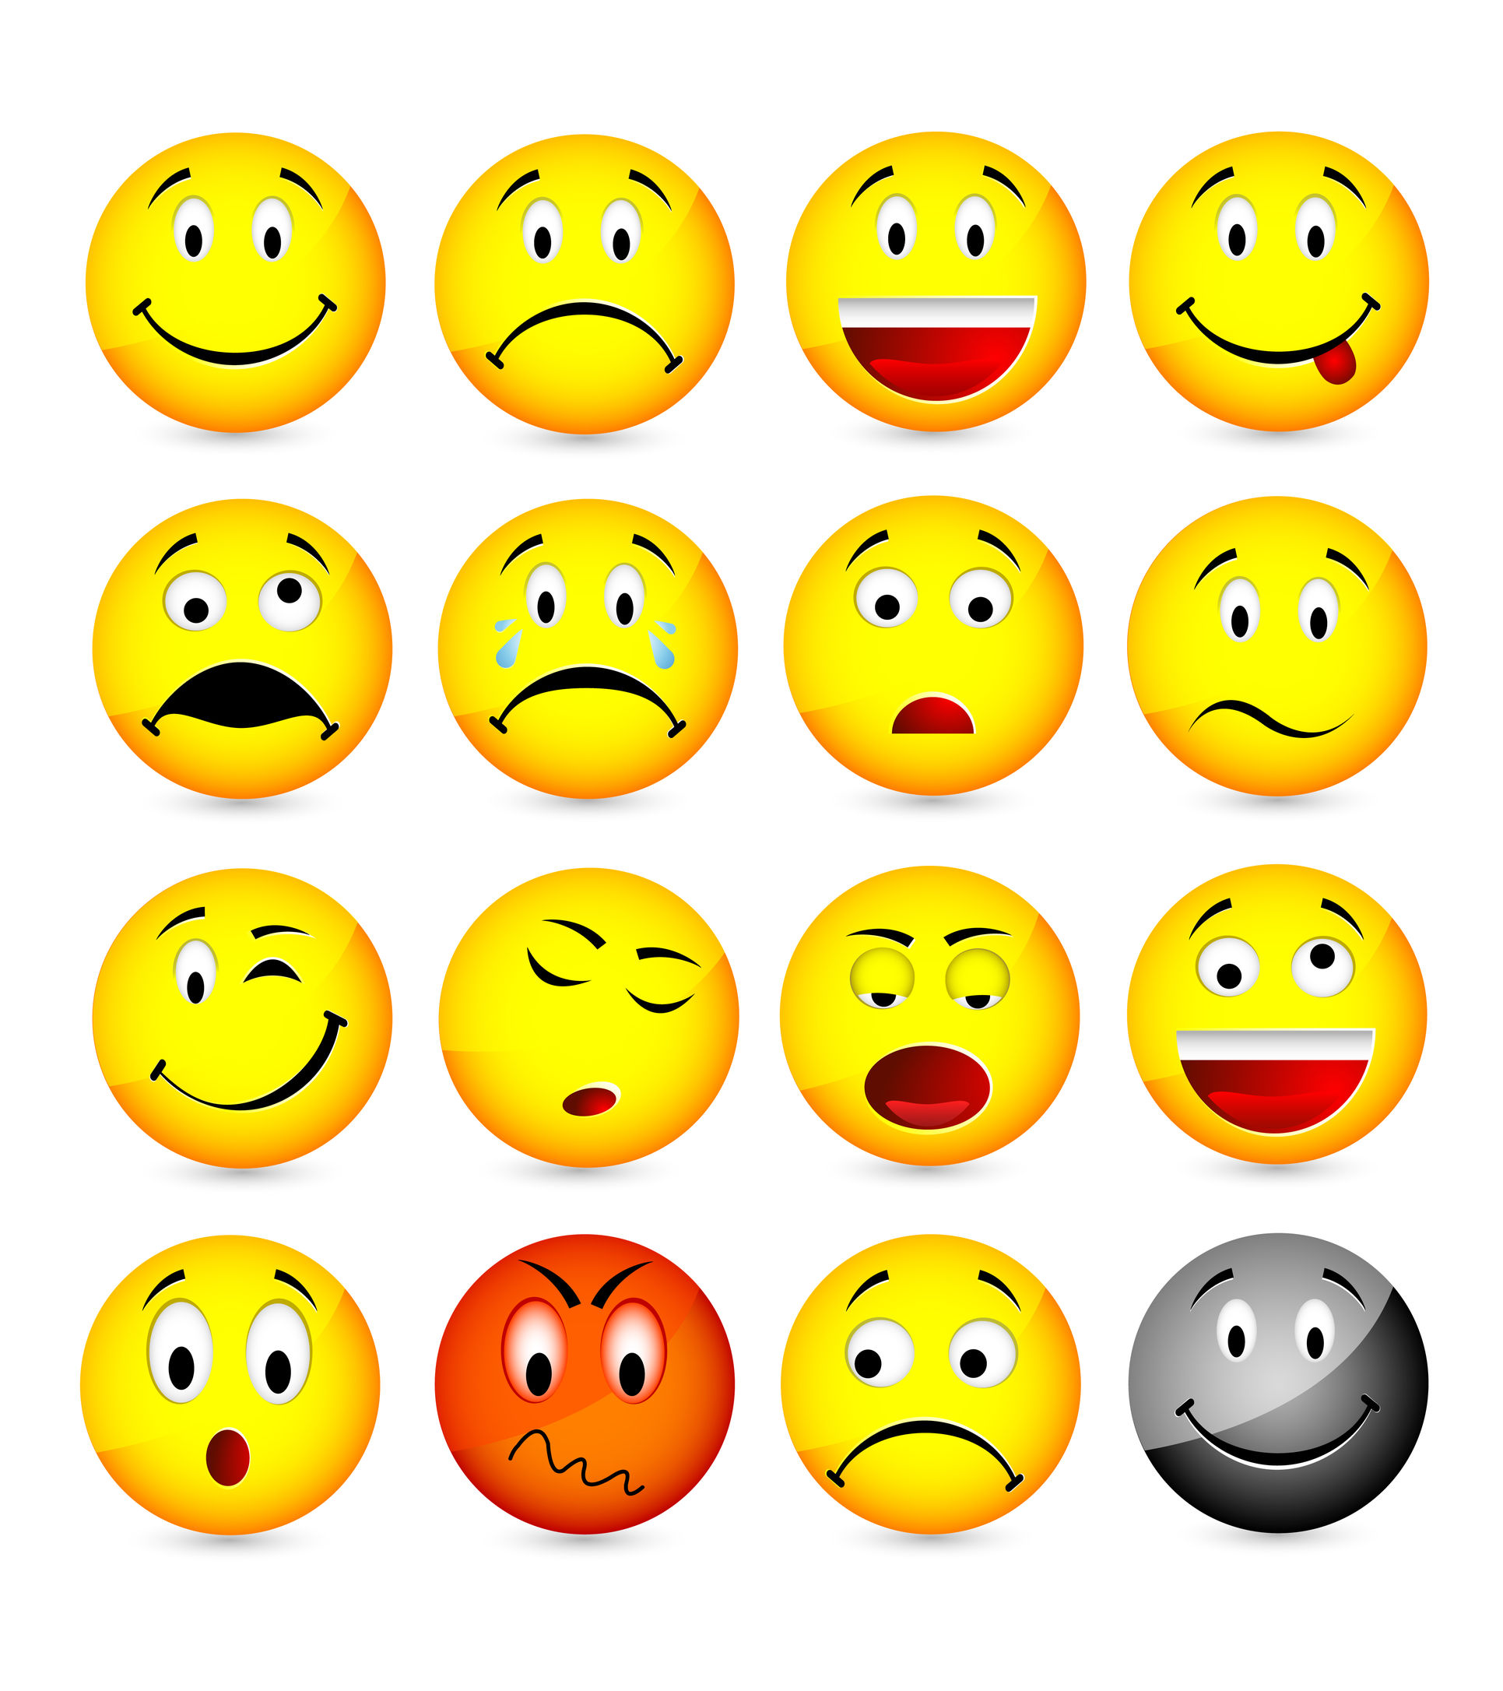
”What is…..What Could Be”
“They Come With…..”
Worries
Emotions
Pain
Challenges
SOCIAL MEDIA!

Slide 4
”What is…..What Could Be”
”My Job…..”
DE-BAG the BAND!!!

Slide 5
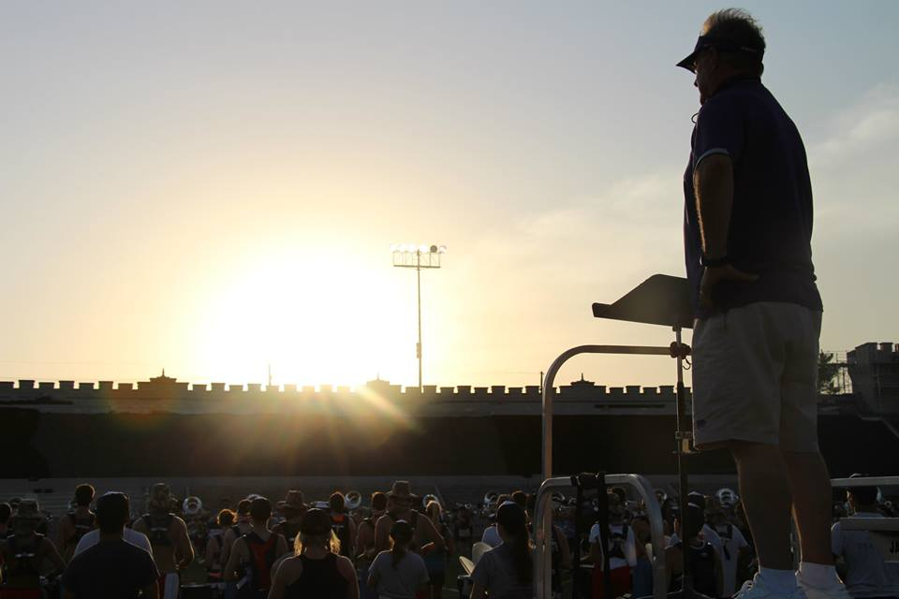
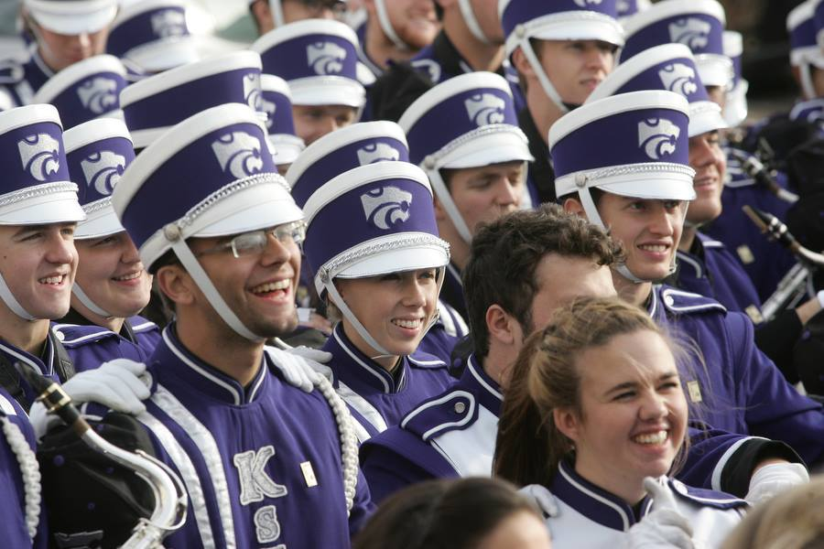
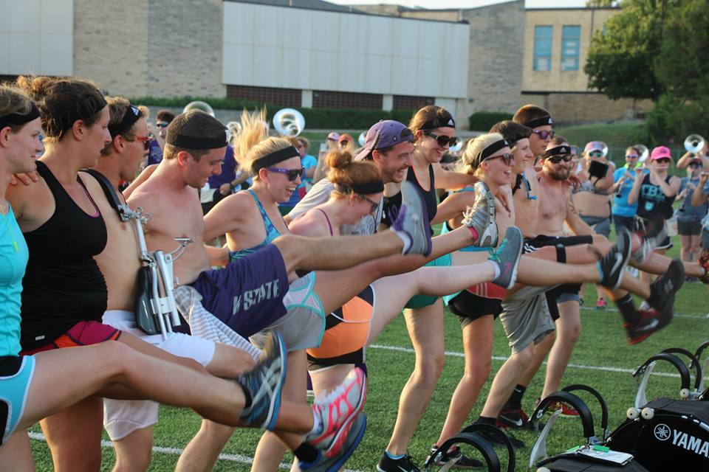
”What is…..What Could Be”
”Why Come To Band?”
Freedom
Escape
Friends
Perspective
Balance
FUN!!!

Slide 6
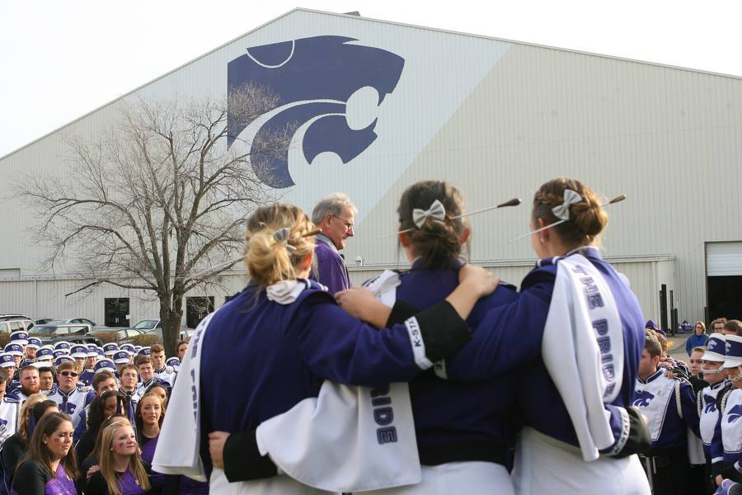
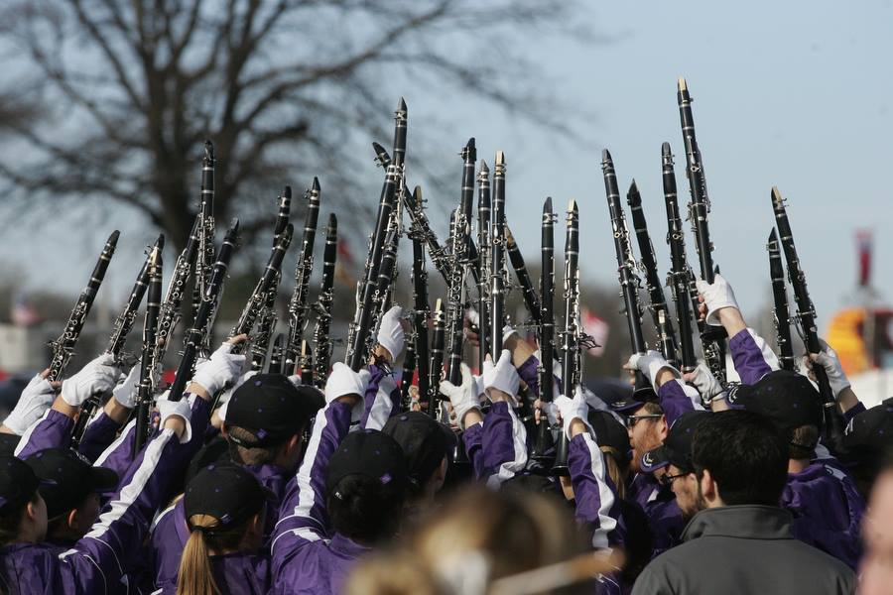
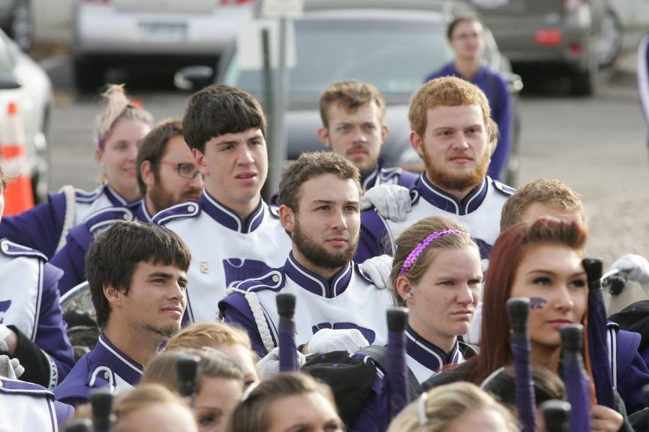
”What is…..What Could Be”
“What Do They Receive?”
Purpose
Cause
Buy-In
Belonging
Ownership!

Slide 7
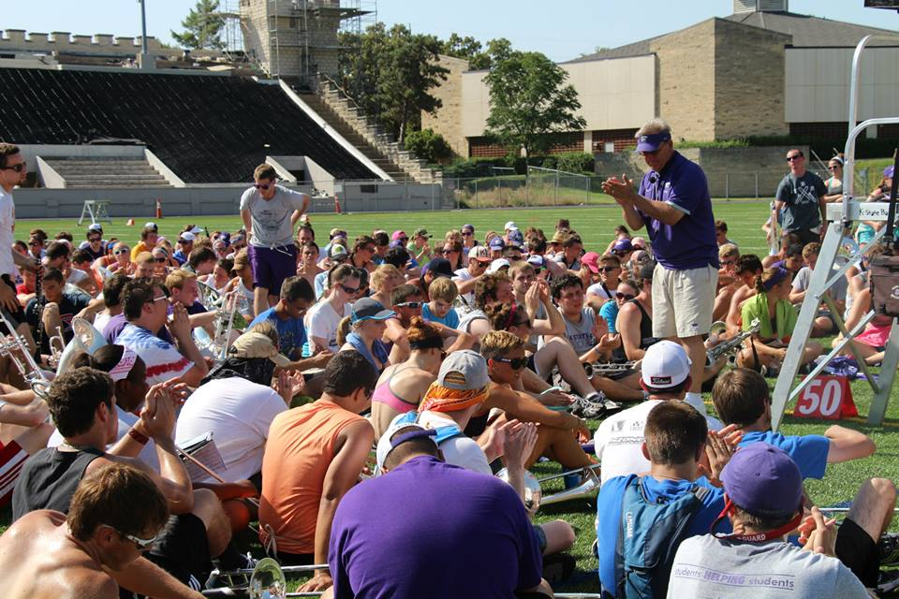
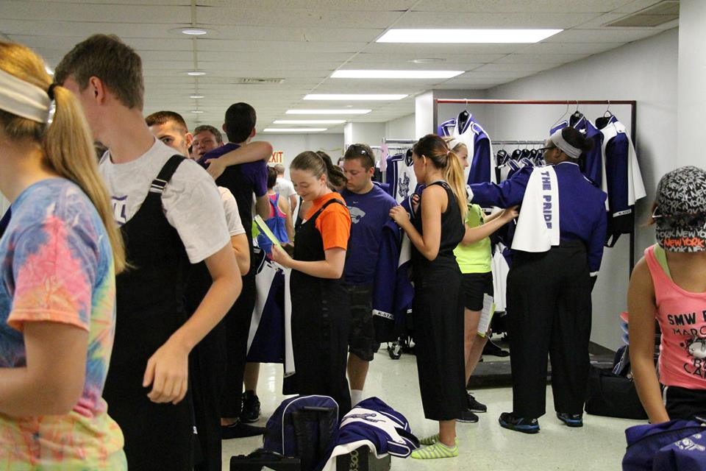
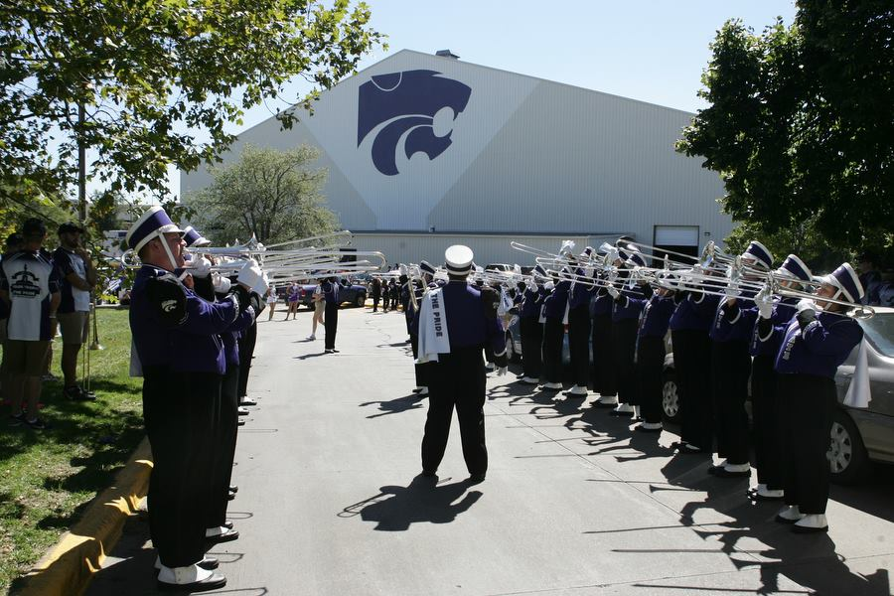
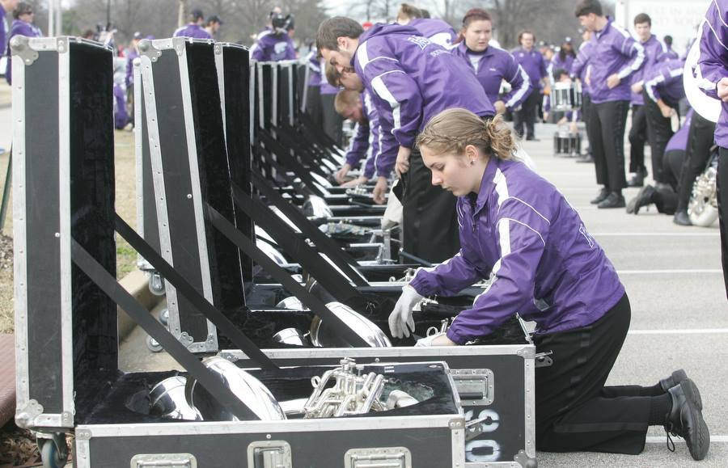
”What is…..What Could Be”
”When?”
Before Band
Beginning of Band
Process of Band
Finale/Send-Off from Band…..

Slide 8
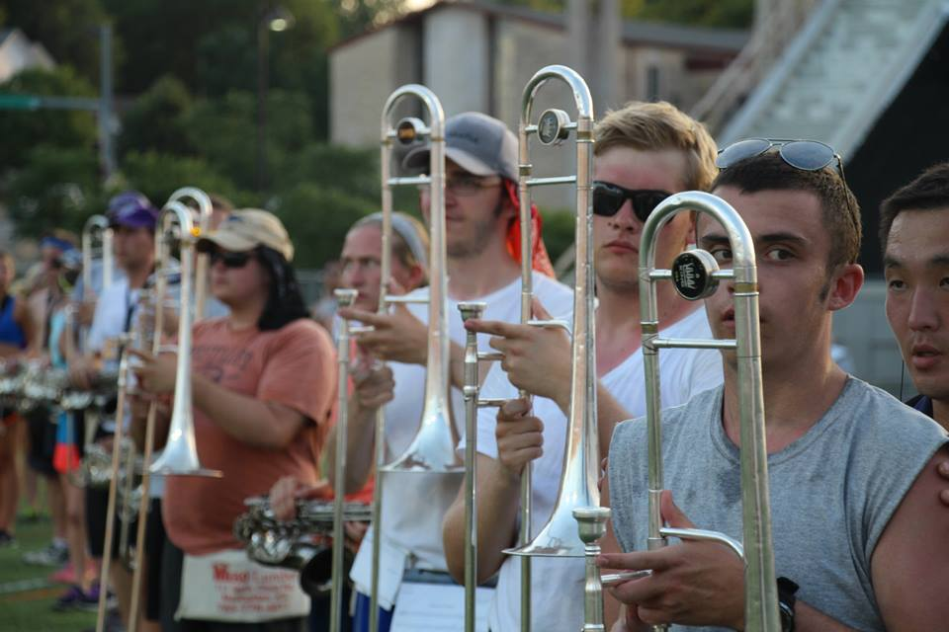
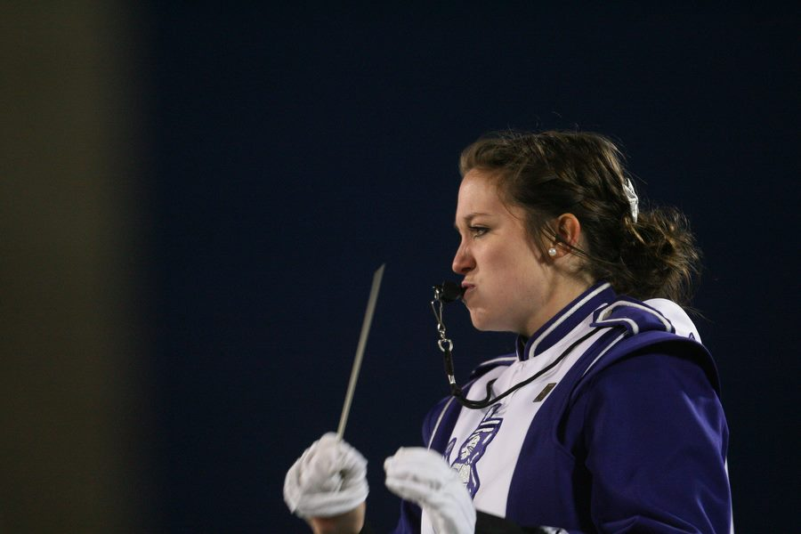
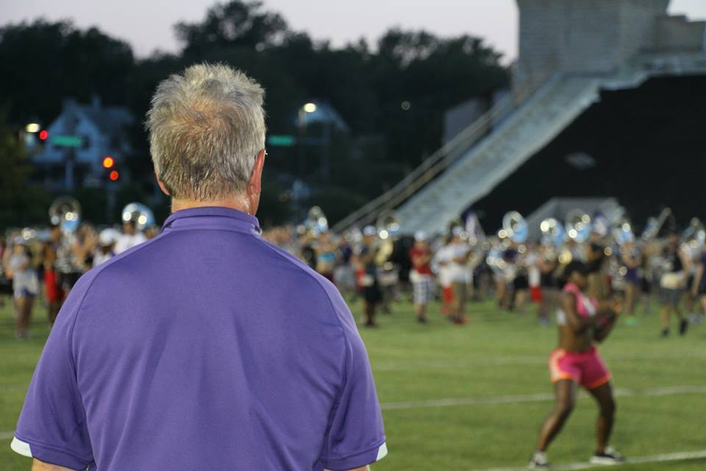
”What is…..What Could Be”
”How?”
“CHANGE”
  Mindset
  Attitude
  Focus
  Priorities
  The way they look at things, challenges, pain, etc. all of the above
  Themselves and
  LIFE!!!

Slide 9
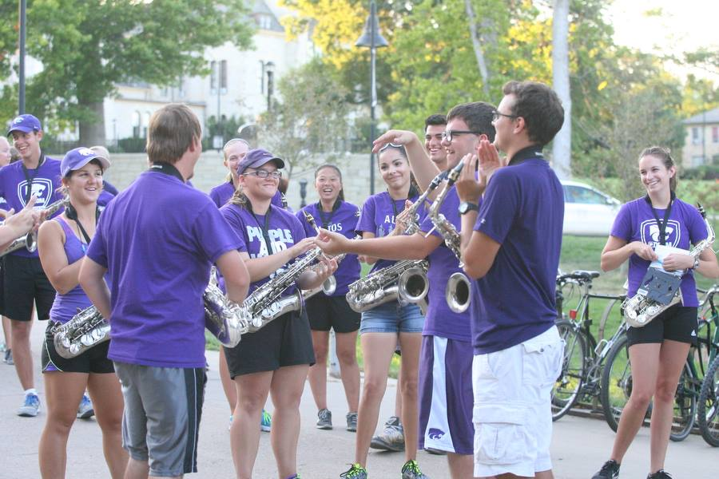
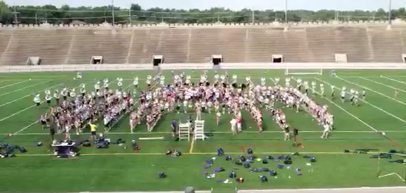
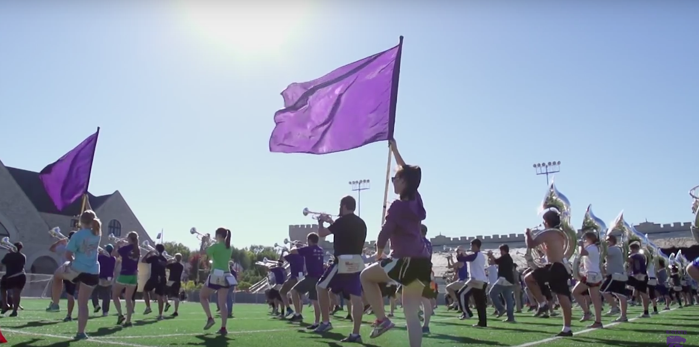
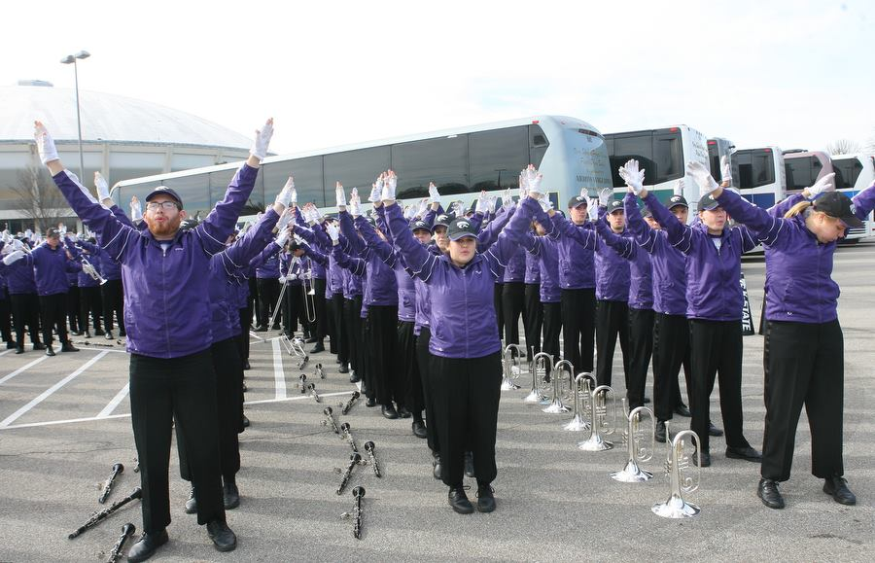
”What is…..What Could Be”
”Successful Techniques”
Communication Change
  Conversation
  Handwritten Notes
  Football, Frisbee, Hacky Sack, Soccer
  Stereo with LOUD MUSIC!!!
  Short Bursts of Verbal and Physical Contacts
Physical Change
  Jumping Jacks
  “Fundies” (technique)
  ”Arcs” Warm-Ups
    Breathing, singing, thinking, playing

Slide 10
”What is…..What Could Be”
Process
Fast Paced
Energetic
Physical
Mind Wandering Time
Move from NON-COMFORT to COMFORT
Result
Positive and Productive Rehearsal
Student Contribution
Student Control
Student Intensity and Focus
Much Accomplished in Very Little Time!!!
Happy and Satisfied Kid
Involved Kid
Student-Centered and Student-Owned
And, The Ultimate Result…..

Slide 11
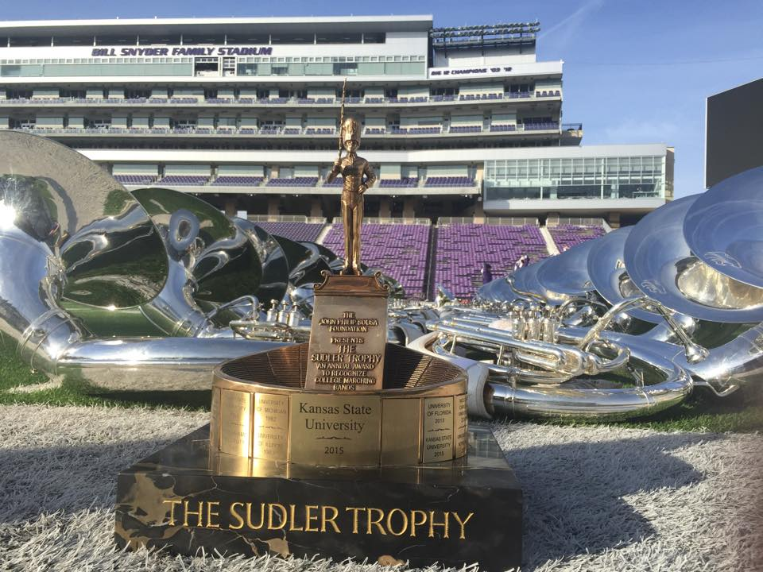
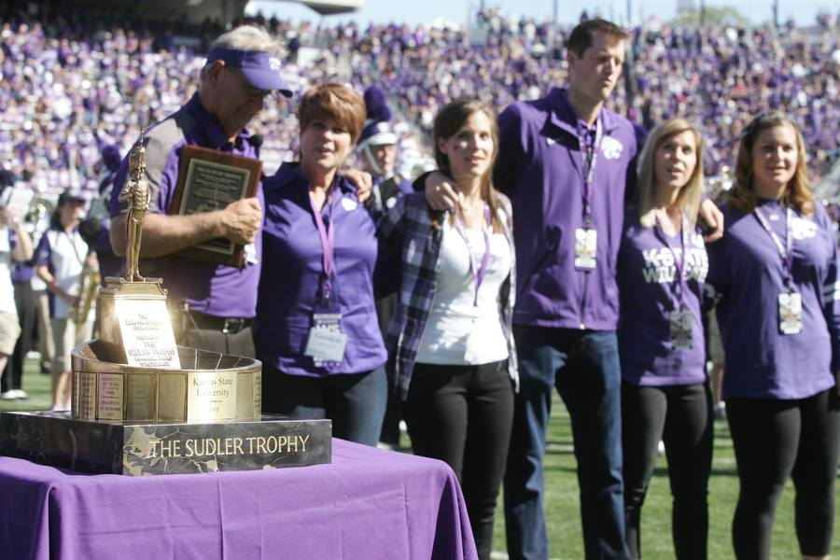
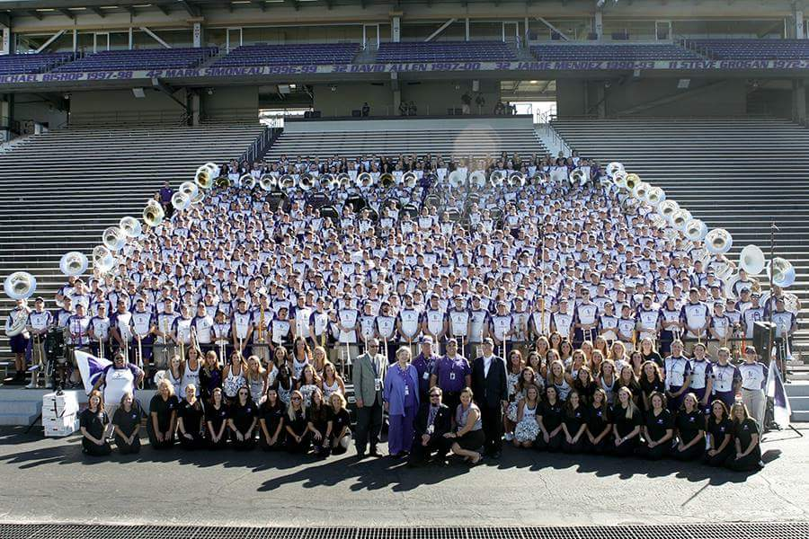
”What is…..What Could Be”
2015-2016 Sudler Trophy Award Winner

Slide 12
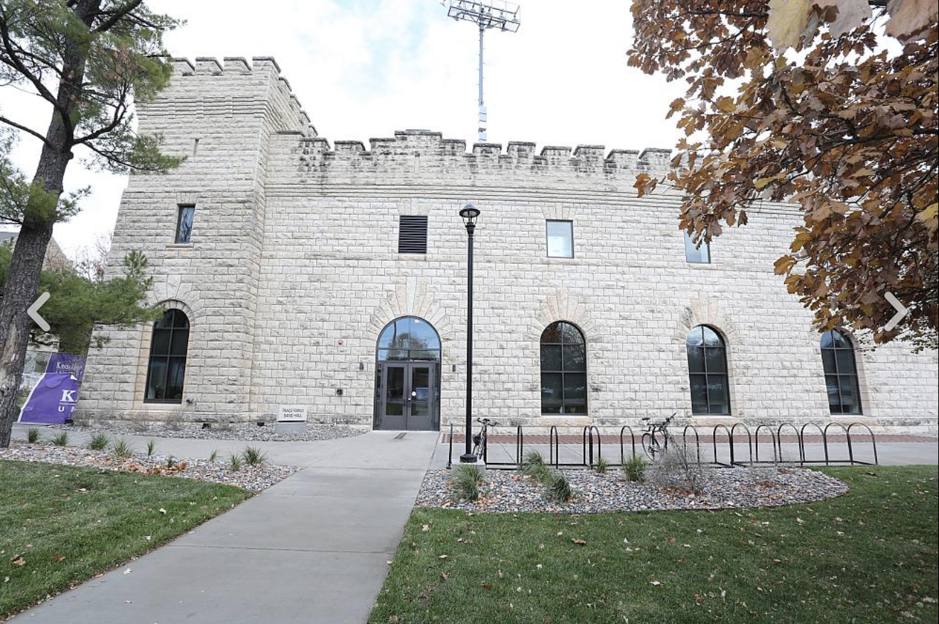
”What is…What Could Be”
The Tracz Family Band Hall

Slide 13
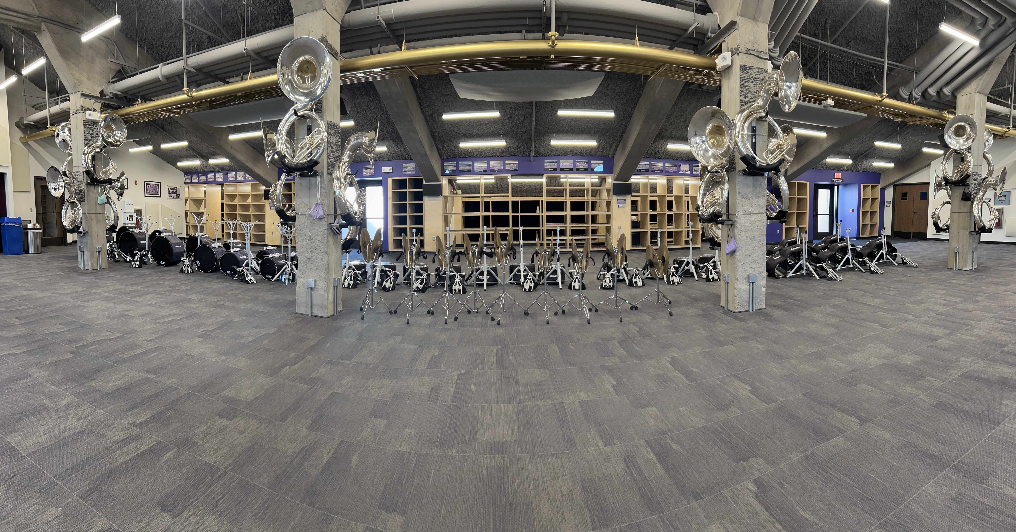
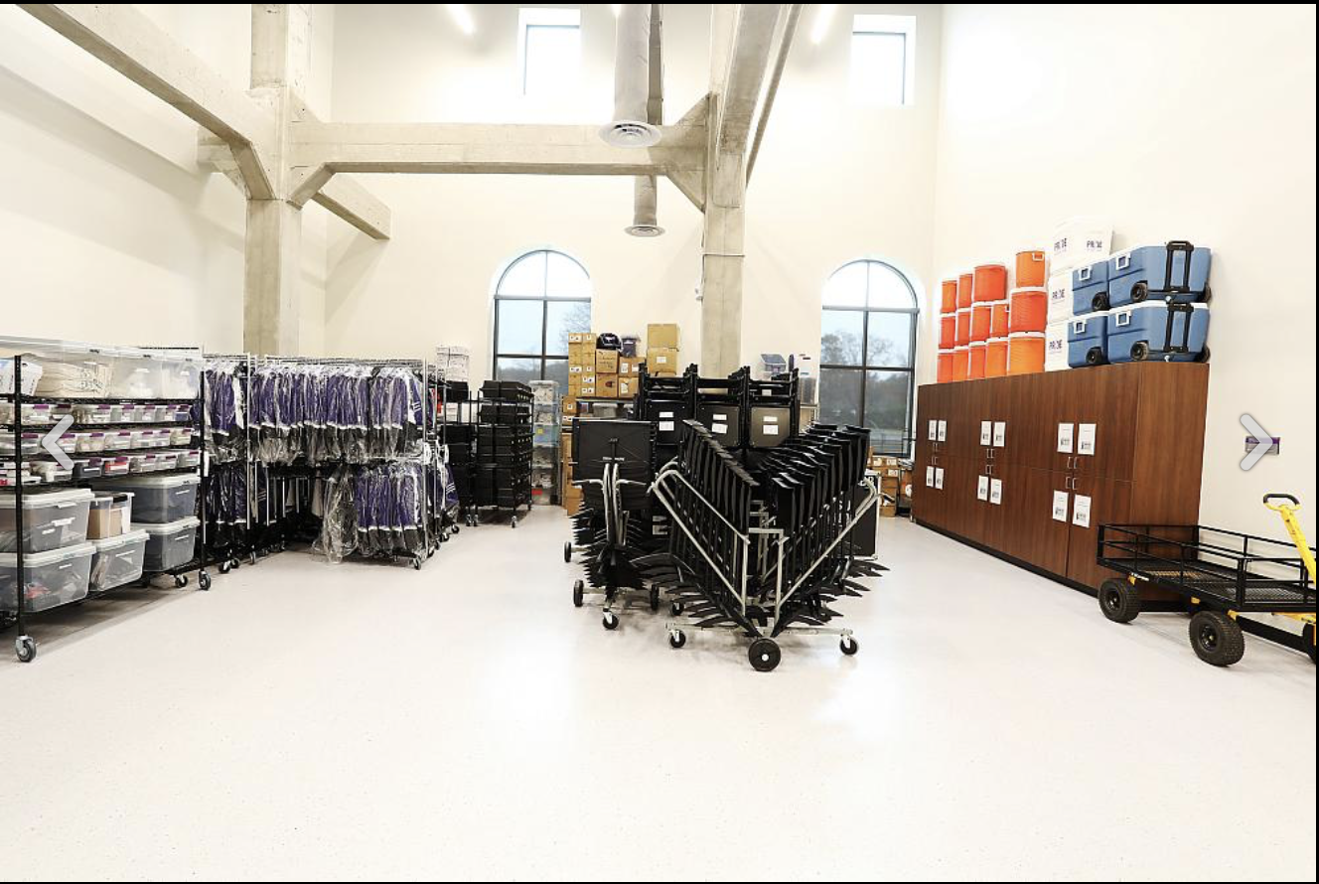
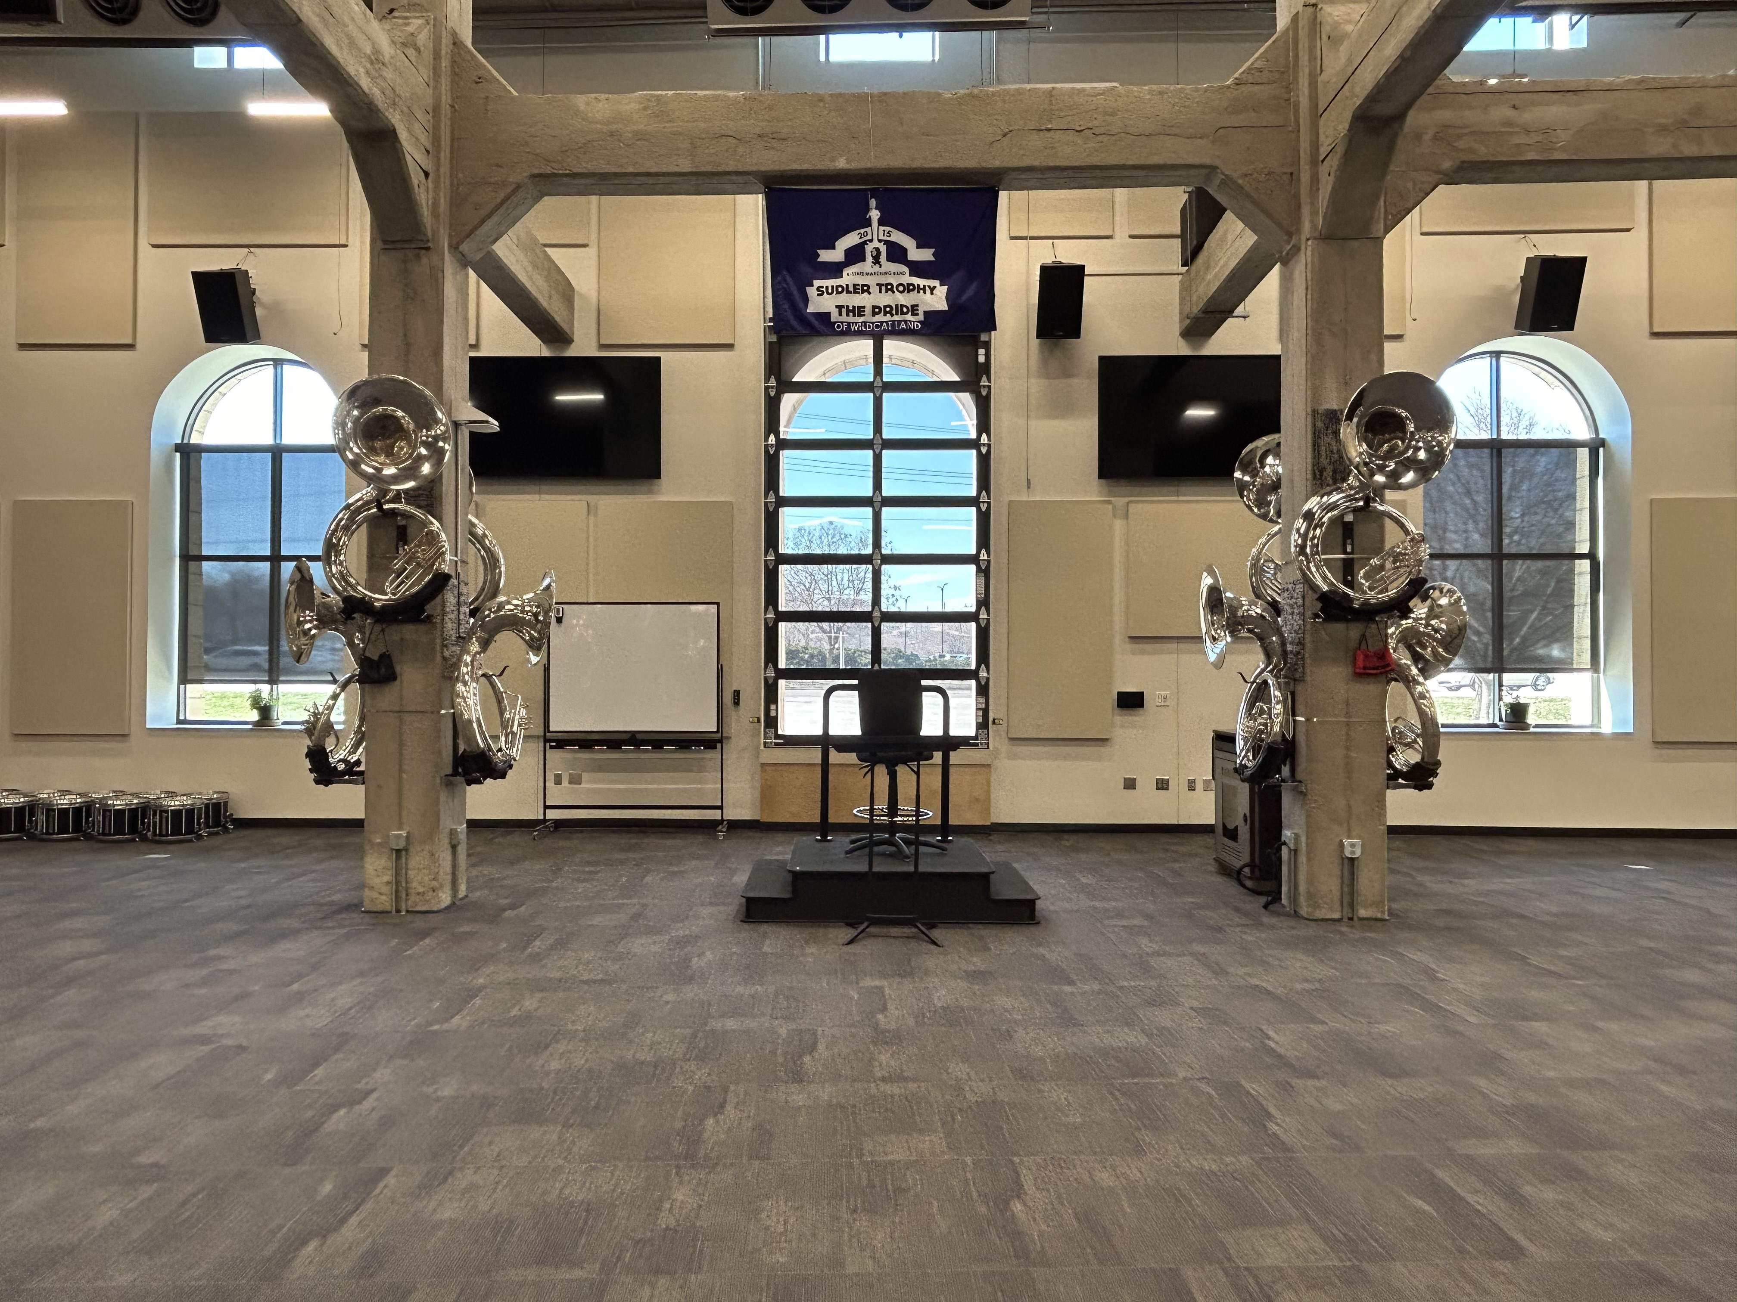
“What is…What Could Be”

Slide 14
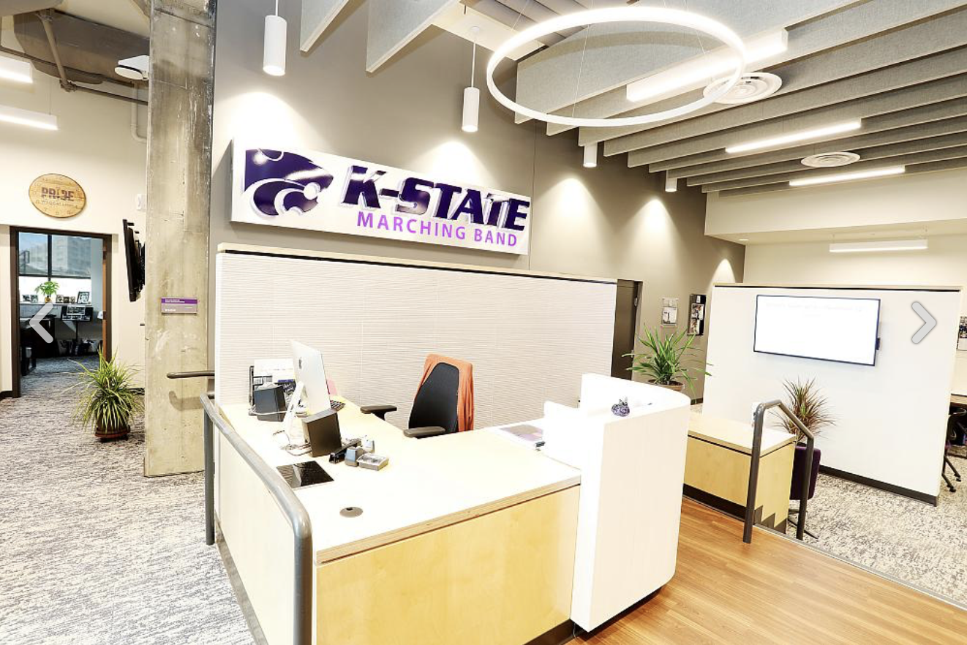
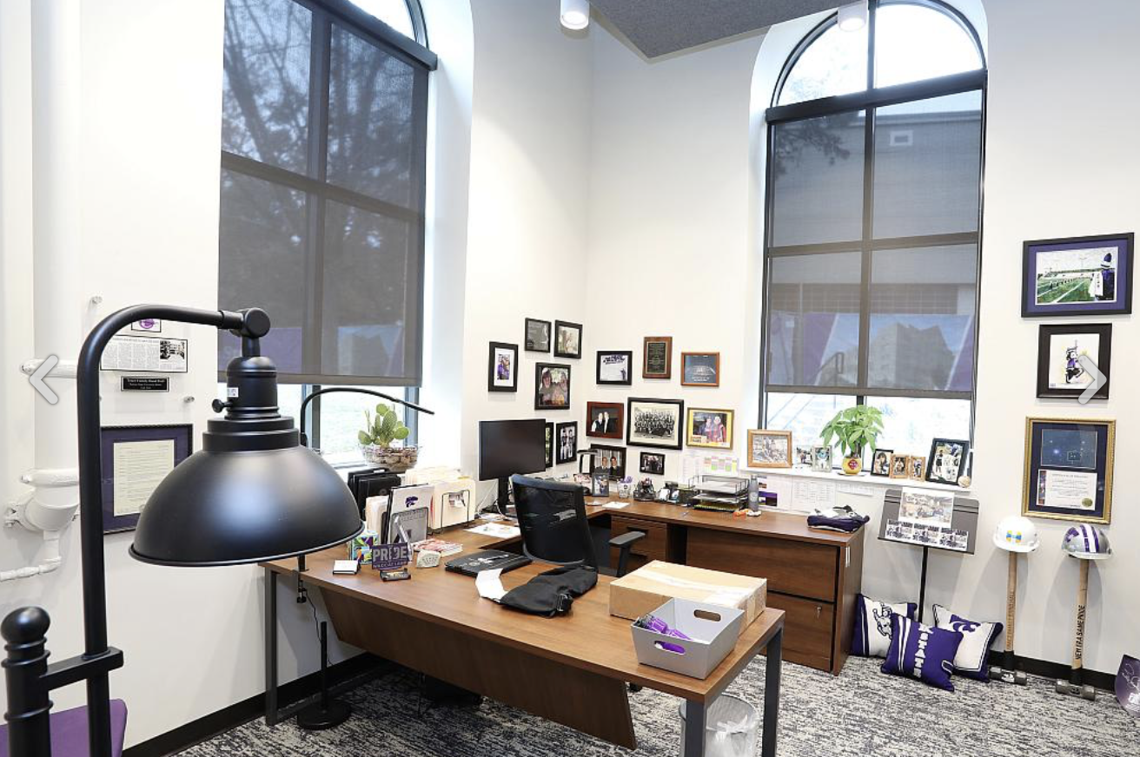
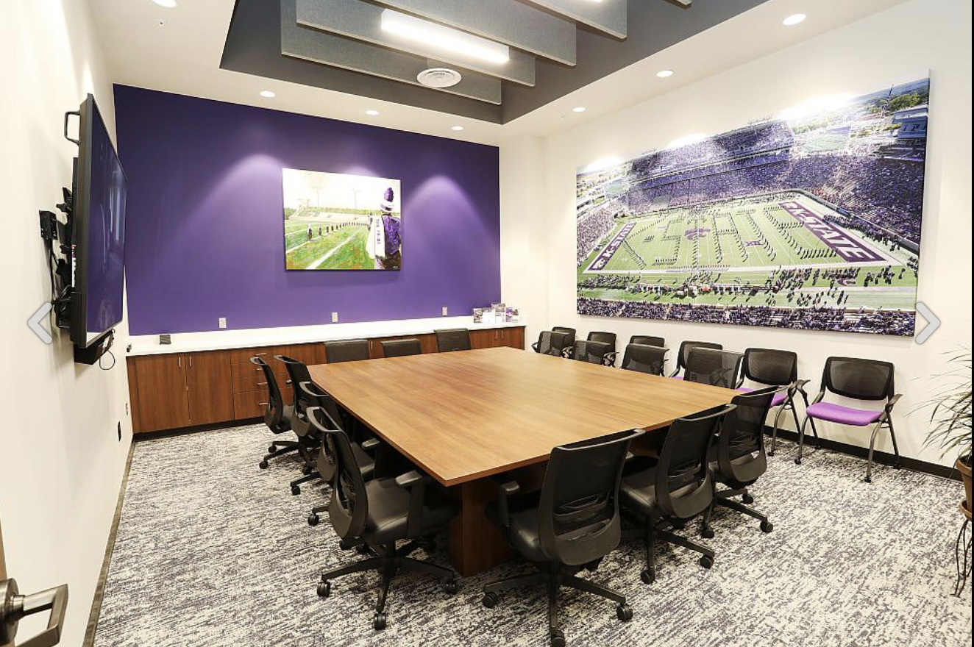
“What is…What Could Be”

Slide 15
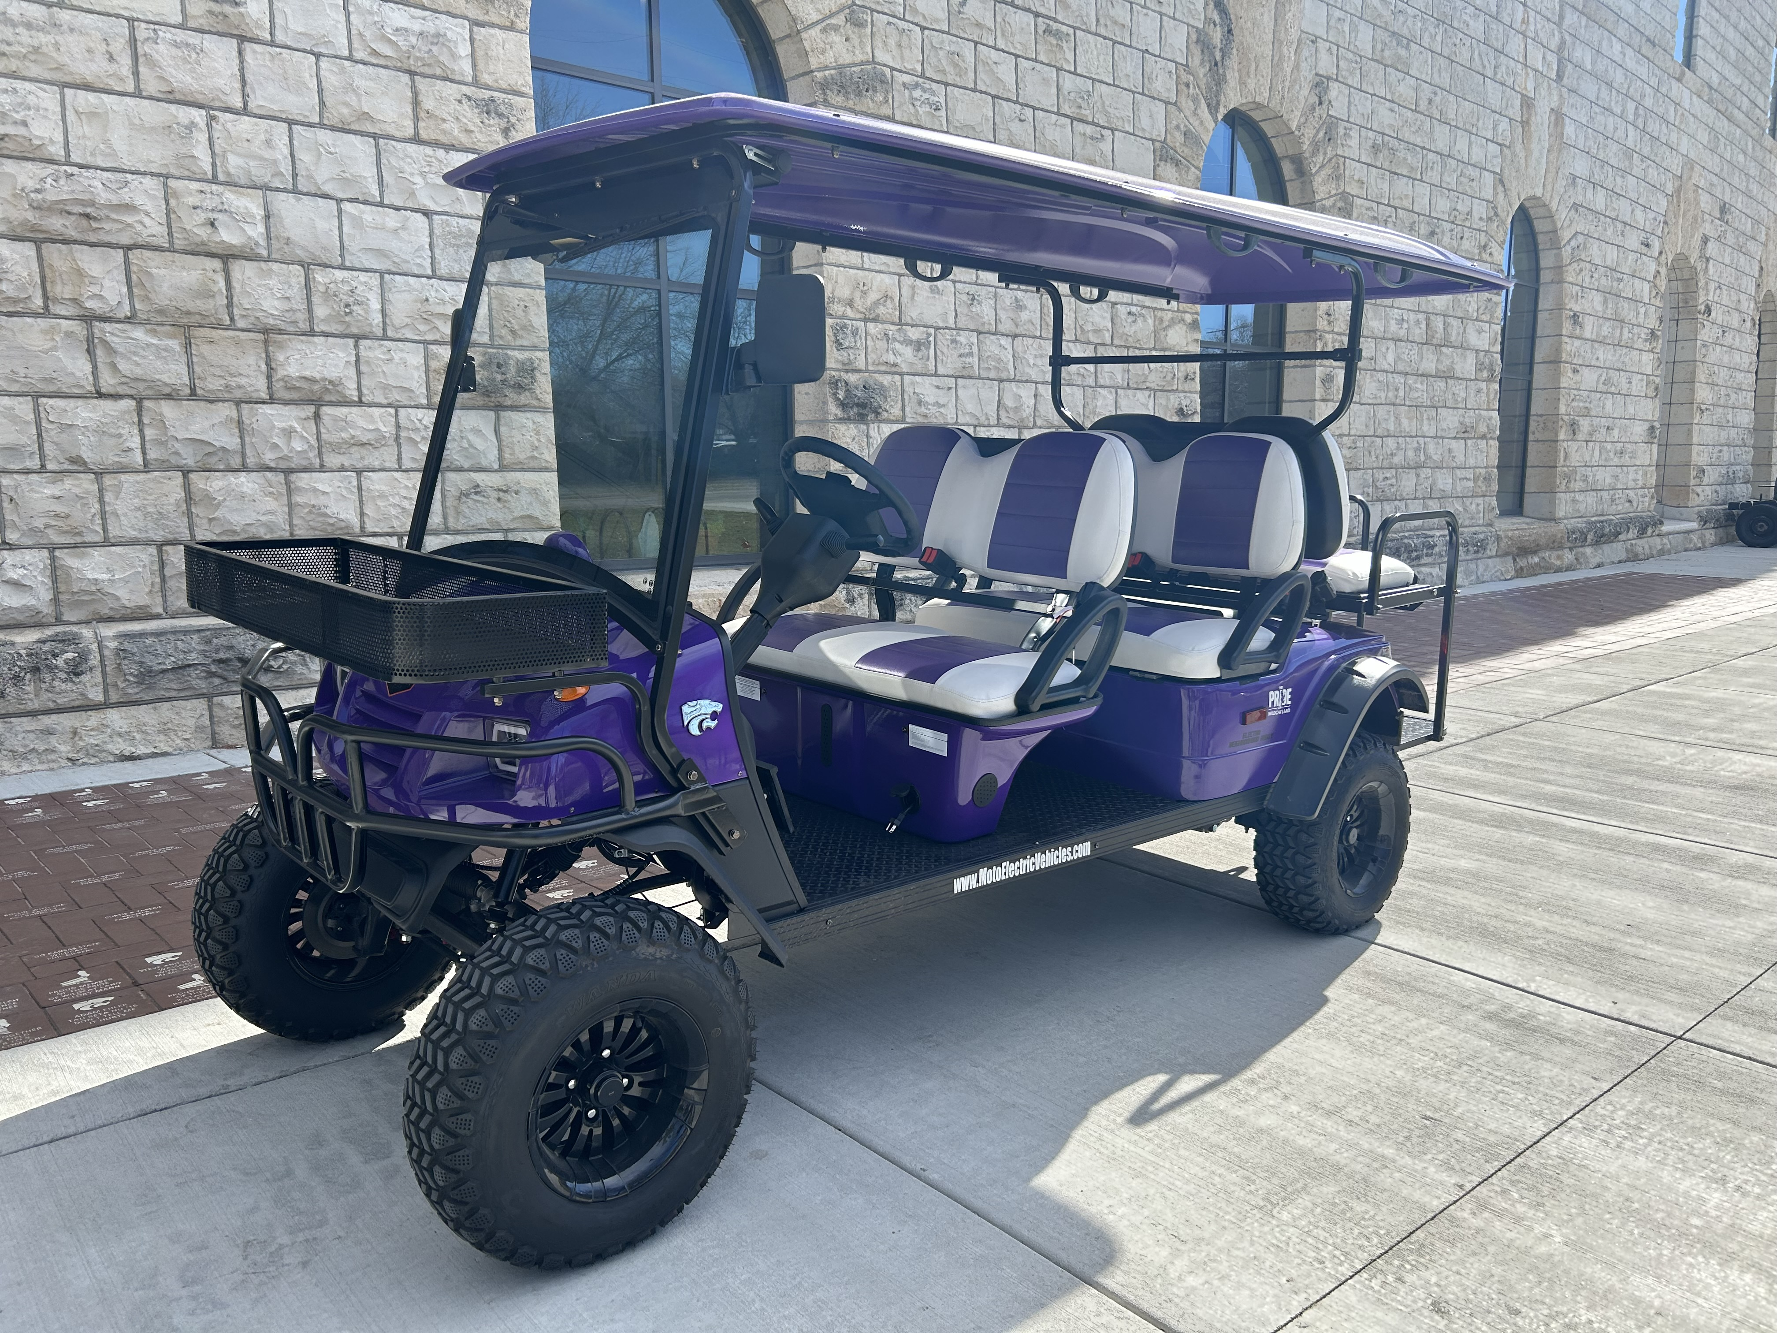
“What is…What Could Be”

Slide 16
Dr. Frank Tracz
Director of Bands
Kansas State University ftracz@ksu.edu

