Slide 1
Thoughts from the Road
Dr. Frank Tracz
Summer 2018

Slide 2
“Just wanna hear it’s gonna be alright.”
- Garth Brooks

Slide 3
“Dialing 6 numbers just to have on the phone.”
- Garth Brooks

Slide 4
“I wish I didn’t know now, what I didn’t know then.”
- Bob Seger

Slide 5
“Life is what happens to you while you’re making other plans.”
- John Lennon

Slide 6
“Too much ain’t enough.”
- Tom Petty

Slide 7
“We’re all in the gutter, but some of us are looking at the stars.”
- Oscar Wilde

Slide 8
“Fear is contagious, so is hope.”

Slide 9
“Do you know of anyone who got hired or promoted because of a tweet?”
- News

Slide 10
“Workin’ on mysteries with no clues.”
- Bob Seger

Slide 11
“Belief that superior people can’t believe their knowledge is being challenged.”
- News

Slide 12
“Let’s take it old school.”
- C.W.

Slide 13
“Looking forward to my best and worst mistakes.”
- C.W.

Slide 14
“Someday is today!”
- C.W.

Slide 15
“Silver, blue, and gold, color of the sky I’m told, but my rainbow is overdue.”
- Bad Company

Slide 16
“Who is the gas pedal, who is the break?”
- Dr. Tim

Slide 17
“Adversity pulls the family apart, or bonds it together. We decide.”
- Dr. Tim

Slide 18
“Achieve escape velocity.”
- Dr. Tim

Slide 19
“Strength through adversity, building for the future, learning from the best.”
- Dr. Tim

Slide 20
“If you argue for your limitations, you get to keep them. But if you argue for your possibilities, you get to create them.”
- Kelly Phipps

Slide 21
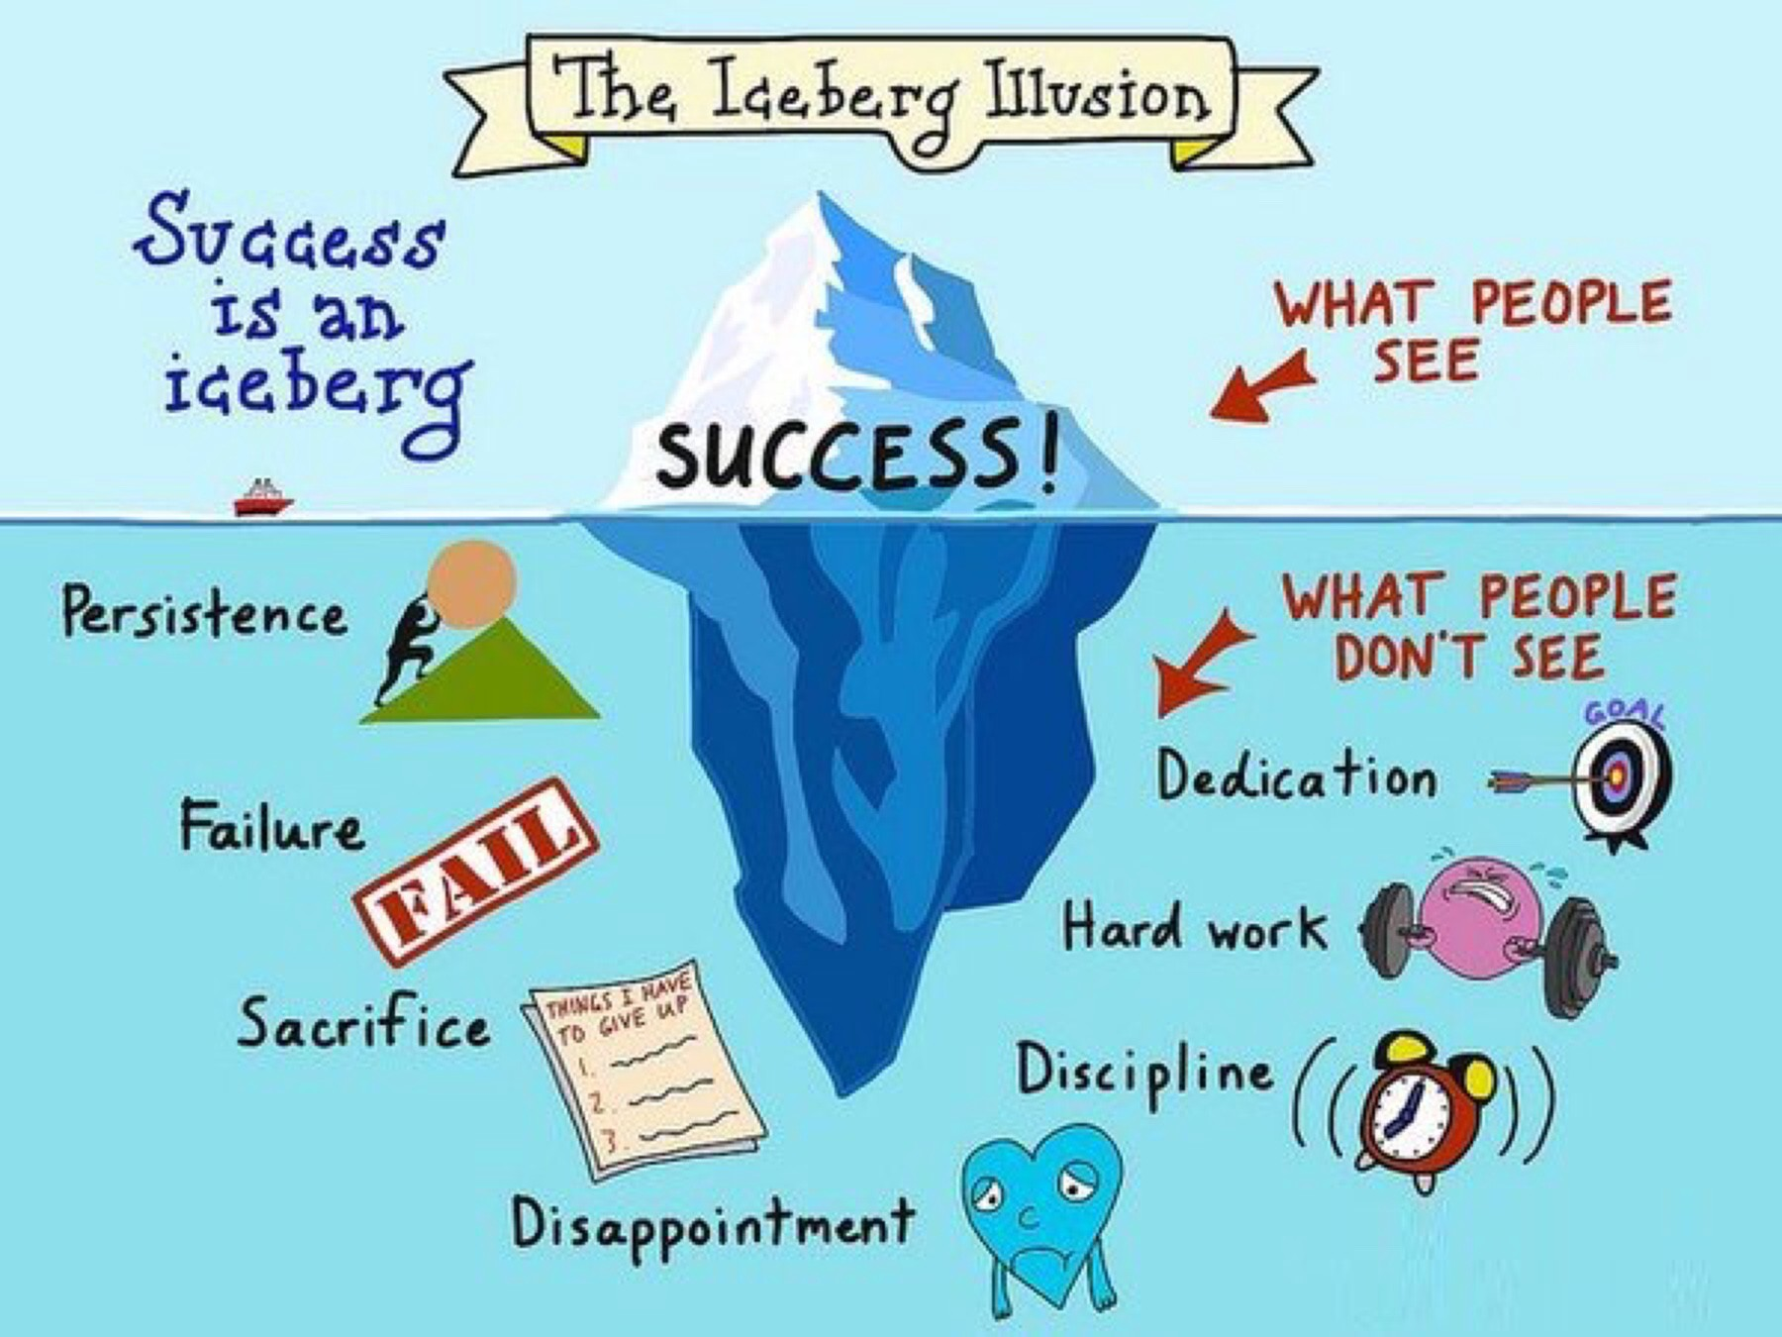

Slide 22
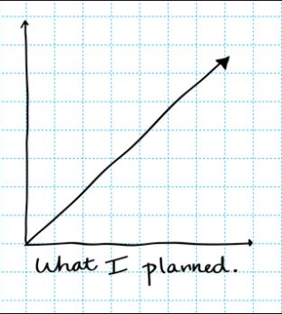

Slide 23
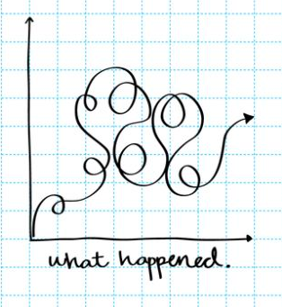

Slide 24
Formula for Success:
Talent + Effort = Skills
Skills + Effort = Achievement

Slide 25
“Nothing in this world can take the place of persistence. Talent will not. Nothing is more common than unsuccessful men and women with talent. Genius will not. Unrewarded genius is almost a proverb. Education will not. The world is full of educated derelicts. Persistence and determination alone are omnipotent.”
Time-and-time again this wisdom has served as a WAKE-UP call (a slap-in-the-face, if you will!) particularly when I was tempted to retreat-in-defeat. For our programs, for our students, and for ourselves; PERSISTENCE IS THE KEY.
… let the music begin….

Slide 26
“I’m no longer accepting the things I cannot change…..I’m changing the things I cannot accept.”
- Angela Davis

Slide 27
“Dream With Your Eyes Wide Open”
- Greatest Showman

Slide 28
Dr. Frank Tracz
ftracz@ksu.edu
785-770-7873

