Slide 1
Let’s get started
Dr. Frank Tracz

Slide 2
Today
COVID/Omicron
Lack of Personnel
Attitudes
Work Ethic
Entitlement

Slide 3
Influential people
Dr. John Wefald
  President of K-State from 1986-2009
    Problem Solver
    Attention to details
    Sense of urgency
Dr. Pat Bosco
  Authentic leadership is rooted in a fundamental commitment to serving others and providing a voice to those who have none or who have been silenced.
Coach Bill Snyder
  It’s all about the people!
My father
  ”You’re so far behind in the race, that you think you’re running first”

Slide 4

“Stuff Happens”
Signs that humanity may be doomed

Slide 5
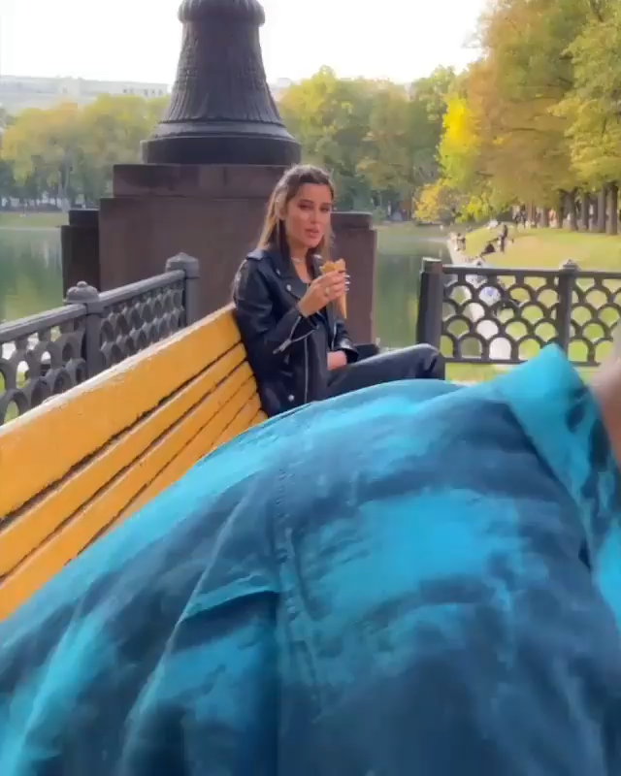
“Stuff Happens”
Signs that humanity may be doomed
Misinterpretation is costly

Slide 6
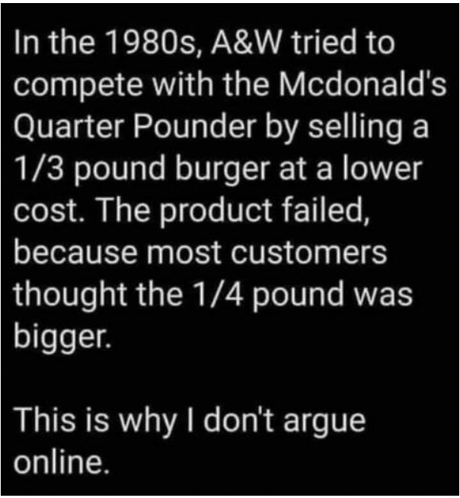
“Stuff Happens”
Signs that humanity may be doomed
Misinterpretation is costly
Social Media…

Slide 7
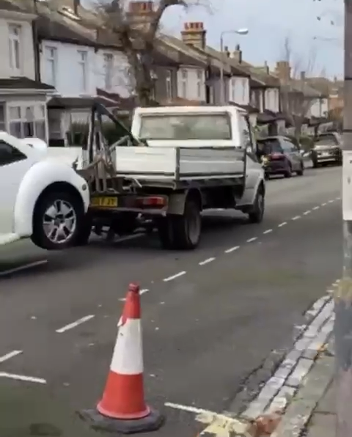
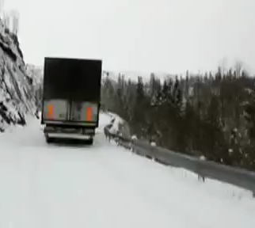
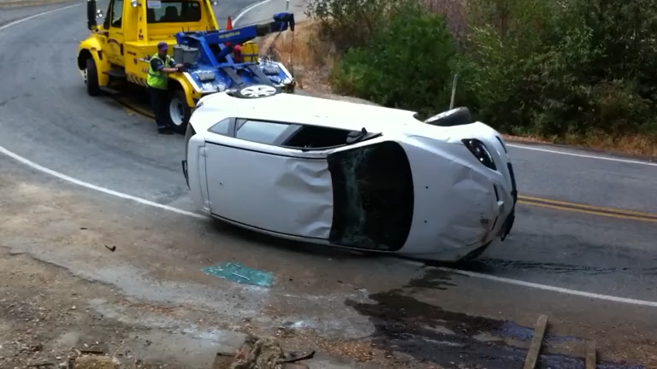
“Stuff Happens”
Signs that humanity may be doomed
Misinterpretation is costly
Social Media…
Best Plans & Equipment

Slide 8
Four Messages we need to hear now
The Kids Are Not Okay
I’ll give you my empathy if you’ll give me your effort
In today’s world, your attitude is as important as your aptitude
You must trade being fragile for being agile
You are strong enough to flourish, not flounder

Slide 9
Attitudes/Skills
Context/Content
Affective/Cognitive

Slide 10
Leaders/teachers Need to Be
Passionate
Fun
Organized
Caring
Trustworthy
Inspiring
What are they? Attitude or skills?

Slide 11
“Attitude” is the strongest
Did you take this class in college?
Why not?

Slide 12
Attitude
Can’t Test It
Can’t Measure It

Slide 13
Above Are ALL skills!
Therefore:
Practice them! Get Better.
“We have information we need, we don’t use it.” – (French Fries)
Change is Unpopular
We Need To Change!

Slide 14
Amelia Earhart, Aviation pioneer
The most difficult is the decision to act. The rest is merely tenacity!

Slide 15
Humor: Shortest Distance Between two People
People will not remember what you do or say
They will remember how you made them feel

Slide 16
The teacher
Is the Most Important Person
This is Your Opportunity
You Provide Influence and Direction

Slide 17
It is Not:
You can Do
Will Do.

Slide 18
It’s what you do “do”!
We Need More ”Do Do”!

Slide 19
Applicable Knowledge
We All Want It!
We All Need It!

Slide 20
First Impressions
Example:
    Feet on Floor
    Sit Taller
    Taller.
    Scoot up 6 inches on chair
    Sit Taller
    Look Around…What Do You See?
    What Have You Established?
“Standards and Expectations”
“The Way”

Slide 21
We/Us Replaces I/Me
We/Us = Becomes Habit
I/Me = This is Easier!!! (Sit Up!)

Slide 22
Start with great expectations
Pause the Starting Point
Move Up and Forward
Start with Good Habits then Teach!
Rehearsals Have to be Better than Performance

Slide 23
Wall of Some Doubt (I/Me)
EGO!
COMFORT
Our Goal!

Slide 24
#1 Fear of All
Embarrassment!
Great Leaders/Teachers Create Trust Relationships

Slide 25
Choose to Understand before being understood
Habits That Make Us
  Clasp Hands
    Left or Right Thumb on Top?
    Which is Correct?
    Right on Top = Good Lovers!
    Left on Top = Good Thinkers!
    Even? = Think You’re Good Lovers!

Slide 26
Habits Do Not Last!
Shower, Food, Cut Lawn
You Have to Keep Doing It!
“Old Way” is the Habit
Teaching Techniques Makes the Difference
“Different” Reverts Back to Talking, Distractions!
Looking Different Looks/Feels Wrong
It Needs to be Comfortable Change

Slide 27
Exercises
SL Groups
Identify
  Your Leadership “Habits”
  Their habits
  Mediate the Two
  d. What is Your Plan for:
    First Meet/Rehearsal
    Plan Your First Day with a Schedule, Goals, and Outcomes!

Slide 28
Comfort Zone
To Leave it, it Must be Safe to Do So
Has to be Challenging With a Reward
Create a “New” Comfort Zone!!

Slide 29
Motivation
Happens “After” You Do Something
You Then Feel Good About Doing Something!
Put Them in the Presence of Courage
Don’t Blow Sunshine!

Slide 30
Leaders vs. Followers
Every Action Forces an “Over action”
Ego and I/Me Take Over
Take the Lid Off the Salt Shaker. What Happens?
Argue for Your Limitations and You Own Them!

Slide 31
You, your talents, your limitations
Your Worst Members/Students will Make You the Best Teacher
We Set our Limits, Nobody Else does

Slide 32
Talent
+
Effort
Skills!

Slide 33
Value – to a 20yr. old is different than it is to a 62 year old!
Why?
What Would You Do if Your Knew You Couldn’t Fail?
Sometimes, We Don’t like What We Love

Slide 34
Time Continuum
Past Now Future
What Does Each Mean to You?
Are They Mutually Exclusive?

Slide 35
Exercise #2
Pair Up
Find Something to Read
Go: Read Out Loud to Each Other

Slide 36
What did you Hear?
What did they Say?
You can’t Read and Listen at the Same Time!!
People Don’t Know This!
I Never Told them They Couldn’t!

Slide 37
Thoughts
What is Your Attitude?
What is Their Attitude?
Can Either or Both Be Changed?
How? When? Where? Why?
Your Turn!

Slide 38
Dr. Frank Tracz
Director of Bands
Kansas State University
ftracz@ksu.edu
ksu.edu/band – Downloads!

