Slide 1
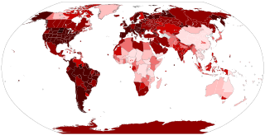
NEVER WASTE A CRISIS
KMEA 2021
Dr. Frank Tracz
Director of Bands
Kansas State University

Slide 2

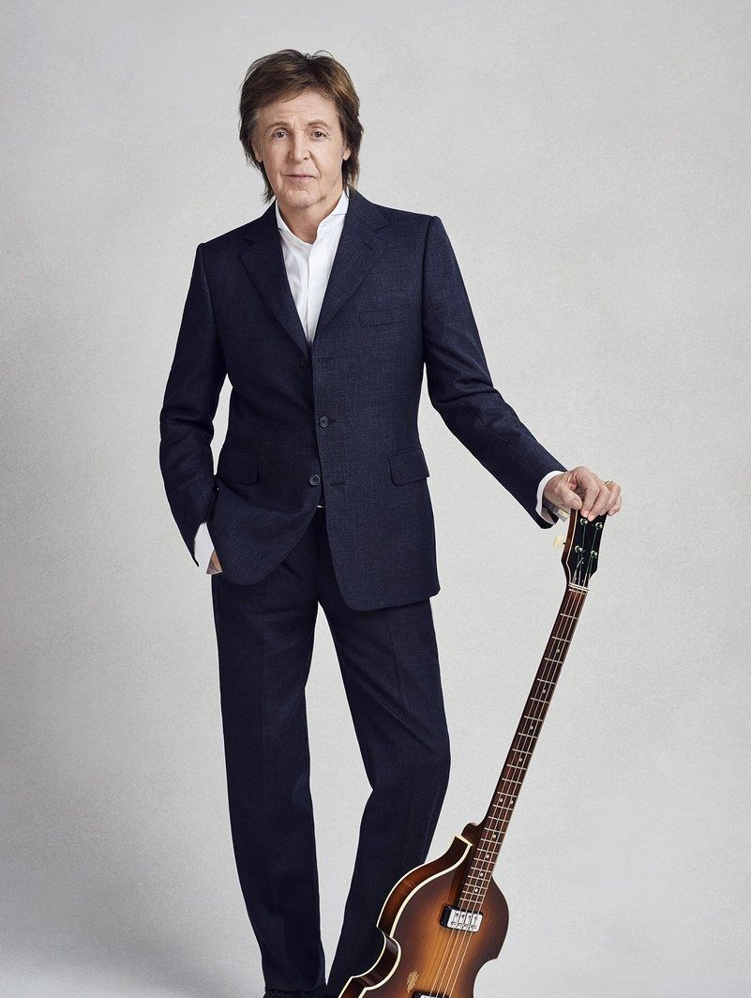
YESTERDAY
Planning our programs.
Recruiting.
Fundraising.
Bus trips, concerts, football Fridays, basketball Saturdays.
Rehearsing our groups face to face.
What were our “real” worries last year?
I miss yesterday……..
“.....all my troubles seemed so far away,” Paul McCartney, 1965.

Slide 3
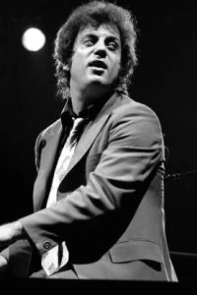
THE CRISIS
The Pandemic of the century
Political turmoil.
Economic disaster.
Social unrest.
Social media.
Vaccinations.
Elections.
Tweets.
COVID-19 Protocol.
What are our real worries right now?
General Richard Meyers
Can’t look back.
“We didn’t start the fire....,” Billy Joel, 1989.

Slide 4
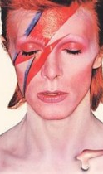
WHAT HAS CHANGED?
You?
Me?
Us?
The world?
Everything?
Our profession?
“Turn and face the change,” David Bowie, 1971.

Slide 5
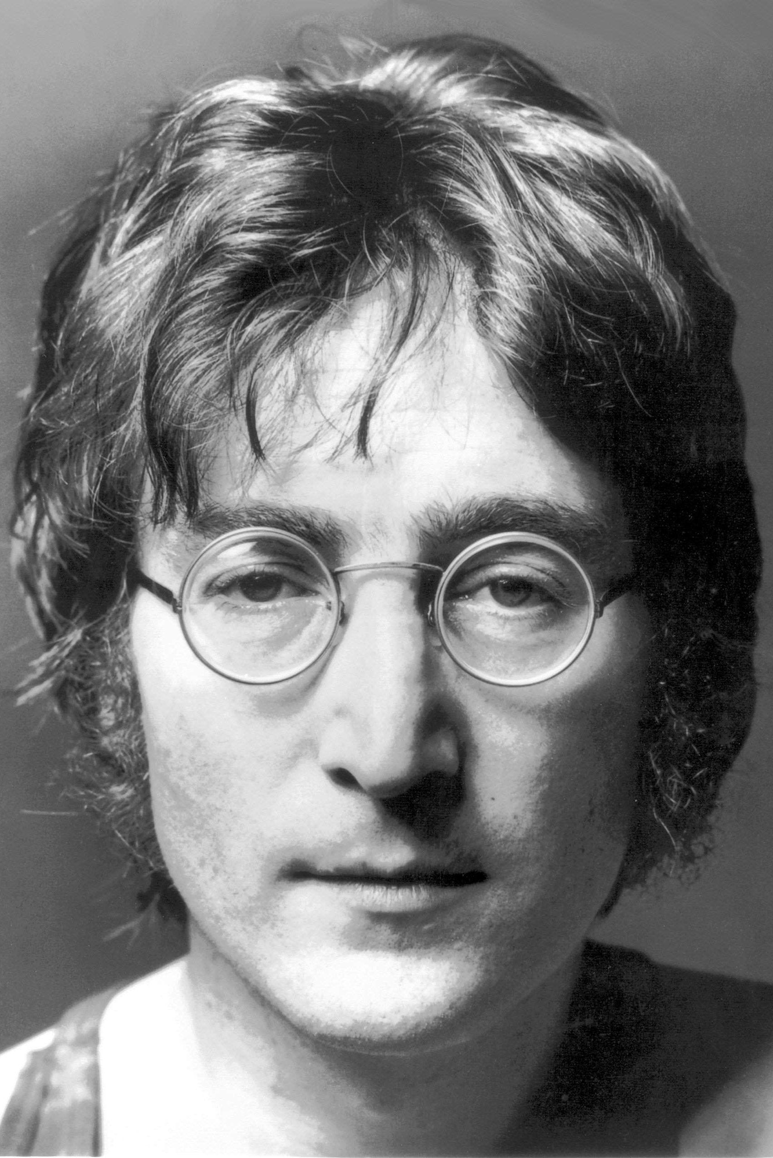
NOW WHAT?
Most crucial time in our lives....so far.
A lot depends on me.....
Can’t do it alone.
Take it from what is, to what could be.
HOW?
Our lives and plans are treading water.
NOBODY planned for this!
“Life is what happens to you while you’re busy making other plans,” John Lennon, 1980.

Slide 6
WHERE DO WE GO FROM HERE?
You!
Your family.
Your ensemble and your students.
Your job and career.
So I asked....let’s break it down.
“The more I look around the more I have to fear,” Chicago IV, Live at Carnegie Hall, 1971.

Slide 7
YOU
It is what it is.....(yikes!!)
What are YOU doing to move forward? (Emphasis on YOU.)
- Time Management is crucial!
- Made a list of “to do’s”.
- Gave up being the victim.
- Realized a need to join forces with others.
- Got moving…..
- Learned to use time more efficiently and got more done at a higher level!!!
- Learned/noticed the “little” things.
- Counted my blessings, and cherished the moment.
- Reflection and planning.

Slide 8
YOUR FAMILY
- Contacted family and friends through ZOOM AND phone calls.
- Looked for “experts” and expanded my “family.”
- Gained pleasure/confidence through helping others!
- Made new friends professionally.
- Asked “What do you think?” …..a lot!
- Discovered plan “B,” and “C,” and “E,” etc., etc., etc.……
- Established new priorities.
- “Made” the time for others and myself.
- Became a juggler of all things important.

Slide 9
YOUR ENSEMBLE AND YOUR STUDENTS
- Learned to record, stream.
- Realized what was most important. Made the challenges more doable!
- Lived and taught “time management.”
- Looked to the future to build a “legacy.”
- Became more understanding of others.
- Acquired “double jointed flexibility!!”
- Learned methods of creative engagement.
- Answered the need for “safe” social interaction….creatively.
- Used my ensemble/class to teach the soul and heart.
- Discovered ”how” to build the “family atmosphere.”

Slide 10
YOUR JOB AND CAREER
- Learned what matters.
- Back to basics.
- Reviewed secondary instruments.
- Realized the opportunity for growth and learning.
- Did more “house-keeping” chores for the band program.
- Discovered the many new and exciting resources that are available!!
- Realized we are all in this together and there are no “silver bullets.”
- Became a better teacher, leader, musician, human being.
- PERSPECTIVE.

Slide 11
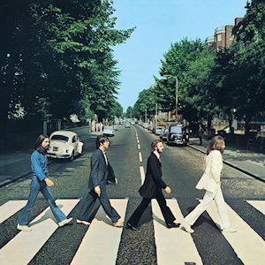
THE “OTHER SIDE”
Look back to learn.
What have we learned?
What will you do differently?
Does this change your teaching? Thinking?
How has your teaching philosophy come through all this??
What have your students learned from all this?
What is “new” in our profession
What has changed?
What will be different for you, your students, your program?
“Here comes the sun, I say, it’s alright,” George Harrison, Abby Road, 1969.

Slide 12
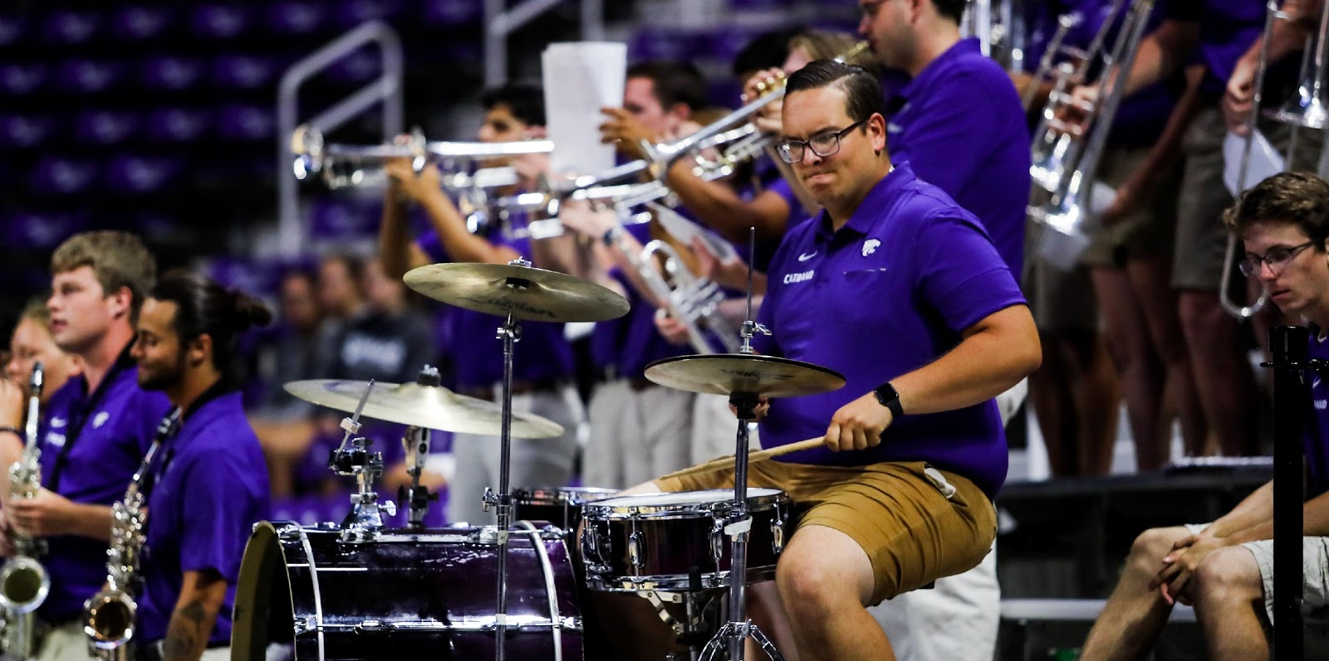
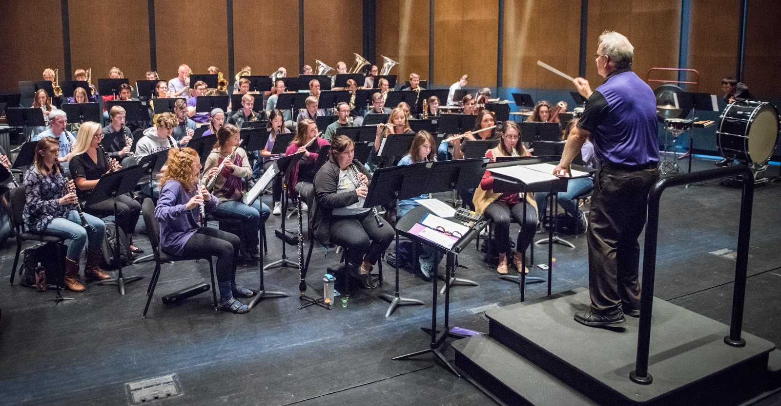
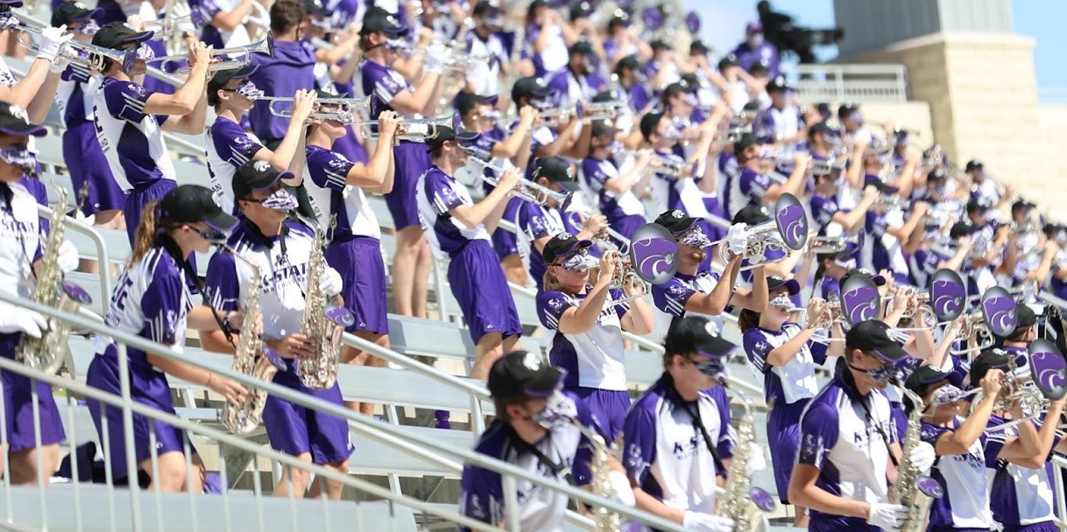
WHERE DO WE GO FROM HERE?
Learn from the past.
Can we be better prepared for “next” time?
What will you do when we get to the other side?
Will this profession be the same?
We must always come back to teaching music!!!
Changing lives is the goal, music is the tool.
If it doesn’t kill us…………….
“Never waste a crisis!”
“....all the doors that closed one time, will open up again,” Steve Winwood, 1986.

Slide 13
Dr. Frank Tracz
Director of Bands
Professor of Music
Kansas State University
226 McCain Auditorium
Manhattan, KS 66506
785-532-3816 – Office
785-770-7873 – Cell
ftracz@ksu.edu

