Slide 1
Learn to Hit the Curve Ball
or Don’t Play the Game
Dr. Frank Tracz
Director of Bands
Kansas State University
June 9-10, 2024
Conn-Selmer Institute

Slide 2

Old Wives Tale
High school hot shot gets drafted.
Hot shot goes to Single A.
The world is a great place.
First week, he hits 420 and calls home…
Second week, he hits 510 and tells mom…
Third week, he calls home…”Mom, they are throwing curve balls. Be home Saturday night!”

Slide 3
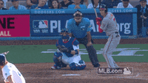
Old Wise Tale
High school hot shot gets drafted.
Hot shot goes to Single A.
The world is a great place.
First week, he hits 420 and calls home…
Second week, he hits 510 and tells mom…
Third week, he calls home…”Mom, they are throwing curve balls. Be home Saturday night!”

Slide 4
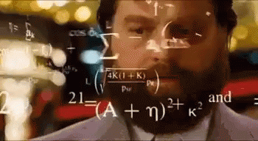
Is What You Think You Know Enough?
Degrees?
Experience?
Resume?
Desire?

Slide 5
Today?

Slide 6
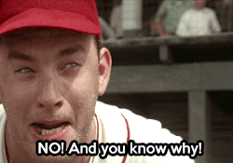
Today?

Slide 7
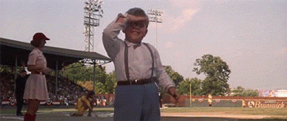
How to Hit the Curve Ball
Know what it is
Know the person throwing it
Know you
  Strengths
  Weaknesses
  Tendencies
  Fears

Slide 8
Baseball vs. Band
To Know:
The batting order/students and people you deal with
Base runners/players in your ensemble
Positions on the field/instruments and parts (SATB)
Elements (weather/school atmosphere)

Slide 9
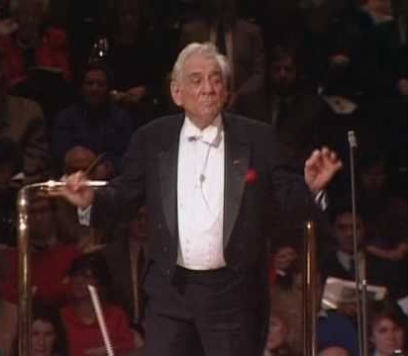
Things to Know
Strengths
Presence
Technique
_________
_________
YOU

Slide 10
What Both People Need To Know
Your “can do” list
Your “can’t do” list
Basics
Fundamentals
Technique
Analytics

Slide 11
Baseball vs. Conductor
“Same Thing”
You must prepare.
Practice fundamentals.
Stay updated (read and research).
Adjust and change

Slide 12
Two Reasons Why We Fail
Lack of People Skills
Lack of Organizational Skills

Slide 13
Problems and Solutions
Both are challenging
Networking
Sponging (Dr. Robert Petzold)

Slide 14

Create Your Circle of Support

Slide 15
Create Your Circle of Support
Everyday Support

Slide 16
Create Your Circle of Support
Everyday Support
Specific Support

Slide 17
Create Your Circle of Support
Everyday Support
Specific Support
Bullpen Support

Slide 18

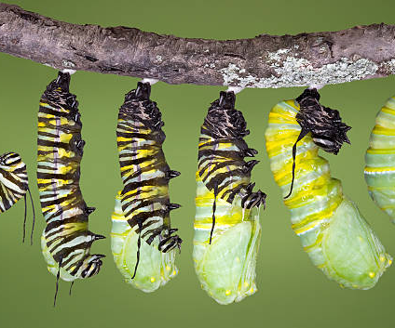
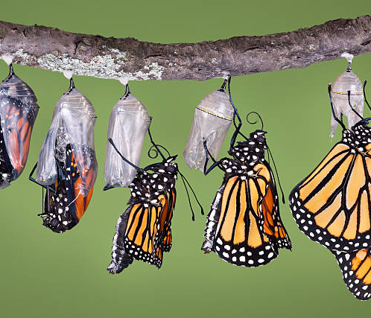

Change!
It happens all the time to all of us forever.
Embrace it.
Learn from it.
Guide it.
Caption

Slide 19
“10 - 80 - 10”
Dr. Jerry Forsythe

Slide 20
Conclusion
You’re young and stupid…
And gullible.
You chose a great profession.
The goal is to be effective and affective for your entire career.
You do not know it all. You will never know it all. That’s the good news.
If you think you know it all and there’s nothing left to learn, that’s the really bad news.

Slide 21
Welcome to the Greatest Profession
“The greatest act of optimism
is the act of teaching.”

Slide 22
Dr. Frank Tracz
Director of Bands
Kansas State University
ftracz@ksu.edu
ksu.edu/band/about
(Click the link above to find today’s presentation handout.)

