Slide 1
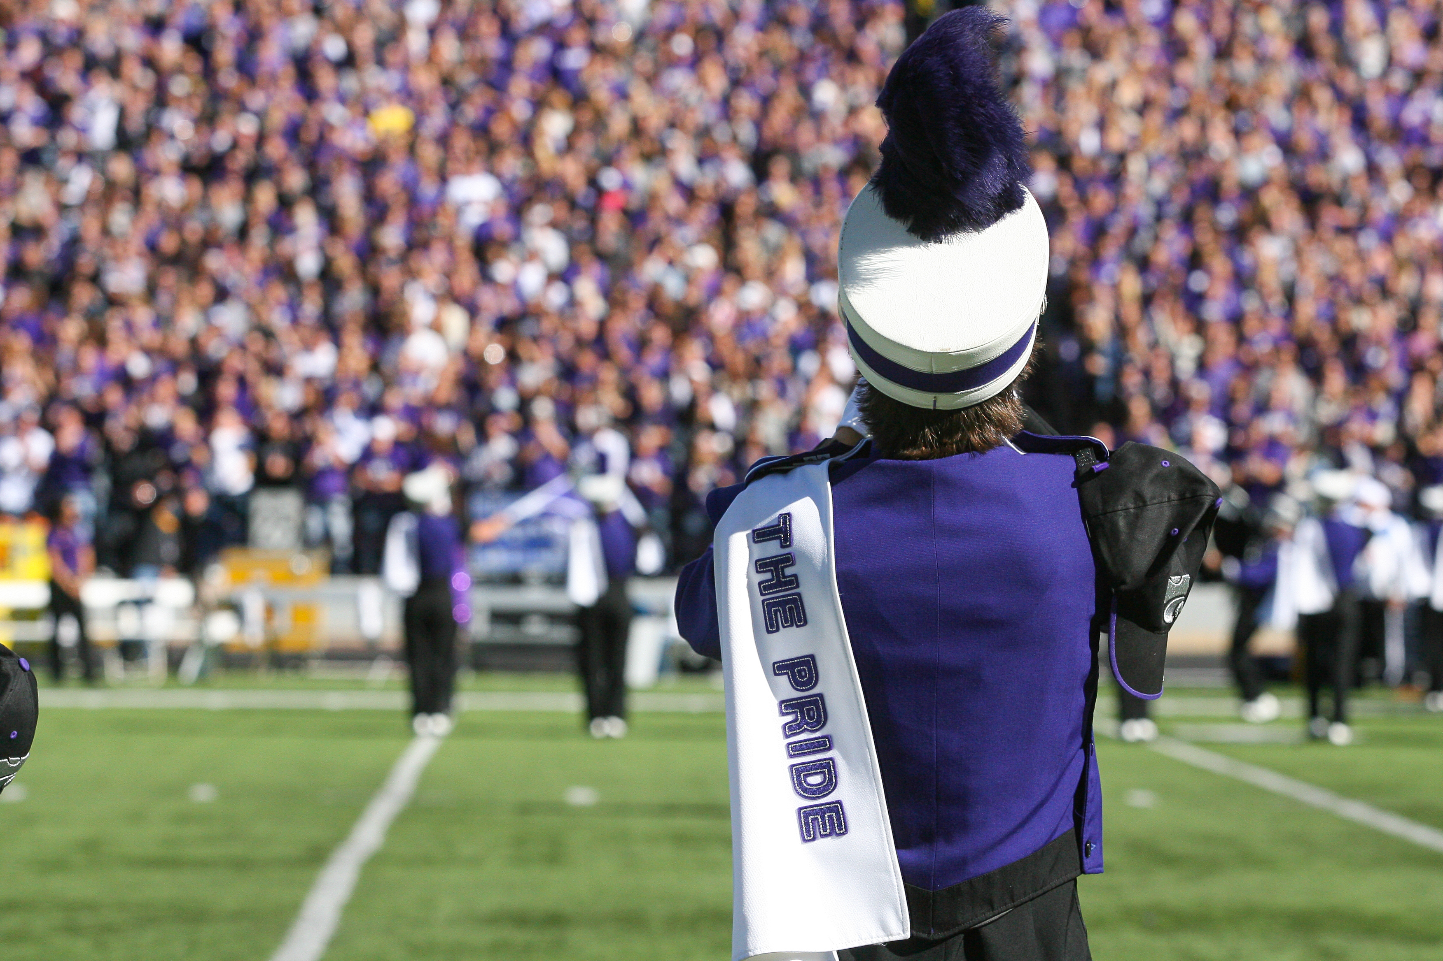
Welcome!!
KSUMB ZOOM
Wednesday, 28 April 2021

Slide 2
Pandemic is losing! We are Winning!
Vaccinated!!
“Normalcy” with a twist…

Slide 3
Band Picnic
Sunday, May 9th, 4 PM to 6 PM
Annenberg Park
Leadership Announcements @ 5 PM
  First SL meeting right after!
Yettis are on the way!

Slide 4
Leadership Dinner Meeting
Monday, May 10th, 5 PM to 6 PM
  Almuni Terrace
Issue folders w/MUCH INFO!!!

Slide 5
Congrats
Miss K-State 2021 – Katie Dreiling
Twirlers - 5
Color Guard - 17
Classy Cats - Tryouts this weekend
DL Day - Saturday, May 8th
DL Auditions - Saturday, May 22nd

Slide 6
Summer
Facebook Live @5 will begin July
Stonestreet Truck Instrument Deliveries
  MHK, Salina, Great Bend, Dodge City, Wichita, Emporia, K.C., Topeka
  Date TBA
SL videos (marching/playing) update!
Electronic newsletter released to all on Sunday, May 9th @ 6 PM

Slide 7
Band Camp - Change!
University is having “sessions” for incoming students to teach leadership, responsibility, commitment, getting aquatinted with people - ALL THINGS WE DO EXTREMELY WELL!!!
  KSUMB is exempt from this event!
Camp will start for:
  Leadership - Friday, Aug. 13th & Saturday, Aug. 14th
  Rookies, DL, All Auxiliaries - Sunday, Aug. 15th
  Vets. - Monday, Aug. 16th
No camp:
  Friday night, Aug. 20th
  Saturday, Aug. 21st
Sunday, Aug. 22nd - 6 PM to 9 PM (ALL)
  BSFS Traditions Training

Slide 8
Fall!
Busy
  8 Home Games (Including Dallas)
  Going to KU
  CSMF
  Bowl Game!
  “New Music!!!”
    Fort Riley Day
    ASMB Day
    Alumni Band Day

Slide 9
YOU!
Come Back!
Recruit!
Pepare!
Be Ready!!

Slide 10
Two Announcements
West Stadium Band Hall Update
  Brochure & Video Being Finished
  Worked w/Architects and Engineers
Video Change!!!

Slide 11
In Conclusion
Stay Tuned
Respond when requested
Stay strong - The Comeback Will Be Stronger Than The Setback!

