Slide 1
“The Process. . .”
2025 KSUMB Leadership
August 8th, 2025
Dr. Frank Tracz

Slide 2


Life’s Book. . . .
Many Chapters
Many Changes
Many Challenges
Many Victories
Many Defeats

Slide 3
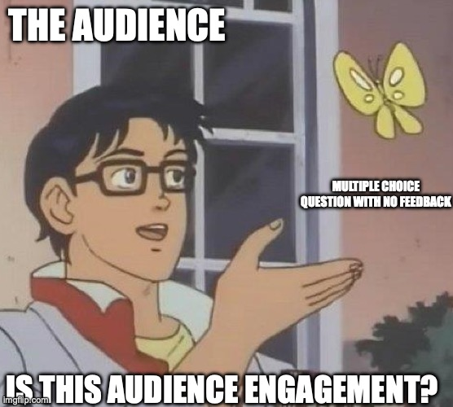
Interactive slide
1. Name Five (5) chapters you have written about your life. . .so far!
2. Name the final/ultimate goal of each of those chapters

Slide 4

Just an fyi:
A Pessimist sees a dark tunnel
An optimist sees a light at the end of the tunnel
A realist sees a freight train
The train conductor sees three idiots standing on the tracks!!!

Slide 5
Let’s discuss your “book” so far. . .
Question #1:
Question #2:

Slide 6
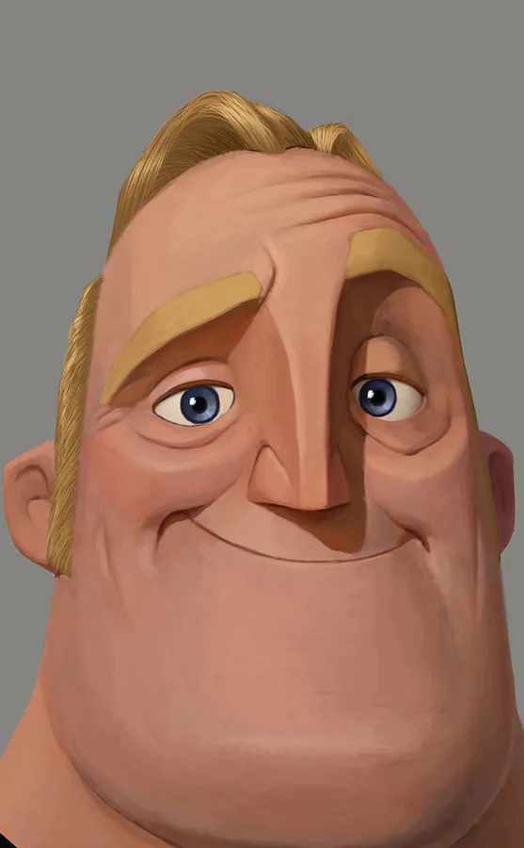
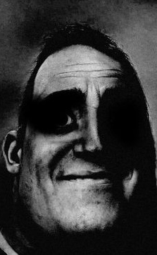
Where do we go from here?
“My mom once told me I might not be the dumbest guy in the world”
. . .but I better hope he doesn’t die!

Slide 7
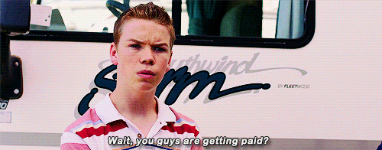
Chapter 6 as continuing. . .
The ”Value” Question:

Slide 8
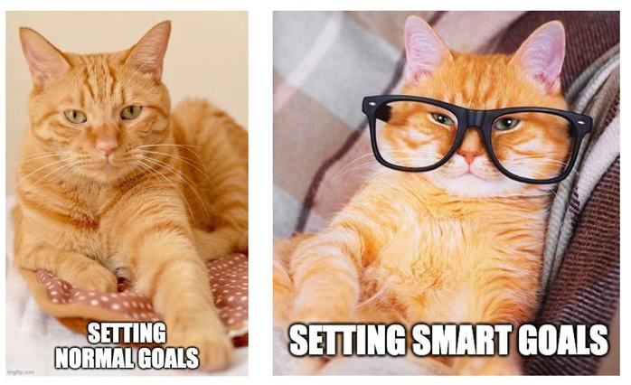
Where is the value in:
“The Goal”

Slide 9
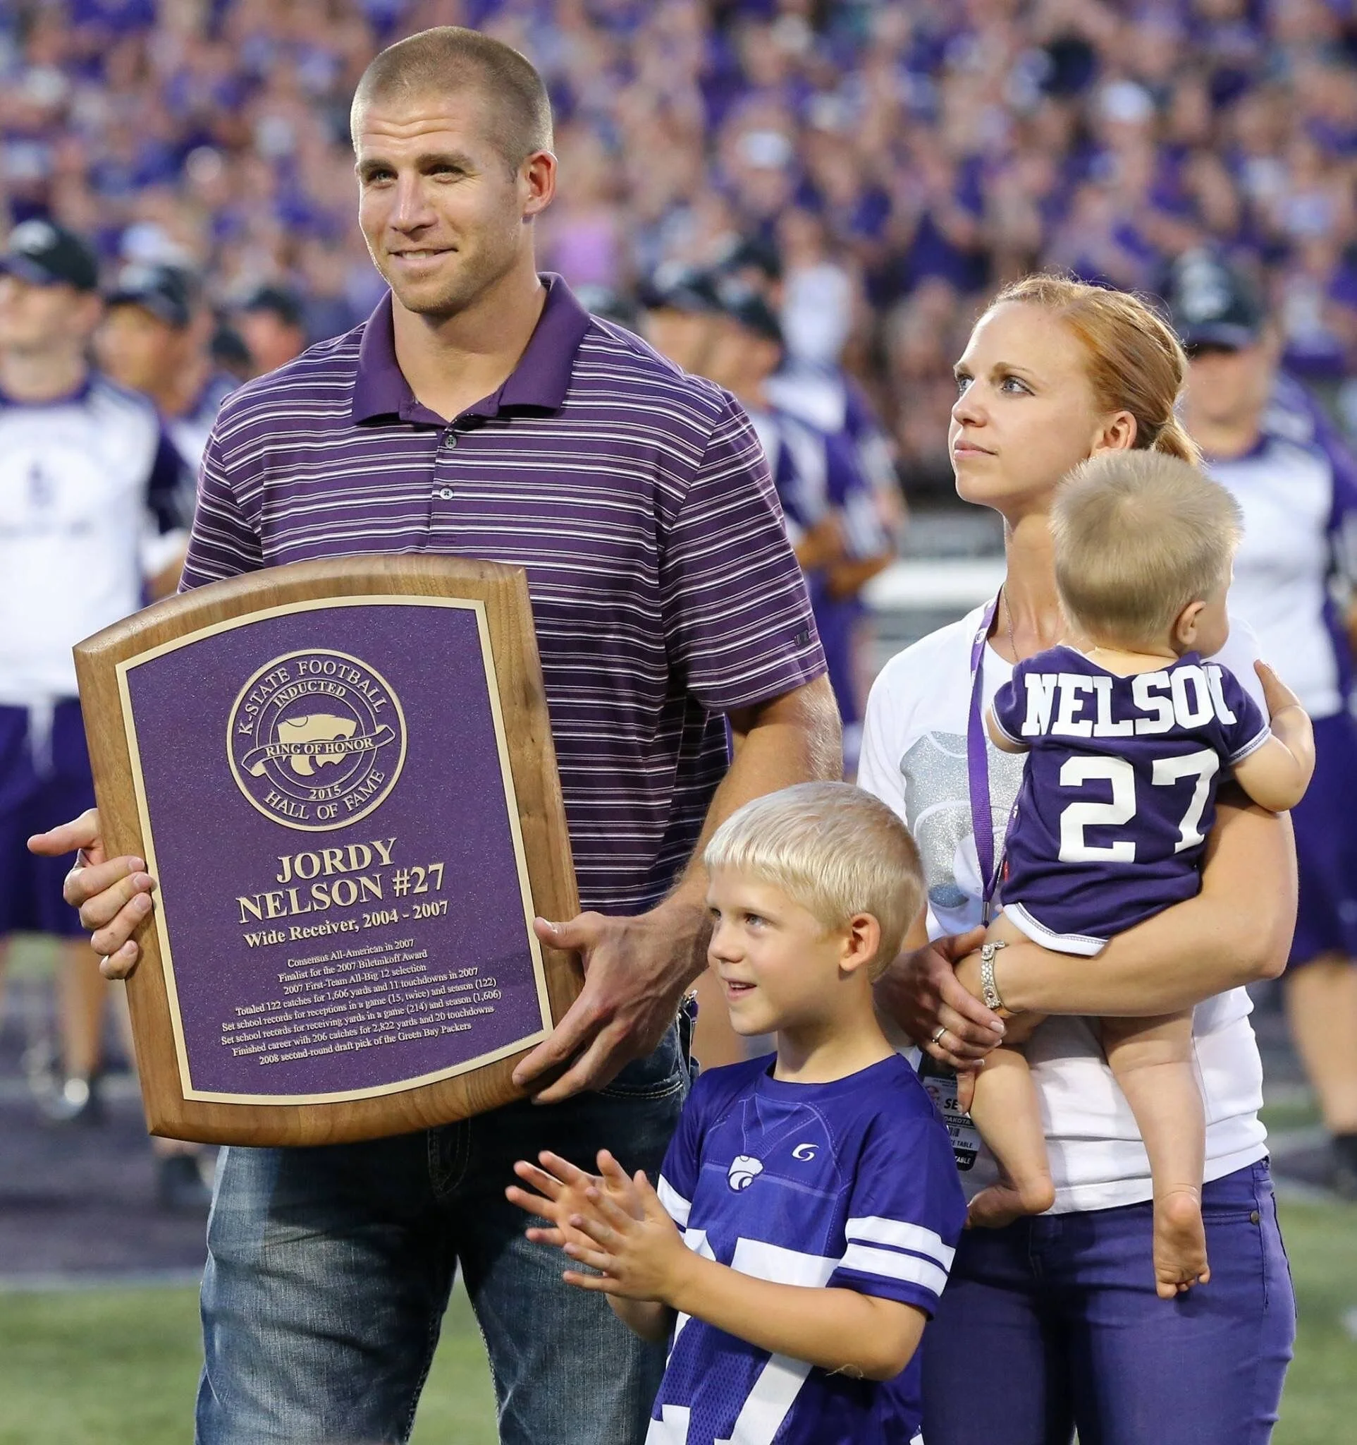
Where is the real value?
The process!!

Slide 10
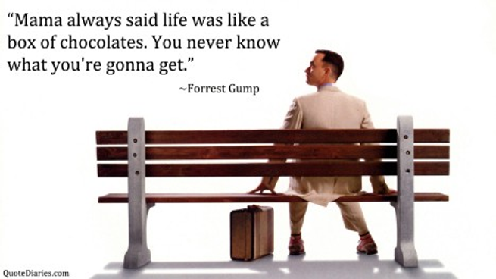
A successful Life is. . .
Not who dies with the most toys. . .
It is who has lived more and better on the way!

Slide 11
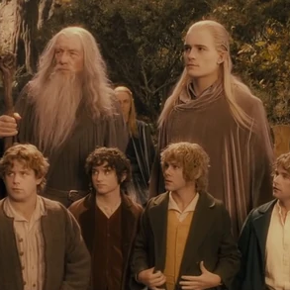
The process is:
The Journey to. . .
What happened to us on the way. . .
What we learn on the way. . .
How has it changed us?

Slide 12

Develop your process (life + Band)
What is important?
Why is it important?
How can you teach it?
  Methods
  Material
  Get/be creative!

Slide 13
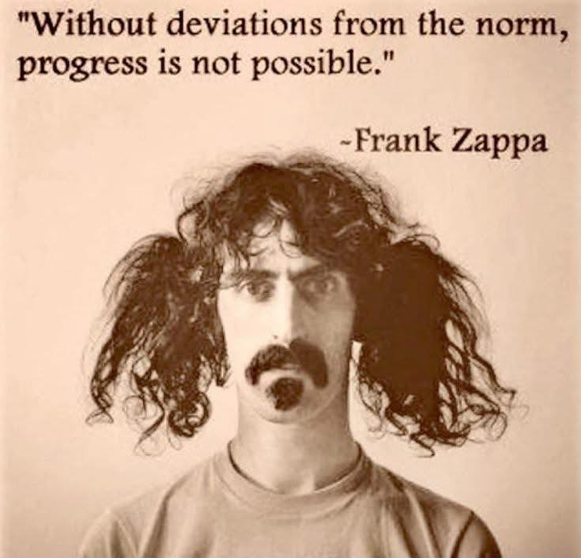

Slide 14
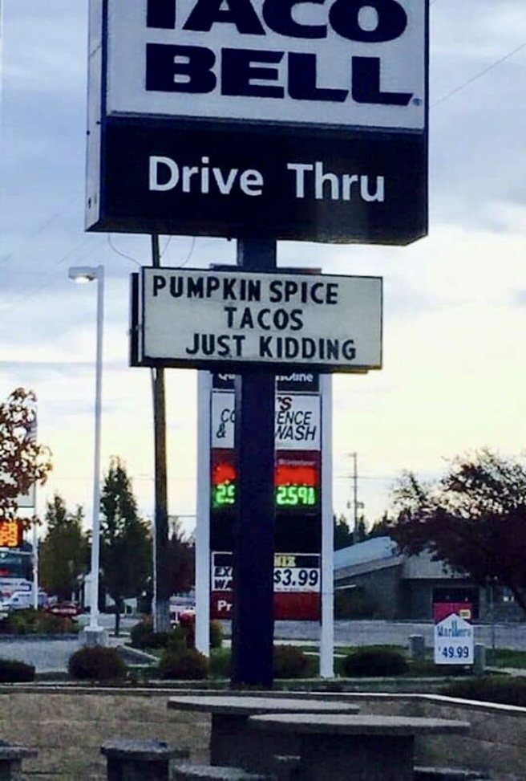
Beware of cute little sayings and fads
THERE ARE NO QUICK FIXES!

Slide 15
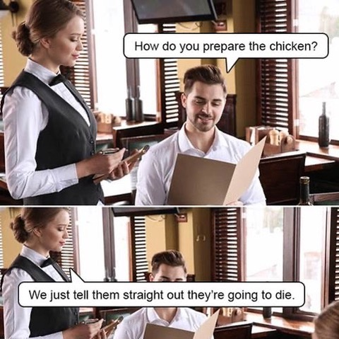
Be honest. . .

Slide 16

THE PROCESS IS THE JOURNEY. . .
WHAT IS THE PROCESS OF YOUR CHAPTERS?
WHAT MAKES YOUR PROCESS INNOVATIVE?
WHAT MAKES IT SUCCESSFUL?

Slide 17
Band leadership
What are your section goals?
More importantly, What is your process to achieve your section goals?
Let’s share!

Slide 18
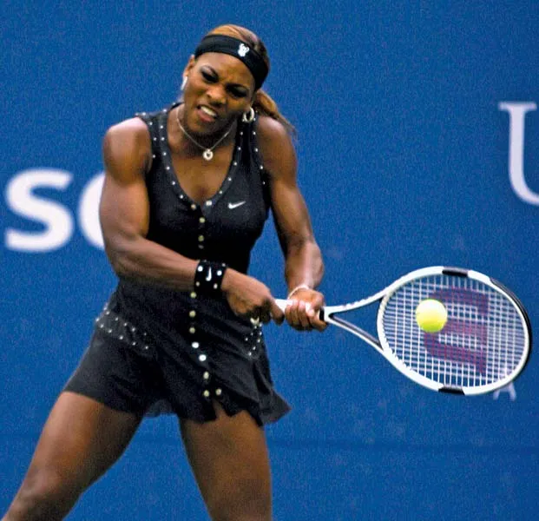
Advice from those who got it. . .
“You have to believe in yourself when no one else does”
  -Serena Willams

Slide 19
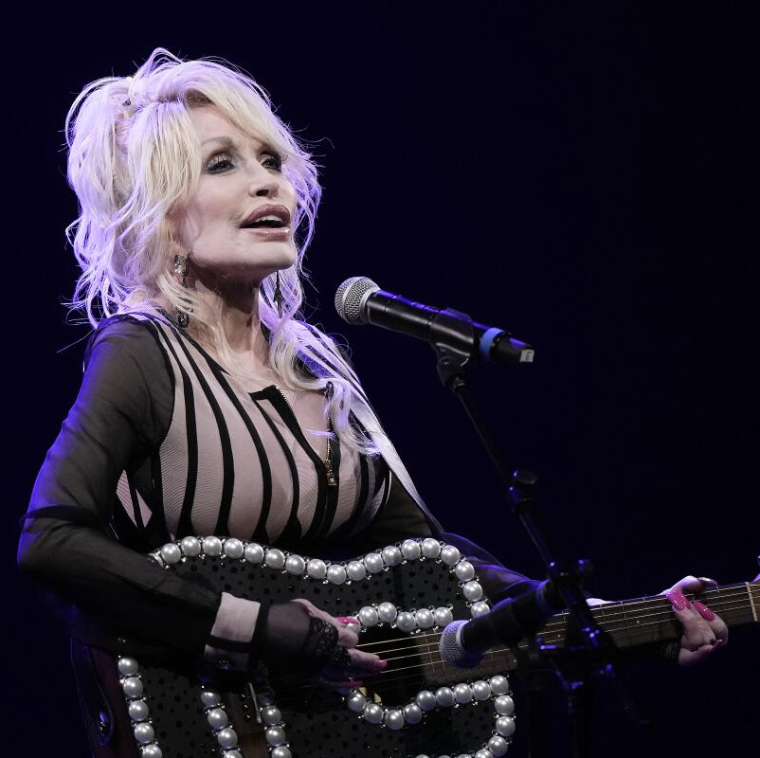
Advice from those who got it. . .
“Find out who you are and do you on purpose”
  -Dolly Parton

Slide 20
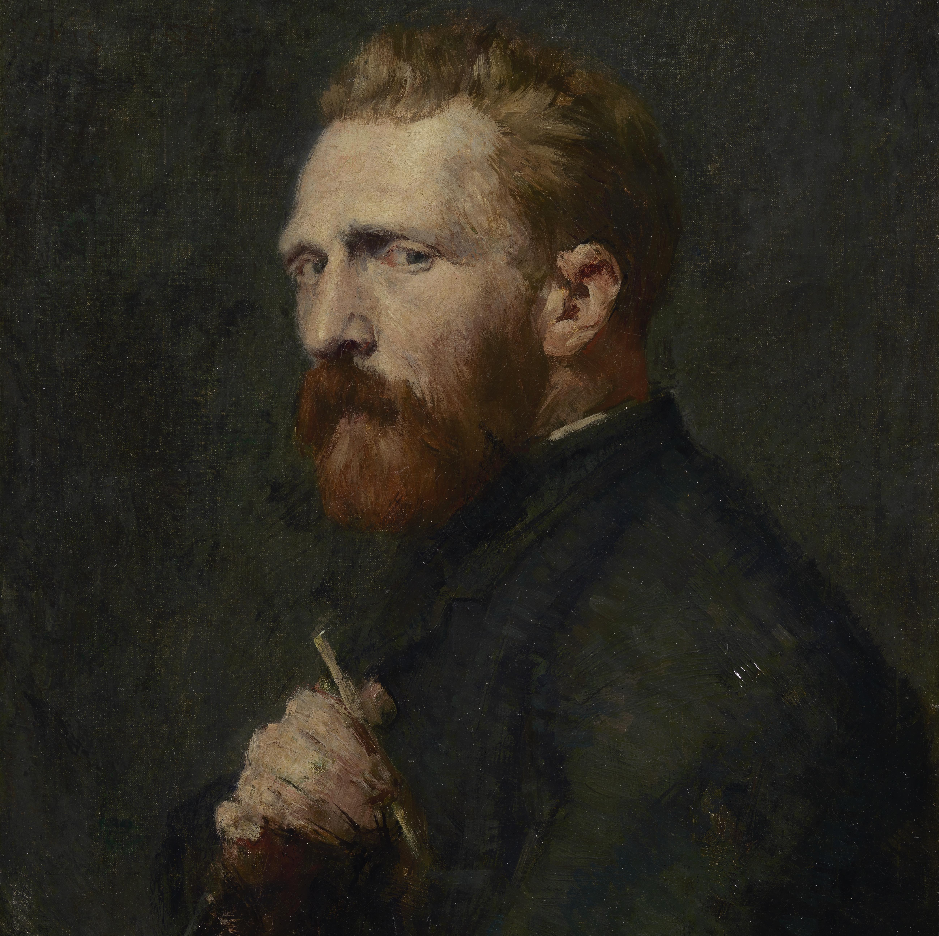
Advice from those who got it. . .
“I dream my painting, and I paint my dream”
  -Vincent van Gogh

Slide 21

Thoughts on leadership
Leadership is a privilege to better the lives of others. It is not an opportunity to satisfy personal greed.
  Mwai Kibaki
Leaders are people who bring others with them, who are ready for action, who have a sense of anger and injustice and an eye for understanding power. These relationship-based networks, or deep coalitions, are a form of power.
  Amanda Tattersall
Followers who tell the truth, and leaders who listen to it, are an unbeatable combination.
  Warren Bennis

Slide 22
Thoughts on leadership
Know your values. Being true to yourself is a critical part of being a leader.
  Victoria Montgomery Brown
The reward for conformity is that everyone likes you but yourself.
  Rita Mae Brown
We avoid the things that we’re afraid of because we think there will be dire consequences if we confront them. But the truly dire consequences in our lives come from avoiding things that we need to learn about or discover
  Shakti Gawain

Slide 23
Thoughts on leadership
Stay afraid, but do it anyway. What’s important is the action. You don’t have to wait to be confident. Just do it and eventually the confidence will follow.
  Carrie Fisher
Do the best you can until you know better. Then, when you know better, do better
  Maya Angelou
Recognizing that you are not where you want to be is a starting point to begin changing your life.
  Deborah Day

Slide 24
Thoughts on leadership
Once we believe in ourselves, we can risk curiosity, wonder, spontaneous delight, or any experiences that reveals the human spirit.
  E. E. Cummings
If you don’t make the time to work on creating the life you want, you’re eventually going to be forced to spend a lot of time dealing with a life you don’t want.
  Kevin Ngo

Slide 25
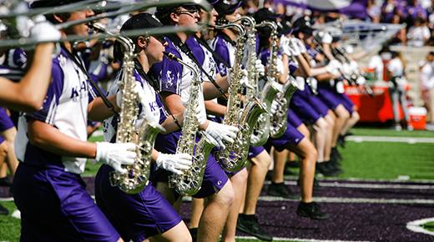

It’s time. . .
Let’s enjoy the heck out of the process!

Slide 26
Dr. frank Tracz
Ksu bands
ftracz@ksu.edu
(785)-770-7873

