Slide 1
“It’s all how we look at it…”
Dr. Frank Tracz
Kansas State University

Slide 2
“OUR” Perception versus the “Truth”…
“The Flood”
  Help!!
Two men in waders, and a boat
Two men in a boat
Two more men in a boat
HELICOPTOR!!!

Slide 3
“Energize” your “Team”
Do you have a clear Vision?
Do you spend time on Priorities?
Do you have a succession Plan?
What would you change?
Do you solicit feedback as well as give it?

Slide 4
“Drive” your “Team”
Self-Interest?
Group Identity
Unconscious Motivation
Character

Slide 5
“Unstuck” the team!
Figure out what you want
Think about the fun-factor
Develop greater self-discipline
Find your sense of purpose

Slide 6
“success” = “motivation”
Clear Rules
Fundamental Skills
Disciplined Action
Passion!!!
Collaboration and Self-Sacrifice
Resilience

Slide 7
“newbies” and “veterans”
Take time to build trust
Acknowledge their experience
Stay Practical
Encourage change
Align teaching with strategy

Slide 8
Design “Goals”
Define the outcome
Measure performance
Outline your process

Slide 9
“Motivate performance Improvement”
Reading/Watching
  (Books, articles, Videos)
Shadowing
Strengths
Questions
Ratings-self!

Slide 10
Do the “Right” Thing
Praise – “Sunshine vs. Truth”
Honesty
Backbone
  Stand up for your people
Set the bar
  Examples to live by

Slide 11
“Sacrifice for the cause”
Have you ever wondered what happened to the 56 men who signed the declaration of independence?
Five signers were captured by the British as traitors, and tortured before they died.
Twelve had their homes ransacked and burned. Two lost their sons in the Revolutionary Army, another had two sons captured.
Nine of the 56 fought and died from wounds or the hardships of the Revolutionary War.
They signed and they pledged their lives, their fortunes, and their sacred honor.

Slide 12
“Sacrifice for the cause”
Have you ever wondered what happened to the 56 men who signed the declaration of independence?
What kind of men were they?
Twenty-four were lawyers and jurists. Eleven were merchants, nine were farmers and large plantation owners, men of means, well educated. But they signed the Declaration of Independence knowing full well that the penalty would be death if they were captured.
Carter Braxton of Virginia, a wealthy planter and trader, saw his ships swept from the seas by the British navy. He sold his home and properties to pay his debts, and died in rags.

Slide 13
“Sacrifice for the cause”
Have you ever wondered what happened to the 56 men who signed the declaration of independence?
Thomas McKeam was so hounded by the British that he was forced to move his family almost constantly. He served in the Congress without pay, and his family was kept in hiding. His possessions were taken from him, and poverty was his reward.
Vandals or soldiers or both, looted the properties of Ellery, Clymer, Hall, Walton, Gwinnett, Heyward, Ruttledge, and Middleton.

Slide 14
“Sacrifice for the cause”
Have you ever wondered what happened to the 56 men who signed the declaration of independence?
At the Battle of Yorktown, Thomas Nelson Jr., noted that the British General Cornwallis, had taken over the Nelson home for his headquarters. The owner quietly urged General George Washington to open fire, which was done. The home was destroyed, and Nelson died bankrupt.
Francis Lewis had his home and properties destroyed. The enemy jailed his wife, and she died within a few months.

Slide 15
“Sacrifice for the cause”
Have you ever wondered what happened to the 56 men who signed the declaration of independence?
John Hart was driven from his wife's bedside as she was dying. Their 13 children fled for their lives. His fields and his grist mill were laid waste. For more than a year he lived in forests and caves, returning home after the war to find his wife dead, his children vanished. A few weeks later he died from exhaustion and a broken heart.

Slide 16
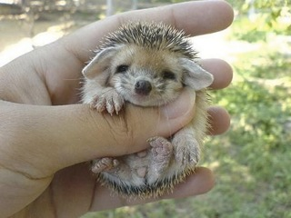
Dealing with difficult People
“Fable of the porcupine”

Slide 17
Dealing with difficult People
“Fable of the porcupine”
It was the coldest winter ever. Many animals died because of the cold.
The porcupines, realizing the situation, decided to group together to keep warm. This way they covered & protected themselves; but the quills of each one wounded their closest companions.

Slide 18
Dealing with difficult People
“Fable of the porcupine”
After a while, they decided to distance themselves one from the other and they began to die, alone & frozen. So they had to make a choice: either accept the quills of their companions or disappear from the Earth.
Wisely, they decided to go back to being together. They learned to live with the little wounds caused by the close relationship with their companions in order to receive the heat that came from the others. This way they were able to survive.

Slide 19
Dealing with difficult People
“Fable of the porcupine”
The best relationship is not the one that brings together perfect people, but when each individual learns to live with the imperfections of others & can admire the other person's good qualities.

Slide 20
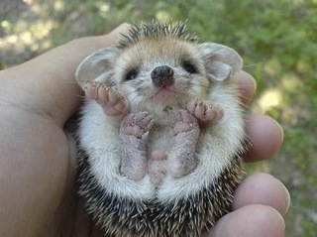
Dealing with difficult People
“Fable of the porcupine”
The Moral of the Story is…
JUST LEARN TO LIVE WITH THE PRICKS IN YOUR LIFE!!!

Slide 21
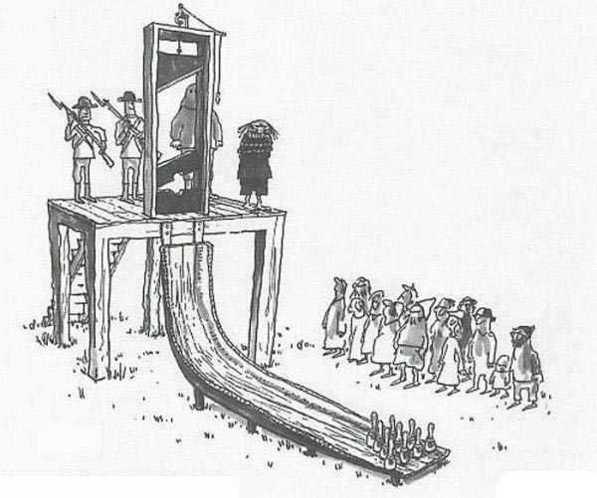
No mater what your job, you should always try to make it interesting…

Slide 22
“It’s all how we look at it…”
Dr. Frank Tracz
Kansas State University
ftracz@ksu.edu

