Slide 1

You Don’t Need A Title To Be
A Leader
Dr. Frank Tracz
Kansas State University

Slide 2
PART I:
Leadership Is…
INFLUENCE
TEST
  Do you shape your life?
  Do you affect the quality of others’ experiences?
  Do you inspire or influence others?
  Do you work to achieve specific goals by working with or coordinating the efforts of others?
  “Yes” to any of these?
  YOU ARE A LEADER!

Slide 3
How Do Leaders Act?
They believe they can positively shape their lives and careers.
They teach through relationships with people as opposed to controlling people.
  Collaborate rather than control.
  Persuade others to contribute, not order.
  Get others to follow this act of respect and courtesy.

Slide 4

Leadership Test- The Real Test
If you had no TITLE or ability to reward or penalize others, would you still get them to follow you?
Are you “Under Titled”?

Slide 5
You Aspire To Lead If…
Take control of your life
Make your organization better
Seize new opportunities
Improve your “service”
Influence others to be their best
Contribute to the betterment of others
Make the world a better place
You Do Not Need a TITLE to do this!!!!

Slide 6
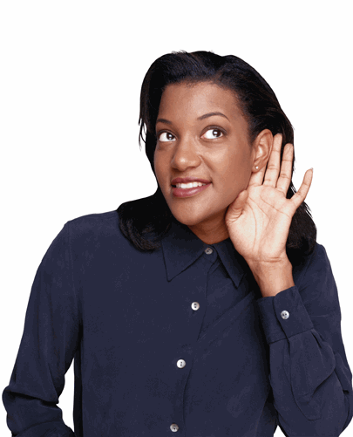
A “Leader” Is…
Listening
Observing
Reacting
Doing

Slide 7

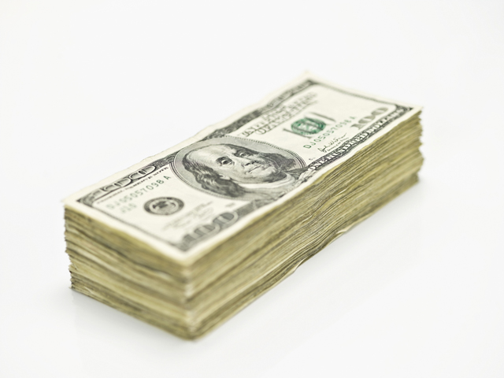

What Good is a “Title”?
Pay raise?
Power?
Freedom?

Slide 8
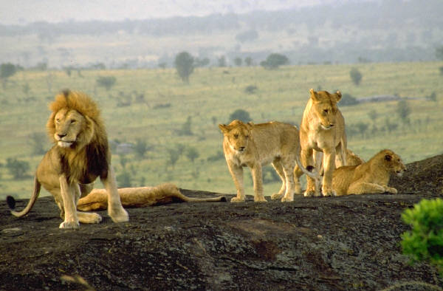
An Army of Lions…
Philip of Macedonia, father of Alexander the Great, said,
        “An army of deer led by a lion is to be feared more than an army of lions led by a deer.”
        WRONG!
        An army of lions led by a lion is unstoppable!

Slide 9
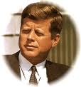
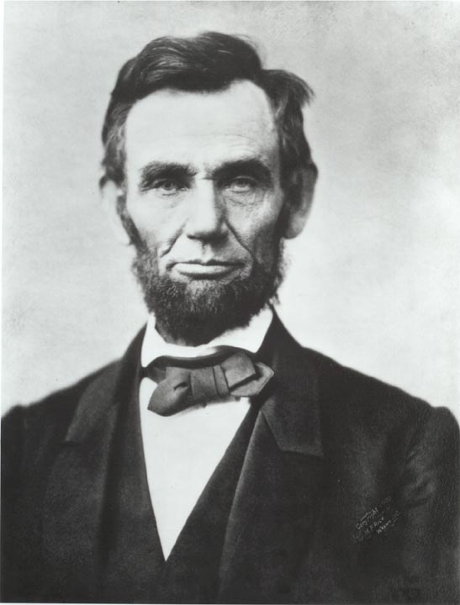
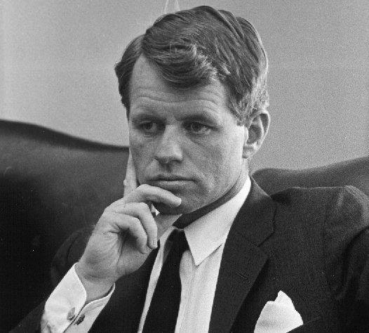
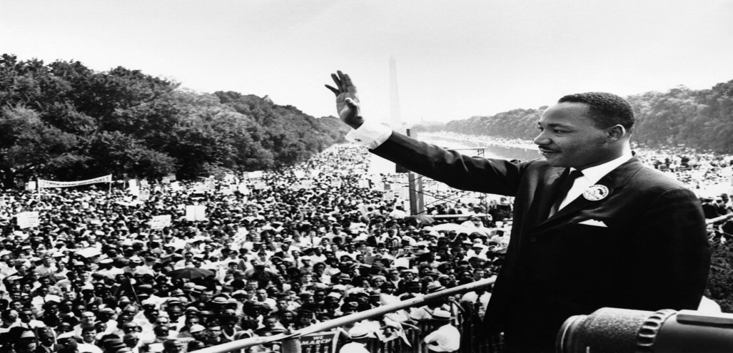
Leadership is Large….
John F. Kennedy
Robert F. Kennedy
Abraham Lincoln
Martin Luther King, Jr.

Slide 10
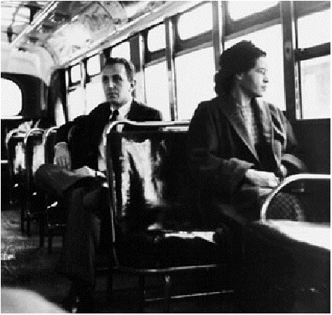
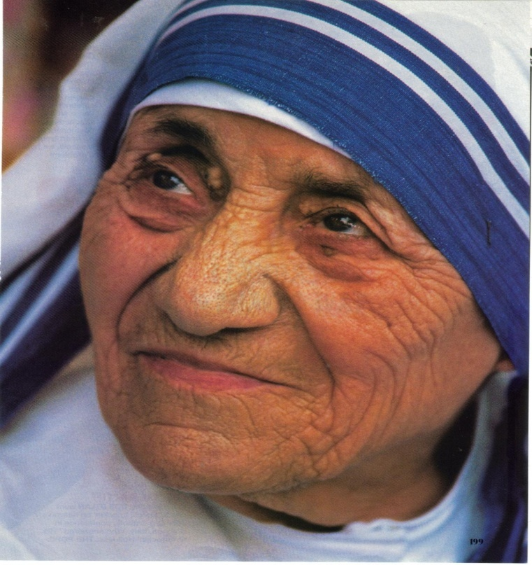
Leadership is Small….
Mother Teresa
Rosa Parks

Slide 11
An Invitation to Greatness
“If you’re Big enough for your dream, your dream isn’t big enough for You.”
- E.R. McManus, Pastor and author
Who Is A Leader?
Do You Think You Make A Difference?
What Is It You Want?

Slide 12
Leadership…
Is NOT Fame!

Slide 13
Leadership…
IS Making Things Better For Others!

Slide 14

Leadership…
Is R.O.I.
Relationships
Outcomes
Improvements

Slide 15
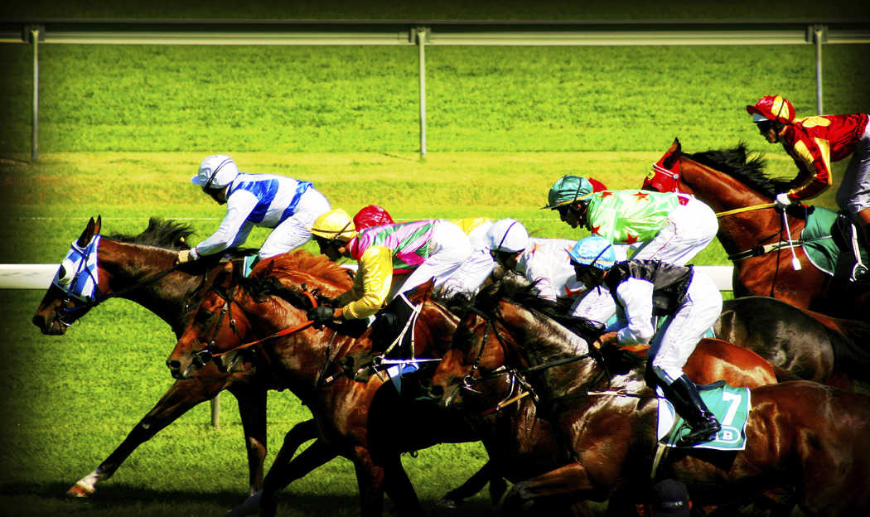
Look For Ways To Lead
Take the Lead

Slide 16
PART II:
Six Principals of Leadership
Principle # 1
The Power of “Self-Mastery”
          Leading from Within
          “Remember to play after every storm”
          BE the change you wish to see in others

Slide 17
“Obligation” or “Opportunity”
Obligation IS Opportunity!
Do It Because You Want To!

Slide 18



“Money” VS. “Meaning”
50%-80% of us dislike our lives/work
Leadership infuses meaning

Slide 19

The Road Less Traveled
Open YOUR Door
Control YOUR Life
Who’s in Charge of YOU?

Slide 20
Think Like A Leader…
The Issues
The Solutions

Slide 21
Make Time to Think…
When Do You?

Slide 22
Take Control of Your Life…
Focus on what you CAN control, first!

Slide 23

Motivation: How to Keep It
Reflect
Dream
Mirror the Successful People Around You
Retreat to Advance
Mentor Someone
Enjoy the Journey
Be a Victor not a Victim
Search for the Pony !
(Haves and Have Nots) (When Something Bad Happens)

Slide 24

Self-Mastery Index
Ratio Between
  Promises Made
  Promises Kept

Slide 25
Leadership “Action Points”
1. Stimulate Your Brain
2. Record Your Insights
3. Pick a Problem

Slide 26
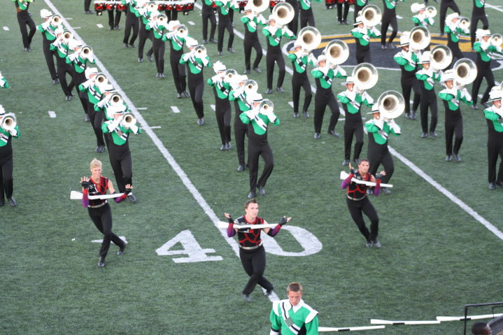
Principle # 2
The Power of “Focus”
Energy and persistence conquer ALL things.”
-Benjamin Franklin

Slide 27

The Power of “Focus”
1. Importance of Focus

Slide 28
The Power of “Focus”
2. Danger of Drifting (Power!)
3. Drifting VS. Waiting (is a choice)
4. Distraction is Detrimental (Keep the Course)
5. Establish an Agenda (…and Stick to It!)
6. Prioritize (the important things)

Slide 29
Leadership Action Points
1. Eliminate Activities that Don’t Add Value
2. Identify Your “MVP” Activities
        (Most Valuable and Profitable)

Slide 30
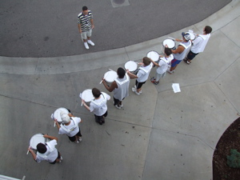
Principle # 3
“Power with People”
People Make It Happen
  Leaders VS. Managers
  Impact Others
  Character, Competency, Connection
  Motivate Others
  Confront Problems
  Don’t be afraid to challenge those
  around you
  Set an example

Slide 31
Leadership Action Points
1. Explain Your Appreciation
2. Ask Others What Motivates Them
3. Collaborates
4. Practice Diplomatic Confrontation

Slide 32
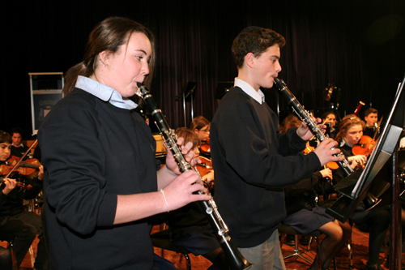
Principle # 4
The Power of
Persuasive Communication
“We have too many high sounding words and too few actions that correspond with them!”

Slide 33
Communicating is NOT the objective- Understanding is!
A subtle change can make a dramatic difference “Funeral” VS “Celebration of Life!”
From Telling to Selling
  Help them make a decision that is good for them.
Establish support
  Make them comfortable.
Influence
Begin with the end in mind!
6. Feed Back and Feed Forward!
  “Pig!!!” (Warning on Highway)
  Evaluative VS. Preventive

Slide 34
7. Tell a better “story”
    They will remember!
8. Everything you do makes a difference!
    They will Listen!
Call for Action!
  Let’s do it.
  Do I have your word?

Slide 35
10. How Leaders Communicate
A. Sell
B. Influence
C. Strive to be Understood
D. Energize
E. Inspire
F. Tell Stories
11. The Power of Clarity
  Lincoln’s Gettysburg Address- 10 Sentences!!
  Senator Everett, Same Day, Second Speech: 2 HOURS!!

Slide 36
Leadership Action Points
Focus on other people
Simplify the message
Entertain to Engage

Slide 37
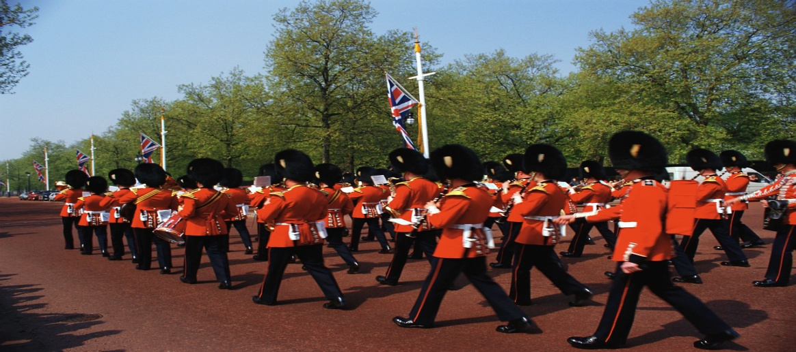
Principle # 5
The Power of Execution
“You can’t build a reputation on what you are going to do”
-Henry Ford

Slide 38
Leaders have a HIGH I.Q.!
  I.Q.= Implementation Quotient
Intent without action is daydreaming.
Vision VS. Visioning
Noun VS. Verb / Idea vs. Inplementaton
Barriers to Execution
  Paralysis by Analysis
  Fear of Failure
  Confusing Talking with Taking Action
  Accepting Explanations as Excuses
HOW to Increase Your I.Q.
  Dream Big
  Plan Small (plan + delegate + To Do’s)
  Team Up
  Keep Striving
  Act Boldly (Keep acting, change the rules of the game!)
FACE YOUR FEARS!

Slide 39
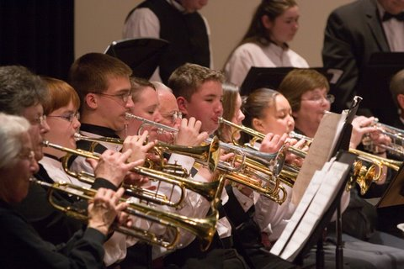
Principle # 6
The Power of Giving
If you truly desire happiness, seek and learn how to serve.”
-Albert Shweitzer

Slide 40
Giving and Returning
1. Giving…
    a. Teaches us how to look beyond ourselves.
    b. teaches us to be of greater service in helping others.
    c. makes the world a better place.
    d. makes us feel good.
2. What Can You Give?
    a. Money?
    b. Time?
    c. You! (Without Recognition)
3. To Lead is to Serve.
4. The Gift of “You” is the gift that gives “back”.

Slide 41
Leadership Action Points
Plan
1. Practice giving without recognition.
2. Determine how you can best contribute.
3. Give as a family (section, band, Wildcat)

Slide 42
PART III
“Leaving a Leadership Legacy”

Slide 43
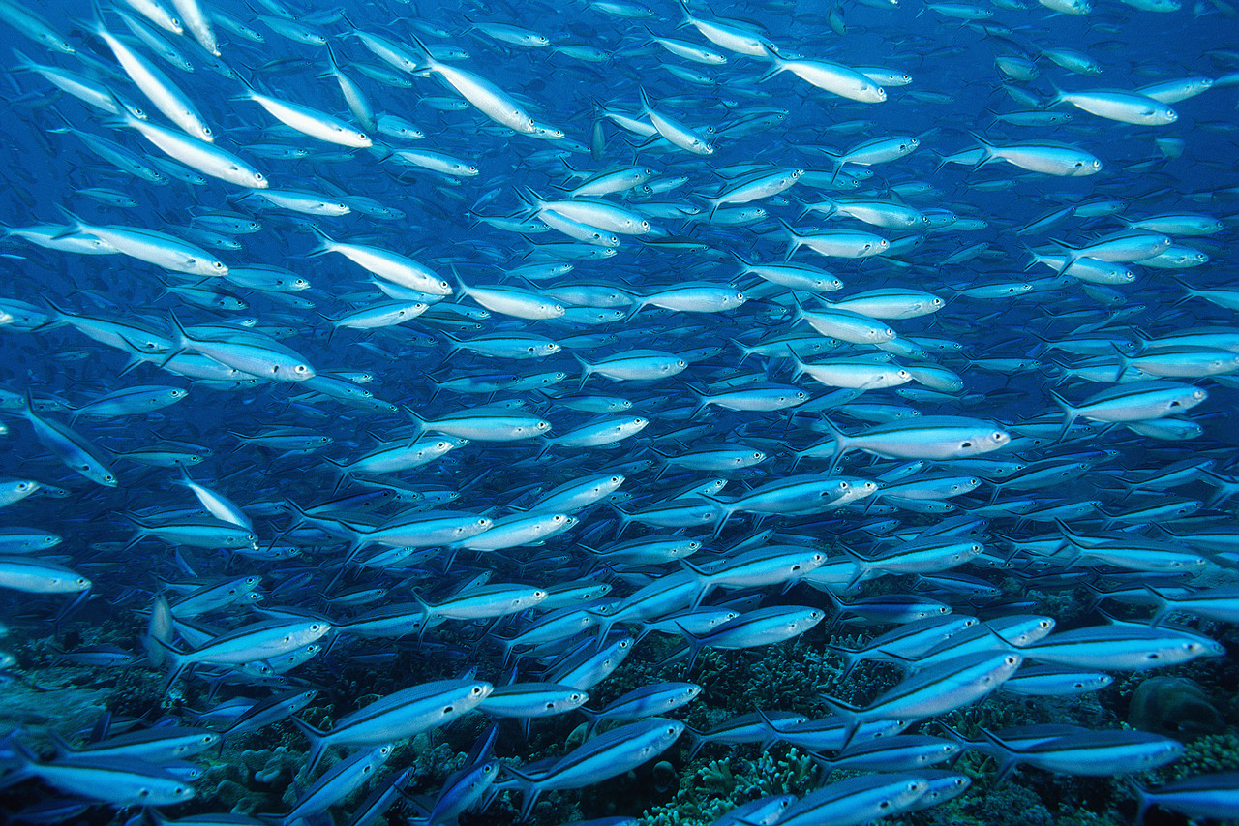
1. Difference Makers:
    -Everyone matters.
    -Everyone makes a difference.
2. Activity Vs. Accomplishment
    -Managing is “activity”.
    -Leading is “accomplishment”.

Slide 44
Resumé Skills Vs. Leadership Skills
Don’t just be good, be good for something!
Resumé
Legacy
What you’ve accomplished
$$$ You’ve Made
The impression
Your career
Self-Improvement
What you’ve contributed
Relationships
Difference you’ve made
The impact
Your organization, family, community
Helping others improve

Slide 45

4. Believe in a better world.
5. Respond to difficulties.
-see what they are
-accept them
-work to solve them
6. Why NOT you?
7. What is your legacy?

Slide 46
Mastering Leadership
How long will it take?
How long do you expect to live?
MAKE A DIFFERENCE!

Slide 47
Dr. Frank Tracz
226 McCain Auditorium
Kansas State University
Manhattan KS, 66506
Ftracz@ksu.edu

