Slide 1
SCORE STUDY
AND PREP FOR
ALL OF US!
DR. FRANK TRACZ
KANSAS STATE UNIVERSITY
MIDWEST BAND AND ORCHESTRA CLINIC
DECEMBER 20, 2017

Slide 2
THE BEGINNING:
YOU
ME
THEM

Slide 3
OUR LIVES:
COMPLICATED
FAST
BUSY!!!!

Slide 4
KIDS TODAY:
Instagram
Entitled
Tweets
Facebook
Director
Students
CNN
Texting
Fox
E-Mails
MSNBC
Administration
Social Media
Parents
Short Attention Spans
WHITE HOUSE BANNED/BAND WORDS:
balance, blend, T.Q., intonation, rhythmic skills, dynamics, articulation.

Slide 5
RESULT:
Not enough time
Lack of focus
Limited patience
Lack of empathy
Little or no respect

Slide 6
iGEN
Jean M. Twenge, PhD
“Why Toady’s Super-Connected Kids Are Growing Up Less Rebellious, More Tolerant, Less Happy – and Completely Unprepared for Adulthood” * and What That Means for the Rest of Us.

Slide 7
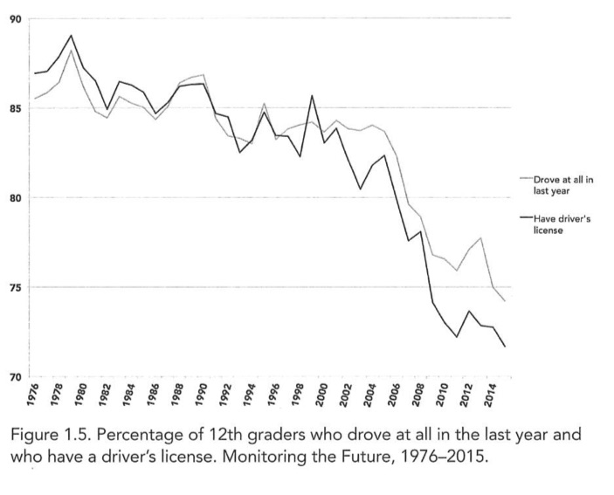
WHAT IS:
Less desire to drive……..

Slide 8
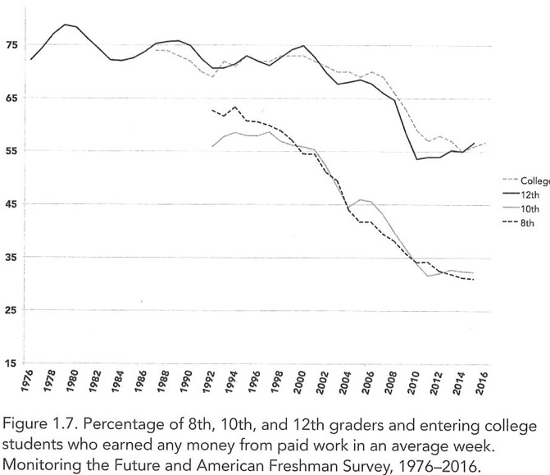
WHAT IS:
Kids who work during high school……..

Slide 9
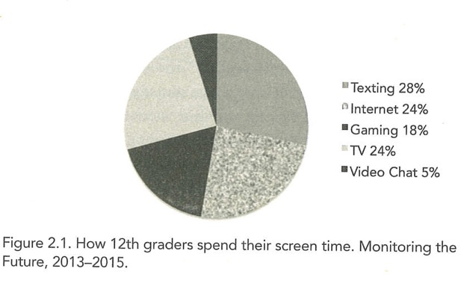
WHAT IS:
How they spend their “screen time”……….

Slide 10
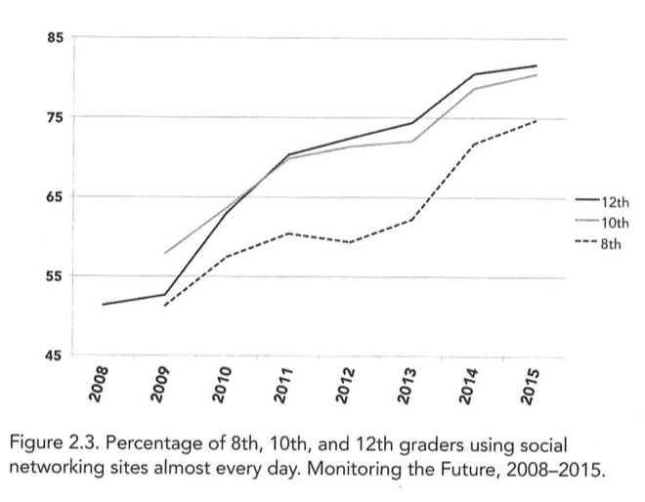
WHAT IS:
Daily social media use……….

Slide 11
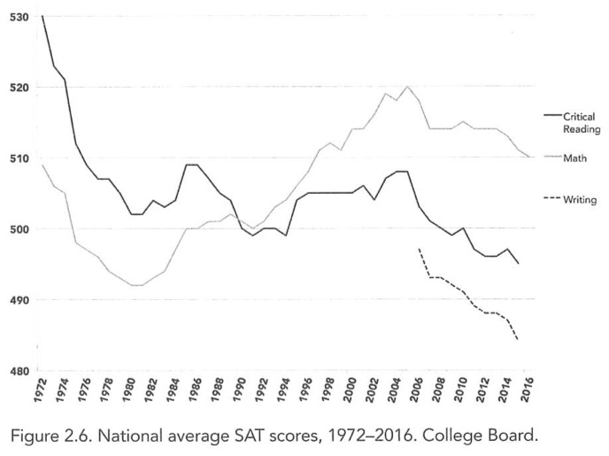
WHAT IS:
SAT scores……….

Slide 12
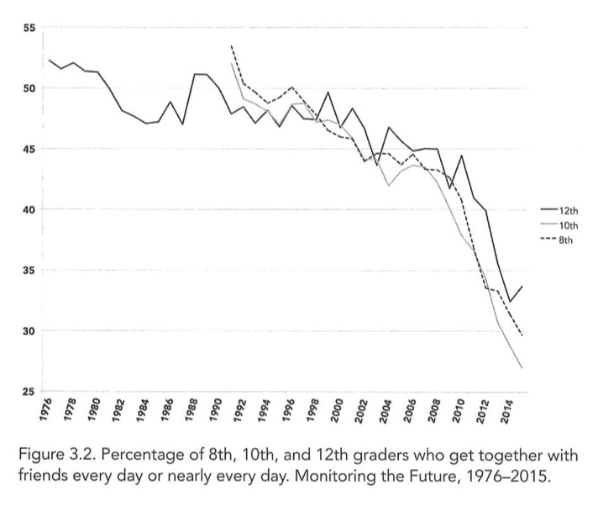
WHAT IS:
Kids who get together with friends everyday…….

Slide 13
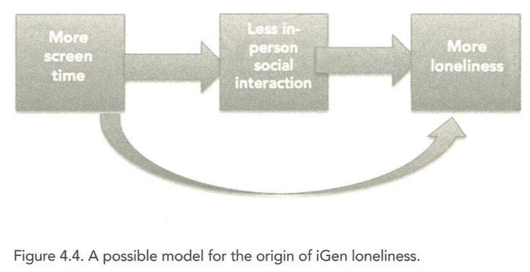
WHAT IS:
iGEN loneliness……..

Slide 14
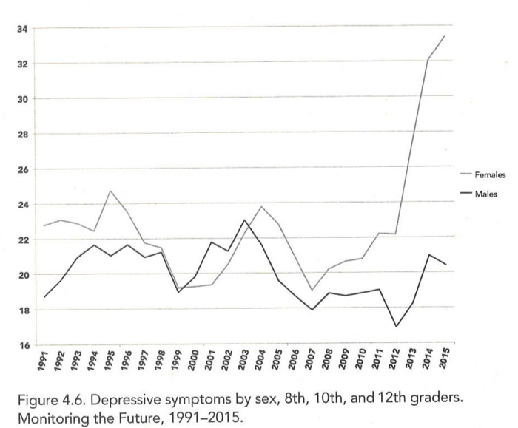
WHAT IS:
Depression………

Slide 15
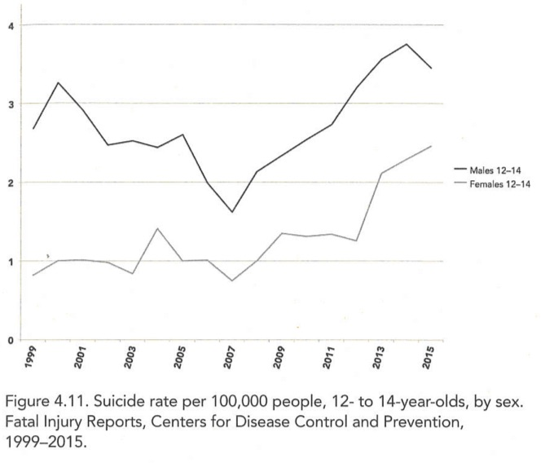
WHAT IS:
Suicide rate…….

Slide 16
WHAT DOES THIS MEAN?????
There is a need.
You can provide what is needed.
What you do matters most.
Teaching music is your tool to change lives.
Change lives from the podium!

Slide 17
Macro – Micro – Macro
MACRO
What is.
MICRO
“me”
MACRO
What could be.

Slide 18
Teacher’s Creed
Tell them what you are going to teach them.
Teach them
Tell them what you taught them.

Slide 19
Know Your “Stuff”
Personality
+
Talents
+
Technique
+
Presentation
=
Your Ensemble!!!!

Slide 20
Framework
Apply
Plan
Reflect
Teach

Slide 21
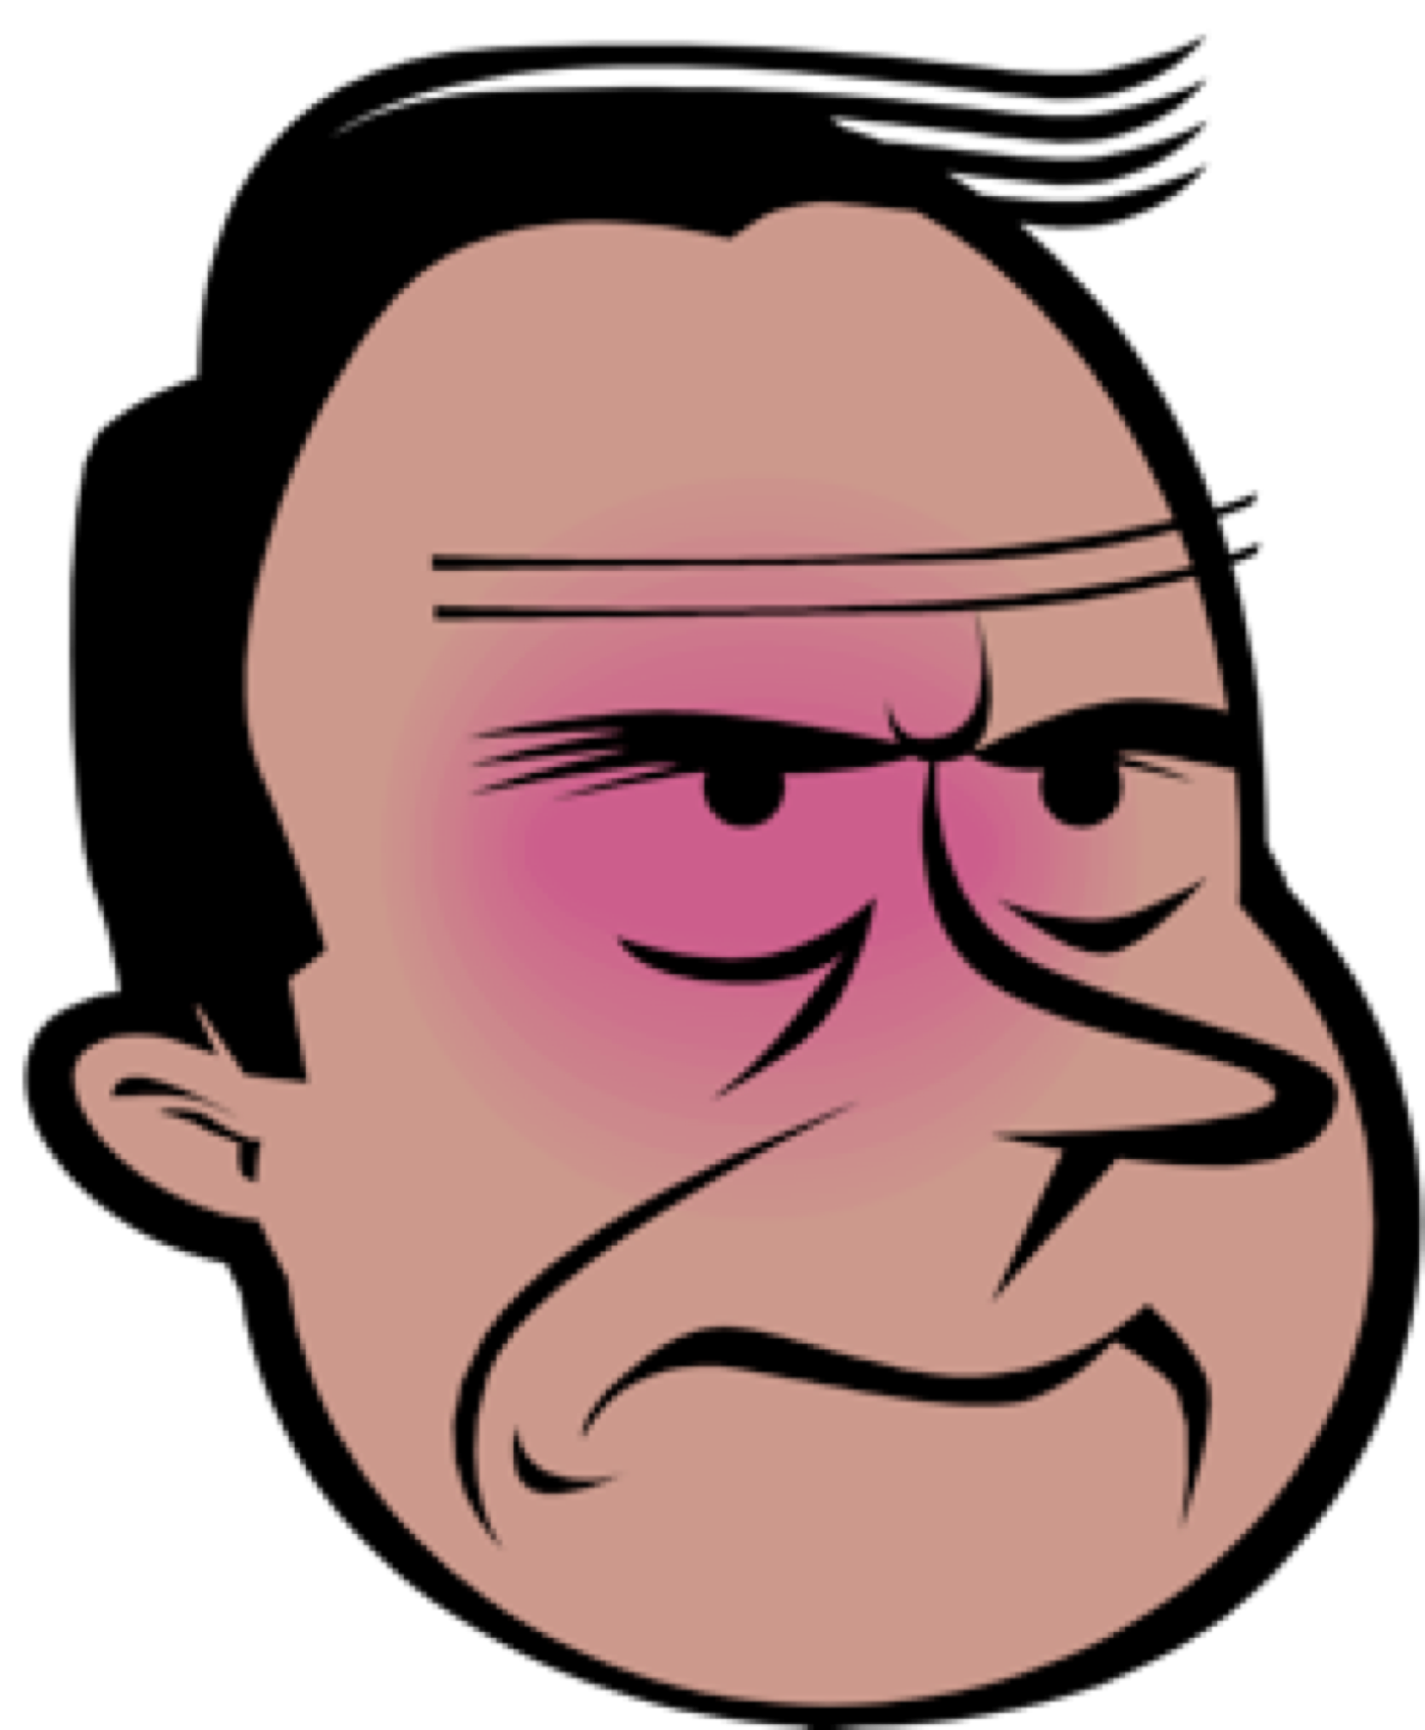

Communication Triangle
1. PLEASE STAND
2. TURN/SHAKE HANDS.
3. OTHER HAND ON SHOULDER
4. SMILE/FROWN
5. TRUMP/CLINTON

Slide 22
Rehearsal Approach
Instruction
Performance
Evaluation
Correct Response
Incorrect Response
Reinforcement
(Feedback)
Identify Error
(Feedback)

Slide 23


Slide 24
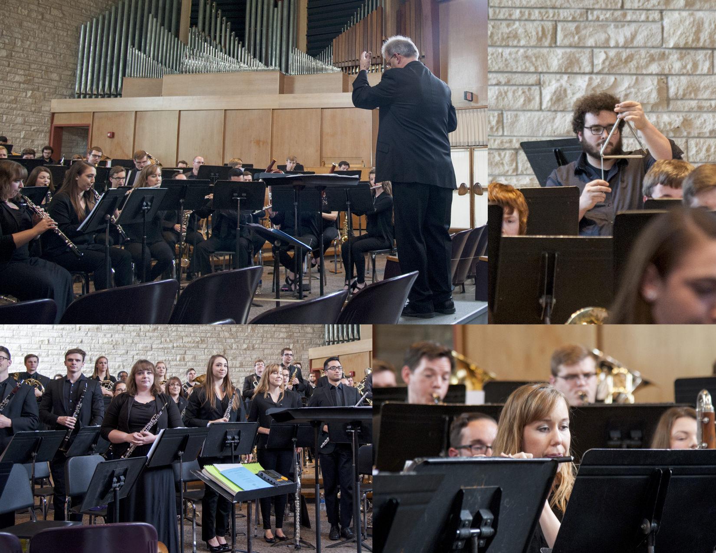
THE SCORE REVEALS:
YOU!!!
Musician
Educator
Rehearsal Technician
Motivator
Conductor
Values

Slide 25
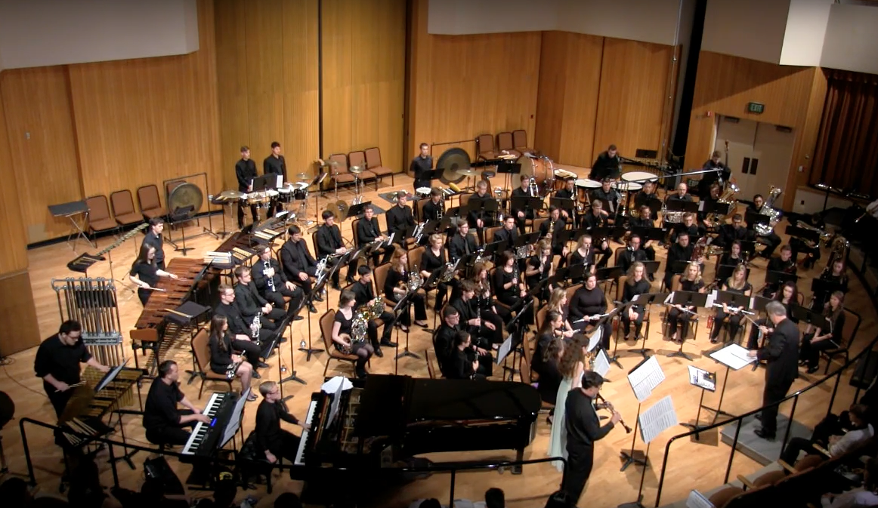
YOUR ENSEMBLE LEARNS ABOUT:
Music
Technique
History
Theory
Relationships
YOU

Slide 26
THEY LEARN THROUGH “YOU”
Repertoire
Unit Study
In Depth Analysis
Score Markings
REHEARSAL

Slide 27
ORDER OF THE PROCESS:
1. Repertoire selection.
2. Unit Study.
3. Graph Analysis.
4. Score Marking.
5. Rehearsal/Conducting Planning.
6. Rehearsing/Conducting.
7. Evaluation.

Slide 28
UNIT STUDY:
1. COMPOSER – Talk about the composer.
2. COMPOSITION – Talk about the piece: “Who, What, Where, When, How”
3. HISTORICAL PERSPECTIVE – Why was it composed, When, significance?
4. TECHNICAL CONSIDERATIONS – The components: instrumentation, solos, ranges, meter, etc.
5. STYLISTIC CONSIDERATIONS – Markings, articulations, dynamics, phrasing.
6. MUSICAL ELEMENTS – Melody, Harmony, Rhythm, Timbre.
7. FORM AND STRUCTURE – Introduction, Themes, Development, etc.
8. SUGGESTED LISTENING – Other pieces by composer, same era, similar style/sound/etc.
9. ADDITIONAL RESOURCES – Recordings, articles, analysis, other sources.

Slide 29
THE “SCORE MARKING SYSTEM”
Define:
- ensemble needs.
- YOUR needs.
- predicted issues.
- your technical conducting needs.
- musical needs/issues.
- pertinent “useful” information.

Slide 30
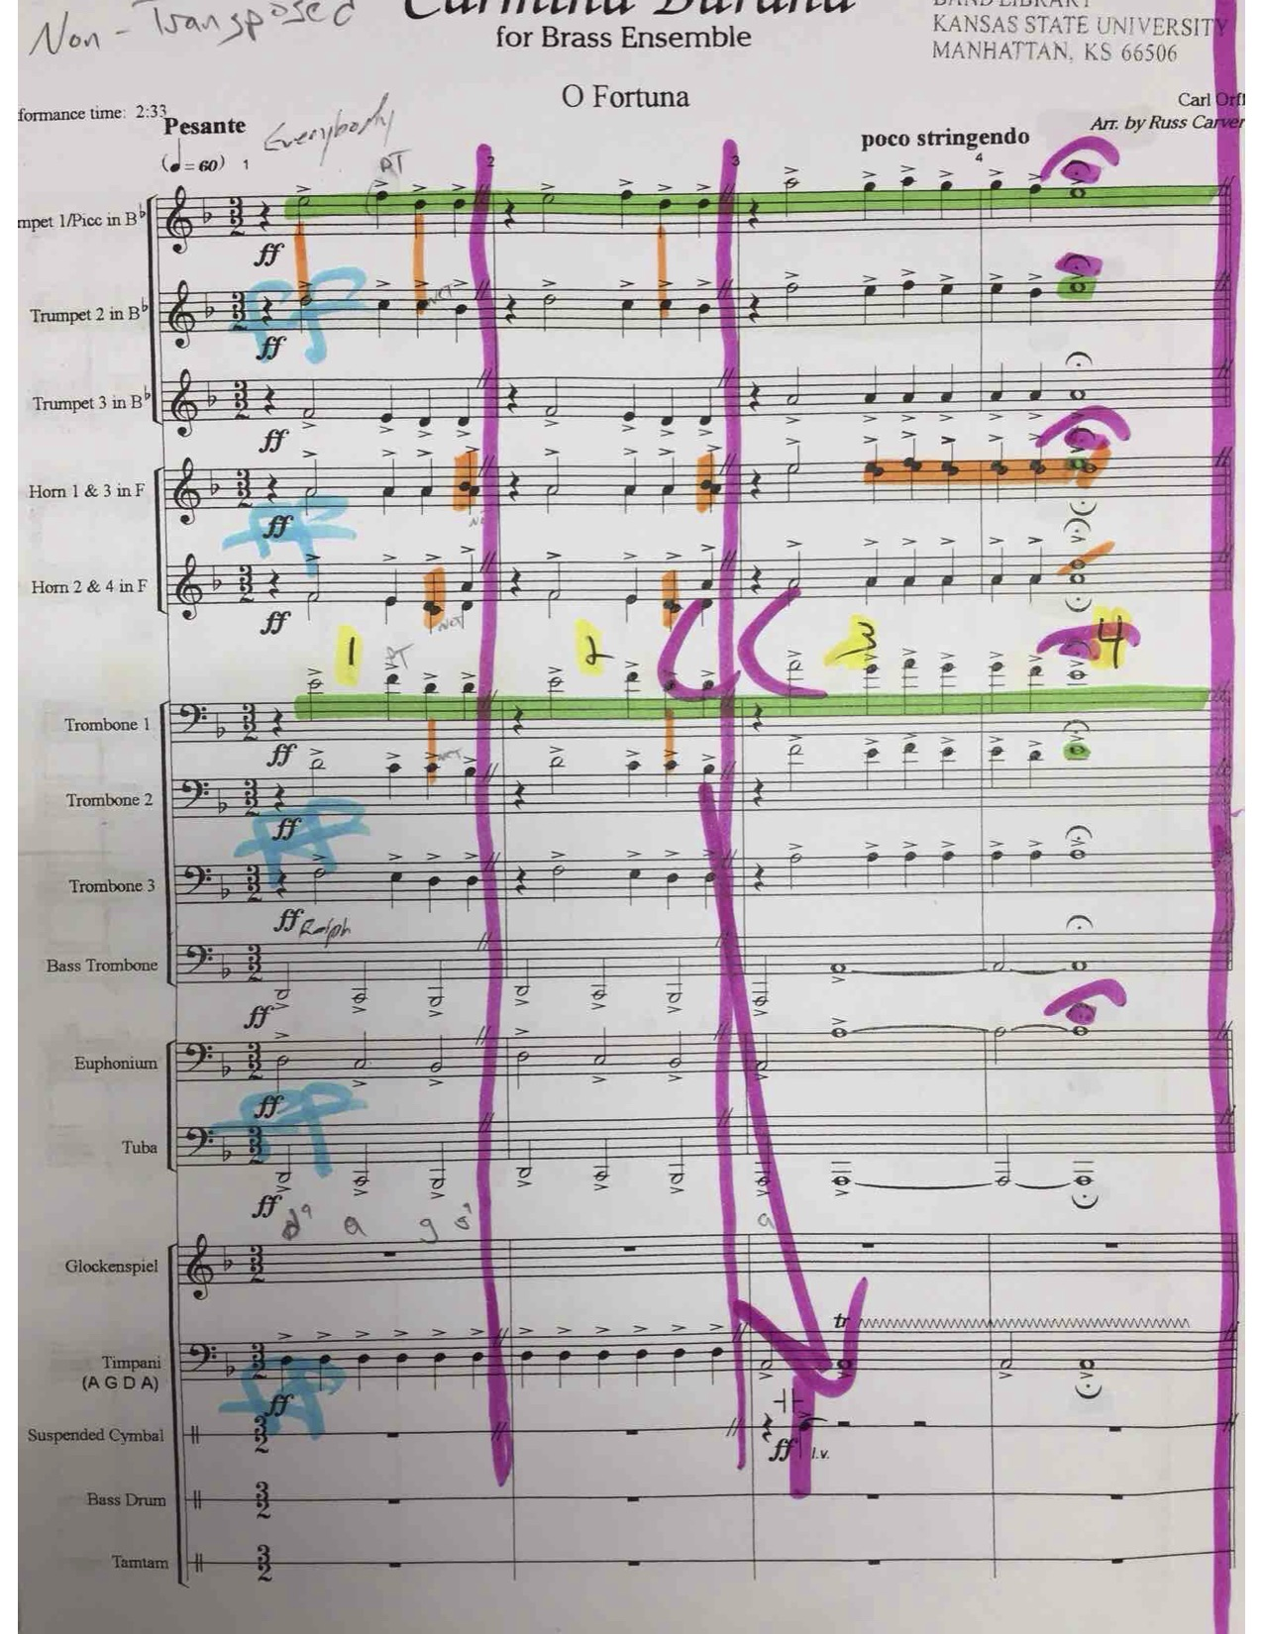
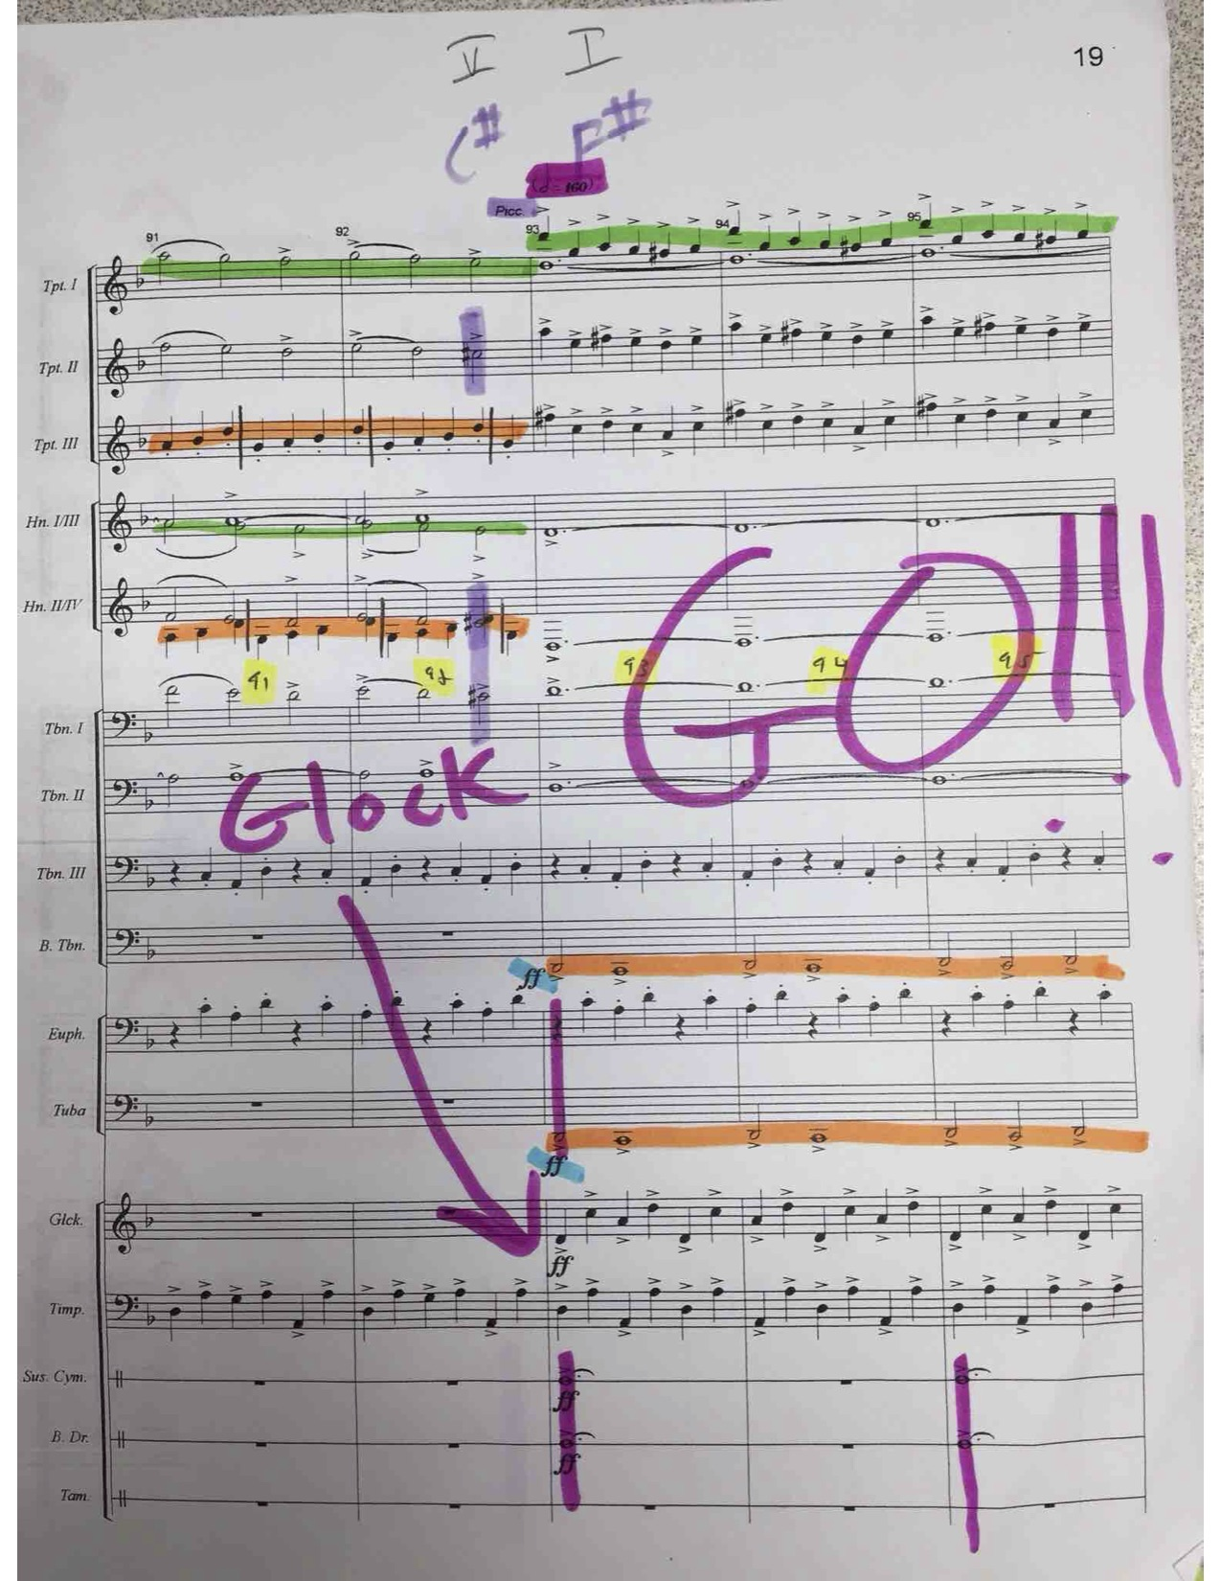
SCORE MARKING
Purpose
Method
Materials
Systems
Technique
Use

Slide 31
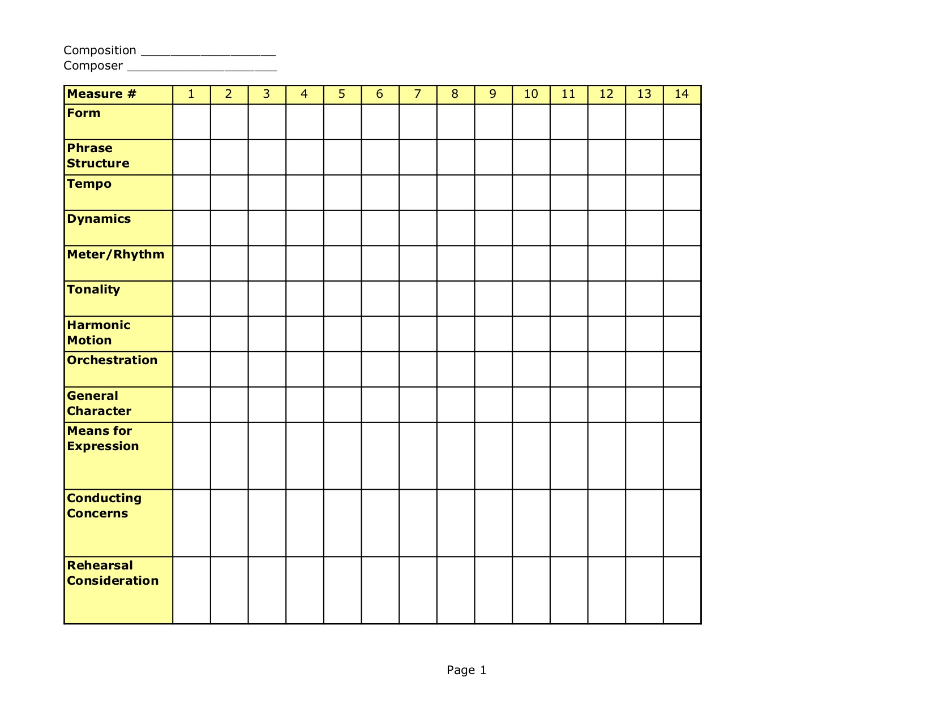
GRAPH ANALYSIS

Slide 32
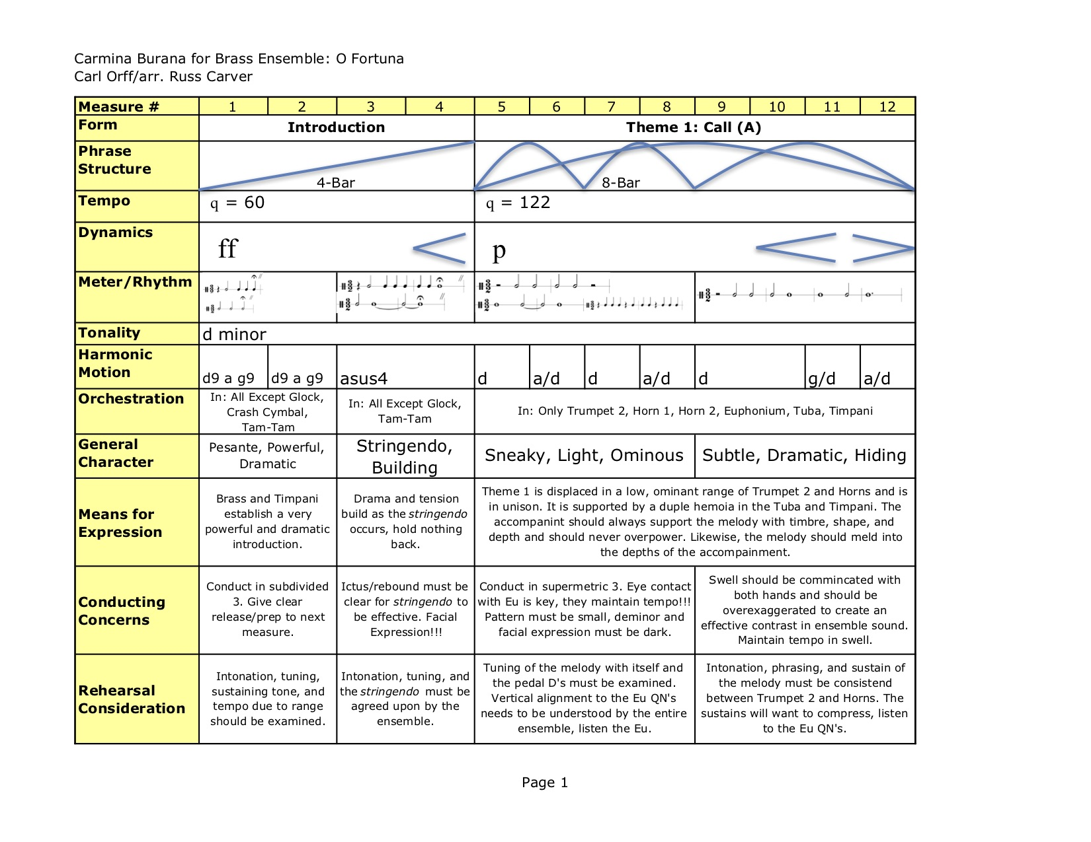

Slide 33
THE REHEARSAL
Plan (Strategy)
Organize (Time)
Manage (Time, People)
Techniques (Methods of Delivery)
Evaluate – Everything!

Slide 34
BOTTOM LINE:
Prepare
Practice
Execute
Review
Evaluate
Start Over!!!!

Slide 35
FINAL THOUGHTS:
Kids need you!!
Kids need Band!!!
Kids need Music!!!!
YOU make the difference!!!!!

Slide 36
REFERENCES:
Basic Conducting Techniques, Joseph A. Labuta
Teaching Music Through Performance in Band, Richard Miles, Editor
Guide to Score Study, Frank Battisti and Robert Garofalo
The Modern Conductor, Elizabeth A. H. Green
The Conductor and His Score, Elizabeth Green, Nicolai Malko
The Creative Conductor, Edward S. Lisk
On Becoming a Conductor, Frank L. Battisti
The Grammar of Conducting, Max Rudolph
Developing the Complete Band Program, Shelley Jagow
Teaching Band and Orchestra, Lynn G. Cooper
The Art of Interpretation of Band Music, Compiled and edited by Mark Walker
Score Rehearsal Preparation, Gary Stith

Slide 37
GRATITUDE:
Kansas State University Bands
Conn-Selmer
GIA Publishing, Garwood Whaley
Dr. Robert Spradling, Western Michigan University
Dr. Larry Blocher, University of Troy
Dr. Jay Gilbert, Doane College
Dr. Alex Wimmer, Asst. Dir. of Bands, K-State

Slide 38
CONTACTS:
Dr. Frank Tracz
Director of Bands
Kansas State University
226 McCain Auditorium
Manhattan, KS. 66506
785-532-3816
ftracz@ksu.edu
WWW.KSU.EDU/BANDS
(click “Downloads”)

