Slide 1


Program Profile:
Kansas State University Bands
2015 CBDNA Athletic Band Symposium

Slide 2
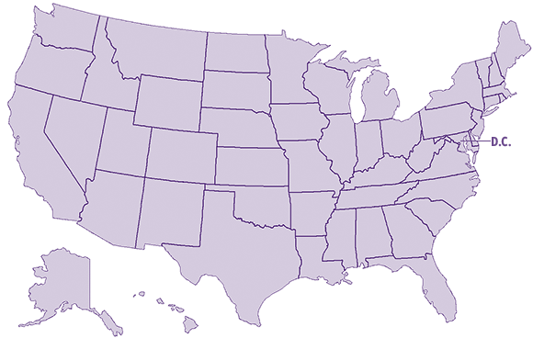
Demographics

Slide 3
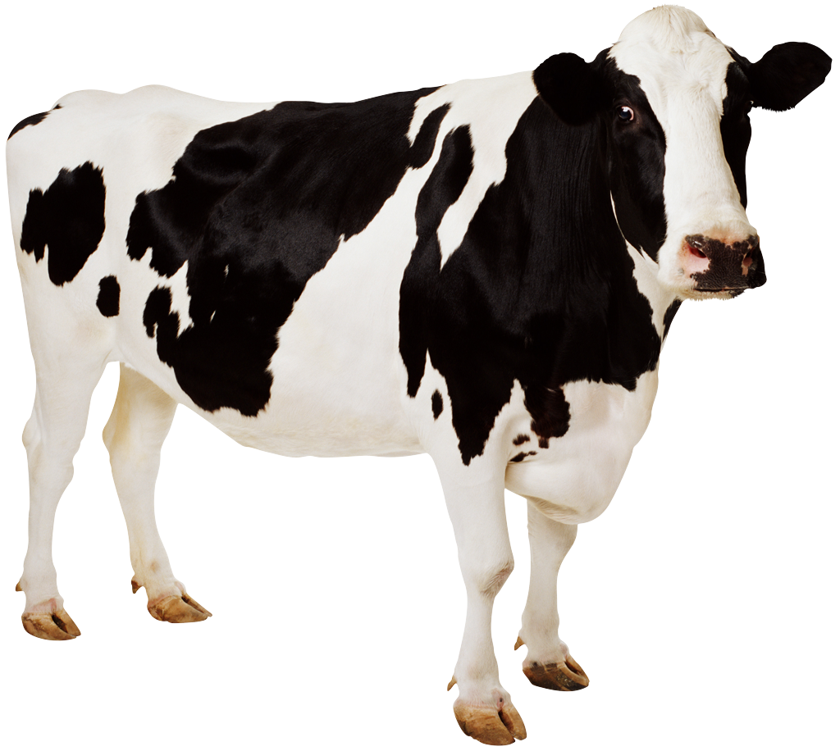

Demographics
6 Million Cows
2.9 Million People
3 Oboe Players

Slide 4
The University
1st Land Grant College: 1863
25,000
3 Campuses
Popular Majors: Engineering, Ag, Vet-Med, Music Ed
New home of NBAF

Slide 5
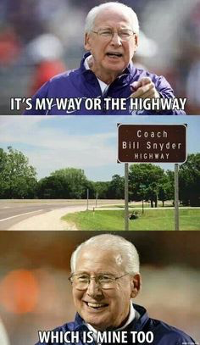

Slide 6
Band Program
5 Concert Ensembles ( 60 – 80 each)
1 Brass Ensemble (24)
Various Chamber Groups
2 Basketball Cat Bands (160)
1 Volleyball Band (24)
2 Pub Crawl Bands (30)
1 Marching Band (400)

Slide 7
Band Program: Staff
1 Director of Bands
1 Assistant Director of Bands
1 Senior Administrative Assistant
5 Graduate Students
3 Marching Band Auxiliary Coordinators
6 Undergraduate Student Staff
4 Managers
20 Band Ambassadors

Slide 8
Building a Program
Recruiting
Administrative Support
Public School Band Director Support
Alumni Support
Athletic Department Support
Community Support
Student Body Support
Family Support

Slide 9
Building Process
Solid Teaching
High Expectations
Marketing
Outreach

Slide 10
Outreach
School Visits (keep in mind: this is Kansas)
Summer Camps (Music, Leadership & Auxiliary)
Central States Marching Festival
Concert Band Clinic
“Instrument” Day
Band Day
Band Director Day

Slide 11
Outreach
Alumni Band Day
Side-by-Side Concerts
Website
Facebook
Newsletters
Phone Calls, Emails
Attend Local School concerts

Slide 12
On Campus Visits
New Student Services
Recruiting Booths ( Open House, Junior Days, Etc…)
Meet with the Directors!
Recruiting Folders
T-Shirts/CDs

Slide 13
Budget
SGA – Special requests/guest artists
Athletics – ADOB, 2 GAs, Admin, Summer $$
University - $215,000
SMTD - $10,000
Alumni Association
Foundation

Slide 14
Scholarships
Music Majors
Marching Pride Scholars
Section Leaders
Volleyball Band
Pub Crawl Band
KKY/TBS

Slide 15
Fundraising
Golf Tournament
Telefund
MPS drive
Catbacker Auctions
Pep Bands
Special Events/Camps

Slide 16
Future Goals
3rd Director
New Band Building
Expanded Scholarships
National Outreach

Slide 17
Kansas State University
226 McCain Auditorium
Manhattan, KS 66503
Frank Tracz : ftracz@ksu.edu
Don Linn: dplinn@ksu.edu
(785) 532-3816

