Slide 1

Using Power BI to Automate Data Cleaning and Visualization

Slide 2


Frederick Burrack
Director of Assessment
Office of Assessment
Chris Urban
Assistant Director of Data Analytics
Planning & Analysis

Slide 3





Visualizing Data through Interactive Reports in Power BI

Slide 4
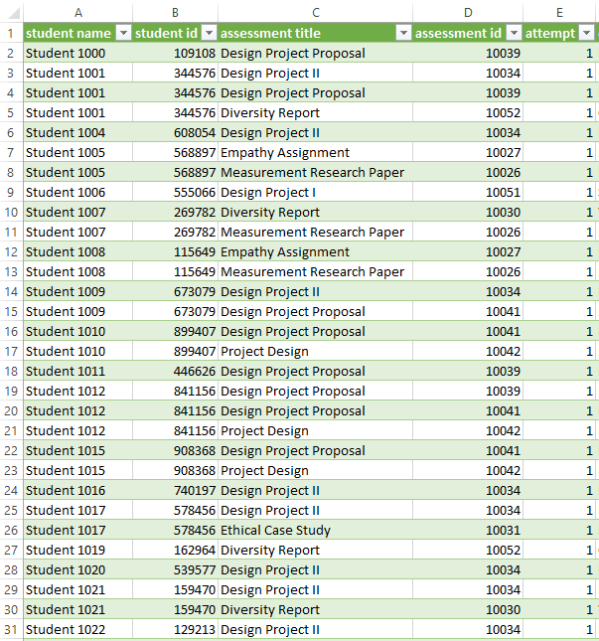
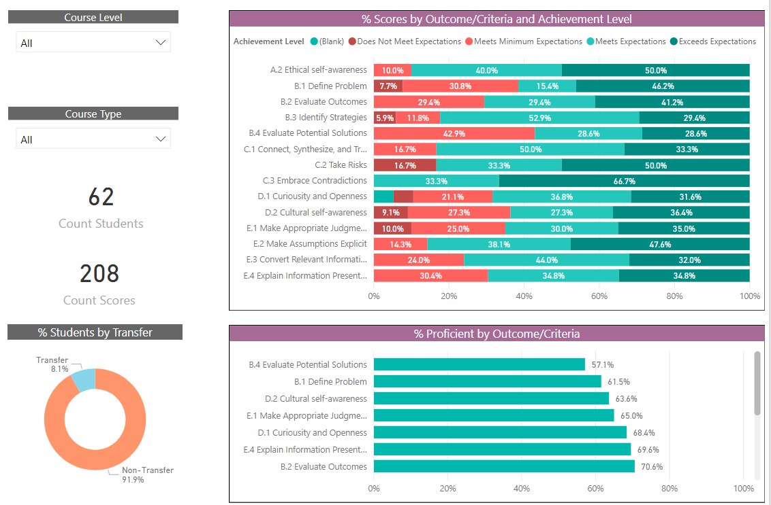
Data Dashboards

Slide 5

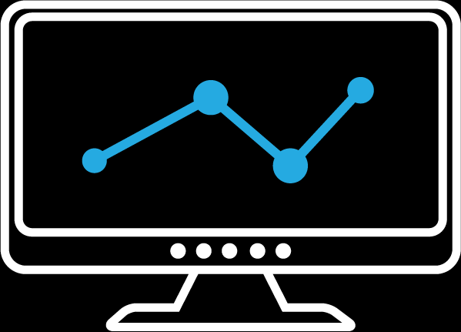




Survey Results
Form Entries
Data Visualization Tool
Assessment Results
Engagement/Clicks
Documents
Combined, interactive dashboards and reports
Data Warehouse
  Student Demographics
  Enrollments

Slide 6
Part 1
Create the
Data Model
Introduce relational data modeling
Connect to data
Transform and clean
Add necessary fields
Part 2
Create the
Report
Introduce DAX
Create measures
Create visuals
Polish and update the report

Slide 7
Relational Data Modeling
Notes:
11:35
Before the live walkthrough, there are some concepts and terms that you need to understand in order to make Power BI work well. The first of those is relational or tabular data modeling, which is the engine that drives Power BI.

Slide 8
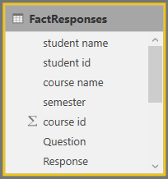
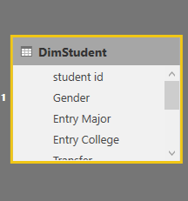
Facts
Dimensions
Contains items you want to identify: Sum, average, count, etc.
Contains fields to break down
a Fact Table

Slide 9
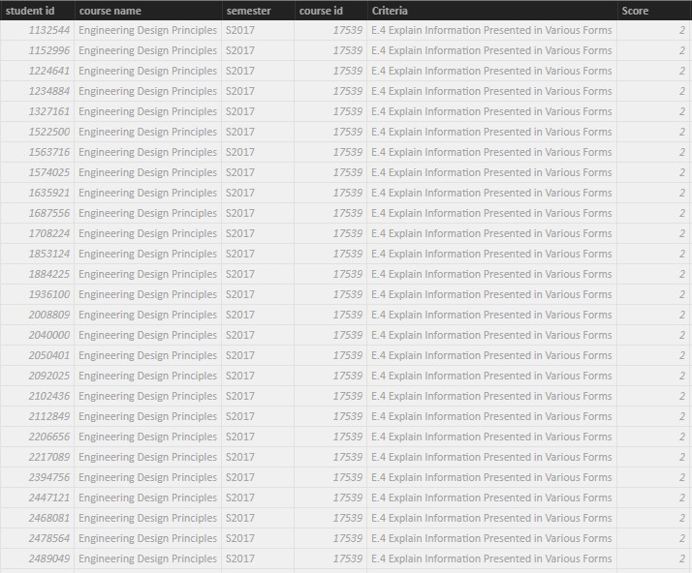
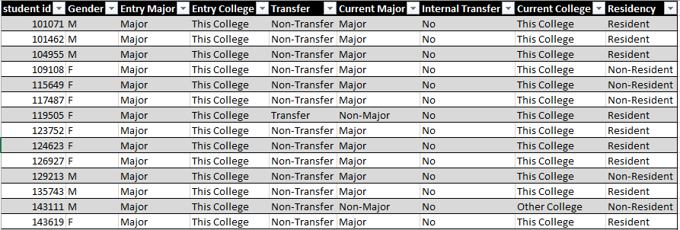
Facts
Dimensions
Long and narrow
Duplicated
Short and wide
Unduplicated

Slide 10
Facts
Dimensions
FactResponses[StudentID]
DimStudent[StudentID]
Dimensions relate to Facts.
Used as a filter via Key Fields.

Slide 11
Fact Responses
Responses
Students
Semesters
Courses
Questions
Dimensions that surround a
Fact Table are called a
“Star Schema”

Slide 12
Automating Data Processes
Fact Responses
Responses
Students
Semesters
Courses
Questions
Get Raw Data
Clean and Prepare Raw Data
Load Clean Data to Model

Slide 13






Power BI Suite
Power BI Service
Power BI Desktop
PUBLISH
ACCESS
Query and Report Creation
Power BI Gateways
Your Institution’s Data
Adapted from Microsoft.com

Slide 14
Step-by-Step Demonstration

Slide 15
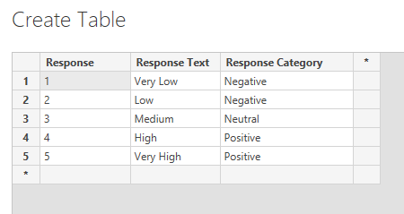

Slide 16
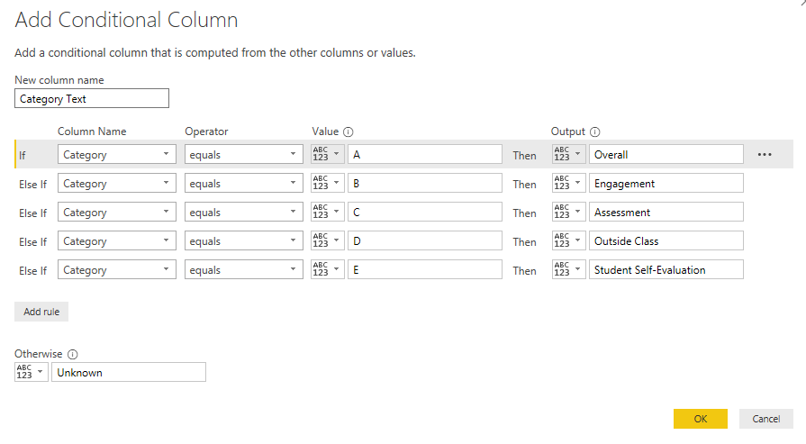

Slide 17
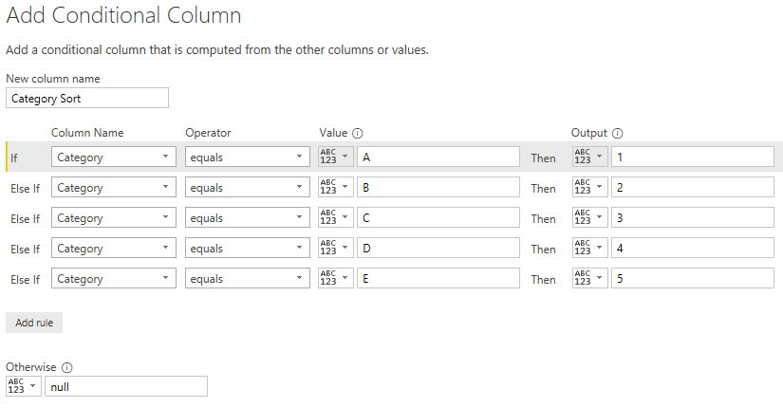

Slide 18
Part 1
Create the
Data Model
Introduce relational data modeling
Connect to data
Transform and clean
Add necessary fields
Part 2
Create the
Report
Introduce DAX
Create measures
Create visuals
Polish and update the report

Slide 19
An Introduction to DAX
Data Analysis Expressions

Slide 20
Data Analysis Expressions (DAX)
Functions used to create reusable measures that analyze data
Basic commands such as COUNT, SUM, AVERAGE, etc.
Generally used in Fact tables to aggregate
Can reference other DAX formulas – no need to re-enter data
Notes:
12:00-12:01
DAX is used to automate calculations in Power BI. DAX is made up of functions that are used to build formulas allowing components in our data tables to interact.
The functions serve many purposes:
They can create measures that will be used to analyze data in the visualizations.
They can provide most types of calculations that are necessary to understand data such as Count, Sum, Average, etc.
They are generally used to aggregate fact table data.
They can make reference to other DAX formulas which eliminates the need to reenter data or duplicate processes.

Slide 21
A Basic Measure using DAX
Function
Column Used to Calculate
Count Responses = COUNT(FactResponses[Response])
Name of the Measure
Table used to calculate

Slide 22
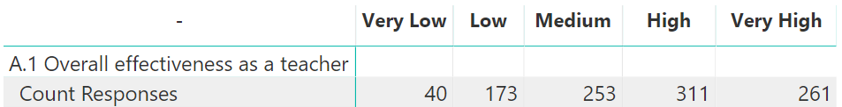
Count Responses = COUNT(FactResponses[Response])

Slide 23
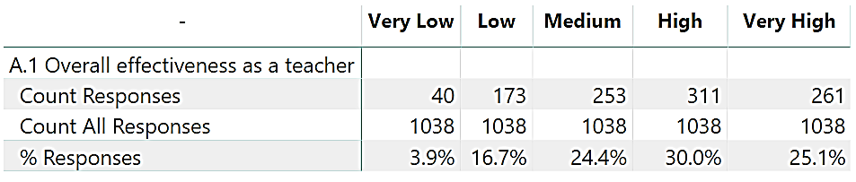
Count All Responses = CALCULATE([Count Responses], ALL(DimResponse))

Slide 24
%Responses = [Count Responses] / [Count All Responses]

Slide 25
Step-by-Step Demonstration

Slide 26
DAX Measures to count Responses
Count Responses = COUNT(FactResponses[Response])
Count All Responses = CALCULATE([Count Responses], ALL(DimResponse))
%Responses = [Count Responses] / [Count All Responses]

Slide 27
DAX Measures to count students
Count Students = DISTINCTCOUNT(FactResponses[student id])
Count All Students = CALCULATE([Count Students], ALL(DimStudent))
%Students = [Count Students] / [Count All Students]

Slide 28
Publishing and Sharing
Power BI Service
Power BI Desktop
PUBLISH
ACCESS
Query and Report Creation
Power BI Gateways
Your Institution’s Data
Adapted from Microsoft.com

Slide 29
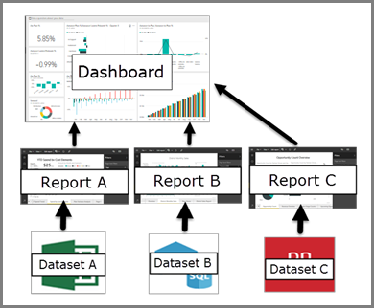

Slide 30
Sharing Options
Sharing Option | Use | Cost
Public Report | Public online link. Not secure. | Free
Share Power BI Desktop Files | Raw data must be accessible by creators and viewers. | Free
Export to PDF | Create a static report from a Power BI report | Free in desktop, requires Pro license in service.
Embedded Report | Secure link to embed in other websites. | Varies. ~$25/user license/year.
Direct Share | Sharing between licensed individuals. | Varies. ~$25/user license/year.
Power BI Premium | Sharing from licensed authors to unlicensed viewers | Varies. ~$20k/year + $25/author license/year

Slide 31
Request a Pro License ($25/user/yr): https://www.k-state.edu/its/software/software-licenses/ms-power-bi/

Slide 32
K-State Power BI Users Group email Chuck Gould – chuck@ksu.edu
K-State Power BI Slack Channel
ksupowerbi.slack.com

Slide 33
What about the data warehouse?

Slide 34
Resource Documents
Example Source Files
Finished Report
DAX Reference Card by Power Pivot Pro
Data Confidentiality Strategies
Publishing Checklist

Slide 35
Questions & Discussion
Thanks for coming!
Using Power BI to Automate Data Cleaning and Visualization

