Slide 1

West Virginia Adventure Assessment
Created by Jessica Michael & Vicky Morris-Dueer

Slide 2


West Virginia University, Main Campus…
Located in Morgantown, West Virginia
Fall of 2013, enrolled 29,466 students (49% WV residents)
Full-time instructional faculty taught 61% of classes
Flagship, public land-grant institution founded in 1967
Offers 191 degree programs
Carnegie High Research activity institution
Notes:
In the fall of 2013, enrolled 22,757 undergraduate students

Slide 3
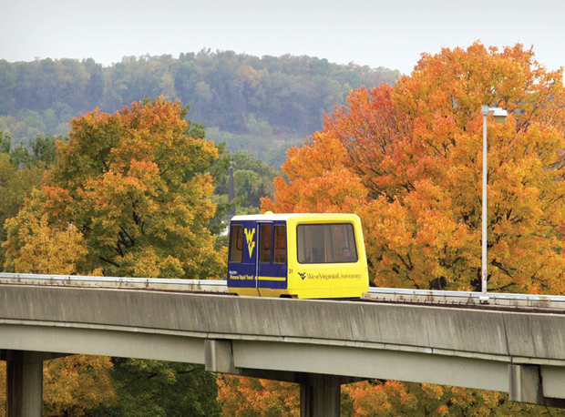
Outline
Study Goal
Outdoor Education Overview
Methodology
Research Design
Profile Results
Financial Impact
Conclusions
Future Research Initiatives

Slide 4

Goal of this Study
Examine the first-time freshmen (FTF) population who chose to participate in the AWV program and compare them to FTF who take the traditional first-year seminar.
Compare the impacts of:
  Residency
  Gender
  Ethnicity
  Expected Family Contribution (EFC)
Notes:
Compare the impacts, if any, of residency, gender, ethnicity, trip type, and year of participation that may have an impact on the students’ success as measured by retention and six year graduation.
And Provide an assessment of the Adventure Program based on the following research questions.

Slide 5


West Virginia Adventure Assessment
Research Questions
Research Question #1: Does participation in Adventure West Virginia increase the likelihood of year one retention compared to the traditional first-year seminar?
Research Question # 2: Does participation in an Adventure West Virginia course increase the likelihood of graduation within a six-year period compared to the traditional first-year seminar?

Slide 6
First-year orientation Seminars
Definition: Programs designed to assist first-year students in the transition from high school to college life by offering ways for students to connect to peers and become familiar with the campus.
WVU Offers Two Orientation Programs:
  Outdoor Orientation Program (Adventure West Virginia)
  Traditional semester in –class setting

Slide 7

Outdoor orientation programs
Characteristics:
  Orientation experiences for small groups (less than 15)
  First-year college students
  Utilize adventure experiences
  Involves at least one night spent in a wilderness setting
Benefits:
  Gets students out of their comfort zone
  Allows them to get in touch with nature
  Meet and spend time with future classmates who can become life long friends

Slide 8


West Virginia University’s wilderness-based orientation program for first-year students supports adjustment to college life, retention, and career success by assisting student development in self knowledge, team work, and leadership skills.

Slide 9

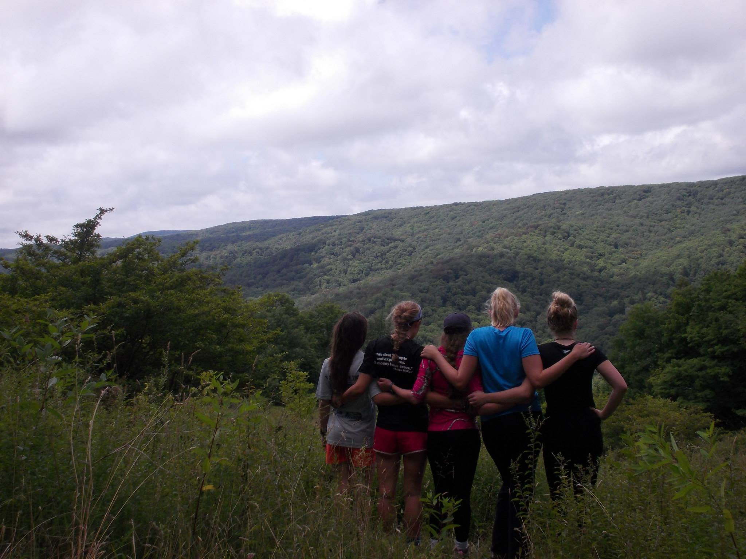
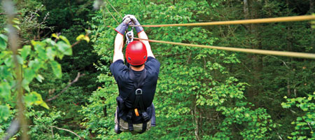
Adventure West Virginia
An alternative to the traditional first-year seminar
Voluntary course enrollment on a first-come, first-serve basis
Length of course varies (average 6-7 days) and cost varies (approx. $400)
In fall 2012, over 600 seats open
Course occurs before beginning of fall semester
Course requires trip completion, paper assignments, classroom attendance, and service project
Notes:
In an effort to increase the percentage of students retained from freshman year to second year, many colleges and universities across the country offer first-year experience courses, also commonly known as first-year seminars. The design of these programs are to assist first-time freshmen in the transition from high school to college life, and offer ways for students to make connections to peers and become familiar with the campus.
At West Virginia University (WVU), a first-year seminar is mandatory for all first-year students and transfer students with less than twenty-nine credit hours. Students have two options to fill this requirement traditional, semester long, classroom course or participation in one of four outdoor orientation trips offered through the Adventure West Virginia (AWV) program.
Students must sign up for these trips, and spots are available on a first come, first serve basis. For example, 600 spots are available for 2014 registration. The length and cost of the trips vary depending on the type of trip the participant chooses. The typical trip spans 6-7 days, with costs ranging from $375-445 per student. Each program includes trip participation, four classroom meetings in the fall, passing grades on three short papers, attendance at one reunion event, and completion of a 3-5 hour service project. WVU trips include; instruction, food, transportation, group gear, lodging, and related activities. Upon successful completion a student receives three hours of course credit. (“Adventure WV”, 2014)

Slide 10
Methodology & research design
Quasi experimental design selected to compare the AWV first-time freshman participants to the entire first-time freshmen population for the years 2004-2012
A logistic binomial regression was used to project probabilities due to the nature of the responses for both dependent variables (retain/not retained or graduate/not graduate)
Probabilities are based off of the regression model results and produce a retention and graduation rate that is not comparable to the traditionally tracked rates.
Notes:
a quasi-experimental design, as it is not possible to rule out alternative explanations for findings based on our population and the variables under research. Creswell-permits strong tests of causal hypotheses testing
Cook and Campbell (1979), using quasi-experimental research- by including a comparison to an appropriate population, first-time freshmen, and inclusion of appropriate control variables strengthen statistical and external validity.
Internal validity threats include- concern that certain types of students may be more likely to participate in AWV, especially since it is first-come, first serve basis. Addressing in the research design whether students who participate have different financial aid needs than those who do not is an important way to look at internal validity threats.
By including a control group and appropriate control variables it is possible to account for interactions between potential self-selection bias and the dependent variables. This permits omitted variables bias, which most certainly exists, possibly overstating the effects of participation in AWV.
The model output from Table 4 was then used to produce 3,072 conditional probabilities. These probabilities produce a prediction for every possible combination of values for the statistically significant variables in the model, while controlling for every other variable in the model. A subset of these conditional probabilities was selected for a probability profile to illustrate the effect of specific variables with a particular focus on the effects of AWV participation

Slide 11
Sample Selection Criteria
All first-time freshman fall 2004-2012, by cohort
Follows federal and state reporting criteria
Tracks first-year retention and graduation within six years
Federal and state financial aid received
A student’s first instance of financial aid is selected
Notes:
The population for this research includes all first time freshmen from fall 2004 - 2012. The data collection for the first-time freshmen cohorts uses the same methodology that WVU uses to track students for federal reporting to the Integrated Postsecondary Education Data System (IPEDS) and the Consortium for Student Retention Data Exchange (CSRDE). The methodology tracks first-time freshmen from their first fall term on file as a cohort of students. The file compiled for this research tracks retention, GPA, and graduation based upon their cohort of entry. Appendix B lists the variables for the first-time freshman student population. Additional variables were created to categorize students based on type of aid received (State vs. Federal). Flagging variables indicate whether a student received financial aid, and if so what type. Once a student’s first term record of financial aid was joined to the student file, additional variables were created that would allow multivariate analyses.
It is important to note that if a student did not receive financial aid during their first term but did receive it in future terms they will not have comparable information. These students remain on the student file but have no financial aid data. The financial aid file picks up a student’s first instance of a financial aid record at census date for these analyses. There are some cases where a student did not receive financial aid in their first year but in a subsequent year, these analyses use only the first instance of financial aid record on file. The financial aid data includes a large group of variables which originate from filing a FAFSA.

Slide 12
Sample Characteristics:
Across FTF cohorts:
  Average age
  18 yrs.
  Average High school GPA
  3.27-3.36
  Average ACT composite
  23-23.5
  Average SAT combines scores
  1038-1070
Across FTF cohorts:
  Average age
  18 yrs.
  Average High School GPA
  3.32 -3.45
  Average ACT Composite
  23.3 – 24.6
  Average SAT Combined Scores 1072 - 1095
Cohort Year | FTF | AWV
2004 | 4,090 | 122
2005 | 4,236 | 207
2006 | 4,330 | 355
2007 | 4,124 | 469
2008 | 4,447 | 542
2009 | 3,879 | 592
2010 | 4,402 | 525
2011 | 4,444 | 506
2012 | 4,609 | 479
Notes:
The average age for all cohorts is eight-teen. Additionally, with the exception of 2008, on average AWV participant cohorts have higher ACT /SAT test scores, and high school GPA’S than non-participants do. This is controlled for in the regression model. After data construction was complete, it was then possible to merge The AWV and FTF datasets. The two dependent variables modeled were: (a.) First-year retention (b.) Graduation within six years. A logistic binomial regression was used to project probabilities due to the nature of the responses for both dependent variables (retain/ not retained or graduate/not graduate).

Slide 13
Variables of interest
Independent Variables
Adventure West Virginia - Participant/non-participant
Gender
Ethnicity
Residency status
First generation student
Adjusted gross income
Expected Family Contribution (EFC)
State aid
Federal aid
Dependent Variables
First-year Retention
Graduation within six years
Notes:
Many of these variables are often among those cited in educational research as important indicators of student engagement and considered of great interest when understanding which variables predict an outcome in college (Tinto, 1999, Murtaugh, Burns, & Schuster, 1999, Sidle & McReynolds 2009).
The independent variables were as follows: Adventure (participant/non-participant), gender, ethnicity, residency, first generation, adjusted gross income, expected family contribution (EFC), state aid, and federal aid. Many of these variables are often among those cited in educational research as important indicators of student engagement and considered of great interest when understanding which variables predict an outcome in college. Receiving State aid based on receiving any of the following types of aid: Vocational Rehabilitation, WV Higher Education Grant, WV Engineering and Science Technology Scholarship,Other WV Scholarships,Promise Scholarship Recipient. Receiving federal aid based on receiving any of the following types of aid:Federal Supplemental Aid,Work Study,Pell Grant Recipient, Direct Subsidized, Loan Direct Unsubsidized Loan, Veterans Benefits, Direct PLUS Loan, Perkins Loan, Other Federal Grants and Scholarships Received. The independent variables of state aid and federal aid are also dummy coded variables, which allow comparison of like-pairs of Adventure students with the general population of freshmen. This purpose serves to create comparisons of groups similar on certain characteristics. The data pulled from WVU financial aid records reflects the census file for financial aid used in official state and federal reporting. Below is a breakdown of each variable (See Appendix C for definitions). ACT, SAT, and AGI ranges are based off the mean.
Ethnicity dummy coded as non-white (0) and white (1)*
Three categories used for EFC based on the distribution of all students;
students whose family can contribute less than $1,000
students whose family can contribute $1,001- $15,000
students whose family can contribute $15,000 or greater
* The majority of the WVU freshman population is white leaving little variance among the other ethnicities to analyze which suggested the dummy coding schema as appropriate.

Slide 14

RETENTION PROFILE

Slide 15
Retention Probability Impact
Overall finding: AWV Participation increased first year retention by 5.4 percentage points on average. Retention increases for specific population subsets were:
    Retention increase by residency status
      Resident — 5.28%
      Non-resident — 5.56%
    Retention increase by gender
      Female — 5.18%
      Male — 5.69%
    Retention increase by Expected Family Contribution (EFC)
      Low EFC (<= $1,000 ) — 6%
      Medium EFC ($1,001 - $15,000) — 5.4%
      High EFC ( > $15,001 ) — 4.7%

Slide 16
Probability Profiles
Variable | Most-At Risk | Highest Probability | Mean Average Probability
Adventure | Non-Participant | Participant | Non-Participant
SAT Average | Below | Above | Above
ACT Average | Below | Above | Below
First Generation | Yes | No | No
State Aid | No | Yes | No
Federal Aid | Yes | No | No
Gender | Male | Female | Male
Ethnicity | Non-White | White | White
Residency | Non-Resident | Resident | Resident
EFC | Low | High | High
AGI | Low | High | High
First-Year Freshman Retention | 61.28% | 96.53% | 85.87%
Notes:
The results revealed that the following variables are statistically significant in the retention model: AWV participation, first generation, state aid, residency, federal aid, EFC, gender, ACT scores and SAT scores. The only variable not found to be significant in the retention model was ethnicity. Statistical significance is a measure of whether an observed effect would have occurred due to chance.
The model output was used to produce 3,072 conditional probabilities. These probabilities produce a prediction for every possible combination of values for the statistically significant variables in the model, controlling for every other variable in the model. Three probability profiles have been chosen based on the aforementioned conditional probabilities, which correspond to the lowest observed probability (most at risk) of first year retention, the highest observed probability, and the mean average observed probability.

Slide 17
Conclusions-Retention
Overall, AWV improves the probability of retention by 5.4 percentage points on average
AWV participant’s underlying affluence may have a causal relationship with retention and graduation.
  Investigating students with low, medium, and high levels of EFC controls for this possible conflating of factors.
Notes:
The possibility exists that participation in AWV may be reflective of a student’s affluence and thus AWV participation effects conflate with the multitude of factors that underlay affluence. This may have a causal relationship with retention and graduation.
However, investigating students with low, medium, and high levels of EFC controls for this possibility.
As expected, students with high EFC are 5.2% more likely retained than students with low EFC.
Nevertheless, students with low EFC that participate are 6.15% more likely retained than students with low EFC that do not participate in AWV.
The increases in likelihood of retention for medium and high EFC are 5.4% and 4.71% respectively.
The retention probability of a student who participates in AWV is 5.4% greater than that of students that do not participate, after controlling for the other variables in the retention model.
Non-residents that participate have a 5.56% greater likelihood of retention than non-residents that do not participate in AWV.
Residents that participate have a 5.28% greater likelihood of retention than residents that do not participate in AWV.
Females that participate have a 5.18% greater likelihood of retention than females that do not participate in AWV. Males that participate have a 5.69% greater likelihood of retention than males that do not participate in AWV.
In short, participants in AWV are over 5% more likely to achieve first year retention regardless of residency status or gender.

Slide 18
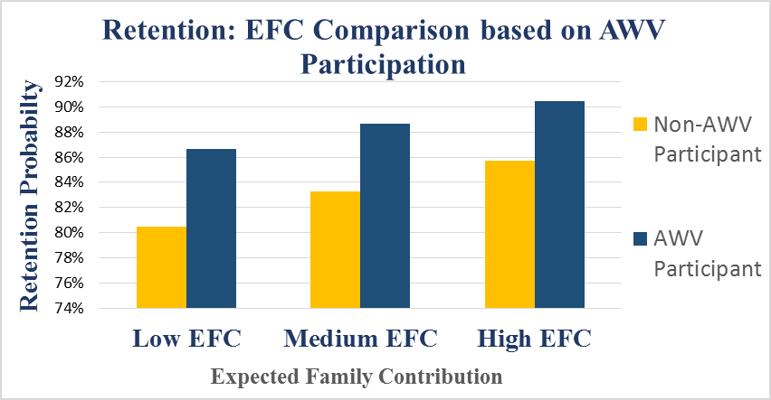
Impact of EFC on Retention
As EFC increases, the impact of AWV participation decreases for retention to year one
Notes:
Students with high EFC are 5.2% more likely retained than students with low EFC.
AWV participants with low EFC are 6.15% more likely retained than students with low EFC that do not participate in AWV.
The increase in likelihood of retention for medium and high EFC are 5.4% and 4.71% respectively.

Slide 19
GRADUATION PROFILE
LESS
LIKELY

Slide 20
GRADUATION PROBABILITIES
Overall finding: AWV Participation increased graduation within six years by 6.53 percentage points on average. Graduation rate increases for specific population subset were:
    Graduation rate increase by residency for AWV participants
      Resident — 6.81%
      Non-Resident — 6.26%
    Gender for AWV participants
      Female — 6.09%
      Male — 6.99%
    Expected Family Contribution for AWV participants
      Low EFC (<= $1,000 ) — 7%
      Medium EFC ($1,001- $15,000) — 6.5%
      High EFC ( > $15,001 ) — 6%

Slide 21
Six-Year Graduation Probabilities
Variables | Most-At Risk | Highest Probably | Mean Average Probability
Adventure | Non-Participant | Participant | Participant
SAT Average | Below | Above | Above
ACT Average | Below | Above | Below
First Generation | Yes | No | No
State Aid | No | Yes | No
Federal Aid | Yes | No | No
Gender | Male | Female | Female
Ethnicity | Other | White | Other
Residency | Resident | Non-Resident | Resident
EFC | Low | High | Medium
AGI | Low | High | Low
Six Year Graduation | 26.73% | 94.00% | 69.03%
Notes:
The logisitic regression model was was also used to predict the probability of graduation within six years. The cohort years for the first-time freshmen have been limited to Fall 2004-2007, which allows for tracking of six-year graduation. The model results revealed that all variables are statistically significant: Adventure, first generation, state aid, residency, federal aid, EFC, gender, ACT scores and SAT scores, and ethnicity. Statistical significance is a measure of whether an observed effect would have occurred due to chance. Once again, the model output was used to produce 3,072 conditional probabilities.
Table 6 presents three different probability profiles, based on the aforementioned conditional probabilities, which correspond to the lowest observed probability (most at risk) of graduation within six years, the highest observed probability of graduation within six years, and the mean average observed probability of graduation within six years.

Slide 22
Conclusions-Graduation
The probability of a student who participates in AWV graduating within six years is 6.53% greater than that of students that do not participate
The possible effects of affluence on graduation is controlled for by examining low, medium, and high EFC levels for both participants and non-participants in AWV.
Notes:
AWV participation
Significantly increases the probability of retention and graduation outcomes.
Compared to students with the lowest probability (most at risk) of retention (61%), students with similar characteristics had a retention probability that was 10 percentage points higher (an increase of 16%).
Compared to students with the lowest probability (most at risk) of graduating within six years (27%), students with similar characteristics had a six year graduation probability that was 7 percentage points higher, an increase of 26%.
The possible effects of affluence on graduation is controlled for by separately examining low, medium, and high EFC levels for both participants and non-participants in AWV.
Students with high EFC are 7.76% more likely to graduate in six years than students with low EFC.
Students with low EFC that participate are 6.95% more likely to graduate in six years than students with low EFC that do not participate in AWV.
Students with high EFC are 6.1% more likely to graduate in six years than students with high EFC that do not participate in AWV.
Participation in AWV increases the probability of graduating in six years across low, medium, and high levels of EFC but with decreasing marginal effects. Though the decrease in marginal effects is not as great as retention.
Students with medium EFC that participate are 6.56% more likely to graduate in six years than students with medium EFC that do not participate in AWV.

Slide 23
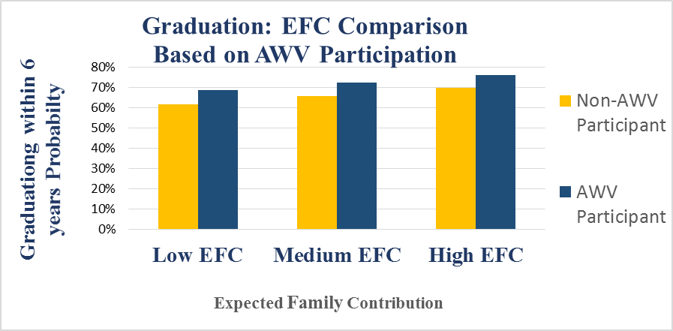
IMPACT OF EFC ON SIX YEAR GRADUATION OUTCOMES
As EFC increases, the impact for AWV participation decreases for graduating within six years
Notes:
Research findings suggest a larger impact of student first-year experiences for low EFC students allowing them to achieve student success similar to more financially advantaged peers.
Students who have high EFC are already more likely to succeed, so the AWV program does not have as large of an effect as it does on those students with low EFC. Students with high EFC are 7.76% more likely to graduate in six years than students with low EFC.
AWV participants with low EFC are 6.95% more likely to graduate in six years than students with low EFC that do not participate in AWV.
Students with high EFC are 6.1% more likely to graduate in six years than students with high EFC that do not participate in AWV.
Participation in AWV increases the probability of graduating in six years across low, medium, and high levels of EFC but with decreasing marginal effects.

Slide 24

Financial Impact

Slide 25
Financial Impact of One Year Additional Retention as a Result of AWV Participation
The following two tables express the estimated revenue gain associated with the increase in retention found to be associated with AWV participation.
For both resident and non-resident students the percentage of students retained was higher for AWV participants across all years in the study (AY 2004-2012).

Slide 26
Retention Probabilities of students by awv status
The total estimated additional revenue associated with a one-year increase in retention as a result of AWV participation for AY 2004-2013 is $3,902,680

Slide 27
graduation rate for all FTF based on participation in AWV
Within the Fall 2006 cohort, the overall graduation rate was 56.2%. If 60 fewer students had graduated (which is the number attributable to AWV participation), the graduation rate would have been 54.9%

Slide 28
Study Limitations
Although the data suggest that expansion of the AWV would have positive results on both retention and graduation rates, the actual costs associated with administering the program were not studied here
Therefore no conclusions about the cost effectiveness of expanding the program can be made from this study.

Slide 29
Future Research Initiative
Findings suggest important implications for improving future student success by utilization of at-risk intervention programs.
Research Implications
Provide a mechanism by which to evaluate other at-risk intervention programs at the university.
Replicate Method
EFC may play a key in understanding the relationship between transition to college & pre-college socialization experiences.
Expand Research

Slide 30
Benefits of Building a student Success tracking profile
Replication of a model
Reproduction of probability profiles
Creation of probability tables
Inclusion of financial information
Notes:
Future Research Initiatives
Findings suggest important implications for improving future student success by utilization of at-risk intervention programs.
Provide a mechanism by which to evaluate other at-risk intervention programs, such as the Mountaineer Success Academy, at the university.
Expected Family Contribution (EFC) may play a key in understanding the relationship between student transition to college and pre-college socialization experiences.
Replication of a model to other intervention programs offers consistent and reliable information.
Reproduce the same probability profiles to predict retention and graduation probabilities.
Create probability tables of students with certain characteristics and the likelihood of retention and/or graduation.
Produce profile tables with the probabilities for lowest, highest, and the average case student.
Using this model provides an advantage over many models often seen in literature because it can predict student success.
Inclusion of financial information offers a more comprehensive Student Tracking Profile.
Replication of a model to other intervention programs to offer consistent and reliable information to serve as a predictor for student success in college.
Reproduce the same probability profiles used in this research for future freshmen cohorts to predict retention and graduation rates.
Create probability tables of students with certain characteristics and the likelihood of year-one retention or graduation within six years.
Produce profile tables (one for retention and one for graduation) with the probabilities for lowest, highest, and the average case student.
Provides an advantage over many models often seen in literature as profiles can be used for predicting student success.
Inclusion of financial information with student success characteristics offers a more comprehensive Student Tracking Profile
Prepare a Student Success Tracking Profile going forward from the fall 2013 cohort for any intervention program of interest.

Slide 31


Questions
Contact:
Office of Institutional Research,
West Virginia University
(304) 293-4245
Jessica Michael,
Institutional Research Analyst, JMMichael@mail.wvu.edu
Vicky Morris-Dueer,
Senior Institutional Research Associate, vjmorrisdueer@mail.wvu.edu

