Slide 1
How to Use AI Effectively for Literature Reviews
K-State AI Consulting Service
July 14, 2026

Slide 2

Today’s Presenter
Jason Coleman
Professor & Science Librarian
Co-director, K-State AI Consultation Service
coleman@ksu.edu
Schedule an appointment with me:
https://jasoncoleman.youcanbook.me/
Notes:
My name is Jason Coleman. I am a professor and STEM Librarian at Hale Library. I am one of the directors of K-State’s AI Consulting Service. I’m happy to answer questions by email, but if you have many questions or if some are complex, it is best to meet with me one-on-one. You can make an appointment with my by visiting jasoncoleman.youcanbook.me

Slide 3
K-State AI Consulting Service
One-Year Pilot
Launched May 11, 2026
Sponsored by four K-State entities:
Center for AI and Data Science
College of Engineering
Institute for Digital Agriculture and Advanced Analytics (ID3A)
K-State Libraries
Current Strengths
Guidance on practical and responsible AI use
Technical AI integration into research processes
Assistance using open-source AI tools
Large referral network
Sharing knowledge through discussions, webinars, and tutorials.
Visit the website at https://www.k-state.edu/ai-consultation/

Slide 4
Goals for Today’s Webinar
1
Describe the current array of tools for literature reviews.
4
Draw your attention to important weaknesses of even the best tools.
2
Identify the key questions you should be asking when you select and use a tool for searching and exploring academic literature.
5
Give advice about how to compensate for those weaknesses.
3
Provide tips about how to communicate with these tools effectively.
6
Q&A

Slide 5
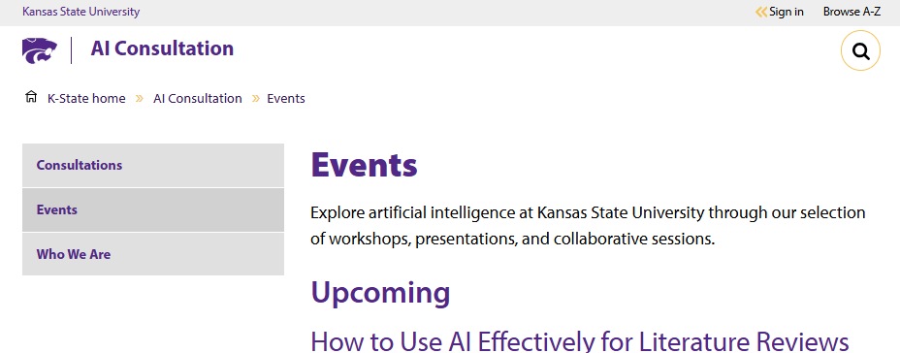
Housekeeping
1
Use chat to ask questions at any time.
Events Page
Access presentation slides, session recordings, and upcoming workshops directly on our events site.
2
During Q&A, raise your hand to be called on.
3
We will post slides and a recording on the events page of KAICS’ website:
Visit the website at https://www.k-state.edu/ai-consultation/events.html

Slide 6
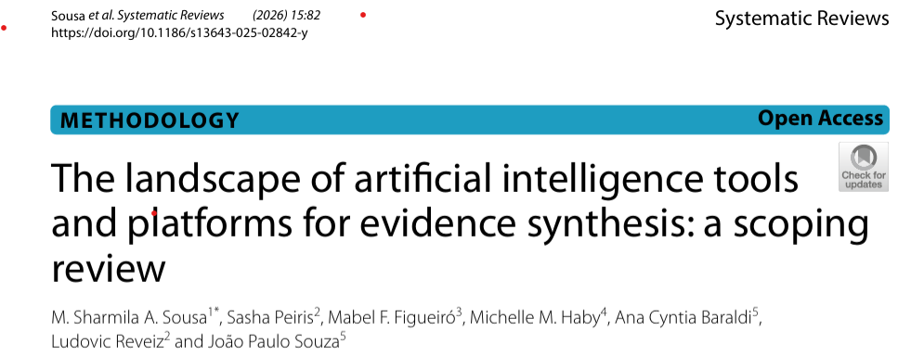
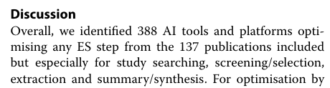
AI Tools for Literature Reviews: Observations
The number of AI tools is vast. A recent systematic review identified 388 optimized for evidence synthesis.
Source: Sousa, M. S. A., Peiris, S., Figueiró, M. F., Haby, M. M., Baraldi, A. C., Reveiz, L., & Souza, J. P. (2026). The landscape of artificial intelligence tools and platforms for evidence synthesis: A scoping review. Systematic Reviews, 15(1), 82. https://doi.org/10.1186/s13643-025-02842-y

Slide 7
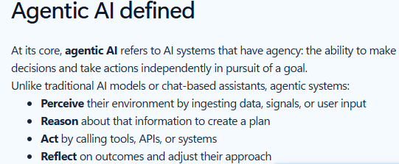
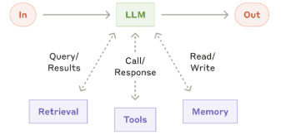
AI Tools for Literature Reviews: Observations
2. The tools are becoming agentic.
Sources: Left: What is Agentic AI? Microsoft. Retrieved July 13, 2026, from https://www.microsoft.com/en-us/software-development-companies/resources/articles/what-is-agentic-ai
Right: Building Effective AI Agents. (n.d.). Retrieved July 13, 2026, from https://www.anthropic.com/engineering/building-effective-agents

Slide 8
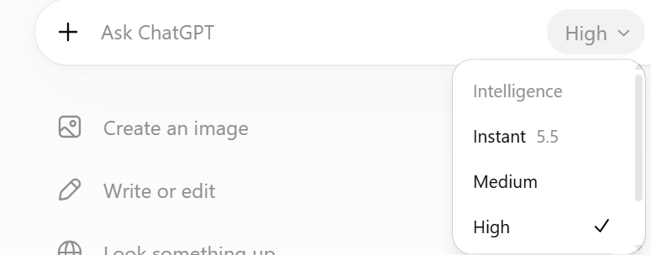
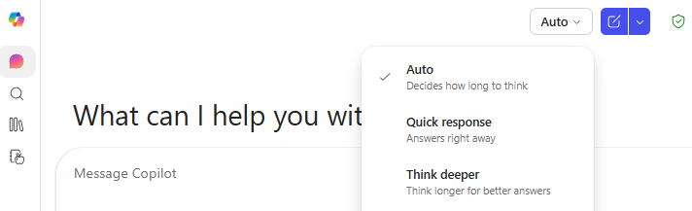
AI Tools for Literature Reviews: Observations
3. You can often toggle the level of effort (and energy) the tool will use.
ChatGPT
Microsoft 365 Copilot Chat

Slide 9
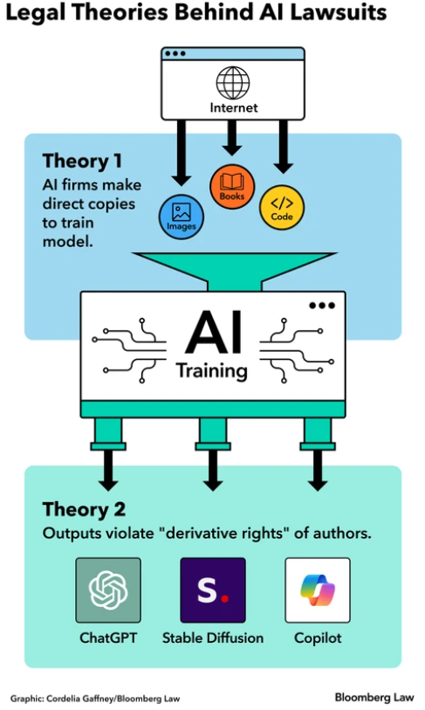

AI Tools for Literature Reviews: Observations
4. Most use Large Language Models (LLMs) trained on copyrighted work.
Sources: Left: Poritz, I. (2023, December 18). AI’s billion-dollar copyright battle starts with a font designer. https://news.bloomberglaw.com/ip-law/ais-billion-dollar-copyright-battle-starts-with-a-font-designer
Right: Authors go to Washington: The Authors Guild takes the AI copyright fight to Capitol Hill. (n.d.). The Authors Guild. Retrieved July 13, 2026, from https://authorsguild.org/news/authors-go-to-washington-capitol-hill/

Slide 10
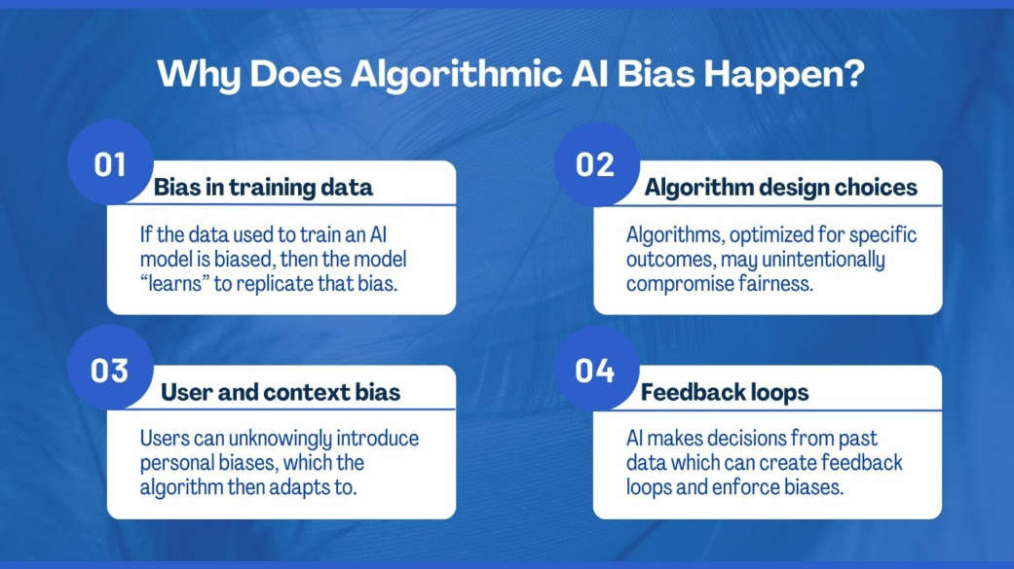
AI Tools for Literature Reviews: Observations
5. They reproduce biases from training, design, prompts, and context .
Source: Dobrilova, T. (2025, January 28). Identifying algorithmic AI bias. Expert Allies. https://expertallies.com/identifying-algorithmic-ai-bias/

Slide 11
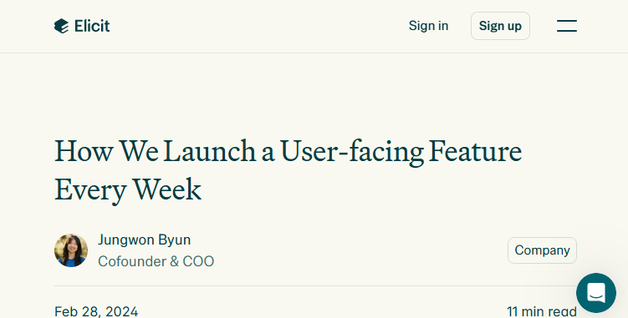
AI Tools for Literature Reviews: Observations
6. They change very frequently - on the order of weekly
Source: Byun, J. How we launch a user-facing feature every week. (2024, February 28). https://elicit.com/blog/launching-a-feature-every-week

Slide 12















































AI Tools for Literature Reviews

Slide 13


AI Tools for Literature Reviews: Categories
Commercial Frontier Chatbots
Examples
Academic AI Source Finders
Examples
Citation Network Mappers
Examples
Grounded Source Interrogators
Examples

Slide 14
Commercial Frontier Chatbots
Description
Enormous
Extensive post-training
Long-term memory
Multiple modes
  Deep research
Invoke tools
  Search open web
  “Reason”
  Write and run code
  Create images
Research Use Cases
Brainstorm
Critique
Explore
Explain
Find sources
Summarize
Synthesize
Translate

Slide 15
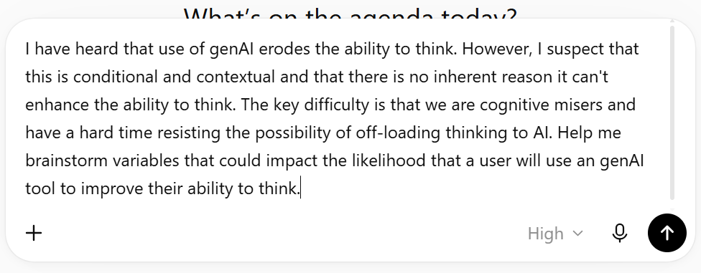
Commercial Frontier Chatbots
Example: Brainstorming
Tool: ChatGPT at high effort with GPT 5.6 sol
Strategy: I recommend prompting in a way that will not invoke searching - i.e., avoid suggesting that you want to know what others think.

Slide 16
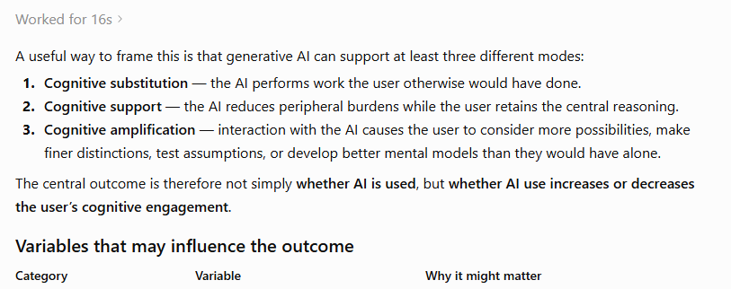
Commercial Frontier Chatbots
Example: Brainstorming
Example: ChatGPT at high effort with GPT 5.6 sol
Full transcript at https://chatgpt.com/share/6a5533d1-9a34-83ea-8988-6580213b3028

Slide 17
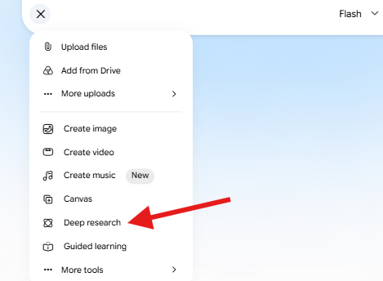
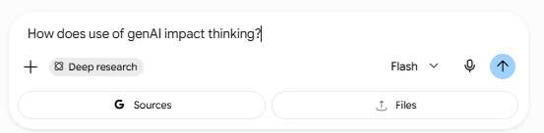
Commercial Frontier Chatbots
Example: Explore a Topic
Tool: Gemini 3.5 Flash in Deep Research mode
Strategy: Ask a broad, open-ended question that doesn’t predispose the tool toward a particular answer.

Slide 18
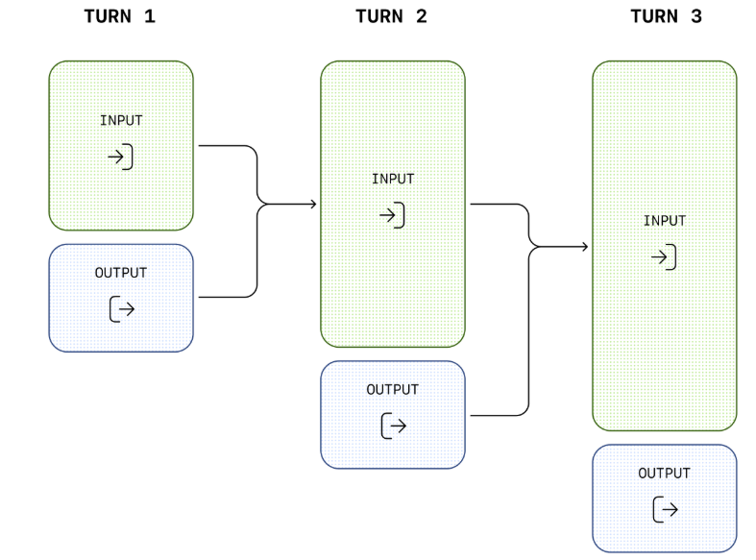
What is “reasoning” to an LLM?
“Reasoning” in the context of GenAI is the process of generating and evaluating intermediate steps to arrive at an answer.
Source: Reasoning models. (n.d.). Retrieved July 14, 2026, from https://developers.openai.com/api/docs/guides/reasoning

Slide 19
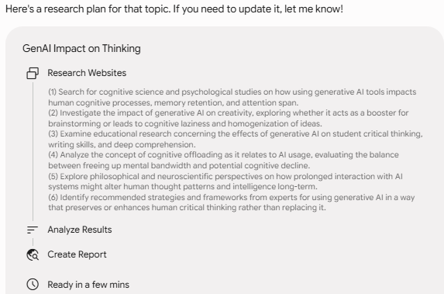
Commercial Frontier Chatbots
Example: Explore a Topic
The plan developed through “reasoning”

Slide 20
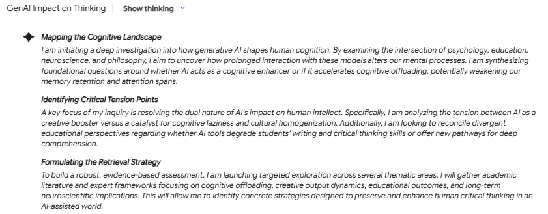
Commercial Frontier Chatbots
Example: Explore a Topic
“Reasoning” in action. The text is a summary of the models “reasoning tokens”
Read report at https://share.gemini.google/mNlipRFusyx1

Slide 21
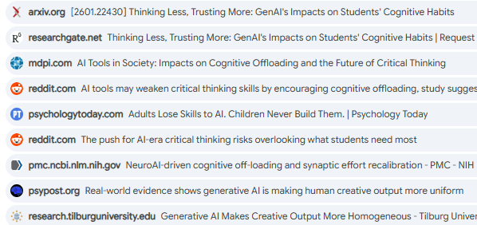
Commercial Frontier Chatbots
Example: Explore a Topic
Some of the sources used to craft the report. Notice the mix of academic and non-academic sources
Read report at https://share.gemini.google/mNlipRFusyx1

Slide 22
Commercial Frontier Chatbots
Example: Explore a Topic
Gemini uses “reasoning” and Retrieval Augmented Generation (RAG) to develop a report:
“Reasoning” passes a query (or set of queries) to a search tool
The tool identifies and ranks several snippets of information
The snippets are passed to the LLM as additional context
The LLM generates an answer by summarizing and organizing the content of the snippets
Find the report at https://share.gemini.google/mNlipRFusyx1

Slide 23
Academic AI Source Finders
Description
Use RAG and “reasoning”
Use data from large OA metadata databases and sometimes from commercial publishers
Some use full-text
Most show a generated overview/synthesis
Some provide ways to filter results
Research Use Cases
Find key terms
Find major topics
Discover relevant papers
Focus a research topic

Slide 24
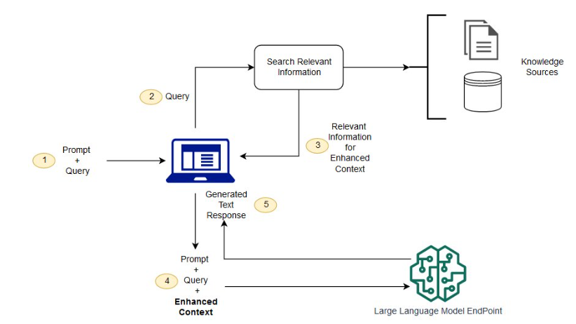
What is RAG?
Source: What is RAG? - Retrieval-augmented generation AI explained.. (n.d.). Amazon Web Services, Inc. Retrieved July 14, 2026, from https://aws.amazon.com/what-is/retrieval-augmented-generation/

Slide 25
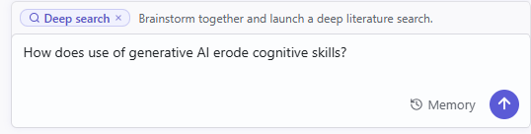
Academic AI Source Finders
Example: Focus a Topic
Tool: Undermind
Step 1: Enter a research question

Slide 26
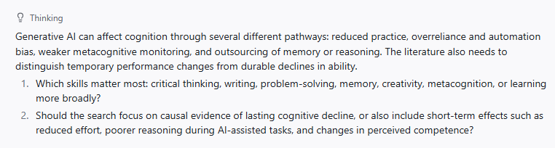
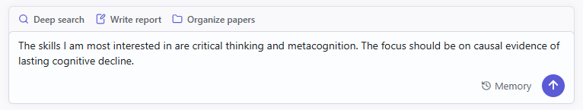
Academic AI Source Finders
Example: Focus a Topic
Step 2: Answer Undermind’s Questions

Slide 27
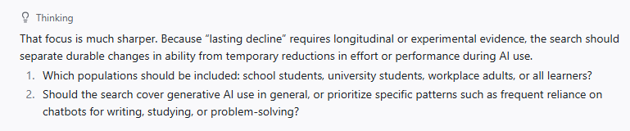
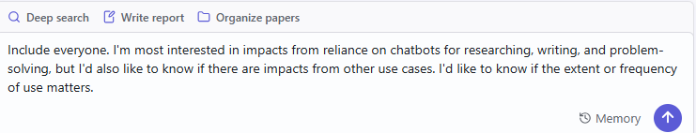
Academic AI Source Finders
Example: Focus a Topic
Step 3: Answer the next set of questions

Slide 28
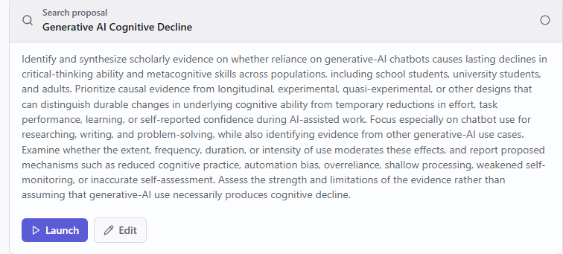
Academic AI Source Finders
Example: Focus a Topic
Step 4: Review and edit Undermind’s proposed research question.
See results: https://ksuemailprod-my.sharepoint.com/:w:/g/personal/coleman_ksu_edu/IQCYAqpW9s5CQaLkwv4rdz52Ac7xF03rDs26x6U5Z4Cd-Do?e=cBxP5w

Slide 29
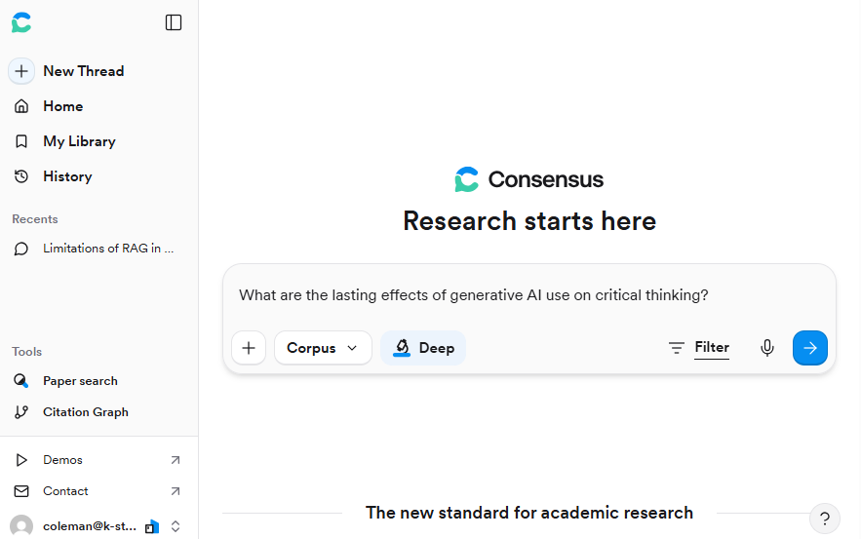
Academic AI Source Finders
Example: Find relevant sources
Tool: Consensus using Deep search mode

Slide 30
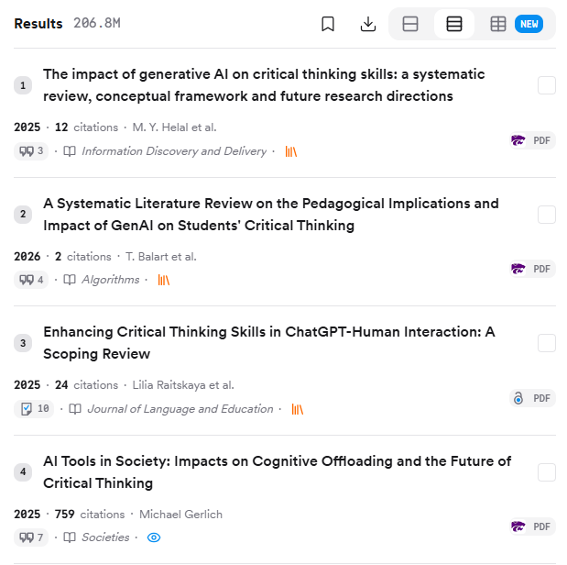
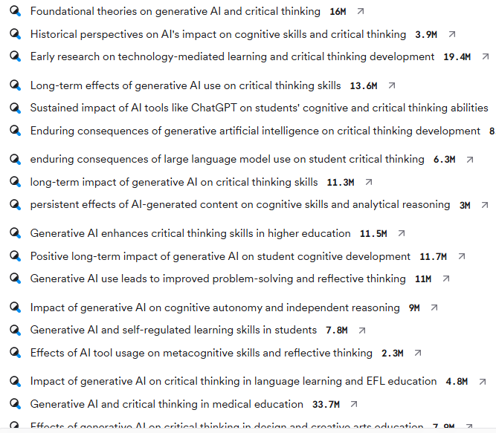
Academic AI Source Finders
Example: Find relevant sources
Runs several searches in parallel
Read results at https://consensus.app/search/generative-ai-impact-critical-thinking/_TIpxB9qROCZ84cZ3czQzQ/

Slide 31
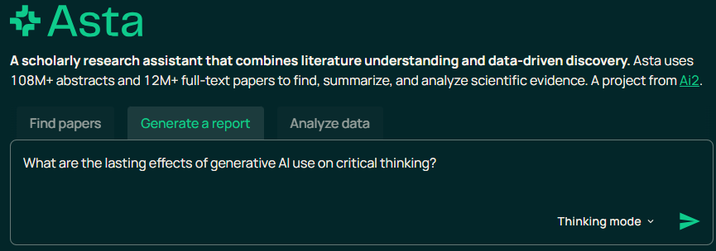
Academic AI Source Finders
Example: Evidence Synthesis
Tool: Ai2 Asta in “Generate a Report” mode
(No Account Required)
Read results at https://consensus.app/search/generative-ai-impact-critical-thinking/_TIpxB9qROCZ84cZ3czQzQ/

Slide 32
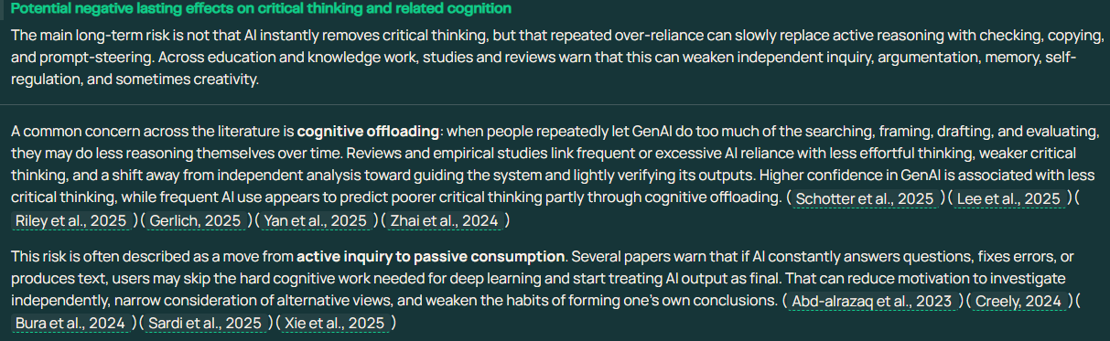
Academic AI Source Finders
Example: Evidence Synthesis
Citations are all real
Read results at https://consensus.app/search/generative-ai-impact-critical-thinking/_TIpxB9qROCZ84cZ3czQzQ/

Slide 33
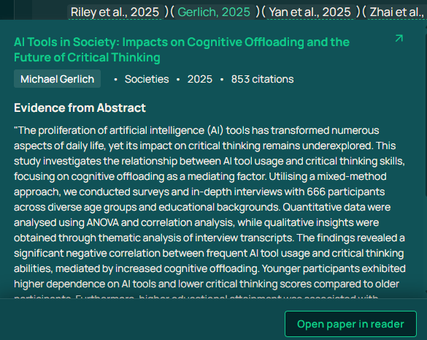
Academic AI Source Finders
Example: Evidence Synthesis
Click a citation to view details and the evidence Asta extracted from the paper
Read results at https://consensus.app/search/generative-ai-impact-critical-thinking/_TIpxB9qROCZ84cZ3czQzQ/

Slide 34
Citation Network Mappers
Description
Use data from large OA metadata databases, e.g., OpenAlex, CrossRef
Not primarily LLM-based
User identifies “seed papers”
Tool creates citation network and ranks by similarity
Research Use Cases
Identify key background papers
Identify popular current papers
Identify researchers
Find similar research from other fields

Slide 35
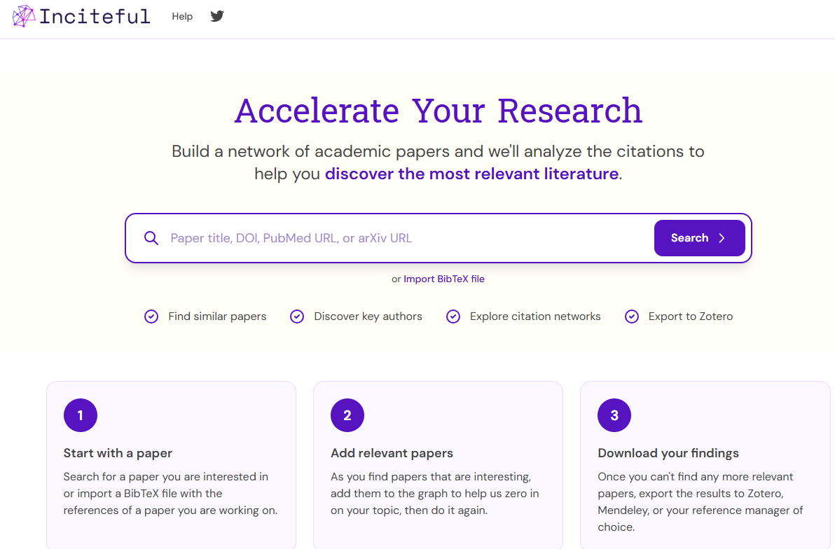
Citation Network Mappers
Example: Identify Key Background Papers
Tool: Inciteful
(No Account Required)
Step 1: Input titles of “seed papers.”
Should be topically similar
Ideally, use at least 4 papers
Ideally, use papers with many references and citations
url for inciteful: https://incitefulmed.com/academic/

Slide 36
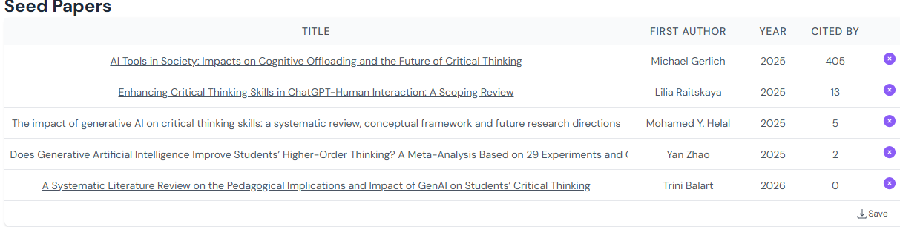
Citation Network Mappers
Example: Identify Key Background Papers
Chart of my “seed papers”
url for Inciteful: https://incitefulmed.com/academic/

Slide 37
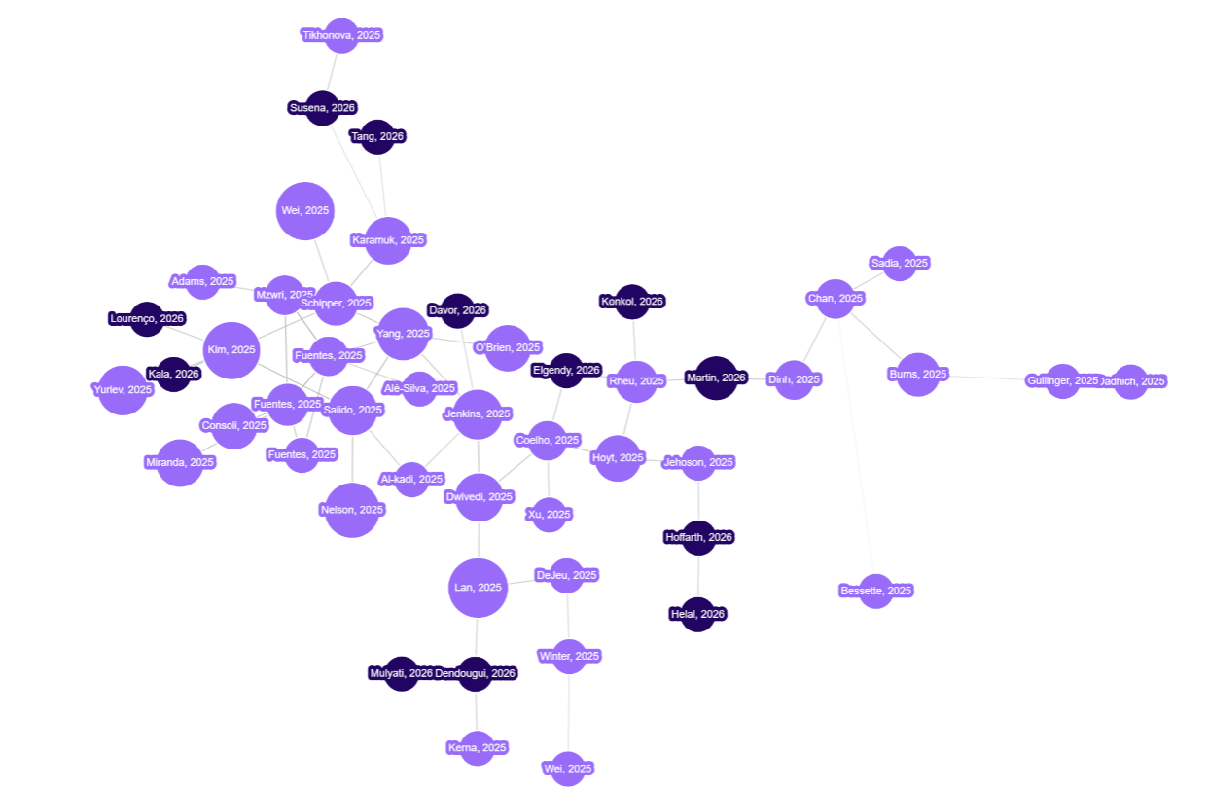
Citation Network Mappers
Example: Identify Key Background Papers
https://incitefulmed.com/academic/

Slide 38
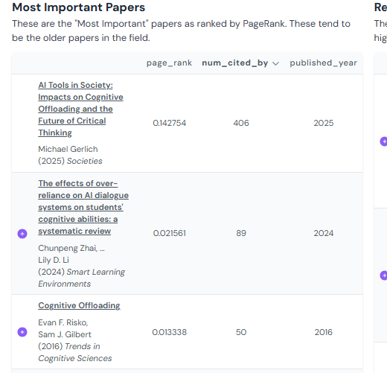
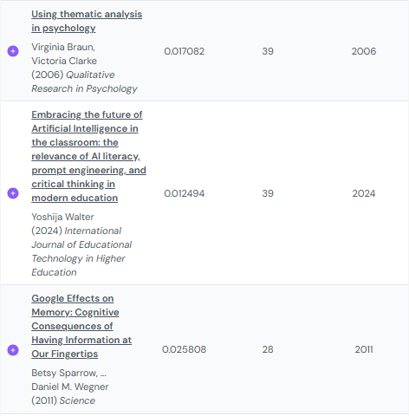
Citation Network Mappers
Example: Identify Key Background Papers
https://incitefulmed.com/academic/

Slide 39
What Do We Need to Know to Use These Tools Effectively?
Some of what we need to know:
How our query is interpreted
What is being searched
What information from the sources is used
How is information assessed
Which information is selected to form a textual synthesis
The balance between the influences of retrieved information and information encoded in the LLMs neural network.
How that information is combined
The extent to which the cited sources actually say what the tool claims they say
How results are ranked

Slide 40

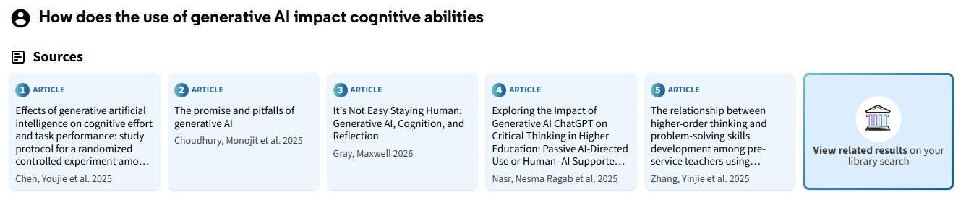
How is our Query Interpreted?
Option 1: Keyword Expansion
Click “View related results” and you will see that the query was converted into an elaborate keyword expression

Slide 41
How is our Query Interpreted?
(generative AI impact on cognitive abilities) OR (effects of generative artificial intelligence on cognition) OR ((cognitive abilities) AND (generative AI)) OR ((generative AI) OR (artificial intelligence cognitive effects)) OR (influence of generative AI on human cognitive functions) OR (("generative AI") AND ("cognitive abilities")) OR (generative artificial intelligence impact cognition) OR (("AI-generated content") AND (cognitive performance)) OR ((machine learning) OR (generative models AND cognitive function)) OR (effects of generative AI on human cognition) OR (How does the use of generative AI impact cognitive abilities)

Slide 42
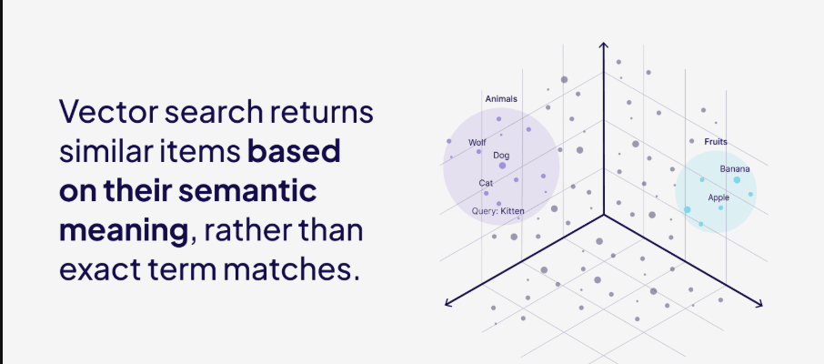
How is our Query Interpreted?
Option 2: Vector search based on semantic embeddings
Source: https://weaviate.io/blog/vector-search-explained

Slide 43
How is our Query Interpreted?
Option 2: Vector search based on semantic embeddings
Query:
“The impact of prehabilitation on patient empowerment and stress reduction in individuals awaiting orthopaedic surgeries.”
The concept of stress reduction in the query matches the following terms in the results: anxiety, depression, psychological well-being
The concept of patient empowerment in the query matches the following terms in the results: self-efficacy, confidence, control, active involvement
The concept of prehabilitation in the query matches the following terms in the results: pre-operative education, psychoeducation, pre-admission education
The concept of Orthopaedic surgery in the query matches the following terms in the results: knee arthroplasty, hip replacement, joint replacement, musculoskeletal trauma
Source: Hunter, R., Booth, A., & Wood, L. (2026). Searching smarter, not harder: Leveraging AI to enhance literature searches for theory-driven reviews—A methodological case study. BMC Medical Research Methodology, 26(1), 82. https://doi.org/10.1186/s12874-026-02814-3

Slide 44
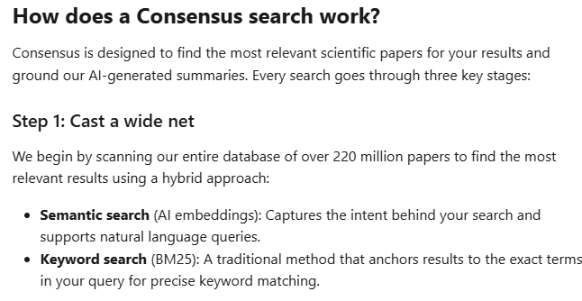
How is our Query Interpreted?
Option 3: Keyword + Vector Search
Source: https://help.consensus.app/en/articles/9922673-how-consensus-works

Slide 45
How is our Query Interpreted?
Practical Implications
If the tool uses vector search without strong “reasoning,” it can get confused by queries containing multiple sentences. If the tool answers quickly, suspect limited reasoning and divide your research into several discrete and simple questions.
If the tool uses keyword expansion, use a powerful LLM first to find terms most relevant to the topic.
If the tool uses vector search, take the time to carefully craft your query to make sure it captures your intended meaning.
If the tool uses both methods, combine 2 & 3.
Source: https://help.consensus.app/en/articles/9922673-how-consensus-works

Slide 46
What is being searched?
Key considerations:
Most Academic AI Source Finders are heavily slanted toward STEM topics because their information sources don’t include many books or book chapters.
Some publishers are pulling abstracts from OpenAlex and Semantic Scholar.
Some tools leverage OA full-text, but it isn’t always clear what parts are used.

Slide 47
Do the cited sources actually say what the tool claims they say?
Onweller et al. (2026)
Used 14 different deep research agents
Tested accuracy of claims using validated LLM judge
Source: Onweller, H., Lumer, E., Huber, A., Ramchandani, P., Subbiah, V. K., & Feld, C. (2026). Cited but Not Verified: Parsing and Evaluating Source Attribution in LLM Deep Research Agents (arXiv:2605.06635). arXiv. https://doi.org/10.48550/arXiv.2605.06635

Slide 48
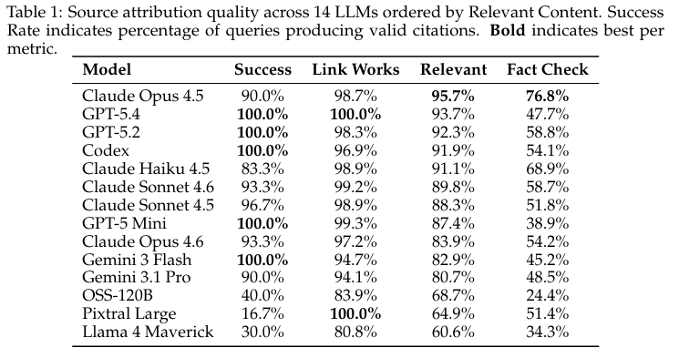
Do the cited sources actually say what the tool claims they say?
Onweller, H., Lumer, E., Huber, A., Ramchandani, P., Subbiah, V. K., & Feld, C. (2026). Cited but Not Verified: Parsing and Evaluating Source Attribution in LLM Deep Research Agents (arXiv:2605.06635). arXiv. https://doi.org/10.48550/arXiv.2605.06635

Slide 49
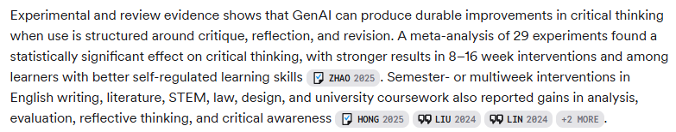
Do the cited sources actually say what the tool claims they say?
Clustered citations for passages with multiple claims misrepresent degree of consensus.
Example from Consensus report:
See full report https://consensus.app/search/generative-ai-impact-critical-thinking/_TIpxB9qROCZ84cZ3czQzQ/?utm_source=share&utm_medium=clipboard

Slide 50
Do the cited sources actually say what the tool claims they say?
Implications for effective use:
Some tools will respond to instructions such as “do not cluster claims.” It is worth a try.
Present a frontier model with the complex claim and the cited sources and ask it to assess whether it is valid to suggest that each source supports all the claims.
Carefully analyze the cited documents to determine if they support the attributed claims.
If you are examining OA articles, upload the articles to a tool trained to provide granular citations (e.g., NotebookLM) and ask it to provide a synthesis.

Slide 51
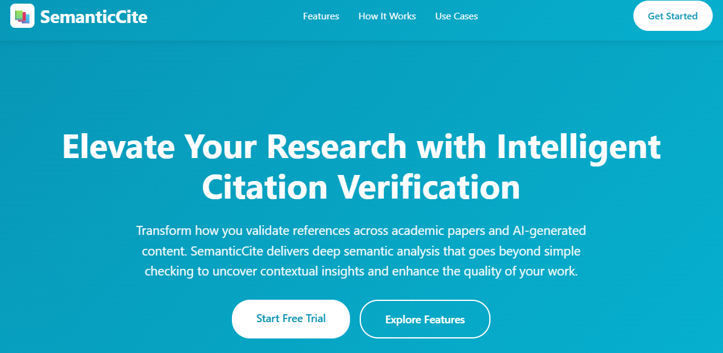
Tips for checking validity of claims made by AI tools
Use other AI tools trained to check citation accuracy
Source: https://semanticcite.com/

