Slide 1
The Kronos In Touch® Terminal Employee Training

Slide 2
What is the Kronos InTouch Terminal?
The terminal is like an Automated Teller Machine (ATM). It helps you:
Get the information that you need, when you need it
View and manage your own information, including
Request time off
View and approve timecard
View accrual balances
View current and future schedules
Cancel meal deductions
English
Español
Français
Add Punch
View Accruals
Delete Punch
View Schedules
Cancel Meal Deduction
View Timecard
Review Punches
Approve Timecard

Slide 3
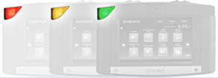
How to use the terminal
Indicator Lights Green indicates that the terminal successfully read a badge
Red indicates that the terminal did not successfully read a badge
Yellow indicates that the terminal is receiving power
Badge Slot/Proximity Reader May be a bar code, magnetic stripe, or proximity reader
English
Español
Français
Soft Keys Press soft keys to perform transactions such as labor transfers
Add Punch
View Accruals
Delete Punch
View Schedules
Cancel Meal Deduction
View Timecard
Navigation Keys Use these like cursor keys to move within fields and menus on the display
Review Punches
Approve Timecard

Slide 4
How to swipe a badge
Our terminal uses badges with a bar code or magnetic stripe:
Hold the badge so that the bar code or magnetic stripe is facing the badge reader
Swipe the badge through the reader from top to bottom
If the punch is successful, the terminal emits a tone and the indicator light flashes green
English
Español
Français
Add Punch
View Accruals
Delete Punch
View Schedules
Cancel Meal Deduction
View Timecard
Review Punches
Approve Timecard

Slide 5
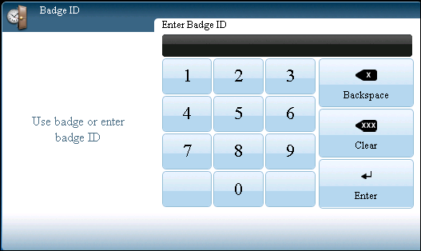
How to enter a personal identification number on a numeric keypad
If you will enter an ID (Wildcat ID, this starts with the number 8) instead of using a badge:
English
Español
Français
Punch
Review Punches
View Schedule
Press the keypad icon to access the Badge ID screen.
Enter the ID.
Press Enter.

Slide 6
Navigating the Kronos InTouch Terminal

Slide 7
Support for multiple languages
You can use the terminal in the language of your choice
English
Español
Français
Add Punch
Remove Punch
Cancel Meal
Review Punches
View Timecard
View Accruals
View Schedule
Approve Timecard

Slide 8
Support for multiple languages
To select a soft key, press the corresponding icon
English
Español
Français
Add Punch
Remove Punch
Cancel Meal
Review Punches
View Timecard
View Accruals
View Schedule
Approve Timecard

Slide 9
Support for multiple languages
Use the left and right arrows to access multiple pages
The indicator on the bottom lets you know how many pages are available, and what page you are currently viewing
English
Español
Français
Add Punch
Remove Punch
Cancel Meal
Review Punches
View Timecard
View Accruals
View Schedule
Approve Timecard

Slide 10
Reviewing company messages
Your organization may display important messages in the Messages area
English
Español
Français
Add Punch
Remove Punch
Cancel Meal
Review Punches
View Timecard
View Accruals
View Schedule
Approve Timecard
Welcome to Kronos!

Slide 11
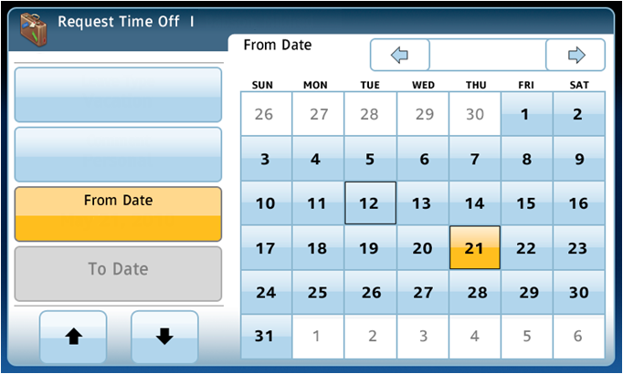
Accessing tasks
Tasks with multiple steps will have steps listed
Tasks with multiple steps may have up and down arrows
Babson, Mildred
May 2014
Leave Type Vacation
Steps
Comment
Personal
May 21, 2014
Step UP/DOWN

Slide 12
Reviewing the terminal status icons
There are various icons that identify the status of the terminal
English
Español
Français
Operating on
Battery Backup
Low Disk Space
Add Punch
Remove Punch
Cancel Meal
Review Punches
Global Home
Override
Network
Communication
Error
View Timecard
View Accruals
View Schedule
Approve Timecard
Global non-Home
Override
System
Maintenance
Required
Welcome to Kronos!

Slide 13
Using the Soft Keys

Slide 14
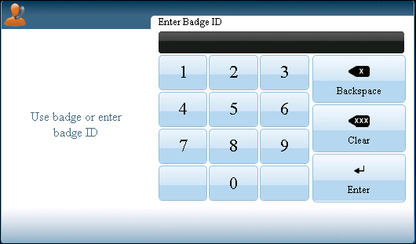
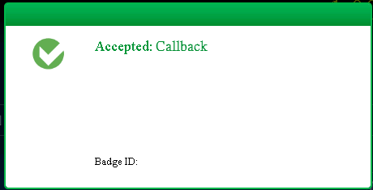
Call Back(Stand by)
Press the Call Back soft key.
Swipe your badge or enter your Wildcat ID.
Press ENTER.
The terminal responds with a message.
English
Español
Français
Callback
Transfer with Comment
Cancel Meal
Request Time Off
View Timecard
View Accruals
Justify
Missing Time
Approve Timecard
Callback
1
Fri Jan-13-2014, 1:00 PM

Slide 15
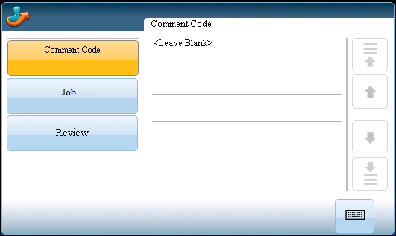
Transfer with Comment (typically students)
Press the Transfer with Comment soft key.
Swipe your badge or enter your Wildcat ID.
Accept or change the comment code. To change the comment, you must know the correct code number.
English
Español
Français
Callback
Transfer with Comment
Cancel Meal
Request Time Off
View Timecard
View Accruals
Justify
Missing Time
Approve Timecard
Transfer with Comment
Job Transfer - 1
140
170
90
230
(Continued)

Slide 16
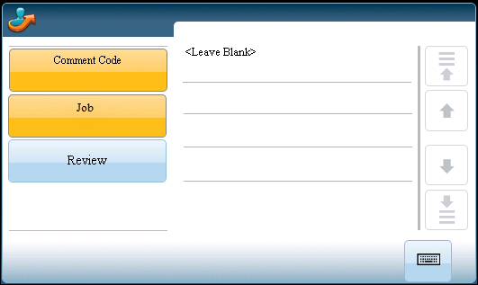
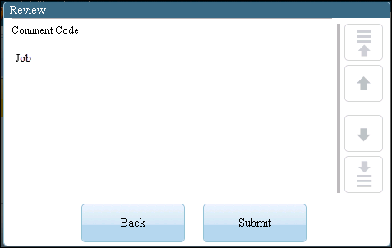
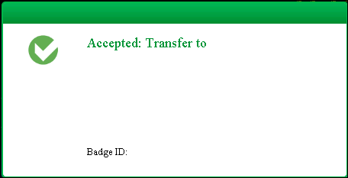
Transfer with Comment (Continued) (Student)
Accept or change the job transfer.
To accept the job that is displayed, press Review, and then proceed to next step.
To select a different job, press the LIST soft key. Select a job from the list, and then proceed to next step.
Review the transfer data. When finished, click Submit.
Review the approval message.
Job Transfer - 1
140
140
Receptionist
Receptionist
Receptionist
1
Wed Jan-18-2014, 11:15 am

Slide 17
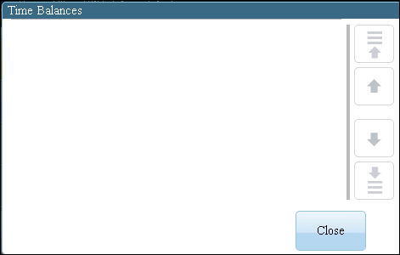
Request Time Off
Press the Request Time Off soft key.
Swipe your badge or enter your Wildcat ID.
To see your available balances, click Time Balances. When finished, click Close.
English
Español
Français
Callback
Transfer with Comment
Cancel Meal
Request Time Off
View Timecard
View Accruals
Justify
Missing Time
Approve Timecard
Request Time Off
Personal
Sick
Vacation
16
80
124
(Continued)

Slide 18
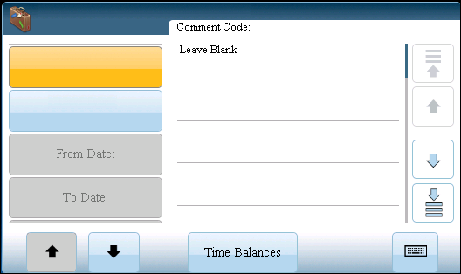
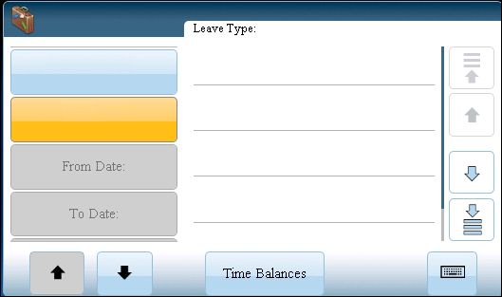
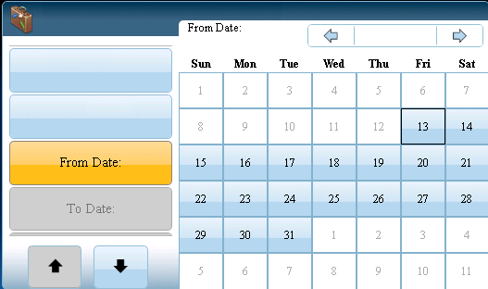
Request Time Off (Continued)
Optionally, press the comment code. Use the arrows on the right to scroll through comments. You must know the code number.
Press the Leave Type code. Use the arrows on the right to scroll through the codes.
Select the From and To dates.
Request Time Off | Adams, Julie
Comment Code:
Leave Type:
140
Approved
150
Child Care
160
Training
Request Time Off | Adams, Julie
Request Time Off | Adams, Julie
201
Personal
Jan 2014
Comment Code:
140
Comment Code:
140
Request Time Off
Leave Type:
202
Sick
Leave Type:
Personal
203
Vacation
204
Jury
(Continued)

Slide 19
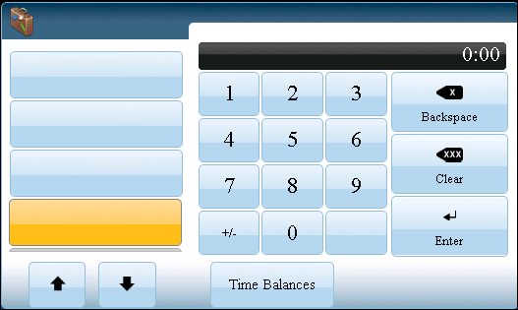
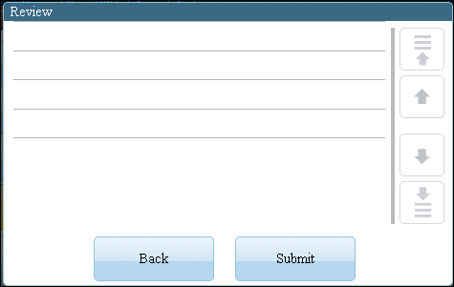
Request Time Off (Continued)
Enter the Hours/Day using the keypad.
When finished, press Enter.
Review the information. When finished, press Submit.
During peak wall terminal usage Leave requests will not be accepted.
Request Time Off | Adams, Julie
Hours/Day:
Comment Code:
Leave Type:
From Date:
To Date:
Hours /Day
140 Approved
201 Personal
1/16/2014
To1/20/2014
8:00
Leave Type:
Personal
From Date
1/16/2014
To Date:
1/20/2014
Hours/Day:

Slide 20
View Accruals Online
Press the View Accruals soft key.
Swipe your badge or enter your Wildcat ID.
Accruals information appears. If necessary, use the up and down arrow keys to scroll through the data.
Please note accruals are estimated, true balances are on HRIS.
English
Español
Français
Callback
Transfer with Comment
Cancel Meal
Request Time Off
View Timecard
View Accruals
Justify
Missing Time
Approve Timecard
View Accruals | Adams, Julie
View Accruals - 1
Vacation
Sick
Personal
160:00:00
80:00:00
0:00:00

Slide 21
View Timecard Online
Press the View Timecard soft key.
Swipe your badge or enter your Wildcat ID.
English
Español
Français
View Time card
Callback
Transfer with Comment
Cancel Meal
Request Time Off
View Timecard
View Accruals
Justify
Missing Time
Approve Timecard
(Continued)

Slide 22
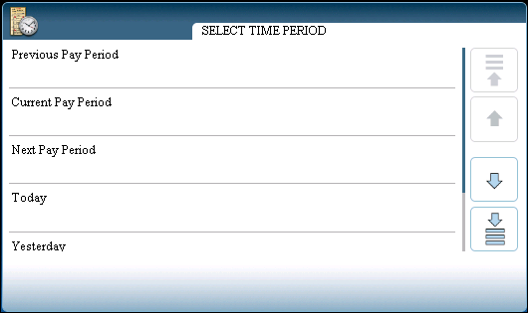
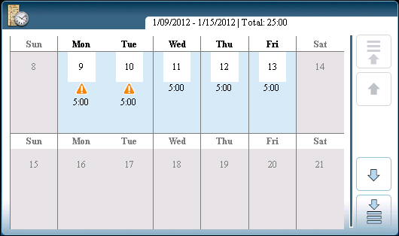
View Timecard Online (Continued)
To select a time period, press the soft key that corresponds to the period of time for which you want to view timecard information.
If there is no information to show, a message tells you this.
If information is available, the timecard appears. To scroll, use the up and down arrow keys.
View Timecard | Adams, Julie
View Timecard | Adams, Julie

Slide 23
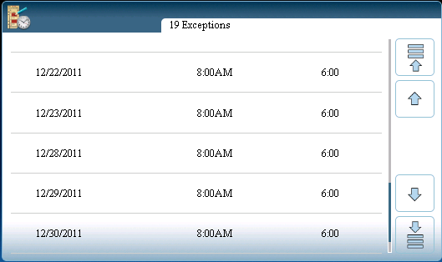
Justify Missing Time
Press the Justify Missing Time soft key.
Swipe your badge or enter your Wildcat ID.
Select the exception you want to justify. Use the arrows to scroll through if there are multiple exceptions.
English
Español
Français
Callback
Transfer with Comment
Cancel Meal
Request Time Off
View Timecard
View Accruals
Justify
Missing Time
Approve Timecard
Justify Missing Time
Justify Missing Time | Adams, Julie
(Continued)

Slide 24
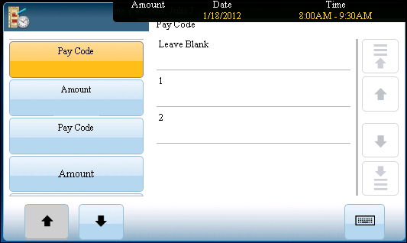
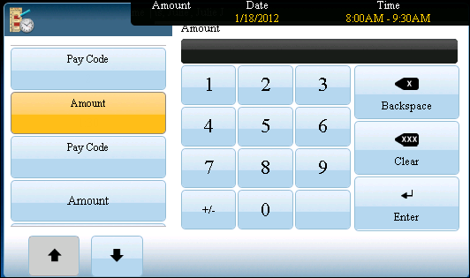
Justify Missing Time (Continued)
Select the duration pay code for this exception from the list of pay codes. Use the arrow keys if necessary.
Note: Pay Codes with an asterisk require a manager’s approval.
Justify Missing
1:30
Justify Missing
1:30
1:30
2
*MT-Absence
1:30
*MT-Training
(Continued)

Slide 25
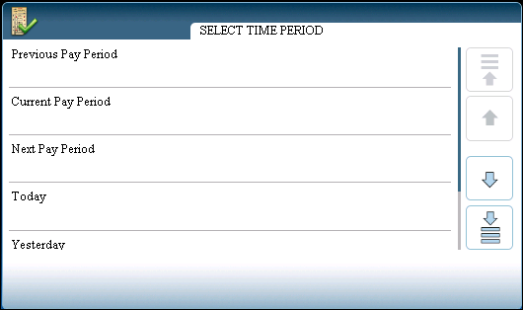
Approve Timecard Online
Press the Approve Timecard soft key.
Swipe your badge or enter your Wildcat ID.
To select a time period, press the soft key that corresponds to the period of time you want to approve.
English
Español
Français
Callback
Transfer with Comment
Cancel Meal
Request Time Off
View Timecard
View Accruals
Justify
Missing Time
Approve Timecard
Approve Timecard
Approve Timecard | Adams, Julie

Slide 26
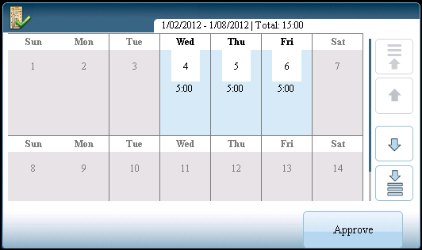
Approve Timecard Online
If there is no information to show, a message tells you this. Otherwise, the timecard appears.
If you have not yet approved the timecard, the Approve option appears. To approve the timecard, press Approve.
The message Timecard successfully approved appears.
Approve Timecard | Adams, Julie
Approve Timecard
Previous Pay Period
Timecard successfully approved.
Name: Adams, Julie
1/13/2014, 4:49PM

Slide 27
View Messages
Press the View Messages soft key.
Swipe your badge or enter your Wildcat ID.
The terminal responds by displaying information.
English
Español
Français
Read Messages
Read Messages
SUPERUSER
Timecard Approval
1/13/2014
3:15 PM

Slide 28
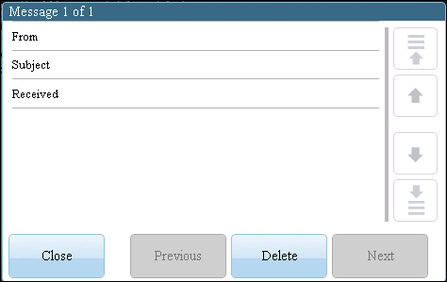
View Messages
Touch the message to view its content.
To delete the message, press the Delete soft key.
SUPERUSER
Timecard Approval
1/13/2014, 3:15 PM
This is a friendly reminder to approve your timecard before close of business today.
Thank you.

Slide 29
Rejected Punches

Slide 30
Error reading badge data
Error message number is [NGT 01-1]
Possible reasons for this error:
You may not have swiped the badge properly. Try again.
If you are swiping correctly and continue to see this error, the quality of the badge may be the problem. Contact your system administrator.

Slide 31
Unknown home employee
Error message number is [NGT 06-2 ({failureCode})]
Possible reasons for this error:
You are a new employee and your information has not been sent to the terminal yet. Contact your system administrator. Refer to the message number and the provide the failure code.
You recently replaced your badge. Your new badge number has not been sent to the terminal yet. Contact your system administrator.

Slide 32
Punch rejected
Error message number is [NGT 04-1 ({failureCode})]
Possible reasons for this error:
You entered a punch earlier than what your schedule permits (109).
You entered a punch later than what your schedule permits (110).
Your punch interpretation rule has not been sent to the terminal. Contact your system administrator (102).
Unscheduled IN punch (108). The terminal does not have a valid schedule for you; see your system administrator. Refer to the message number and the provide the failure code.

Slide 33
Clocking in on the Kronos website (URL)

Slide 34
Accessing the Navigator
You are required to have an established user name and password.
If your organization chooses to use Kronos authentication, you can also use the security features that are provided in the application.
Always end your work session by clicking the Sign Out link, located in the top left corner of the Navigator:
Clicking Close (x) without first logging off might leave your connection to the application open, allowing unauthorized people to view and edit information
(Continued)

Slide 35
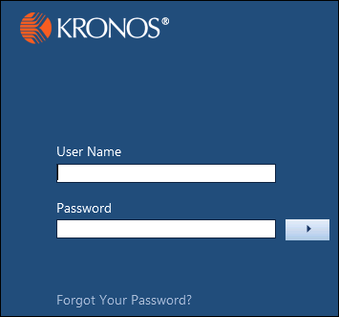
Accessing the Navigator (Continued)
Log on to Workforce Navigator_WFC
If you forget your password, click Forgot Your Password?
Reference: Logging in and signing out job aid

Slide 36
Navigating the Navigator
What is a Navigator?
A user interface that allows you to access, view, and modify time and labor data through a web browser
Configured to reflect responsibilities and tasks for specific roles
Available workspaces, widgets, and alerts as determined by your organization
Reference: Navigating the navigator job aid
(Continued)

Slide 37
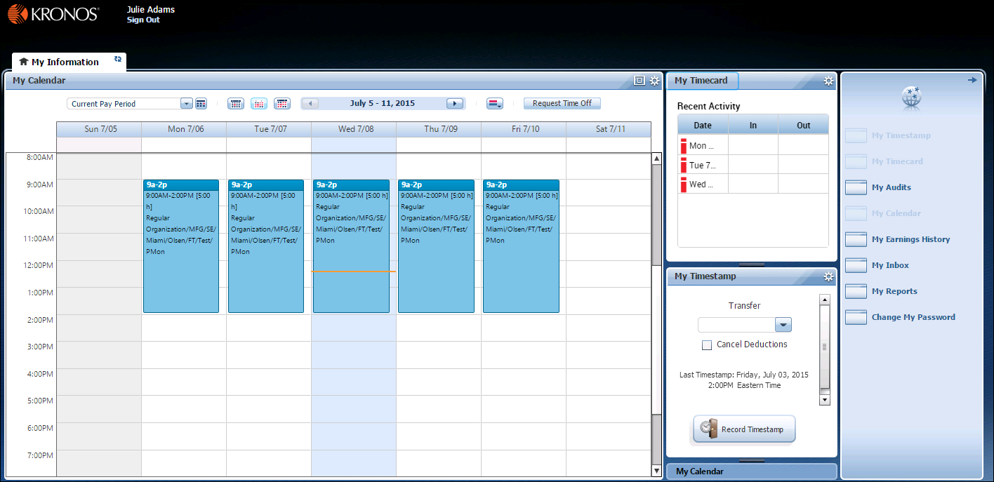
Navigating the Navigator (Continued)
A
B
C
D
E
F
G
H
A
Active Bar
D
G
Maximize/restore
Secondary widget
B
Name/Sign Out
H
Primary widget
E
Gear icon
C
Home workspace
F
Related Items pane
Notes:
Active Bar: Displays active workspace.
Name/Sign Out: Identifies the user who is signed into the application and a link to sign out.
Home workspace: Includes widgets to execute common tasks related to your job responsibilities.
Maximize/Restore icon: Click to maximize the applicable widget. Click again, to change the widget back to its original size.
Gear icon: Within each widget there is a gear icon where you can set preferences, promote a widget (if in secondary position), or close a widget (to move it back to the Related Items pane, if applicable).
Related Items pane: Contains widgets for related tasks. To open a widget within the Related Items pane in your home workspace, simply click and drag the widget to the workspace. To open a widget in the Related Items pane in a new window, click the widget link. Open widgets are grayed out and available widgets are in bold.
Secondary Widget: Secondary widgets provide helpful, summarized details. You can change a secondary widget to a primary widget to complete a task or view more details within the widget.
Primary Widget: Depending on the configurations of the home workspace, you may have more than one widget within your home workspace. If that is the case, one of those widgets will be the primary widget, which is where all work is completed and details are displayed.

Slide 38
Using the My Calendar widget
View your schedule by day, week, or month
Time off:
Submit time-off request
Review time-off details
Retract time-off request
The My Calendar widget can appear as a primary or secondary widget, or be located in the Related Items pane:
You can only perform tasks if the widget is in the primary position
The widget in secondary position shows summarized details
Reference: Using the My Calendar widget job aid
Notes:
If Workforce Scheduler is installed, employees might be able to submit open shift and shift swap requests.

Slide 39
Using the Timestamp widget
Perform tasks while the widget is in the primary and secondary position:
Punch in and out
Perform job transfer
Perform labor account transfer
Reference: Navigating the timestamp job aid

Slide 40
Punching in and out
Records time through the Timestamp widget
Keep track of your worked hours
Multiple punches are interpreted as alternating in and out punches:
First punch of the day is assumed to be an in punch
Second is assumed to be an out punch
Reference: Punching in and out job aid

Slide 41
Leave requests on the Kronos website (URL)

Slide 42
Benefits of employee self-service for requesting leave
My Leave Requests features allow you to:
View and manage your leave requests quickly and easily
Submit requests for leave
Cancel requests for leave
Submit requests for additional leave time and cancel requests for additional leave time
Review leave case information

Slide 43
Viewing your accrual information
Use the My Accruals tab to view your accruals data
This information can help you assess the accrued time that you have available and how it might be affected by your request for leave time
Notes:
Remove this slide if your organization does not provide the accruals tab in employees’ home workspaces.

Slide 44
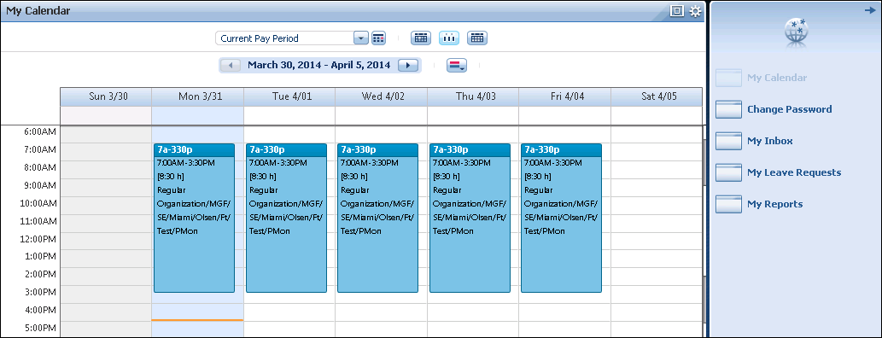
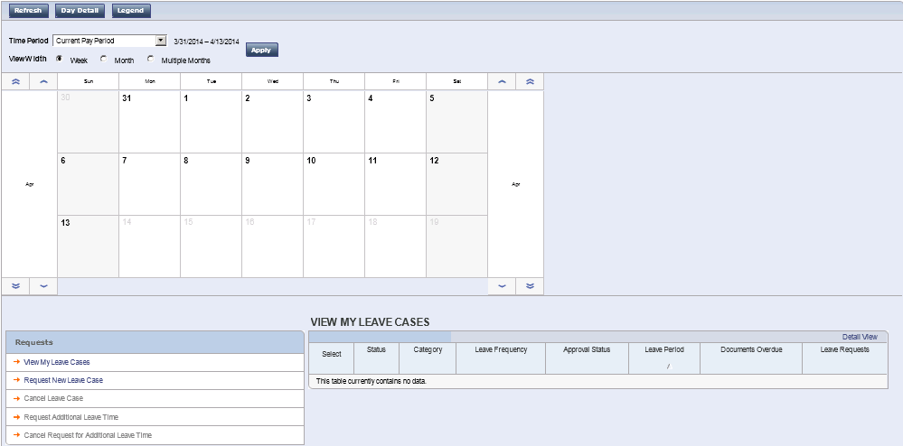
Accessing the My Leave Requests widget
In your home workspace, select My Leave Requests from the Related Items pane
Notes:
You might need to modify the instructions for accessing the My Leave Requests widget if your organization chooses a different configuration.

Slide 45
Navigating the My Leave Requests widget
B
C
D
A
E
F
G
H
In My Leave Requests, use the calendar options to control the leave information that that you want to be displayed in the widget
A
Person & Id: View your name and ID number.
E
Time Period: Select the time period you want to be displayed in the leave calendar area.
B
Refresh : Click to refresh the calendar data after submitting a leave request or making a change to a leave request.
F
Apply: Click Apply after selecting a new time period to display those dates in the widget.
C
Day Detail: Select one or more days in the leave calendar area and then click to review leave and schedule details for the selected days.
G
View Width options: Click an option to show weekly, monthly, or multiple months dates displayed in the leave calendar area.
D
Legend: Click to view information about how the text colors and fonts indicate leave case information in the leave calendar.
H
Leave calendar area: View leave case details in a calendar format here.
(Continued)
Notes:
This slide shows the top section of the My Leave Requests widget where you see the Leave calendar indicators and selection options. The time period selected here determines which leave cases are displayed at the bottom of the widget (shown on the next slide).

Slide 46
Navigating the My Leave Requests widget (Continued)
A
B
C
In the View My Leave Cases area of the My Leave Requests widget, select options to perform leave tasks and to view information for leave cases that are open during the time period that you selected in the calendar.
A
Requests: Select items in this list to perform leave-related tasks.
C
Detail View: In a selected leave case, click to display more columns of leave-related information.
B
Leave case information grid: Review information about your leave cases for the time period selected in the calendar.
Notes:
This slide shows the bottom section of the My Leave Requests widget where you work with requests for leave cases.

Slide 47
Using the View My Leave Cases Detail View
A
B
Use the My Leave Cases Detail View to see more information about a leave case
A
Leave case information grid: Review the expanded columns of information for the leave case that you selected in View My Leave Cases.
B
Return: Click to return to View My Leave Cases.

Slide 48
Performing employee self-service for requesting leave key tasks
Task | Description | Job Aid
Request leave | You can submit a request for a new leave case from My Leave Requests. | Requesting a new leave case
Request additional leave time and then cancel the request | When you need to extend your leave time, you can submit a request for additional leave time for an open leave case from My Leave Requests. You can also cancel a request for additional leave time. | Requesting and canceling a request for additional leave
Cancel a leave request | If you have submitted a request for leave and later learn that you do not need to take the leave, you can cancel your request for leave from My Leave Requests. | Canceling a leave case request
Notes:
You might need to modify the table, depending on which job aids you will provide to your employees.

Slide 49
Tracking self-service requests for leave
You can track the status of your leave case requests in My Leave Requests.
You can track the approval status of your leave case requests in My Leave Requests.
Case status | Description
Submitted | You have submitted the request to your manager. You can cancel the request at this point, if necessary
Retracted | You or your manager has canceled the request.
Open | Your leave case request is being managed as an open leave case.
Closed | Your leave case is no longer active.
Approval status | Description
Pending | You have submitted the request to your manager. You can cancel the request at this point, if necessary
Approved | Your manager has approved the request. Your leave case request is being managed as an open leave case.
Denied | Your manager has rejected your leave case request.
Closed | Your leave case is no longer active.
Notes:
You might need to modify the table, depending on which status values have been implemented for your organization.

Slide 50
Questions?

