Slide 1
Scheduling Exams with SAC Testing Center
AIM Software Portal

Slide 2
Scheduling Exams in AIM
Before you schedule an exam:
Be sure the letter of accommodation for that class has been approved and sent.
Do not schedule exams with the SAC Testing Center if:
The course instructor can provide testing accommodations and proctor exams in the department
or
Exams are not proctored.
Plan ahead. You must submit requests at least 3 business days before the scheduled exam. For final exams, you must submit requests at least 10 business days in advance.
You can submit requests for all exams/quizzes/finals once the instructor has provided assessment dates. You do not have to wait until a few days before the exam to schedule.
You are expected to arrive on-time for exams. You will NOT be permitted to make up time due to being late.

Slide 3
Steps to Schedule an Exam Overview
Login to AIM (https://bear.accessiblelearning.com/KState/Login.aspx)
Click “Alternative Testing" on the left sidebar menu.
If you have not already done so, read the IMPORTANT MESSAGE section.
In the SCHEDULE AN EXAM section, “Select Course” from drop-down menu. (If you do not see the course in the drop-down list, then you have not sent the testing accommodation letter to the instructor).
Click “SCHEDULE AN EXAM”.
Complete the EXAM REQUEST section.
Carefully read the TERMS AND CONDITIONS. If you agree, check the boxes.
Click “ADD EXAM REQUEST“
Tips:
Letter of accommodation must be approved and sent before scheduling exams.
Submit exam requests for the whole semester.
You can view, modify, or submit exam requests any time on the AIM Portal.

Slide 4
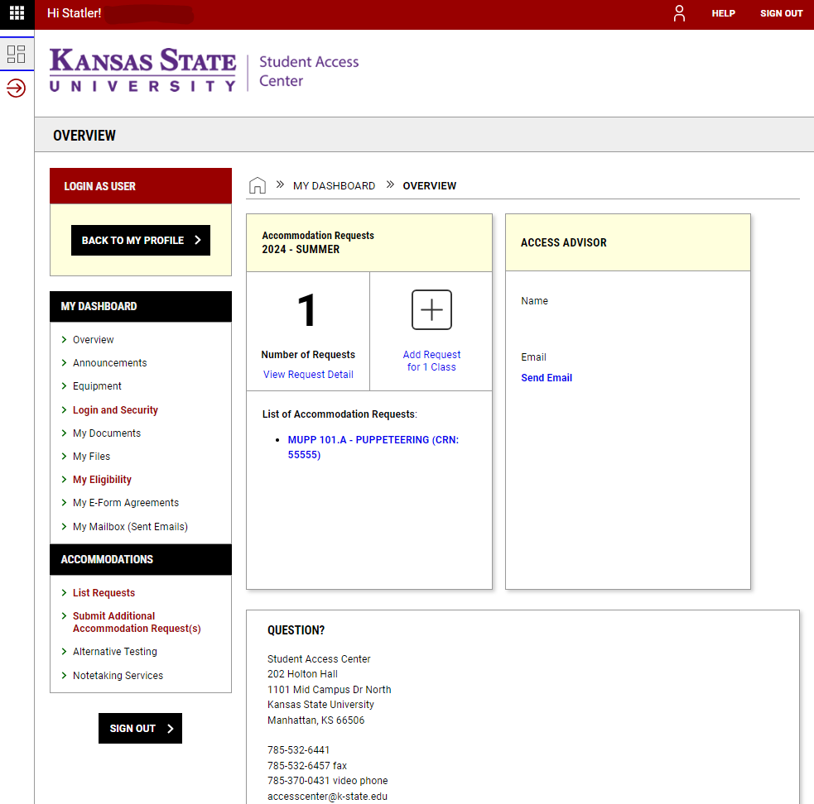
AIM Portal
On the AIM DASHBOARD Overview, you can see all the classes for which you have requested accommodations, your Access Center advisor, and other information.
On the left sidebar menu under ACCOMMODATIONS, click “Alternative Testing”.

Slide 5
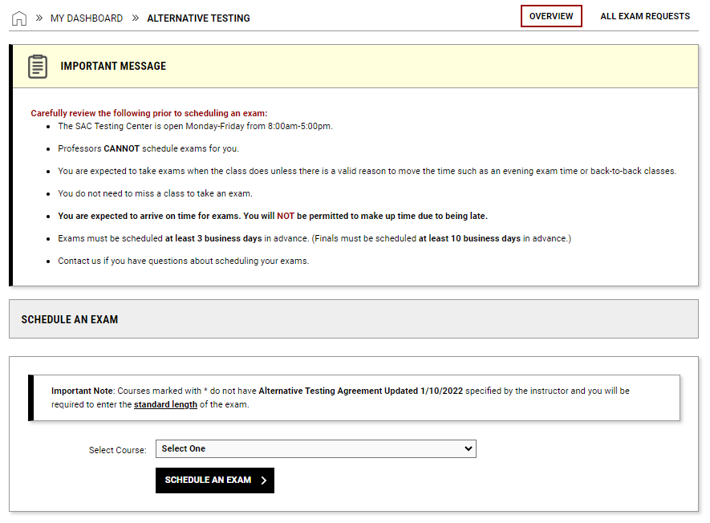
AIM Portal (Cont’d)
Read the IMPORTANT MESSAGE
In the SCHEDULE AN EXAM section, Select Course from the drop-down menu.
Click SCHEDULE AN EXAM.
Notice:
Do not schedule the following:
Exams proctored by instructor with accommodations in the department
Exams not proctored at all (example: take-home exam)
Global Campus (online) exams

Slide 6
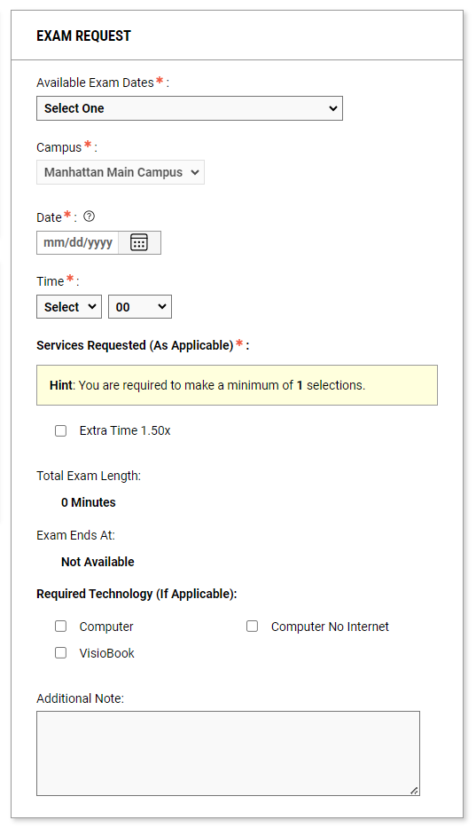
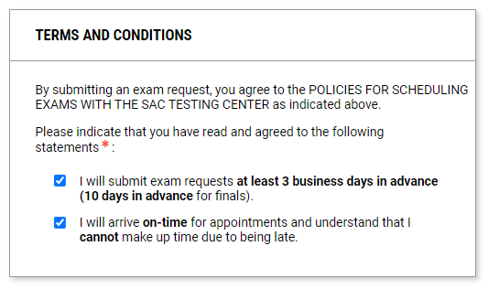
AIM Portal (Cont’d)
Complete the EXAM REQUEST section.
Exams should be taken at the same time as the class unless there is a valid reason to take them at a different time such as evening exams or back-to-back classes.
If the TERMS AND CONDITIONS checkboxes have not been selected, you will receive an error message when you try to schedule an exam request.

Slide 7
AIM Portal (Cont’d)
After you submit your exam request, you will see one of these message boxes near the top of the screen.
Submission error: There was a problem processing your request. Check the indicated fields to input the correct information and try submitting again (SCHEDULE AN EXAM).
Success! The exam request was successfully submitted. You should receive an email confirming your exam request details.

Slide 8
AIM Portal Alternative Testing
On the AIM Portal Alternative Testing page, you can
Schedule exams with the SAC Testing Center
View upcoming exams and their details
Cancel upcoming exams
View completed exams

Slide 9
SAC Testing Center Contact Information
Email: tst@k-state.edu
Phone: 785-532-5317
Hours: Monday – Friday, 8:00am – 5:00pm
Holton Hall 002 Kansas State University 101 Mid Campus Dr North, Manhattan, KS 66506

