Slide 1
Student Access Center
AIM Portal

Slide 2
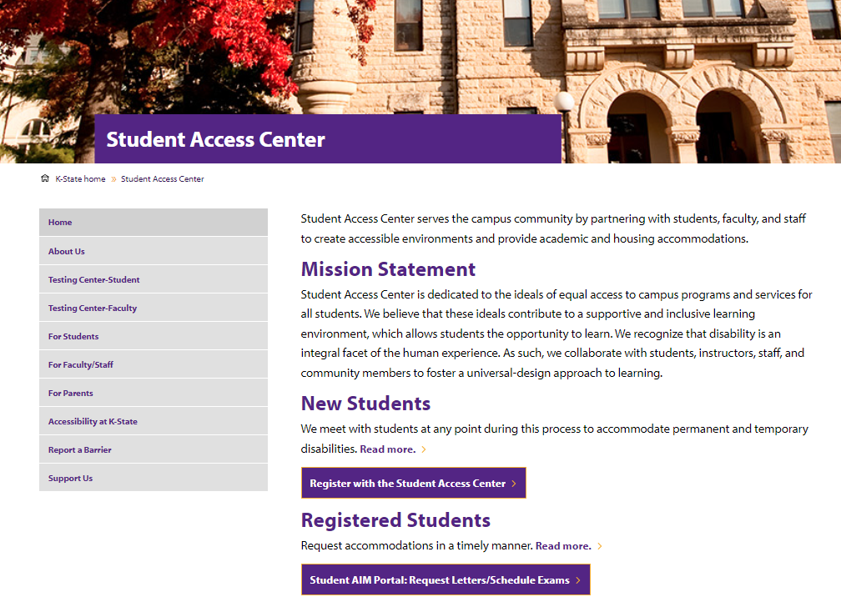
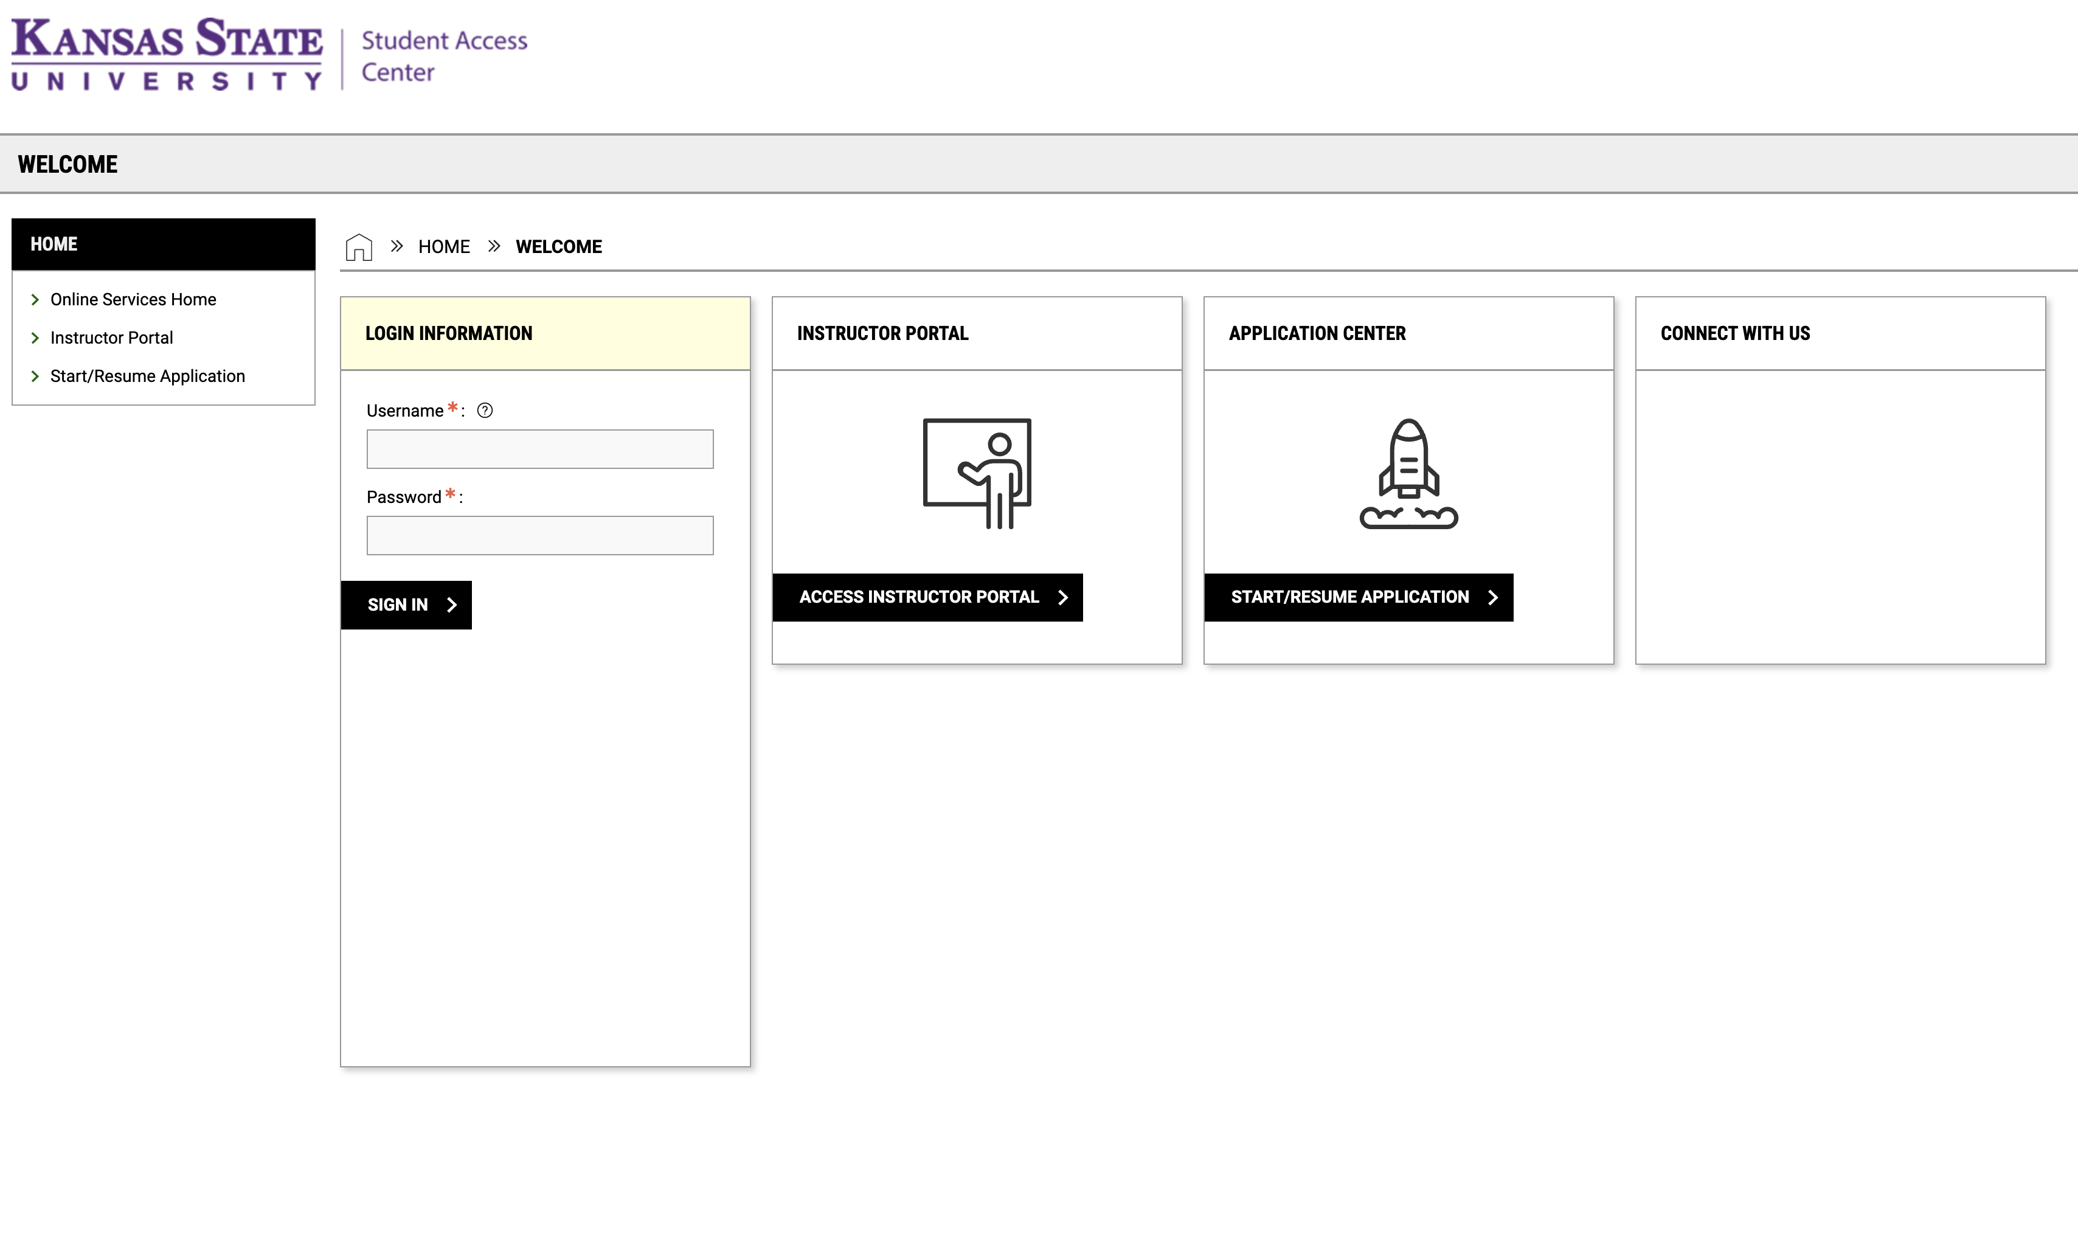
Request Letters of Accommodation for Current Students
1. Choose Student AIM Portal to start the process on the Student Access Center’s homepage.
2. You will be directed to your K-State sign-on.
3. Sign in with your K-State eID and password.

Slide 3
Your Dashboard
Once a year, you will be asked to sign an Annual Student Agreement. This agreement outlines your responsibilities for requesting and utilizing accommodations.
On the navigation bar on the far left, there is a link to a list of your approved accommodations; list of courses you are enrolled in; and a link to Alternative Testing where you will schedule exams with the Testing Center.

Slide 4
Seeing Your Eligible Accommodations
My Eligibility
This link on the left navigation bar will list your accommodations (see red box in graphic). Each accommodation you are eligible for will also have a dropdown button to display the full accommodation text.

Slide 5
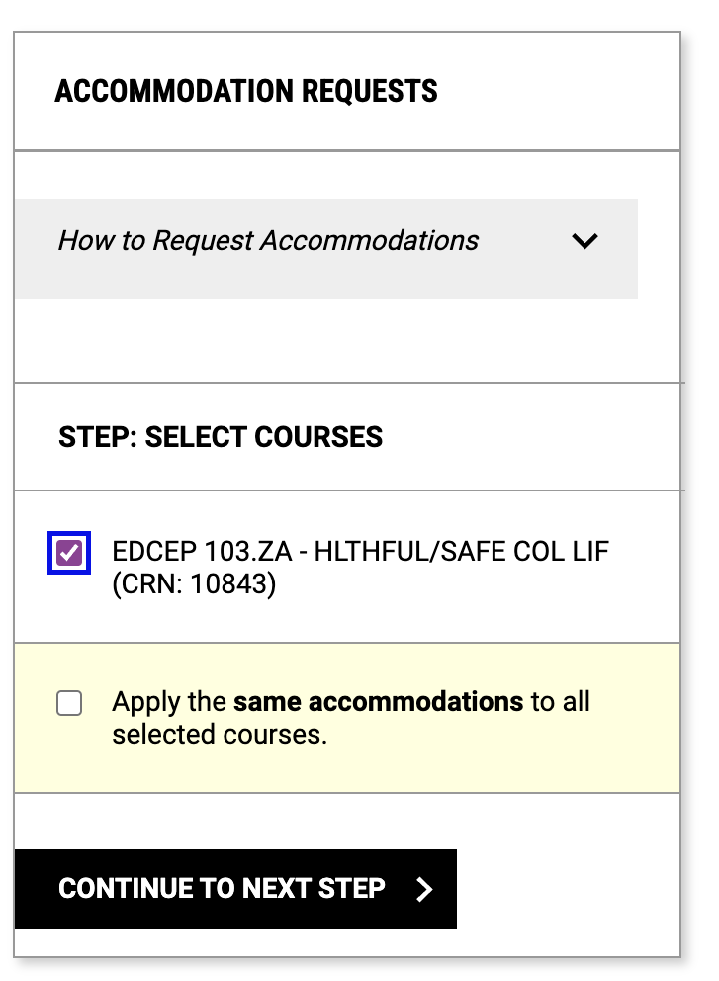
Request Letters
Use the “Add Request” option to start your process.
You will select the course(s) that you are requesting accommodations.
Then click CONTINUE to customize your accommodations.

Slide 6
Select Accommodations
You now have the flexibility to decide what accommodations you want to request for each course.
To continue, click SUBMIT REQUEST.

Slide 7
Confirmation
If you successfully submit the request, you will see a green check mark and “SUCCESS! YOUR ACTION HAS BEEN COMPLETED”.
or
If there is an error, an alert will appear in a yellow box at the top of the page saying, “SUBMISSION ERROR”. Check for missing or invalid information and submit the request again.
You can see which classes are processing your requests and which accommodations are approved.
If you have testing accommodations and need to schedule an exam, check the step-by-step guide on the Student Access Center website under Testing Center-Student.

Slide 8
Checking your Accommodation Letters
Once you have requested your letters, staff will approve your request. AIM will send the letters to faculty.
Letters will be sent a week before classes begin if you request letters before the semester start.
During the semester, letters are sent within one business day.
You can use the Student AIM Portal to check on your accommodation letters. Go to ”View Request Detail" to see the list of your classes and when letters were sent to faculty.

Slide 9
Student Access Center
If you have any questions or concerns, please contact the
202 Holton Hall 1101 Mid Campus Dr North, Manhattan, KS 66506
accesscenter@k-state.edu
785-532-6441

