Slide 1



K-State 105
Living our public service and land-grant mission for Kansas

Slide 2
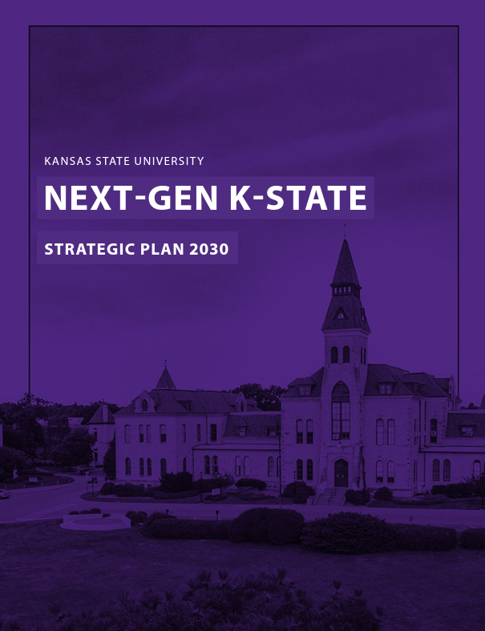
Next-Gen K-State
Kansas State University will lead the nation as a next-generation land-grant university — setting the standard for inspiring learning, creativity, discovery and engagement that positively impacts society and transforms lives in Kansas and around the world.
Next-Gen K-State

Slide 3

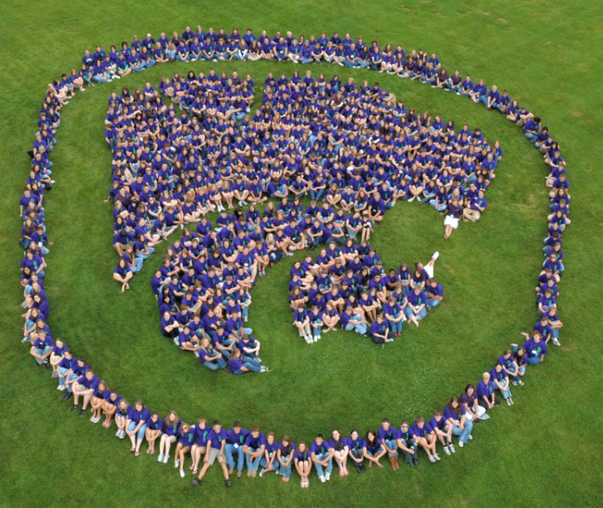



K-State Opportunity Agenda
Global Food Security and Biosecurity
  Ag Innovation Initiative
  Animal Diagnostic Lab
Sustainability
  Kansas Water Institute
Enabling Technologies
  Digital Ag/Data Analytics Institute
Community Health and Well-Being
  K-State 105 – Economic Development Engine
Next-Gen K-State

Slide 4

K-State 105: Catalyzing Change
Leverage the K-State Research and Extension network to deliver the full breadth of Kansas State University into every corner of Kansas.
Partner with other state universities, community colleges and tech schools to deliver solutions through our established K-State Research and Extension infrastructure.
Build additional capacities and strengths within the state by forging partnerships with non-profits, state agencies, industry and others.
K-STATE 105: AN ECONOMIC GROWTH AND ADVANCEMENT INITIATIVE

Slide 5
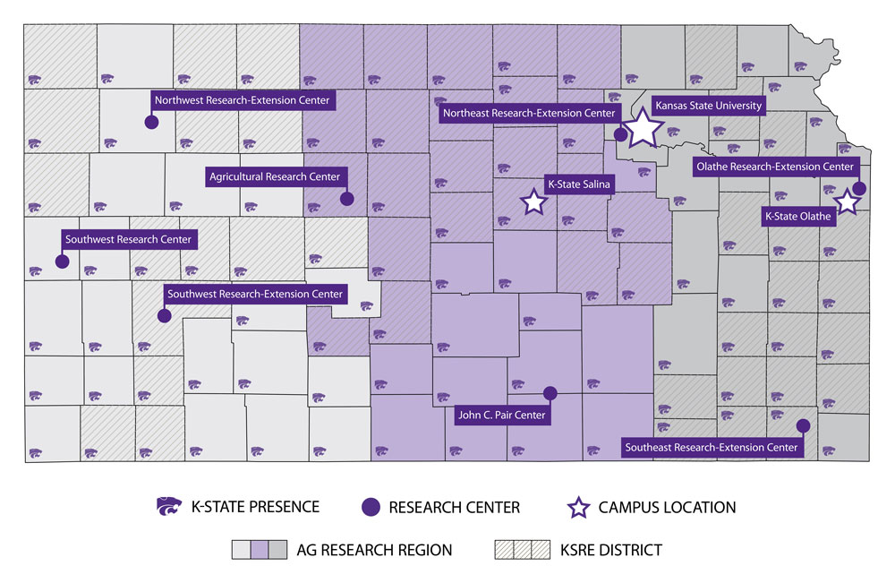
K-State 105: K-State Research and Extension
Leverage the K-State Research and Extension network to deliver the full breadth of Kansas State University into every corner of Kansas.
We will model what a land-grant university can and should do to enhance prosperity for all Kansans.
Our partners can deliver solutions through K-State Research and Extension.
K-STATE 105: AN ECONOMIC GROWTH AND ADVANCEMENT INITIATIVE

Slide 6

SERVE
DELIVER
K-STATE 105: AN ECONOMIC GROWTH AND ADVANCEMENT INITIATIVE

Slide 7
K-State 105: All about partners
Leveraging the strength of partnerships through and beyond the
K-State Research and Extension presence in all 105 Kansas counties, Kansas State University will lean into its land-grant mission of serving Kansas communities by:
  Growing economic prosperity.
  Increasing educational access.
  Improving health and well-being.
K-STATE 105: AN ECONOMIC GROWTH AND ADVANCEMENT INITIATIVE
Notes:
Our mission is simple: K-State 105 is all about partnerships. It's about extending our land-grant mission across all 105 counties in Kansas.
We're not just present; we're actively engaged and partnering with communities to achieve several key objectives:
Growing economic prosperity: Through strategic collaboration with partners, K-State 105 seeks to ignite economic growth, drive job creation and stimulate investment across our state.
Increasing educational access: We're dedicated to improving access to quality education, training and resources for Kansans, regardless of where they reside.
Improving health and well-being: Health and well-being are foundational to prosperous communities. K-State 105 is committed to enhancing these aspects in every corner of Kansas.

Slide 8

A statewide small business initiative
In the last 25 years, 66% of all new U.S. job creation has come from small business.
We believe all Kansas communities — urban and rural — can experience economic growth through locally driven entrepreneurial small business growth strategies.
With its presence in all 105 counties, K-State is uniquely positioned to create a statewide small business initiative.
K-STATE 105: AN ECONOMIC GROWTH AND ADVANCEMENT INITIATIVE
Notes:
One of the most challenging issues facing Kansans is the uneven economic growth in our state. Many communities in Kansas struggle to find practical solutions to advance local prosperity, including support for local entrepreneurs.
Kansas State University believes all Kansas communities, urban and rural, can experience economic growth when community leaders are committed to locally driven entrepreneurial growth strategies connected to a broad range of technical, business, and support services. That's where K-State 105 comes in.
In the last 25 years, 66% of all new U.S. job creation has come from small business. With our presence in all 105 counties, K-State is uniquely positioned to create a statewide small business initiative.

Slide 9
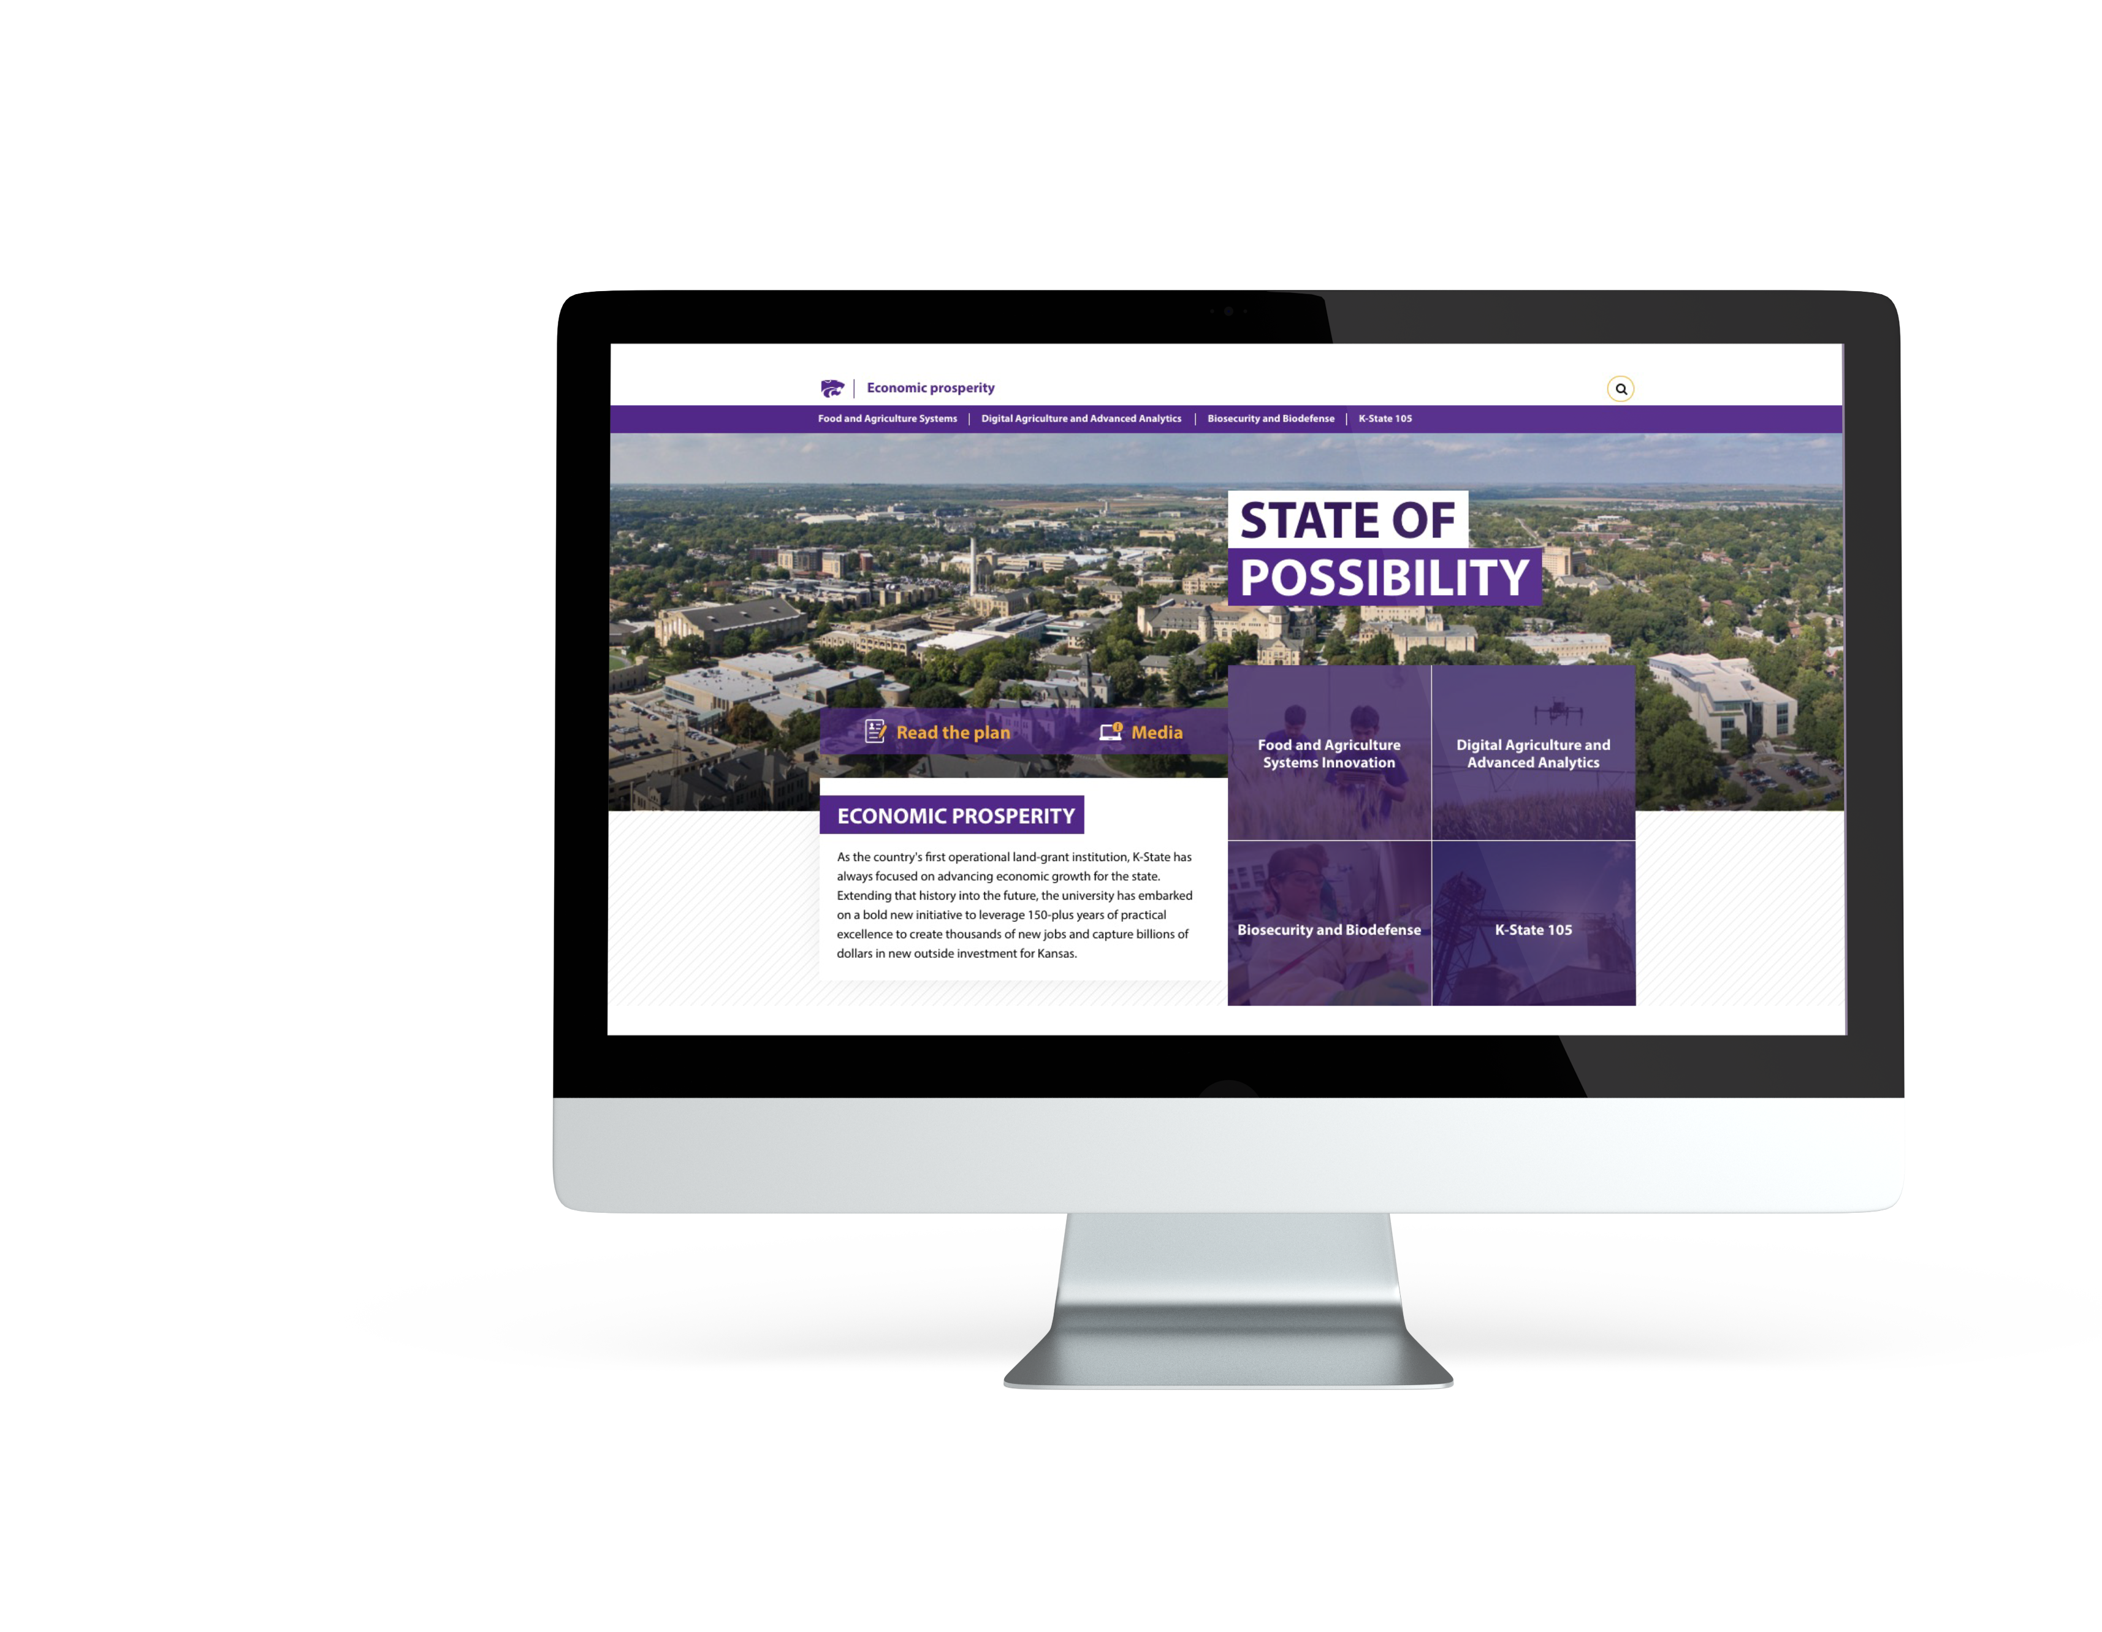

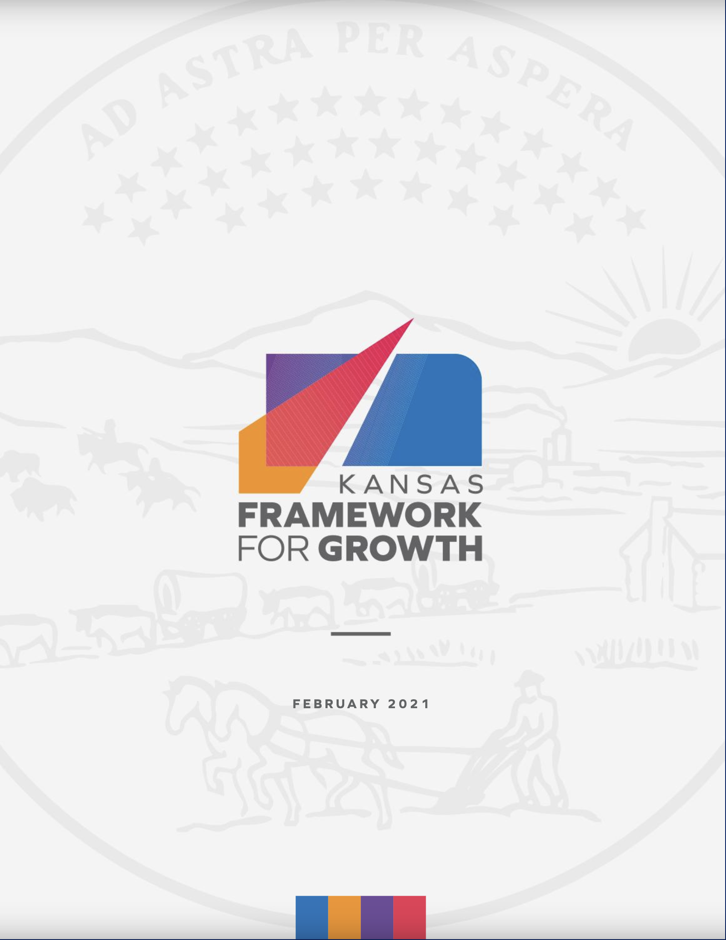
K-State 105 = Economic prosperity in Kansas
KBOR STRATEGIC PLAN
FOR KANSAS
KANSAS FRAMEWORK
FOR GROWTH
K-STATE ECONOMIC PROSPERITY PLAN
Aim to create 3000 direct new jobs and
attract $3 Billion in new Kansas investments by 2030.
K-STATE 105: AN ECONOMIC GROWTH AND ADVANCEMENT INITIATIVE
Notes:
K-State 105 is part of Kansas State University’s larger Economic Prosperity Plan, which is aligned with the Kansas Board of Regents' strategic plan and vision for how universities are key contributors to economic prosperity in Kansas.
As part of this plan, we aim to create 3,000 direct new jobs and attract $3 billion in new Kansas investments by 2030.
K-State 105 and the Kansas Department of Commerce's Framework for Growth are also aligned in purpose and vision. We acknowledge the hard work the Department of Commerce already does in many areas. Our efforts will complement the key initiatives outlined within Kansas Framework for Growth which seeks to emphasize harnessing the state’s colleges and universities for job and business creation.
With K-State 105, we're leveraging our reach to foster job creation and support new businesses throughout all 105 Kansas counties.
We also share a commitment to 'Community Assets and Regional Approaches to Economic Development.' K-State 105 has already begun forming partnerships across the state and connecting with regional communities to spur economic growth.

Slide 10
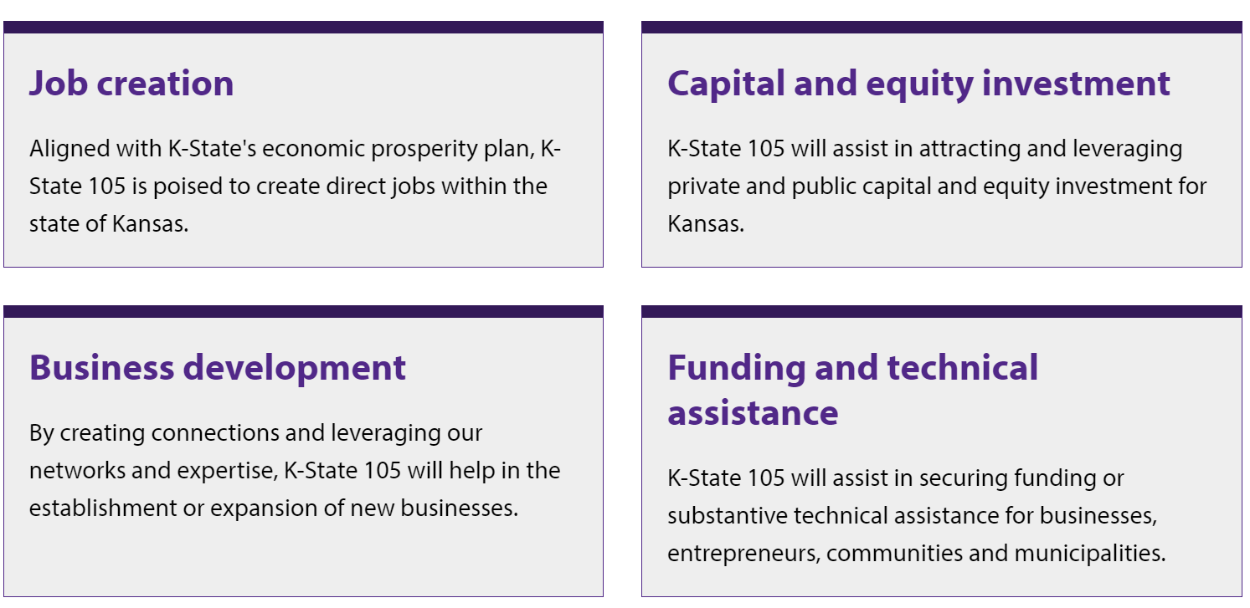
K-State 105
K-STATE 105: AN ECONOMIC GROWTH AND ADVANCEMENT INITIATIVE
Notes:
What can you expect from K-State 105? By building and leveraging networks of support, technical solutions, business creation and workforce development, the K-State 105 initiative, along with our partners, will enhance well being of all Kansans.
K-State 105 is poised to create direct jobs within the state of Kansas, assist in attracting and leveraging private and public capital and equity investment, assist in the establishment or expansion of new businesses, and secure funding or technical assistance for businesses, entrepreneurs, communities, and municipalities.
And we aren’t doing it alone…

Slide 11


K-State 105: Higher Ed Partners
Partner with other state universities and colleges to deliver solutions through our established K-State Research and Extension infrastructure.
K-STATE 105: AN ECONOMIC GROWTH AND ADVANCEMENT INITIATIVE
Notes:
Through K-State 105, we are also building connections with other higher education institutions.
We also have had conversations with the University of Kansas, Wichita State University, Pittsburg State University and many community colleges and tech schools across the state about possible ways to partner together.

Slide 12

A K-State 105 story: Sunflower State partnership
K-State 105 partnerships are expanding the Kansas Small Business Development Center.
The partnership involves:
Kansas State University
Fort Hays State University
NetWork Kansas
The Innovation Center
K-STATE 105: AN ECONOMIC GROWTH AND ADVANCEMENT INITIATIVE
Notes:
Digger deeper into higher ed Partnerships, the K-State 105 initiative is supporting small business development in northwest Kansas through a collaborative approach that leverages the expertise and small business connections of higher education and statewide and regional partners.
Two universities — Kansas State University and Fort Hays State University — as well as two K-State 105 partners — NetWork Kansas and the Innovation Center — are working together to expand the service offerings of the Fort Hays State University-led Small Business Development Center in northwest Kansas.
The Fort Hays University-led Kansas Small Business Development Center, or SBDC, operates as a network of eight regional economic development and business consulting centers that currently serve all 105 counties in the state.

Slide 13
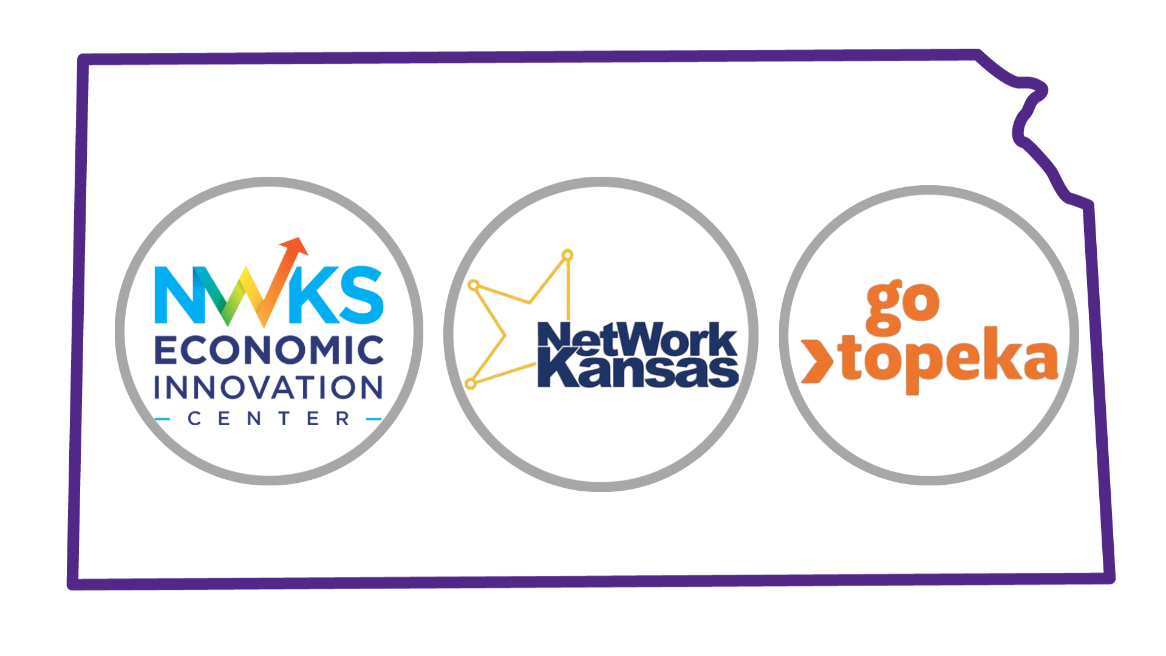
K-State 105: Partnerships
Build additional capacities and strengths within the state by forging partnerships with nonprofits, state agencies, industry and others.
K-STATE 105: AN ECONOMIC GROWTH AND ADVANCEMENT INITIATIVE
Notes:
We are also working with a network of committed and creative external partners to advance the economic prosperity of our state. Our current partners include statewide, regional and project collaborators.
NetWork Kansas is our statewide partner, and we have regional implementation partners such as Innovation Center and GO Topeka.
•Innovation Center will provide business consulting and network support to loan clients and businesses. They will provide direct assistance and workshops and develop online materials to support company growth and scale. They are helping to address rural housing concerns.
•GO Topeka is providing technical and business solutions, developing new products/services, implementing new advanced technologies, developing and educating the workforce, and growing and expanding operations.

Slide 14
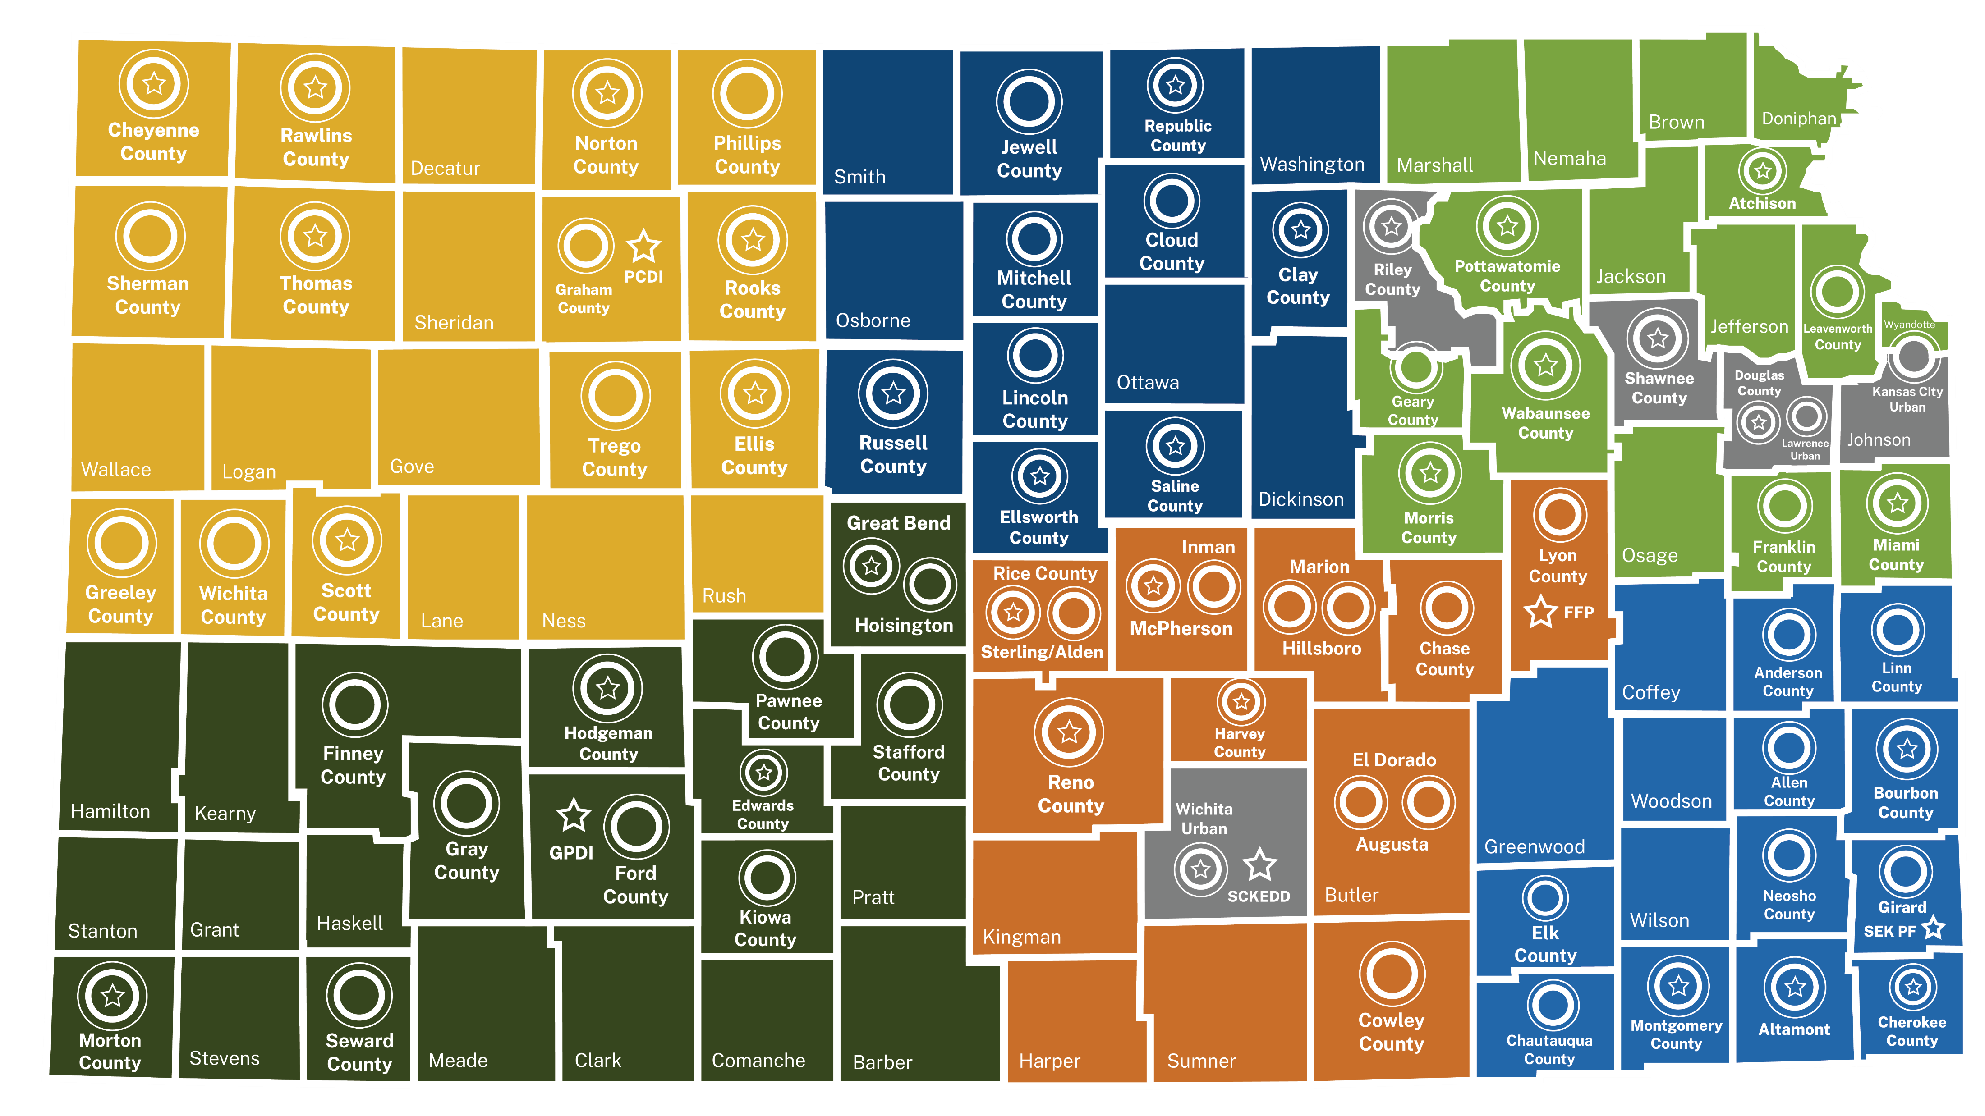
Entrepreneurship (E-) Communities
Notes:
A little more about our statewide partner, NetWork Kansas. Alongside NetWork Kansas, K-State 105 will enhance capabilities to advance community vitality, increase small business startups, expand existing businesses and increase direct investment across the state.
We will leverage the K-State Research and Extension statewide footprint to align with e-Communities and ensure work in economic development and entrepreneurship with NetWork Kansas.
Our community development and leadership through K-State Research and Extension will help connect to resources, on and off K-State campuses, for not only business building services, but for community development areas such as child care, housing and grant writing.

Slide 15
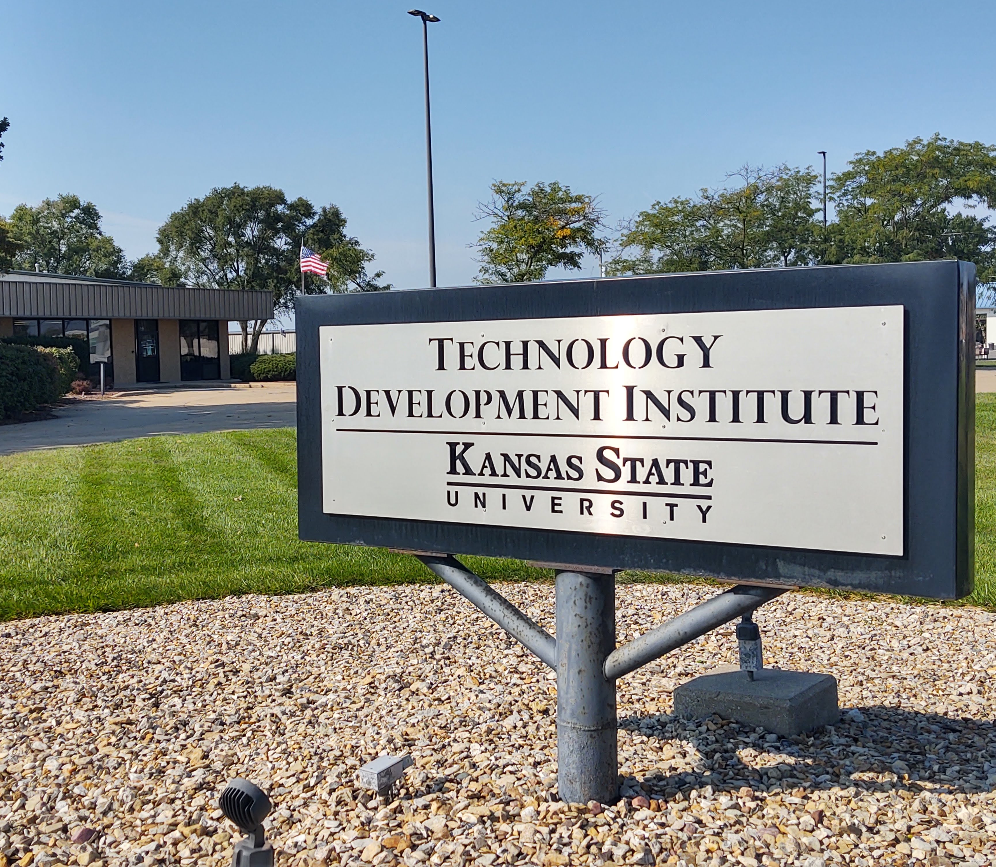

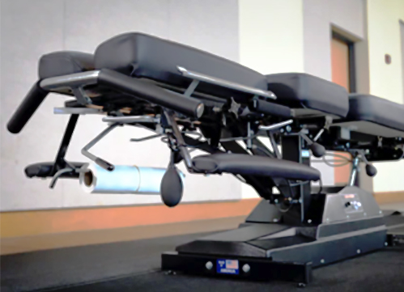
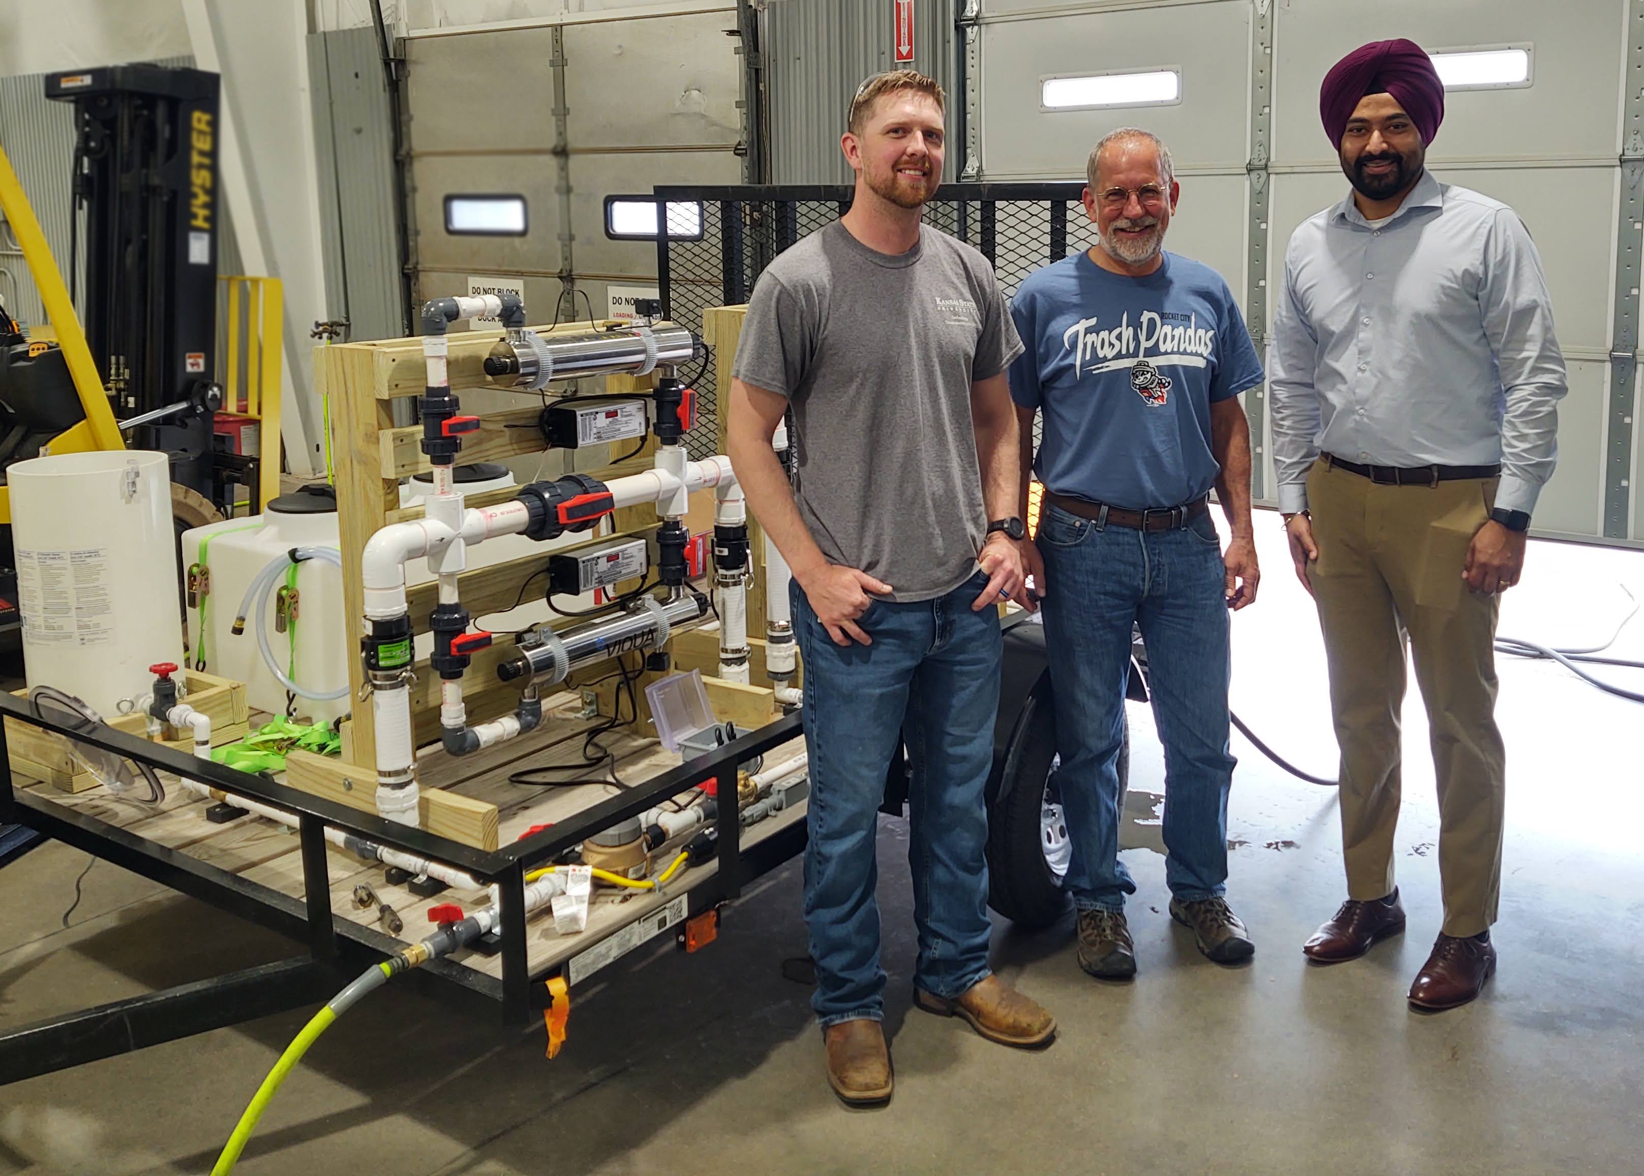
A K-State 105 story: TDI
The K-State Technology Development Institute is a U.S. Department of Commerce Economic Development Administration University Center.
TDI helps businesses, entrepreneurs and researchers with:
Product design and development.
Machining and prototyping.
Business and intellectual support services.
K-STATE 105: AN ECONOMIC GROWTH AND ADVANCEMENT INITIATIVE
Notes:
Speaking of university expertise, K-State 105 partners are helping entrepreneurs and small business across the state. One example is the K-State Technology Development Institute, which is a U.S. Department of Commerce Economic Development Administration University Center, which helps businesses, entrepreneurs and researchers with product design and development, machining and prototyping as well as business and intellectual support services.
TDI was renamed an EDA University Center in October 2023.
Some of TDI’s recent success stories highlight entrepreneurship and research collaborations.
A TDI partnership with GO Topeka helped a local inventor create the Pars A Par surfacing tool, which removes the scuffs and other damage from golf balls. (top right)
TDI worked with Lawrence-based Leander LLC, which produces chiropractic tables, to redesign parts to improve manufacturability, increase quality and reduce costs. (lower left)
TDI also collaborated with the University of Missouri to create a water disinfection demonstration trailer for farmers in Kansas and Missouri. (lower right)
This is another great example of how K-State 105 will help drive economic growth and advancement solutions for Kansas!

Slide 16
K-State 105 metrics
  Direct jobs created.
  Capital and equity investment attracted and leveraged, private and public.
  New businesses established or expanded.
  Businesses and entrepreneurs receiving funding or substantive technical assistance, tracked by:
    Industry/Business type.
    Geography/Population.
    Demographic, including veteran, women and minority-owned.
  Communities/Municipalities receiving substantive technical assistance, tracked by:
    Geography
    Population
K-STATE 105: AN ECONOMIC GROWTH AND ADVANCEMENT INITIATIVE
Notes:
Measuring success - The K-State 105 metrics we are gathering with our internal and external partners are shown here. We will be highlighting all of these metrics in a baseline partnership report and we will provide an in-depth impact report.

Slide 17
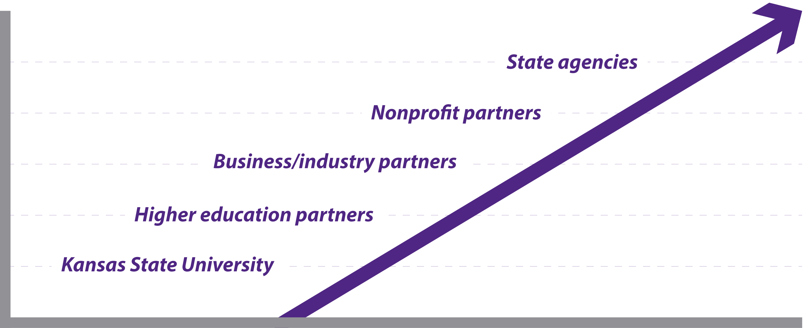
K-State 105: Collective Impact for Kansas
We will draw upon K-State’s strengths, intentionally layering in the targeted expertise
held within our state to foster the best lives possible for Kansans.
K-STATE 105: AN ECONOMIC GROWTH AND ADVANCEMENT INITIATIVE
Notes:
In our mission to serve all 105 counties in Kansas and foster economic prosperity, we're not walking this path alone. K-State 105 is a collective effort, drawing upon the strengths of various partners.
Our partnership begins right here at Kansas State University, the state's first operational land-grant university. But it doesn’t stop there. Together, we will harness the collective knowledge and innovation from other institutions to advance Kansas communities.
Business and industry partners are critical components of our network. Their expertise and resources are woven into our mission, propelling economic growth and creating opportunities for Kansans.
Nonprofit partners play a pivotal role in our initiative. Their commitment to the greater good adds depth to our efforts, reaching those in need and in underserved communities.
State agencies provide essential support and we've established strong ties to these organizations.
By working hand in hand, we can unlock the full potential of Kansas. This collective impact is what defines K-State 105. We are intentionally layering the targeted expertise held within our state, creating a strong heartbeat of knowledge and support. Together, we are on a journey to foster the best lives possible for every Kansan.

Slide 18



K-State 105 is ALIVE.
Answers the call for economic growth.
Leverages the statewide K-State Research and Extension network to deliver Kansas State University.
Forges the connections and partnerships that create access to additional expertise within other state institutions and agencies, nonprofits and corporations.
K-STATE 105: AN ECONOMIC GROWTH AND ADVANCEMENT INITIATIVE
Notes:
As we navigate the path to becoming the university for Kansans, K-State 105 will step boldly into the spotlight. Our mission is greater than just existing; it's about serving and elevating the lives of every Kansan in all 105 counties. K-State 105 answers the call for elevated economic growth.
This bold vision signifies that we are uniquely positioned to serve Kansas. We don't just touch the lives of those in the populous areas; we extend our impact far and wide. We have a presence in urban centers and rural communities alike, in every corner of this great state.
And we are partnering up, creating connections and enhancing expertise within our state and beyond.
K-State 105 is alive.

Slide 19

Questions?
Next-Gen K-State

