Slide 1

FCS Program Evaluations:
Focus Groups
When, why, and how
What to do with the data collected
and
the KOHP Pilot focus group

Slide 2
Focus Groups Defined
Facilitated Discussion of a Target Group
  6 to 15 people from a defined target audience
  Goal of gathering specific types of information to support data-driven decision making
  Can be formal or informal
Roles:
  Moderator and Assistant Moderator / Documenter
  Analyzer, Writer, Editor / Verifier
Participants:
  Common characteristics but with diversity
Notes:
A focus group is a facilitated discussion of six to 15 people from a defined target audience with the goal of gathering specific types of information intended to support data-driven decision making.
Formal vs Informal Focus Groups
Formal focus group interviews are those where you will schedule a meeting of pre-selected participants representing the target audience with the express goal of discussing a topic. These are usually no longer than 90 minutes, are in a comfortable and inviting environment, are restricted to only those who were invited, and have an incentive to attend.
Informal focus group interviews occur when you are speaking informally to a group with the expressed interest of discussing a specific topic. These do not usually have a specified time limit, occur in a variety of settings, are not restricted to invited participants, and do not have an incentive to attend.
Roles
Moderator
Documenter/Assistant Moderator
Analyzer
Writer
Editor/Verifier
Participants
Participants are representative of the larger target audience whom you desire feedback from, meaning that they should all of common characteristics but are still diverse enough to reflect the opinions and perspectives of the entire target audience.
program participants

Slide 3

When to Conduct Focus Groups
Consider Focus Groups, if you…
  Want in-depth qualitative data
    Detailed success stories
  Have a short amount of time
  Seek to affirm the value of the program, identify ways to improve the continuation of the program, and/or identify needs for a program
Do not use focus groups if you…
  Want or need quantitative data Survey
  Require confidentiality or will discuss extremely sensitive topics Interview
Notes:
1st step that you need to answer is “What is your purpose?”
Conducting a focus group should be considered when you want to
Gain a lot of qualitative information in a short period of time
Gain insight into the target audience’s perceptions, or the differences in their perspectives -- of a current or proposed process or program
Learn how people are thinking about or reacting to a multi-faceted or complicated topic
Gain ideas as they emanate from the group
A survey or interviews may be more appropriate to:
Gather statistical, quantitative data
Gather information from such a diverse population that they will not be comfortable speaking openly about the topic
Gather sensitive or confidential information that should not be shared amongst a group
Discuss a topic will be undermined by intense conflict amongst the participants

Slide 4

Developing Questions
Question Basics:
  Open-ended
  Simple, easy to remember
  Write out complex questions for group
  Move from general to topic (key) questions
  Avoid “why” questions
  Utilize consistent questions for FCS programs
Notes:
Use open-ended questions – to elicit details and discussion, not Yes/No, dichotomous
Use simple questions that are easy to remember, or if you must ask complex questions use materials to keep the entire question visible to the group
Avoid why questions – some perceive as defensive or that you are seeking one particular answer – ask for influences on decision-making, or attributes instead
If you use consistent or similar questions in all FCS focus groups, you will be able to see patterns across the groups and FCS programming

Slide 5
Developing Questions
Question Types:
  Opening questions / Ice Breakers
    “How did you first become aware of KOHP?”
  Introductory questions
    “Thinking back on the tools you learned about, are there any that you continue to use?”
  Transition questions
    “Do you develop action plans to help manage your chronic condition?”
  Key questions
    “Tell us a little about the quality of your life since completing KOHP?”
  Ending questions
    “Is there anything else you would like to share about your experience with KOHP?”
Notes:
Examples taken from KOHP focus group questions
Opening questions/Ice Breakers
Quick and easy to answer, gets the group talking and feeling comfortable
Introductory questions
Beginning questions to get started thinking about topic
Transition questions
Link introductory questions with the key questions
Key questions
Focus on the topic
Ending questions
After conclusion, to ensure everyone does not have further information to share.

Slide 6
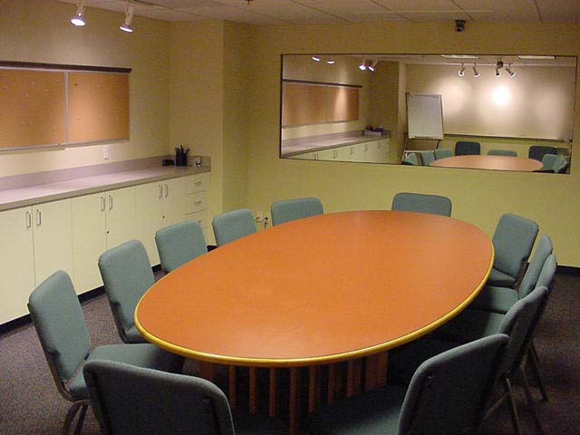
Preparing for the Focus Group
Recruiting Participants
  Getting the Word Out
  Incentives
Materials
  Refreshments
  Recording Equipment
  Name Tags, Paper/Pens/Markers
Environment
  Inviting, comfortable for the number of people
  Arrange the room to accommodate an open discussion
Notes:
Start with a large pool of participants. Begin with written invitations and use phone calls to express your interest in having them participate or confirmations and reminders. The personal touch goes a long way.
Incentives: know what documentation you need to provide for funder
Refreshments are “mandatory” (i.e., so important you don’t want to overlook this). These will help to provide a comfortable atmosphere.
When thinking of incorporating recording equipment, keep your audience in mind. Will being recorded in any way deter or encourage open dialogue? Many times you’ll just rely on good notetaking.

Slide 7
Conducting the Focus Group
The First Moments
  Create a thoughtful, permissive atmosphere
  Welcome participants as they enter
    Try to learn names
  Overview and topic, consent
  Ground rules
  First question
Notes:
Cover consent and confidentiality and agree as a group on ground rules.

Slide 8
Conducting the Focus Group
Moderator Tips
  Prior to the Focus Group
    Know the questions well, so that you can probe for more detail, alter the question order if necessary to flow with the group
  During the Focus Group
    Be ready for the unexpected, but keep your cool and have fun!
    Pay attention to group dynamics, use strategies to manage
Notes:
The moderator facilitates the focus group interview. He or she provides the introduction and conclusion, asks the initial and probing questions, and keeps the discussion respectful, orderly and on topic.

Slide 9
Conducting the Focus Group
Documenter Tips
  Prior to the Focus Group
    Decide the level of detail you need to document and whether you will be looking to focus on consensus or dissension
    Develop a field note form with a system to identify quotes, paraphrases, observations of non-verbal communication, and your comments and questions
  During the Focus Group
    Take detailed notes organized by question, verbal, non-verbal, and your comments or questions
    Do not rely too heavily on recording
Notes:
The documenter does not participate in the discussion. He or she is responsible for preparing the room, greeting participants, monitoring the recording equipment (if it is being used), and taking notes. After the discussion, the documenter should ask follow-up or clarifying questions of participants.
Remember keep your purpose in mind
What level of detail do you need to document? Notes/Audio Recording/Video Recording/Transcription
Are you looking for consensus or dissension?
Developing a field note form you will allow you to organize notes for several focus groups and will assist analysis – especially if you will not be conducting the majority of this analysis.
During
Use computers to take notes: ease the burden of keeping legible notes and allows you to easily keep items organized; provides easier method to keep consistency of notes across all sessions.
Quotes: note as much as you can with attention to key phrases, use … to indicate more was said, note the speaker and the time on the audio recording. Later you can go to the audio recording to pull the entire quote for the analysis.
Keep track of the emerging themes you notice for each question – during your debriefing with the moderator you can discuss these.
Make note of follow-up questions you’d like to ask at the end of the session
Don’t just make note of verbal comments, but also indicate non-verbal activity like physical excitement or disagreement. These notes may aid in the analysis.
Create a sketch of the seating arrangement may help in debriefing and analysis to spark memories

Slide 10
Conducting the Focus Group
Troubleshooting
  Trickle in effect
    Mini-Survey will allow you to gather sensitive information or quantitative data, while also maximizing the time when participants are arriving
  Handling Conflict
  Big Talkers vs Non-Talkers
Notes:
Troubleshooting
Trickle in effect – using paper to ease transition of those who arrive early and those who arrive late; also allows you to gather individualized information or make sure you get information regarding all topics no matter if time runs out.
Conflict arises – handling heated situations
Big talkers vs. Non-talkers – finding balance and engagement from all participants

Slide 11
Analyzing the Data Collected
Analysis Tips
Systematic Analysis Approach (Krueger)
Pattern Identification (Coding)
  Note approximate frequency, but be careful how you quantify (e.g., “majority,” “about half”)
  Non-verbal indicators for agreement, intensity, reluctance
Using technology
  Use what you feel comfortable with: Word, Excel, paper
Interpreting the data
  What is the purpose of the focus groups?
  What is interesting, surprising, confirming?
Notes:
Systematic Analysis Approach: Richard A. Krueger
Begin analyzing while in the group: probing for understanding of inconsistent or vague comments, summarizing discussion of key questions and seeking confirmation
Directly after the session: moderator and documenter/assistant moderator debriefing noting themes, interpretations, insights, ideas and comparing to prior sessions; organize materials.
Within the same day as the session (ideally): back-up files and recordings (notify transcriber of file); the analyzer will reviews notes and develop a “report” with common themes and quotes for each question, which another person will verify.
Within a few days of the session: analyzer reviews each of the session’s analyses to find emerging themes by question and overall themes for all the sessions; describe these findings illustrated by quotes, which another person will verify.
Once analysis of all sessions is complete: write up the impact report.
Pattern identification
Keep the focus on your purpose
Keep track of frequency but don’t try to quantify it using percentages or numbers
Interpreting the data
Again, what is the purpose of the focus groups? How does your data relate to that purpose, what is it telling you?

Slide 12
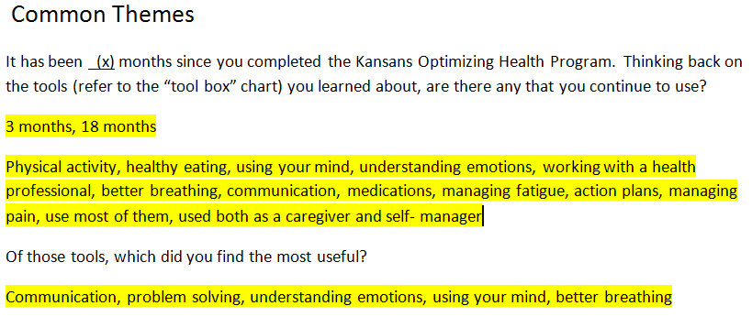
Analyzing the Data Collected
Analyzing as a team
Notes:
Example from KOHP of compiling themes that arose from their notes into a Word file.

Slide 13
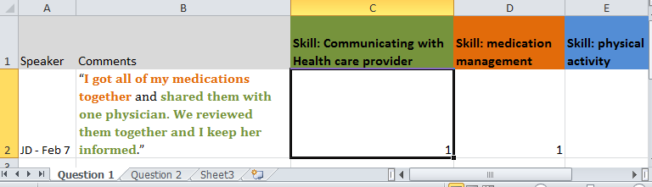
Analyzing the Data Collected
Analyzing in Excel
Notes:
Example using information provided by the KOHP focus group
If you’re comfortable with Excel and have several focus groups you’ll be analyzing Excel may assist you in keeping data organized. It also be a method to use if more than one person will be analyzing the data or if the analyzer was not at the focus group.
Be aware that using this method may make it easier to focus on frequency but you need to think about extensiveness (# of different people who said similar comments or expressed agreement with this comment) and intensity found through the non-verbal interactions (was this comment emotionally charged, did it amplify other’s emotions?)
This color coding could easily be placed in a Word document with lists and quotes.

Slide 14
Writing Up the Findings
Reporting Tips
  Five Principals of Writing (Krueger and Casey)
    Know the Point and Get to it Quickly
    Clear, Effective Writing Takes Time
    Provide Enlightenment
    Involve People Throughout the Study
    Use Multiple Reporting Strategies
  Incorporate visual elements
  Consider an oral presentation when presenting the written report to stakeholders
  Using the KSRE Impact Report Template
Notes:
Krueger and Casey’s 5 Principals of Reporting
Know the Point and Get to it Quickly: keep your purpose in mind
Clear, Effective Writing Takes Time: Be prepared for this; plan for multiple revisions; have someone else review your report
Provide Enlightenment: Ask “What do I have that is new, important, or valuable to my audience?”
Involve People Throughout the Study: “If you want people to actually use your results, make it their study instead of your study” Involve the end-users throughout the process
Use Multiple Reporting Strategies: Use visual elements (charts, images), incorporating bullets and narrative, using quotes; developing oral and written
Needs assessments reports: perhaps would want to make an oral report when presenting the written report

Slide 15
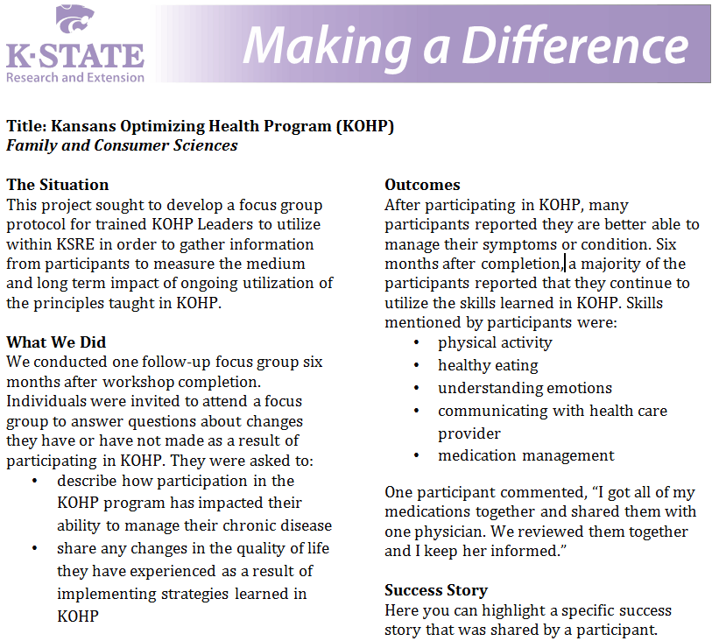
Writing Up the Findings
Notes:
Example using information provided by KOHP’s focus group.
Embed quotations in the outcomes section to enhance the descriptions and quantitative data.
Continually think of how to incorporate the information you gathered in previous evaluation efforts and use the newly gathered information to support your previous findings.

Slide 16
KOHP Pilot Focus Group
Community Health KOHP Evaluation
Laurie Chandler

Slide 17
Questions asked at the February 7, 2012 FCS Update
Can you combine more than one target audience into one focus group, e.g., caregivers and those that have a chronic disease?
Yes, if it serves your purpose. If you are most interested in understanding the range of experiences individuals have had, it makes a lot of sense to include different groups in your one focus group. However, if you are more interested in gaining an in-depth understanding of a particular experience, like that of individuals dealing with a chronic disease, it may make more sense to only include these individuals in the group. As always, practical constraints may influence your decision to combine the two audiences or do separate focus groups session with each audience.

Slide 18
Questions asked at the February 7, 2012 FCS Update
Do you have to have participants sign a formal consent or complete the IRB process for any focus group you do?
In all focus groups, consent and confidentiality should be discussed at the beginning but you do not necessarily have to have a signed consent form. If the focus group is designed around your program evaluation, it will most likely fall under the greater umbrella of the Extension human subject protections. Although, if you think that somewhere in the future you will be publishing information gained from the focus group in a journal or a venue other than your Impact Reports or your direct communications with stakeholders, then you will want to complete the IRB process. Keep in mind, most program evaluations will be found to be "exempt" in the IRB review so that little bit of effort can be fairly quick and manageable.

Slide 19
Questions asked at the February 7, 2012 FCS Update
Can you merge the responses to questions for short-, medium-, and long-term outcomes into one Impact Report?
Yes, you can and should keep adding to the your descriptions of short-term outcomes in your Impact Report as you have information supporting the medium- and long-term outcomes. By continually updating the report, by the end of the year you will have a comprehensive Impact Report that shows the connections between short-, medium- and long-term outcomes and provides a well-rounded view of your program.

Slide 20
Contact Information
Laurie Chandler
Shawnee County Extension
(785) 232-0062
lchandle@ksu.edu
Amy Hilgendorf
OEIE
(785) 532-5538
aehilgen@ksu.edu
Mandi Peters
OEIE
(785) 532-3423
mpeters8@ksu.edu

