Slide 1
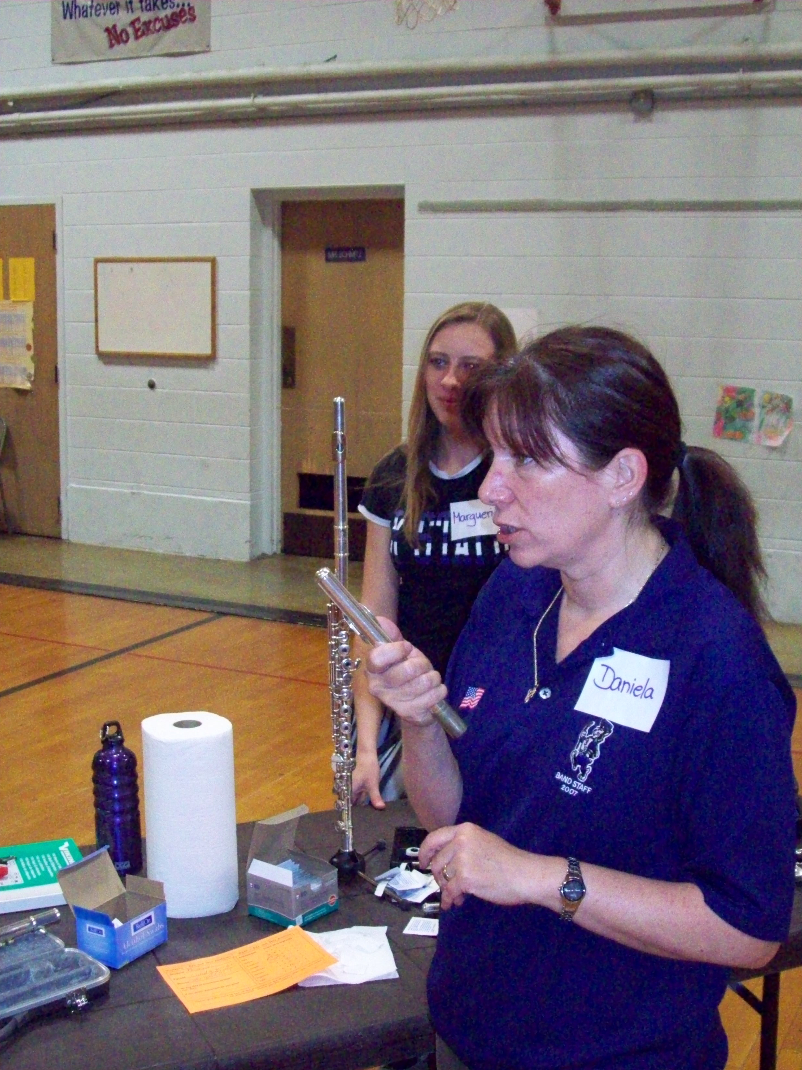
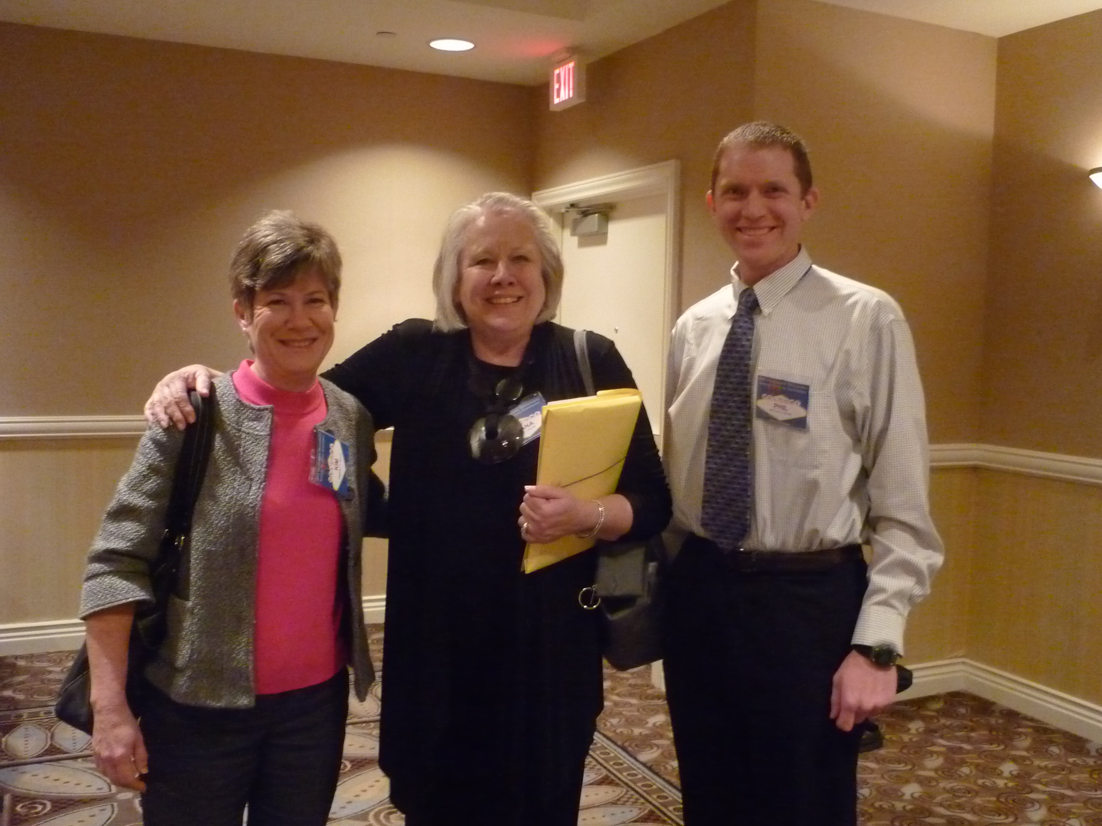
Welcome to Future Music Educators Day
Kansas State University

Slide 2
So, you want to be a music major?
Here’s what you will need for your journey…
Private Lessons
Aural Skills
Music Theory
Vocal Ability
Piano Skills
A passion for music AND teaching!

Slide 3
What should I ask?
When do we get in the classroom?
How often do we get to teach?
How do you develop your teachers?
How much do we have to perform?
What are the requirements for the degree?
Who will be my advisor?
How often will I meet with them?
What are your placement rates like?
Ask them to describe their philosophy…
What about alternative approaches to music education?

Slide 4
Year 1
40 Hours of Observation
Introduction to the Music Teaching Career

Slide 5
Year 2
Fundamentals of Music Teaching

Slide 6
Year 3
Block 1 Classes
36 Hours of Observation
Ed Psych
Core Teaching
Special Populations

Slide 7
Year 4
Secondary Methods
Elementary Methods
Advanced Methods
16 Hours of Teaching

Slide 8
Student Teaching and Licensure
8 Weeks Elementary
8 Weeks Secondary
Licensed to teach PK-12 All Music

Slide 9
Other Opportunities
U-Band
U-Choir
Volunteer Teaching

Slide 10
Two models that are growing…
http://www.youtube.com/watch?v=8G9UIt6SHI0&list=FL782cQ2nPnz9gvEDxsXNlxA&index=6
http://www.youtube.com/watch?v=2W9z-nrTQD4
http://www.youtube.com/watch?v=NqmBH5M-qtU

Slide 11
A passion for music and teaching
To be an effective teacher and musician, you must have the right attitude and have an unmatched passion for music and teaching! With this passion and a strong work ethic, the music education career is one of the most fulfilling!
How do we prepare for this?
www.k-state.edu/musiceducation/apprenticeship

