Slide 1
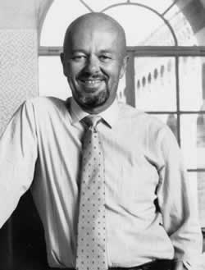
Rubrics
“You need to learn what rubrics are and how they can help you do a better job of testing your students and a better job of teaching your students. .”
–Dr. W. James Popham
Kansas State Department of Education
ASSESSMENT LITERACY PROJECT

Slide 2
Origin of the word Rubric
The celebrant then kisses the altar in the middle and turning to the people, says:
V: “The Lord be with you.”
R: “And with thy spirit.”
– Holy Week Book in Latin and English According to the Ordo Hebdomadae Sanctae Instauratus, (C. Goodliffe Neale: Birmingham, UK, 1956), p. 64.
Kansas State Department of Education
ASSESSMENT LITERACY PROJECT
ASSESSMENT LITERACY PROJECT
2
Notes:
The Oxford English Dictionary notes that from the late 14th century, the word “rubric” was applied to the red-colored directions provided for the celebrant of a religious ritual by medieval monks who transcribed liturgical missals by hand, adding the directions in red.
The word “rubric” originated from the consistent directions provided to clergy in medieval religious books. These directions were printed in red ink. The work rubric means red.
Rubrics provide consistent descriptors of student work at various skill levels. This helps teacher make consistent judgments about the quality of student work.

Slide 3
What are rubrics?
Rubrics are a guide to teaching and learning
In general, “rubrics represent not only scoring tools, but more important, instructional illuminators.”
–W. James Popham
Kansas State Department of Education
ASSESSMENT LITERACY PROJECT
3

Slide 4
How are rubrics helpful in instruction?
Rubrics help us to understand curriculum by operationalizing standards and benchmarks inactual examples of student work
Kansas State Department of Education
ASSESSMENT LITERACY PROJECT
ASSESSMENT LITERACY PROJECT
4

Slide 5
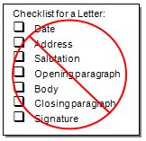
A Rubric is NOT a checklist!
Kansas State Department of Education
ASSESSMENT LITERACY PROJECT
ASSESSMENT LITERACY PROJECT
5
Notes:
A checklist isn’t descriptive and isn’t appropriate to use in evaluating a range of qualitatively different performance levels.
A rubric provides a description of the different levels of performance.
Here you see a checklist for a letter. It isn’t descriptive and it isn’t going to tell a student or teacher anything about the quality of a well written letter.

Slide 6
Activity One
1
Complete Activity One:
What is a rubric?
Kansas State Department of Education
ASSESSMENT LITERACY PROJECT
6

Slide 7
What kinds of rubrics are there?
There are two types of rubrics:
Generic
Task Specific
Kansas State Department of Education
ASSESSMENT LITERACY PROJECT
7
Notes:
We need to take time to go to the Module 7: Rubrics Activities and complete the activities described in Activity 2.

Slide 8
Generic Rubrics
Generic Rubrics address broad learning targets
Kansas State Department of Education
ASSESSMENT LITERACY PROJECT
ASSESSMENT LITERACY PROJECT
8
Notes:
A generic rubric describes broad learning targets. Generic rubrics are better for complex skills that generalize across tasks.
The goal of generic rubrics is to help students apply what they learn about quality in one task to a number of similar tasks. Generic rubrics become part of the learning process.

Slide 9
Task Specific Rubrics
A task specific rubric judges whether or not a student knows specific facts, equations, methods or procedures
Kansas State Department of Education
ASSESSMENT LITERACY PROJECT
ASSESSMENT LITERACY PROJECT
9
Notes:
Task specific rubrics are clear and simple to understand.
But – task specific rubrics do little to help students learn and teachers teach.
Task specific rubrics have their place – but they are limited. They focus on one specific task rather than a full range of comparable tasks.

Slide 10
Generic vs. Task Specific Rubrics
A generic or general rubric can be used across similar performances
Task specific rubrics are clear and simple to understand
Kansas State Department of Education
ASSESSMENT LITERACY PROJECT
ASSESSMENT LITERACY PROJECT
10
Notes:
A generic or general rubric can be used across similar performances. For example the Six Trait Writing Rubric may be used to judge a wide variety of writing assignments.
Task specific rubrics are clear and simple to understand.
But – task specific rubrics do little to help students learn and teachers teach.
Task specific rubrics have their place – but they are limited. They focus on one specific task rather than a full range of comparable tasks.

Slide 11
Activity Two
2
complete Activity Two:
What kinds of
rubrics are there?
Kansas State Department of Education
ASSESSMENT LITERACY PROJECT
11
Notes:
We need to take time to go to the Module 7: Rubrics Activities and complete the activities described in Activity 2.

Slide 12
How are rubrics scored?
Holistic Scored Rubrics
Analytic Scored Rubrics
Single overall impression rating
traits judged separately
Kansas State Department of Education
ASSESSMENT LITERACY PROJECT
12
Notes:
We need to take time to go to the Module 7: Rubrics Activities and complete the activities described in Activity 2.

Slide 13
Holistic Scored Rubrics
To get a holistic score all of the important ingredients of a performance or product are combined to arrive at a single judgment of quality
Kansas State Department of Education
ASSESSMENT LITERACY PROJECT
ASSESSMENT LITERACY PROJECT
13
Notes:
When holistic scoring is used, there are no detailed analyses of the strengths and weaknesses of a student’s work.
Holistic scored rubrics are summative. This means they are used for determining student’s performance at the end of the learning process. There is one score or rating.

Slide 14
What are holistic scored rubrics used for?
Judging simple products or performances
Getting a quick snapshot of quality or achievement
Judging the impact of a product or performance
Kansas State Department of Education
ASSESSMENT LITERACY PROJECT
ASSESSMENT LITERACY PROJECT
14
Notes:
Holistic scored rubrics are used for:
Judging simple products or performances. Ones that don’t have more than one trait of importance – such as the answer to an essay question requiring a description of osmosis for a biology class. This type of scoring rubric is also called primary trait.
Getting a quick snapshot of overall quality or achievement – such as scoring a final essay assignment.
Judging the “impact” of a product or performance. For example to what extent a persuasive essay persuades.

Slide 15
Holistic scored rubrics are summative.
Holistic scoring is not used during
the learning process
Kansas State Department of Education
ASSESSMENT LITERACY PROJECT
ASSESSMENT LITERACY PROJECT
15
Notes:
Holistic scoring is used either at the beginning to obtain a benchmark or at the conclusion of the learning process.
Because holistic scoring is summative, it is limited.
Two students can get the same score or rating for very different reasons.
Holistic scoring does not identify strengths and weaknesses and because of this isn’t good for planning instruction.

Slide 16
Analytic Scored Rubrics
Analytic scoring splits up a student’s product or performance into logical groupings called traits or dimensions
Kansas State Department of Education
ASSESSMENT LITERACY PROJECT
ASSESSMENT LITERACY PROJECT
16
Notes:
When analytic scoring is used, a separate score is given for each trait.
For example, the Kansas Writing Assessment uses the 6-TRAIT model to score student writing analytically.

Slide 17
Analytic scored rubrics integrate assessment with instruction.
The Kansas 6 TRAIT Scoring rubrics integrate assessment with instruction and help teachers communicate with students about the qualities of writing. This is true of all good analytic scored rubrics
Kansas State Department of Education
ASSESSMENT LITERACY PROJECT
ASSESSMENT LITERACY PROJECT
17
Notes:
When analytical scored rubrics are used routinely in the classroom, assessment is integrated with instruction. Feedback from quality analytic scored rubrics guide improvement of teaching and learning.

Slide 18
Analytic scored rubrics
Show strengths and weaknesses of student’s work
Teach quality
Provide detailed feedback
Evaluate complicated skills, products, or performances
Examine each dimension or trait separately
Kansas State Department of Education
ASSESSMENT LITERACY PROJECT
ASSESSMENT LITERACY PROJECT
18
Notes:
Analytic scored rubrics:
Show relative strengths and weaknesses of a student’s work.
Teach students what quality products or performances are by providing detailed descriptions.
Provide detailed feedback to students, teachers, and parents.
Allow teachers and students to evaluate multi-dimensional, complicated skills, products, or performances.
Require examination of each dimension or trait separately for understanding mastery and quality.
When analytical scored rubrics are used routinely in the classroom, assessment is integrated with instruction. Feedback from quality analytic scored rubrics guide improvement of teaching and learning.

Slide 19
Rubric scores converted to grades
How are rubrics converted to traditional grades of A, B, C, D, and F?
Kansas State Department of Education
ASSESSMENT LITERACY PROJECT
ASSESSMENT LITERACY PROJECT
19
Notes:
It is very tempting to convert a rubric score to a grade by adding up all the points of the evaluative criteria the student earned and dividing by the total number of points available. But this would be wrong!

Slide 20
“3” is not a “C”
Rating of 3 – Drafting Stage
The writing demonstrates a fully realized draft that begins to satisfy both the writer’s and readers’ needs and helps to identify areas where large scale revision is still needed. The drafting stage suggests that the writer has progressed through such activities as writing introductions, full body paragraph(s), transitions, and conclusions.
Kansas State Department of Education
ASSESSMENT LITERACY PROJECT
ASSESSMENT LITERACY PROJECT
20
Notes:
According to the Kansas 6 Trait Scoring Manual:
“From the blossoming of an initial idea to the act of publication, writing is an ongoing recursive process, not necessarily a linear one. The Kansas scoring rubric is designed to reinforce this idea and help writers to understand at what particular stage a piece of writing may be for each of the six traits (Ideas and Content, Organization, Voice, Word Choice, Sentence Fluency, and Conventions).”
Here you see what a rating of 3 means on the Kansas 6 Trait Writing Model.
Now consider this: What if a student got a “1” on a trait. It would take a lot of 4’s to balance out a 1 to a passing grade if all we did was average rubric scores.
One more thing to think about – should work done at the end of a grading period count as much as work done at the beginning? When the learner may have developed and improved over time?

Slide 21
Don’t average – use logic!
Kansas State Department of Education
ASSESSMENT LITERACY PROJECT
ASSESSMENT LITERACY PROJECT
21
Notes:
So what should you do? Here is what we recommend:
Don’t average or use strict percentages to determine grades from rubrics.
Do come up with a logic rule for converting the descriptions of the evaluative criteria points to a grade that reflects a performance standard.
Here you see an example of a “Logic Rule for Converting Rubric Scores to Grades” from the book Scoring Rubrics in the Classroom by Judith Arter and Jay McTighe. You don’t need to use this logic rule – Arter and McTighe suggest you come up with one you can live with.

Slide 22
Activity Three
3
Complete Activity Three:
How are rubrics scored?
Kansas State Department of Education
ASSESSMENT LITERACY PROJECT
22
Notes:
We need to take time to go to the Module 7: Rubrics Activities and complete the activities described in Activity 3.

Slide 23
How are rubrics developed?
Start with the evaluative or performance criteria.
Kansas State Department of Education
ASSESSMENT LITERACY PROJECT
23
Notes:
For definitions of the Six Traits used for the Kansas Writing Assessments check out the document
Introduction to Analytic Scoring for the Kansas Writing Assessment: The 6-TRAIT Model.
It’s available on the Web at http://www.ksde.org/Default.aspx?tabid=165

Slide 24
How many evaluative criteria should be in a rubric?
Kansas State Department of Education
ASSESSMENT LITERACY PROJECT
ASSESSMENT LITERACY PROJECT
24
Notes:
Many rubrics use a 4 point scale in which 3 is defined as “meeting the standard” and 4 is defined as “exceeding the standard.”
Many rubrics use a 4 point scale in which 3 is defined as “meeting the standard” and 4 is defined as “exceeding the standard.”
A 2 means “just below the standard” and a
1 means “way below the standard.”
Because keeping a rubric simple makes it easier for the teacher to score and for the student to understand, we recommend 3 to 6 evaluative criteria.

Slide 25
Practice using Evaluative Criteria
Step one: gather at least 30 random samples of student performance or work that illustrate the skills or behavior
Kansas State Department of Education
ASSESSMENT LITERACY PROJECT
ASSESSMENT LITERACY PROJECT
25

Slide 26
Step two: Sort student work
Does Not Meet Standard
Approaching Standard
Meets Standard
Exceeds Standard
Kansas State Department of Education
ASSESSMENT LITERACY PROJECT
ASSESSMENT LITERACY PROJECT
26
Notes:
With a group of your colleagues, sort student work into groups. You may want to start with four piles sorted according to these four labels:
Does Not Meet Standard,
Approaching Standard,
Meets Standard, and
Exceeds Standard.
Write a list of the reasons for placing pieces in the 4 stacks. Why does the student work Exceed Standard? Why doesn’t it Meet the Standard? Be certain to include specific details.
Keep sorting work until you are not adding anything new to your list of attributes.

Slide 27
Step three: Cluster reasons into traits or dimensions of performance.
6 + 1 Writing Traits
Ideas/Content
Organization
Voice
Word Choice
Sentence Fluency
Conventions
Presentation
Kansas State Department of Education
ASSESSMENT LITERACY PROJECT
ASSESSMENT LITERACY PROJECT
27
Notes:
Cluster the reasons into traits or important dimensions of performance.
Of course, we’ve already talked about the 6 + 1 Writing Traits but they provide great examples:
Ideas/Content
Organization
Voice
Word Choice
Sentence Fluency
Conventions
Presentation

Slide 28
Step four: Write value neutral definitions for each trait
This is the definition of the trait Technology Problem-Solving and Decision Making:
Students use technology resources for solving problems and making informed decisions
From: Resources for Student Assessment. By M. G. Kelly and Jon Haber, International Society for Technology in Education, Eugene, OR.
Kansas State Department of Education
ASSESSMENT LITERACY PROJECT
ASSESSMENT LITERACY PROJECT
28
Notes:
After identifying the traits, it’s time to write definitions of each.
Keep in mind your definitions should describe what each trait is about – not what good performance looks like. We’ll get to good performance when we write descriptors for the Exceeds level.
This is the definition of the trait Technology Problem-Solving and Decision Making:
Students use technology resources for solving problems and making informed decisions.

Slide 29
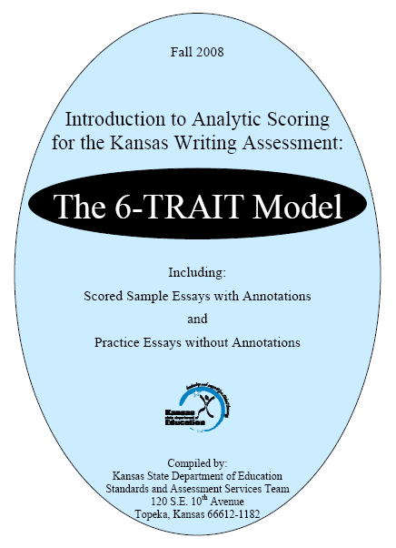
For definitions of the Six Traits used…
Available on the Web at:
http://www.ksde.org/
Default.aspx?tabid=165
Kansas State Department of Education
ASSESSMENT LITERACY PROJECT
29
Notes:
For definitions of the Six Traits used for the Kansas Writing Assessments check out the document
Introduction to Analytic Scoring for the Kansas Writing Assessment: The 6-TRAIT Model.
It’s available on the Web at http://www.ksde.org/Default.aspx?tabid=165

Slide 30
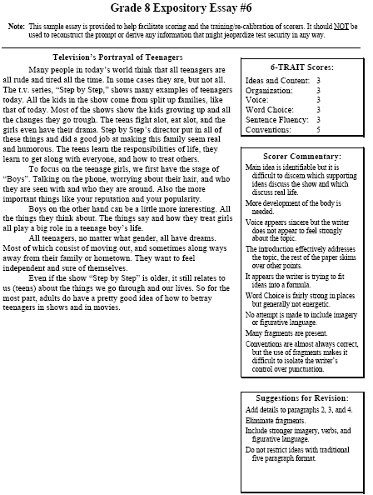
Step five: Identify student samples that show evaluative criteria
After the traits have been defined, find samples of student performance that show each evaluative criterion 1, 2, 3, and 4
These samples are going to become “exemplars”
Kansas State Department of Education
ASSESSMENT LITERACY PROJECT
ASSESSMENT LITERACY PROJECT
30
Notes:
After the traits have been defined, find samples of student performance that show each evaluative criterion 1, 2, 3, and 4.
These samples are going to become “exemplars.” They are also called “anchors, models, and range finders.” But we will just call them exemplars.
Exemplars guide the user of the rubric. They help the raters using the rubric to see what 3 or “Meets Standard” looks like and how the 3 criterion is different from the 2 criterion.
Here we see an exemplar for the Kansas 8th grade Expository Essay taken from the Introduction to Analytic Scoring for the Kansas Writing Assessment. It is found on p. 36.

Slide 31
Step six: Write descriptors for each performance level
This is the highest evaluative criterion of the trait Technology Problem-Solving and Decision Making:
Students develop strategies for use of data analyses, models, and simulations to make specific decisions regarding a course of action for solving real-world problems
From: Resources for Student Assessment. By M. G. Kelly and Jon Haber, International Society for Technology in Education, Eugene, OR.
Kansas State Department of Education
ASSESSMENT LITERACY PROJECT
ASSESSMENT LITERACY PROJECT
31
Notes:
Now it’s time to write the descriptors for the evaluative criteria. These need to be brief but still capture the essence of what makes a student’s work a 1 or a 4 on the rubric scale.
This is an example of the descriptor for the highest evaluative criterion for the trait “Technology Problem-Solving and Decision Making” from the book Resources for Student Assessment.

Slide 32
Step seven: Establish validity
Rate the samples and share results
This helps establish the rubric’s validity.
Kansas State Department of Education
ASSESSMENT LITERACY PROJECT
ASSESSMENT LITERACY PROJECT
32
Notes:
After the descriptors are written, teachers rate the student samples and share their results. Then they review the descriptor and the exemplar until they reach agreement on both.
This helps establish the rubric’s validity.

Slide 33
Step eight: Establish reliability
Re-rate the student work using the new rubric and exemplars
address the consistency of the Rubric
This process helps establish the
rubric’s reliability
Kansas State Department of Education
ASSESSMENT LITERACY PROJECT
ASSESSMENT LITERACY PROJECT
33
Notes:
Now it is time to address the consistency of the Rubric.
Teachers re-rate the 30 exemplars using the new rubric and exemplars.
Scores are then compared, and discrepancies greater than 1 evaluative criterion on a trait are assigned to a third rater, whose score becomes final.
This helps establish the rubric’s reliability.

Slide 34
Step nine: Continuously refine
Use the rubric and revise, revise, revise
Rubrics and the criteria in them evolve with use
As you revise, don’t be afraid to let students help
This process helps establish the rubric’s reliability
Kansas State Department of Education
ASSESSMENT LITERACY PROJECT
ASSESSMENT LITERACY PROJECT
34
Notes:
And when we have finished the process of creating a rubric can we relax?
No! Rubrics and the criteria in them evolve with use. You will have to try a new rubric out. You’ll find some parts of the rubric work and some don’t.
You may need to add and modify descriptors or choose better exemplars that illustrate what you mean. You may even need to revise traits.
As you revise, don’t be afraid to let students help. After all, rubrics are all about student learning.
This helps establish the rubric’s reliability.

Slide 35
Activity Four
4
complete the nine steps in Activity Four:
How are rubrics developed?
Kansas State Department of Education
ASSESSMENT LITERACY PROJECT
35
Notes:
We need to take time to go to the Module 7: Rubrics Activities and complete the activities described in Activity 4.

Slide 36
What is a quality rubric?
Choosing which rubrics are worth using and which are not requires discrimination
Kansas State Department of Education
ASSESSMENT LITERACY PROJECT
ASSESSMENT LITERACY PROJECT
36
Notes:
Teachers can find a variety of rubrics by simply entering the name of a performance task into an Internet search engine.
But be careful!!!
Choosing which rubrics are worth using and which are not requires a little more discrimination.

Slide 37
Popham’s Rubric for Rubrics
Four essential components:
Significance
Evaluative Criteria
Quality Distinctions
Concise Clarity
Kansas State Department of Education
ASSESSMENT LITERACY PROJECT
ASSESSMENT LITERACY PROJECT
37
Notes:
Dr. Popham offers a rubric to help us tell the difference between "rubrics that are rapturous and those that are rancid."
His rubric addresses four essential components:
1. Significance
2. Evaluative Criteria
3. Quality Distinctions and
4. Concise Clarity.

Slide 38
Significance
A strong rubric:
Focused on students’ attainment of a high level cognitive skill
A weak rubric:
Focus on students’ acquisition of knowledge or a quickly taught, low-level cognitive skill
Kansas State Department of Education
ASSESSMENT LITERACY PROJECT
ASSESSMENT LITERACY PROJECT
38

Slide 39
Evaluative Criteria
A strong rubric:
Clear descriptions of how each evaluative criteria is applied, so that different rubric users come up with essentially the same evaluations for same student work
A weak rubric:
Many different evaluations for the same student work
Kansas State Department of Education
ASSESSMENT LITERACY PROJECT
ASSESSMENT LITERACY PROJECT
39
Notes:
Popham goes on to address Quality Distinctions:
Are degrees of excellence satisfactorily described for each of the rubric’s evaluative criteria?
A strong rubric will provide clear descriptions of how each evaluative criterion is applied, so that, with reasonable training, different rubric users will come up with essentially the same evaluations for student work.
A weak rubric’s evaluative criteria will lead to many different evaluations for the same student work.

Slide 40
Concise Clarity
A strong rubric:
Presented briefly enough and clearly enough so that busy teachers will use it
A weak rubric:
Too lengthy or too technical for teachers and students to use
Kansas State Department of Education
ASSESSMENT LITERACY PROJECT
ASSESSMENT LITERACY PROJECT
40-41
Notes:
He then considers the Concise Clarity of the rubric by asking:
Is the rubric presented in a sufficiently succinct and lucid manner so that it is likely to be used?
A weak rubric will be too lengthy or too technical for teachers and students to use.
A strong rubric will be presented briefly enough and clearly enough so that busy teachers will use it.
A weak rubric’s evaluative criteria will lead to many different evaluations for the same student work.

Slide 41
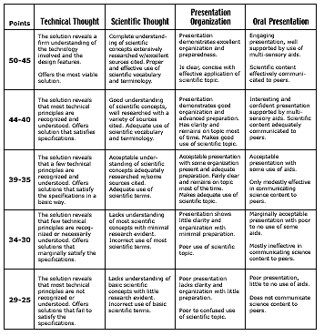
Summary
In this module we’ve addressed the following questions:
What is a rubric?
What kinds of rubrics are there?
How are rubrics scored?
How are rubrics developed?
What is a quality rubric?
Kansas State Department of Education
ASSESSMENT LITERACY PROJECT
42
Notes:
We need to take time to go to the Module 7: Rubrics Activities and complete the activities described in Activity 5.

Slide 42
Activity Five
5
Complete Activity Five:
What is a quality rubric?
Kansas State Department of Education
ASSESSMENT LITERACY PROJECT
43
Notes:
We need to take time to go to the Module 7: Rubrics Activities and complete the activities described in Activity 5.

