Slide 1
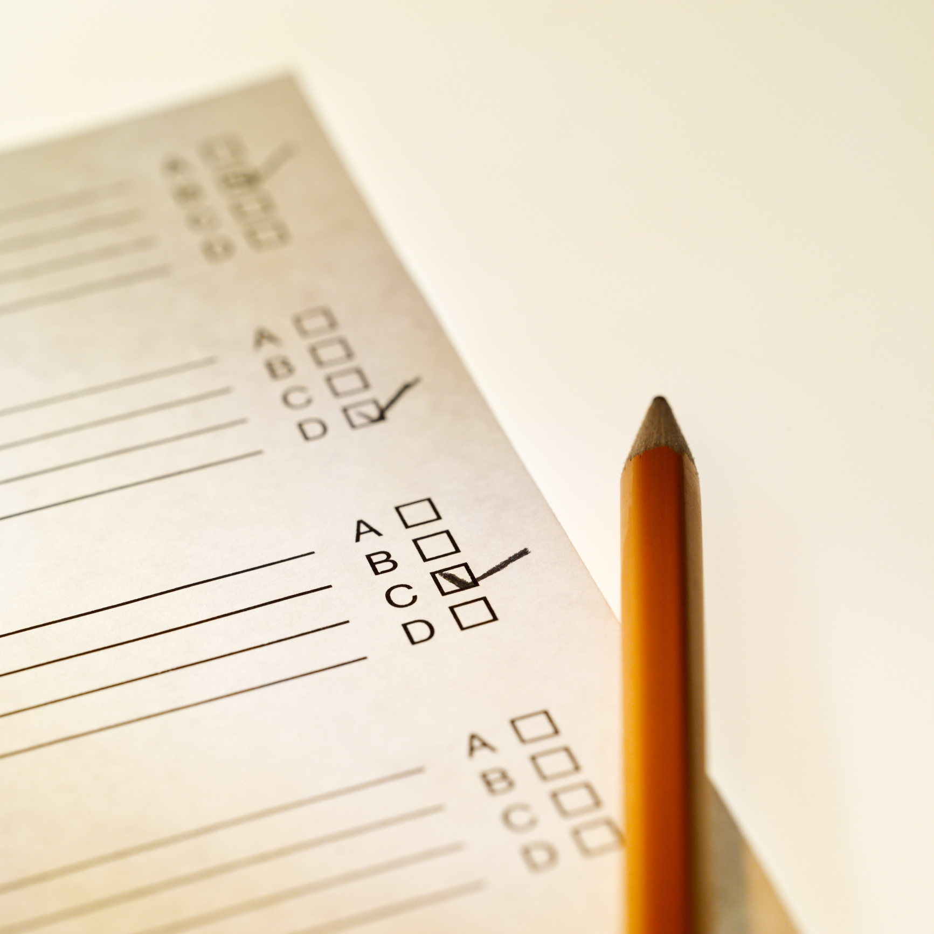
Reliability for Teachers
Reliability = Consistency
Kansas State Department of Education
ASSESSMENT LITERACY PROJECT
1

Slide 2
Essential Questions:
What is test reliability?
What are some of the issues related to reliability?
What are the three types of reliability?
How can teachers increase their classroom tests’ reliability?
Kansas State Department of Education
ASSESSMENT LITERACY PROJECT
ASSESSMENT LITERACY PROJECT
2

Slide 3
Reliability is Essential
Tests must be reliable to be valid – but can be reliable and still not be valid
Kansas State Department of Education
ASSESSMENT LITERACY PROJECT
ASSESSMENT LITERACY PROJECT
3

Slide 4
Reliability Represents Consistency
Test reliability represents the consistency of test measurement. Unreliable tests can’t be trusted.
Kansas State Department of Education
ASSESSMENT LITERACY PROJECT
ASSESSMENT LITERACY PROJECT
4

Slide 5
Tests - Reliable / Results - Valid
Results of a test are valid or invalid
The test itself is either reliable or unreliable
A test must be both reliable and valid to be useful
Kansas State Department of Education
ASSESSMENT LITERACY PROJECT
ASSESSMENT LITERACY PROJECT
5

Slide 6
What is Reliability?
Reliability is the consistency, stability, accuracy, and precision of the scores that a test yields
Kansas State Department of Education
ASSESSMENT LITERACY PROJECT
ASSESSMENT LITERACY PROJECT
6

Slide 7
Three Varieties of Reliability
Kansas State Department of Education
ASSESSMENT LITERACY PROJECT
ASSESSMENT LITERACY PROJECT
7

Slide 8
Reliability Depends on Correlational Analyses
Kansas State Department of Education
ASSESSMENT LITERACY PROJECT
ASSESSMENT LITERACY PROJECT
8

Slide 9
Correlation-Coefficients
Kansas State Department of Education
ASSESSMENT LITERACY PROJECT
ASSESSMENT LITERACY PROJECT
9

Slide 10
No Pre-Determined Reliability Coefficient
It’s important to understand there is no predetermined reliability coefficient that tests must attain in order to show consistency of a test’s scores
Kansas State Department of Education
ASSESSMENT LITERACY PROJECT
ASSESSMENT LITERACY PROJECT
10

Slide 11
Activity One
1
Take time to answer the essential question:
What is reliability?
Kansas State Department of Education
ASSESSMENT LITERACY PROJECT
ASSESSMENT LITERACY PROJECT
11

Slide 12
Classification Consistency Reliability
Classification consistency reliability is a representation of the proportion of students who are classified identically on two different test forms or two different administrations of the same test.
Kansas State Department of Education
ASSESSMENT LITERACY PROJECT
12

Slide 13
Example of Classification Consistency (Good Reliability)
Test-Retest Reliability Classification Table
2nd Administered Test
1st Admin. | Upper 3^{ed} | Middle 3^{ed} | Lower 3^{ed}
Upper 3^{ed} | 35 | 5 | 2
Middle 3^{ed} | 4 | 32 | 6
Lower 3^{ed} | 11 | 3 | 38
Kansas State Department of Education
ASSESSMENT LITERACY PROJECT
ASSESSMENT LITERACY PROJECT
13

Slide 14
Example of Classification Consistency (Poor Reliability)
Test-Retest Reliability Classification Table
2nd Administered Test
1st Admin. | Upper 3^{ed} | Middle 3^{ed} | Lower 3^{ed}
Upper 3^{ed} | 13 | 15 | 4
Middle 3^{ed} | 10 | 24 | 8
Lower 3^{ed} | 11 | 10 | 18
Kansas State Department of Education
ASSESSMENT LITERACY PROJECT
ASSESSMENT LITERACY PROJECT
14

Slide 15
Issues Related to Classification Consistency
Inter-rater reliability. Inter-rater agreement is the degree of agreement in the ratings that two or more observers assigned to evaluate the same behavior or performance
The focus of inter-rater reliability is the accuracy of the ratings
Kansas State Department of Education
ASSESSMENT LITERACY PROJECT
ASSESSMENT LITERACY PROJECT
15

Slide 16
16

Slide 17
Issues Related to Classification Consistency
Two types of errors are likely to occur when cut scores on tests are used to classify students
The first error is setting cut scores too high
The second error is setting cut scores too low
Kansas State Department of Education
ASSESSMENT LITERACY PROJECT
ASSESSMENT LITERACY PROJECT
17

Slide 18
For tests used with cut scores,
get answers to the following questions:
What proportion of students would be classified the same way if they had taken a different form of the same test?
What proportion of students would be classified the same way if they had taken the same form on a different day (assuming no changes in knowledge)?
What proportion of students would be classified the same way if their responses to the constructed-response questions, such as essays, had been scored by different people?
Kansas State Department of Education
ASSESSMENT LITERACY PROJECT
ASSESSMENT LITERACY PROJECT
18

Slide 19
Reliability of Classification is Not Perfect
Every test is only a sample of all the questions that could be asked
Test takers are not likely to be equally knowledgeable about all of the possible questions that could be asked, so test form to test form differences are likely
Day-to-day fluctuations in students’ attention, memory, health, and so on also impact reliability classification
Kansas State Department of Education
ASSESSMENT LITERACY PROJECT
ASSESSMENT LITERACY PROJECT
19

Slide 20
Cut Scores and Classification Consistency
Most tests cannot distinguish well between students with scores that are very close to one another. Whenever a cut score is used, however, students with scores just above the cut score and students with scores just below the cut score will be classified differently
What this means is that students who score near the cut score may pass or fail a test because of random fluctuations
Kansas State Department of Education
ASSESSMENT LITERACY PROJECT
ASSESSMENT LITERACY PROJECT
20

Slide 21
Reliable Tests = Classification Consistency
The more reliable a test is, however, the less likely it is that the scores will be affected by large random fluctuations
Longer tests are more reliable than shorter tests
Objectively scored tests are more reliable than subjectively scored tests
Kansas State Department of Education
ASSESSMENT LITERACY PROJECT
ASSESSMENT LITERACY PROJECT
21

Slide 22
Activity Two
2
Let’s stop now and participate in Activity Two where we will answer the essential question:
What are some of the issues related to reliability?
Kansas State Department of Education
ASSESSMENT LITERACY PROJECT
ASSESSMENT LITERACY PROJECT
22

Slide 23
Stability Reliability
Definition:
Assessment results consistent over time (over occasions).
Why might test results NOT be consistent over time?
Kansas State Department of Education
ASSESSMENT LITERACY PROJECT
23

Slide 24
Determining Stability Reliability
Test-Retest Reliability
Compute the correlation between a first and later administration of the same test
Classification-consistency
Compute the percentage of consistent student classifications over time
Main Concern is with the stability of the assessment over time
Kansas State Department of Education
ASSESSMENT LITERACY PROJECT
ASSESSMENT LITERACY PROJECT
24

Slide 25
Standard Error of Measurement (SEM)
SEM is an estimate of the consistency of a student’s score if the student had retaken the same test over and over again
Kansas State Department of Education
ASSESSMENT LITERACY PROJECT
ASSESSMENT LITERACY PROJECT
25

Slide 26
Standard Deviation (SD)
Standard Deviation of test scores is a statistical indicator of how spread out a set of test scores is
Kansas State Department of Education
ASSESSMENT LITERACY PROJECT
ASSESSMENT LITERACY PROJECT
26

Slide 27
Formula for Computing Standard
Error of Measurement (SEM)
Where:
SEM = the standard Error of Measurement
S_{x} = the standard Deviation of the test scores
r_{xx =} the reliability of the test
Kansas State Department of Education
ASSESSMENT LITERACY PROJECT
ASSESSMENT LITERACY PROJECT
27

Slide 28
Alternate-Form Reliability
Concerned with the question:
Are two, supposedly equivalent, forms of an assessment in fact actually equivalent?
The two forms do not have to yield identical scores
The correlation between two or more forms of the assessment should be reasonably substantial
Kansas State Department of Education
ASSESSMENT LITERACY PROJECT
ASSESSMENT LITERACY PROJECT
28

Slide 29
Determining Alternative-Form Reliability
Administer two forms of the assessment to the same individuals and correlate the results
Determine the extent to which the same students are classified the same way by the two forms
Alternate-form reliability is established by evidence, not by proclamation
Kansas State Department of Education
ASSESSMENT LITERACY PROJECT
ASSESSMENT LITERACY PROJECT
29

Slide 30
Internal Consistency Reliability
Concerned with:
Extent to which the test items of an assessment function consistently
Extent items in an assessment measure a single attribute
For example, consider a math problem-solving test. To what extent does reading comprehension pay a role? What is actually being measured?
Kansas State Department of Education
ASSESSMENT LITERACY PROJECT
ASSESSMENT LITERACY PROJECT
30

Slide 31
Formulae for Computing
Internal Consistency (Terminology)
Kuder-Richardson (K-F Formula) = used for right/wrong answers such as multiple choice
Cronbach Coefficient Alpha – for items in which students are given points such as essay questions
Dichotomous items = right/wrong
Polytomous = multiples responses/scores
Kansas State Department of Education
ASSESSMENT LITERACY PROJECT
ASSESSMENT LITERACY PROJECT
31

Slide 32
Most Common is the
Kuder-Richardson or K-R Formula
The closer the K-R value is to 1.00 the higher the
internal reliability
Kansas State Department of Education
ASSESSMENT LITERACY PROJECT
ASSESSMENT LITERACY PROJECT
32

Slide 33
Activity Three
3
Take time now to participate in Activity Three to answer the essential question:
What are the three types of reliability?
Kansas State Department of Education
ASSESSMENT LITERACY PROJECT
ASSESSMENT LITERACY PROJECT
33

Slide 34
Review of Reliability
Reliability is the consistency, stability, accuracy, and precision of the scores that a test yields
Validity refers to what inferences can be made about the test’s results. A test can have high reliability but not have validity. However a test cannot have validity unless it is reliable
Reliability depends upon correlational analyses. These are score consistency and classification consistency
Kansas State Department of Education
ASSESSMENT LITERACY PROJECT
23

Slide 35
Review of Reliability
There are three different types of reliability:
Stability reliability is the consistency of results between two time-separated tests
Alternate form reliability is the consistency of results between two different forms of a test
Internal consistency reliability is the consistency in the way a test’s items function
Kansas State Department of Education
ASSESSMENT LITERACY PROJECT
ASSESSMENT LITERACY PROJECT
35

Slide 36
Review of Reliability
Standard deviation of test scores is a statistical indicator of how spread out a set of test scores is
Standard error of measurement or S E M is an estimate of the consistency of a student’s score if the student had retaken the same test over and over again
If the standard error of measurement for a test is small this is a good thing. And the standard error of measurement is smaller when the standard deviation of the test scores is small and the reliability coefficient is large
Kansas State Department of Education
ASSESSMENT LITERACY PROJECT
ASSESSMENT LITERACY PROJECT
36

Slide 37
Improving Classroom Tests’ Reliability
Always remember to encourage students to perform their best
Match the assessment difficulty to the students’ ability levels
Have scoring criteria that are available and well understood by students before they start an assignment or assessment
Kansas State Department of Education
ASSESSMENT LITERACY PROJECT
ASSESSMENT LITERACY PROJECT
37

Slide 38
Improving Classroom Tests’ Reliability
Allow enough time to complete the assessment
For objective assessments like multiple choice tests:
Have enough items - longer tests are more reliable than shorter tests
Kansas State Department of Education
ASSESSMENT LITERACY PROJECT
ASSESSMENT LITERACY PROJECT
38

Slide 39
Improving Classroom Tests’ Reliability
For papers, essays, and projects:
Have clear directions for all students
Have a systematic scoring procedure that the students are familiar with
Have multiple markers (scorers) when possible
Kansas State Department of Education
ASSESSMENT LITERACY PROJECT
ASSESSMENT LITERACY PROJECT
39

Slide 40
Activity Four
4
Take time now to participate in Activity Four to answer the essential question:
How can teachers increase their classroom tests’ reliability?
Kansas State Department of Education
ASSESSMENT LITERACY PROJECT
ASSESSMENT LITERACY PROJECT
40

