Slide 1
“The Great Equalizer: Equality, Equity, and Social Justice”
Blane Harding
University of Kansas

Slide 2


Slide 3
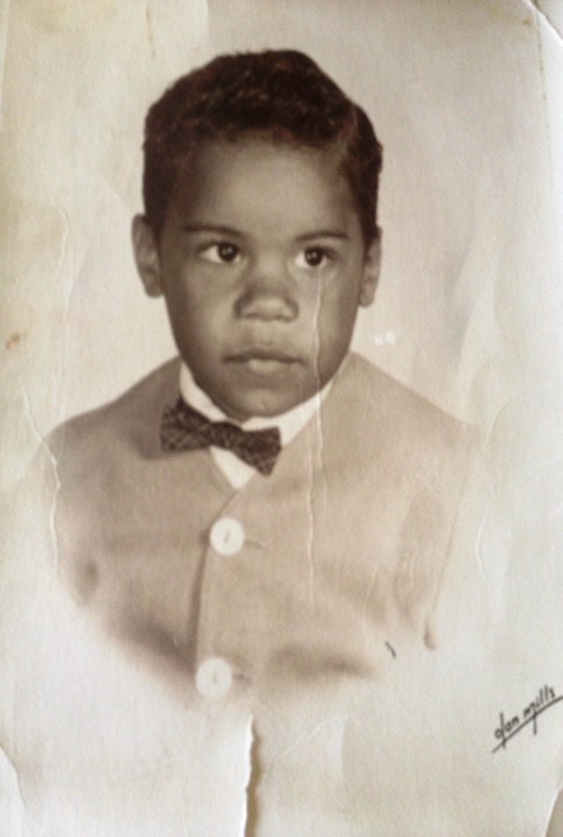
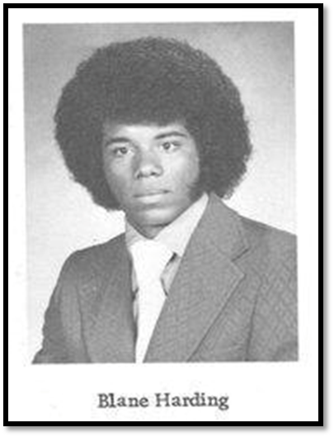
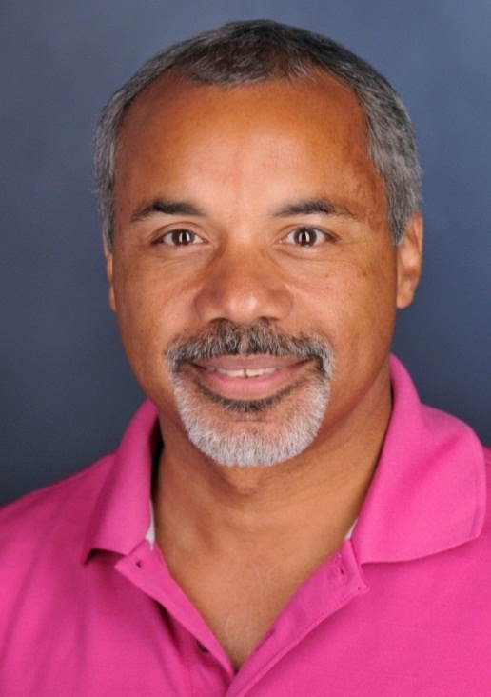
Change can be good!!!

Slide 4
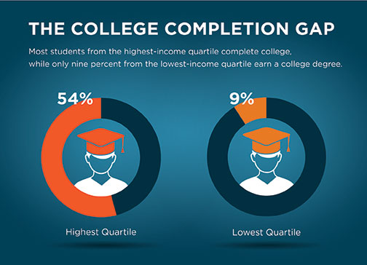

Slide 5
We believe college can be a reality for everyone, no matter your income or background. It's a matter of finding good information, the right people to help and planning wisely.

Slide 6
IMPACT OF DIVERSITY
Psychologist Charlan Nemeth showed that the mere presence of a minority viewpoint on a work team stimulated creativity among all the members by forcing reexamination of basic assumptions and by encouraging more open and frank dialogue.

Slide 7
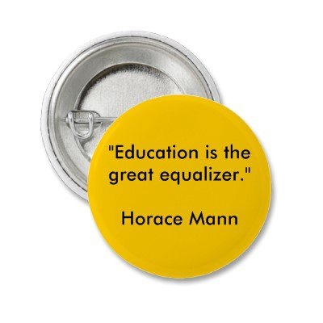

Slide 8


Slide 9
Privilege
A right or immunity granted as a peculiar benefit, advantage, or favor.
A right or benefit that is given to some people and not to others.
The advantage that wealthy and powerful people have over other people in a society.
A special advantage, immunity, permission, right, or benefit granted to or enjoyed by an individual, class, or caste.
The advantages and immunities enjoyed by a small usually powerful group or class, especially to the disadvantage of others.
The principle or condition of enjoying special rights or immunities.

Slide 10
We need to ask ourselves:
  What does it mean to be privileged?
  Who tends to be marginalized?
  What does it mean to be marginalized?
  Ways we tend to deny that privilege is occurring?
  What happens when one group is privileged over another?
  How can we take action to interrupt these cycles of oppression and inequality?

Slide 11
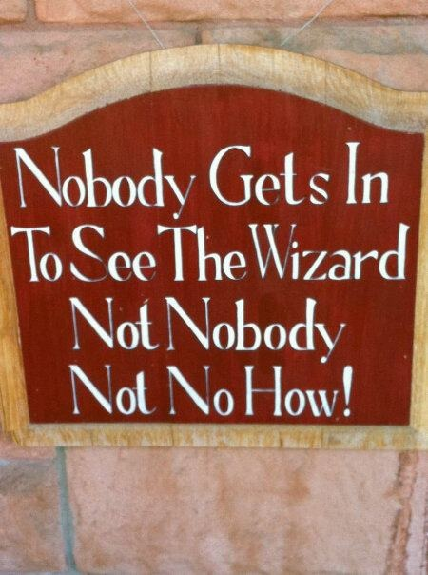

Slide 12
ACCESS
A means of approaching, entering, exiting, communicating with, or making use of.
The ability or right to approach, enter, exit, communicate with, or make use of: has access to the restricted area; has access to classified material.
Freedom or ability to obtain or make use of something.

Slide 13
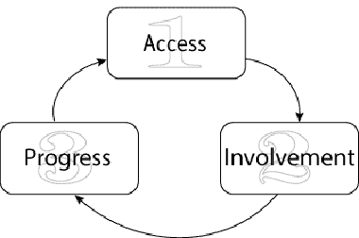
THE CYCLE OF ACCES

Slide 14
Universal Access to Education
All people to have equal opportunity in education, regardless of their social class, ethnicity, background or physical disabilities.
Professors and instructors at the college level shoud rethink methods of facilitating universal access in their classroom.
Encourages a variety of pedagogical approaches to accomplish the dissemination of knowledge across the diversity of social, political, cultural, economic, national and biological backgrounds.

Slide 15
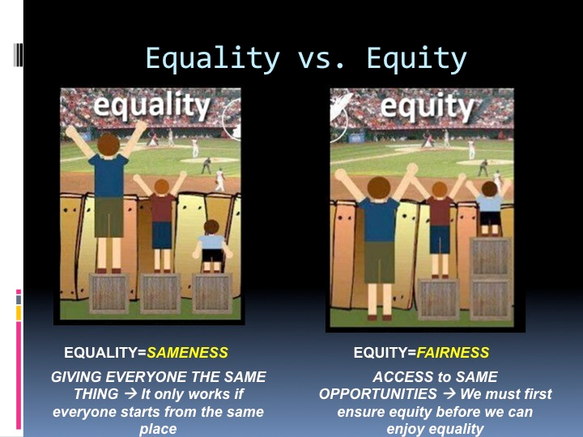

Slide 16
SOCIAL JUSTICE
“The practice of promoting and protecting human rights and responsibilities, with a particular emphasis on the economic and social rights of society’s most vulnerable groups” - Human Rights Resource Center

Slide 17
WHY SOCIAL JUSTICE ?
  Inequality is the status quo.
  Inequality in access to resources.
  Inequality in securing human rights and safety.
  Inequality in freedom from discrimination.
  Reducing inequality is both morally right and pragmatically necessary.

Slide 18
Key Themes in Social Justice
Making the world better
Equity of opportunity
Equality of treatment
Fairness
Appreciating differences
Giving voice
Power dynamics
Asking questions
Empathy through multiple perspectives

Slide 19
Key Elements of Social Justice
Multiple perspectives.
Examining root causes.
Empowering the disenfranchised.
Goal: to change the system.
Connecting to individuals’ lives.
Individual ownership and leadership.

Slide 20
PAULO FREIRE
It is impossible to talk of respect for students, for the dignity that is in the process of coming to be, for the identities that are in the process of construction, without taking into consideration the conditions in which they are living and the importance of the knowledge derived from life experience, which they bring with them to school. I can in no way underestimate such knowledge. Or what is worse, ridicule it.”
Paulo Freire, Pedagogy of Freedom, 1998

Slide 21
Social Justice Thinking
Transformative Education
Transformative education (i.e., Education is part of the political-social process; education reflects social ideologies).
Equity (i.e., Conviction to and belief in equitable treatment; takes into account individuals of diverse races, genders, social classes, languages and cultures; critical of inequality and marginalizations)..
Equal educational opportunities for all (i.e., Belief that all can achieve to full potential; provides access to challenging academic curriculum; inclusive).
Student -centered (i.e., critical pedagogy, reflective practice, teachers as students/ students as teachers; focuses content & process).
Critically examining Culture, including my own and how they come to be. (i.e., Deep reflection regarding assumptions, values, beliefs; critically examines “whiteness”.)
Broad outcomes and multiple assessments (i.e., Follows growth from where they started; solutions oriented after identifying a problem; builds coalitions through valuing and integration).

Slide 22
“IT’S NOT THE FIGMENT OF THE PIGMENT
BUT THE ENIGMA OF THE STIGMA”

Slide 23
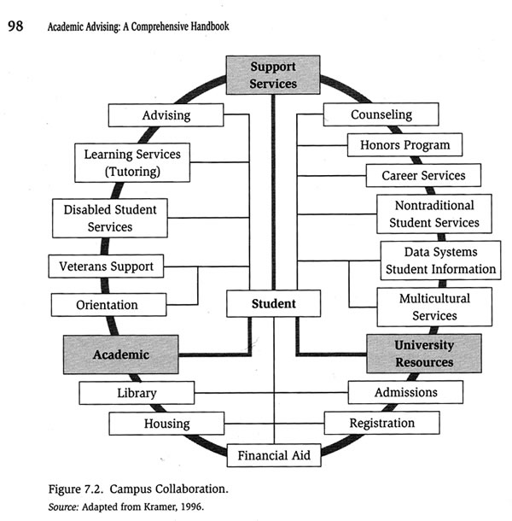

Slide 24
BARRIERS/CONCERNS
Lack of college preparation and basic academic skills.
Stereotypical attitudes, expectations, and images held by college personnel toward these students
Lack of role models on campus representing their individual groups
Limited coping skills
Lack of “fit” on some campuses resulting in isolation
Limited or ineffective multicultural training from campus personnel
Curriculum that does not reflect their experiences or include their histories
Lack of campus support systems to address their unique needs
Enrollment later in life as nontraditional students
Enrolled as part-time students
Families may have limited support or understanding of higher education

Slide 25
RESPONSIBILITIES
A commitment to the whole student.
Recognition and appreciation of individual differences.
A commitment to facilitate student development, success, and learning.
The ability to provide students access and opportunity.
Adequate ongoing multicultural advisor training.
Building a sense of community on campus for targeted groups.
Increased awareness of demographic trends in society.

Slide 26
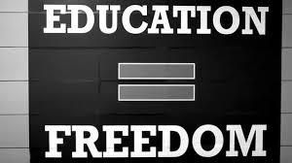
THAN YOU VERY MUCH!!

