Slide 1
Student Success is a Personal Matter
Fred B. Newton, Ph.D.
Kansas Student Affairs Conference
Manhattan, KS
November 1, 2013

Slide 2
Questions to be Addressed
Can we identify the factors that impact student success?
Why are personal (psychosocial) factors important?
Can we identify best (research based) practices?
What role does Student Affairs play?
What are the present realities and future trends impacting our practice?

Slide 3
Why should we be research based?
Increases our predictions for success
Provides efficiency of cost and time effort
Outcome measures demonstrate what works
Consistent with emphasis on value added
Gives credibility within the educational system

Slide 4
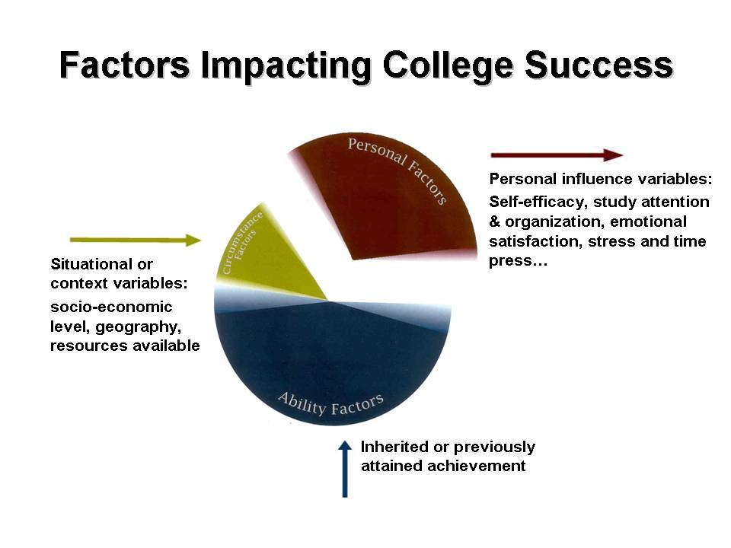
Personal Factors Make a Difference!
Research from more than 1,000 published studies on predictions of college success.
Meta-analysis of over 50 research articles on psycho-social variables
Current studies utilizing the CLEI inventory

Slide 5
Why are personal factors an important area to enhance student retention?
They are shown to relate directly to student success (approximately 25-35% of the predictive formula).
They are within the power of the individual to influence, enhance, and implement.
There are methods to engage and intentionally assist students in personal development goals.

Slide 6

Key Success Variables:
Beliefs and attitudes – Includes confidence, desire, discipline, motivation, values.
Meaningful study and time use Understands and utilizes behaviors and workable methods to organize and carry through learning tasks.
Emotional management – Able to self-regulate, control emotional responses, and social maturity.
Involvement – Meaningful engagement with campus life and activity. Finding social support and connection to the campus community.
Communication – Productive interpersonal interaction with instructors, fellow students and community resources
Holistic well-being – Includes physical, nutritional, sleep, spiritual.

Slide 7
Complexity of personal factors
Personal factors are often difficult to know and detect because they are “personal”!
One exit study listed the following reasons: job opportunity, marriage, illness, changing career interest, finances, grades, family problems, general dissatisfaction.
Mixed educational philosophies include desire by some educators to “weed out” those who should “not be students”
Expert says: A reasonable increase in student retention from past institutional history through an intentional and extensive effort could be 2% to 4% (Gary Hanson)
In spite of the above we do have an evidence base that we can improve GPA, outcome retention rates, and most important, the quality of a student’s learning experience. While classroom activity, improved facility, and coherent educational experiences are important- a relatively unnoticed, yet extremely productive source of improvement, includes the means to enhance student personal factors in learning!

Slide 8

KSU Studies on Personal Factors
STEPS:
Identify and define the key personal variables
Utilize or develop an accurate assessment tool
Apply assessment results to intervention strategies
Utilize best learning principles to target change
Track and measure outcome results
TASKS COMPLETED:
Developed the CLEI, HBA, and KPIRS
Factor analysis, validation, confirmatory studies
Created intervention packages including manuals, workbooks, and on-line delivery systems
Reported through 7 refereed journals
Several more outcome measurement studies in progress

Slide 9
Development of the CLEI
Started with requests for assistance with at-risk students
Inductive practice experience provided from task force of 8 practitioners.
Based upon Russell & Petrie model (1992)
Reviewed meta analysis and key studies of the field (Robbins et.al. 2004)
Revised with 4 versions of CLEI (1998 to present)

Slide 10
CLEI Six Scales
(1) Academic Self-Efficacy (ASE Scale):
Expressing confidence in academic ability, awareness of effort toward study, and expectation for success in college attainment.
(2) Organization and Attention to Study (OAS Scale):
The organization of tasks and structuring of time to set goals, plan, and carry out necessary academic activity.
(3) Stress and Time Press (STP Scale):
Dealing with pressures of time, environmental concerns, and the academic demands that impact academic study.
(4) Involvement with College Activity (ICA Scale):
Belonging to organizations and participating in activities, including formal or informal gatherings of friends and classmates, within the campus environment.
(5) Emotional Satisfaction (ES Scale):
Degree of interest and emotional response to academic life including people and the campus educational environment.
(6) Class Communication (CC Scale):
Both verbal and non-verbal effort to engage in class activity.
Notes:
10

Slide 11
CLEI Study Results

Slide 12
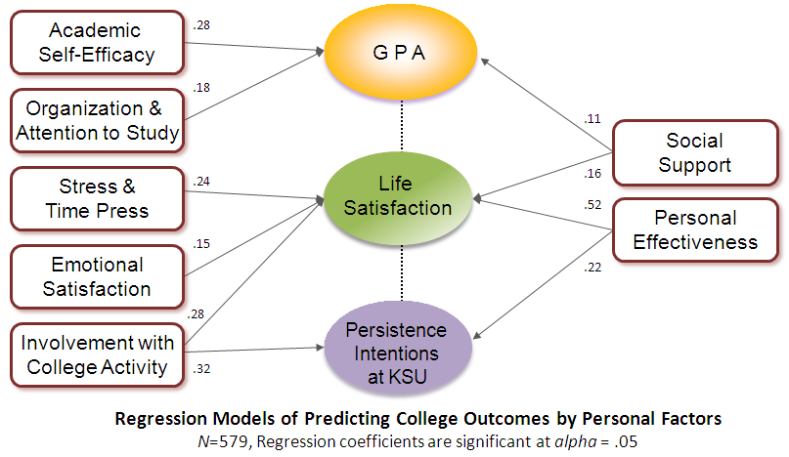
Prediction of CLEI Variables w Outcomes
- Correlation Coefficients -
*p<.05, **<.01
Notes:
12

Slide 13
Relationship of Health Behavior with
Student Success Outcome (HBA)
Alcohol
Consumption
- .216
G P A
Unhealthy Eating
- .184
.147
.115
Personal
Management Skill
.497
Life
Satisfaction
.167
Healthy Eating
.090
Vigorous Exercise
- .175
.104
- .136
BMI
Moderate
Physical Activity
Regression coefficients of health behavior variables for each predictors (GPA, Life Satisfaction, BMI); Significant at alpha=.05; N=347).
Notes:
13

Slide 14
What have we learned?
Summary Conclusions
Self Efficacy – An essential but not sufficient condition*
Study Behavior – Learning, as any activity, is best accomplished by sound study procedures and time commitment.
Stress management – The #1 expressed concern of students includes the experience of pressure, anxiety, and stress reactions that interfere with performance. **
Involvement – Engagement with people, organizations and activity of an academic community impacts and maintains the interest and commitment to persist in college.***
Individuality – Each person follows a unique pattern of style, personality, preferences, and culture. Knowing the individual condition is important to forming a working relationship.
* UCLA Freshmen student study (2011), Bandura (1997)
** ACHA (2009)
*** Astin (1999)

Slide 15
What have we learned? (continued)
Readiness – Individual awareness falls along a path from pre-contemplation, contemplation, planning, action to maintenance.*
Goal Attainment – Translating dreams and aspirations to everyday action involves very realistic tangible steps. (teaching one to fish) **
Balance and Well-Being – Maintaining holistic wellness practice impacts performance to either enhance or inhibit outcomes.***
Peer Influence – The impact of the peer social contact can enhance or inhibit learning performance. Using trained peers to support educational goals is extremely powerful.+
* Hamlin (McPherson College, 1986), Prochaska & DiClemente (1994)
** Goal Attainment Scaling & Force Field Analysis
*** Healthy PAC-CATS program, The WELL (UCRiverside)
+ Malcolm Gladwell Tipping Point, EWU Scholars Program.

Slide 16
How do we apply assessment to personal understanding and change?
What?
Assessment – Accurate and meaningful measurement of individual attitudes, behaviors and personal/emotional impact
So What?
Integration – Understanding and making personalized and meaningful connection to the individual within the system context
Now What?
Application – Appropriate intervention to create new learning strategies, better habits, problem-solution, and self-confidence
Notes:
16

Slide 17
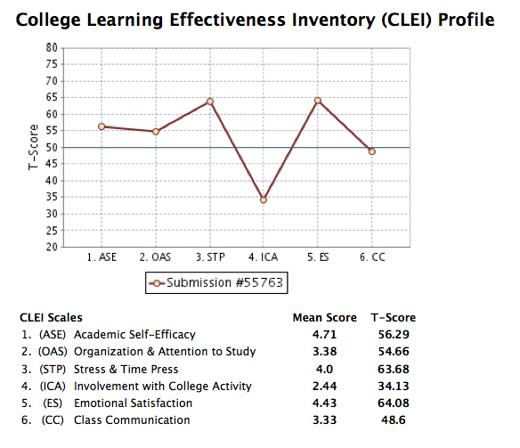

Slide 18
MEASUREMENT TO OUTCOME
CLEI
Baseline
Implication
(Goal Directed Activity)
Improvement
(Outcome Measures)
Readiness
Standard
Performance
Interview
Identification
(Assessment)
Notes:
18

Slide 19
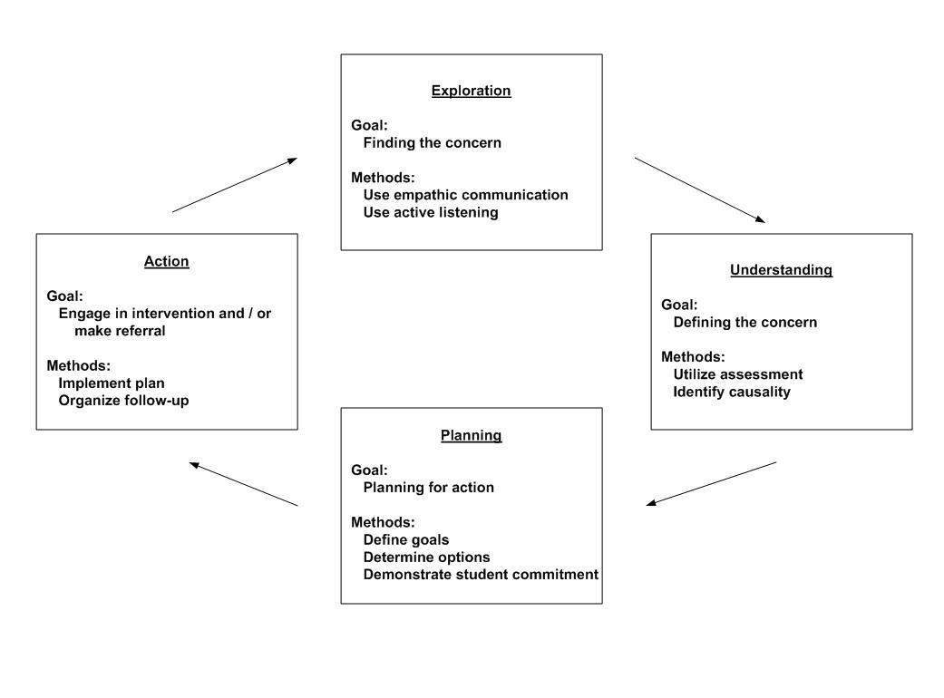
Student Success through Personal Enhancement
An important point to emphasize when working with the personal factors you are dealing with individual differences and a matrix of complex situational factors so it becomes more of a process than a set formula to create an improved situation.

Slide 20
Case Example: Architect Student
Background Information: Sally entered the university on an academic scholarship based upon both ACT scores and high school records. Her goal was to be an architect. She had started her first semester two times and had withdrawn after a period of 3 to 4 weeks due to personal issues described as emotional illness.
Initial Resolution: Waive any reentry restrictions due to her very high academic promise, and advise her of campus resources. During the 3rd week of her third reentry she received a request from her family physician to reduce her academic load due her anxiety responses. Also, recommended treatment assistance.
Assessment & Treatment: Advising referred to physician and counseling for assistance. Assessment focused the problem to specific performance anxiety related to project critique assignments. Treatment followed measured protocol with dramatic change at 6th week. Dramatic shift to become highly successful and graduate with top marks in class.

Slide 21
Case Example: Frosh on Probation
Background Information: After her first semester, Sally met with her advisor to discuss her course for improvement.
Initial Resolution: Sally showed personal resolve that she felt she was disappointing her family and herself and made a serious promise that she “would study harder, apply herself by putting more time aside for each class.”
Follow-up: At the end of her second semester her G.P.A. was still not sufficient to get off of her probation. However, at this juncture advisement focused on more specific problem solving. Taking the CLEI assessment it became apparent that her weaknesses were demonstrated difficulty with focus of attention and anxiety in performance activity. The intervention gained a specific focus.
Changes in the Concordia College Program: Improvement in retention of student in an academic support program from freshmen to sophomore year increased from 57% (without use of assessment) to 80% when using the CLEI assessment to plan model.

Slide 22

Good to Best Practice Examples
Good: Friendly, open and inviting. Take pride in atmosphere that invites cordiality and sensitivity to students, parents, prospects.
Better: Efficient and effective responsiveness to student needs when the timing is important and necessary. This is by having informed staff knowing when, where, and how to get students to the support they need. This includes receptionists, instructors, and other students.
Good: Provide remedial services and support for students who go on academic probation after first semester.
Better: Use anticipatory interventions through summer advance programs, orientation classes that assess and prepare. Example: EWU First Year Scholars Program
Good: Community with vast array of support services (advising, tutoring, financial, social, health, recreation, counseling, and more). Invite students to use resources.
Better: Connecting these services in more seamless coordinated manner. Example: UCR The Well: Power of the Peers
Good: Student offenders of alcohol, drug, or behavior policies receive mandate to attend educational session on problem area and provide community service.
Better: Student offenders mandate to go through self assessment process, determine own areas for improvement, design a program of change and do follow up of progress. Example: ABC program

Slide 23
Student Affairs:
How do we contribute to student learning?
Traditional responsibilities by integrating functions (service, student development, & learning)
Collaboration with academic areas
Utilizing and balancing time and task
Increasing preparation, training, skills in area
Demonstrating our expertise
Dealing with forces such as budgets, delivery system, institutional priorities

Slide 24

Checklist of Factors that Make a Difference
Differences between customer service and a friendly atmosphere
Holistic approach to student life…self responsibility can be developed in health, social, emotional, educational well-being
How can we tie the various support sources into an integrated resource
Account for student differences especially readiness level
Influence of peers – Students do Help other Students
Utilizing newest communication technology (on-line – UniversityLifeCafe.org)
Academic arena (including the classroom, laboratory, and research efforts) as partners in engagement.

Slide 25

Future Challenges
Today, Tomorrow, or 2025 ?
KSU 2025 Visionary Plan
Recognized top 50 Public Research Institution
Planning, goal setting, bench marking.
Funding, building, attaining $
Specific student retention & recruitment, & educational advances
October 7, 2013 Issue of TIME raises future questions concerning cost, marketplace demands, curriculum controversy, exit exams (CLA), exclusivity, and the role of distance learning

Slide 26
Research Abstract
Krumrei, E., Newton, F.B., Kim, E. & Wilcox, D. “Psychosocial Factors Predicting First-Year College Student Success”. Journal of College Student Development, 54 (3), May/June, 2013.
This study makes use of a model of college success that involves students achieving academic goals and life satisfaction. Hierarchical regressions examined the role of six psychosocial factors for college success among 579 first-year college students. Academic self-efficacy predicted end-of-year GPA even when controlling first semester GPA. In addition, 1st semester GPA fully mediated links between five psychosocial factors (organization and attention to study, stress and time management, involvement with college activity, emotional satisfaction with academics, and class communication) and end-of-year GPA. Stress and time management skills, involvement with college activity, and emotional satisfaction with academics were each predictive of life satisfaction. We explore how formulating interventions on the basis of psychosocial factors offers an avenue for students to address specific attitudes, emotions, and behaviors that relate to college success.
Link for copy: http://psychologyprogress.com/psychosocial-factors-predicting-first-year-college-student-success/

