Slide 1
Division of Financial Services Credit Card Deposit Training
Hosted By:
Bryan Kraus
Jen Schlegel

Slide 2
Main Point of Contact
Division of Financial Services
Cashier’s & Student Accounts
Jim Keating
Keating@ksu.edu
532-1834

Slide 3
What is happening?
The way credit card deposits are processed will change for transactions processed on or after January 30, 2013.

Slide 4
Why is this happening?
The number of departments accepting credit cards and the number of credit card transactions the University processes has increased dramatically.
Accounting, processing and reconciling credit card transactions has become extremely time consuming.

Slide 5
Who is affected?

Slide 6
Who is affected?
Credit Card Processors
Applicable:
Terminal/Application Users
Not Applicable:
CASHNet Storefronts
Cashiers Terminal Users

Slide 7
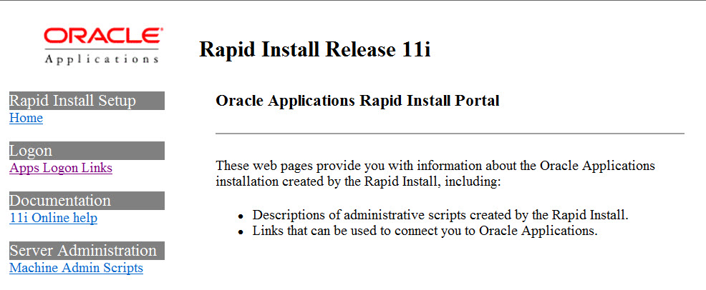
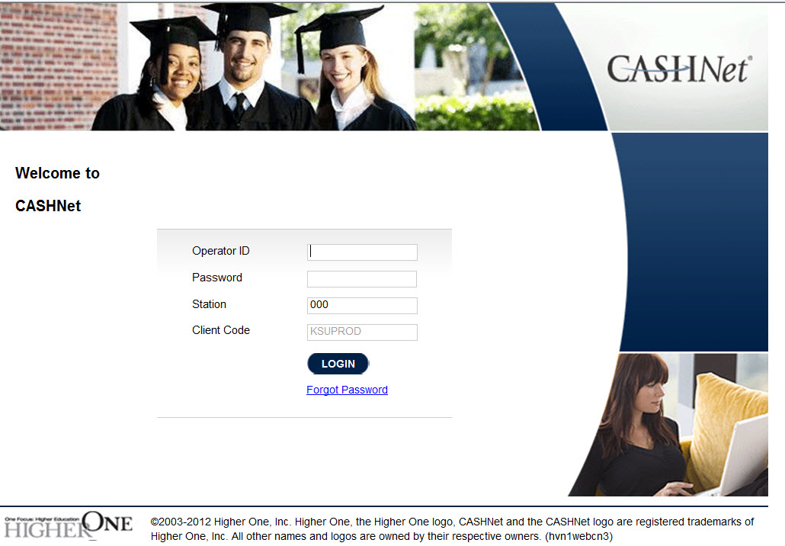
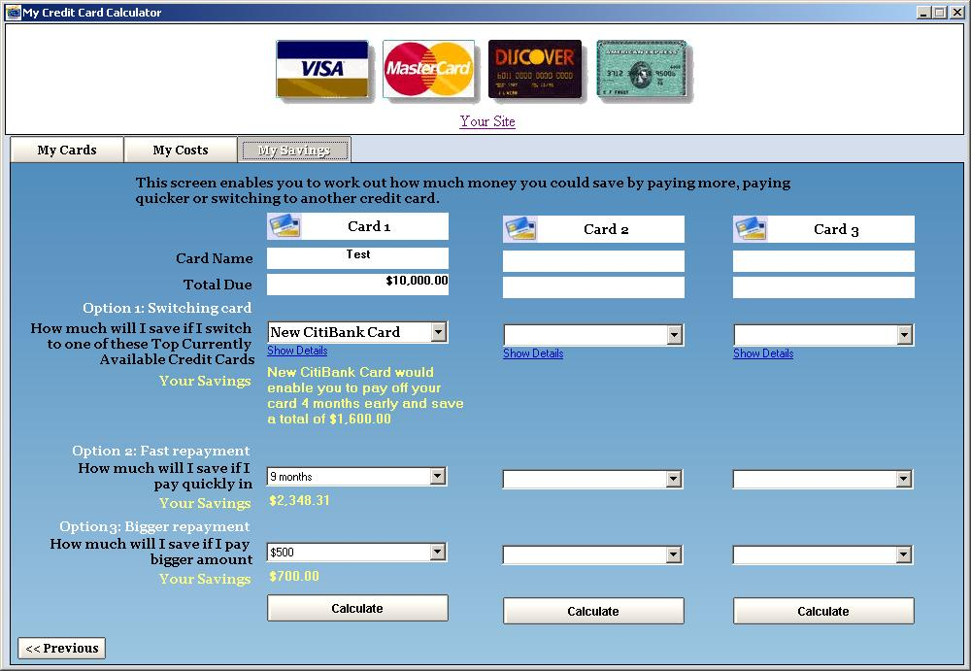
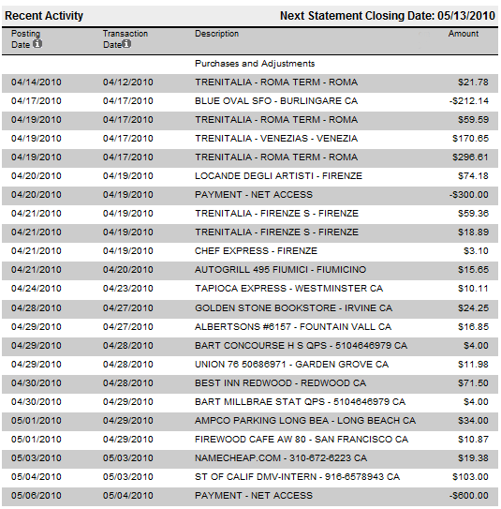
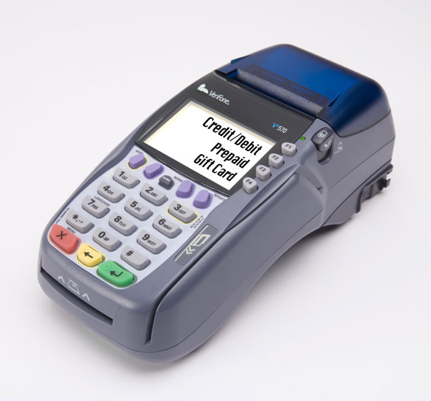
What is affected?
Current Credit Card Process
FIS
Credit Card Processor
CASHNet
KSU Departments

Slide 8
What is affected?
New Credit Card Process
FIS
Credit Card Processor
Where is this report?
CASHNet
KSU Departments

Slide 9
Where is the FIS Deposit Report?
Login to FIS
Navigate to the Reports
Select the KSU Credit Card Report

Slide 10
1. Login to FIS
https://ebiz.as.ksu.edu:8000/

Slide 11
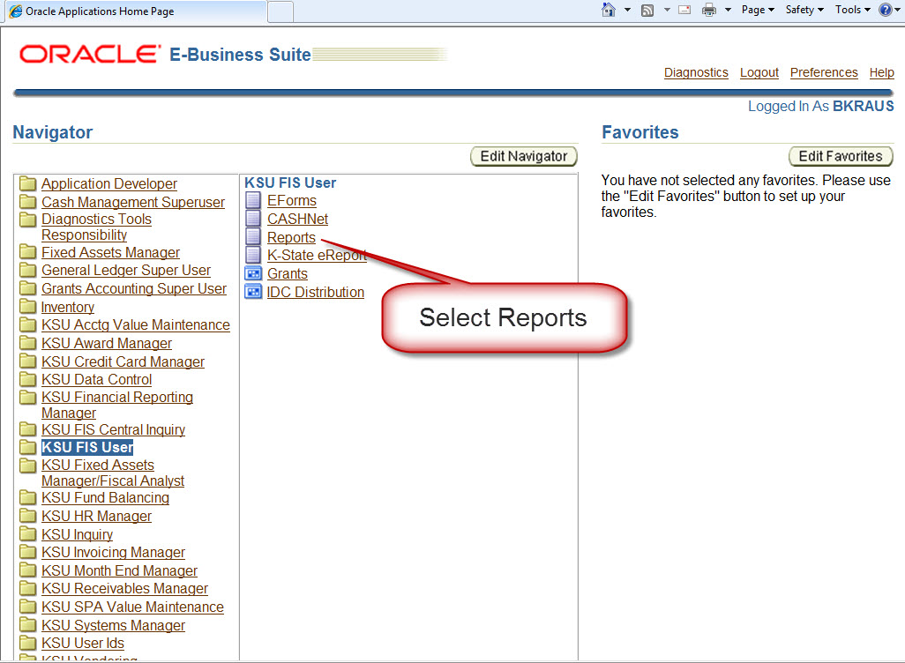
2. Navigate to the Reports

Slide 12
3. Select the KSU Credit Card Report

Slide 13
3. Select the KSU Credit Card Report

Slide 14
KSU Credit Card Deposits

Slide 15
KSU Credit Card Deposits

Slide 16
KSU Credit Card Deposits

Slide 17
KSU Credit Card Deposits
Key fields
Merchant Nbr Key : Department’s merchant number
Merchant Nbr : Corresponding merchant number for identification at credit card processor
File Date : The day the information was received from Bank of America
Summary Type :
VMD Batch – Visa/Mastercard/Discover transactions
Amex – American Express transactions (Non Thursday and Friday)
Amex Weekend – American Express transactions (Thursday and Friday combined)

Slide 18
KSU Credit Card Report
Key fields
File Date : The day the information was received from Bank of America
Tran No: Transaction number that is used to identify the transaction on the monthly Transaction Report.
*** Drill down to detail

Slide 19
KSU Credit Card Deposits
Click on the CC_DepSumId to drill into the deposit’s detail.

Slide 20
KSU Credit Card Deposits - Detail

Slide 21
KSU Credit Card Deposits - Detail

Slide 22
KSU Credit Card Deposits - Detail

Slide 23
KSU Month-End Transaction Detail

Slide 24
KSU Month-End Transaction Detail
Comparison
Tran No and Amounts match between reports
Tran Date is the File Date
Tran Type is GMSACC
Voucher No begins with SCC

Slide 25
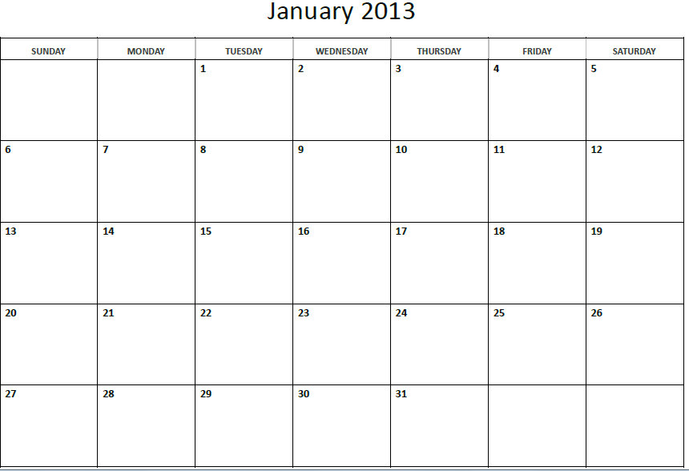
When does it change?

Slide 26
When does it change?
30
For transactions “dated” after January 29, 2013 no CASHNet deposit should be created.
Transactions will be deposited to the FIS account that is associated with the transactions merchant number.

Slide 27
How Do I Move Funds?
If your organization has credit card sales that fall into only one project and only one revenue code, you won’t need to!
If you have sales that need partitioning between multiple projects or multiple revenue codes, do a CashNet Red/Black.

Slide 28
Moving Funds: CashNet Red/Black

Slide 31
Notes:
Item Code
User Number & Description, anything you want

Slide 34
Conclusion
New system affects your organization if you use credit card terminals or an application
Now, no CASHNet deposit to receive your credit card sales in FIS Account
New credit card reports in FIS Discoverer showing batches and detailed transactions
Use a CASHNet Red/Black to move funds between Projects or Revenue Codes
Make sure your Merchant Number has a default FIS Account!!!

Slide 35
Questions?
To view this entire PowerPoint presentation visit the Cashier’s Office website at:
www.ksu.edu/finsvcs/cashiers/training

