Slide 1
Sleep is a Superpower
Today's Guide for A Healthy Conversation
We will begin at 12:10 p.m.
PRESENTER
Be respectful and open to others.
Please type your questions in the Q&A box and comments into the chat box for our moderators.
Today's session will be recorded and will be posted to our Living Well Wednesday web page at www.ksre.k-state.edu/fcs/livingwellwed/
Michelle Lane
RN, MSN, CMSRN, CHC, NE-BC
Sr Director Community Health and Wellness
K-State Research and Extension is an
equal opportunity employer.

Slide 2
Kansas State University is an affirmative-action,
equal-opportunity employer.
K-State Research and Extension programs and materials are open to all, without regard for race, color, national origin, sex, gender, gender identity, religion, age, height, weight, disability, political beliefs, sexual orientation, marital status, family status, or veteran status.

Slide 3
Sleep is superpower. Period
Notes:
Sound alarm clock--That’s a sound we are familiar with and what that awful sound does, is stop us from doing the single most important behavioral experience that we have, sleep. If you're an average person, 36 percent of your life will be spent asleep, which means that if you live to 90, then 32 years will have been spent entirely asleep. Yet, for most of us, we don't give sleep a second thought.
For most of my life I have tolerated the need for sleep and thought of sleep as an illness that needed a cure. Well, it's because you don't do anything while you're asleep, right? You don't eat. You don't drink. And you don't have sex. Well, most of us anyway. And so, therefore it's a complete waste of time, right? Wrong. Sleep is an incredibly important part of our biology and neuroscientists are beginning to explain why it’s a superpower.
My goal today is to change your views, ideas and thoughts about sleep. Share what I have learned First let's talk about the brain.

Slide 4
Notes:
If sleep is a superpower, then the brain is a Swiss army knife.
The brain only weighs 3 pounds and is made up of 75% water- that means just a 2% decrease can have a negative effect on brain functions. My son did the 75 days hard and one of the challenges is drinking the right amount of water our body needs around 4 Liters- he said by far this was the most beneficial thing he did as far as “feeling better”.
Another fascinating fact; did you know we have 2 brains…in utero as our brain develops part of that tissue stays back and forms our gut and is tied to the manufacturing of neurotransmitters like serotonin…it makes 95% of the feel-good hormones
The brain is amazing, complex and somewhat misunderstood but scientists are learning so much!

Slide 5
The lymphatic system
The Lymphatic system
Notes:
Scientist have found that sleep may be a kind of elegant design solution to some of the brain's most basic needs. All organs need a continuous supply of nutrients to fuel its cells. In the brain, that is especially critical; its intense electrical activity uses up a quarter of the body's entire energy supply, even though the brain accounts for only about two percent of the body's mass.
Our cardiovascular system solves the nutrient delivery problem by sending blood vessels to supply nutrients and oxygen to every corner of our body. So- just as every cell needs nutrients, every cell also produces a byproduct, and the clearance of this waste is the 2nd basic problem all organs must solve. All of the organs in the body use the awesome lymphatic system…it is a 2nd parallel network of vessels that extends throughout the body. It takes up proteins and other waste from the spaces between the cells, it collects them, and then dumps them into the blood so they can be disposed of.
But if you look closely at this diagram, one of the things you notice is the only area of the body where there is no lymphatic system is the head. So how, then, does the brain solve its waste clearance problem? The brains solution is really quite genius, downright beautiful.

Slide 6
Notes:
The brain has this large pool of clean, clear fluid called cerebrospinal fluid, called CSF. The CSF fills the space that surrounds the brain and wastes from inside the brain make their way out to the CSF, which gets dumped, along with the waste, into the blood. Sounds like the lymphatic system, right? But what's interesting is that the fluid and the waste from inside the brain, they don't just percolate their way randomly out to these pools of CSF. Instead, there is a specialized network of plumbing that organizes and facilitates this process.
The CSF is pumped back into and through the brain along the outsides of the blood vessels. If you think about it, using the outsides of these blood vessels like this is a clever design solution, because the brain is enclosed in a rigid skull, so there is no extra space inside it for a whole second set of vessels like the lymphatic system. Yet the blood vessels extend down to reach every cell in the brain, which means that fluid that's traveling along the outsides of these vessels can gain easy access to every nook and cranny in the brain…this .redefines repurposing! No other organ takes quite this approach to clearing away the waste from between its cells. This is a solution that is entirely unique to the brain. But our most surprising finding was that all of this, everything I just told you about, with all this fluid rushing through the brain, it's only happening in the sleeping brain.

Slide 7
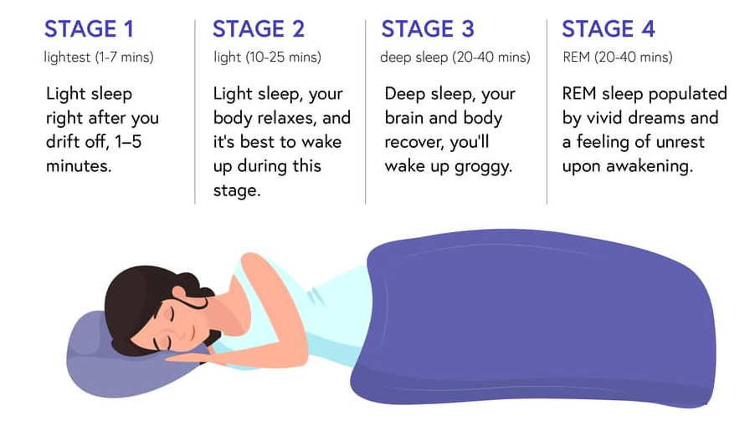
Notes:
There are sleep stages
Stage 1- very light sleep, makes up about 2% of sleep time, it’s the transition between awake and sleep, this when muscles relax, breathing slows and your brain slows down, your eyes roll back and forth to the right and left and if you wake up during this stage you might not even think you were asleep…only last 5-10 min
Stage 2 at the very beginning you might even feel like you are falling as you get into this stage, many people experience it, you wake up with a jump, that’s called a sleep start, that’s because you were woke up as you were falling asleep, your body temp decreases and so do your heart rates, about 50% of your sleep
Stage 3/4 lumped together- deep or delta sleep, this is the physically restorative sleep…the wake up and feel great sleep, growth hormone which is like taking your car into the body shop and get the dings/scratches taken out…that is what happens…sleep walking occurs is the stage -your brain despite resting is pretty active creating delta waves
REM- this is the mental restoration…your eyes move rapidly during this stage…its even observable from the outside of the eyes even though they are closed….despite your active eyes, the rest of your body excluding breathing freezes during this stage…this is so you don’t act out your dreams…your essentially paralyzed…sleep paralysis is real…occurs when brain wakes up during REM sleep but body is holding still….unlike your body your brain is highly active….this is when we move short term memory into long term

Slide 8
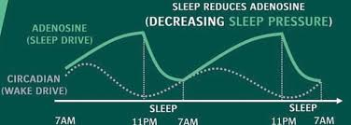
Notes:
Turns out there are 2 specific systems that drive our sleep cycle
1st Sleep drive is like hunger drive-get hungrier and hungrier, eat and it dissipates. Same holds true for sleep. When a cell eats a piece of glucose something comes out back end, one of these things is a chemical called adenosine, that chemical works itself thru your brain, as adenosine accumulates you get sleepier and sleepier-
Kind of a geeky, the molecular structure of adenosine and caffeine is one molecule off….so caffeine fits perfectly into that receptor site in the brain…this is why when you drink coffee it keeps you awake…its blocking that adenosine….sleep drive comes from the buildup of adenosine
2nd system is your circadian rhythm…just like hungry during breakfast time, lunch time and dinner time…those are circadian rhythms for eating…turns out we have a rhythm for sleep too (there are over 300 circadian rhythms in the body…)
We want a balance between drive and rhythm…

Slide 9
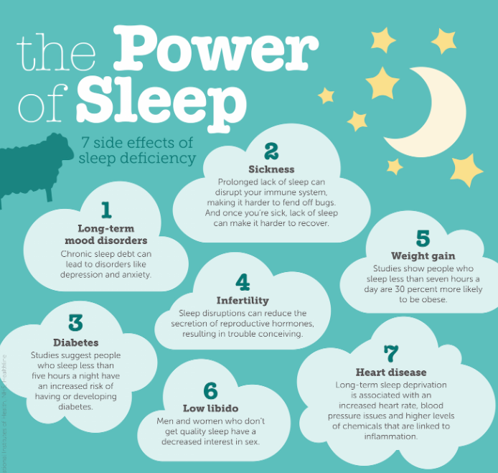
Notes:
ne reason we talked about is the literal brain washing. There are so many more scientific benefits for sleep. I am going to discuss the benefits, identify some consequences for sleep deprivation and give you evidence-based strategies to improve your sleep.

Slide 10
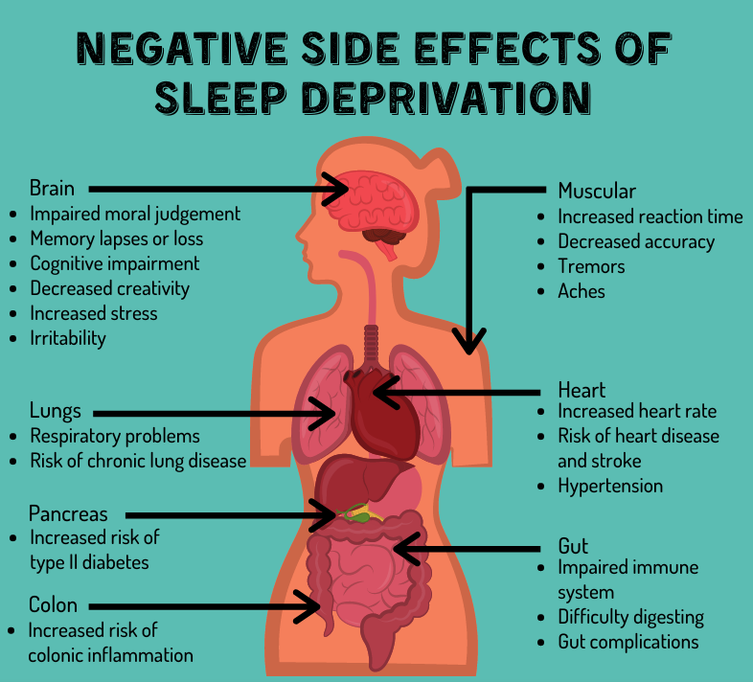
Notes:
It might be easiest to show the value of sleep by talking about what happens when we don’t get sleep.
Shift work. Shift work is extraordinary, it’s 20% of the working population. The body clock does not shift to the demands of working at night. It's locked onto the same light-dark cycle as the rest of us. So, when the poor shift worker is going home to try and sleep during the day, desperately tired, the body clock is saying, "Wake up. This is the time to be awake." So, the quality of sleep that you get as a night shift worker is usually very poor…around five-hours.
One of the things that the brain does is indulge in micro-sleeps, this involuntary falling asleep, and you have essentially no control over it. Now, micro-sleeps can be sort of somewhat embarrassing, but they can also be deadly. 31% of drivers fall asleep at the wheel at least once in their life. in the US-100,000 accidents on the freeway have been associated with tiredness, loss of vigilance, and falling asleep in the last year.

Slide 11
Learning and Memory
Notes:
We've all been told to get a good night's sleep before a test…science says whether you're cramming for an exam or trying to learn a new musical instrument or even trying to perfect a new sport, sleep may actually be your secret memory weapon.
Studies have shown that sleep is critical for memory in at least three different ways. First, we know that you need sleep before learning to actually get your brain ready, almost like a dry sponge, ready to initially soak up new information. And without sleep, the memory circuits within the brain effectively become waterlogged, as it were, and we can't absorb new information. We can't effectively lay down those new memory traces.
But it's not only important that you sleep before learning, because we also know that you need sleep after learning to essentially hit the save button on those new memories so that we don't forget. In fact, sleep will actually future-proof that information within the brain, cementing those memories into the architecture of those neural networks. And we've begun to discover exactly how sleep achieves this memory-consolidation benefit.
-The first mechanism is a file-transfer process. And here, we can speak about two different structures within the brain. The first is called the hippocampus and the hippocampus sits on the left and the right side of your brain. And you can think of the hippocampus as you inbox of your brain. It's very good at receiving new memory files and holding onto them.
-The second structure is called the cortex. This wrinkled massive tissue that sits on top of your brain. And during deep sleep, there is this file-transfer mechanism. Think of the hippocampus like a USB stick and your cortex like the hard drive. And during the day, we're going around and we're gathering lots of files, but then during deep sleep at night, because of that limited storage capacity, we have to transfer those files from the hippocampus over to the hard drive of the brain, the cortex. And that's exactly one of the mechanisms that deep sleep seems to provide.
-But there's another mechanism that we've become aware of that helps cement those memories into the brain. And it's called replay. Several years ago, scientists were looking at how rats learned a maze. And they were recording the activity in the memory centers of these rats. And as the rat was running around the maze, different brain cells would code different parts of the maze. And so if you added a tone to each one of the brain cells what you would hear as the rat was starting to learn the maze was the signature of that memory.
It was this signature of learning that scientists could hear. But then they did something clever. They kept listening to the brain as these rats fell asleep, and what they heard was remarkable. The rat, as it was sleeping, started to replay that same memory signature. But now it started to replay it almost 10 times faster than it was doing when it was awake. That seems to be the second way in which sleep can actually strengthen these memories. Sleep is actually replaying and scoring those memories into a new circuit within the brain, strengthening that memory representation.
The final way in which sleep is beneficial for memory is integration and association. Sleep doesn't just simply strengthen individual memories, sleep will actually cleverly interconnect new memories together. And as a consequence, you can wake up the next day we can come up with solutions to previously impenetrable problems…people say they have their best ideas waking up in the shower
In another study by Matt Walker (a sleep scientist) who researched if pulling the all-nighter was a good idea. They took a group of individuals and we assigned them to one of two experimental groups: a sleep group and a sleep deprivation group.
The sleep group got a full eight hours of slumber, but the deprivation group, we’re going to keep them awake in the laboratory, under full supervision. There’s no naps or caffeine, by the way, so it’s miserable for everyone involved. And then the next day, participants are put in MRI scanners and they had them try and learn a whole list of new facts as they were taking snapshots of brain activity.
And then they tested them to see how effective that learning has been. And when you compare these two groups it’s a significant difference., 40% deficit in the ability of the brain to make new memories without sleep. I think this should be concerning, to put that in context, it would be the difference in a child acing an exam versus failing it miserably – 40%.

Slide 12
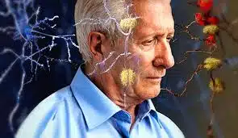
Alzheimer's and Dementia
Notes:
The disruption of deep sleep contributes to cognitive and memory decline in aging, and most recently we’ve discovered, in Alzheimer’s disease as well. Alzheimer's disease is a form of dementia typified usually by memory decline and loss. And what we've started to understand is that there are several different proteins that seem to go awry in Alzheimer's disease. One of those proteins is a sticky, toxic substance called beta-amyloid that builds up in the brain.
My brain's making beta-amyloid right now, and so is yours. But in patients with Alzheimer's disease, beta-amyloid builds up in the spaces between the brain's cells, instead of being cleared away like it should and it’s the build up…that's thought to be one of the key steps in the development of that terrible disease. So, if sleep, then, is part of the brain's solution to the problem of waste clearance, then this may dramatically change how we think about the relationship between sleep, beta-amyloid, and Alzheimer's disease.
Positive: because unlike many of the other factors that are associated with aging and Alzheimer's disease, like changes in the physical structure of the brain, are difficult to treat & medicine doesn't have any good approach yet. By understanding that sleep is a missing piece in the puzzle of Alzheimer's disease is exciting because we could fix

Slide 13
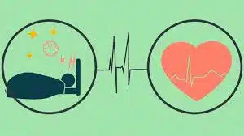
Sleep and the Cardiovascular System
Notes:
All it takes is one hour less sleep to have a significant impact on your cardiovascular system.
There is a global experiment performed on 1.6 billion people across 70 countries twice a year, and it’s called daylight saving time.
In the spring, when we lose one hour of sleep, we see a subsequent 24% increase in heart attacks that following day. In the autumn, when we gain an hour of sleep, we see a 21% reduction in heart attacks. Isn’t that incredible?
And you see exactly the same profile for car crashes, road traffic accidents, even suicide rates.

Slide 14
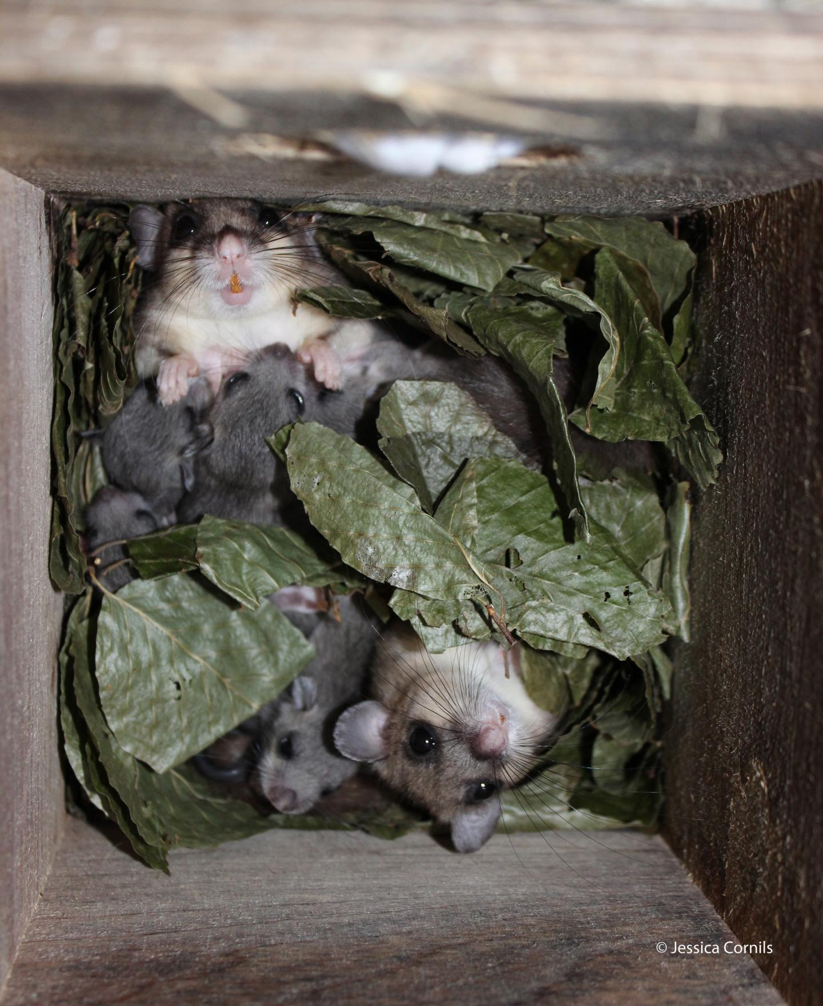
Sleep and Reproductive Organs
Notes:
Lets talk about our reproductive organs and sleep…
Men who sleep five hours a night have significantly smaller testicles than those who sleep seven hours or more. In addition, men who routinely sleep just four to five hours a night will have a level of testosterone which is that of someone 10 years their senior.
Sleep deprivation influences the chances of fertility in women. Sleeplessness among female shift workers suppresses melatonin production as well as excessive HPA activation which results in early pregnancy loss and failed embryo implantation.
A decrease in libido is seen in women with less sleep.

Slide 15
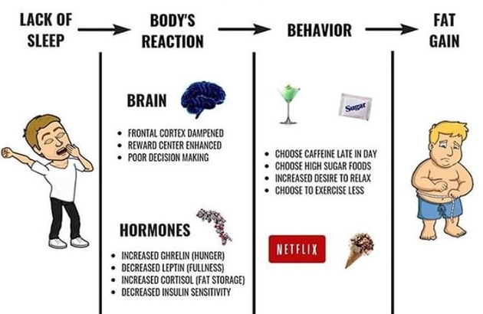
Sleep and Weight Gain
Notes:
Another connection between loss of sleep is weight gain. If you sleep around about five hours or less every night, then you have a 50 percent likelihood of being obese. What's the connection here?
One 10-week study showed that just being in bed for 8 hours made people lose weight!! is this because they weren’t in the pantry scarfing Cheez-its maybe…but the connection is still there
Our body has ways of communicating without us even knowing.
Science shows when we are sleep deprived:
1st metabolism slows down and Cortisol increases which increases appetite your body tells you to eat more!
2nd there have hormonal changes….we have hormones that tell our brain when we are hungry (Ghrelin- that increases during sleep) and hormones that tell our brain when we are full (leptin-which decreases during sleep).
I don’t think my nightly ice cream is helping but I am glad to hear that maybe my sleep hygiene could be a reason too!
But when you think sleep “isn’t that important”, think about it in relation to some of the other goals you may have…weight loss/weight maintenance….

Slide 16
Notes:
Our nightly slumber affects the emotional centers in our brains-think of sleep as first aid for our feelings.
An excellent study done at Oxford Univ took a group of healthy adults were divided into 2 groups – one had a full night of sleep and the other was sleep-deprived. The next day, they placed them inside an MRI scanner, and we looked at how their emotional brain was reacting. They focused on one structure in particular; it's called the amygdala. And the amygdala oversees the generation of strong emotional reactions, including negative emotional reactions.
The people who had had a full night of sleep, had nice appropriate moderate degree of reactivity from the amygdala. It wasn't as though there was no response at all, but it was an appropriate response. Yet in those people who were sleep-deprived, that deep emotional brain center was in fact, hyperactive. Indeed, the amygdala was almost 60 percent more responsive under conditions of a lack of sleep.
But why? Scientist discovered that there's another brain region that's involved. This brain region is called the prefrontal cortex, and it sits directly above your eyes. You can think of the prefrontal cortex almost like the CEO of your brain. It's very good at making high-level, executive, top-down control decisions and reactions. And one of the parts of the brain that it controls is this deep emotional center, the amygdala.
Now in those people who had had a full night of sleep, there was a nice, strong communication and connection between the prefrontal cortex, regulating that deep emotional brain center. But in those people who were sleep-deprived, that communication, that connection between the prefrontal cortex and that deep amygdala emotional brain center had essentially been severed. And as a consequence, the amygdala was responding far more reactively due to a lack of sleep. It’s hitting the emotional accelerator, and hardly any regulatory control brake. And that seems to be the reason that we become so unbuckled in terms of our emotional integrity when we haven't been sleeping well.

Slide 17
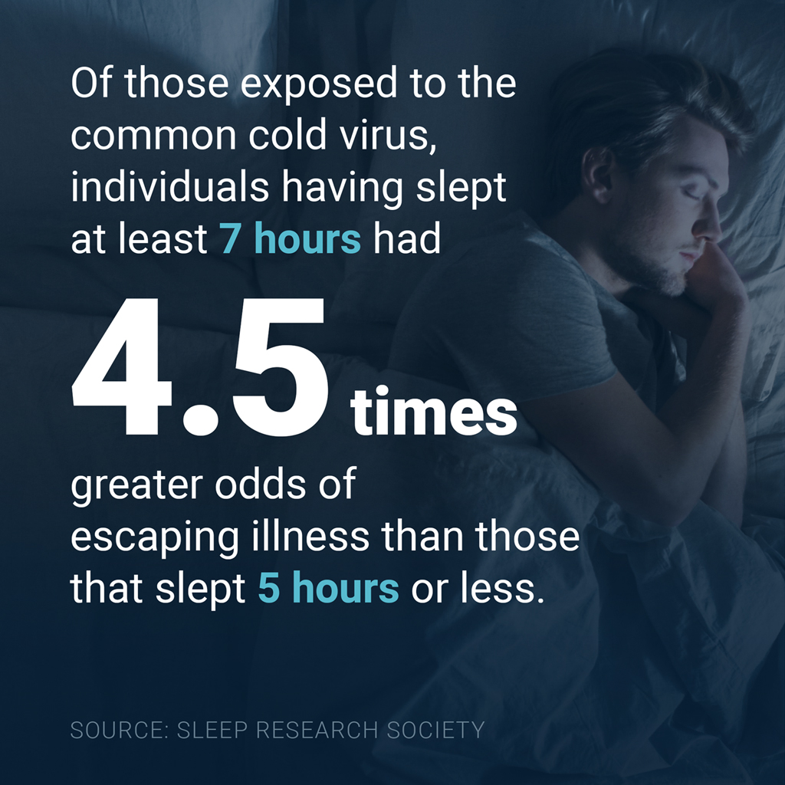
Notes:
But as a deeper dive, I want to focus on this: sleep loss and your immune system. And here, I’ll introduce you to natural killer cells, and you can think of natural killer cells almost like the secret service agents of your immune system. They are very good at identifying dangerous, unwanted elements and eliminating them. In fact, they can even destroy a cancerous tumor mass. So, what you wish for is always a virile set of these immune assassins, and tragically, that’s what you don’t have if you’re not sleeping enough.
In another experiment, people were sleep restricted to four hours for one single night, and then evaluated to see if there was a reduction in immune cell activity. Well, it wasn’t small…not 10%, it’s not 20%. But a 70% drop-in natural killer cell activity. That’s a concerning state of immune deficiency, and you can perhaps understand why there is significant links between short sleep duration and your risk for cancer (specifically cancer of the bowel, prostate and breast). In fact, the link between a lack of sleep and cancer is now so strong that the World Health Organization has classified any form of nighttime shift work as a probable carcinogen, because of a disruption of your sleep-wake rhythms.
There’s a simple truth: the shorter your sleep, the shorter your life. Short sleep predicts all-cause mortality.

Slide 18
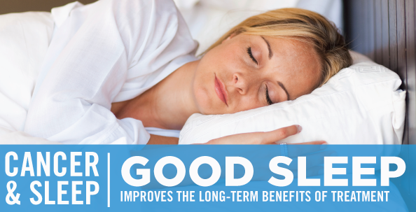
Notes:
Turns out the more sleep deprived you are the faster cancer cells multiple…like period end of story
Also recently learned that if chemo is administered during specific times in the circadian cycle we can use less chemo and its more effective….new research!

Slide 19
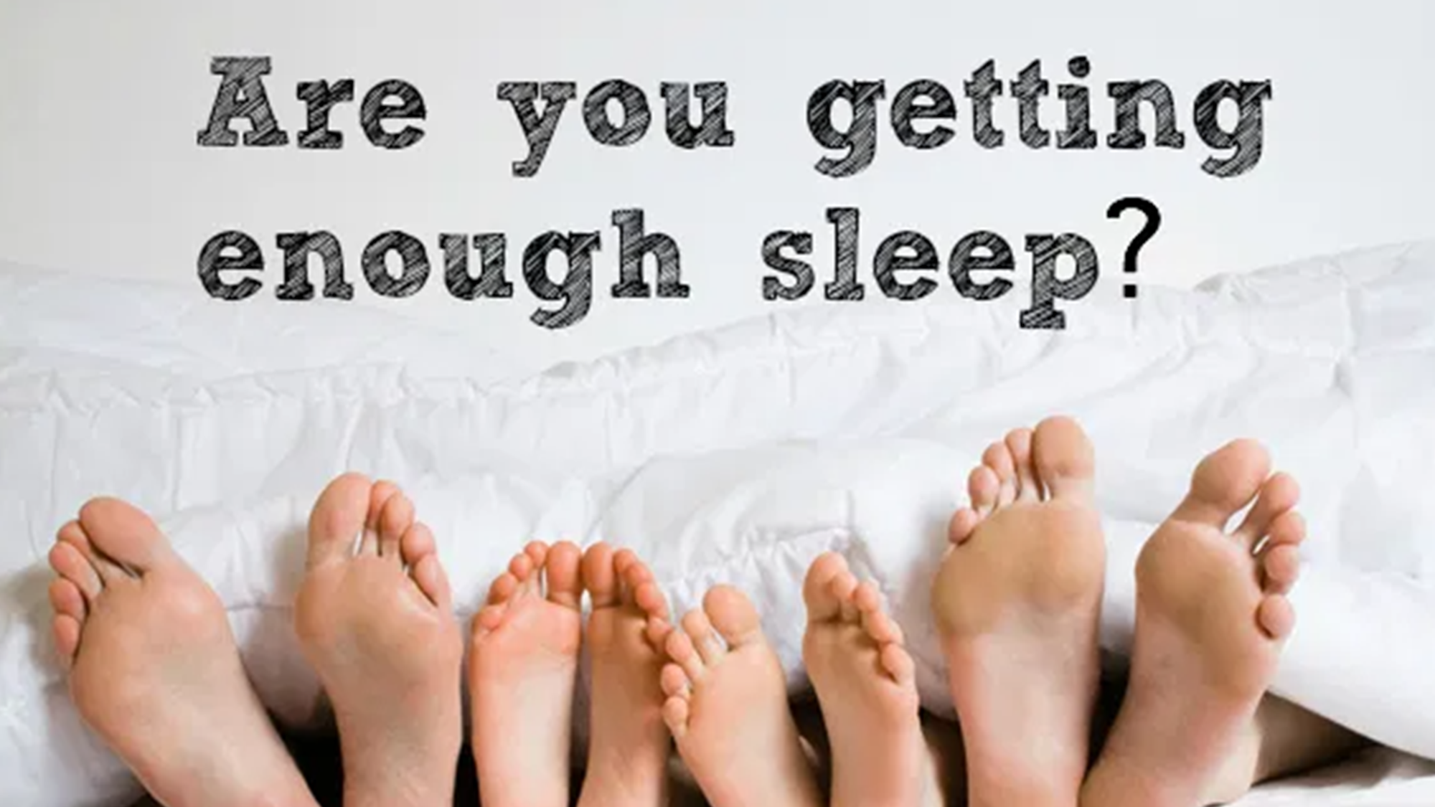
Notes:
So "How do I know whether I'm getting enough sleep?"
When you wake are you rested?
Do you wake up naturally or need alarm clock
Are you grumpy/irritable?
Told by co worker you look tired or that your irritable?
Do you struggle to get going in morning?
Would you fall back asleep at 10 or 11 am?
Would you be able to function optimally without caffeine before noon?
Chances are your sleep deprived but the good news is all of this is reversible, with good sleep we see that people have lower blood pressure, lower heart disease, increase immune function, reduced sexual dysfunction….

Slide 20
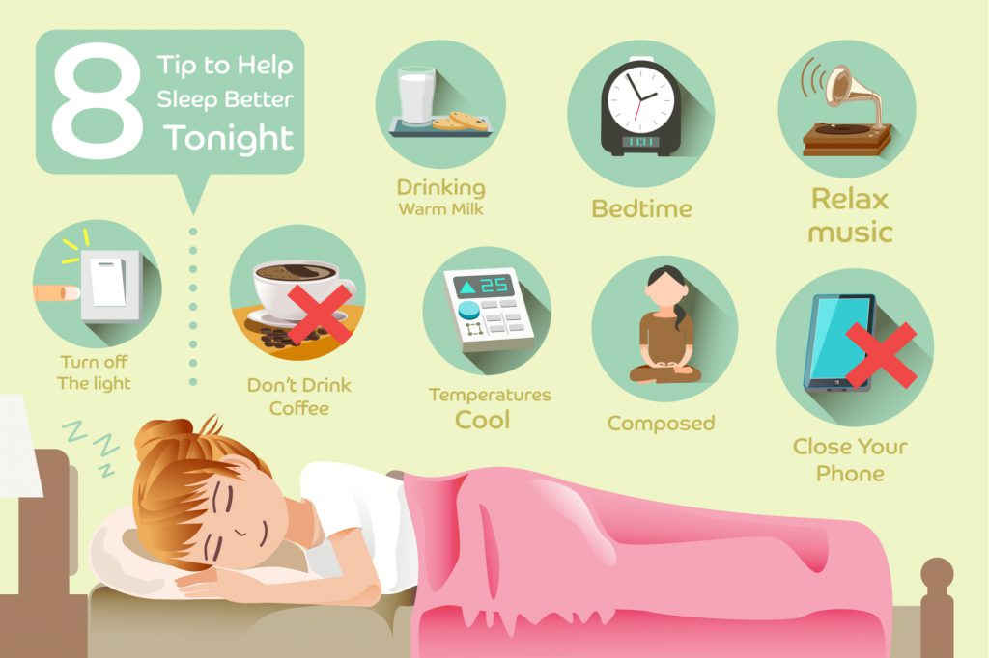
Notes:
What do you do? It’s a performance activity-if I run in jeans and flip flops different than dry fit and Asics
Evidence shows:
1. Regularity. Go to bed/same time, wake up/same time, weekday or the weekend. Regularity is king, and it will anchor your sleep and improve the quantity and the quality of that sleep.
2. Keep it cool. Your body needs to drop its core temperature by 1-2 degrees Fahrenheit to initiate sleep and then to stay asleep, studies show 65 degrees is the ideal sleep temp.
3. Make your bedroom a haven for sleep-dark as possible. Very important, reduce your amount of light exposure at least half an hour before you go to bed. Light increases levels of alertness and will delay sleep. It decreases the production of melatonin in your brain. If its too dark in am and you struggle waking up get a sunrise alarm that makes the room brighter and brighter as it near alarm time. Seriously, what's the last thing that most of us do before we go to bed? We stand in a massively lit bathroom, looking into the mirror cleaning our teeth. It's the worst thing we can do
4. When Blue Light (440-490 nanometers) it hits your eyeball it sends a message to your brain to turn off the melatonin faucet in your head. Turn off those mobile phones, computers and I pads unless you use a filter
5. get exercise, even 10 min can improve your sleep quality- note: intensive workouts should be done during daylight-vigorous exercise 4 hours before sleep can diminish sleep quality.
6. Only use your bed for sleep or sex

Slide 21
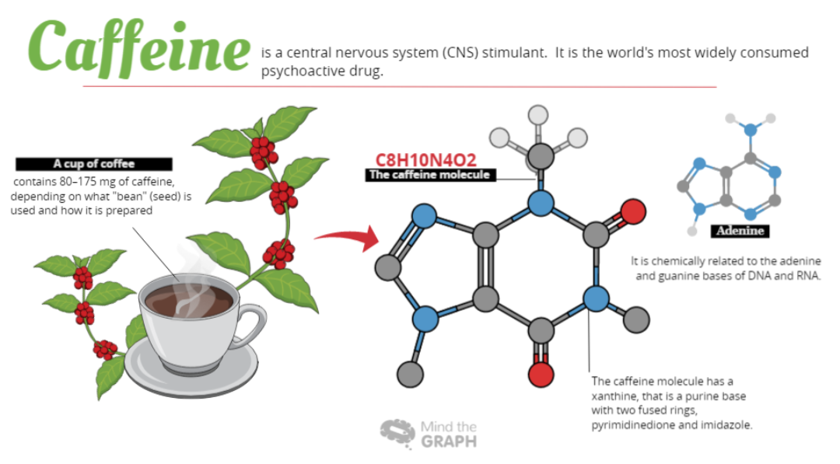
Notes:
Let’s talk about stimulants. Caffeine represents the stimulant of choice for most of us and if you're naughty… nicotine. Side note about caffeine, it has two what I like to call hidden features that some people are not aware of. First is its duration. Caffeine, for the average adult, will have a half-life of about five to six hours. What that means is that after about five to six hours 50 percent of that caffeine that you had is still circulating in your system.
In other words, let's say that you have a cup of coffee at 2pm in the evening. It could be that almost a quarter of that caffeine is still swilling around in your brain at midnight. And as a result, it can make it harder for an individual to fall asleep or even stay asleep soundly throughout the night
The second feature with caffeine is that it can change the quality of your sleep. Some people will tell me that they can have espresso with dinner, and fall asleep fine, and can stay asleep. But even if that's true, it turns out that caffeine can decrease the amount of deep, non-rapid eye movement sleep that we have, stages three and four. That's that restorative deep sleep. And as a consequence, you can wake up the next morning, and you don't feel refreshed, you don't feel restored by your sleep. But you don't remember waking up, you don't remember struggling to fall asleep, so you don't make the connection.
Let’s move to alcohol. Many of us turn to alcohol…now alcohol, short-term, once or twice, to use to mildly sedate you, can be very useful. It can ease the sleep transition. But alcohol doesn't provide sleep-it sedates you. So, it harms some of the neural processing that's going on during memory consolidation and memory recall. The 2nd problem with alcohol is that it can fragment your sleep. Alcohol can trigger and activate during sleep what we call the fight or flight branch of the nervous system, which will therefore wake you up more frequently throughout the night. The last issue with alcohol and sleep is that alcohol can block your rapid eye movement sleep, (or dream sleep). If you have ever woke up from a night of drinking with odd, vivid dreams its because you didn’t get thru your REM sleep

Slide 22
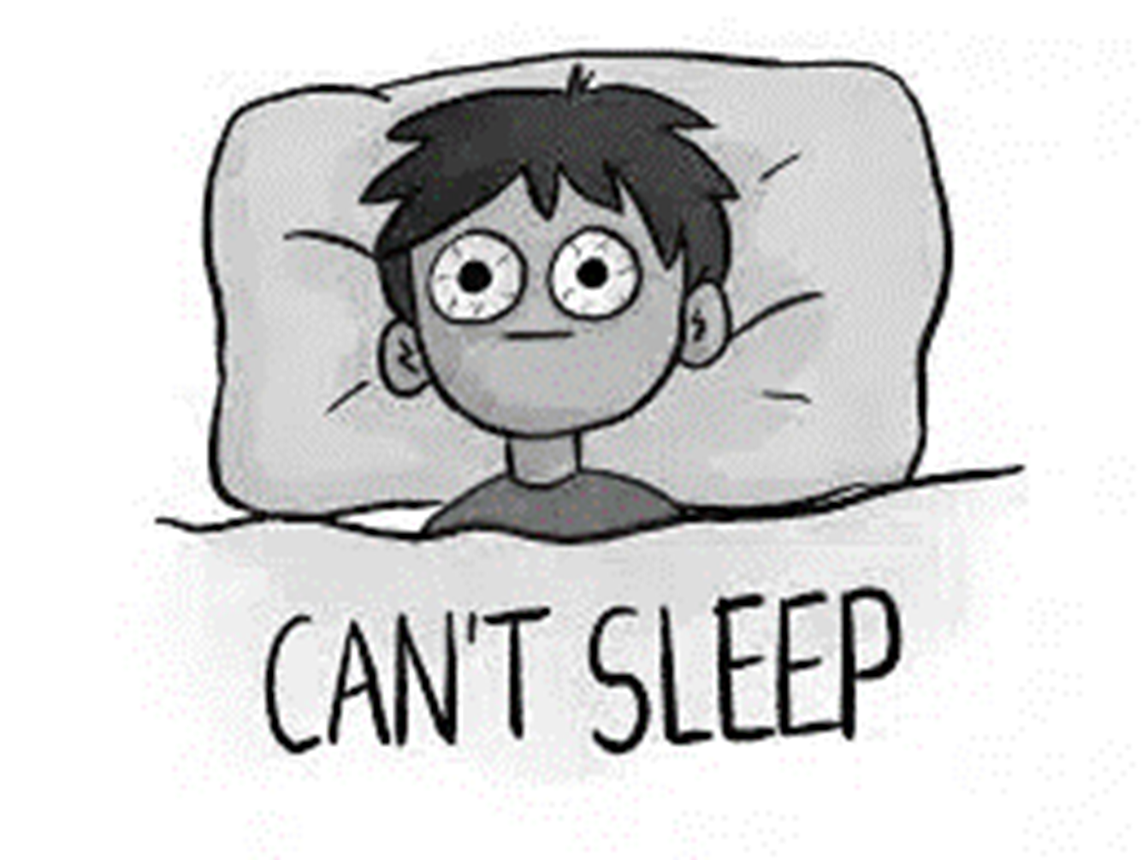
Notes:
You might be thinking, what if I cannot sleep, what do I do?
Cognitive behavioral therapy (CBT), learn to relax…75% of people report improvement, 6 sessions/ insurance covers
If you are staying in bed awake for too long (20 min+), get out of bed and go to a different room and do something different. The reason is because your brain will very quickly associate your bedroom with the place of wakefulness, and you need to break that association. Only return to bed when you are sleepy, and that way you will relearn the association that bed is the place of sleep. You’d never sit at the dinner table, waiting to get hungry, so why would you lie in bed, waiting to get sleepy?
Controlled breathing- reduces stress to the nervous system
Ear plugs
Sounds machines
Calm app-nature sounds, story telling, meditation
Meditation and mindfulness is centered around slow, steady breathing and non-judgmental focus on the present moment.
Progressive muscle relaxation- gradually tighten and tense your muscles for10 sec while breathing in and out and relaxing
Remove clocks with numbers, alarm clocks are fine but don’t need to see that it is 2 am and you're not asleep…adds to angst
Aromatherapy-double blind placebo study-lavender, vanilla, jasmine and elang/elang…all help us relax
Limit any nap during the day to 20 minutes- best time to take a nap is between 1-3 in afternoon, we have a dip in core temp, this dip releases melatonin (also happens around 1030 pm)
Best hack…if you ever have only about 4 hours sleep- 6 ounce black (no sugar or cream)…add 3 ice cubes, immediately take 20 min nap (set timer)…remember we talked about adenosine and caffeine are only off by 1 molecule, that nap with eat up the adenosine and the caffeine will sneak in and block the rest of the adenosine from making you stay sleep, then caffeine kicks in

Slide 23
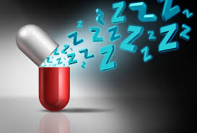
Notes:
Supplements:
Avoid benedryll-next day mental impairment and long term causes cognitive impairment
Vitamins (Vitamin deficiency- get blood work done, vitamin D, magnesium, iron, melatonin- start with those 4….these can be supplemented easy)
B3 lengthens triptopham (whole grains, dairy, meat, broccoli, asparagus) and increases REM sleep, tryptophan is the building blocks of melatonin which is an important hormone in sleep
B6 is required for serotonin reproduction, body craves high fat because wants serotonin
Vitamin D functions as a hormone, produced in your body after sunlight….fatty fish, egg yolks….can take supplements
Magnesium- boost quality of sleep, dark leafy grains, banana- banana water
Foods:
Super food for sleep…salmon, fatty omega 3 fatty acids…good for skin, brain and boost levels of melatonin that helps people fall asleep, choose wild/farmed
bananas…they are loaded with magnesium, boiled it and drink it,
Over the counter sleep aids
melatonin is a natural hormone that is excreted in darkness, not great for insomnia, works great for jet lag or shifting circadian rhythms—not a sleeping pill, remember when we talked about the sleep drive and sleep rhythm…it’s a regulator not an initiator, correct dose is 1 mg to reach plamsa concentration according to MIT, take it 90 minutes before bed if pill form…takes that long to absorb, not regulated by FDA (can be substandard quality…). Plus melatonin is a hormone….be careful. Works well with autism spectrum and people over 50 bc there is drop in melatonin after this age)
Velarium root…reduce anxiety – low tolerance or abuse…. take it with hops…same hops as with beer
Remember if you have an injured tendon– you need an expert-could be your thyroid, B12, sleep apnea, menopause, low blood sugar, arthritic pain, heartburn,

Slide 24
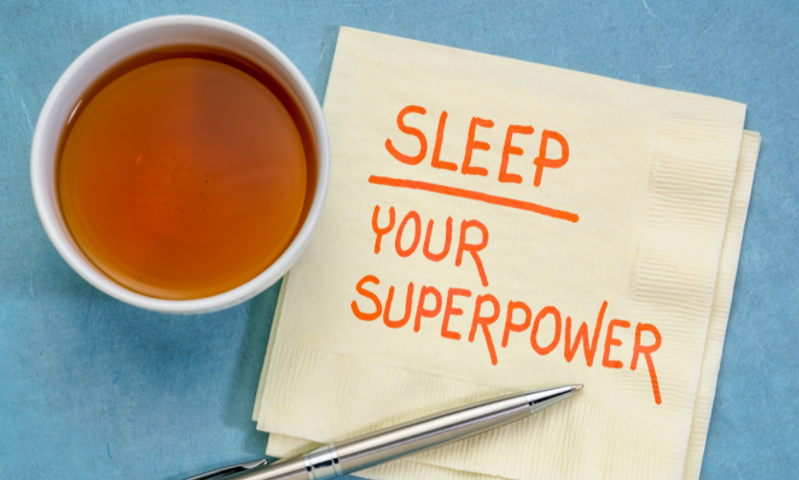
Notes:
Well, I think it may be this: sleep is not an optional lifestyle luxury, sleep is a non-negotiable necessity.
Take sleep seriously. Defend your sleep, this isn't some sort of crystal-waving nonsense. This is a pragmatic response to good health. If you have good sleep, it increases your concentration, attention, decision-making, creativity, social skills, health. If you get sleep, it reduces your mood changes, your stress, your levels of anger, your impulsivity, and your tendency to drink and take drugs. It’s a superpower, use it.

Slide 25
The Science of Sleep
Michelle Lane RN, MSN, NE-BC, CHC
Michelle.lane@nkch.org
Notes:
Thank you for having me…I am grateful to be here today.

Slide 26
THANK YOU FOR ATTENDING!
Join us next month on February 14th for Women’s Health & Functional Medicine
Please take a few seconds to complete our Living Well Wednesday Survey.
Find your local Extension Office at ksre.kstate.edu
Scan the QR code with your camera phone or follow this link:
https://bit.ly/3tCwdp4
Recordings of presentations and handouts will be posted on our Living Well Wednesday website.
www.ksre.k-state.edu/fcs/livingwellwed/

