Slide 1
Alternative Protein Sources
Londa Nwadike and Sandy Procter
KSRE Agent Update
Feb 12, 2020

Slide 2
Outline
Information on new fact sheet
Meat
Regulations
Food safety considerations
Nutrition considerations
Plant-based proteins
Cultured meat

Slide 3
KSU pub: MF3476

Slide 4
Reviewers

Slide 5
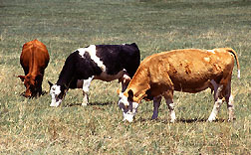
What is NOT included:
Environmental impacts
Animal welfare concerns
related to these various protein sources
Includes a list of some resources that address those topics

Slide 6
References and Resources

Slide 7
Intention of fact sheet
Provide information about novel protein sources
Help consumers understand about these products
Regulations
Food safety considerations
Nutrition considerations
Marketplace status
Provide objective, science-based information

Slide 8
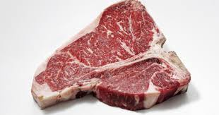
Meat
Federal definition: part of the animal that is skeletal or found in various other animal parts
Regulation: USDA
Slaughter: daily inspection
Processing: inspection during every shift
Food safety checks, pathogen and residue testing
Processors must have HACCP plans and processes

Slide 9
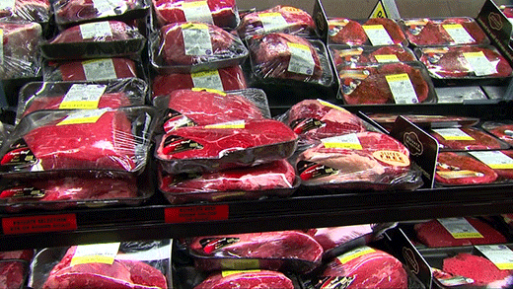
Meat- 2
Food Safety considerations: contamination with pathogens from live animal can occur
From intestinal tract and/or environment
Consumers should use good food safety practices
Poultry: 165°F, ground meat: 160°F, roasts: 145°F
Nutrition: Fresh (not processed) meat contains one ingredient- meat
Nutrition comparison with plant products in next section

Slide 10
Plant-based proteins
Made from soy, peas, lentils, wheat, or other proteins mixed with ingredients such as oils
Binding agents such as methylcellulose may be added
May be called “meat analogues”, “veggie burgers”
Some products have been formulated to “bleed” like meat
Impossible™ burger uses genetically engineered soy leghemoglobin
Beyond Meat® uses beet juice

Slide 11
Plant-based proteins- 2
Regulation: FDA regulates
Daily regulation not required
Food processors must have risk-based preventive food safety system in place
Discussion in many states and federal level on what can be called a “burger”, “sausage”, “meat” or similar terms

Slide 12
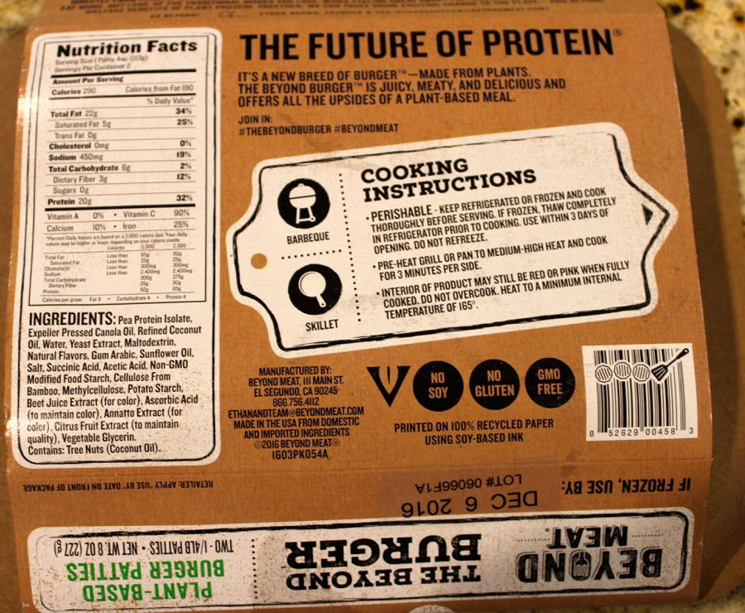
Plant-based proteins- 3
Food safety considerations: consumers with allergies to wheat, soy, etc should check label
Cook to 165F, use same good practices as with meat
Marketplace status: Available in many restaurants and grocery stores

Slide 13
Plant-based proteins- nutrition comparison
Slightly different than meat

Slide 14
Further nutrition considerations
Noted nutrients likely lacking in most beef replacements and meat replacements include:
Monounsaturated fatty acids
Vitamins B₃ (niacin), B₁₂*
Zinc
Choline
Selenium
*Lack of B₁₂ represents a well-known and potentially serious limitation of plant based diets

Slide 15
But we DON’T know…
Will processed plant foods have same health benefits as less processed?
Will increased heme intake lead to related health concerns?
Increased iron stores?
Increased T2 diabetes risk?

Slide 16
Cultured meat
NOT currently available for consumers
Not currently produced on large scale
Grown in laboratories from animal cells in culture medium
Grown on an edible non-meat scaffold that holds cells in position
May be called “cultured protein”, “clean meat”, “lab-grown meat”, “in vitro meat”, others

Slide 17
Cultured meat
Future regulations: USDA and FDA agreed in March 2019 who would regulate what
Discussion on how “cultured meat” should be labeled
Food safety: will be grown in sterile conditions
Could be potential for cross-contamination
Generally use antibiotics in culture medium
Consumers should handle product like meat
Nutrition: assumed to be similar to meat
Note: cultured milk, egg white, leather in development

Slide 18
Additional references
Eshel G, Stainier P, Shepon A, Swaminathan A. (2019). Environmentally optimal, nutritionally sound, protein and energy conserving plant based alternatives to U.S. meat. Sci Rep. 2019; 9:10345. Published online 2019 Aug 8.
doi: 10.1038/s41598-019-46590-1
Hu FB, Otis BO, McCarthy G. (2019). Can plant-based meat alternatives be part of a healthy and sustainable diet? JAMA. 2019;322(16):1547-1548. https://jamanetwork.com/journals/jama/fullarticle/2749260 Accessed February 4, 2020.

Slide 19
Contact Details
Londa Nwadike, PhD
Extension Consumer Food Safety Specialist
Kansas State University/ University of Missouri Phone: 913 307 7391; Email: lnwadike@ksu.edu
http://www.ksre.ksu.edu/foodsafety/
Sandy Procter, PhD
Extension Nutrition Specialist, KSRE
Phone: 785 532 1675; Email: procter@ksu.edu

