Slide 1
Move More, Sit Less
Amy Lorenzen
Golden Prairie Extension District #12
August 2017
Notes:
Let’s take a minute and stand up, take some steps

Slide 2
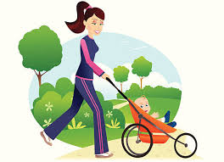
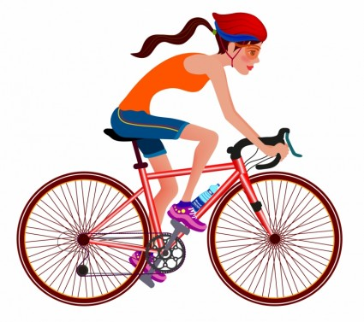
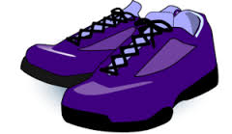
20 years ago these shoes were busy...

Slide 3
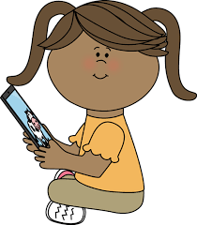
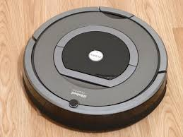
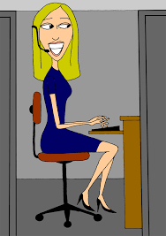
Now, we’re busy sitting

Slide 4
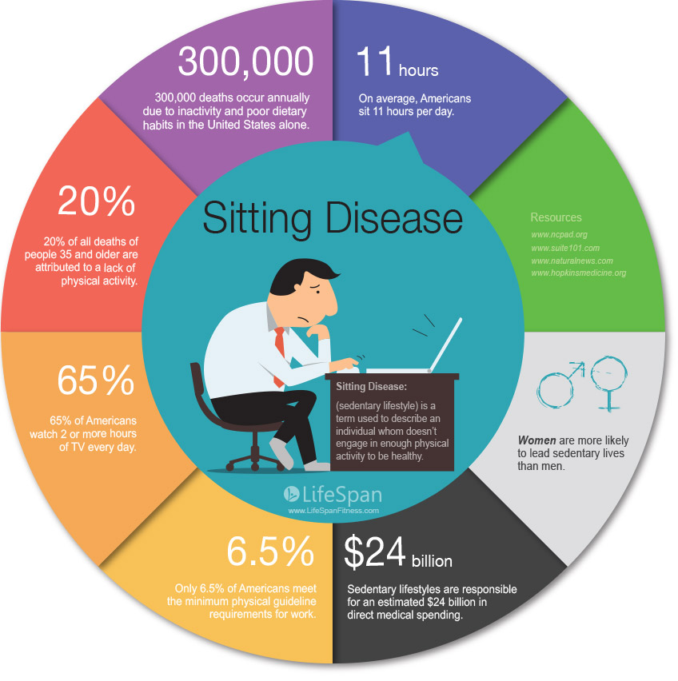

Slide 5
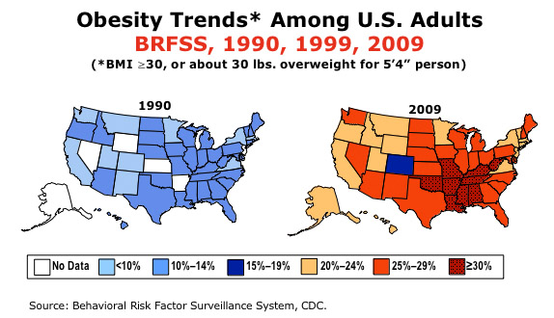

Slide 6
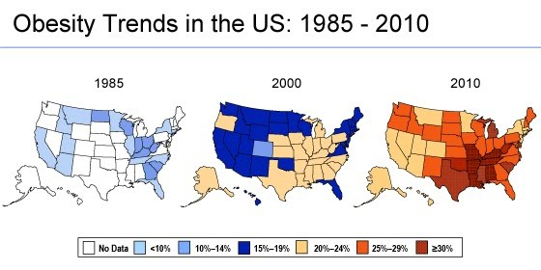
https://americaninfomaps.wordpress.com/2013/10/03/map-obesity-rates-united-states-by-county/

Slide 7
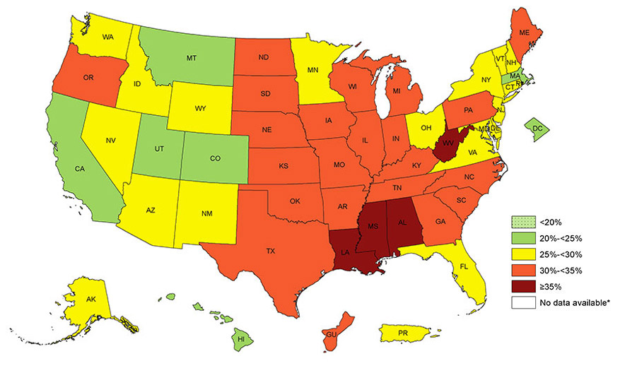
30-35% of adults are obese!
https://www.cdc.gov/obesity/data/prevalence-maps.html

Slide 8
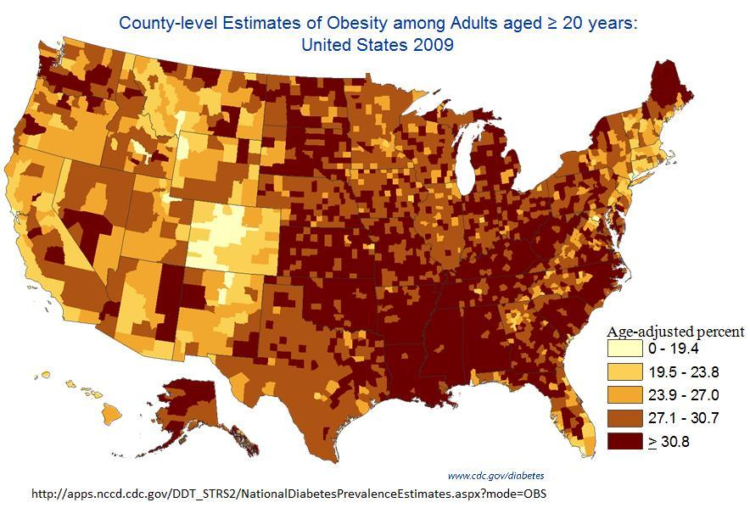
Let’s do something about it!

Slide 9
Sitting too much is serious business
Increases risk for weight gain
Depression
Aches and pains
Exhaustion
Heart disease and certain cancers

Slide 10
You just ‘gotta move!
http://www.juststand.org/tabid/866/language/en-US/Default.aspx
Fun test to see how much you sit each day!

Slide 11
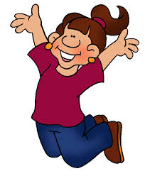
Motion is key
Live a NEAT Life
NEAT = nonexercise activity thermogenesis
Just move more!

Slide 12
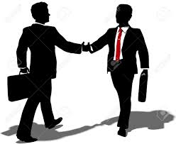
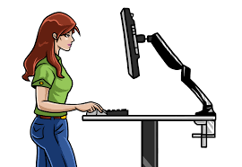
New habits for life at work

Slide 13
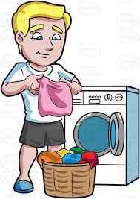
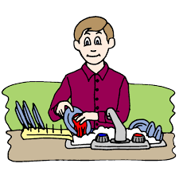
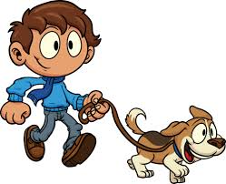
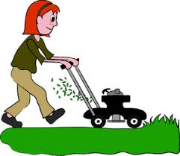
New habits for life at home

Slide 14
Resources
http://www.quittingthesitting.org/
http://www.juststand.org/tabid/816/default.aspx
http://stateofobesity.org/states/ks/
https://go4life.nia.nih.gov/tip-sheets/work-out-work
https://www.heartfoundation.org.au/active-living/sit-less

Slide 15
http://www.moveitmonday.org/portfolio-items/nano-workout-9/?portfolioID=459

Slide 16
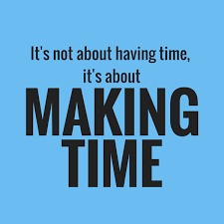

Slide 17
Stand up to live your best life!
Move more
Sit Less!

