Slide 1
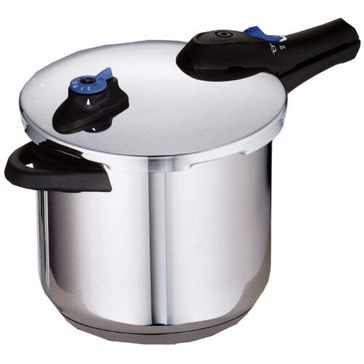
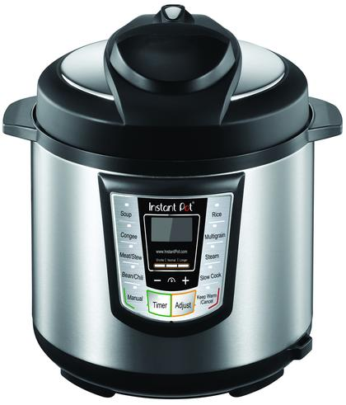
Meals Under Pressure! Meals in Minutes
Erin Petersilie, Walnut Creek District
Anna Schremmer, Phillips-Rooks District
Karen Blakeslee, M.S.

Slide 2
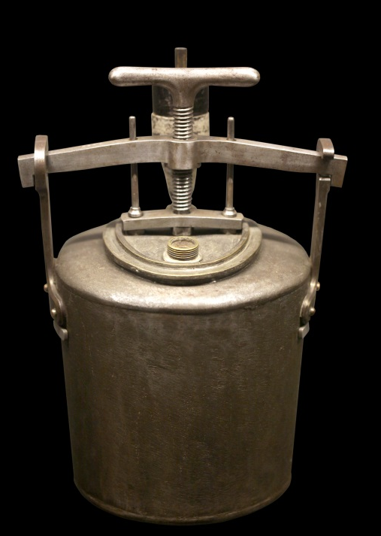
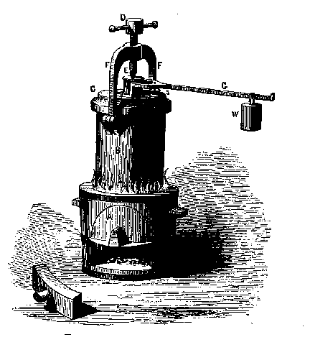
The History
Denis Papin
17th century – 1679
Papin’s Digester
Papin cooking pot
Notes:
Steam digester – effort to reduce time needed to cook foods
Airtight cooking vessel used internal steam pressure to increase boiling point of water, thus cooked foods faster.

Slide 3
100 years later…
Nicolas Appert
Developed canning process
“The Book of All Households: or The Art of Preserving Animal and Vegetable Substances for Many Years”
Notes:
Canning is the newest of the food preservations methods being pioneered in the 1790s when a French confectioner, Nicolas Appert, discovered that the application of heat to food in sealed glass bottles preserved the food from deterioration. He theorized “if it works for wine, why not foods?” In about 1806 Appert's principles were successfully trialed by the French Navy on a wide range of foods including meat, vegetables, fruit and even milk. Based on Appert's methods Englishman, Peter Durand, used tin cans in 1810.
Appert had found a new and successful method to preserve foods, but he did not fully understand it. It was thought that the exclusion of air was responsible for the preservations. It was not until 1864 when Louis Pasteur discovered the relationship between microorganisms and food spoilage/illness did it become clearer. Just prior to Pasteur’s discovery Raymond Chevalier-Appert patented the pressure retort (canner) in 1851 to can at temperatures higher than 212ºF. However, not until the 1920’s was the significance of this method known in relation to Clostridium botulinum.
http://nchfp.uga.edu/publications/nchfp/factsheets/food_pres_hist.html

Slide 4
Why Pressure Cook?
Saves Time
3 to 10 times faster
Saves Work
prepare in minutes
Saves Energy
reduced cooking times conserve energy

Slide 5
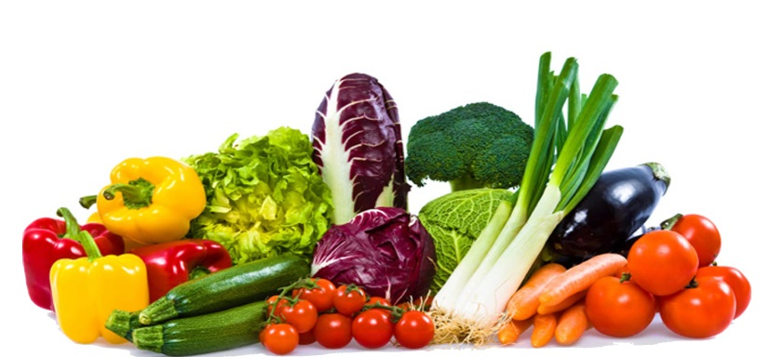
And…
Saves Money
lower fuel bills
less tender cuts of meat
Save Nutrients
small amount of liquid
retains nutrients
Notes:
Many research studies have shown that more nutrients are retained when vegetables are cooking in a small amount or even no extra liquid. Examples include:
http://www.sciencedirect.com/science/article/pii/S1878450X15000207
https://www.health.harvard.edu/staying-healthy/microwave-cooking-and-nutrition

Slide 6
No Canning in Small Pressure Cookers!
USDA does not have recommended processes for canning in a small pressure cooker. The recommendation for using USDA pressure processes for low-acid foods is to use a canner that holds at least four (4) quart-size jars standing upright on the rack, with the lid in place. The research for USDA pressure processes for vegetable and meat products was conducted in pressure canners that are most similar to today's 16-quart or larger pressure canners.
http://nchfp.uga.edu/publications/nchfp/factsheets/pressurecookers.html

Slide 7
Food Safety with Electric Multi-Cookers
No canning!
“Even if there are instructions for pressure canning in the manufacturer’s directions, we do not support the use of the USDA canning processes in the electric, multi-cooker appliances now containing "canning" or "steam canning" buttons on their front panels. Our pressure process directions have not been developed for that type of appliance, and the canner being used does matter. Our recommendations were determined for stovetop pressure canners which hold four or more quart-size jars standing upright.”
“We do not know if proper thermal process development work has been done in order to justify the canning advice that is distributed with these pressure multi-cooker appliances. What we do know is that our canning processes are not recommended for use in electric pressure multi-cookers at this time.”
http://nchfp.uga.edu/publications/nchfp/factsheets/electric_cookers.html

Slide 8
How it works
Notes:
The pressure cooker is a sealed pot in which pressure builds and is maintained between 5 and 15 pounds per square inch (psi). This pressure results with food being cooked at about 250° F which is hotter than the normal boiling point (212° at sea level and about 204° F at our Utah altitude). This elevated pressure converts liquid to steam which cooks the food faster. Most foods are cooked three to ten times faster than conventional cooking. Very little moisture is lost so less liquid is required, which results in more intense flavors. This also allows you to retain more vitamins and nutrients in your food during the cooking process.
Here's how pressure cooking works.
produces steam
traps this steam
builds pressure
cooking temperatures raised higher
higher temperatures cooks foods quickly, evenly, deliciously

Slide 9
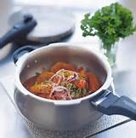
Which Do I Want?
Aluminum
lighter in weight and
significantly less expensive
Stainless steel
heavier
more expensive
Notes:
*select a model with a bimetal base since stainless steel is a poor conductor of heat

Slide 10
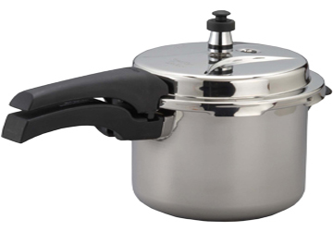
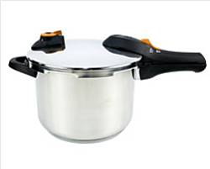
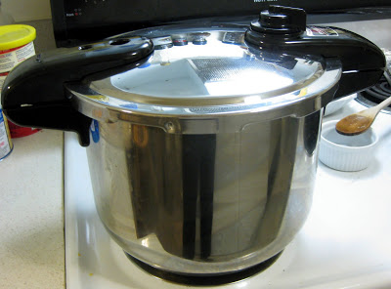
What size pressure cooker is right for you?
4-QUART:
singles or couples
one course food
6-QUART:
most popular size for families
8-QUART:
larger families
large quantity recipes

Slide 11
What is the best brand of pressure cooker for your needs?
A company that has been in business for a number of years
periodically need to replace a few inexpensive parts
parts are not interchangeable
don't select a "brand X" model simply because it is less expensive
Follow instructions for specific brand!
https://www.youtube.com/watch?v=IiCUKA7dDUs
America’s Test Kitchen
Cuisinart
Nesco
T-fal
Instant Pot
Secura
All American
Presto
Prestige
Fagor
Mirro
Notes:
To keep your pressure cooker operating properly and safely for many years, you will have to periodically replace a few inexpensive parts (like tires and fan belts on your car) and you need to be confident that the brand you purchase today will be from a company that will be in business for years to come in order to assure a supply of the proper parts. Parts are not interchangeable from one brand to another, so don't select a "brand X" model simply because it is less expensive.

Slide 12
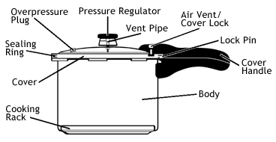
Parts of Pressure Cooker
https://www.gopresto.com/recipes/ppc/howtouse.php
Notes:
PRESSURE REGULATOR Controls and maintains pressure inside the cooker and indicates when the ideal cooking pressure - usually 15 pounds - is reached.
VENT PIPE The pressure regulator fits on the vent pipe and allows excess pressure to be released.
AIR VENT/COVER LOCK Automatically exhausts air and serves as a visual indicator of pressure within the cooker. When pressure begins to build, it slides up, causing the LOCK PIN to lock the cover on.
SEALING RING Forms a pressure-tight seal between the cover and the pressure cooker body during cooking.
OVERPRESSURE PLUG Automatically releases pressure in case the vent pipe becomes clogged and pressure cannot be released normally.
COOKING RACK Holds foods out of the cooking liquid. The rack also allows several different foods to be cooked at the same time without an intermingling of flavors. When a blending of flavors is desired, the rack is not used.
COVER HANDLE The top of the air vent/cover lock can be seen through a hole in the cover handle, enabling you to tell at a glance if there is pressure inside the unit.

Slide 13
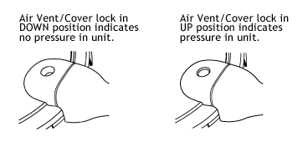
Parts of Pressure Cooker
Notes:
AIR VENT/COVER LOCK Automatically exhausts air and serves as a visual indicator of pressure within the cooker. When pressure begins to build, it slides up, causing the LOCK PIN to lock the cover on.

Slide 14
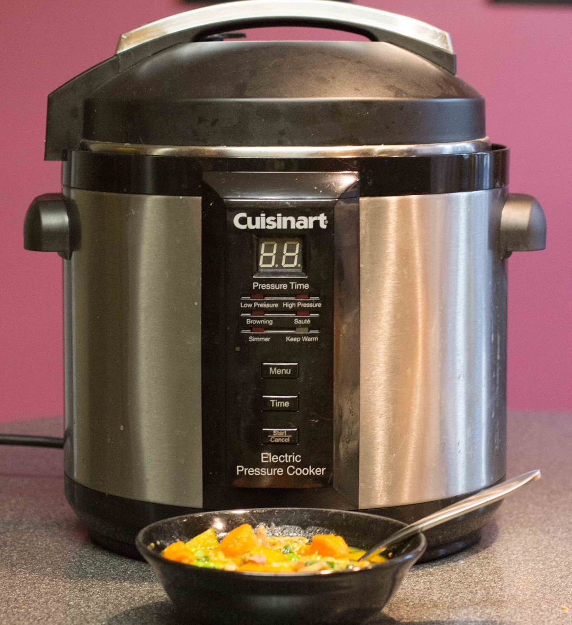
Pressure Cooking Today!
Scared of pressure cooking? Just set it and go!

Slide 15
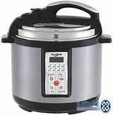
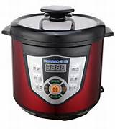
Which One Do I Want?
Electric
Convenient
Preprogramed
Notes:
*select a model with a bimetal base since stainless steel is a poor conductor of heat

Slide 16
What is the best brand of pressure cooker for your needs?
Buy a brand handled by a reputable retailer.
select a retailer that also stocks the replacement parts

Slide 17
Buying Tips
What features are important to you?
Do you have space?
If you can’t see it, you won’t use it!
How many people are you feeding?
How much do you want to spend?
May want to buy an extra inner pot

Slide 18
What size to buy?
Estimate 1 quart per person in your household
Many recipes built for 6 or 8 quart size
https://www.hippressurecooking.com/pressure-cooker-buying-guide/
Most brands between $60-$160

Slide 19
Pros
6, 8, 10 quart volume
Easy cleaning, non-stick coating in liner or stainless steel
“Keep warm” mode
Cook in ¼ to 1/3 of the normal time
Uses less liquid
Multi-function
Up to 7 functions in one appliance
Size of food pieces affects cooking time
Good for small kitchens

Slide 20
Cons
6 quart volume
Hard to handle hot liner
Heating element for browning weaker than stove
“Keep warm” mode
Could be food safety and food quality consequences
Where will you store it?
Lots of buttons
In some cases, traditional cooking is better
Cannot use cold water cooling with electric models
Higher elevations can affect performance

Slide 21
“Bells and Whistles”
R.I.P.
Slow
Cooker
Replace multiple other appliances
“Appliance graveyard”
Quick or slow pressure release
Some memorize cooking time and pressure setting last used
Detachable cord

Slide 22
Converting Favorite Recipes to Pressure Cooking
Trial and Error!
Not for all foods
Won’t make foods crispy
Not for lean, already tender meat
Need at least 1 cup liquid
Look for similar recipes
Start with pressure cooking times for main ingredient
Don’t add thickeners, wait until done cooking

Slide 23
No Pressure
Food stuck on bottom of insert
Sauce too thick
Screen/vent plugged up
Plate/gasket not inserted correctly
Not enough liquid
https://chefallisfarmfreshkitchen.com/2017/07/30/pressure-cooker-problems-top-5-reasons-your-cuisinart-electric-pressure-cooker-wont-pressurize-and-what-to-do-about-it/
Notes:
https://chefallisfarmfreshkitchen.com/2017/07/30/pressure-cooker-problems-top-5-reasons-your-cuisinart-electric-pressure-cooker-wont-pressurize-and-what-to-do-about-it/

Slide 24
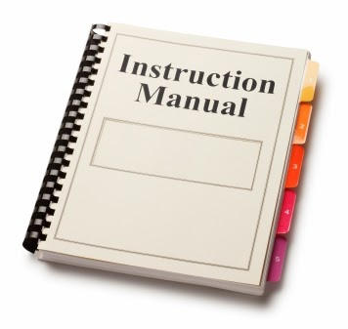
Appliance Safety
READ THE MANUAL!!
Redundant safety systems
Pay attention to hot steam!
Follow filling recommendations
Clean vent area
Replace gasket when needed
Don’t cover or obstruct the vent
Removing hot insert is tricky!
Avoid foamy, frothy foods
Be mindful of hot steam!

Slide 25
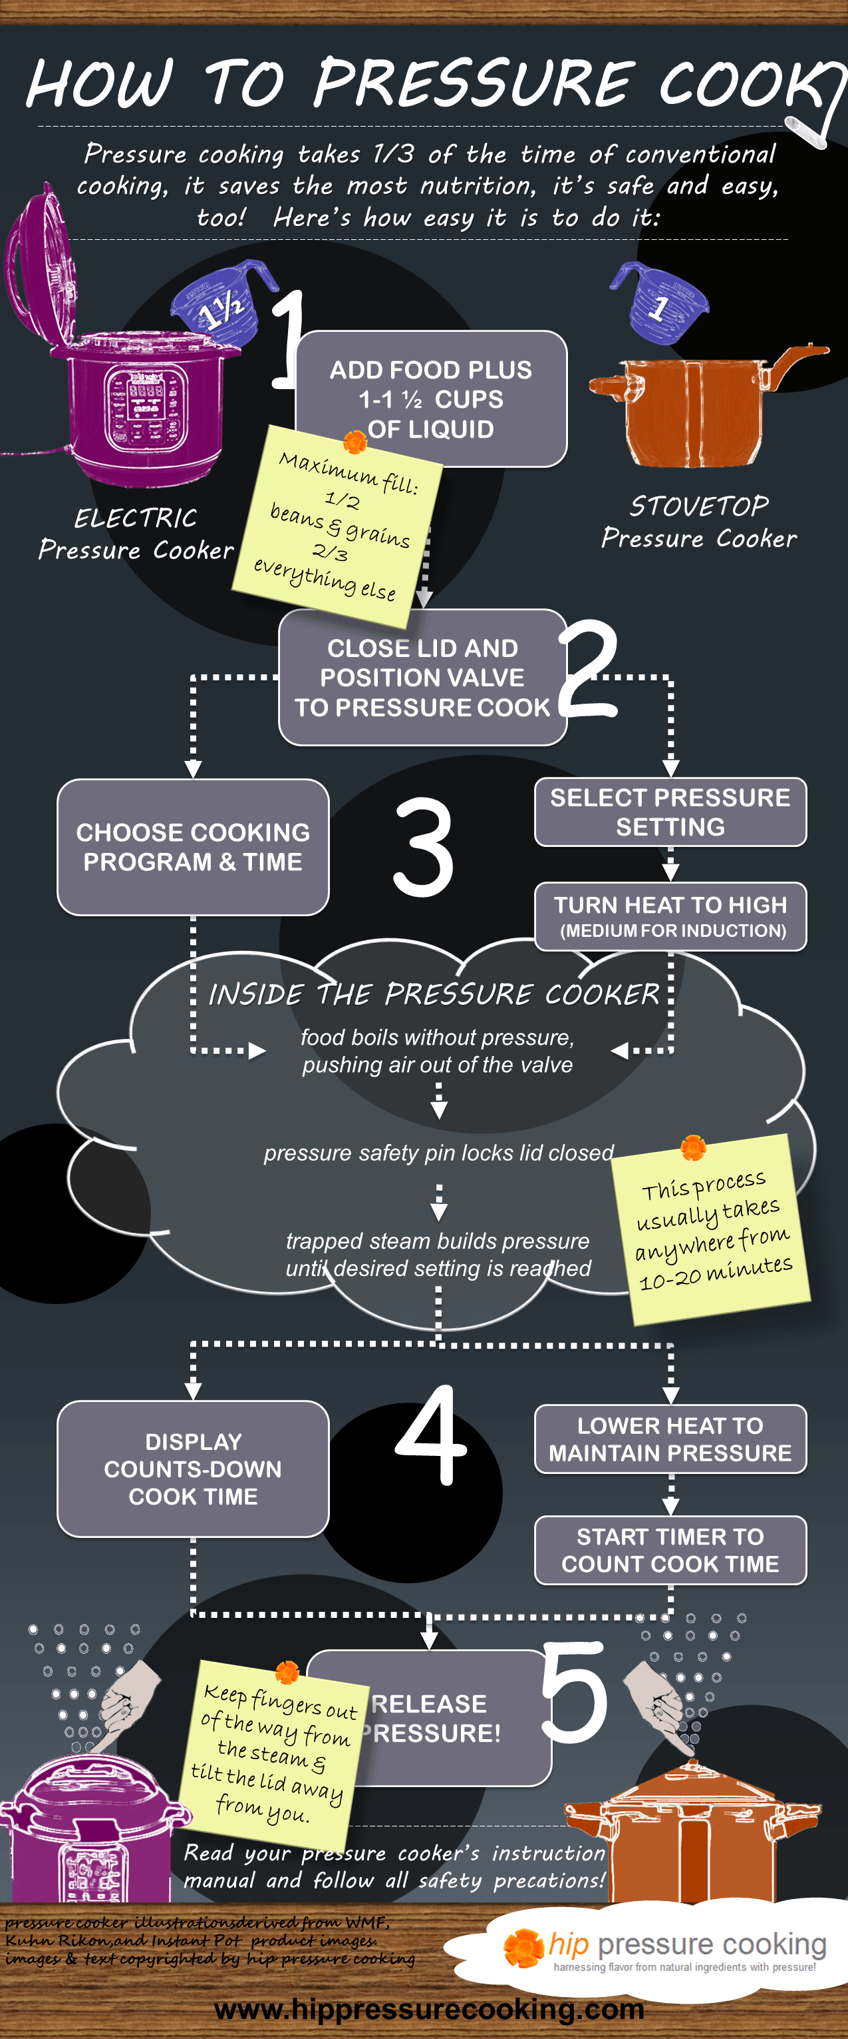
Electric vs. Stove Top
https://www.hippressurecooking.com/how-to-use-the-pressure-cooker/

Slide 26
Let’s Cook!
Start with something simple
Hard boiled eggs
Pasta
Corn

Slide 27
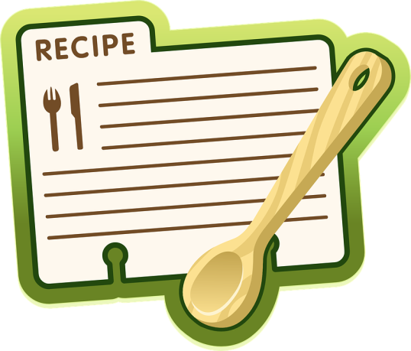
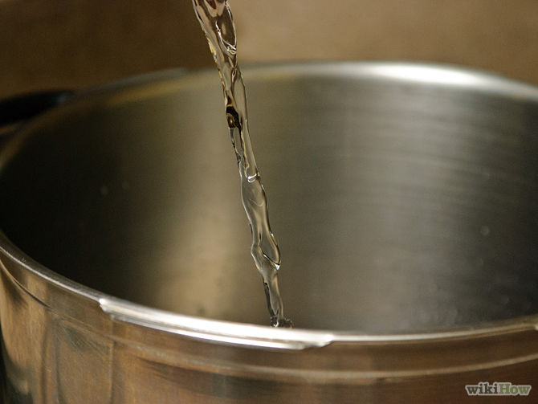
The Pressure Cooking Method
Check recipe
Pour liquid into the pressure cooker
https://www.gopresto.com/recipes/ppc/howtouse.php
Notes:
Check recipe for specific cooking method and cooking time. Pour required amount of liquid into the pressure cooker, then add food. Use the cooking rack, if desired.

Slide 28
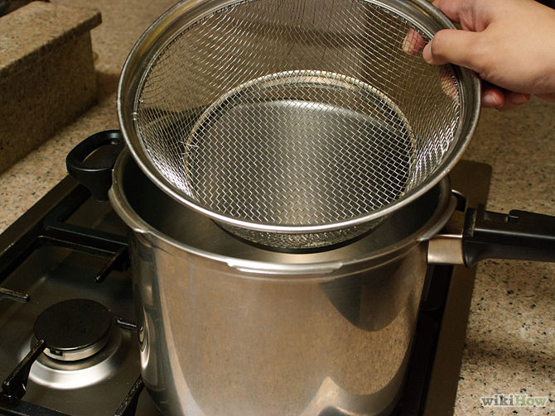
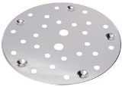
The Pressure Cooking Method
Add food
Refer to recipe for use of
cooking rack
basket
Notes:
Check recipe for specific cooking method and cooking time. Pour required amount of liquid into the pressure cooker, then add food. Use the cooking rack, if desired.

Slide 29
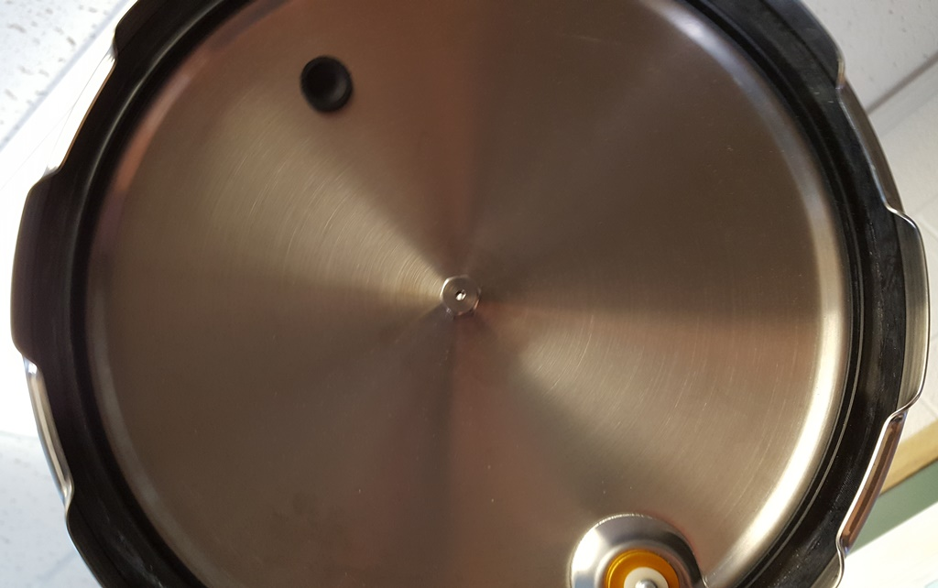
The Pressure Cooking Method
4. Vent pipe is open and unclogged
Notes:
Hold cover up to light and look through the vent pipe to make certain it is open and unclogged. Then, place cover on pressure cooker and close securely (cover handle should be directly above the body handle).

Slide 30
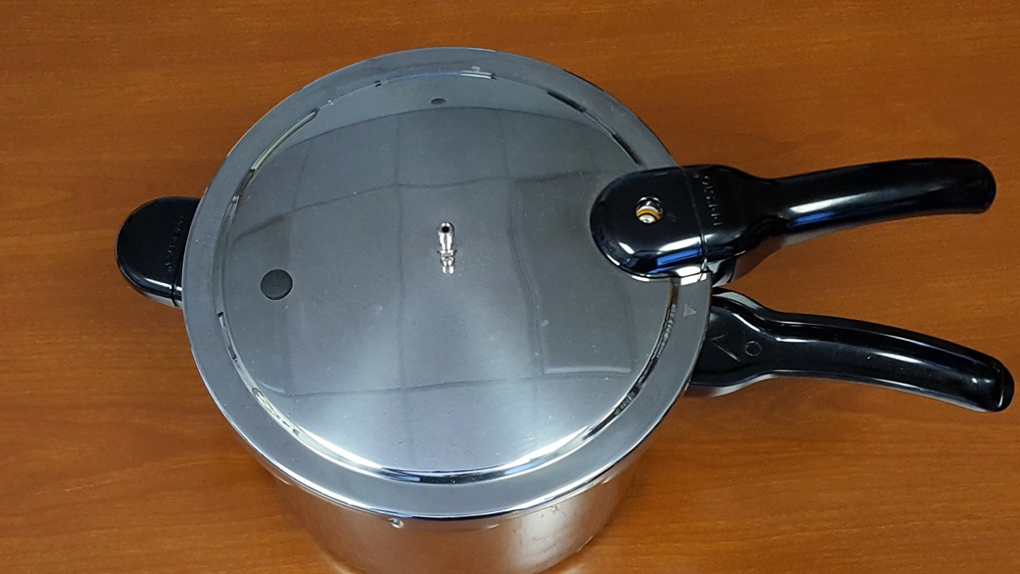
The Pressure Cooking Method
5. Place cover on pressure cooker and close securely (cover handle should be directly above the body handle).

Slide 31
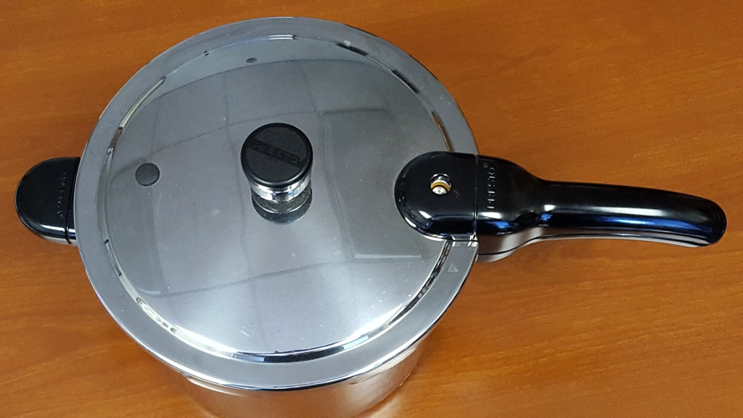
The Pressure Cooking Method
6. Place pressure regulator firmly on the vent pipe.
Notes:
Place pressure regulator firmly on the vent pipe. Heat the pressure cooker until the pressure regulator begins to rock slowly. Adjust heat to maintain a slow, steady rocking motion. Cooking time begins at this point.

Slide 32
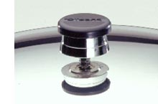
The Pressure Cooking Method
7. Heat the pressure cooker until the pressure regulator begins to rock slowly. Adjust heat to maintain a slow, steady rocking motion. Cooking time begins at this point.

Slide 33
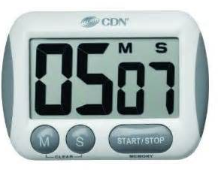
The Pressure Cooking Method
8. Cook for the length of time specified in recipe, then reduce pressure as specified.

Slide 34
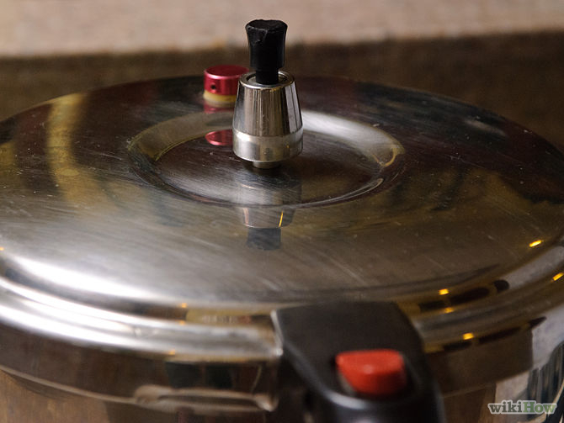
The Pressure Cooking Method
9. When recipe states "let pressure drop of its own accord," set the cooker aside to cool.

Slide 35
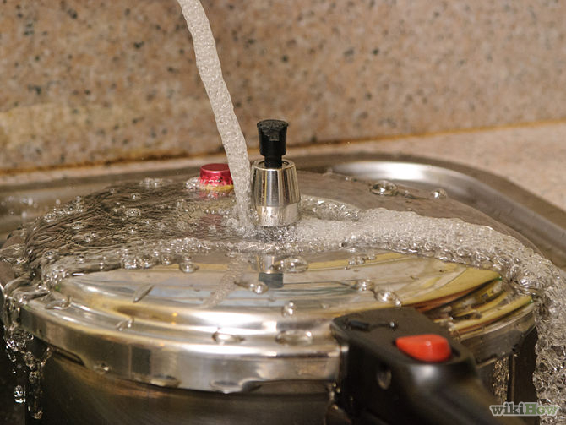
The Pressure Cooking Method
10. When recipe states "cool cooker at once," cool immediately under a water faucet or by pouring cold water over it

Slide 36
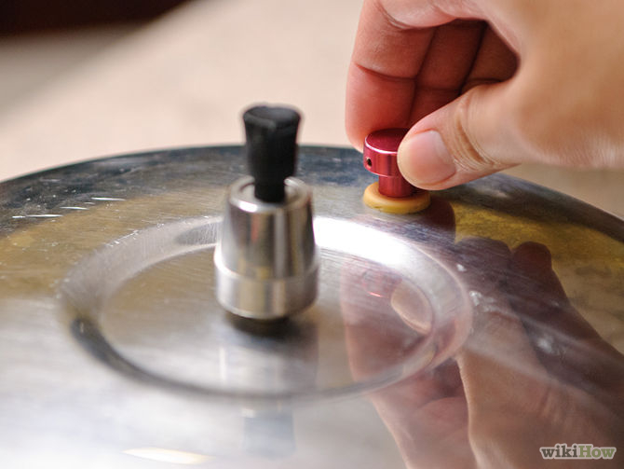
The Pressure Cooking Method
11. Pressure is completely reduced when the air vent/cover lock has dropped.

Slide 37
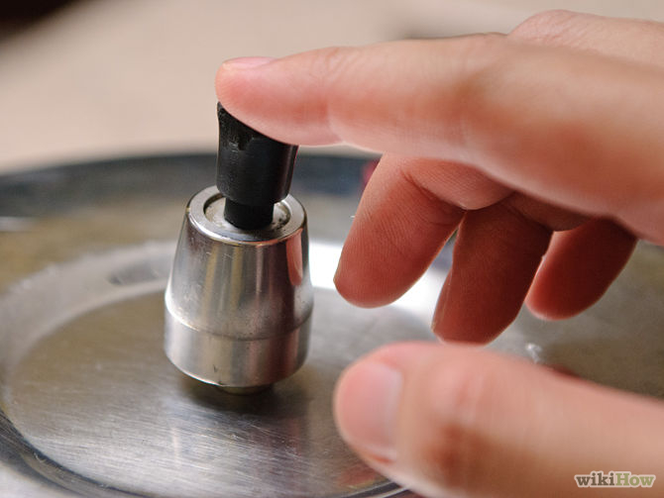
The Pressure Cooking Method
Check to make sure that all of the pressure has been released.

Slide 38
The Pressure Cooking Method
12. Remove the pressure regulator. Then, remove pressure cooker cover and serve food

Slide 39
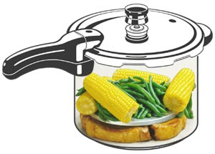
Whole Meal Magic!
1. Cook Chicken Breasts in bottom
2. Quick cool
3. Place corn and green beans on cooking rack
4. Quick Cool
5. Serve
https://www.gopresto.com/recipes/ppc/mealmagic.php
Notes:
One of the handiest advantages of pressure cooking is being able to prepare an entire meal at one time, in only one pot! By using the cooking rack to keep certain foods out of the cooking liquid, each food - whether it's an entree, side dish or dessert - retains its own individual, delicious flavor.
Ideally, you should select foods which require the same cooking time when planning a pressure cooker meal-in-one. The size of the food pieces, of course, will affect the cooking time. For instance, 1/2 inch slices of potato cook in 3 minutes, while 3/4 inch slices take 5 minutes. So, you can adjust cooking times by cutting your foods into larger or smaller pieces.
If the foods you select for your meal-in-one require widely different cooking times, you can easily make adjustments. For example, when your menu features barbecued chicken (8 minutes) with corn-on-the-cob (2 minutes) and green beans (2 minutes), follow this common sense cooking schedule:
1. Place chicken in pressure cooker with desired amount of cooking liquid. Close cover securely. Bring cooker to pressure and cook for 6 minutes.
2. Quick cool the pressure cooker under cold water until pressure is completely reduced. Remove the pressure regulator and then the cover. Place corn and green beans on cooking rack in pressure cooker.
3. Close cover securely. Bring pressure cooker back to pressure and cook 2 minutes more.
4. Quick cool the pressure cooker until pressure is completely reduced, remove the cover and "presto!" Dinner is served!

Slide 40
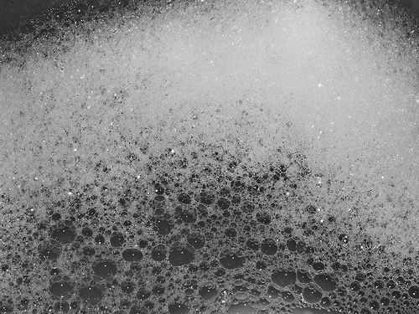
Store It Right
Before storing, always wash the pot, lid and rubber gasket by hand with soapy, warm water; dry well before putting away.

Slide 41
Store It Right
Always check the safety valves to make sure that they are clean and unobstructed and that the rubber gasket is always pliable and flexible before inserting it under the lid

Slide 42
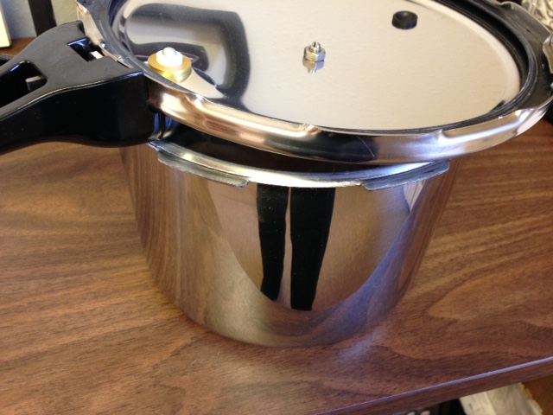
Store It Right
The most convenient and best way to store your pressure cooker after using it is to place the lid upside down, on top of the pot.

Slide 43
All This and More at….
http://www.rrc.k-state.edu/professional-development/index.html
Thanks to Crystal Futrell and Diane Burnett for sharing their handouts!

Slide 44
Meals Under Pressure! Meals in Minutes
Erin Petersilie, Walnut Creek District
Anna Schremmer, Phillips-Rooks District
Karen Blakeslee, M.S.

Slide 45
Brand names appearing in this publication are for product identification purposes only. No endorsement is intended, nor is criticism implied of similar products not mentioned.
Kansas State University Agricultural Experiment Station and Cooperative Extension Service
K-State Research and Extension is an equal opportunity provider and employer. Issued in furtherance of Cooperative Extension Work, Acts of May 8 and June 30, 1914, as amended. Kansas State University, County Extension Councils, Extension Districts, and United States Department of Agriculture Cooperating, John Floros, Director.

