Slide 1
Is It Safe? Information on Genetically Engineered Foods for Consumers
Londa Nwadike
Extension Food Safety Specialist
University of Missouri/ Kansas State University

Slide 2
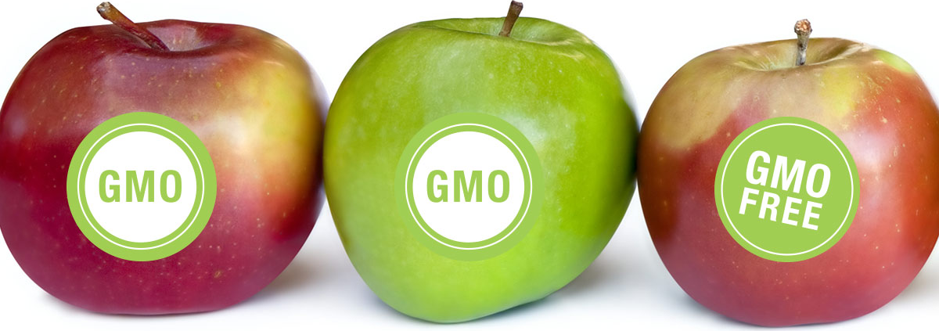
Outline
What are GE Foods?
What are the benefits of GE foods?
Which foods are currently GE?
GE product regulation
Are GE foods safe?
Concerns with GE foods
Labeling of GE foods

Slide 3
Multiple concerns
Increasing consumer interest in source of food
Health implications of food production methods
Will use term “Genetically engineered (GE)”
Scientifically accurate term used by FDA
Genetically modified organisms (GMOs- synonym)
Transgenic crops or animals- synonym
37 % of U.S. adults vs. 88% AAAS scientists think GM foods are safe- Pew Research, 2015
Many issues tied together

Slide 4
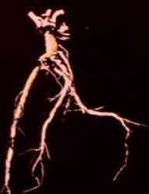
Modification of foods
All food crops have been modified by man to improve taste, yield, disease resistance, etc.
Done through crossbreeding, selective breeding, etc.
Takes years!
Top Photo: Peggy Lemaux
Bottom Photo: Corbis

Slide 5
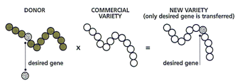
What are GE foods?
Plant or animal with DNA (genes) altered in a lab to enhance desirable traits
Crossbreeding: other undesirable traits may also come along
Genetic engineering: more precise gene transfer- only desired gene
Source: Mary Lee Chin, RD

Slide 6
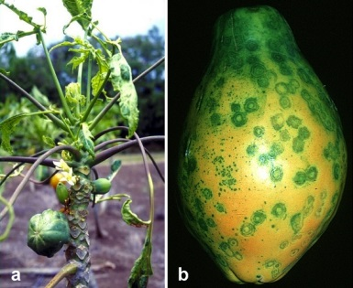
Benefits of GE foods
GE can help produce more food and/or enhance quality to feed growing world population
Reduces: yield loss, crop damage from weeds, diseases and insects, drought
More recent crops/under development: improved nutrition, taste, quality, shelf life
Notes:
The photo shows the effects of papaya ringspot virus. Virus-resistant papaya has been developed through GE technology, which has greatly benefitted the papaya industry in Hawaii.

Slide 7
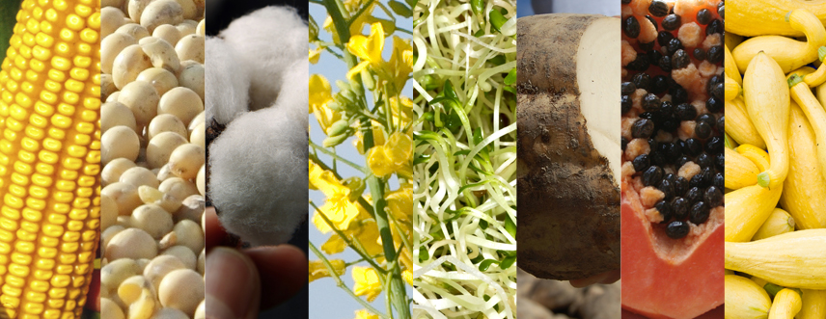
GEs currently in US food supply
Corn (field and sweet)- insect, herbicide
Soybeans- insect, herbicide
Cotton- insect, herbicide (animal feed)
Canola- herbicide
Alfalfa- herbicide (animal feed)
Sugar beets- herbicide tolerance
Potatoes- reduced bruising, low acrylamide
Papaya- disease
Squash- disease

Slide 8
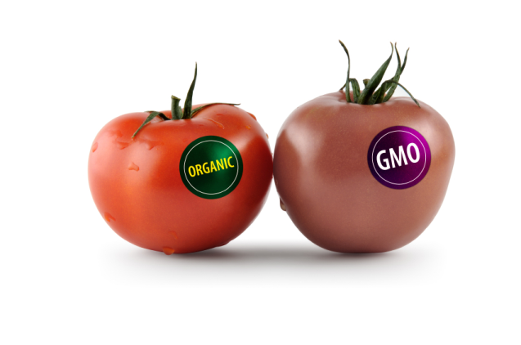
Not a GMO..
Tomatoes
Wheat
Sorghum
Anything not on previous slide

Slide 9
Regulation of GE products:
FDA rigorously reviews for:
Unintended effects/ toxicity
Allergenicity (i.e. nut gene into other crops)
Nutritional composition- not significantly different
Human trials not conducted
Study of composition better indicator of safety
USDA and EPA also regulate

Slide 10
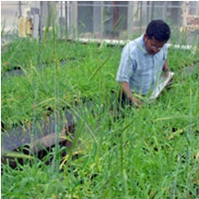
Regulation of GE products-2:
Development and approval process rigorous
~13 years from development to market
GE are most researched and tested products
Plants developed using other breeding techniques do not go through any formal regulatory assessment
*Essential to maintain this oversight

Slide 11
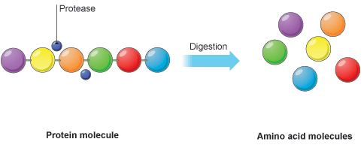
GE product digestion
All plant and animal foods have DNA and proteins
Consumed food is broken down by stomach acid and digested into basic units:
DNA → nucleotides
Proteins → amino acids
The basic units are absorbed into the body and used to make human DNA and proteins
Intact DNA or protein from food is NOT absorbed directly into our bodies
GMO DNA and protein is digested like all other sources

Slide 12
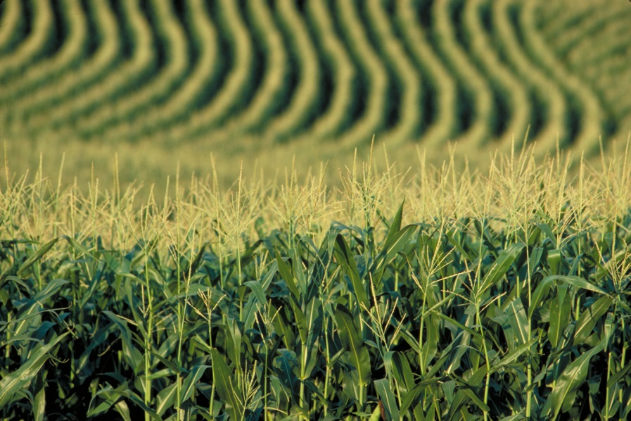
GEs and safety
100s of studies have shown that GEs do not present any health risk
No documented instance of harm to human health from GE (since 1994, first GE seeds)

Slide 13
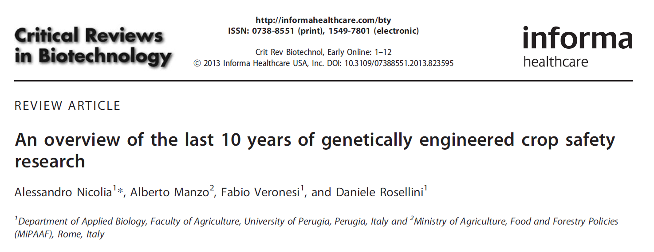
“We have reviewed the scientific literature on GE crop safety for the last 10 years that catches the scientific consensus matured since GE plants became widely cultivated worldwide, and we can conclude that the scientific research conducted so far has not detected any significant hazard directly connected with the use of GM crops.”

Slide 14
Concerns about GEs
Environmental effects- may lead to pesticide resistance (Bt corn or herbicide resistant weeds)
Likely due to improper farming practices with this
Need to use crop rotation, alternate varieties, good practices
Concerns about corporate control
Uncertainty of long-term effects, future research results
Know that 20 years of consumption is safe (since GE introduced), but what about longer?

Slide 15
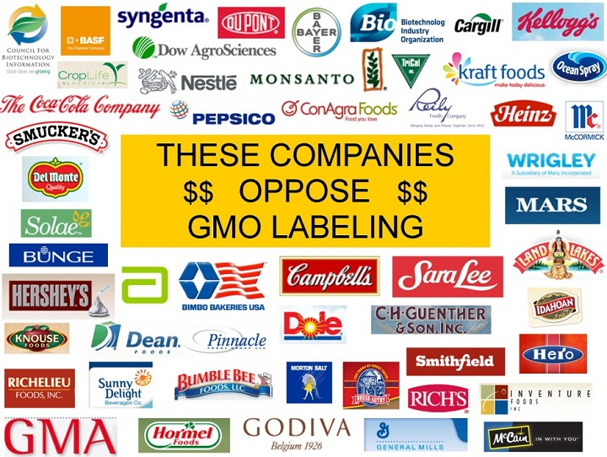
Concerns about GEs-2
Fear of the unknown
Small number of studies may show that GE causes harm
Companies may not favor GE labeling- why not?

Slide 16
GE Labeling
President signed federal law on July 29, 2016
Most packaged food products to require label, website/phone #, OR smartphone readable code w/ GE status
USDA (not FDA) to write specific rules by July 2018
Overrules VT and other state GE labeling laws (which may all be different)
Vermont GE labeling law was in force July 1, 2016
Required products to be labeled with GE status

Slide 17
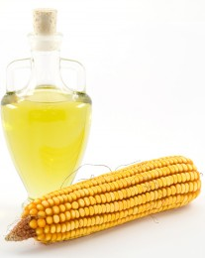
Federal GE labeling law questions
What is a GE product?
e.g.: corn oil, corn sweeteners- no DNA or protein left- are they still GE?
USDA rule making process will decide
Proponents say a website can provide more details on this than a food label
Penalties for companies not complying?
Is this enough information for consumers?

Slide 18
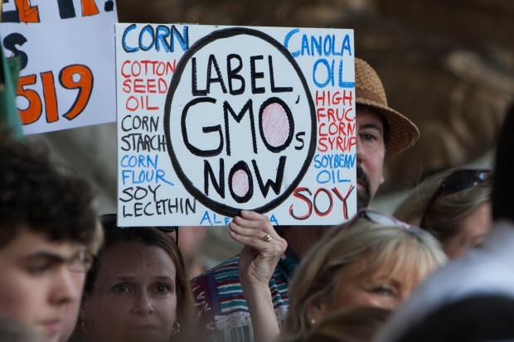
Diverse perspectives on GE labeling
Many consumers: want the right to know
FDA, some food companies:
No harm from GE foods
Foods are not made ‘different’ by GE
No allergies or specific health risks of GE
Difficult to do accurately
Some companies already labeling voluntarily

Slide 19
GE/GMO free options already available
Certified Organic foods- not allowed to have GEs
Products labeled as “GMO free”

Slide 20
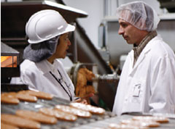
Challenges of GE labeling
Need to define level of “GE free”
Industry will need to track all ingredients and production methods
More sensitive methods to detect GEs in foods need to be developed and purchased by inspectors and industry
More inspectors needed to educate and monitor industry

Slide 21
Balancing it all…
Recognize that there are diverse perspectives, uncertainties
How do we meet current food needs without compromising food needs of other countries, future generations around the world
Need to ensure that information is science based
Also need to respect individual food sourcing philosophies

Slide 22
Helpful websites
IFIC www.foodinsight.org
GMO Answers www.gmoanswers.com
Genetic Literacy Project www.geneticliteracyproject.org
Colorado State- GMO labeling: www.ext.colostate.edu/pubs/foodnut/09371.html

Slide 23
Contact Details
Londa Nwadike
Extension Consumer Food Safety Specialist
Kansas State University/ University of Missouri
Phone: 913 307 7391 Email: lnwadike@ksu.edu
www.ksre.k-state.edu/foodsafety/

