Slide 1
Family Dance! Using dance as a healthy family engagement activity.
Bradford Wiles, Ph.D. and Laura Schachtner

Slide 2
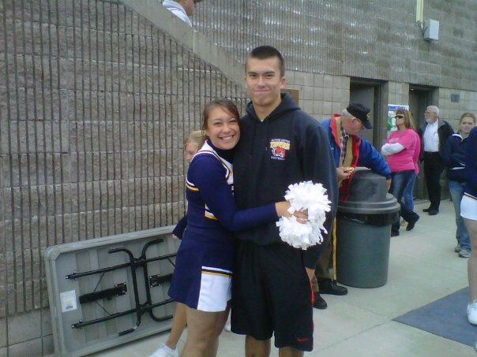
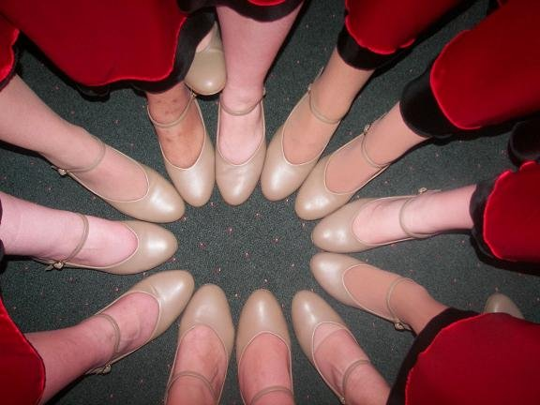
Introduction of presenters

Slide 3
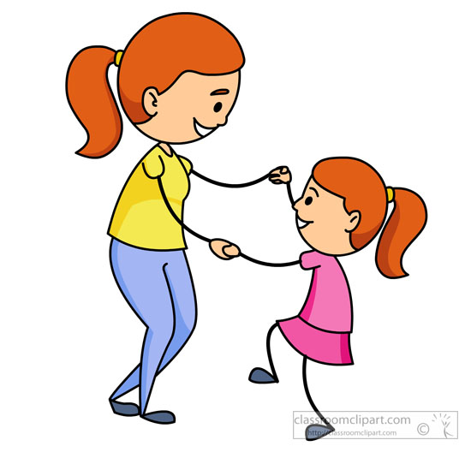
Program Overview
What is it?
Dance program for beginners
Promotion of family health and parental involvement
Scaffolding strategies
Dancing!
What do we hope to achieve?
Family health
Strong families
Notes:
This program is a program in which we will be teaching tap dance to children and their families in order to promote family health and parental involvement with their children. This program will include brief segments in which you will teach parents scaffolding strategies for interacting with their children in order for parents to make their interactions with their children more conducive to their child’s development. Last, but certainly not least, this program involves a lot of dancing!
By participating in this program, we hope to help families achieve 2 main goals. First, we hope to improve family health by introducing physical activity in a fun format for both parents and their children. Participants of previous dance interventions have noted that dancing is carried over into the home and that even siblings of participants become more physically active (Beaulac, Kristjansson, & Calhoun, 2011). Lastly, we want to promote strong Kansan families via a fun, shared family activity that encourages family togetherness.

Slide 4
Research informing our goals
Enjoyable time together makes families strong (University of Nebraska-Lincoln Extension, 2007.)
Children are more physically active with parents (Rebold, Lepp, Kobak, Mcdaniel, & Barkley, 2016)
Notes:
Research and interventions from previous studies strongly support the likelihood that our tap program will help us to achieve our goals. Researchers with University of Nebraska’s extension for Early Childhood development asked parents “What makes your family strong?” (University of Nebraska-Lincoln Extension, n.d.). Enjoyable time together was listed as one of the top responses. This provides support that our activity (dance) can help strengthen families because our format ensures that families will have enjoyable time together.
That’s not the only research that shows that our program is likely to help families. In addition to strengthening families, our program encourages physical activity, an important component for overall health. Research shows that children are the most physically active when their parents are participating with them. In a research study conducted by Rebold, Lepp, Kobak, Mcdaniel, and Barkley (2016), children were given a choice of various sedentary or active activities in a gymnasium. Sedentary activities included coloring, reading books, and dolls and action figures. Physical activities included basketballs, footballs, soccer balls, jump ropes, and obstacle courses. Each child and his/her parent took part in all three levels of parent participation, participating in each level on different days. These levels were the child playing alone, in which the parent was not in the gym, the child playing with the parent watching in the gym, and the child and parent playing together. These researchers found that in the last condition, the parent participating condition, the children were more active than the other 2 and found that children were least active when they played alone. They also asked which condition the child preferred and the majority of children reported that they preferred to do the activities with their parents.
Because of this study, there are components in our program which encourage interaction between parents and children. The dances in our program can also be used at home. Parents who take this home have an increased likelihood of having children who are more active, because parents play essential roles in making sure their families are healthy.

Slide 5
Why are our goals important? Strong families/Parental involvement
Parental involvement linked to higher reading and math scores
Organized activities also enhance academic performance
(Cooper, Crosnoe, Suizzo, & Pituch, 2010)
Parental involvement also increases children’s involvement in their own learning
(Zimmerman, 1990, as cited in Xu, Benson, Mudrey-Camino, & Steiner, 2010)
Notes:
By promoting family engagement, we are hoping to further promote additional parental involvement in their children’s lives. In addition to promoting children’s physical activity, parental involvement also has benefits for children’s education (Cooper, Crosnoe, Suizzo, & Pituch, 2010). Cooper et al. (2010) found that parental involvement is partially responsible for the relationship between poverty and child achievement scores in reading and math at the kindergarten-age. Though poverty is a risk factor for low achievement scores, children with involved parents were less likely to have low scores. They also found that children are more likely to have higher achievement scores in math when they are participating in an organized activity, such as our program.
As I’ve stated before, we hope that parental involvement in children’s physical activity will spread to other domains of family life, such as children’s education. The more parents are involved in their children’s education, the better children perform. Parents who are involved have children who score higher in reading and math and their children are also more likely to be self-regulated learners.
Children who are self-regulated in their learning are able to think about their learning and are motivated to take steps to further their own learning without much influence from outside pressure, such as parents and/or teachers. They are “metacognitively, motivationally, and behaviorally active participants in their own learning” (Zimmerman, 1990, p. 4, as cited in Xu, Benson, Mudrey-Camino, & Steiner, 2010)
In short, in addition to increasing children’s physical activity, parental involvement also increases the likelihood that children will perform well academically, which holds significant implications for their futures

Slide 6
Benefits of dance/physical activity (PA)
Physical
Weight loss
Increased fitness, energy, and strength
Psychological
Higher confidence
Positive mood changes
Behavioral
Increased physical activity at home in participants and participants’ siblings
Improved eating habits
(Beaulac, Kristjansson, & Calhoun, 2011)
Notes:
In addition to benefiting from the relationship with their parents, children will also benefit from the physical activity our program offers. These researchers provided a 13-week long hip-hop dance program to a group of adolescents and outcomes were reported by parents, program staff, and the participants themselves. All reported several benefits gained as a result of the dance program.
These benefits included weight loss, increased energy, increased strength, increases in physical activity at home, increases in the physical activity of participants’ siblings, improved eating behaviors, and higher confidence.

Slide 7
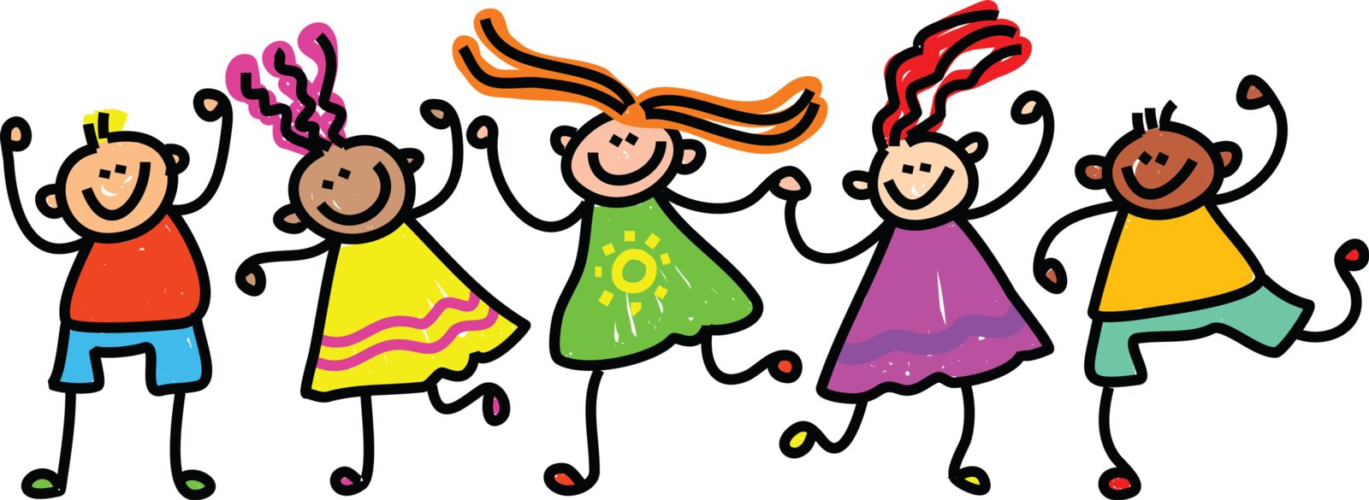
Benefits of dance/physical activity cont’d.
Interpersonal
More relationships
Improved social skills
Academic
Better grades
Improved homework completion
(Beaulac, Kristjansson, & Calhoun, 2011)
Notes:
This list of benefits continues; it was also reported that adolescents benefited from the program because they gained more relationships, better interactions with parents and teachers, and improved academic performance

Slide 8
Why?
Why is it needed?
“A crucial determinant influencing PA is the environment in which a child lives” (Wilke, Opdenakker, Kremers, & Gubbels, 2013, p. 226)
The reach of physical activity interventions is very limited.
Notes:
Now that we’ve covered our goals and the research supporting the likely utility of this program, why is this program needed?
As Wilke et al. state, “A crucial determinant in influencing PA (physical activity) is the environment in which a child lives.” By participating in this program, we hope that parents will take the dance moves home with them and change their home environment to an active one, if it is not already.
In addition, other researchers note that the reach of physical activity interventions is very limited. Pate, O’Neill, Brown, McIver, Howie, and Dowda (2013) state “Most effective physical activity interventions have only reached the participants in physical activity research studies or in a limited number of formal physical activity groups. Systematic dissemination of preschool physical activity interventions to early childhood educators is sorely needed” (p. 453)
By teaching you the curriculum, we are able to spread this program to multiple communities in Kansas and overcome this barrier.

Slide 9
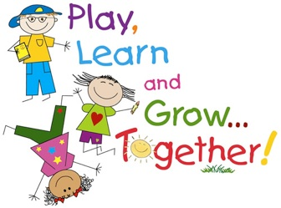
Teaching components-Scaffolding
6 strategies of scaffolding
Questioning
Explaining/Instructing
Modeling
Feedback
Maintaining focus
Structuring
Notes:
Now that we’ve covered what the program is, what we hope to achieve, and the research backing it, we’re going to cover the teaching strategies that you will be using and teaching to parents each session.
You will be teaching using a process called scaffolding. During this learning process, adults and children are able to build upon previous knowledge in order to consolidate what they already know and integrate it with new knowledge given to them. There are 6 strategies of scaffolding and they are questioning, explaining and instructing, modeling, feedback, maintaining focus, and structuring. We will go over all of these with you now and provide you opportunities to practice each one.

Slide 10
Scaffolding-Questioning
Assessment
Yes/no/one-word answers
For example “Do you like dancing?”
Assistance
Open-ended
For example “What do you think about dancing?”
Practice
Notes:
The first scaffolding strategy on the list is questioning. There are two types of questions that parents can ask their children and that teachers can ask any adult or child who is learning: Assessment and assistance questions

Slide 11
Scaffolding-Explaining and instructing
Parents can help their children learn by explaining what is happening
For example, “Dancing is when we move our bodies in a different way. It usually happens when there is music playing but you can dance without music too.”
Practice

Slide 12
Scaffolding-Modeling
Modeling occurs on 2 levels
Parents are always modeling for their children
Parents can also intentionally model specific things, such as characters out of a book or dance moves
Practice
Notes:
Parents always model behavior for their children, whether it is good behavior or not. Children like to copy.

Slide 13
Scaffolding-Feedback
Important to tell children what the feedback is about
Use “because” or explain what the feedback is for
For example “You’re doing a good job today because you’re getting up and dancing!”
Practice

Slide 14
Scaffolding-Maintaining focus
Adult should model their own interest
Can go along with distraction and then redirect
Offer options
Practice

Slide 15
Scaffolding-Structuring
Set the stage for what will happen
Practice

Slide 16
General tap session format
Greet parents and children
Welcome and introduce yourself for those who do not know you
Explain how the session will go that evening (scaffolding strategy of structuring ☺)
Short explanation of one of the scaffolding strategies
Teach moves
Dance
Notes:
Now that we’ve covered the basic process of teaching, we’re going to move on to the actual tap curriculum. To begin, you will be greeting parents and their children. Make sure to interact with them before the session starts so you can increase their enthusiasm and likelihood of participation.
You will then explain how the session will go that night. You will tell them that you’ll teach them for a very short time ways that parents can help children learn and after they practice this, they will be learning dance moves without music. After that, they will be dancing using the dance moves you taught them while music is playing

Slide 17
Dance Step Playlists
Tap Steps for All Sessions
Tap Steps - Basics

Slide 18
Link for all Family Dance! Resources
Family Dance!

Slide 19
Dance moves
Stamp-https://www.youtube.com/watch?v=yCMkj-LiIPQ (0:35-0:50)
Step and clap-https://www.youtube.com/watch?v=a-15PIJNpyE (0:00-0:09)
Shuffle-https://www.youtube.com/watch?v=7D582WY2Et4 (0:00-0:52)
Irish-https://www.youtube.com/watch?v=43UoZ0a4cIA (0:00-1:13)
Toe drops and heel drops-https://www.youtube.com/watch?v=_p3H7csi_A8 (0:00-1:20)
Flap-https://www.youtube.com/watch?v=WcxRnK4-r1s (0:00-0:39)
Notes:
Now that you know how each session will generally go, I’m going to review the dance moves that you will be using in most of the sessions.
Though these are basic tap moves, they will be modified in the choreography to make it easier for children who have not yet developed fine motor skills.

Slide 20
Dance moves cont’d.
Straight kick-https://www.youtube.com/watch?v=1-wzOXT_orc (0:55-1:03)
Shuffle ball change-https://www.youtube.com/watch?v=7wmmBLi1EyI (0:00-1:41)
Buffalo-https://www.youtube.com/watch?v=unszgGPxC0Y
Thunderstorm (run in place)
Toe tap-https://www.youtube.com/watch?v=X61YfjtjjD4&index=4&list=PLSc9hQHuK-PKr2NJfLNMEIG0Bx3DxHsC6 (0:00-0:48)
Notes:
After demonstrating the straight kick, note to the audience that the kicks we are using will be below hip level. Demonstrate.
Pause the toe tap video at 0:48 and note that the toe taps we will be doing in our program will be using the whole leg because many younger children have not yet developed the fine motor skills needed to move just the ankle for toe taps. Then demonstrate.

Slide 21
References
Beaulac, J., Kristjansson, E., & Calhoun, M. (2011). 'Bigger than hip-hop?' impact of a community-based physical activity program on youth living in a disadvantaged neighborhood in Canada. Journal of Youth Studies, 14(8), 961-974. Retrieved from www.scopus.com
Cooper, C. E., Crosnoe, R., Suizzo, M., & Pituch, K. A. (2010). Poverty, race, and parental involvement during the transition to elementary school. Journal of Family Issues, 31(7), 859-883. Retrieved from www.scopus.com
Pate, R. R., O'Neill, J. R., Brown, W. H., McIver, K. L., Howie, E. K., & Dowda, M. (2013). Top 10 research questions related to physical activity in preschool children. Research Quarterly for Exercise and Sport, 84(4), 448-455. Retrieved from http://search.proquest.com.er.lib.k-state.edu/docview/1651852128?accountid=11789
Rebold, M., Lepp, A., Kobak, M., Mcdaniel, J., & Barkley, J. (2016). The Effect of Parental Involvement on Children's Physical Activity. The Journal of Pediatrics, 170, 206-210.
University of Nebraska-Lincoln Extension. (n.d.). Family relationships: Strong family relationships. Retrieved from http://child.unl.edu/strongfamilies
Wilke, S., Opdenakker, C., Kremers, S. P., & Gubbels, J. S. (2013). Factors influencing childcare workers' promotion of physical activity in children aged 0-4 years: A qualitative study. Early Years: An International Journal of Research and Development, 33(3), 226-238. Retrieved from http://search.proquest.com.er.lib.k-state.edu/docview/1651832479?accountid=11789
Xu, M., Benson, S. N. K., Mudrey-Camino, R., & Steiner, R. P. (2010). The relationship between parental involvement, self-regulated learning, and reading achievement of fifth graders: A path analysis using the ECLS-K database. Social Psychology of Education, 13(2), 237-269. Retrieved from www.scopus.com

