Slide 1
Food Safety for At-Risk Populations
Londa Nwadike
Extension Consumer Food Safety Specialist
University of Missouri/ Kansas State University

Slide 2
Outline
Food safety tips for everyone
Food safety for people that are:
Young
Older
Pregnant
Sick/ Immune compromised
Why at higher risk
How to lower food safety risk

Slide 3
4 steps to food safety
Cook, Chill, Clean, Separate
Cook: Heat kills germs
Check temperature with thermometer
Beef, pork, lamb steaks, chops, roasts: 145°F with 3 min rest
Ground beef, pork; egg dishes (quiche): 160°F
All poultry products, reheated foods: 165°F
Need to calibrate occasionally

Slide 4
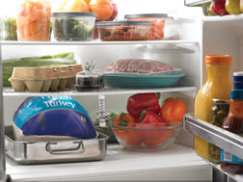
4 steps to food safety
2. Chill: refrigerate or freeze perishables immediately
Refrigerate cut or peeled produce, meats within 2 hours
Pathogens (germs) love room temperature, so grow fast!
Frig: <40F
Freezer: 0F

Slide 5
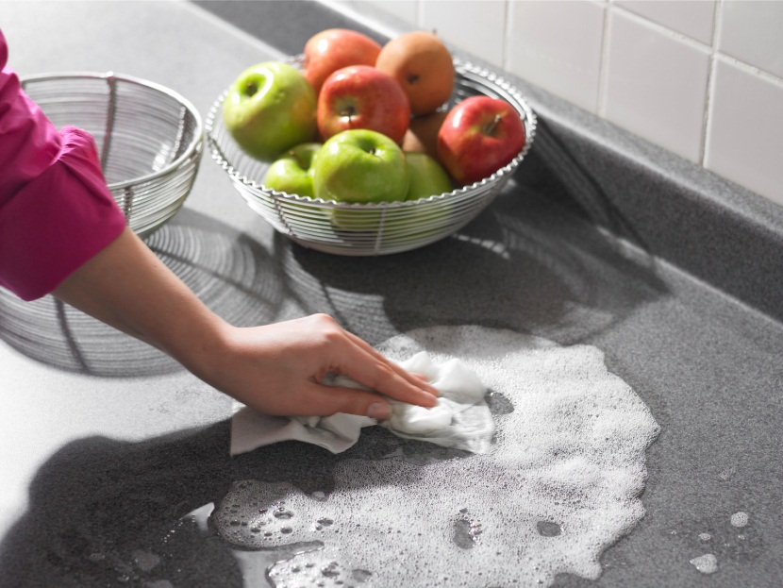
Step 3: Clean
- Keep surfaces, utensils clean: before and after use
Cleaning steps:
a) Clean/wash
b) Rinse (dishes)
c) Sanitize:1 tablespoon bleach per 1 gallon water (200 ppm)
d) Air dry
- Good personal hygiene

Slide 6
4 steps to food safety
4. Separate: Keep raw, RTE foods separate
Use separate cutting boards, plates, utensils for raw meat and produce or cooked foods
Keep raw meat, eggs separate from other foods in frig
Raw items in sealed plastic bags or other containers
Keep eggs in carton and do not store in door (keep cooler)

Slide 7
Food Safety for Under 5s- Why
Immune systems still developing
Produce less stomach acid to kill bacteria
Diarrhea can quickly cause dehydration in small bodies
Highest incidence rates of many FBIs, including HUS from E. coli

Slide 8
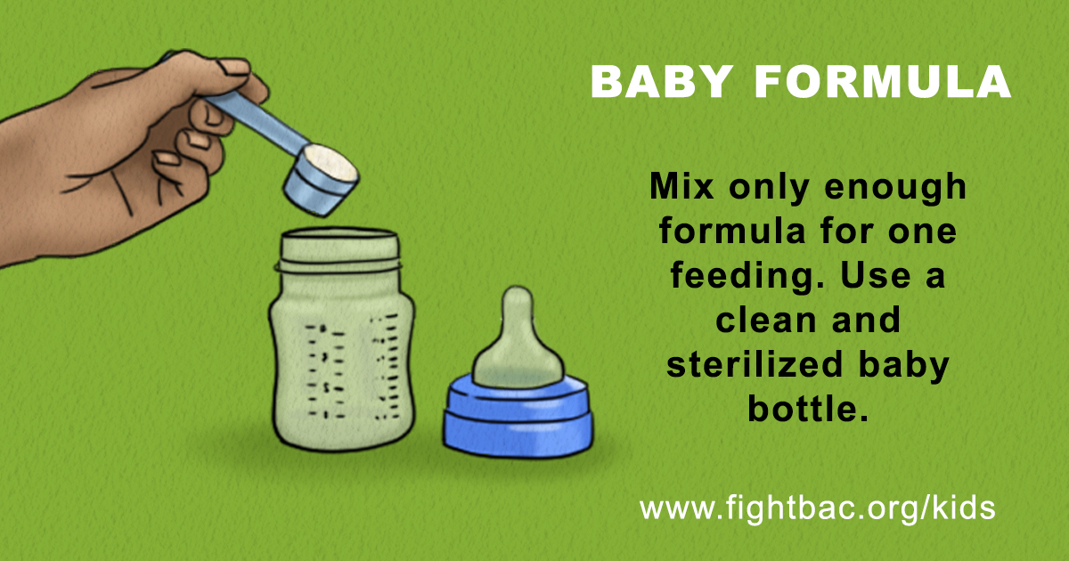
Tip #1
Notes:
Infant formula also has inherent risks. Like breast milk, formula is not a sterile product. Furthermore, milk-based infant formula contains lactose, protein, and milk fat that may protect bacteria during the drying process. These sublethally injured microorganisms have been reported to survive for up to two years.

Slide 9
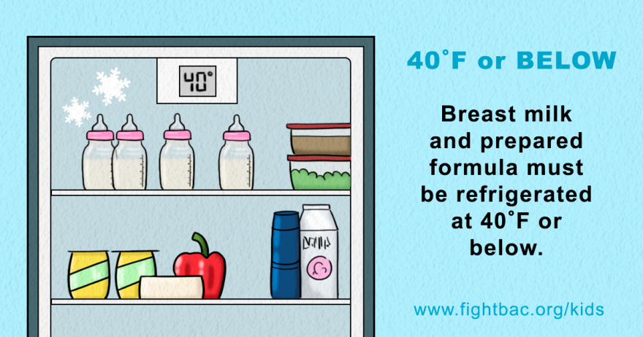
Tip #2

Slide 10
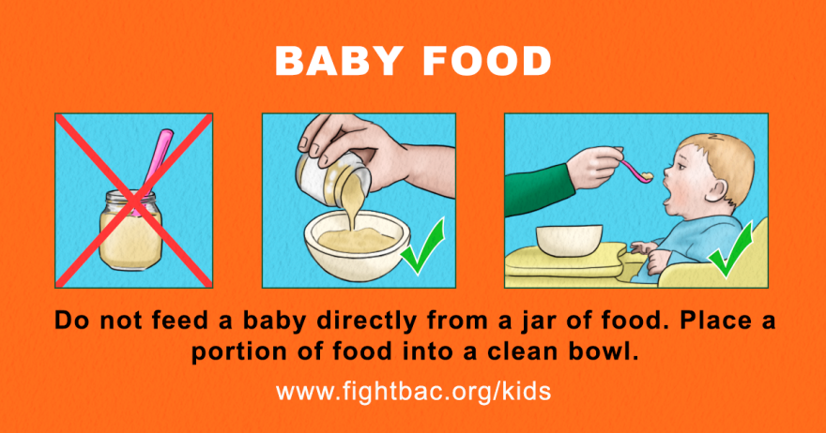
Tip #3

Slide 11
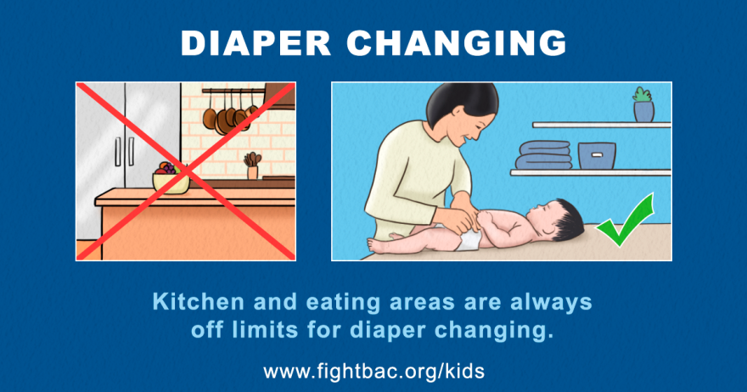
Tip #4

Slide 12
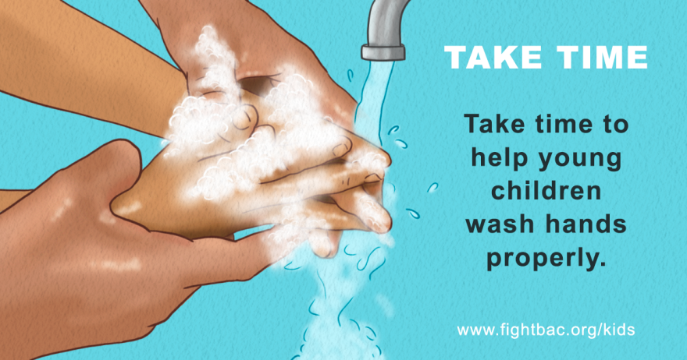
Tip #5

Slide 13
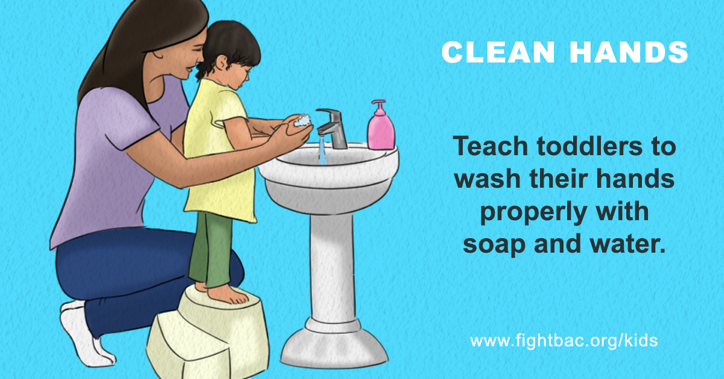

Slide 14
Using breast milk safely
Breastfeeding has many benefits!
Need to follow safe handling and storage practices with expressed breast milk
Maintain high quality of milk and health of baby

Slide 15
Storing breast milk
Location | Temperature | Duration | Comments
Countertop | Room temp (up to 77°F) | 6-8 hours | Be sure containers are covered
Insulated cooler bag | 5-39°F | 24 hours | Keep ice packs in contact with milk container, limit opening bag.
Refrigerator | 39°F | 5 days | Store milk in the back of the main body of the refrigerator where temperatures are coldest
Freezer compartment of a refrigerator | 0°F | 3-6 months | -Note that if the freezer compartment is within the refrigerator (using the same main door), milk can only be stored 2 weeks. -Store milk toward the back of the freezer, where the temperature stays colder. -Milk stored for longer listed durations is safe, but may be lower nutritional quality.
Chest or upright freezer | -4°F | 6-12 months

Slide 16
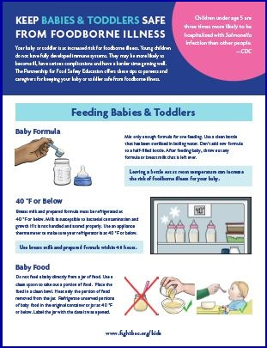
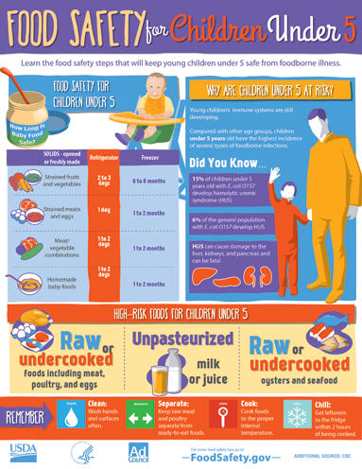
Resources Available
www.fightbac.org/kids
www.foodsafety.gov
www.ksre.k-state.edu/foodsafety/topics/risk.html

Slide 17
Food Safety for Older People- Why
GI tract holds food longer, allows bacteria to grow
Liver, kidneys may not rid body of bacteria, toxins
Stomach may not produce enough acid, increased bacterial growth
Underlying chronic conditions
May not see or smell spoilage
Older Adults in nursing homes 10x more likely to die from bacterial gastroent. than general pop.

Slide 18
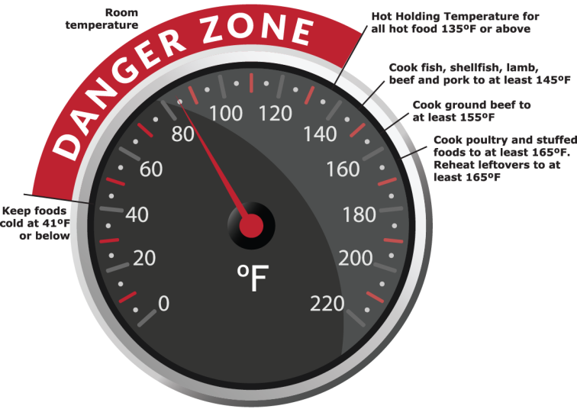
Home delivered meal safety/ older adults food safety tips
Do not leave food in 40-140F danger zone more than 2 hours
Refrigerate meals as quickly as possible
Follow refrigeration time recommendations (3-4 days)
When in doubt, throw it out (food waste concerns..)
Reheat foods to 165F

Slide 19
More resources

Slide 20
Fight Bac resources

Slide 21
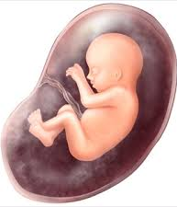
Food Safety in Pregnancy- why
Hormones reduce mom’s immune system
More susceptible to food borne illness
Baby: under-developed immune system
Certain organisms can transfer to baby
Toxoplasma gondii
Parasite- cat feces; hearing loss, mental retardation, blindness
Listeria monocytogenes
Miscarriage, premature delivery, sickness
Pregnant women are 10x more likely to contract

Slide 22
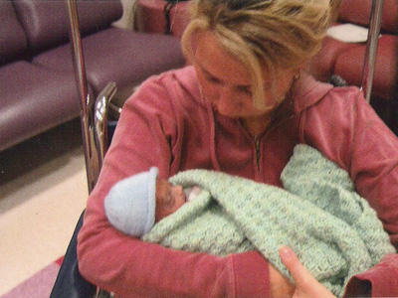
Listeria effects
Michael, pre-term infant
Died from Listeria
Mom ate infected lettuce while pregnant
Source: www.stopfoodborneillness.org

Slide 23
Pregnancy food choices
Raw or undercooked meat?
Raw or undercooked fish or seafood; refrigerated smoked fish?
Raw milk?
Raw fruit juice or cider?
Foods with raw eggs- raw cookie dough?
Soft boiled/ over-easy eggs?

Slide 24
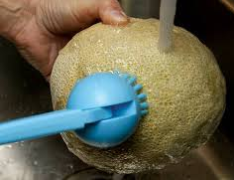
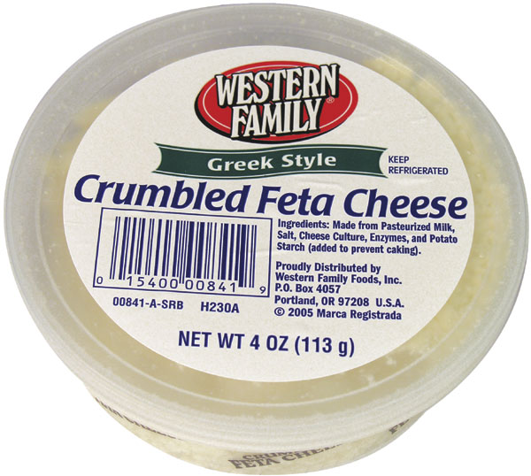
Pregnancy food choices-2
Raw sprouts?
Unwashed fresh fruits and vegetables?
Soft cheeses made from unpasteurized milk (feta, brie, queso fresco)?
Cold hot dogs, cold deli meats?
Unpasteurized, refrigerated pates or meat spreads?

Slide 25
Resources available

Slide 26
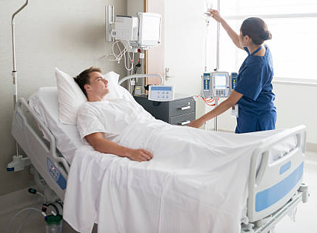
Sick/ immune compromised- why
Weakened immune system- by disease or medications
Body cannot fight infection as well- decreased white blood cells, etc
Diabetes- less stomach acid, kidney function
Metabolism altered

Slide 27
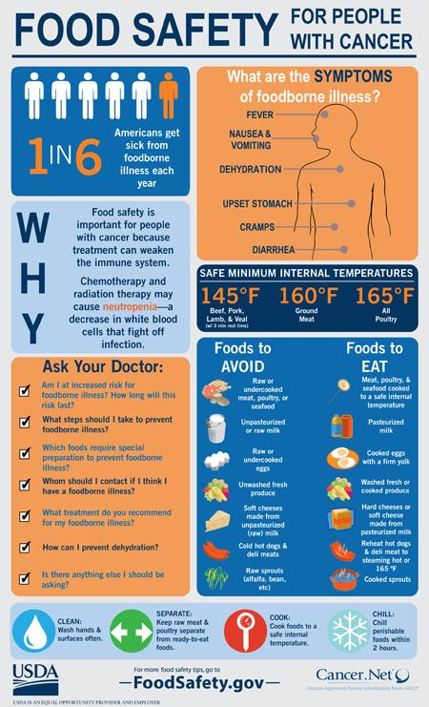
Food safety tips- sick
Avoid raw foods
Wash fruits and veggies
Wash hands, utensils, etc
Ensure that water is safe

Slide 28
Resources available

Slide 29
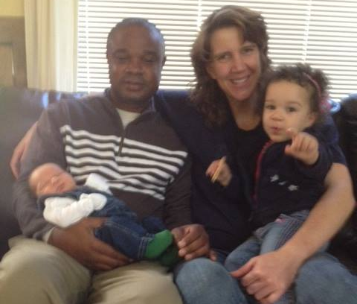
Questions?
Thank you
for your attention!

Slide 30
Contact Details
Londa Nwadike
Extension Consumer Food Safety Specialist
Kansas State University/ University of Missouri
KS Phone: 913 307 7391 Email: lnwadike@ksu.edu
www.ksre.ksu.edu/foodsafety/

