Slide 1
The Battelle Study Analysis of the Value of Family and Consumer Sciences Extension in the North Central Region
Presented by
Paula Peters, Sharolyn Flaming Jackson,
Gayle Price, Debra Bolton, and Libby Curry
August 25, 2015
Notes:
Paula
Analysis of the Value of Family and Consumer Sciences Extension in the North Central Region

Slide 2
Background
Why the study?
Who is “Battelle” and Why?
Who was involved
Process of the study
Methodology
Literature Review

Slide 3
FCS Recognized in 19th Century…
focused on the home and its management:
cooking
management of the household
preparation of medicines
food preservation
1899 – Home Economics
Notes:
Libby

Slide 4
1914 Smith-Lever Community Education
1920: Home Economics added to American Association of Public and Land Grant Universities

Slide 5
A Nation of Contrasts
9.6 Million Millionaires
vs
45 Million Americans in Poverty

Slide 6
Abundant Opportunities – Significant Challenges
500 Prisoners/100,000 population
vs
100 Prisoners/100,000 population
55% of black children live in single parent households
603,000+ children confirmed by CPS as victims of maltreatment within a single year
75 % of young Americans cannot enlist in military:
Failure to graduate high school
Criminal record
Physical fitness issues (obesity)

Slide 7
FCS Addresses Challenges
NIFA/USDA
“Family & Consumer Sciences is the integrative, multidisciplinary field of science that studies relationships among humans and their environments to foster quality of life, strengthen communities, and achieve a healthy, sustainable world.”

Slide 8
The Issues Have Changed
Definition of Family
Workforce more Diverse
Neighborhood and Communities –
more complex

Slide 9
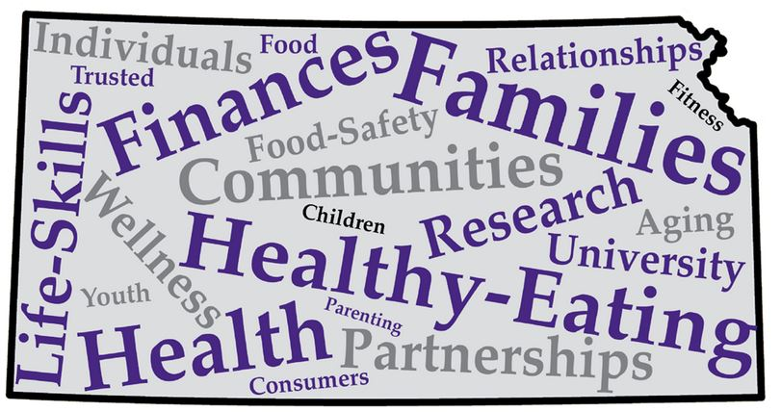
FCS Today
Food, Nutrition & Health
Family & Human Development
Family Resource Management

Slide 10
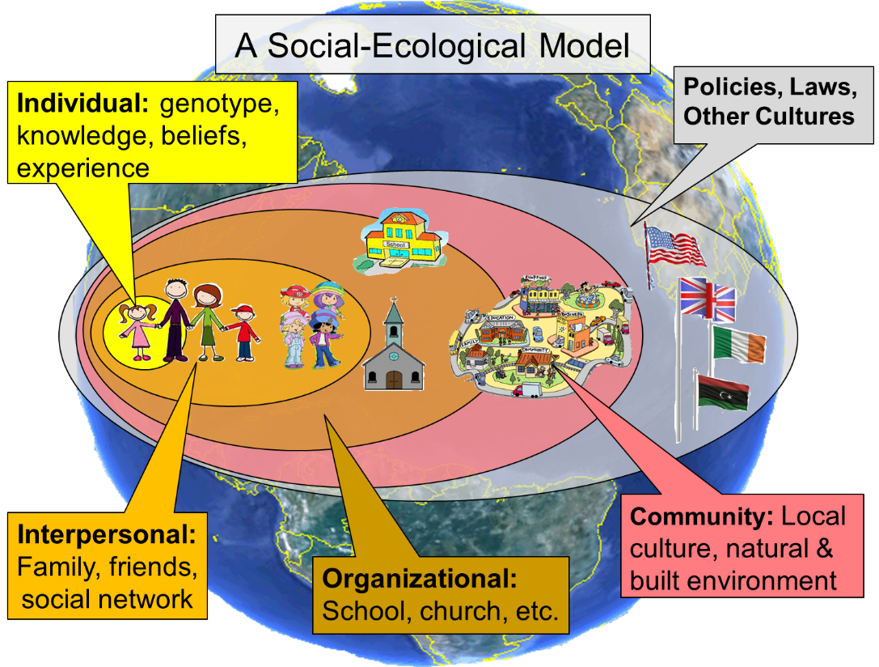

Slide 11
Domains-Meeting the Needs of Families
Education (Extension)
Therapeutic or Clinical Intervention
Case Management
Evidenced-informed Evidenced-based

Slide 12
FCS Professionals…
Transfer program knowledge to end-users, paraprofessionals, volunteers, and others
Use train-the-trainer approach
Multiply the reach and impact of programming

Slide 13
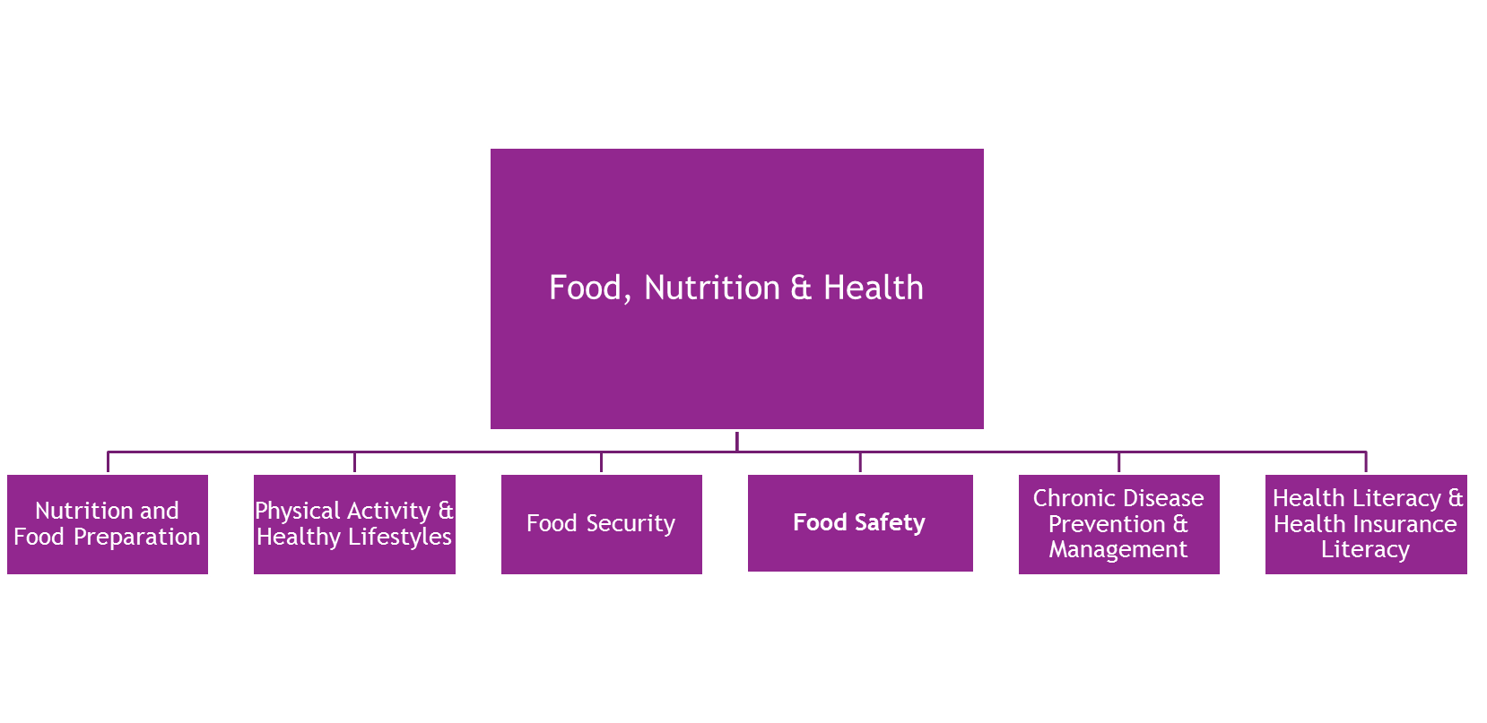
Section II: Food, Nutrition & Healthful Lifestyles
Notes:
Sharolyn

Slide 14
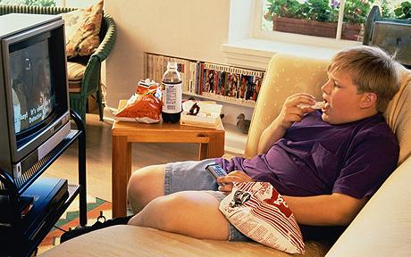
Why Food, Nutrition & Health?
Half of all adults have at least 1 chronic health condition
Chronic disease costs more than $1 trillion/year
More than 1/3 of U.S. adults are obese
81% of Kansans don’t eat enough fruits and vegetables
14.5% of U.S. households are food insecure
52% of adult Kansans don’t meet recommendations for physical activity
Children spend an average of 7 ½ hours a day in front of screens
In 2007, low health literacy cost was $106 - $238 billion
Notes:
Half of all adults have at leas 1 chronic condition: 1 in 4 adults have 2 or more chronic conditions; If things don’t change, 1 in 3 Americans will have diabetes by 2050
Chronic disease costs more than $1 trillion/year in healthcare costs/lost productivity
Only 48% of adults meet PA recommendations: 16.5% also meet muscle strengthening guidelines

Slide 15
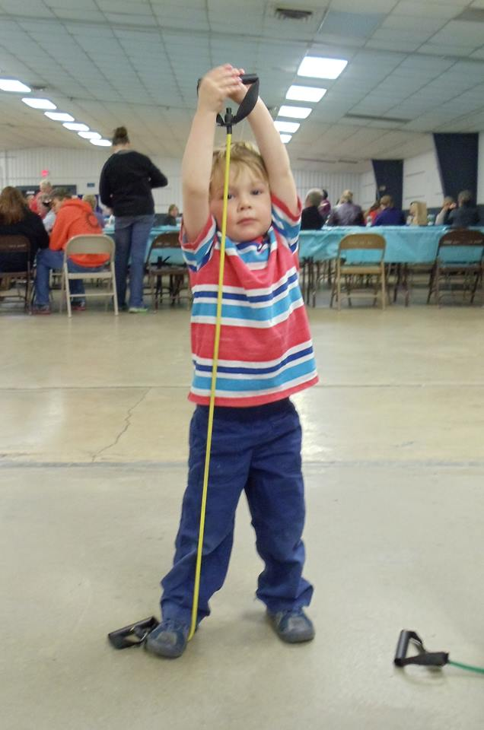
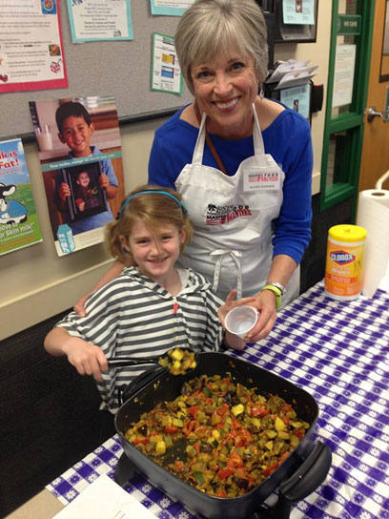
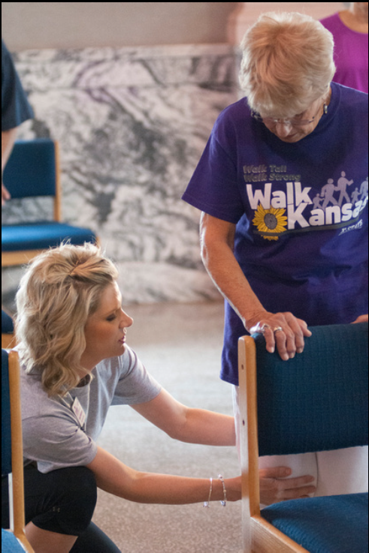
Extension Healthy Eating, Physical Activity & Healthy Lifestyles
Expanded Food & Nutrition Education Program (EFNEP)
Communities Preventing Childhood Obesity
Snap-Ed
Eat Healthy, Be Active
Eat Smart, Live Strong
MyPlate for My Family
Master Food Volunteers
Walk Kansas
Stay Strong, Stay Healthy (Strong Women/Strong People)

Slide 16
Extension Food Security
EFNEP and SNAP-Ed
Farm to School
“If you don’t have food, you don’t think right. You don’t function right. You go into crisis mode. You can go to food banks, but do you know what to do with the food you get at a food bank? That’s how Extension helped me.”
Tracie Hanzel, family resource specialist and past participant in the OSU Extension nutrition programs

Slide 17
Chronic Disease Prevention & Management
Dining with Diabetes
Chronic Disease Self-Management Program (KOHP)
According to the Partnership to Fight Chronic Disease:
If Americans were to stop smoking, exercise regularly, and eat well, they could prevent up to 80% of heart disease and stroke, 80% of type 2 diabetes and 40% of cancers

Slide 18
Health Literacy
Poor health literacy by itself is a stronger predictor of a person’s health than age, income, employment status, education level, and race.

Slide 19
Health Literacy & Health Insurance Literacy
Senior Health Insurance Counseling (SHICK)
Smart Choice Health Insurance
Smart Choice for Farm Families

Slide 20
FCS Programming Impacts in Kansas
Every $1 spent on EFNEP = $2.56 savings in food expenditures (KS); $3.63-$10.75 savings in healthcare costs; $86 million over lifetime of participants
Over 150 active Master Food Volunteers are in place in Kansas and provide relevant and valued programs
16,000+ participate in Walk Kansas each year: 87% increased physical activity, 69% were confident they would continue
$1 spent on Chronic Disease Self-Management Program = $4 saved in healthcare expenditures over a lifetime
Dining with Diabetes: 52% followed a meal plan to help manage diabetes; 59% used food label to plan; 55% kept track of carbohydrate foods daily
Notes:
EFNEP projected to result in savings of over $86 million over the lifetime of participants

Slide 21
“….it is likely that Family & Consumer Sciences Extension nationally reaches more people with nutrition education than any other source in the nation.”

Slide 22
Why Food Safety?
Annually:
Millions of foodborne illnesses occur in the United States
1 in 6 Americans get sick from and 3,000 die of foodborne diseases.
Reducing foodborne illness by 10% would keep 5 million Americans from getting sick.
Acute foodborne illnesses cost the U.S. an estimated $152 billion in healthcare, workplace, and other economic losses.
Preventing a single fatal case of E. coli O157 infection would save an estimated $7 million.
Reference: CDC. “Environmental Health Practice and CDC’s Food Safety Winnable Battle”
Notes:
Gayle
The Center For Disease Control and Prevention- Winnable Battle
CDC has identified reducing foodborne diseases as a winnable battle. With additional effort and support for evidence-based, cost-effective strategies a significant impact on our nation's health will occur.
2. Reducing foodborne illness by 10% would keep 5 million Americans from getting sick
each year. Preventing a single fatal case of E. coli O157 infection would save an estimated $7 million.
Extension FCS Agents in Kansas and across the county are trained professionals that provide Food Safety training which is key in helping to prevent food borne illnesses.

Slide 23
Extension Food Safety Program Focus
Food, Nutrition & Health
Nutrition and Food Preparation
Physical Activity & Healthy Lifestyles
Health Literacy & Health Insurance Literacy
Chronic Disease Prevention & Management
Food Security
Food Safety
Notes:
Extension Food Safety Programming includes
Farmers’ Market Vendor Safe Food Handling- Local Foods, Food Stands,
Food Product- Value Added Food Safety Issues
Commercial and Institutional Food Handlers- Training and Certification
Consumer Food Safety, Food Prepared at home- Safe Food Handling, Outdoor cooking,
Home Food Preservation
Producers: Good Agricultural Practices- GAP

Slide 24
Successful Extension Food Safety Programs
ServSafe© Food Handlers
ServSafe© Manager Certification
Home Food Preservation
Notes:
Here are a few examples of primary Food Safety programming that occurs in Kansas. Additionally, work and education is provided to consumer groups of all ages with the objective being to increase knowledge and skills in how to safely purchase, store, prepare, serve and process food.
Proper hand washing is known to help prevent the spread of bacteria and is taught frequently in schools, day-care centers, senior centers, public meetings, youth programs, and in summer cooking programs.
FCS professionals also work with Farmers’ Market Vendors and gardeners to safely handle produces.

Slide 25
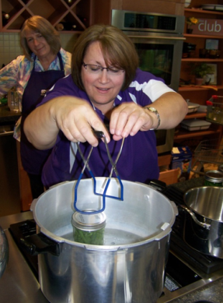
Food Safety Programming Impacts in Kansas
FCS Extension:
Food Safety education and training helps reduce foodborne illnesses.
Increased awareness of safety and improved skills of home food preservation.
North Central Region educated more than 6000 food handlers in 2014
Notes:
Educating and training consumers of all ages about safe food handling and food preservation is one way extension in Kansas and across the county can help reduce the number of food related illnesses. Studies indicate that individuals who are trained in proper hand-washing and food handling techniques are more likely to practice safe food handing procedures.
Extension is a key partner in fighting the “winnable battle” of fighting food borne illness thru all its’ food safety programming efforts.

Slide 26
Family Resource Management Program Focus
Financial Literacy
Advanced Financial Management
Family Resource Management
“Guiding families, daily, to make the most of what they have.”
Notes:
Gayle
Family Resource Management focus includes:
Financial education for adults, children and youth.
Family and home management and budgeting
Home loans, first time home buyers issues
Prepare for Natural Disasters and Disaster Recovery
Investing in the future- Estate Planning and Retirement Planning
Income Tax Preparation and support
Understanding and Buying Insurances
Home base businesses

Slide 27
Why Family Resource Management?
⤓ Decline in personal savings rate in U.S. since 1970
“Real wages” flat or falling for past decades
36% of Americans report worrying about not being able to pay monthly bills
42% of parents expecting children to have post-high school education have saved nothing for that
27% of workers report having $1000 or less in retirement savings
48% of U.S. adults are worried about not being able to maintain their standard of living
Notes:
Finances effect each of us everyday. Paying bills, buying food and clothing, saving for education/college, saving for a home, retirement or for an emergency fund. Money/resource management is an essential life skill.
Good financial practices help families make better decisions. It allows them to make the most of the resources they have no matter how few or how large. Leaning how to develop a budget that is realistic and manage debt are key components of Family Resource Mgt programs. Financial and resources management education and skills development is an essential life skill that helps people make the most of what they have.

Slide 28
Successful Family Resource Management Programs in Kanas
Money Smart (FDIC)
Welcome to the Real World
America/Kansas Saves
Prepare Kansas
Volunteer Income Tax Assistance (VITA)
Who Gets Grandma’s Yellow Pie Plate?
Notes:
Here is a list of some of the specific programming efforts that occur in Kansas.
Money Smart is an experiential learning series focused on personal and family financial management. Financial education fosters financial stability for individuals, families, and entire communities. The more people know about effectively managing their money, the more likely they are to increase savings, successfully buy and maintain homes, and improve their financial health and well-being.
Prepare Kansas- Forty-two. That’s how many Kansas counties have been declared major disaster areas this year alone, due to severe weather events that swept through the state May 4 through June 21. Prepare Kansas is an online challenge, now in its second year, which focuses on simple activities with the goal to make it as easy as possible for individuals or families to complete each activity – and become better prepared.

Slide 29
Kansas State University’s
“The Senior Health Insurance Counseling program was found to generate $20.69 in savings on medical prescription cost for each $1 spend on the program in 2014.”
Notes:
KSRE FCS professionals directly and thru training and utilizing volunteers assist individuals with immediate financial decisions and issues. One example is the Senior Health Insurance Counseling program. In 2014, FCS programming resulted in a $20.69 savings on prescriptions cost for each $1 spent on the program.
Debra will cover the Family and Human Development Study findings.

Slide 30
Section III: Family & Human Development
Child Development
Adult Development and Aging
Relationships and Family Dynamics
Family and Human Development
Early Childhood Education
Parent Education
Notes:
Debra

Slide 31
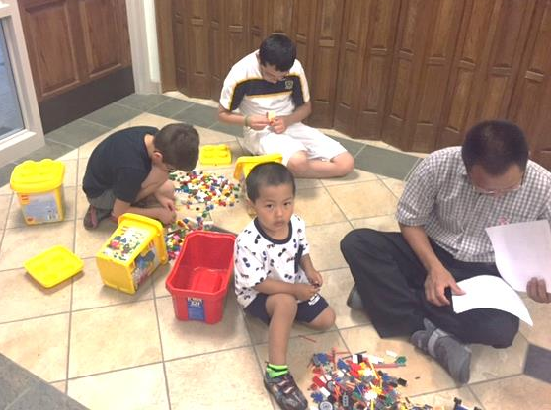
Five Domains of Child Development
Physical Development & Health
Social and Emotional
Language and Literacy
Cognition and General Knowledge
Approaches to Learning

Slide 32
FCS Strives to:
Educate parents, pre-emptively, to promote positive development
Educate children & youth with tools to combat negative influences
Help create environments to foster healthful development

Slide 33
FCS Impactful Programming
Better Kid Care
Have a Healthy Baby
Rock Solid Foundations
Nurturing Parent
In quality programming: $1 Spent = $12.90 gained

Slide 34
Relationships & Family Dynamics
FCS Impactful Programming:
CoupleTALK
Co-Parenting for Successful Kids
Stepping Stones for Stepfamilies
$1 Spent on strengthening families = $9.60 saved in interventions

Slide 35
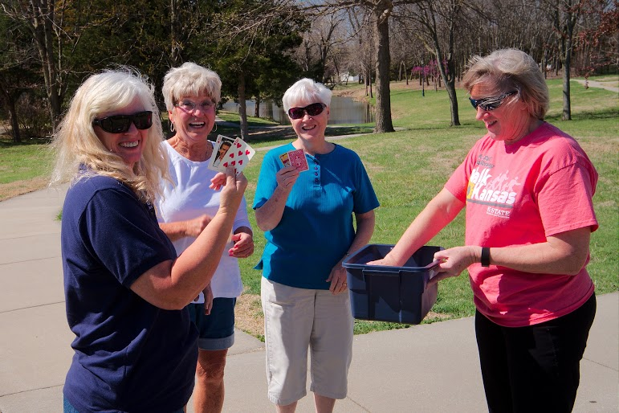
Adult Development & Aging
FCS Impactful Programming
Nutrition & Physical Activity
Fall Prevention ($1 = $1.64)
Disability & Disease Management
Powerful Tools for Caregivers
Aging Expos
SHICK (crossover program)
Notes:
Aging Expos like Aging with Attitude, Full Circle and Positive Aging.

Slide 36
So, what do you think?
1. In your opinion, what are the top 3 to 5 messages from the study?
2. How do you think K-State Research and Extension could use or share this information?
3. How will you use the information to alter or enhance your FCS programming?
Notes:
Paula
20 Minutes
Three Discussion Questions
Work independently first then as a small group 3-5.
Ask adm to divide among the groups.
Some report back.
Collect Discussion sheet

Slide 37
Key Findings
FCS Extension Programming:
Results in substantial economic returns to the nation
Makes a positive difference in behaviors and shaping policy
Utilizes the most effective educational materials available
Partners with others to leverage resources and reach people effectively
Focuses on education and prevention, different than social services agencies
Utilizes train the trainer to multiply impact
Notes:
Results in substantial economic returns to the nation.
Makes a positive difference at the community level by putting into place infrastructure that facilitates positive behaviors, and helps shape policy at the local, state, and national levels.
Utilizes the most effective educational materials available, regardless of where they were developed.
Partners with other agencies and non-profits to leverage resources and reach people as effectively as possible.
Focuses on education and prevention which is a key differentiating factor between it and social services agencies.
Utilizes extensive train-the-trainer work to multiply the impact of its educational efforts.
Meeting a growing need for funding for Family & Consumer Sciences Extension would result in the ability to support staff and additional programming that would help reach a larger percent of children, youth and families in need of life stabilizing education.

Slide 38
Economic Impacts of FCS Extension to the State of Kansas
EFNEP results in savings in food expenditures and future health care costs of at least $4 million each year
SNAP-Ed results in savings of at least $27 million each year
KOPH provides $4 in health care savings for every $1 spent on the program
ServSafe reduces the incidence of foodborne illness and results in savings in associated healthcare costs
SHICK resulted in $20.69 in savings on medical and prescription costs for each $1 spent in 2014
Notes:
Economic Impacts of FCS Programming
A review of research literature revealed that every $1.00 spent on EFNEP results in savings in food expenditures of $2.48 and savings of anywhere from $3.63 to $10.75 in future healthcare costs. As a result, long-term cost savings to the North Central Region based on 2014 participation in EFNEP can be estimated at $86–$185 million. (Potential savings in Kansas is estimated to be $4 to $9.4 million.) SNAP-Ed is a significantly larger program, and had 728,000 participants in the North Central region in 2014. Cost savings estimated at even half the level of the most conservative scenario for EFNEP would be at least $185 million each year. (In Kansas, $27 million per year.)
The Chronic Disease Self-Management Program, developed at Stanford University (and called Kansans Optimizing Health Program or KOHP in Kansas), provides an approximate $4.00 savings in health care expenditures for every $1.00 spent on the program.
Family & Consumer Sciences Extension partners with the National Restaurant Association to provide ServSafe® education which can reduce foodborne illness and savings in associated healthcare costs and losses annually.
Senior Health Insurance Counseling to provide education to Medicare beneficiaries resulted in $20.69 in savings on medical and prescription costs for each $1.00 spent on the program in 2014.
“We can gain money by investing early to close disparities and prevent achievement gaps, or we can continue to drive up deficit spending by paying to remediate disparities when they are harder and more expensive to close. The argument is very clear from an economic standpoint.”
James Heckman, Nobel Prizewinning economist from the University of Chicago, quoted in “The Two Year Window”, New Republic Magazine, 2011

Slide 39
FCS Essential Living Skills
Healthy Relationships
Healthy Living Choices
Financial Well Being
Strong Leaders
Strong Communities

Slide 40
“FCS Extension is not only about transfer of knowledge through educational programming, but empowering individuals, families and communities to make positive behavior changes by influencing norms, creating policies and changing environments where we live, work and play.”

