Slide 1
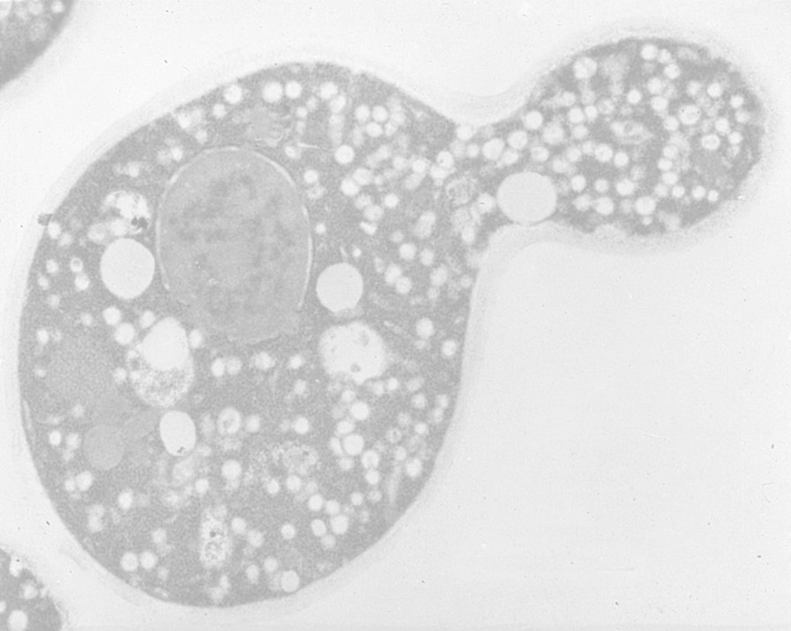
Kansas State University Provost’s Lecture May 11, 2015 How cells export proteins
Randy Schekman
Department of Molecular and Cell Biology
Howard Hughes Medical Institute
University of California, Berkeley

Slide 2
Origins and influences

Slide 3
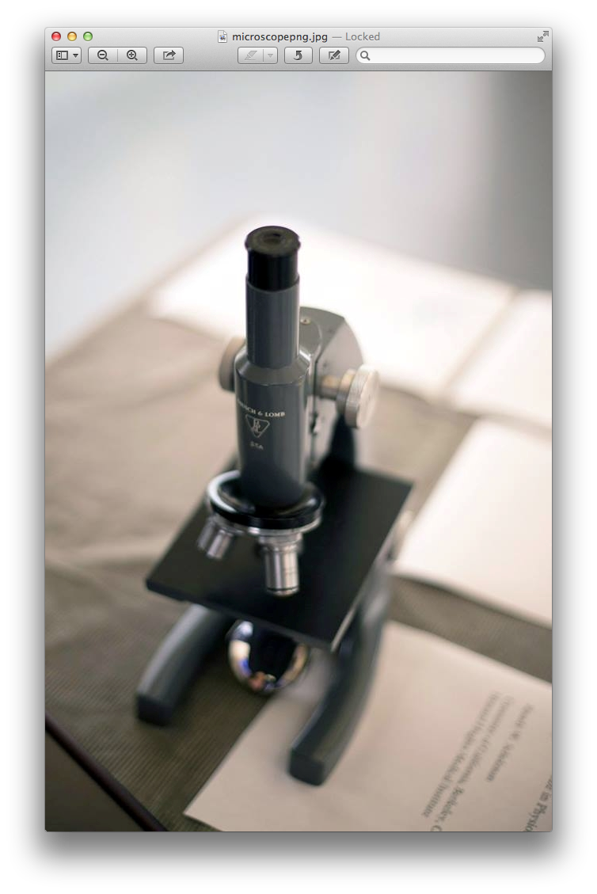

Slide 4
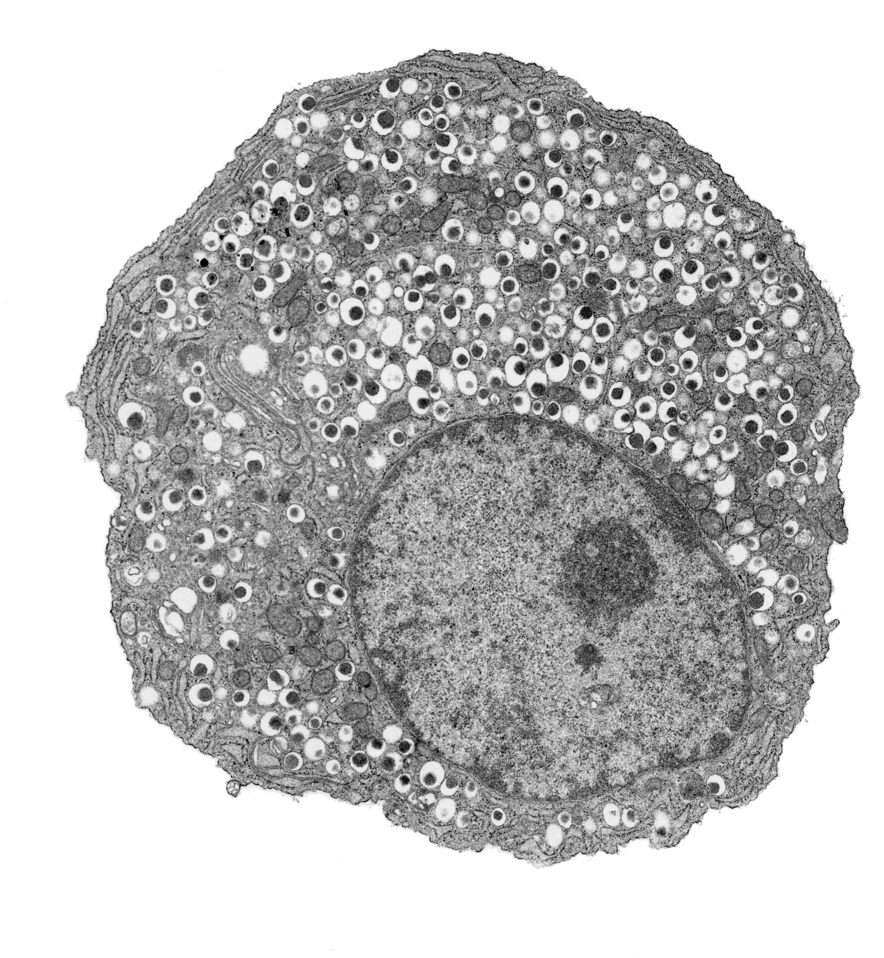

Slide 5
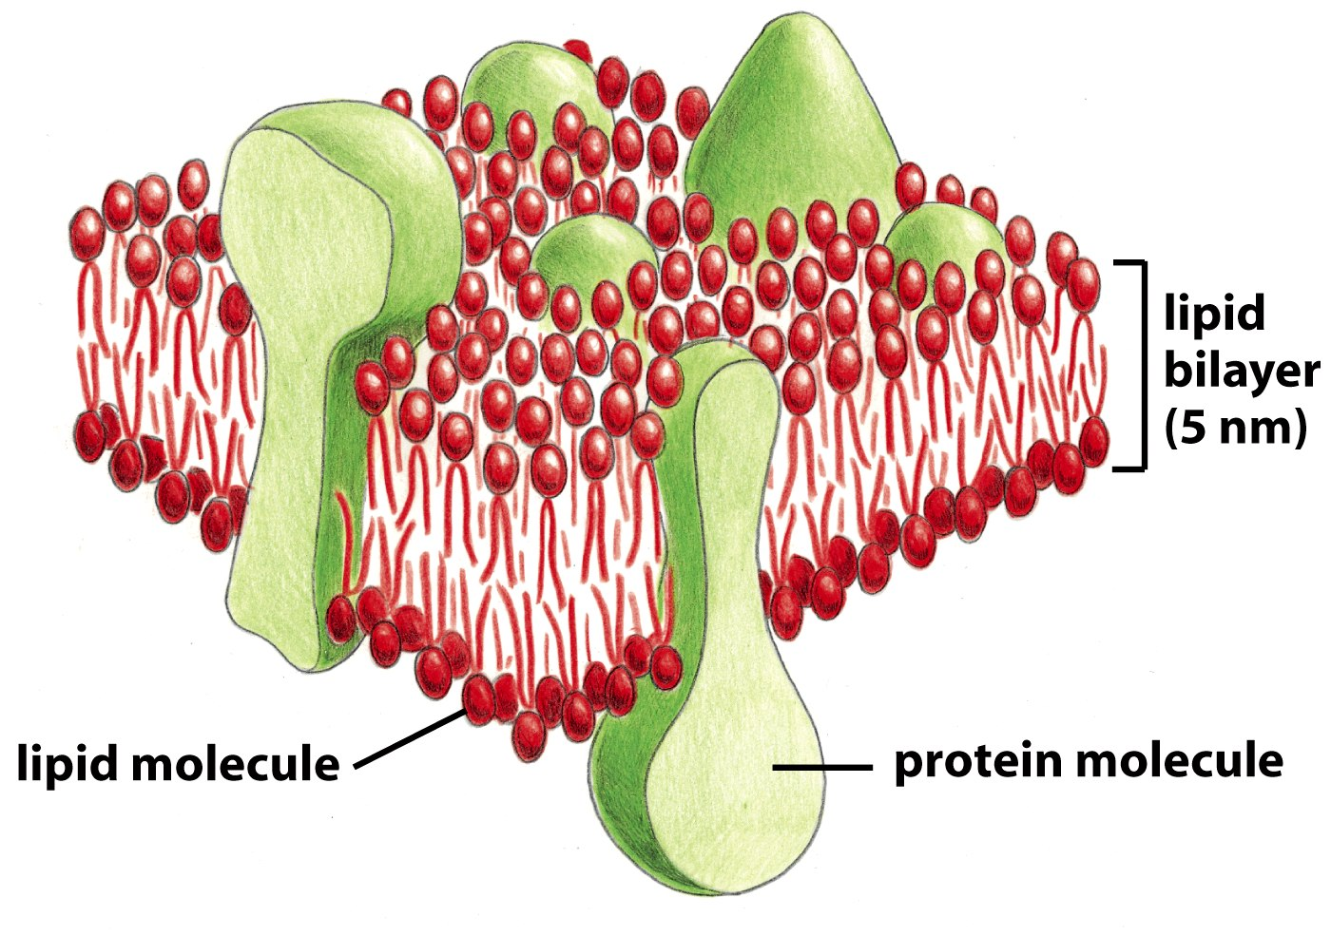
Figure 10-1c Molecular Biology of the Cell (© Garland Science 2008)

Slide 6
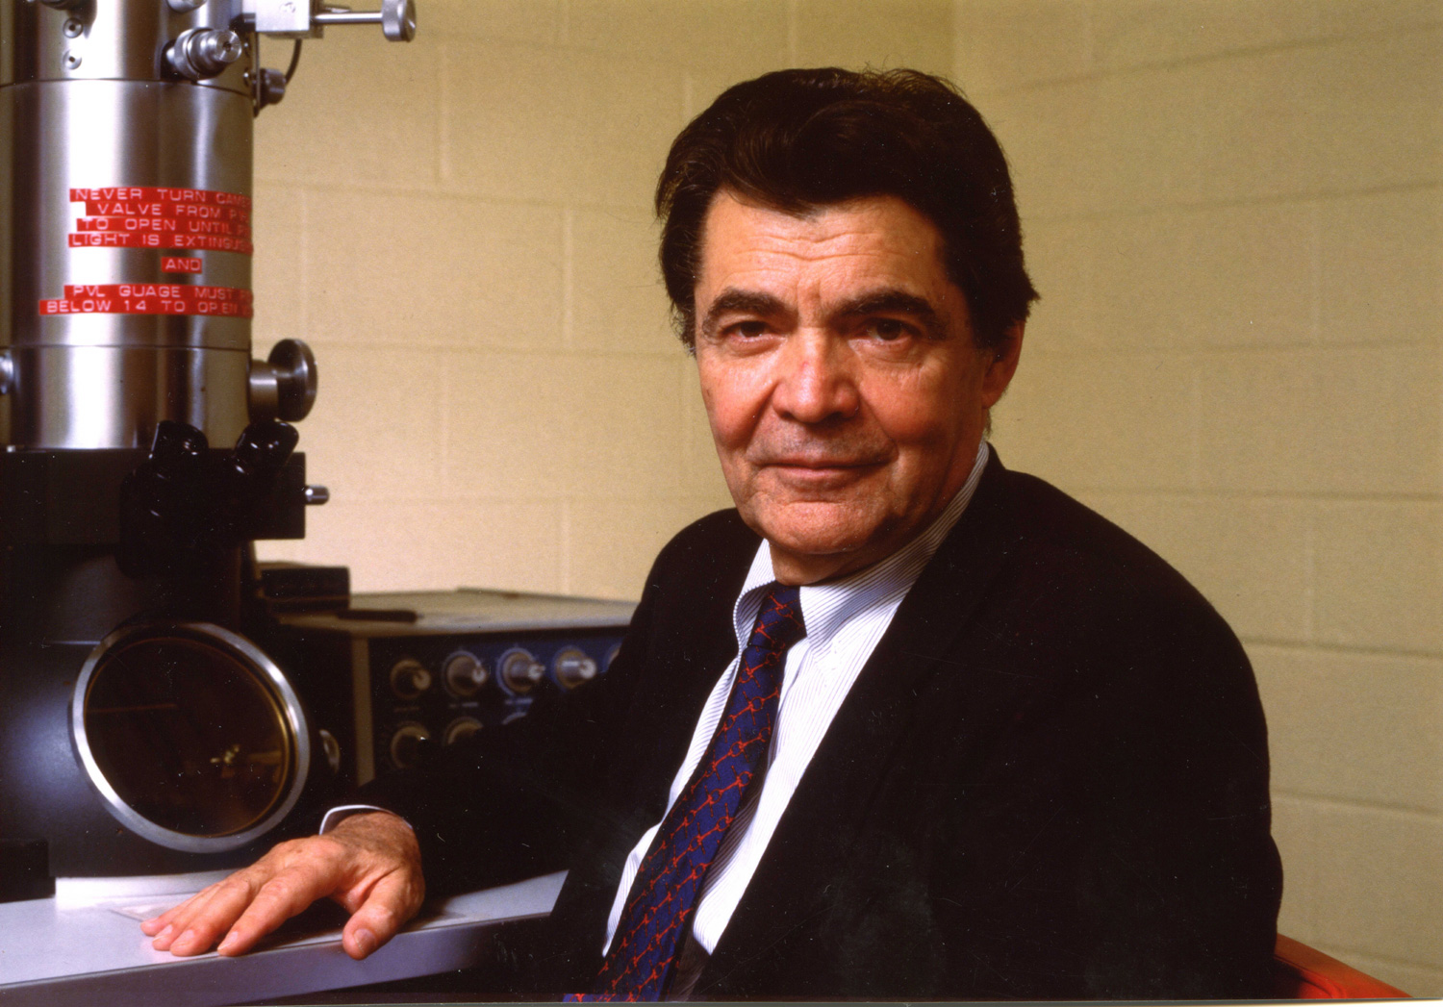

Slide 7
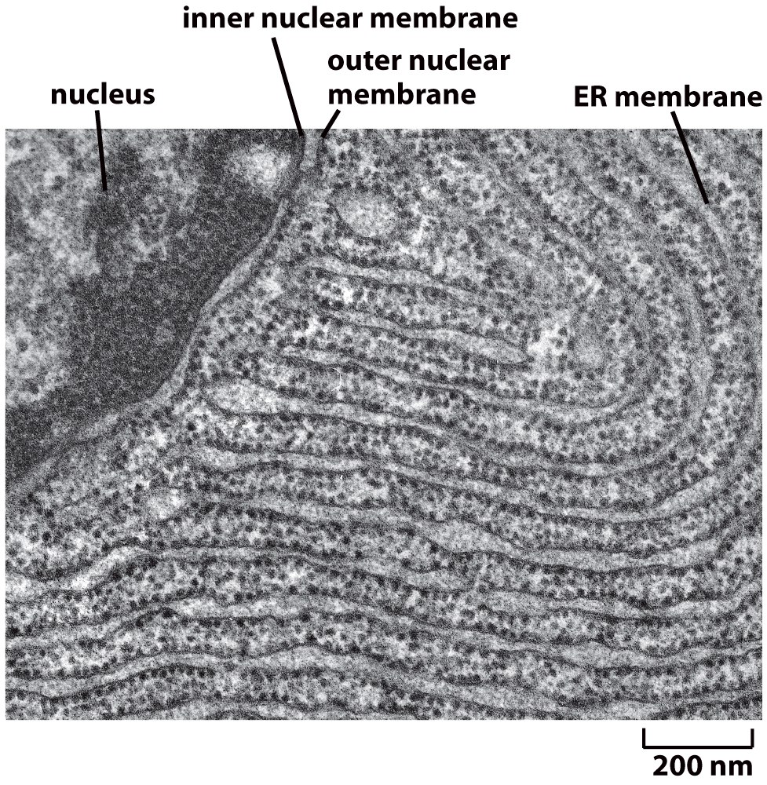
Figure 12-36a Molecular Biology of the Cell (© Garland Science 2008)

Slide 8
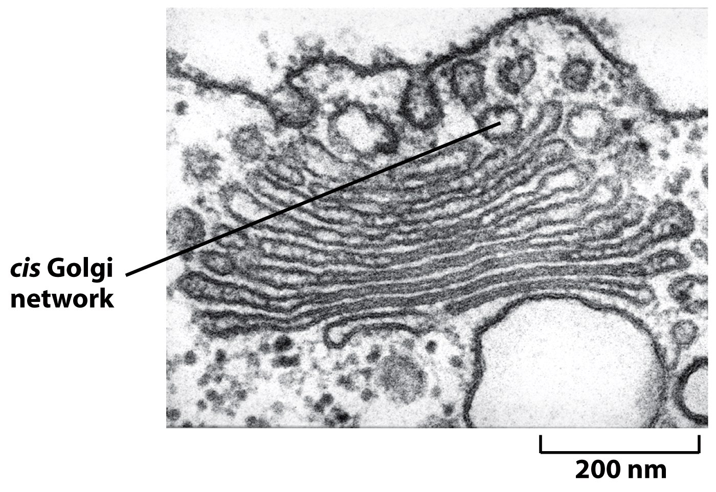
Figure 13-25c Molecular Biology of the Cell (© Garland Science 2008)

Slide 9
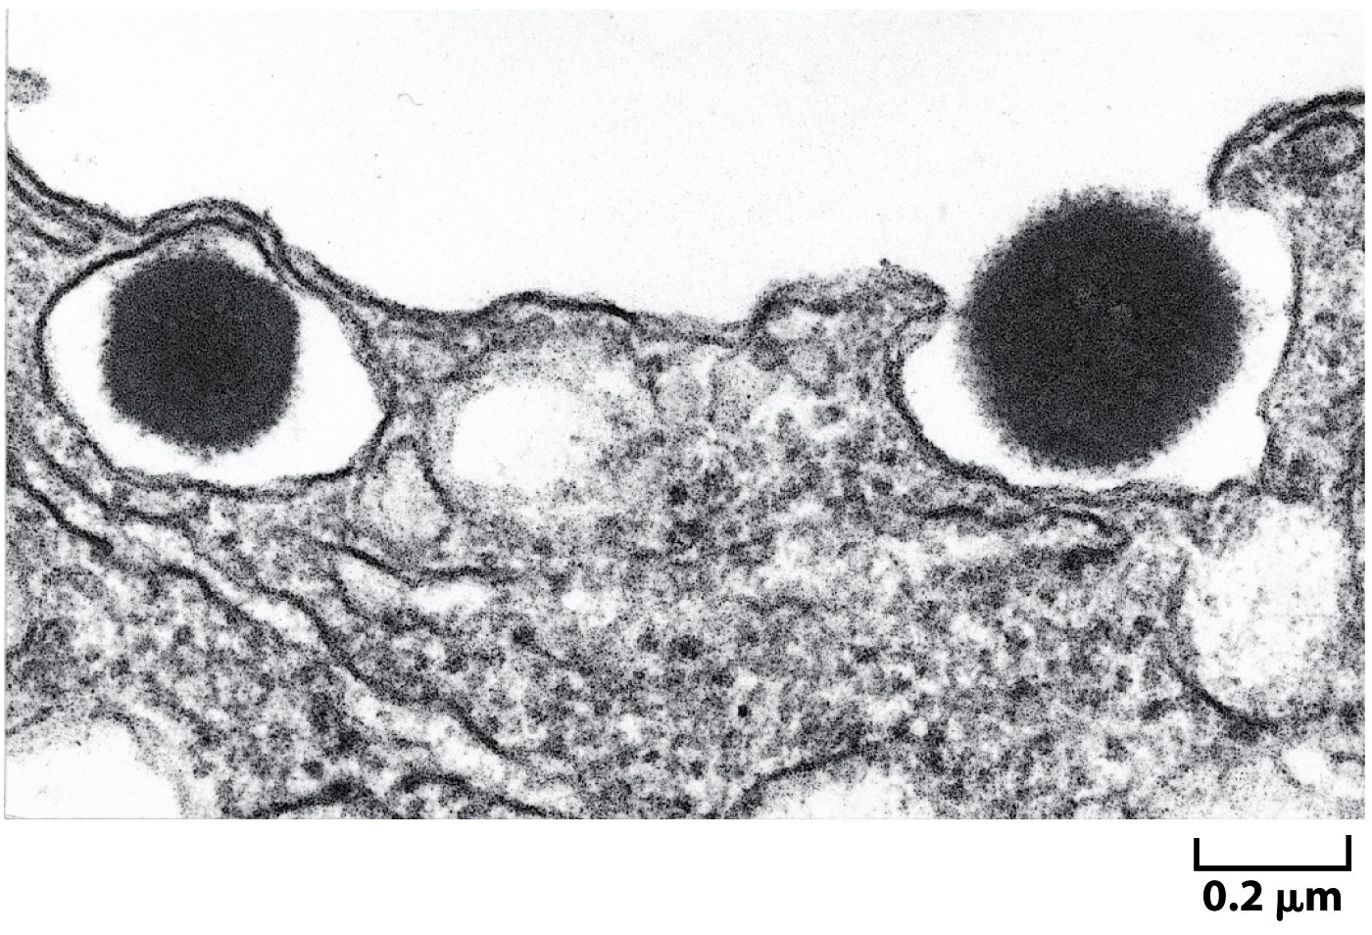
Figure 13-66b Molecular Biology of the Cell (© Garland Science 2008)

Slide 10
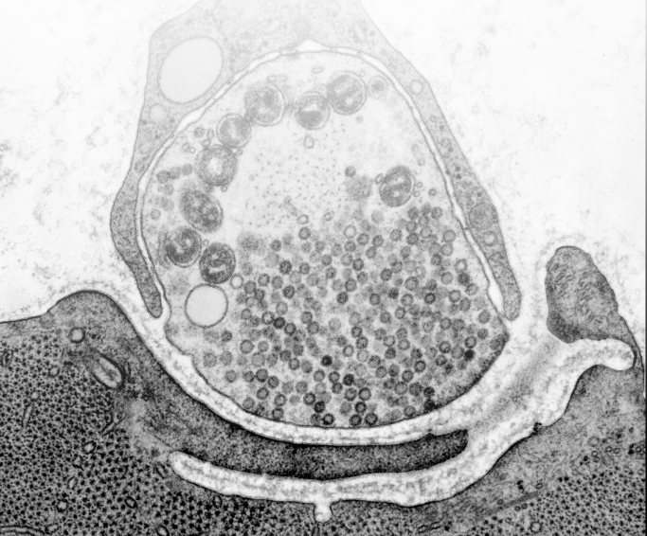
How does endocytosis take place at a synapse?
10
frog neuromuscular junction
image courtesy of John Heuser

Slide 11
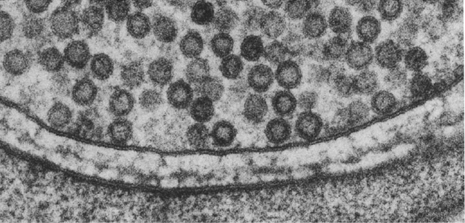
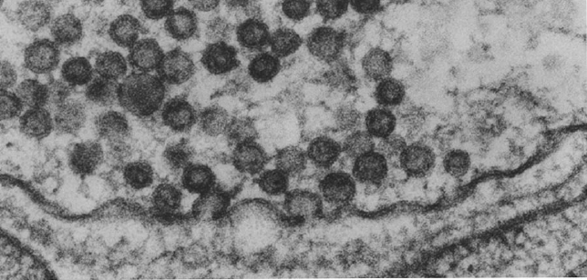
Synaptic vesicles fuse with the plasma membrane
0 msec
5 msec
Heuser and Reese 1981
Notes:
TEM

Slide 12
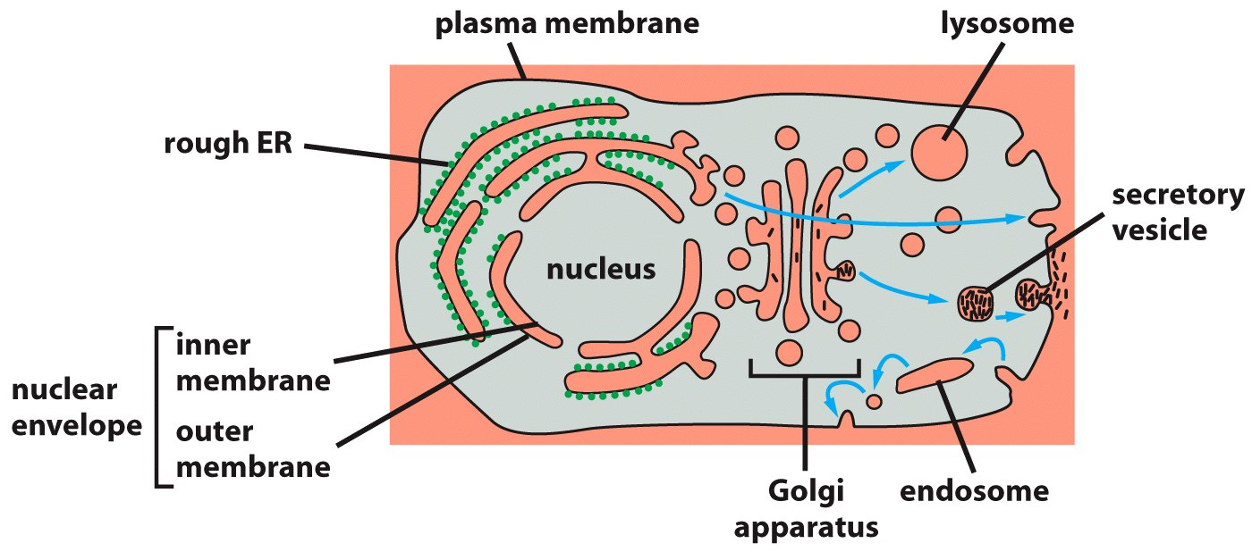
Figure 12-5 Molecular Biology of the Cell (© Garland Science 2008)

Slide 13
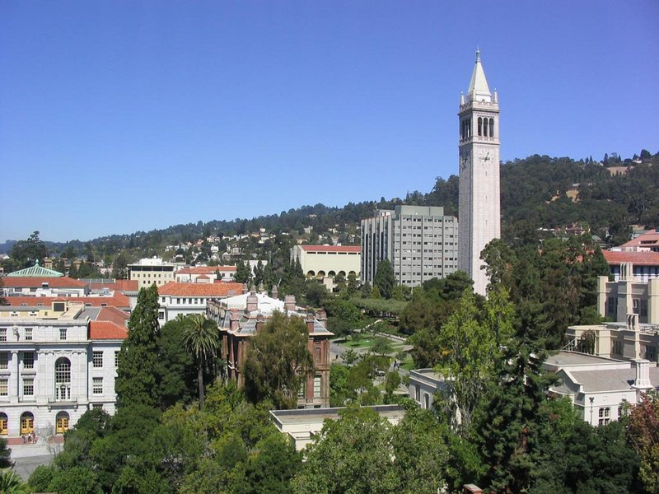
Berkeley, 1976

Slide 14
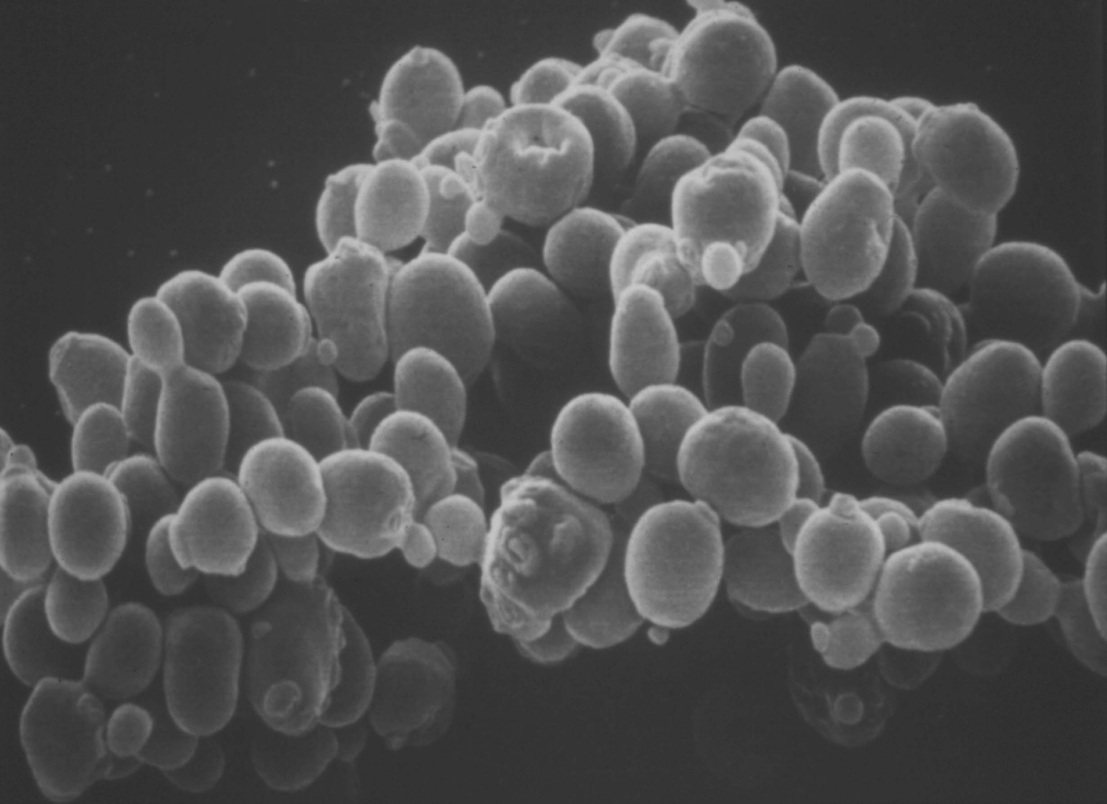

Slide 15
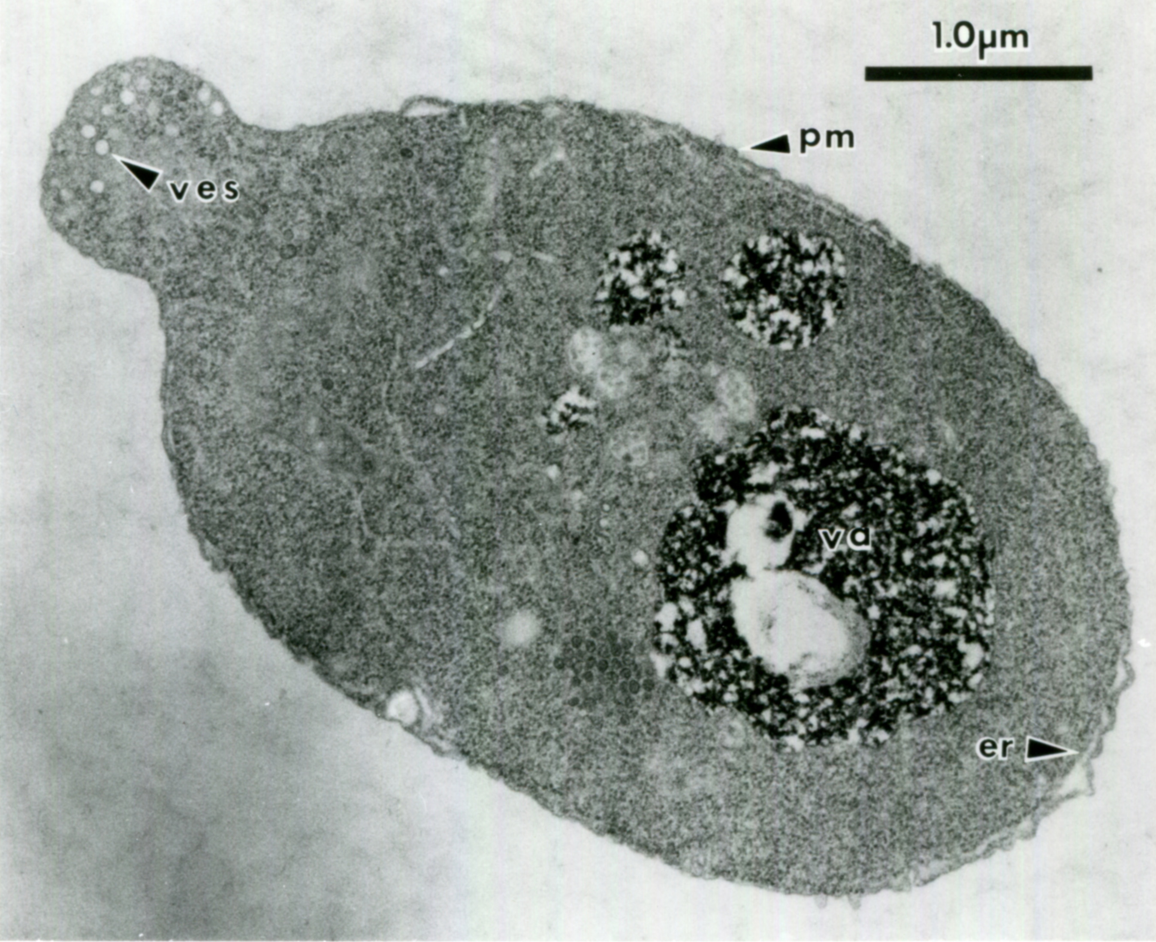

Slide 16
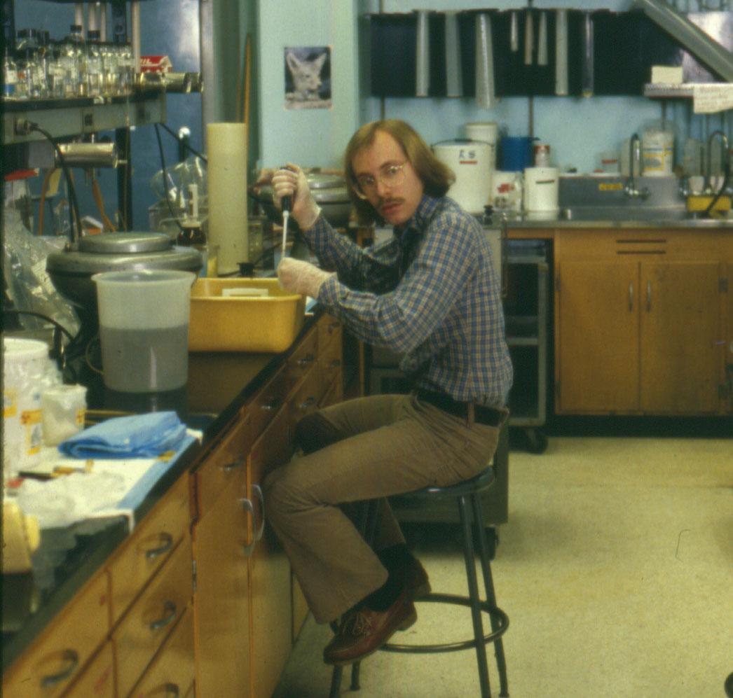

Slide 18
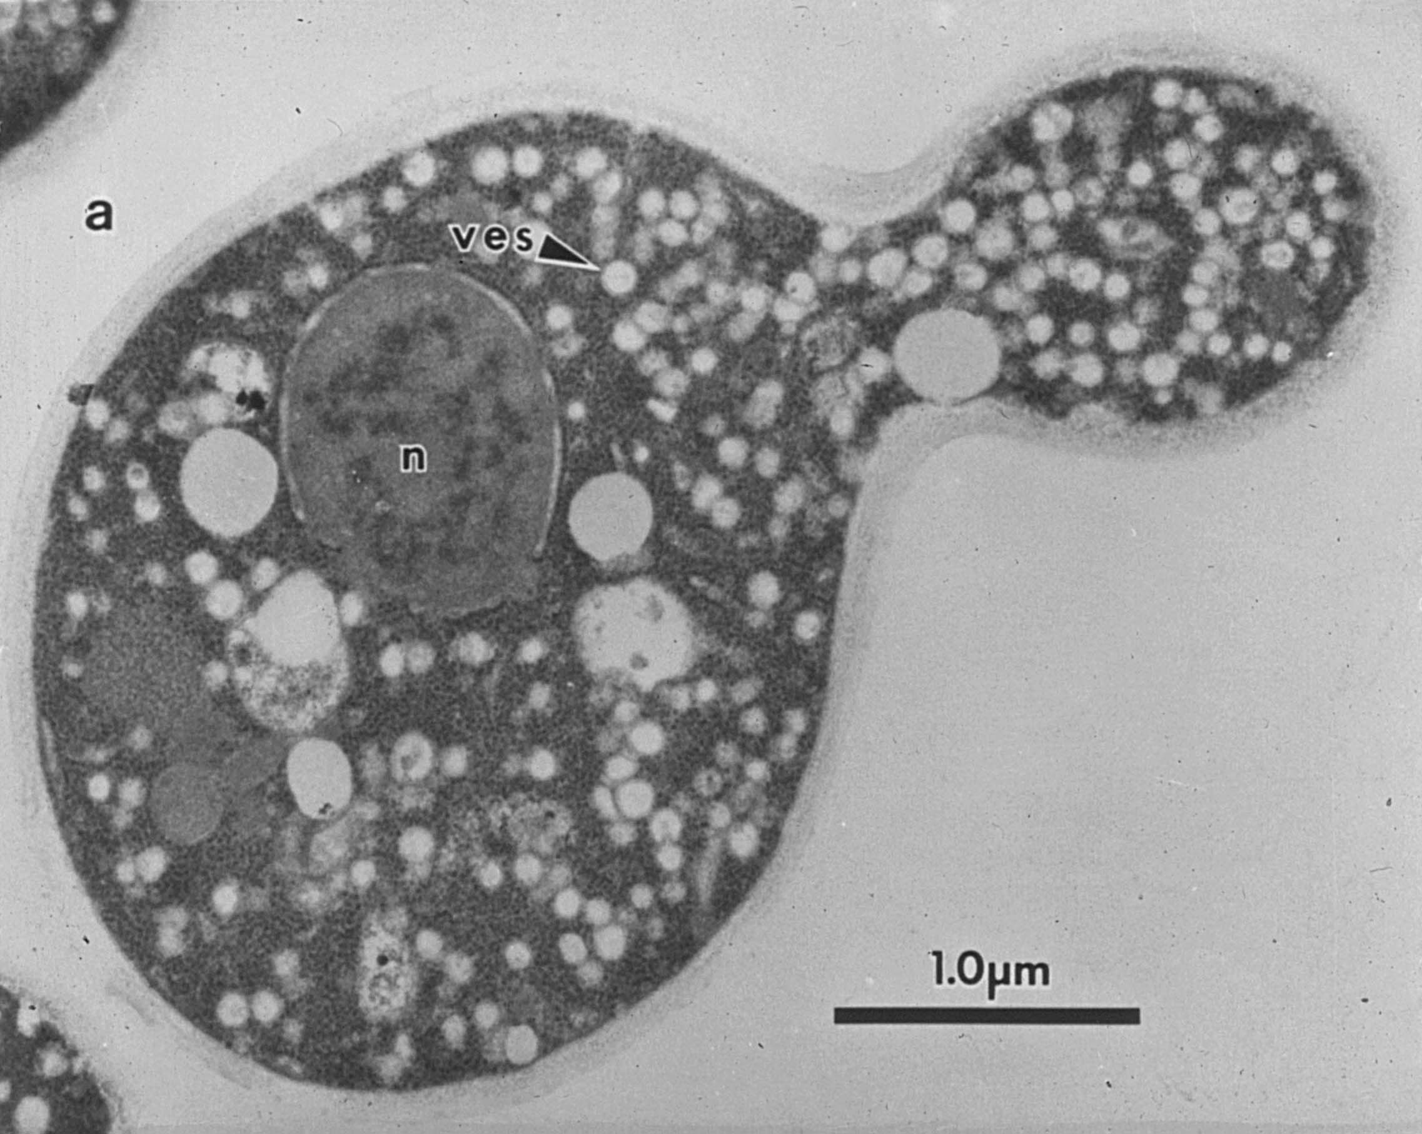

Slide 19
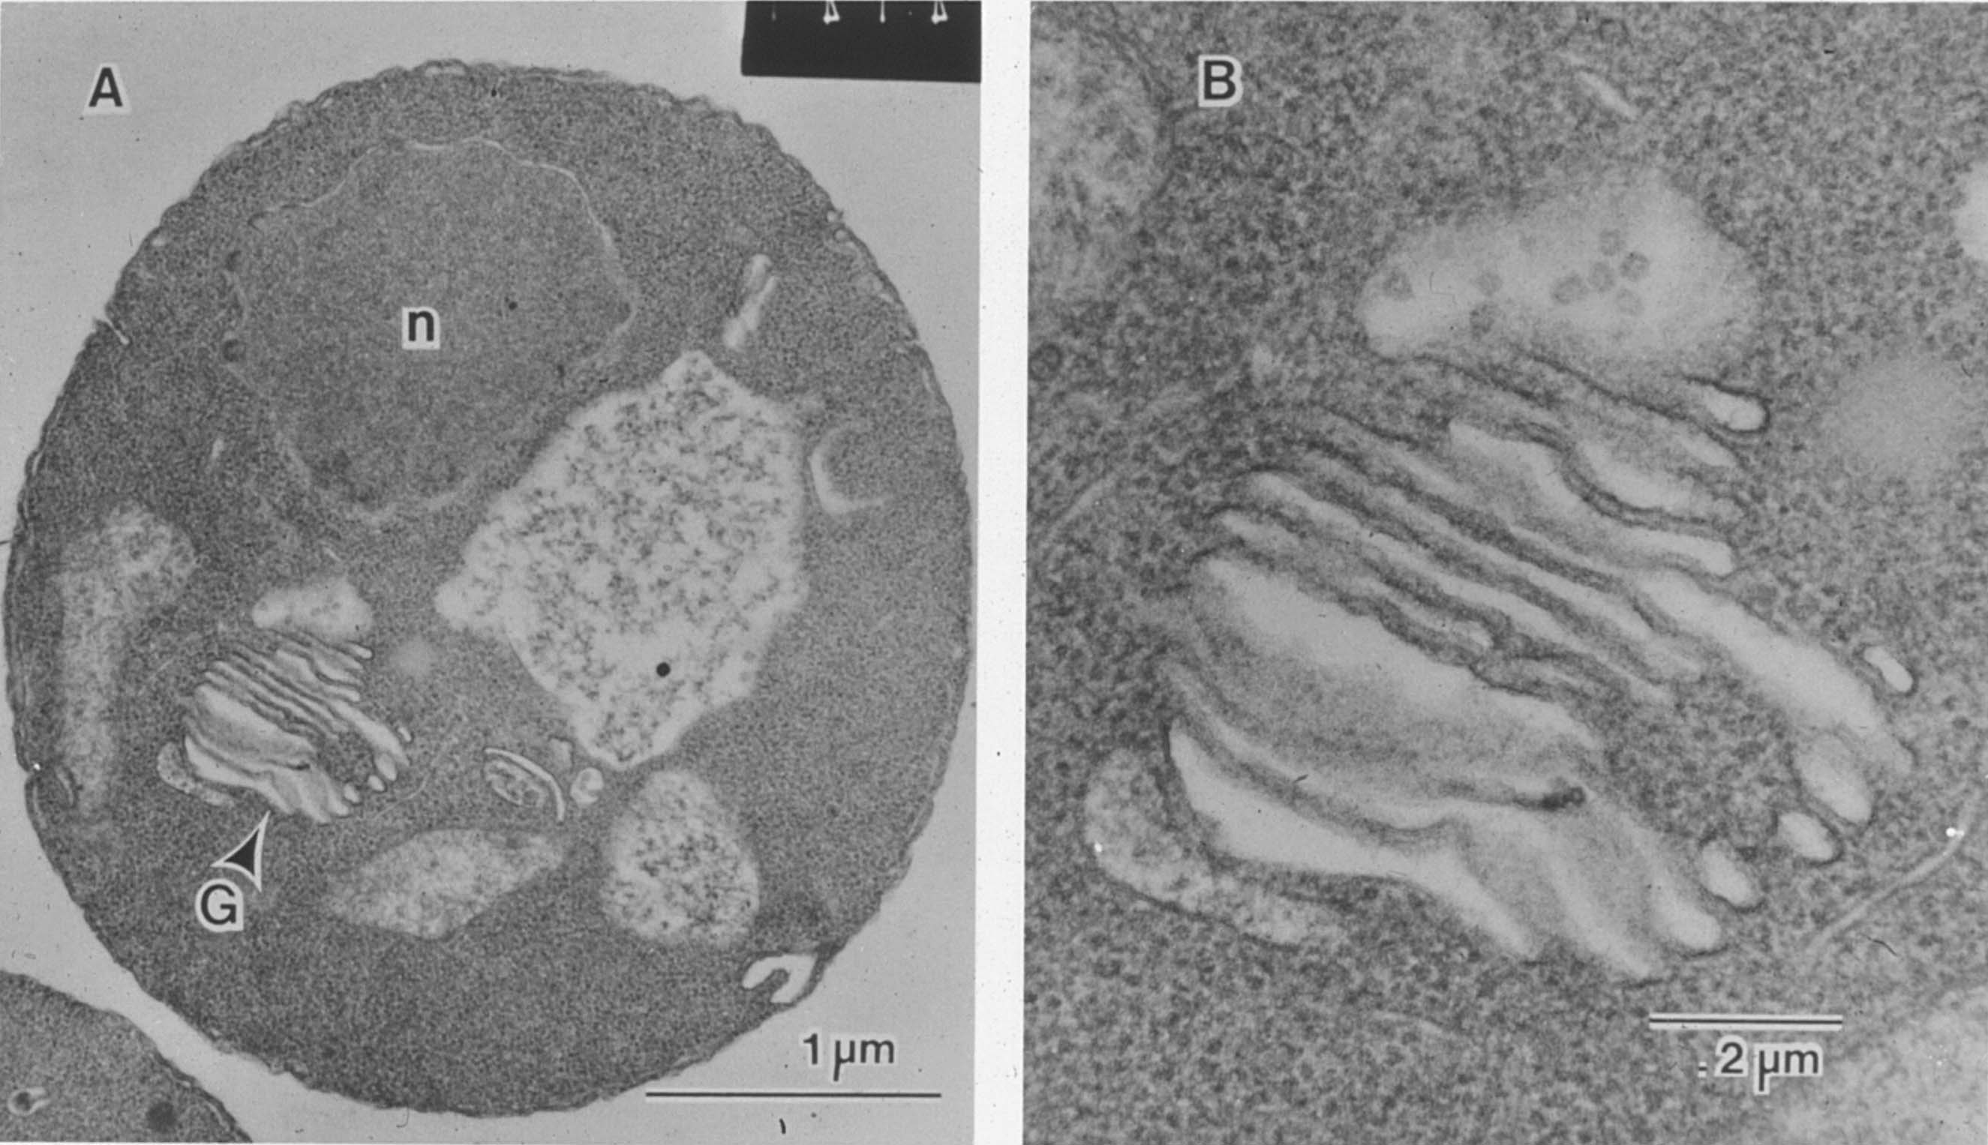

Slide 20
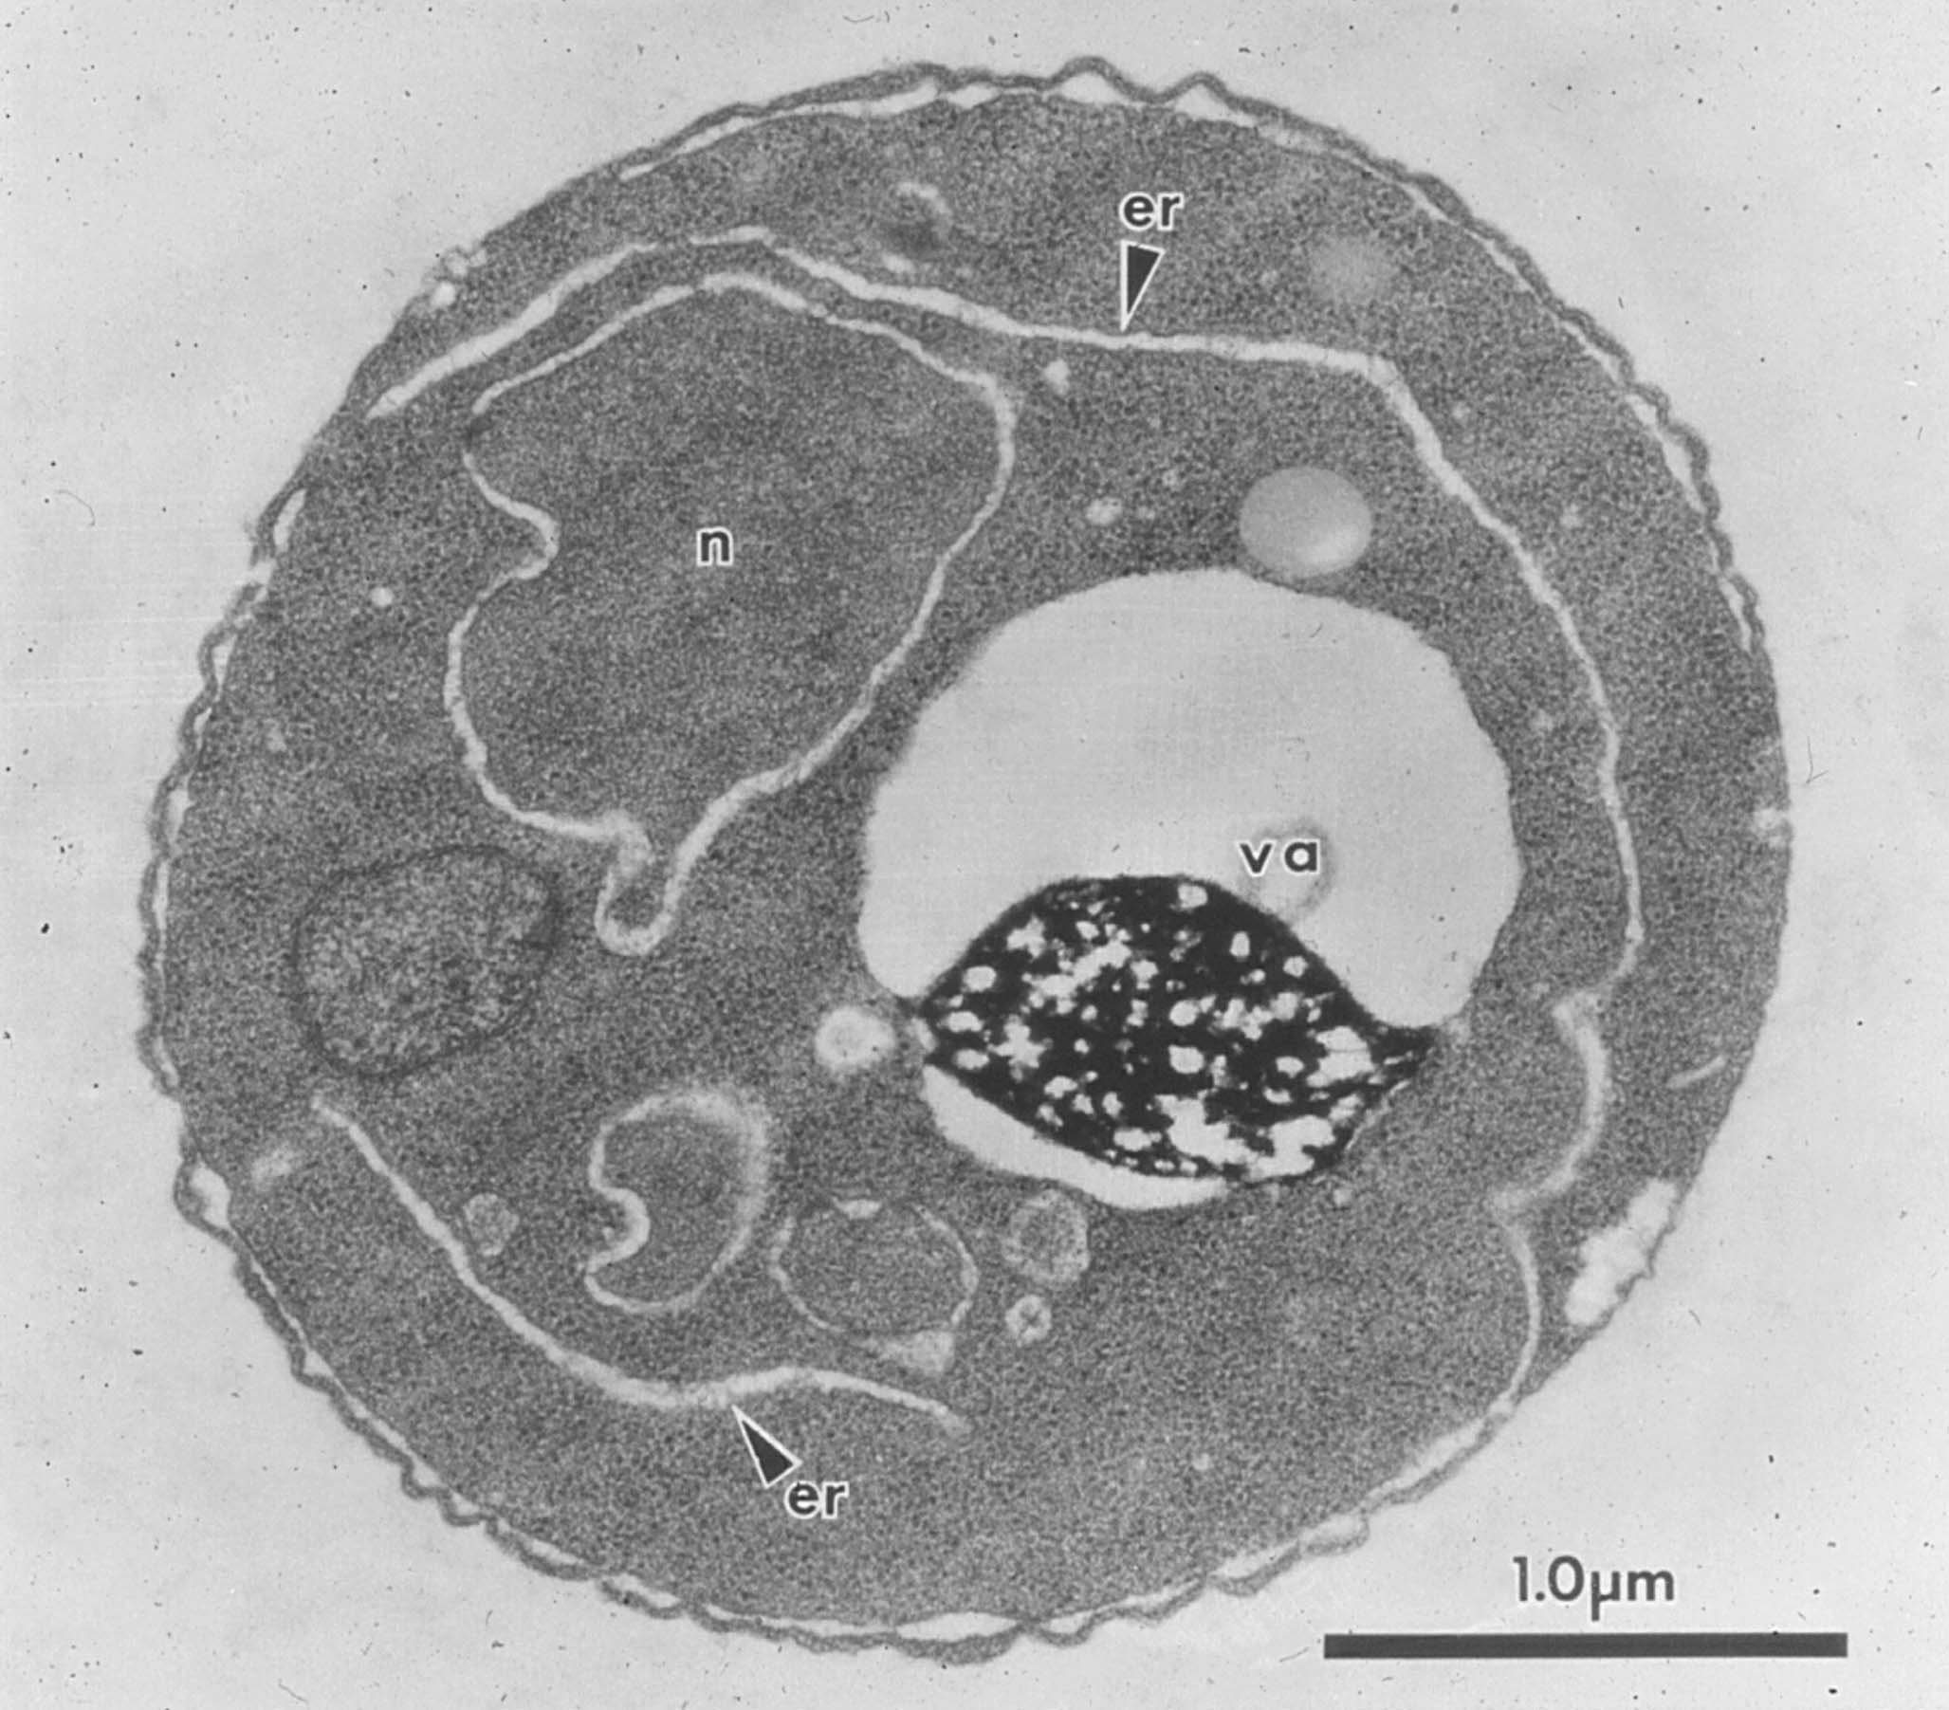

Slide 21
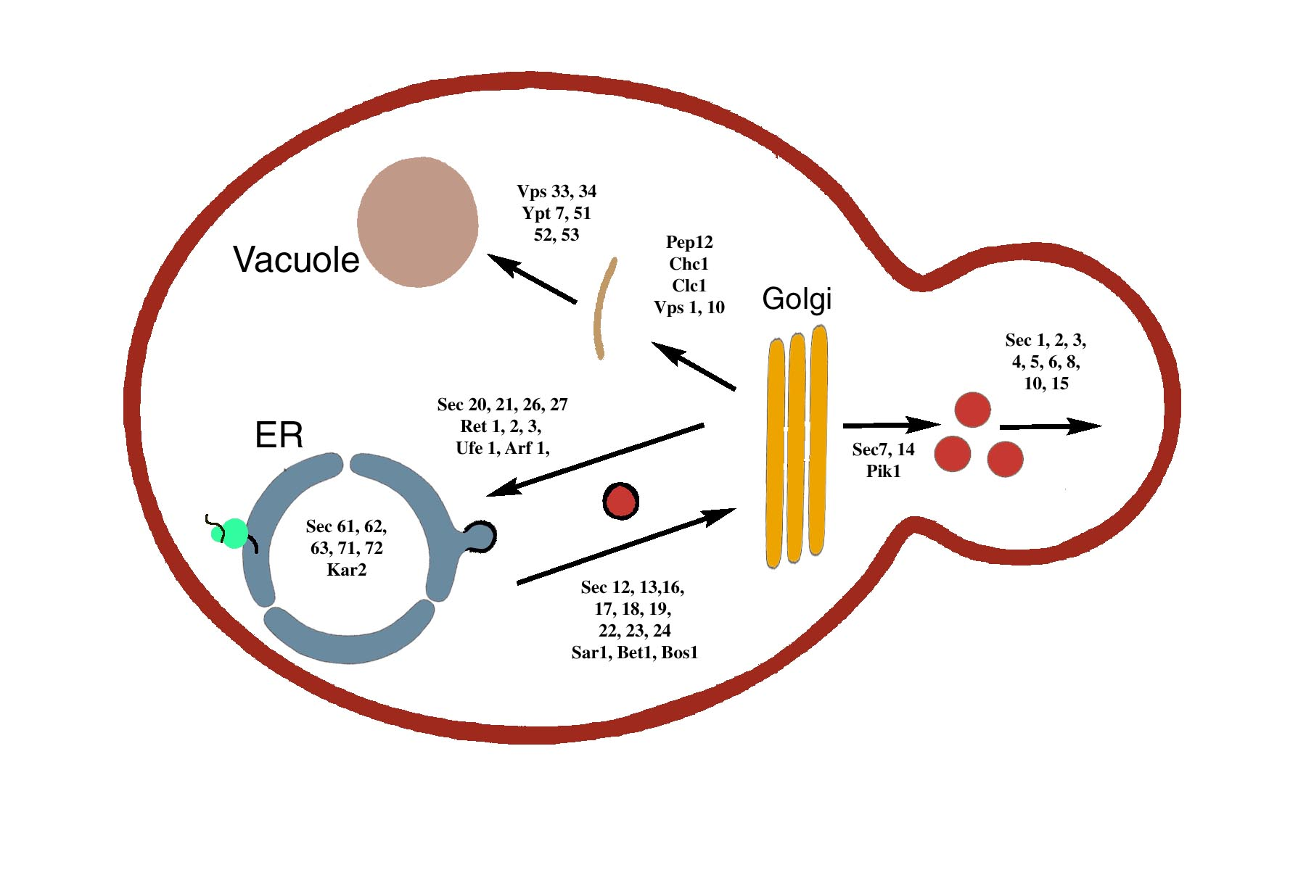
Yeast secretory pathway

Slide 22
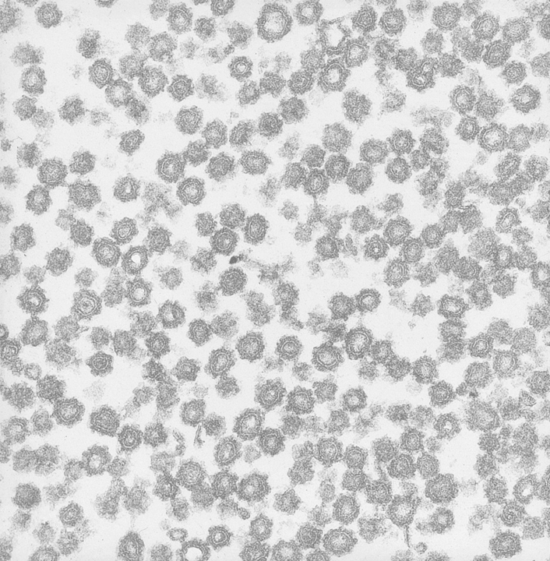
Biochemistry and
the connection to
human disease

Slide 23
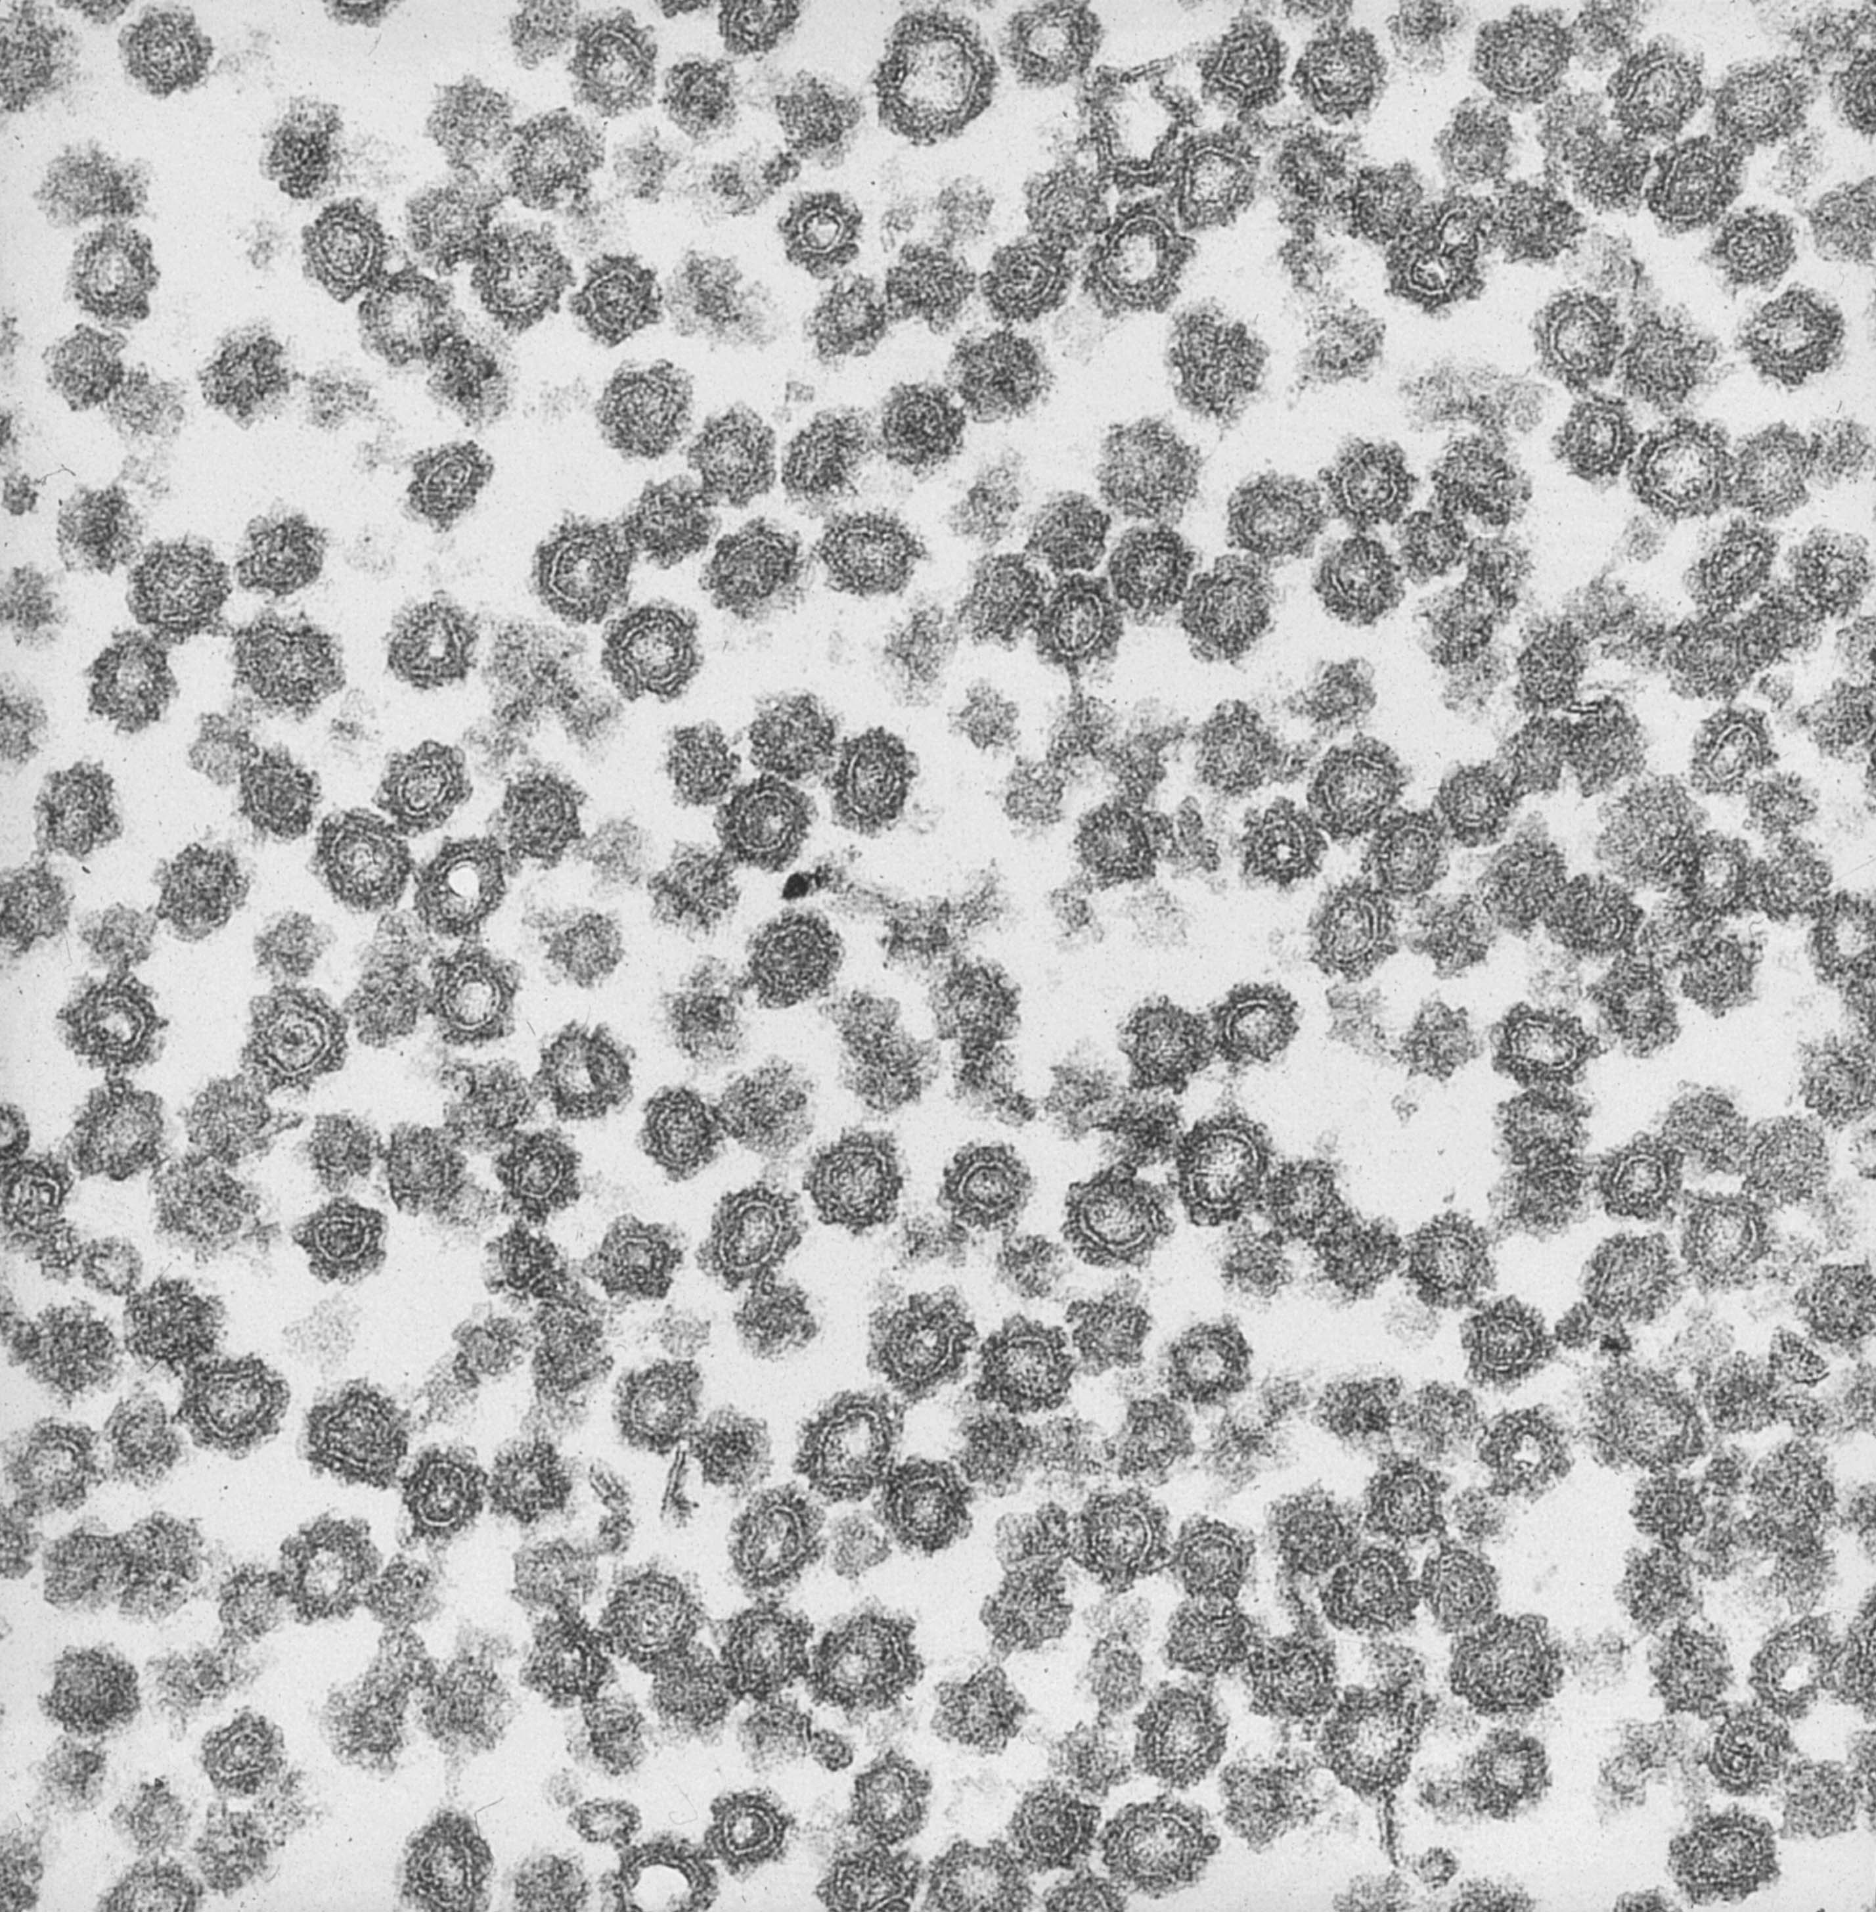

Slide 24
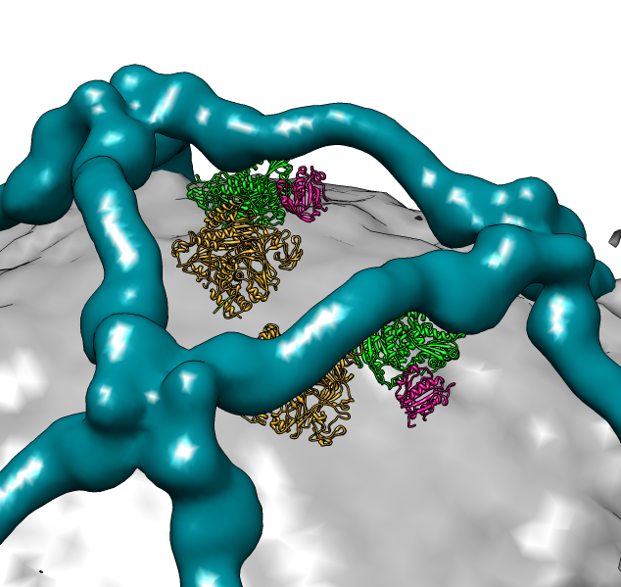

Slide 25
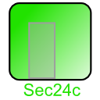
COPII gene duplication in mammals explains tissue-specific secretion diseases
Notes:
25

Slide 26
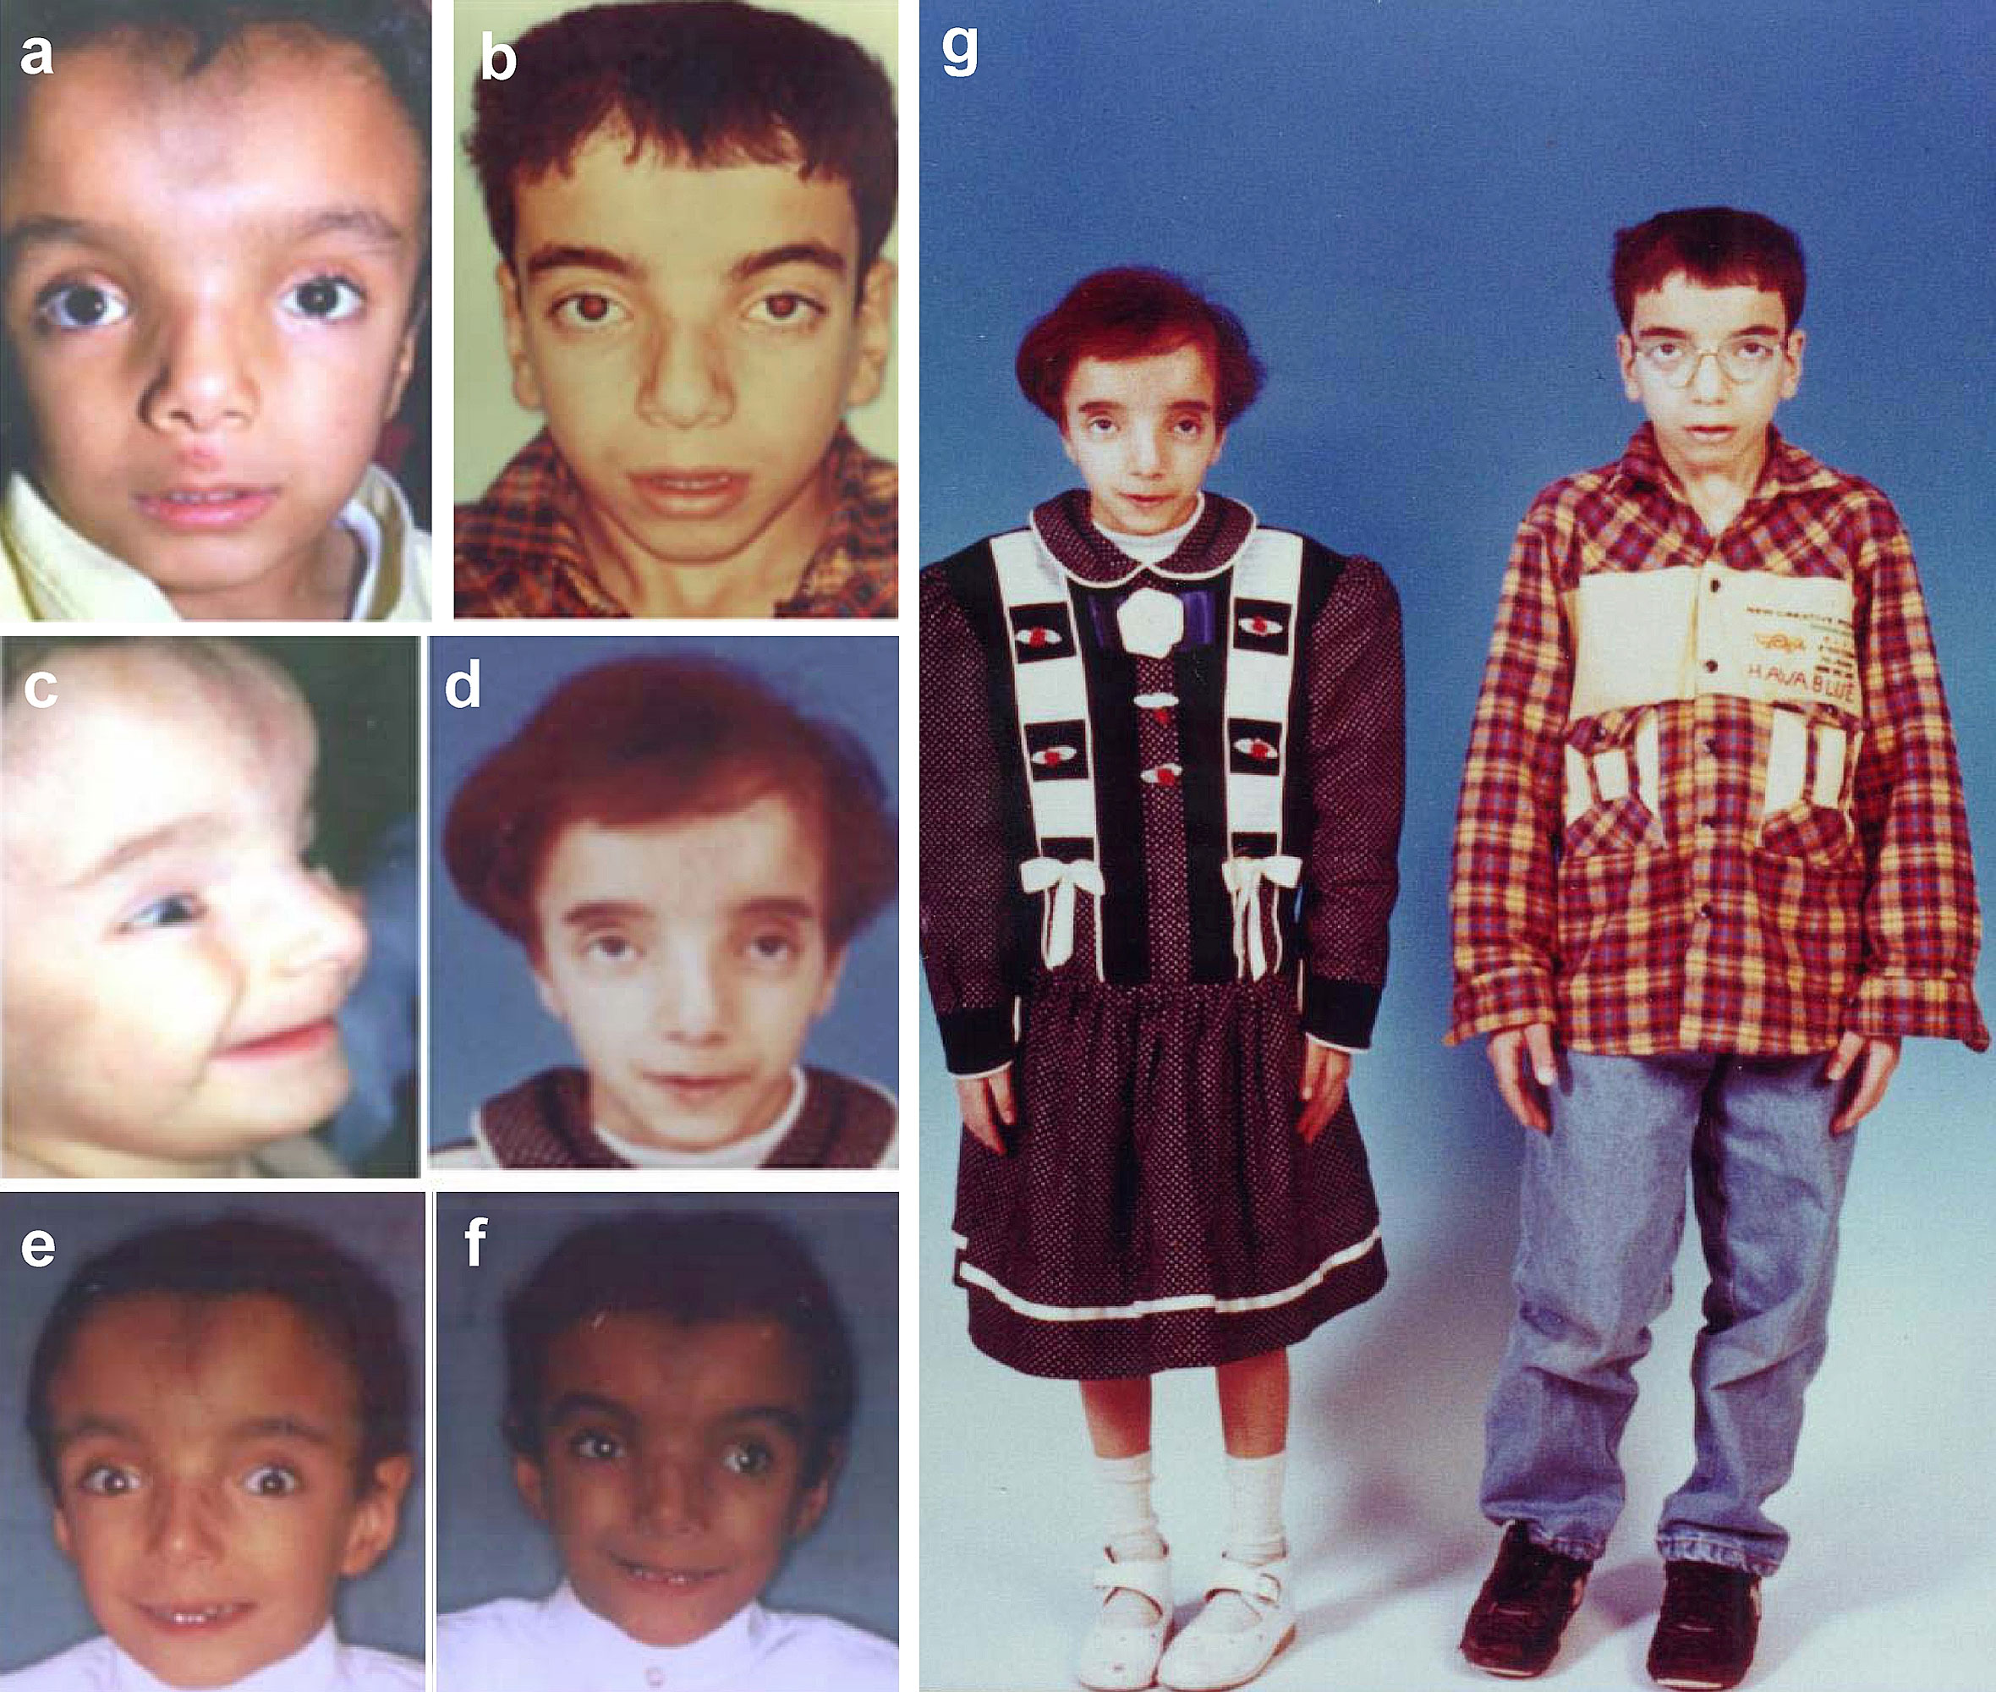

Slide 27
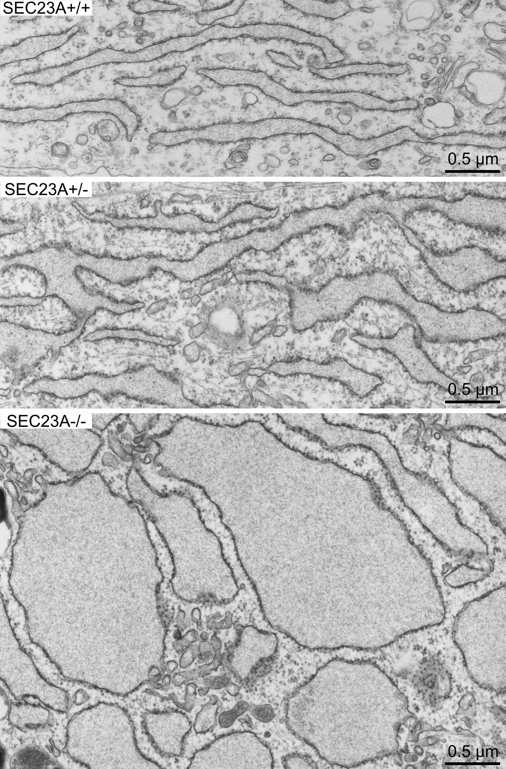

Slide 28
Major conclusions
Secretion and plasma membrane assembly are
physically and functionally linked through a
series of obligate organelle intermediates.
Polypeptide translocation and vesicular traffic
machinery conserved over a billion years of
evolution.
COPII coat sorts cargo molecules by recognition
of transport signals and physically deforms the
ER membrane to create budded vesicles.
4. Tissue specific expression of secretion machinery
proteins explains several human diseases

Slide 29
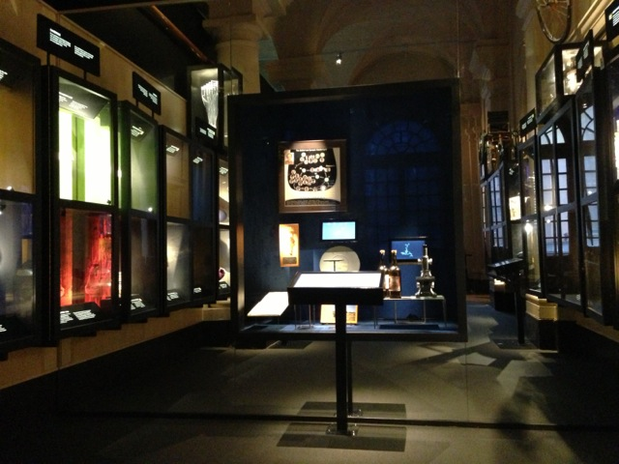

Slide 30
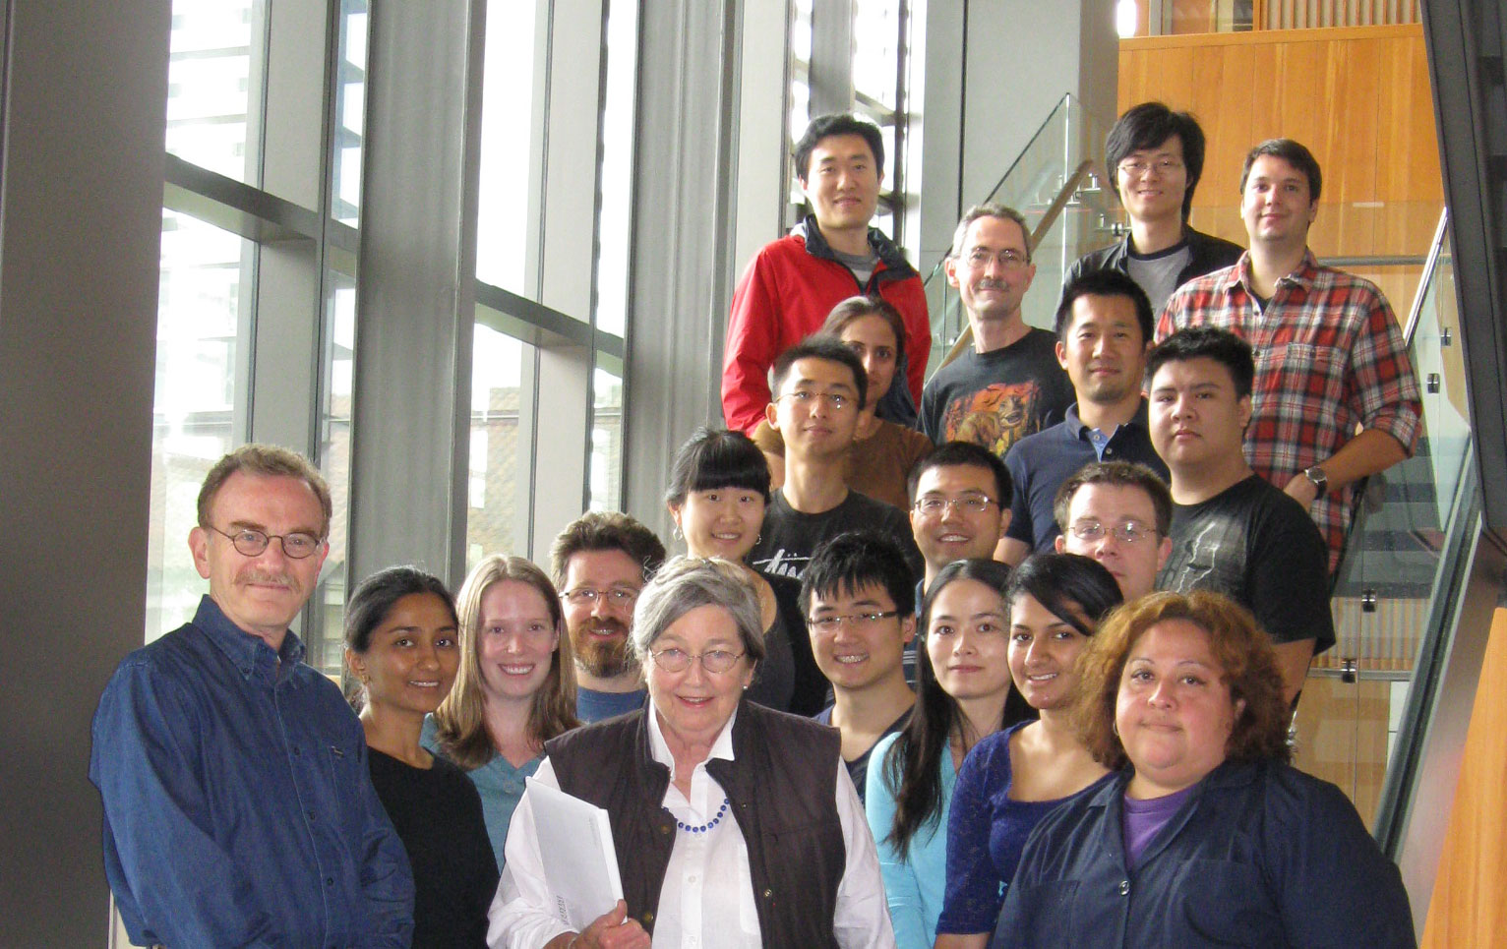

Slide 31
Notes:
eLife is a new initiative in research communication
The initial goal is to launch an outstanding new journal
Longer term, the vision is to catalyse fundamental change in research communication

Slide 32
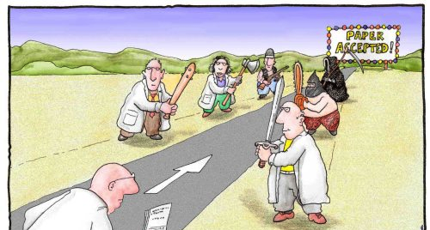
How does peer review work?
The goals of peer review
Assess technical merits of work
Assess likely significance of work
Open access is just one part of a broader transition
http://www.scienceforseo.com/wp-content/uploads/2009/04/peerreview.jpg

Slide 34
General recommendations
Move away from impact factors
Assess outputs on their own merits
Exploit new tools and approaches
And specific recommendations for publishers, funders, institutions, metrics suppliers, and researchers
>11000 signatories

