Slide 1
Working with Rubrics:
Using the Oral Communication, Writing, and Critical Thinking Rubrics VALUE Rubrics
Ashley Finley, Ph.D
Senior Director of Assessment & Research, AAC&U
National Evaluator, Bringing Theory to Practice
Kansas State University
March 14, 2014

Slide 2
VALUE Rubrics Project: Background & Implications
Rubric Development
16 rubrics
Created primarily by teams of faculty
Inter-disciplinary, inter-institutional
Three rounds of testing and revision on campuses with samples of student work
Intended to be modified at campus-level
Utility
Assessment of students’ demonstrated performance and capacity for improvement
Faculty-owned and institutionally shared
Used for students’ self-assessment of learning
Increase transparency of what matters to institutions for student learning

Slide 3
VALUE Rubrics (www.aacu.org/value)
Knowledge of Human Cultures & the Physical & Natural Worlds
Content Areas →No Rubrics
Intellectual and Practical Skills
Inquiry & Analysis
Critical Thinking
Creative Thinking
Written Communication
Oral Communication
Reading
Quantitative Literacy
Information Literacy
Teamwork
Problem-solving
Personal & Social Responsibility
Civic Knowledge & Engagement
Intercultural Knowledge & Competence
Ethical Reasoning
Foundations & Skills for Lifelong Learning
Global Learning
Integrative & Applied Learning
Integrative & Applied Learning

Slide 4
How have campuses used rubrics to improve learning?
Using the VALUE Rubrics for Improvement of Learning and Authentic Assessment
12 Case Studies
Frequently asked questions
http://www.aacu.org/value/casestudies/

Slide 6
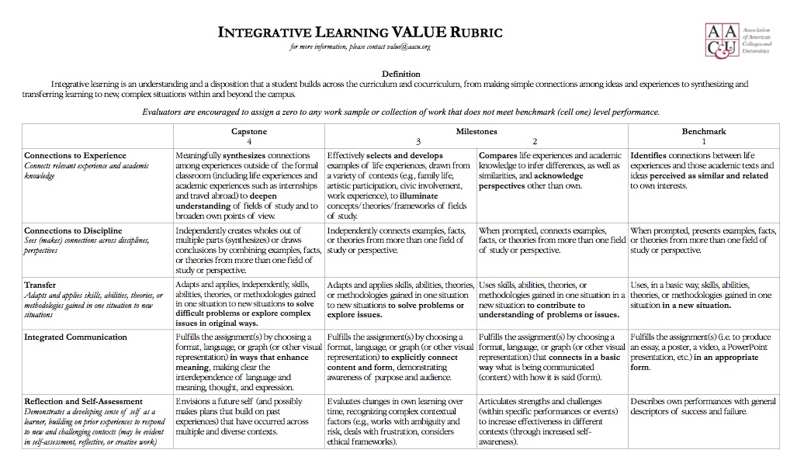
The Anatomy of a VALUE Rubric
Criteria
Performance Levels
Performance
Descriptors

Slide 7
Key Points on Rubric Development
Intended to be user and student –friendly
Jargon-free (mostly)
Intended to be shared with students for self-assessment
Four-point scale reflects developing levels of cognitive complexity (not specifically aligned with year in school)
Approved by Voluntary System of Accountability

Slide 8
Working with Rubrics
What assignments are you already using that address a particular outcome?
What are students being asked to do to demonstrate the outcome in the assignment?
How do assigned demonstrations align with dimensions and performance benchmarks within a corresponding rubric?
In what ways do demonstrations build upon or challenge existing levels of competence?

Slide 9
Example of Sampling Process
Step 1: All Gen Ed Courses reported as addressing and assessing Info. Tech. Literacy identified as potential courses from which to request artifacts. (54 courses)
Step 2: Of courses identified, approx. 20% were randomly selected for sample (10 courses, 36 total sections)
From: Carroll Community College
Flow chart of sequential steps in the request, submission, and scoring of student artifacts for Learning Goal 4: Information and technology literacy.
Step 3: Within each selected course, 2 students randomly selected by roster # to submit artifacts (74 artifacts)
Step 4: Start of semester, department chairs notified of courses in from which artifacts were to be requested. Chairs worked with individual faculty to fulfill request.
Step 5: Artifacts submitted to Director of Learning Outcomes for scoring. (66 artifacts)
Step 6: Faculty scoring team met at the close of spring semester for a norming session and scoring. (62 artifacts)

Slide 10
Campus Examples of Outcomes Assessment Using Rubric data
From: UNC-Wilmington, Critical Thinking Rubric
Dimension | % of students who scored 2 or higher | % of students who scored 3 or higher
Explanation of Issues | 68.3 | 35.5
Interpreting & Analysis | 65.0 | 28.2
Influence of Context and Assumptions | 48.8 | 21.2
Student’s position | 54.5 | 24.0
Conclusions and related outcomes | 47.7 | 17.0

Slide 11
Using Rubric Data to Build Evidence – Univ. of Kansas
Critical Thinking: Issues, Analysis, and Conclusions
(Inter-rater reliability = >.8)
Percent of Ratings

Slide 12
Comparing Course Designs: University of Kansas
Critical Thinking: Evaluation of Sources and Evidence
Percent of Ratings

Slide 13
Univ. of Kansas: “Value Added” over 4 yrs. (Written Comm.)
Percent of Ratings

Slide 14
LaGuardia Community College
Crit. Lit. (CT, Rdg, Writing): 1,072 samples=gain of 0.88 bet. lower & higher credit students.
Research & Info. Literacy: 318 samples = gain of 1.49. Scoring team found program definitions & practices varied widely, difficult to consistently score for plagiarism.
Oral Comm: 875 samples = gain of 0.14. 39% of samples not related to rubric. Samples had wide range of quality & other technical limitations.
Quant. Reas.: 322 samples= gain of 0.97. 30% of samples not related to rubric…rubric too narrow to encompass range of assignments across the curriculum.

Slide 15
Resources:
Me: finley@aacu.org
VALUE Rubrics: http://www.aacu.org/value/
Additional Campus Examples: http://www.aacu.org/peerreview/pr-fa11wi12/

