Slide 1
Real-Time Tweet Analysis W/ Maltego Carbon 3.5.3
(and Maltego Chlorine 3.6.0)

Slide 2
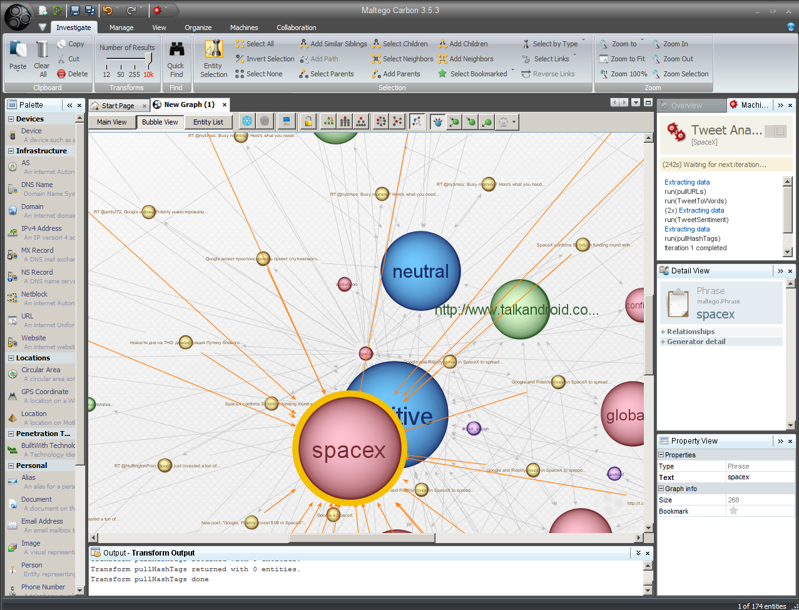

Slide 3
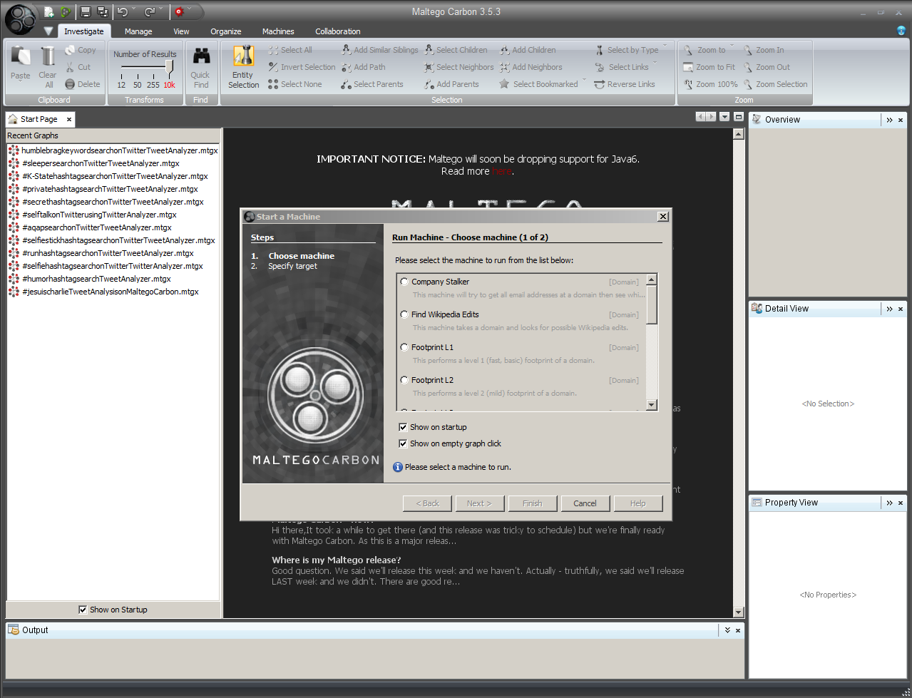

Slide 4
Overview
Self-intros
Your ideas for data extractions
Twitter Facts
Internet as Database
Maltego Carbon Facts
Tweet Analyser (sic) “Machine”
Human “Sensor Networks”
Event Graphing
“Tweet Analyzer” Data Extraction as a Jumping-Off Point to Further Research
Computer-Enhanced Data Mining
Content Mining
Structure Mining
Assertability and Qualifiers
Your ideas for research

Slide 5
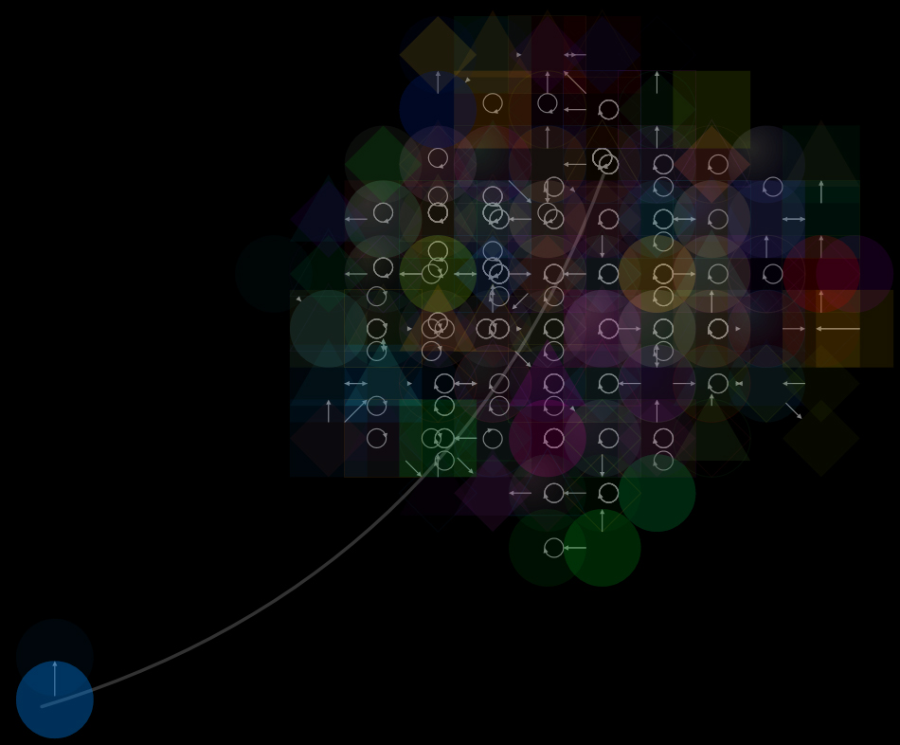
Self-Intros
Experiences with social media platforms?
Areas of research interest?
Particular topics you want addressed, questions you want answered?
Your ideas to “seed” data extractions
#hashtags
@mentions
@names
Keywords
Phrases
Names
Events, and others

Slide 6
Twitter Facts
So-called “SMS of the Internet”: “short message service”, 140 characters, culture of “status updates”
Multilingual Platform: Available in 33 languages (URL Encode/Decode sometimes needed for some languages)
Linguistic Sub-communities/Subgraphs: Identification of linguistic sub-communities in various networks
Those on Twitter: 500 million+ users (as of late 2014), hundreds of millions of Tweets a day
8% automated or robot accounts (“Twitterbots”); also automated sensor accounts; also cyborg accounts (part-human, part-automation)
Those not on Twitter: Blocked in N. Korea, China, and Iran; individual Tweets censored from certain countries and regions at the requests of governments

Slide 7
Twitter Facts (cont.)
Tweets: Text, abbreviations, shortened URLs, images, and videos; used complementarily with online sites (highly linked)
Microblogging Grammar and Syntax: @, #, and others; replies; retweets; @mentions; labeled conversations on a shared topic; favorites; embed Tweets on another Web page
Synchronic Conversations: The assumptions of (near) real-time interactivity and relational intimacy across social and parasocial relationships, distances, cultures, and identities
Volatile Micro(nano)blogging Messaging: “Bursty” popularity but fading / decaying within hours (brief temporal scales, fleeting user attention), based on “survival analysis”
Seems like Ephemera, but Not: Archival of Tweets by the Library of Congress (not sure how usable, findable)
Public messages may be quickly deleted but are always already recorded and captured

Slide 8
Twitter Facts (Cont.)
Data Extractions from Twitter
Public (Released) Data Only: Twitter application programming interfaces (APIs) allow access to public data only, not private data
Two Types of Data Extractions: Slice-in-time (cross-sectional) or continuous data (both rate-limited by Twitter’s API)
Whitelisting: Need to be white-listed (with a verified account) for enhanced API access
Historical Twitter data beyond a week or so generally requires going with a Twitter-approved commercial company to do the extraction

Slide 9
Internet as Database
Web 2.0: The Social Web
Social networking sites (Facebook, LinkedIn)
Microblogging (Twitter)
Blogging
Wikis
Content sharing sites (YouTube, Flickr, Vimeo, SlideShare, and others)
Collaborative encyclopedias (Wikipedia)
Surface Web (and Internet)
http networks
Content networks
Technological understructures
Hidden or Deep Web
…

Slide 10
Maltego Carbon Facts
Penetration (“Pen”) Testing Tool
Mapping URLs and “http networks”
Reconnaissance on the understructure of web presences and technologies used
Geolocation of online contents (GPS coordinates to online content)
Extractions of social networks on Facebook and Twitter
Conversions of various types of online contents to other related information
De-aliasing identities
Tying an individual to phone numbers and emails
Parameter-setting: 12 entities – 10K entities (results)
Caveats: Noisy data, challenges with disambiguation, challenges with knowing how large of a sample was collected (from the amount available)

Slide 11
Maltego Carbon Facts (cont.)
Machines and Transforms: Data extractions and visualizations
“machines”—sequences of scripted data extractions
“transforms”—converting one type of information to other types
Relationships of online contents (expressed as undirected 2D graphs)
Web-based Application Programming Interfaces: Use of web-based application programming interfaces (APIs) of various social media platforms
Versions: Commercial vs. (limited) community versions
Company: Created by Paterva, a S. African software company

Slide 12
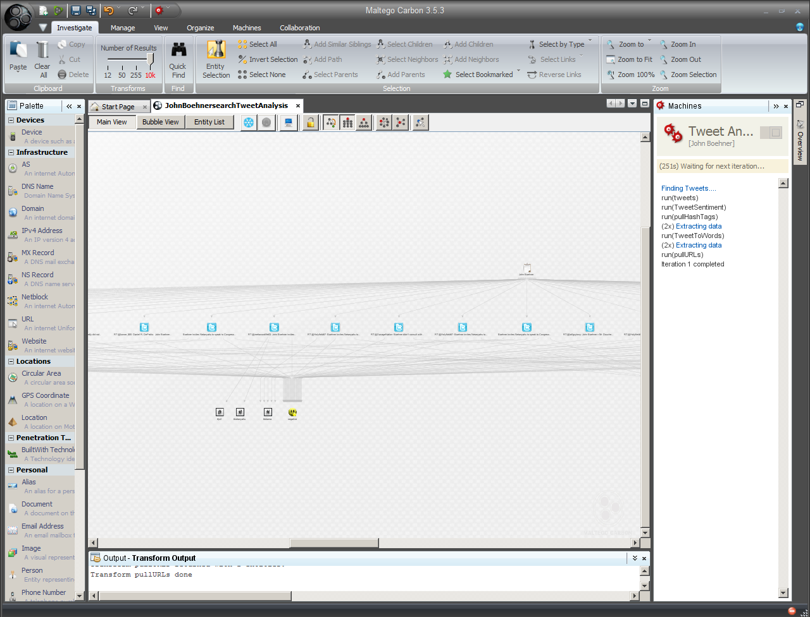
Tweet Analyzer “Machine”

Slide 13
Tweet Analyzer Machine (Cont.)
Dynamic and continuous iterated extractions
Pay attention to the status or progress bar because some analyses take some time to get started. The sentiments (positive, negative, and neutral) do not show up until a sufficient number of messages are collected.
Text-seeded
Links Tweet topics, social media accounts (“Twits”), URLs (uniform resource locators), and digital contents on the Web and Internet
Clusters related (potentially similar) Tweets
Outputs data as various types of 2D graphs (static and dynamic) and as entity lists in tables (partially exportable from Maltego as .xlsx files)

Slide 14
The AlchemyAPI
Runs an automated sentiment analysis tool (by AlchemyAPI, which uses both a linguistic and statistical-based analysis of language and built off of using a Web corpus of 200 billion words as a training corpus) against the Tweets captured by Maltego Carbon / Chlorine in a streaming way
AlchemyAPI, which is part of IBM Watson (recently acquired), retrains its cloud-based (software as a service) algorithm monthly on Web-extracted data (which is mostly unstructured data)
The API can identify over 100 languages (for cross-lingual analysis); there are eight (8) main languages supported for most AlchemyAPI services
New services being introduced include machine vision, particularly object recognition and facial recognition in collected images (based on “deep learning” techniques)

Slide 15
The AlchemyAPI (cont.)
Messaging is classified as positive (close to +1), negative (close to -1), or neutral (close to or equal to 0) based on semantics, co-occurring words in proximity, and statistical analysis (probabilities, levels of certitude or confidence)
Probably TMI:
IBM Watson may enable “personality insights” from the extracted textual data
The AlchemyAPI is offered as a web-based service for app developers to enable various data extractions and analytics (on an apparent micropayment context)

Slide 16
A Brief History of AlchemyAPI
Founded in 2005
Has 40,000+ developers around the world
Is used in 36+ countries
Has three main APIs: AlchemyLanguage, AlchemyVision, and AlchemyData (news service)
AlchemyLanguage enables named entity extraction, sentiment analysis, keyword extraction, relations extraction, and taxonomy creation (classification of text documents based on thousands of categories and subcategories)
AlchemyVision enables image analysis and tagging; face detection (along with the identification of gender, age, and other identifying information)
AlchemyData enables the extraction of named entities, events, locations, dates, and other relevant information for text summarization of news events

Slide 17
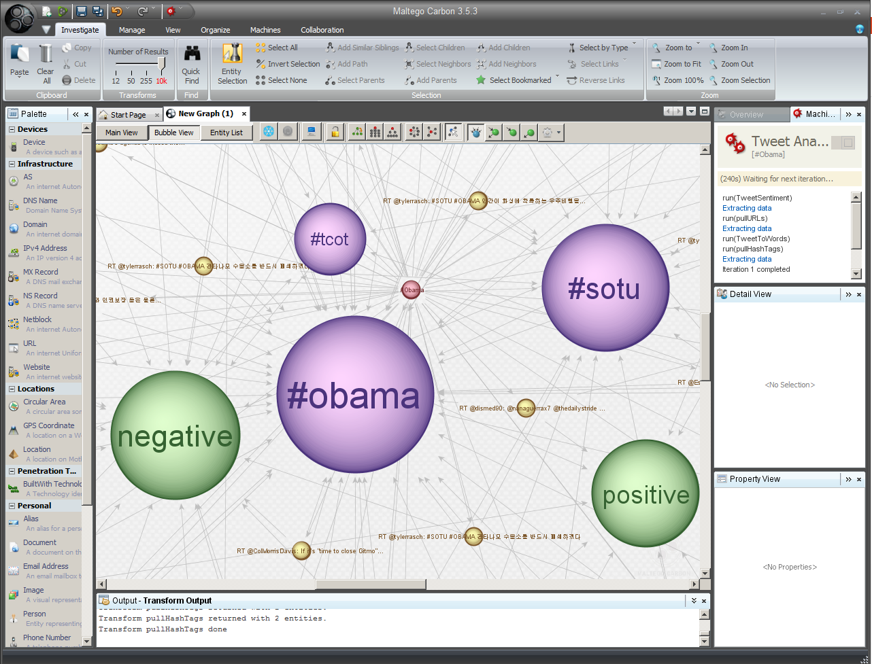

Slide 18
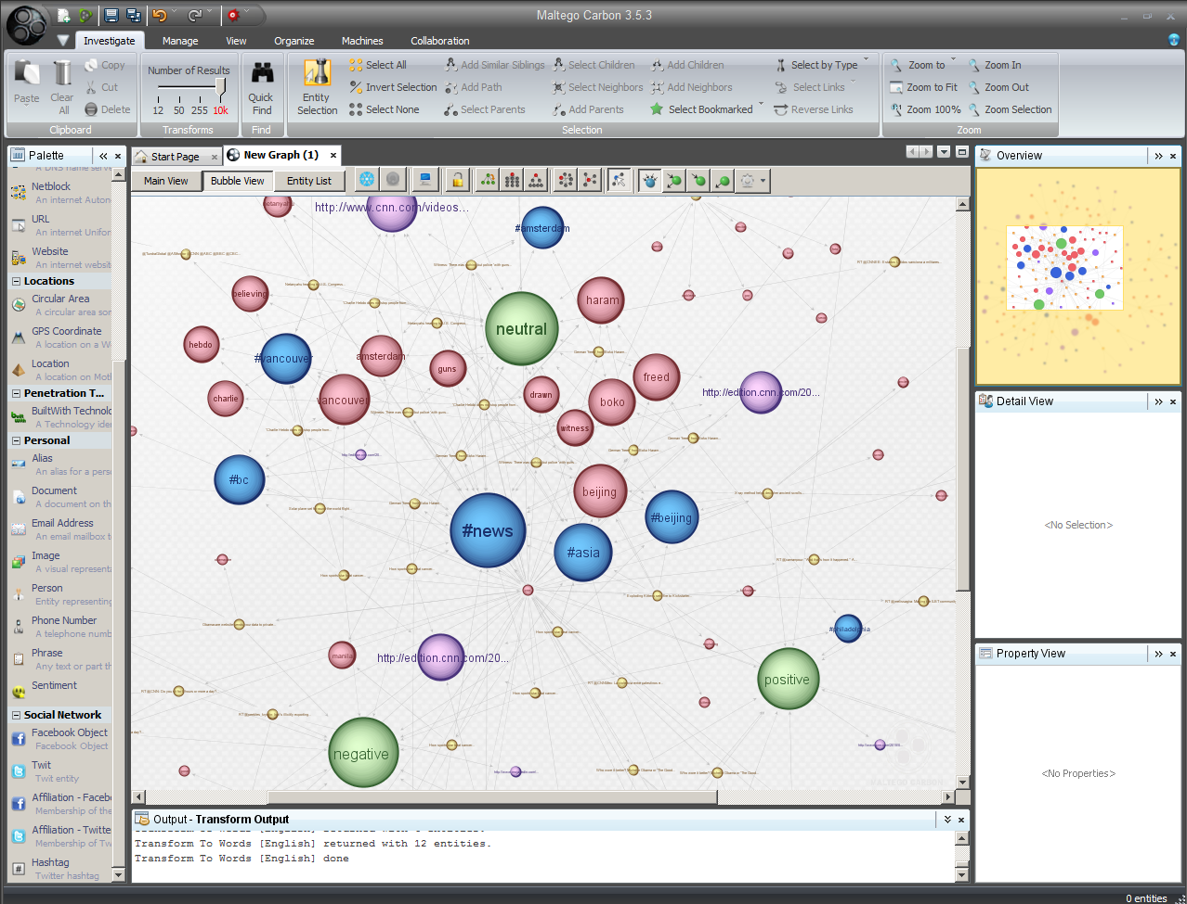

Slide 19
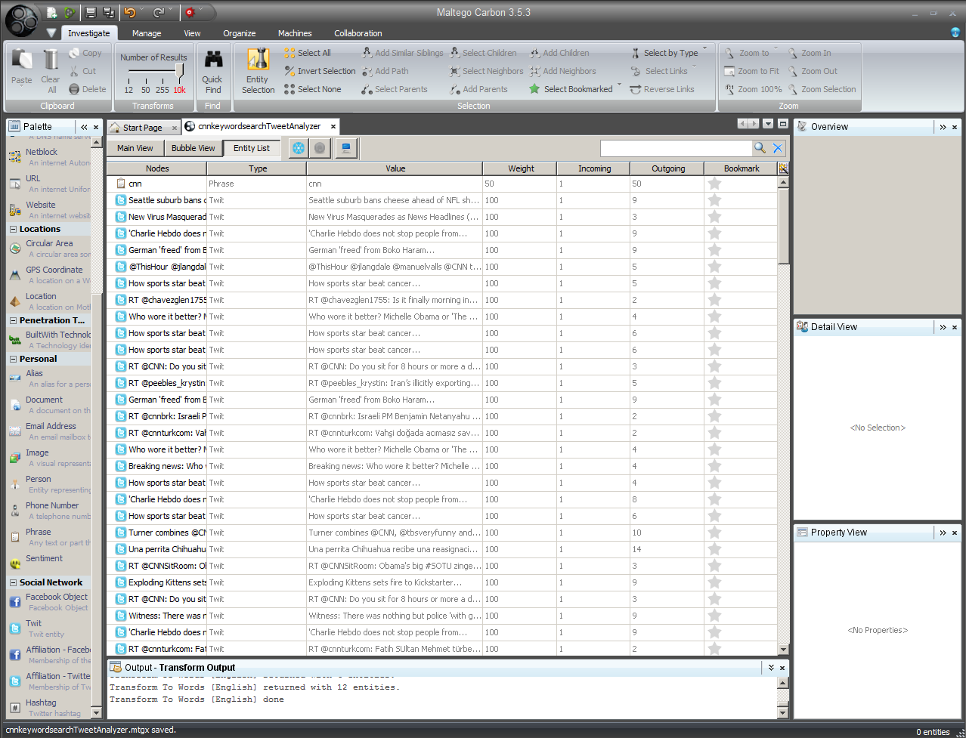

Slide 20
Human “Sensor Networks”
Use of each human “node” in a network as a sharer of information
Benefitting from human presence and locational coverage (location-aware devices and applications)
Benefitting from human sensing (awareness) and intelligence
Filtered through perception, cognition, emotion, and thought (mental processing)
Benefitting from smart device sensing
Enhanced with photographic-, audio-, and video-recording capabilities; enhanced with location-aware capabilities
Thought to have value in unfolding emergency or crisis situations
Theoretically and practically possible to have city-wide / region-wide / country-wide and broader electronic situational awareness by drawing on a number of electronic data streams (public and private)

Slide 21
Event Graphing
Eventgraphs: Data visualizations of time-bounded occurrences or “events” including information about participating individuals, messaging, audio, video, and other related files
Topics of Tweet Conversations: Most popular topics around a word or phrase or symbol or equation (any keyword “string”); making mental connections that were not apparent before
Entities and Egos: Social networks and individuals interacting around the particular topic
“Mayor(s) of the hashtag” (egos and entities), those most influential and active
Sub-groups / islands / clusters around an event
Pendants, whiskers, and isolates

Slide 22
Event Graphing (cont.)
Seeding for the “Event” Data Extraction: Defined #hashtags (and variants) around an event (whether formal or informal) or phenomenon or campaigns or movements; select keywords (words or phrases without the hashtag); select social accounts @names

Slide 23
“Tweet Analyzer” Data Extraction as a Jumping-Off Point to Further Research
A “breadth-and-depth” search (mapping the network and then drilling down on various aspects of the graph that is of-interest, such as particular nodes, clusters, messages, links, or other aspects)
Examples:
Mapping targeted ego neighborhoods and networks
Identifying geographical locations linked to online Tweet discourses
Identifying geographical locations linked to online accounts and entities
Identifying images, videos, and URLs linked to particular discourses (based on campaigns or movements or events)

Slide 24
Computer-Enhanced Data mining
Content Mining of Digital Contents and Messaging
Structure Mining of Social Networks and Content Networks
CORE: text, imagery, videos, audio, URLs, and others
Sentiment analysis (expressed feelings, beliefs, attitudes, direction of opinion, strength of opinion, polarity, inferences on purpose, and others; obvious and latent)
Content analysis (of messages)
Word-sense disambiguation
Semantic analysis
Frequency counts (word clouds)
…via machine-reading and human “close reading”
CORE: egos and entities (individuals and groups; humans, cyborgs, sensors and ‘bots); social media platform accounts for various purposes
Relationships (formal links): Follower-following / friend
Relationships (interaction-based links): Emergent networks around issues, Twitter campaigns, and others (actual interactions)
…via machine data visualization and human analysis

Slide 25
Assertability and Qualifiers
The Social Medium Platform and its Constituencies: What different types of assertions can you make about data on a particular type of social media platform? Its users? Its regionalisms? Its cultures? Its jargon?
What are They Saying? What does the messaging mean? How is the multimedia messaging understood along with the text messaging (more easily machine-processed and even easier to disambiguate through human processing than audio / imagery / video / web pages / other)?
What is the relevance of the sentiment—positive, negative, and neutral?
How far can you generalize about online conversations?
What can you assert about meaning or intention?
And what does the talk suggest about possible behaviors?

Slide 26
Assertability and Qualifiers (cont.)
Size of Data Extraction: How do you know how much of what is available was actually captured? (no N = all, no API-enabled knowledge of % of data captured vs. amount of data actually available)
Spatial Mapping: Given the sparsity of geolocational information in microblogging messages and the locational inaccuracy of what may be shared, what sorts of “digital maps” may be drawn around conversations related to certain issues?
How would confidence in such information be measured?
How would error rates be understood?

Slide 27
Assertability and Qualifiers (cont.)
Egos and Entities: What can you generalize about individuals and groups ascribing to particular ideas? What can you assert about the human or group (or ‘bot or cyborg) identities behind social media accounts?
Trending Issues: What can you assert about how issues “trend” on various social media platforms?
When is continuous sampling desirable (as with dynamic data)? When is slice-in-time sampling desirable (as with more static data)?
Are there space-time interactions that may be captured?

Slide 28
Your Ideas for Research?

Slide 29
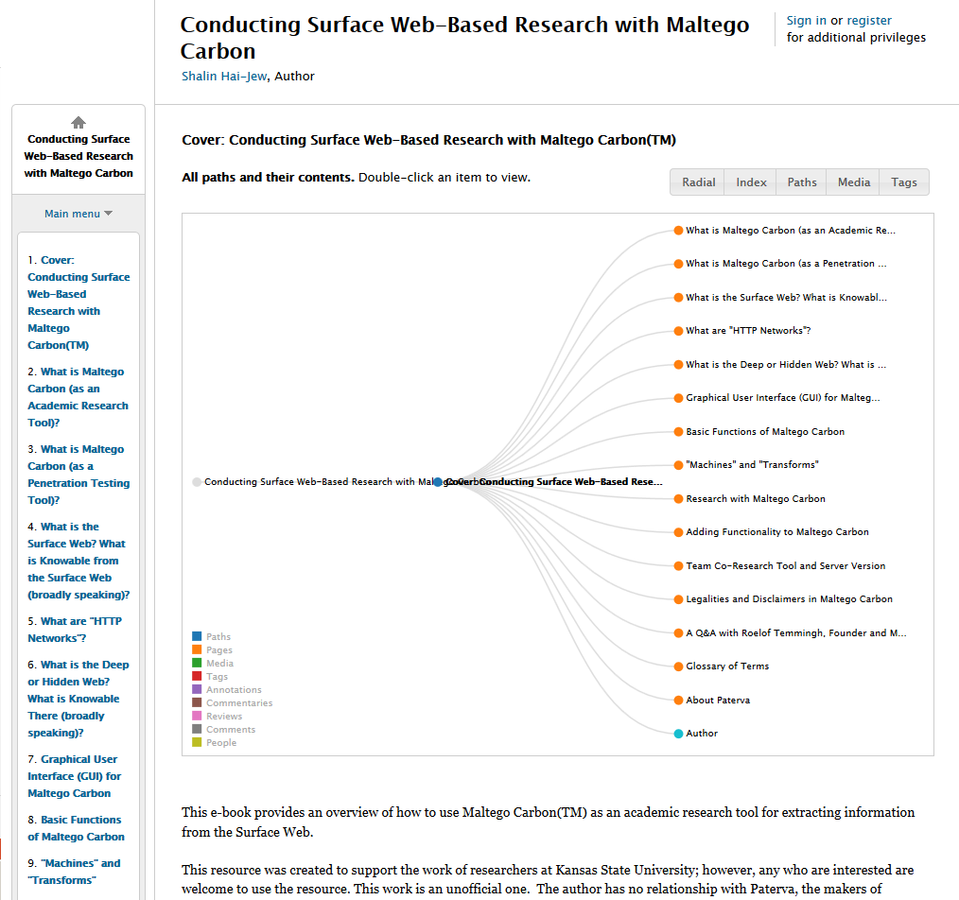
Contact and Conclusion
Dr. Shalin Hai-Jew
iTAC, K-State
212 Hale Library
785-532-5262
shalin@k-state.edu
Resource:
Conducting Surface Web-Based Research with Maltego Carbon (on Scalar)

