Slide 1
Maltego Radium™:
Mapping Network Ties and Identities across the Internet
Shalin Hai-Jew
Kansas State University
Conference on Higher Education Computing in Kansas (CHECK)
May 29 – 30, 2013, Pittsburg State University, Pittsburg, Kansas

Slide 2
Abstract
Maltego Radium™ (v. 3.3.3; v. 1 in 2008) is a penetration testing tool that collects public data about organizations, websites, and identities, for awareness of social and technological presence across the Internet. The tool’s interface is highly usable and interactive. The tool enables a deep dive analysis into the interrelationships online, and it extends the “knowability” of electronic identities. This tool enables explorations of emails, telephone numbers, websites, organizations, by offering access to information that would often be “invisible” otherwise. The visual outputs are interactive and include half-a-dozen visualizations in a social network (node-link) format. The presentation will show how to conduct “machines” and “transforms” of a target, how to visually map the data, and how to analyze it.

Slide 3

Some Assumed
Assumptions of the Software Tool
People at some point will have linked their pseudonyms with real-world personally identifiable information (PII)
People act on interests (which are expressed in some way electronically), and their interests reveal something about the unknown node
People’s online relationships can identify an unknown node based on the connections, power relationships, intercommunications, and the external identities
All online actions can be linked to geographical locations, and those locations may be revealing
Knowability of an unknown node / entity (or group) is increased when a collective and comprehensive electronic footprint is rendered

Slide 4
Intros and Interests
Hi! Who are you, and what are your interests re: the topic? Anyone ever use a “hacking” tool? If so, what?
Do you have an idea for a Maltego Radium™ “machine” or “transform” run that you want us to try during this session? (I’ll ask you near the end of the presentation.)

Slide 5
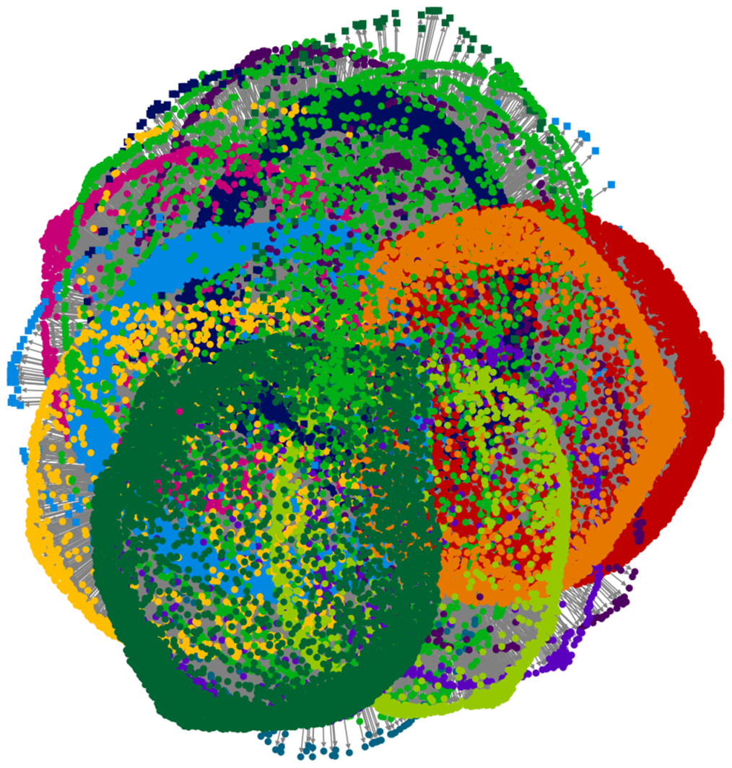
Social Network Analysis (SNA)
Electronic Network Analysis:
  People
  Content
  Technologies

Slide 6
Assumptions of Electronic Social Network Analysis
People often interact in homophilous (preferential selection based on similarities with the self or the in-group; assortative mixing) or heterophilous (preferential selection by difference; disassortative mixing) ways
  Depending on the non-kin social context (such as work-based, volunteer-based, romance-based, friendship-based, hobby-based, or others)
People find meaning and identity in ways similar to those that are close to them (the “company you keep” assumption); yet, people’s identities in this age are not necessarily coherent and unified but are fragmented and multiple and experimental
World is socially constructed in various types of hierarchies (structurally)
  Resources and information (and inter-exchanges) move through these hierarchies through particular social paths

Slide 7
Assumptions of Electronic Social Network Analysis (cont.)
Electronic socio-technical spaces (STS) somewhat mirror the real world but not 1-1 (or even close); called the “cyber-physical confluence”
  Electronic data may be used to make some cautious extrapolations (or informal intuitions or “whispers”) about real-world off-line personalities, values, and actions
  Social network analysis (SNA) data are used with other information to set a full(er) context

Slide 8
Assumptions of Electronic Social Network Analysis (cont.)
Electronic spaces offer empirical in vivo (in-field) relational information (based on actual links, actual connections, and actual relationships based on electronic documentation) that is behavior- and action-based and not professed only
  May include “big data” analyses of entire datasets of complete networks
  May include cross-references between numbers of data sets
Strength of inter-relationships is critical based on interaction patterns
  Complex statistics and layout algorithms are used to express relationships in social network analysis
  Radically different visualizations may be possible depending on the layout algorithms

Slide 9
Assumptions of Electronic Social Network Analysis (cont.)
What moves through network topologies (digital information, resources, influence and socialization, and memes, etc.) is also important to understand and analyze
  Machine-analyzed computerized sentiment analysis (through text mining) is one way to evaluate messages moving through virtual communities
  Word frequency counts is another machine-based way to evaluate messages
  Image analysis is another way to evaluate message

Slide 10
Network Graphs / Visualizations
Graphs built from graph metrics, which describe structural aspects of the network (such as numbers of nodes and links, types of connections, density or sparseness of ties, leadership and role types, motif censuses, and other factors)
Graphs as 2D spaces
  Not x or y axes but about relationships between the nodes and the links
  Can lay out the same information in multiple ways using the same layout algorithm
Nodes and links (node-link diagrams); vertices and edges / arcs
  Direct and indirect ties
  Centrality-peripherality dynamic (degree centrality); closeness-distance dynamic (paths; degrees of separation)

Slide 11
Network Graphs / Visualizations (cont.)
Fat (influential) and thin (peripheral) nodes; bridging nodes
  Nodes are parts of multiple or many networks
  Nodes play different roles in different networks
Dense networks vs. low-density (sparse) networks
  Networks function better with density for some group objectives; networks function better with low-density or sparseness for some other group objectives
  Path dynamics for percolation and flow
In-group; out-group dynamics; social identity (node, sub-group, network, and multi-network levels)
Layering effects; network dependencies; network overlap and interrelationships

Slide 12
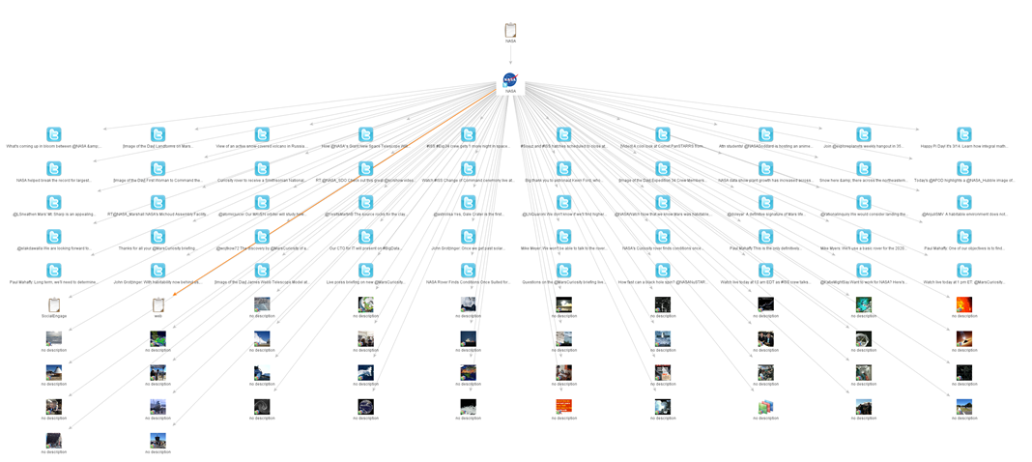
Automapped Tree Hierarchies
Multimodal elements
  Root entities
  Leaf entities
  Branching connections
  Connective events
Notes:
NASA Twitter Geolocation crawl depicted

Slide 13
Penetration Testing?
What do you know about penetration (pen) testing?
Any prior experiences with Maltego Radium™?

Slide 14

Maltego Radium™
Uses Java
  Runs on Windows, Mac, and Linux operating systems
Applies a 2D or 3D Graphical User Interface (GUI)
Enables complex and fast crawls without need for command line coding
Uses Maltego Radium™ (by Paterva) Transform Application Servers for some data extractions

Slide 15
Basic Features of Maltego Radium™
Shows links between people; groups of people (social networks); companies; organizations; web sites; internet infrastructure (domain, DNS names, netblocks, IP addresses); phrases; affiliations; documents and files
  Based on open-source (publicly available) information or “open-source intelligence” (OSINT)
  Does not involve the breaking of network controls to access information
  Assumes benign information in isolation may be turned malicious in combination and / or relationship to other data (as in “big data” analytics)
Is a “dual use” technology with a range of applied “data harvesting” / structure-mining / datamining and analytical uses

Slide 16
Network Penetration (“Pen”) Testing
“Penetration”: Unauthorized access or a “break-in” to a protected network
  Combination of attacks on hardware (device exploits), software (malware, password cracking, keyloggers, and Trojan Horses), and wetware (social engineering, phishing, and spear phishing)
  Black Box, Gray Box, or Crystal Box (no knowledge of the target network; partial knowledge of the target network; full knowledge of the target network)
  Conceptualized and practiced in an adversarial way

Slide 17
Network Penetration (“Pen”) Testing (cont.)
Risk environment modeling with adversaries (white and gray-hat hackers; red teams)
  Offensive and defensive campaigns (pen testing part of offensive security testing)
  Countermeasures: security awareness, self-awareness of vulnerabilities (technological, human, political, policy, and others), policy-setting, surveillance / intrusion detection, firewalls, training of staff, security networks, technologies, communications, professional partnerships, and others

Slide 18
Network Penetration (“Pen”) Testing (cont.)
Maltego Radium™
  Enables crawls / scrapes / scans of the potential public and private “attack vectors” of an organization or network’s structure
  Shows what is seeable and knowable by others, so proper protections may be put into place (as part of basic electronic reconnaissance or surveillance of so-called “perimeter systems”)
  May be used as part of a “red team” simulated (or actual) attack to test defenses in pen testing
  Offers a starting point for the strategy, planning, further probes, and other actions
    May be followed by more focused, targeted, and nuanced attacks

Slide 19
Individual-Level Attacks
“Doxing” (DOCUMENTING) attacks
Cyber-stalking
“Doxing” based on “documenting” by tracking personally identifiable information
Creation of “dossiers” of individuals or groups by hacktivists to use in ad hominem and other attacks
Tracking individuals’ electronic presences and relating that to real-world presences for harassment and other nefarious purposes

Slide 20
Electronic Surveillance
Interpersonal electronic surveillance (ies)
Organizational or group surveillance
Self-surveillance
  Electronic grooming
  Sousveillance (inverse surveillance; watchful vigilance from below or inside an organization or social structure; participant surveillance)
Horizontal surveillance
Vertical surveillance
Mapping one’s own organization for public relations purposes
  Analyzing telepresences on social media platforms through extractions of Representational State Transfers or “REST”
Perusing Internet and Web-based presences of organizations
  Creating outreach and marketing strategies for external organizations
  Finding identities of individuals for contact in corporations or organizations (through the back door)

Slide 21
Making the Hidden Visible
There are legitimate reasons to pursue pseudonymity and anonymity (such as to prevent harm)
Eliminating pseudonymity (untraceable long-term anonymity; exclusive use of a pseudonym over time for reputation transfer, branding, and “authornym” use; ability to prove “holdership” of a pseudonym) and anonymity (temporary, ephemeral, and partial hiding) and enforcing an “inescapable identity” and non-discretionary revelation
  Traceability means that at least a single intermediary knows actual identity (for traceable anonymity or traceable pseudonymity)
  The problem of time involves the fact that archived electronic sites are fixed (as big data corpuses), and may be analyzed using a variety of future tools with increasing capabilities
Making the Internet more of a nonymous, transparent, and traceable space

Slide 22
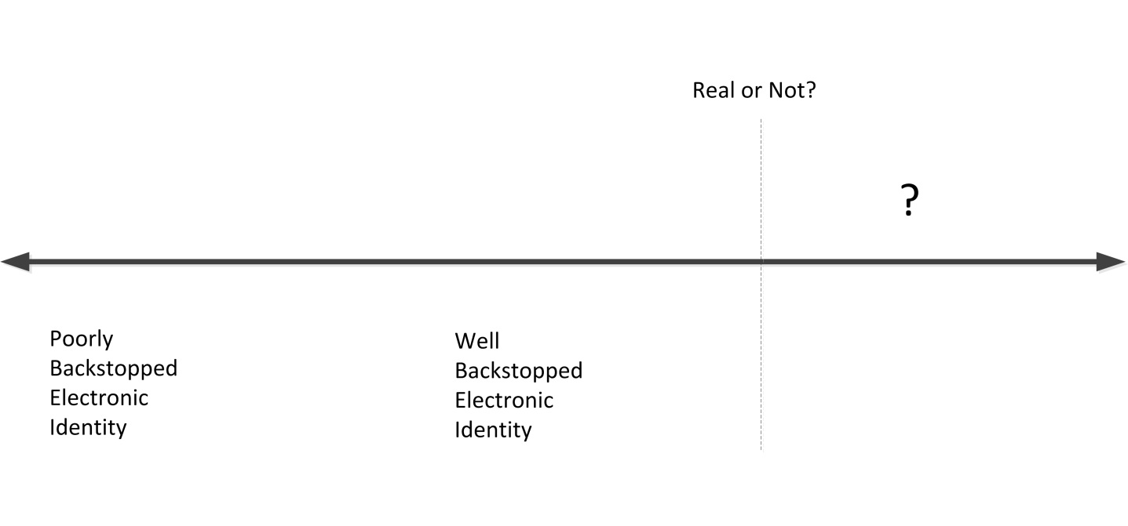
Making the Hidden Visible (cont.)
Harder to use Maltego Radium™ for actually verifying identity and real-ness / personhood, without the affordances of a verified real-persons database and other checks
  May guess that a virtual online identity is faked or improperly back-stopped

Slide 23
Making the Hidden Visible (cont.)
THE INDIVIDUAL EXPERIENCE
De-anonymizing / re-identification: Connecting personally identifiable information (PII) of the physical self to aliases, pseudonyms, handles, or accounts
  Narrowing the potential “anonymity sets” for various individuals (those to whom one may be temporally anonymous); the protection of identity as a “layered” one
  Linking partitioned parts of an individual’s online life, and connecting partial identities (from various contexts) to coalesce for a fuller version of an individual

Slide 24
Inescapable Identity
Identifying hidden (inter)relationships in electronic information:
  Showing hidden connections and affiliations (for exploration and analysis)
    Identifying sleeper communities of interest
    Identifying influential nodes (or clusters) in a network
  Revealing personal information
    Extrapolation of user interests and online seeking behavior
Revelation of potentially private documents
The Human Flaw
“All aliases initially originate from one person, with one mind, and one personality.”
  Tal Z. Zarsky (2004, p. 1352), in “Thinking outside the Box: Considering Transparency, Anonymity, and Pseudonymity as Overall Solutions to the Problems of Information Privacy in the Internet Society”…
  Said another way: “Character reveals…”
  Vulnerable to “the aggregation attack” on profiles (requiring only a few unique data points)
Notes:
Note: Legal authorities can lift all walls of anonymity or pseudonymity if there are indicators of potential law-breaking by appealing to the third-party service providers; this issue is not addressed here.

Slide 25
The Data Crawl Process
…using Maltego Radium™
(likely with complementary other software, equipment, and tools)

Slide 26
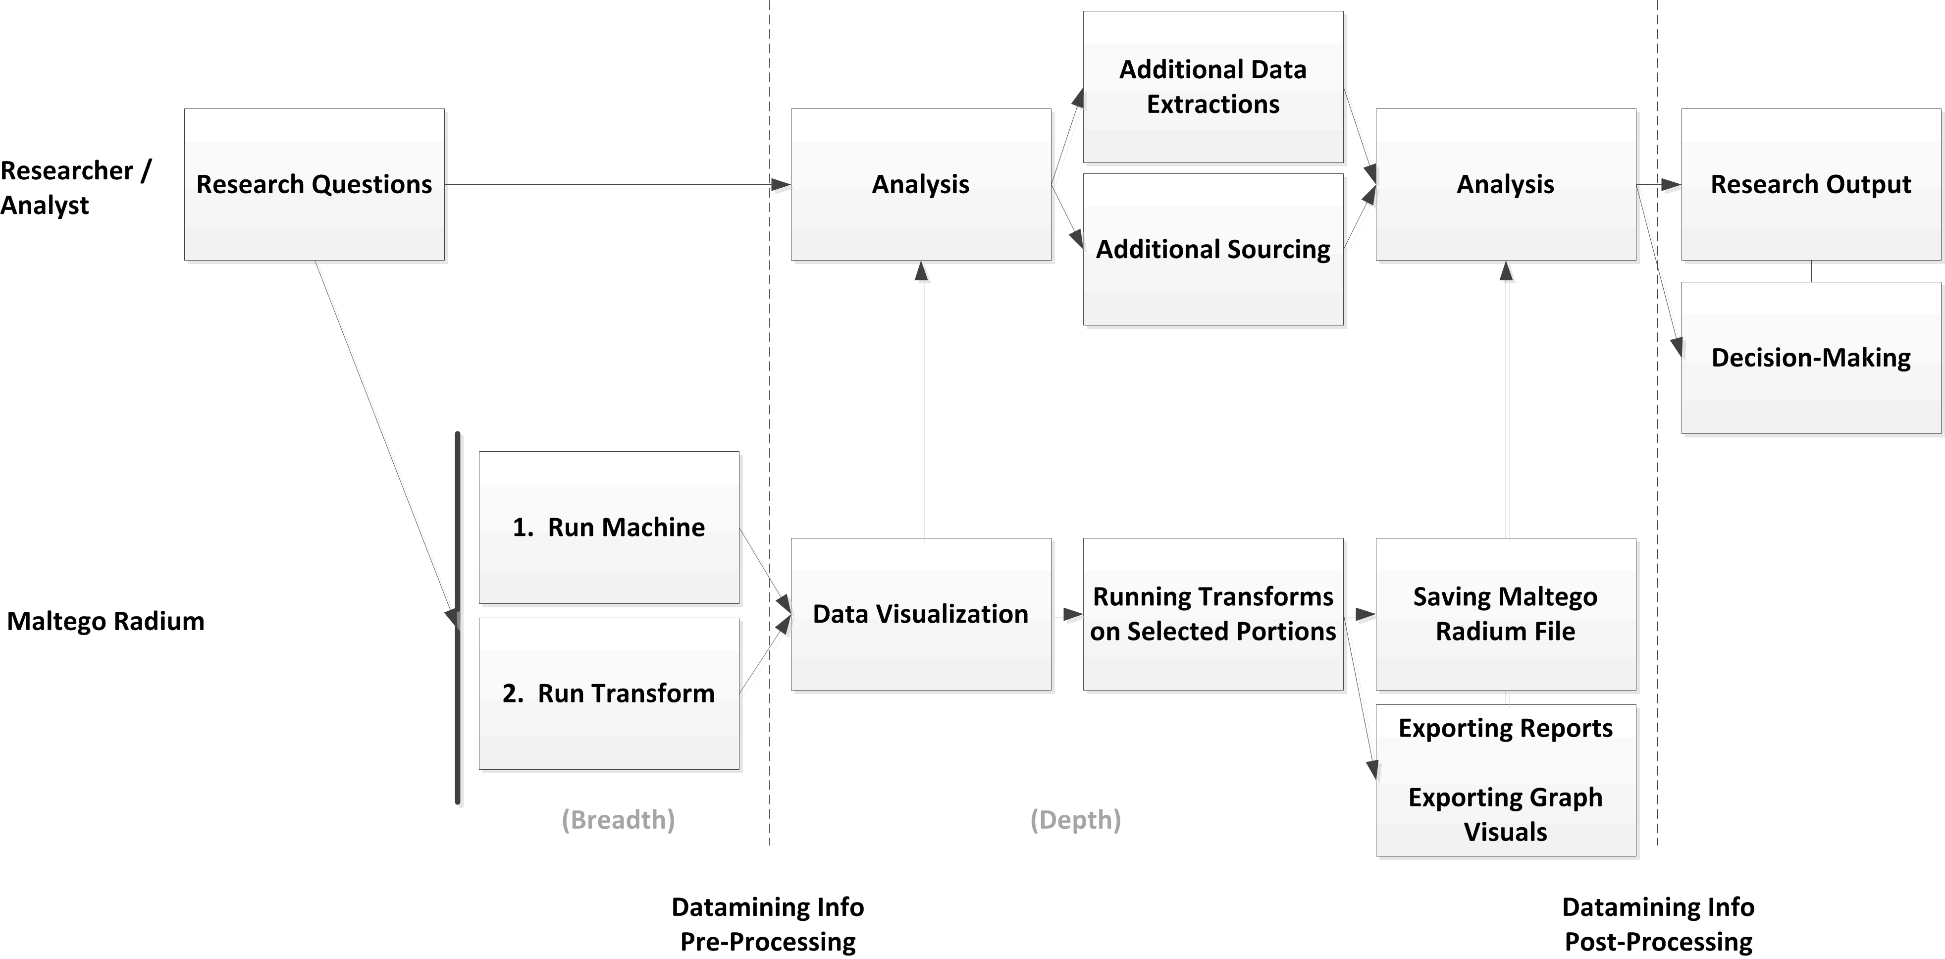
Steps to a Data Mining Crawl

Slide 27
Two Ways to Start a Data Crawl
Think breadth and depth
Run a Maltego Radium™ Machine (sequencing including synchronicity of selected “transforms” through macros)…then further select transforms on selected nodes
Drag and drop from the left menu “palette” to the work space to actualize different select searches
  Tailoring the data crawl through user filters (selecting options at various junctures during the crawl)
May layer further queries on former search results (in the same session or in later sessions)

Slide 28
Caveats: Showing your Hand to Some Targets
Maltego Radium™’s “machines” and “transforms” are not invisible to the crawled or scanned networks; the surveiller faces counter-surveillance
  Radium™ user often gives up his or her identity and other information when conducting a data extraction or crawl (by leaving trace data)
  Organizations and networks (their network administrators) have it in their interests to know who is scoping them out / possibly “prospecting”
    Many “attack surfaces” are honeypots (lures / traps / sentinel plots for hackers to self-reveal); there will be purposeful obfuscation
    Forensic analyses post-attack may result much more about the objectives and criminal skill sets of the attackers

Slide 29
Caveats: What’s Logged with Paterva
General crawl
Access to some web services
API key (application programming interface)
IP Address (Internet Protocol -- yours or the proxy one you are using)
The transform executed
The time it executed
The user ID (which gives first name, last name and email address)
Paterva does not log the questions asked or the results
First name
Last name
Email address
Time registered
Time first used
How many transform you ran
MAC address you selected
Your operating system type and version, but not details of service packs etc.
GUI version

Slide 30
Caveats: Disclaiming Liabilities
User has to allow Paterva to disclaim liabilities before transform runs may be made
  Crawl “Damage”: Unclear what “damage” may occur from transforms (but some crawls may be trespassing)
  Sample of a Disclaimer: “Please note this transform is being run on the Paterva Transform Distribution Server and has been written by the user 'Andrew MacPherson'. This transform will be run on * and Paterva cannot be held responsible for any damage caused by this transform, you run this AT YOUR OWN RISK. For more information on this transform feel free to contact…”

Slide 31
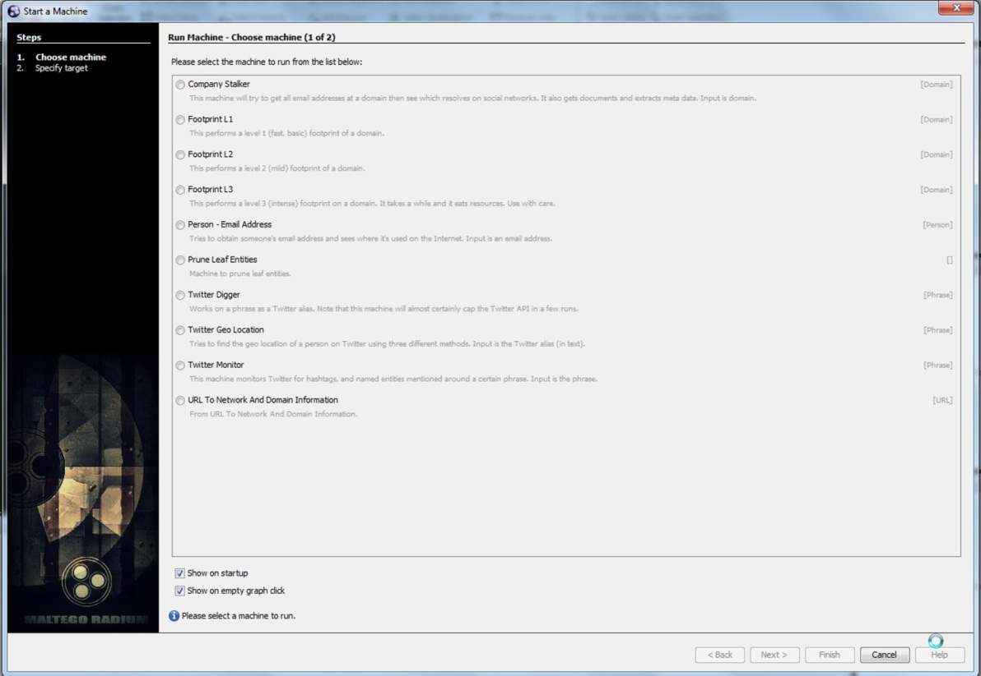
Start 1. Run Maltego Radium™ Machine on Start Screen
Select machine (a sequence of “transforms”)
Identify target (phrase, name, URL, organization, etc.)

Slide 32
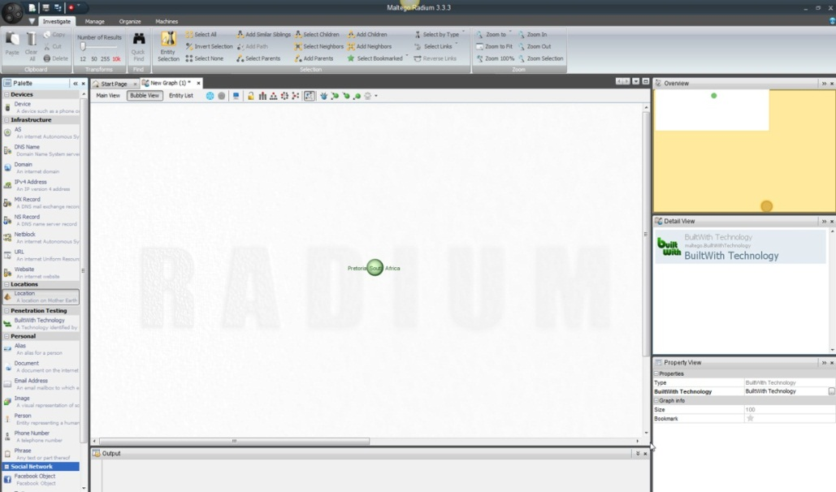
Start 2. Run Transforms in the Workspace
Select a transform (one type of information changed to another type) by dragging and dropping from left menu bar to the work space
Identify target by double-clicking node
May highlight a range of icons to conduct transforms on
  Sub-transforms customized to particular types of entities or nodes
Information resolves out from type to type

Slide 33
1. Types of Run Maltego Radium™ Machines
Company Stalker: Email addresses at a company’s domain(s)
Footprint L1: “Fast” and limited footprint of a domain
Footprint L2: “Mild” and semi-limited footprint of a domain
Footprint L3: “Intense” and fairly in-depth and internal footprint of a domain
Person- Email Address: Identifies a person’s email addresses (but needs a disambiguated or fairly uncommon name…or the data is noisy)

Slide 34
1. Types of Run Maltego Radium™ Machines (cont.)
Prune Leaf Entities: Prunes all leaves (entities with no outgoing links and just one incoming link—aka pendant nodes) to clear the screen for re-crawls (and to de-noise the data)
Twitter Digger: Phrase as a Twitter search
Twitter Geo(graphical) Location: Finding a person’s location based on multiple information streams

Slide 35
1. Types of Run Maltego Radium™ Machines (cont.)
Twitter Monitor: Monitors Twitter for hashtags (#) and named entities mentioned (@)
  All Twitter crawls rate-limited by amounts of information downloadable per time period by Twitter API
URL to Network and Domain Information: From URL to network and domain information

Slide 36
2. Types of Node-level Transforms via Palette Options
Devices
  A phone, mobile device, or other used by the individual or connected to various accounts or a network
Infrastructure
  AS – Autonomous System Number (as assigned by IANA to RIRs)
  DNS Name – Domain Name System (identification string)
  Domain – Internet Domain
  IPv4 Address – IP version 4 address
Infrastructure (cont.)
  MX Record – DNS mail exchanger record (indicator of mail server accepting email messages and how email should be routed through SMTP)
  NS Record – A DNS name server record (with indicators of subdomains)
  Netblock – An internet autonomous system
  URL – An internet Uniform Resource Locator (web address as a character sting)
  Website – An internet website (related web pages served from a single domain)

Slide 37
2. Types of Node-level Transforms via Palette Options (cont.)
Locations
  A location on Mother Earth (to find domains and other such information)
Penetration (“Pen”) Testing
  Company
Social Network
  Facebook Object
  Twit entity
  Affiliation – Facebook
  Affiliation – Twitter
Personal
  Alias
  Document
  Email Address
  Image (EXIF or “Exchangeable Image File” data extraction: geotagged data, GPS, and general image conditions information like digital camera settings)
  Person
  Phone Number
  Phrase

Slide 38
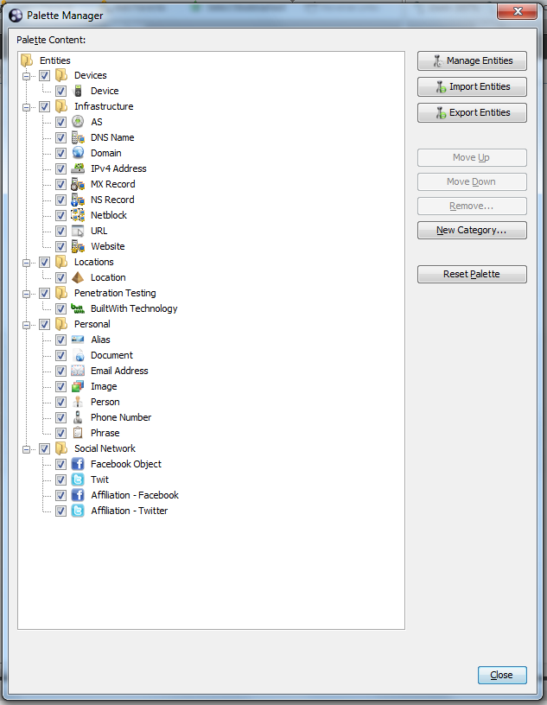
Customized Transforms /
Macros via the Palette Manager
May import or export palette contents / entities (macros for customized “machines” sequences / transforms sets, or stand-alone “transforms”)
  Assumes some ability to create one’s own scripted Maltego Radium™ macros (with Maltego™ Scripting Language or MSL) as well
  May be as simple as drag-and-drop with existing transforms

Slide 39
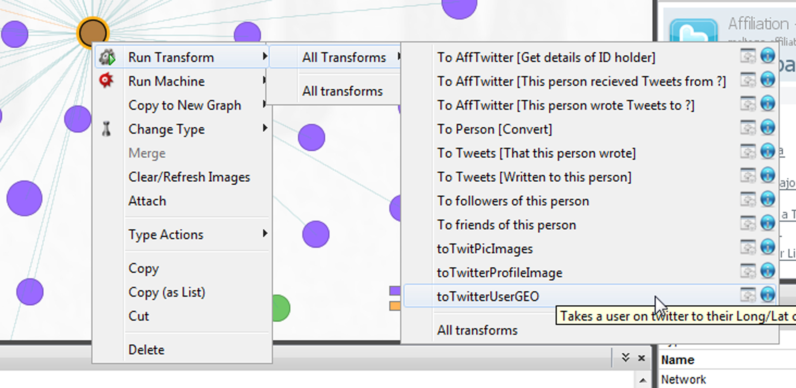
Node-level Targeted Transforms via Dropdown Menus

Slide 40
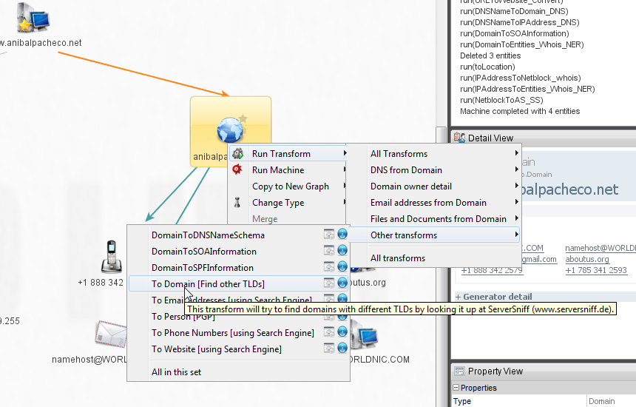
Node-level Targeted Transforms via Dropdown Menus (cont.)

Slide 41
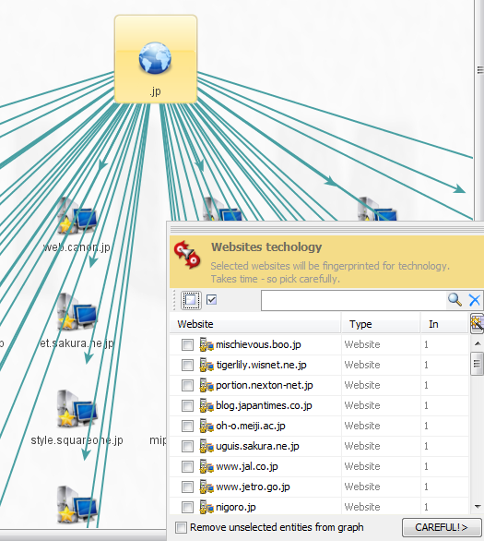
Filtering / Pruning Current Searches
Delinking
  User pruning of nodes that are not interconnected or related to the search
  User filtering or identification of bad domains to exclude from the crawl
Linking
  May link multiple nodes to run further transforms to identify possible relationships

Slide 42
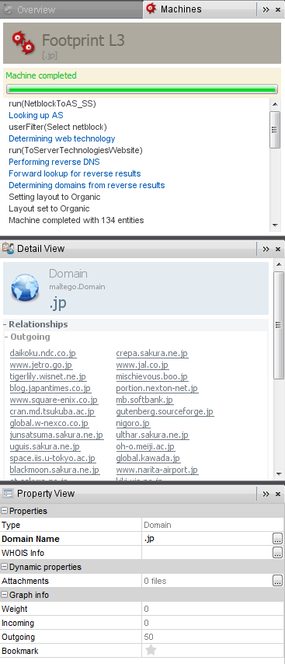
Detail View,
Property View
Extraction of close-in node-level multiplex data (vs. meta-level networks)
  Put cursor on a node for the details in the right pane
  May conduct more transforms on that node for more data

Slide 43
User Annotation of Graph Entities
May right-click to add notes on various entities to keep written records and annotations
Paterva’s Case File enables even more sophisticated human-annotated record-keeping of information discoveries (like research journals or investigator files)

Slide 44
Data Visualizations
What have your experiences been with data visualizations? Graphs?
What are graphs?
How is data used to create graphs?
How are graphs interpreted?

Slide 45

Multi-Modal Graph Data Visualizations
Layout (and interaction) modes:
  Block
  Hierarchical
  Circular
  Organic
  Interactive organic

Slide 46
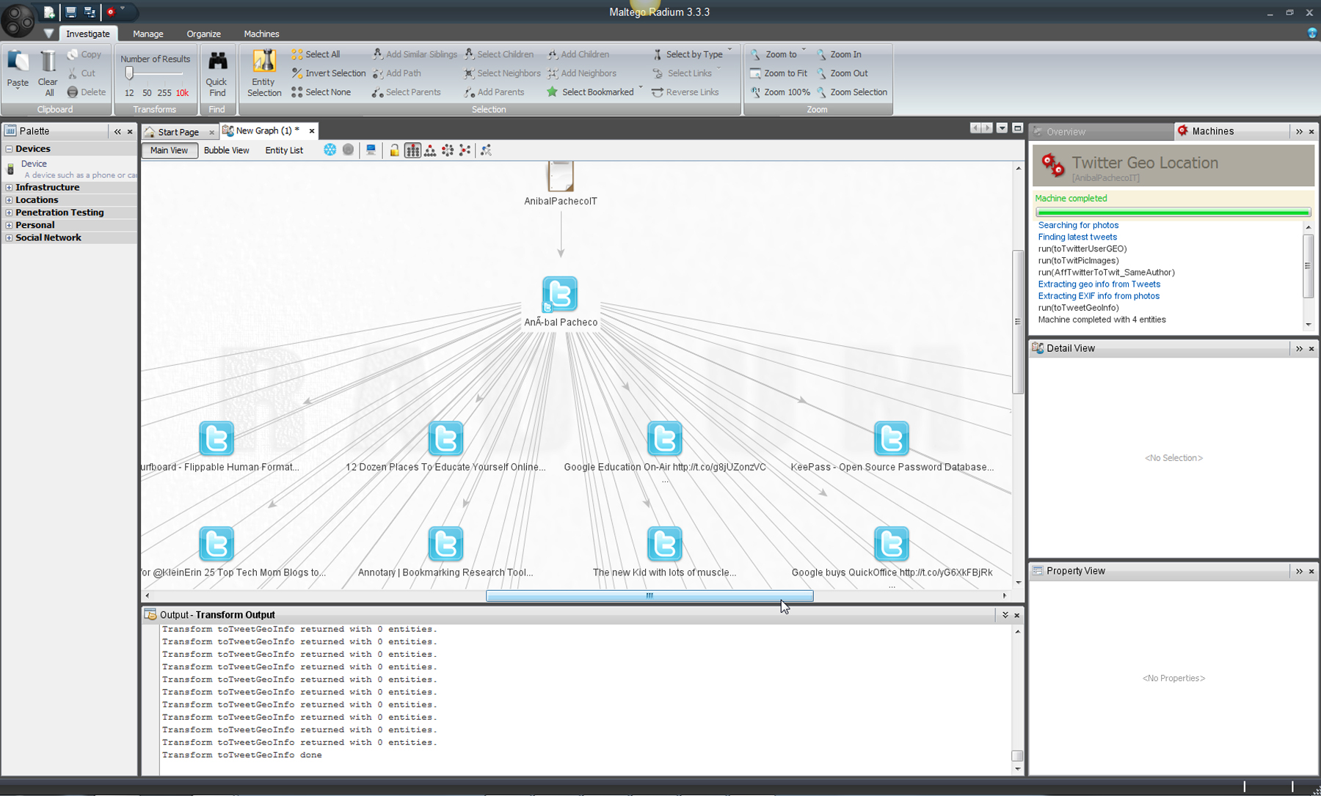

A Twitter Social Network Crawl

Slide 47
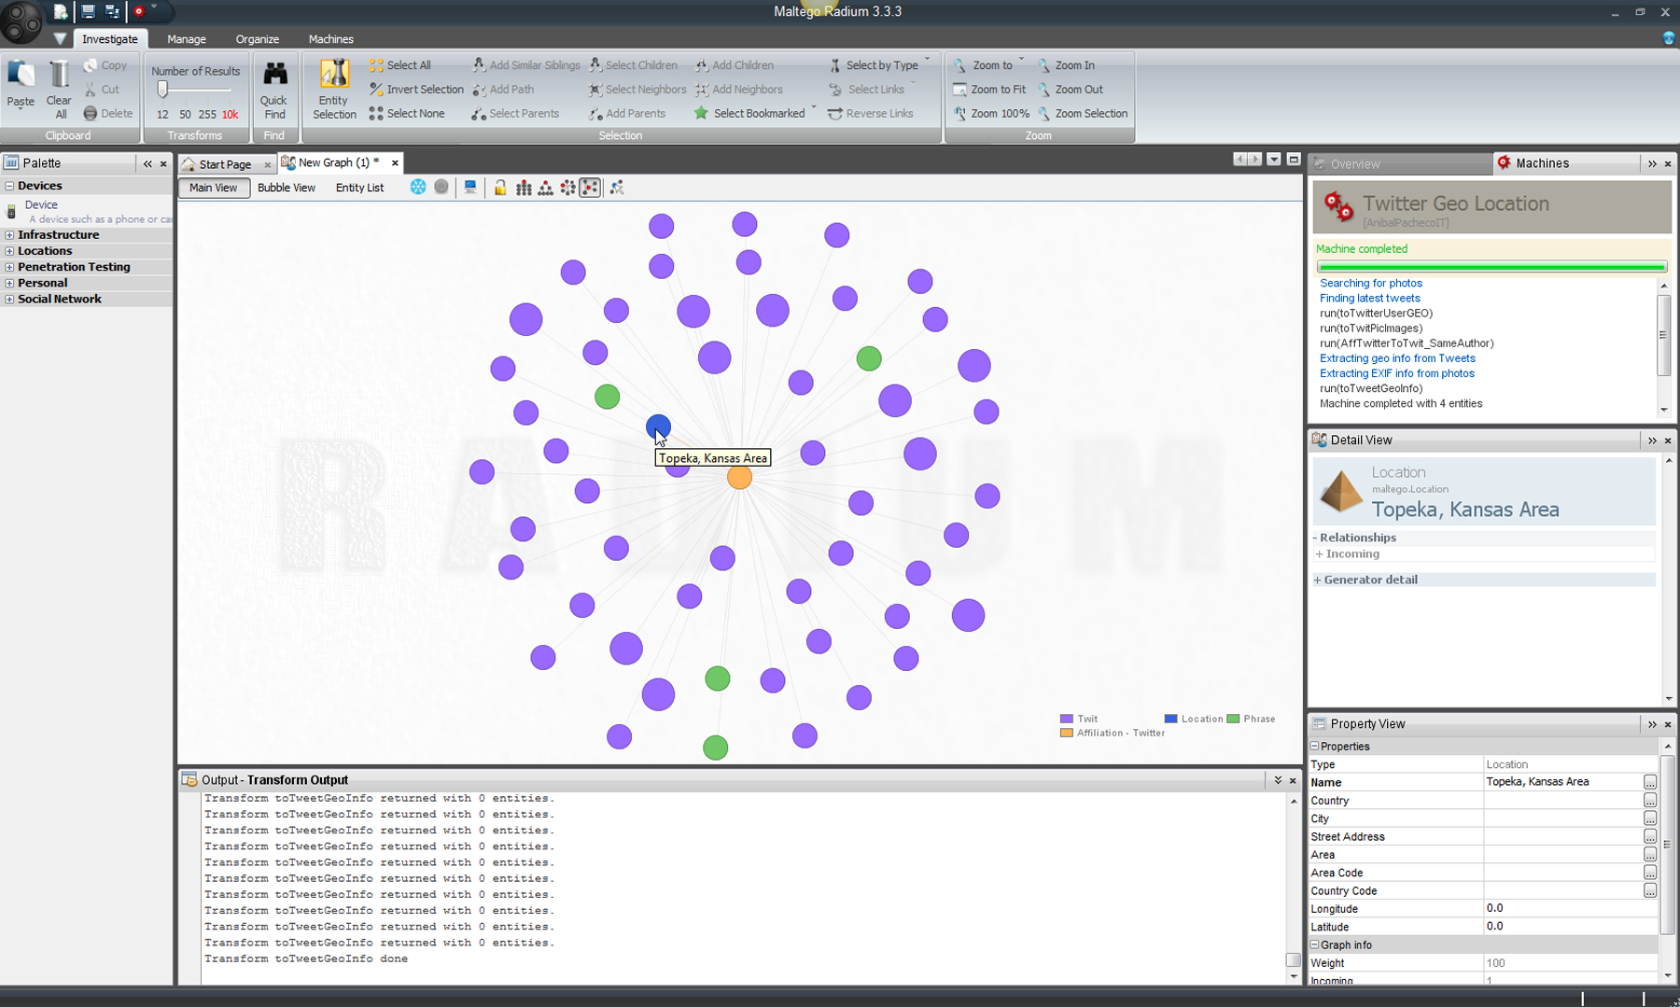
A Twitter Social Network Crawl (cont.)

Slide 48
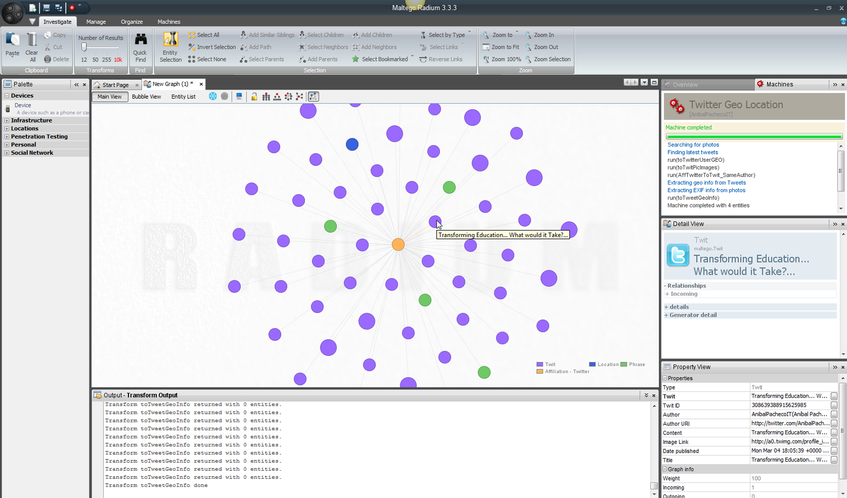
A Twitter Social Network Crawl (cont.)

Slide 49
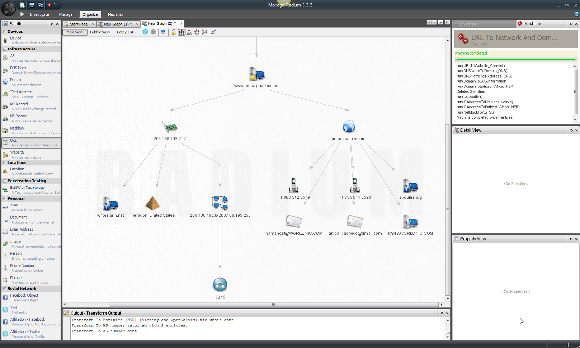
A URL Exploration for Internet and Web Networks
Notes:
Uniform Resource Locator

Slide 50
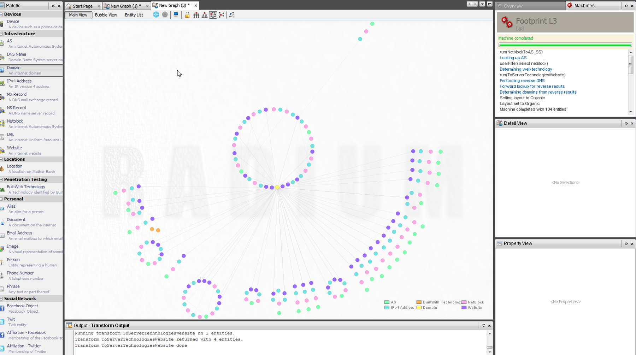
A Macro Crawl of the .jp Domain

Slide 51
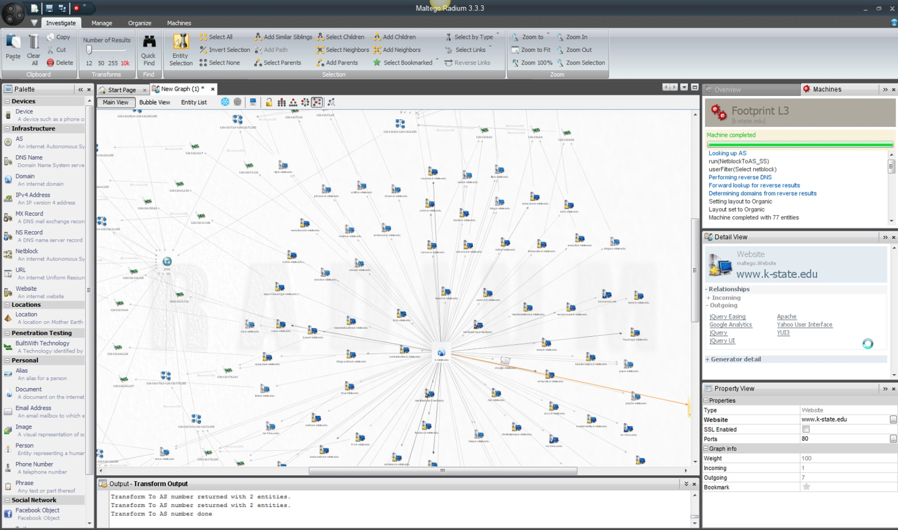
A Micro Crawl of K-State.edu Domain

Slide 52
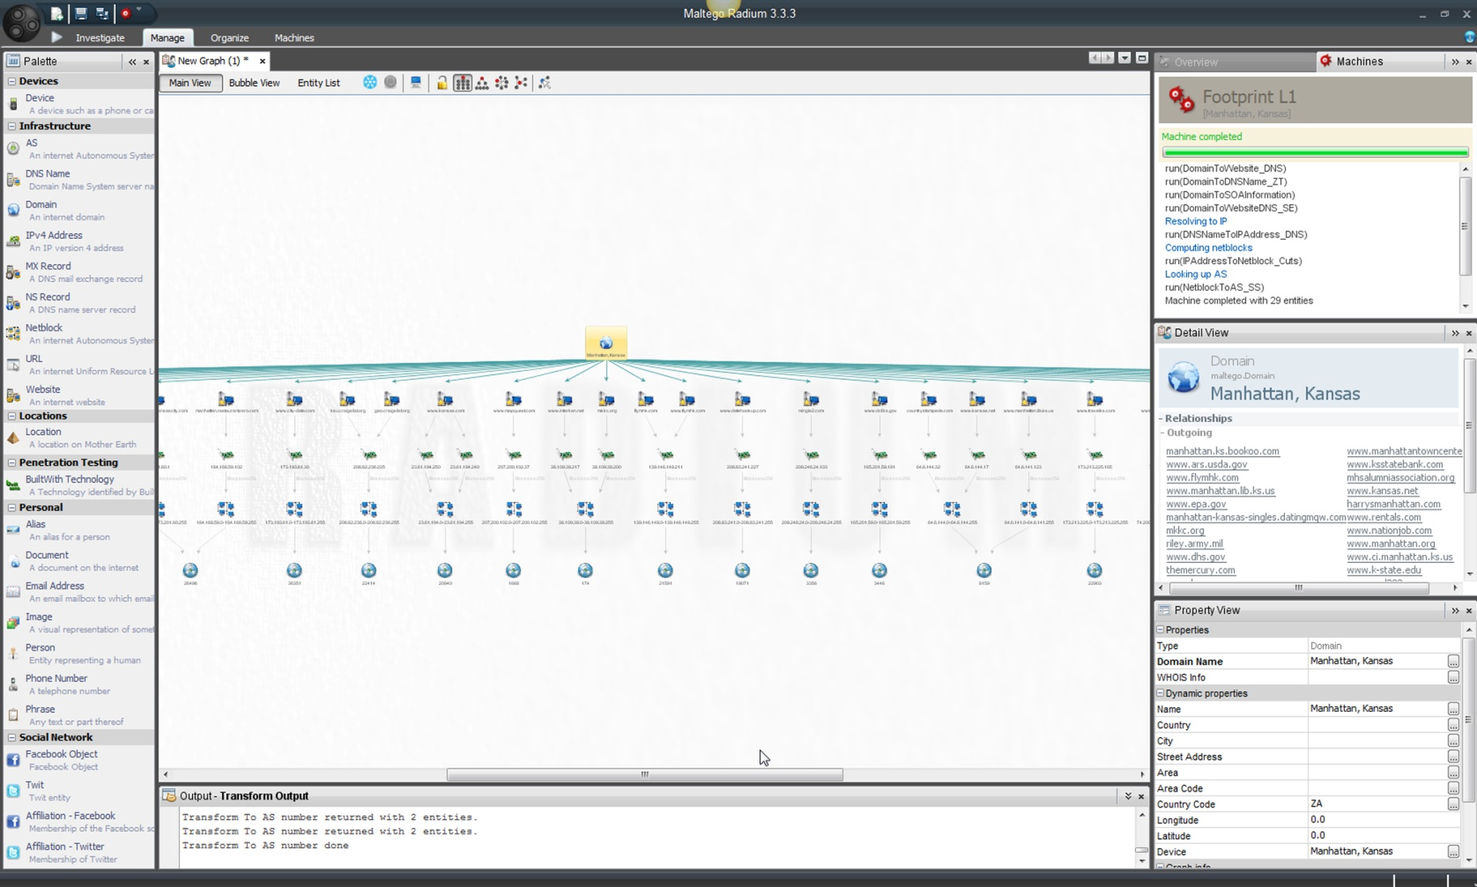
A Location-Based Domain Search: Manhattan, Kansas

Slide 53
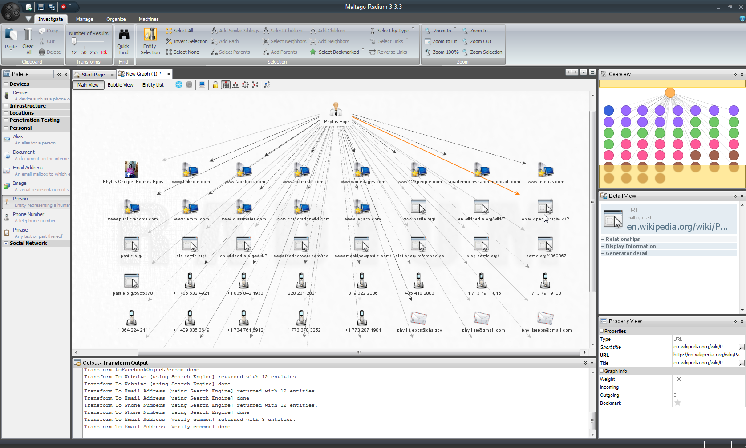
An Entity or “Person” Exploration for His / Her Electronic Doppelganger

Slide 54
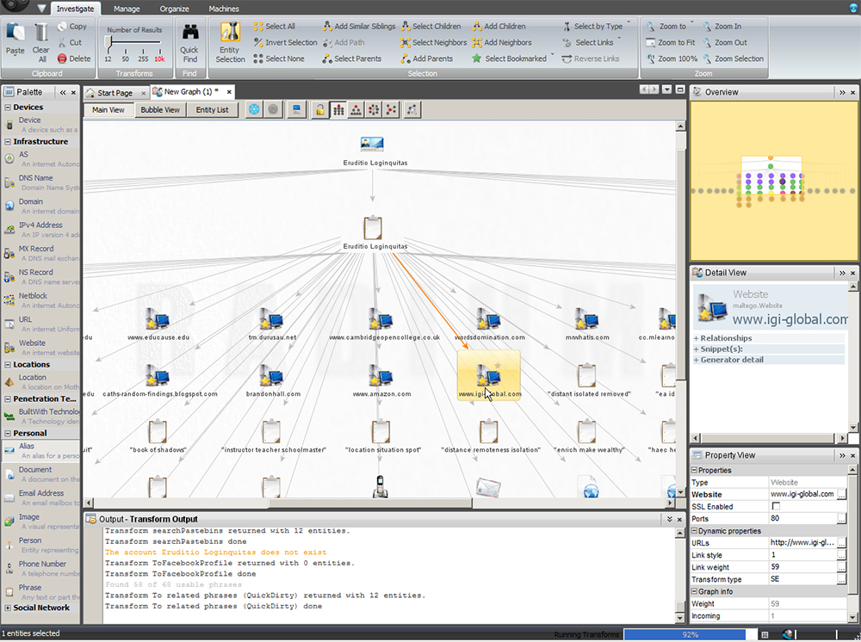
A De-Aliasing of an Pseudonymous Individual via Connections

Slide 55
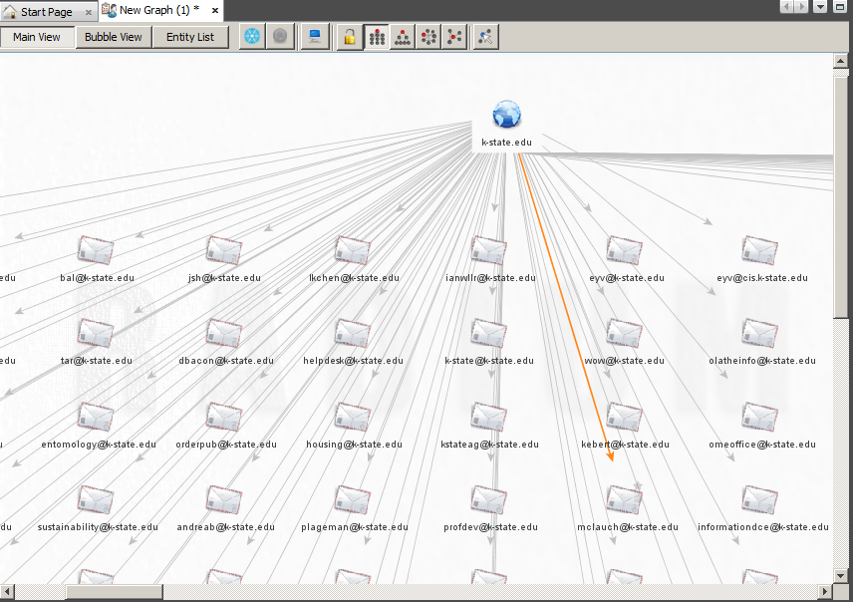
Emails Accounts Linked to a Domain
“Company Stalker” (~ hackerish semantics)

Slide 56
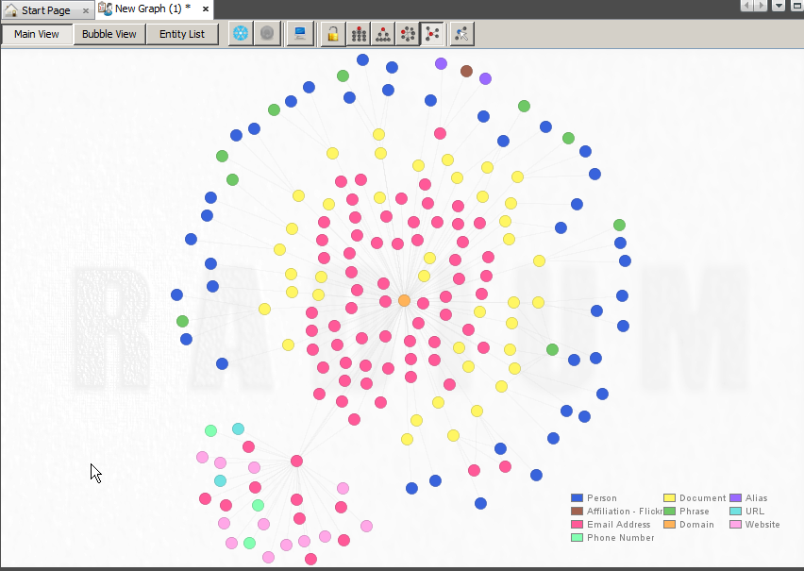

Emails Accounts Linked to a Domain (cont.)
Person
Affiliation (Flickr)
Email Address
Phone Number
Document
Phrase
Domain
Alias
URL
Website

Slide 57
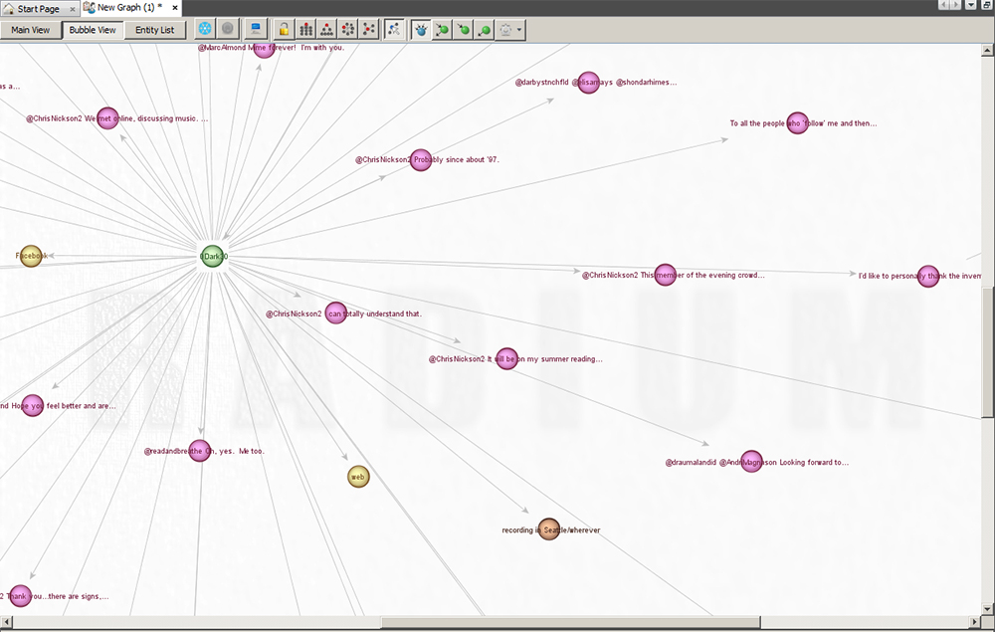
A Twitter Digger of #0Dark30
Bubble View

Slide 58
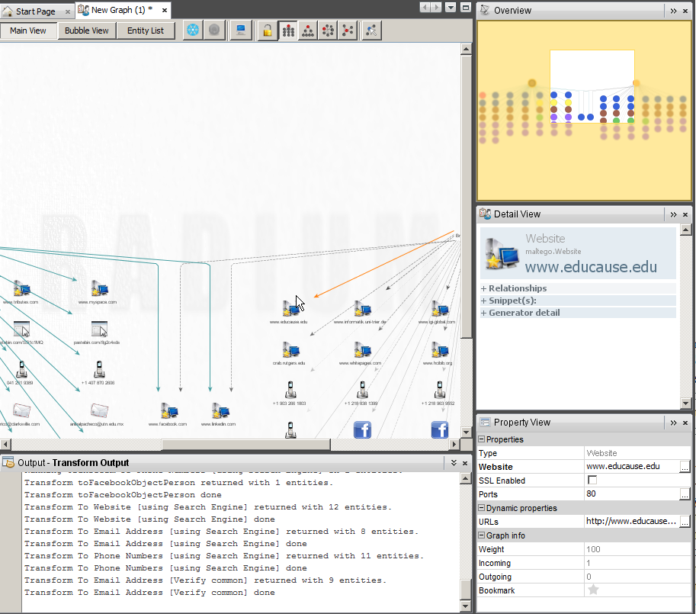
Electronic Connections between Persons?
Crawling two persons to see if anything links up
Combining crawls to answer directed questions

Slide 59
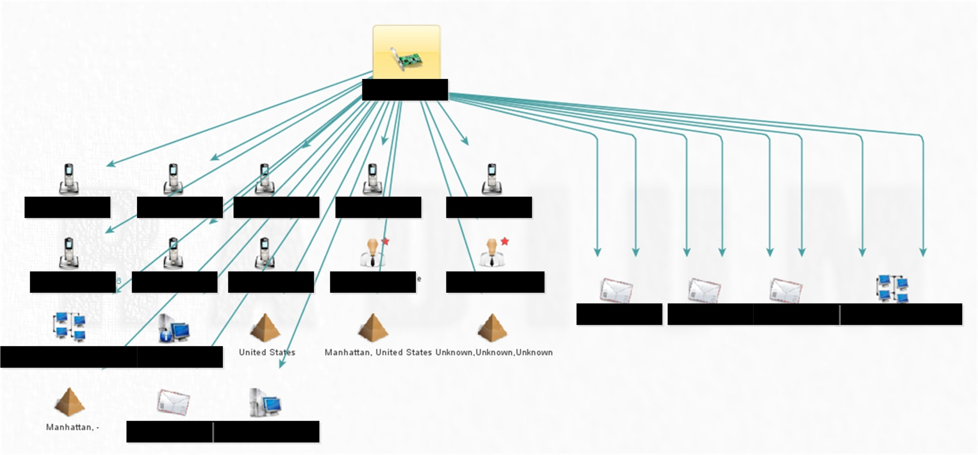
An IP Address Crawl
Links to an IP address

Slide 60
I/O: Importing, Saving, and Exporting
Importing:
Maltego Radium™ files
Tabular files
Saving :
.mtgx files
Exporting:
Data sets
Reports
Graphs

Slide 61
Importing Files
Maltego Radium™ Files
.mtz files (for Palette Transform entities)
.mtgx files (for graph visualizations and crawls)
Tabular Files
.csv, .xlsx, and .xls (for graphs)

Slide 62
Saving Files
Saving Proprietary Data Sets
Saves as a .mtgx (Maltego Radium™ graph file)
  May encrypt as AES-128 (Advanced Encryption Standard 128)
  Native files are not particularly large
Saves “machine” and “transform” parameters to re-crawl and update data sets for future runs
Note: Datasets considered to be “unstructured” or “loosely structured” because of the mix of content structures among the types of captured data

Slide 63
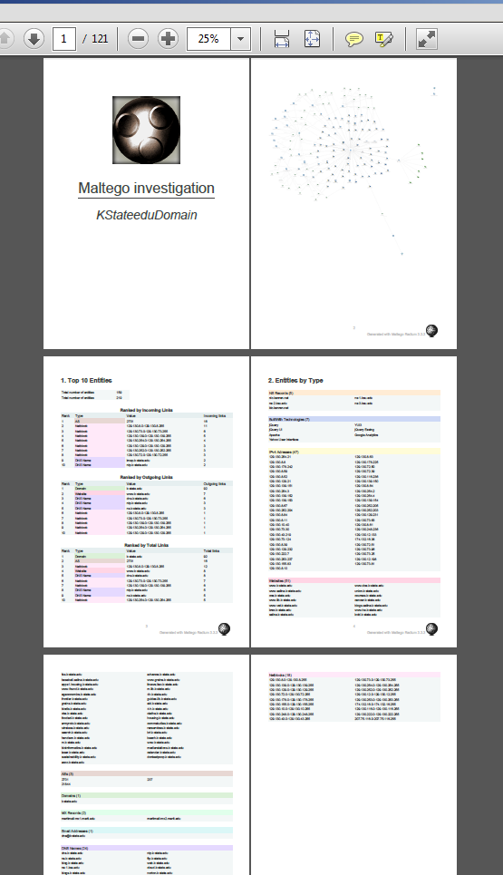
Exporting Reports and Graphs
Exporting Reports and Graphs
Report file types (complete summaries of extracted information): .pdf
2D graph as image (including zoomed-in): .gif, .png, .bmp, and .jpg

Slide 64
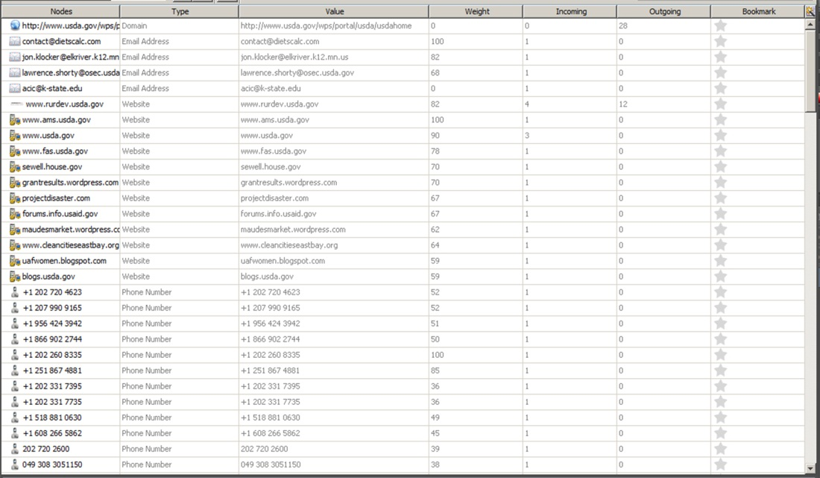
Extracting Entity Lists
May extract graph data as tables of textual information for further analysis through “Entity Lists” tab

Slide 65
Knowability
Applied deception
Applied Academic research
So far, what do you think is “knowable” (linkable) using tools like Maltego Radium™ (along with other research tools)?
What do you think your online profile looks like?
How does this knowledge of Maltego Radium™ capabilities change how you deceive, project, hide, obfuscate, or throw others off your trail (assuming you might)? ☺
Is there any interest in using this tool for academic research applications? If so, what sorts of research applications are you considering?
What may be asserted about the data? How is this data bounded or limited?
How can this high-dimensionality data be used in an “inference attack”? How accurate or inaccurate would such attacks be? How can the accuracy of such attacks be improved?
Notes:
About Applied Deception (bullet 3): What about single-use transactional pseudonyms? What about anonymization tools like TOR? What about using totally clean machines for very dedicated purposes? What about sheltering within another person’s identity? What about living quietly? (How does one avoid self-deception at the same time?)

Slide 66
“Knowability”
…through data-mining, structure mining
…through syntactic and semantic stylometry (with writing style as an “invariant,” with discernible “tells” for obfuscated and imitated writing) for authorship recognition
…through electronic “tells” and sufficiently detailed individual profiles
…through cross-referencing information from multiple databases (“big data” analysis, especially statistical correlations)
…through computational research
…through human analytics and logic

Slide 67
Exploration for Sense-Making
A data crawl as a starting point…
  Interactions with the data
    Logical deductions and inferences (e.g. Internet “traffic analysis”—where people go online—based on linkability structures)
    Ties to physical locations from multiple related accounts
  Pruning of leaf entities to disambiguate the findings
  Additional data extractions and crawls or computational research
    Supplementary research with other complementary or even overlapping software tools
  Further hypothesizing and testing
  Real-world explorations

Slide 68
Software’s Dynamic Range
Scale: Data set sizes
time
Giant (macro) data sets
  Forever crawls for the L3 footprints (if one filters unwisely by being too inclusive; otherwise, blisteringly fast)
  Total domain searches (including whole-country domain searches) but at a high level
  Huge depth that is time-consuming to explore (demanding on researchers)
Micro data sets as well (to the level of the individual ego node)
  May be a slice-in-time, sequential, or continuously dynamic (for real-time dynamic network analysis or “DNA”; focus on changes over time or trendline data) temporal data
Continuous dynamic for an “intel dashboard” or “data feed” for situational awareness
May be used to link space and time dimensions
SPATIO-TEMPORAL

Slide 69
(Affordances and) Constraints
A fast-changing electronic environment
  Need to update and review data extractions regularly
  Need to be aware of the existence of private channels
  Need to work within an evolving legal ecosystem
Costs: time, computational expense, attention
  Binding up time (even with blinding speeds of millisecond crawls) and computational expense on even high-end consumer machines
  Premature crawl stoppages, incomplete crawls, or over-data (excessive data)

Slide 70
(Affordances and) Constraints (cont.)
User / analyst strengths and limitations
  Need to wield the tool intelligently and not over-claim or under-claim results
  Could use tool for initial discovery, pattern recognition, and anomaly detection
  Engage a fairly high learning curve
  Apply complementary data for informed interpretation
  Avoid conflating popularity with influence, thin node peripheral positions with powerlessness, and other challenges
  Avoid under-sampling (collecting too little information)

Slide 71
(Affordances and) Constraints (cont.)
Newness of computational research in some academic / research / professional fields and analytical applications
  Challenges to research rigor and generalizability
  Challenges to domain field acceptability
  Openness in terms of methodologies
  The “primitiveness” of network science in various practical (research, analysis, decision-making, and other) applications

Slide 72
Limits to Generalizability for Research and Decision-making
May not be able to generalize far with only a partial data extraction or crawl (social media platform API limits, software limits), which provides descriptive data about networks
  Even relatively “complete” crawls have to be properly analyzed and documented
    Particular “branches” may be analyzed to understand particular ego neighborhoods or focal nodes
    Crawls may include long-closed accounts (such as for emails)
    Other branches need to be pruned to de-noise the data
  Analysis requires the making of inferences from what may be seen structurally
  May only assert within legal bounds (no hackerish techniques to access information—of course)

Slide 73
Limits to Generalizability for Research and Decision-making (cont.)
Social media platform accounts may be human, ‘bots, or cyborgs
  Various socio-technical systems (STS) may be gamed
    People engage in impression management and spin; they engage in obfuscation (they are strategic about information); identities may be back-stopped electronically with various hoaxed accounts
  Electronic systems may all be hoaxed (like honeypots or black holes, accounts, online email systems, digital contents, and websites)
  Accounts may have some “light leakage” or “data exhaust” (unintended revelations that may be observed, analyzed, inferred, deduced, or extracted by practiced researchers) or “behavior leakage” (oblique indicators that may be observed from accounts), but these are often subtle and observed through machine learning and statistical analyses

Slide 74
Limits to Generalizability for Research and Decision-making (cont.)
Maltego Radium™ only captures some information. It cannot…
  “see” what’s not connected to the Internet and WWW or capture what is happening non-electronically in the real or physical or non-cyber world (it cannot bridge the cyber-physical confluence)
  “go back in time” to map sites that are no longer online (in some form)
  “see” what is labeled “private” in social media platforms
  “see” how users navigate the electronic network
  “see” what the characteristics are for particular entities / nodes / sub-graphs or sub-groups (identify or describe node “biases” in social network-speak)

Slide 75
Limits to Generalizability for Research and Decision-making (cont.)
It cannot…
  “see” what is in the Deep Web or Invisible Web (dynamically created pages or those requiring registration), only what’s on the publicly indexable “static” Web
  explicitly indicate to researchers which nodes or links to explore in more depth
  maintain a continuous crawl for more dynamic data like Twitter Digger on background (unless the machine is kept running)
  (currently) trace and extract what information is moving through networks (content diffusion or percolation)
  create an invisible or stealth crawl (you will be seen skulking about)

Slide 76
To Review
Multimodal data extractions may be done to understand…
  Network ties (social, technological, and content)
  Spatiality and geo-location
  Technological structures
  Human and organizational identity (PII) (through cross-referenced information)
  Device usage online (~ to what Shodan computer search engine reveals)
  Available contact information
“Not knowing” / being unaware is a “dominated strategy,” an inherently “losing” or subordinated approach (in game theory)

Slide 77
To Review (cont.)
Maltego Radium™ brings together various functionalities that may be done separately with separate customized programs, Google Search, Network Solutions’ WHOIS, DNS, NodeXL social media platform data extractions, and then data visualization tools… but not as efficiently or as elegantly (especially for high-scale analyses and link analysis) …and not continuously over time
Maltego Radium™’s capabilities may be tested by conducting “machines” and “transforms” on known targets with known answers initially
Maltego Radium™ is styled in a sophisticated way, with cool visuals and sound effects

Slide 78
?s: Yours and Mine
Maltego RADIUM™ as a software tool
Maltego RADIUM™ as a penetration testing tool
What are some other possible practical and “feral” applications of Maltego Radium™ (adapted “unintended use” applications)?
  Computational journalism? Outreach and marketing? Academic research?
  Predictivity? Is it possible to predict group dynamics based on electronic network structures? Traffic? Contents?
What are some new functionalities that would enhance this tool?
In terms of its pen testing applications, what are some complementary software programs that may be used to
  Test network defenses?
  Surface hidden information?
  Identify and exploit vulnerabilities?

Slide 79
Resources
Paterva’s Maltego Radium™
Paterva
  Maltego Radium
  CaseFile
  Maltego Tungsten (for collaborative data extractions)*
Maltego Radium Blog
Maltego Tutorials: The Complete and Official Set (on YouTube)
Maltego Scripting Language (1.1) Guide (2012)
Maltego Radium Release (2012)
Maltego Version 3 User Guide (2011)

Slide 80
Resources (cont.)
Community version
Commercial version
Free limited “community” version available for non-commercial use
  API keys expire every few days
  Runs in private or public mode on community servers (slower crawls); latter collects back-end statistics to benefit the community
  User information collected
  Lag in features already in the professional version
Annual subscriptions to the software license available (with a 10% educational discount)
  Initial higher cost ($650 first year; $350 for consecutive years thereafter—or 365 days)
Includes access to crawls using Paterva servers

Slide 81
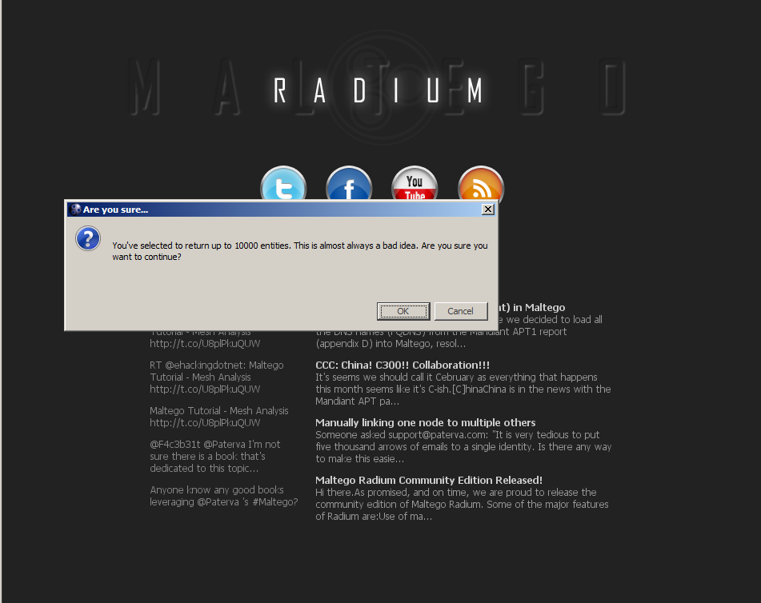
Learning Maltego Radium™
Semantics
Tool functions
Processes
Practical applications
Worldviews and mindsets
Drat! No Ctrl + Z “Undo” Function Yet

Slide 82
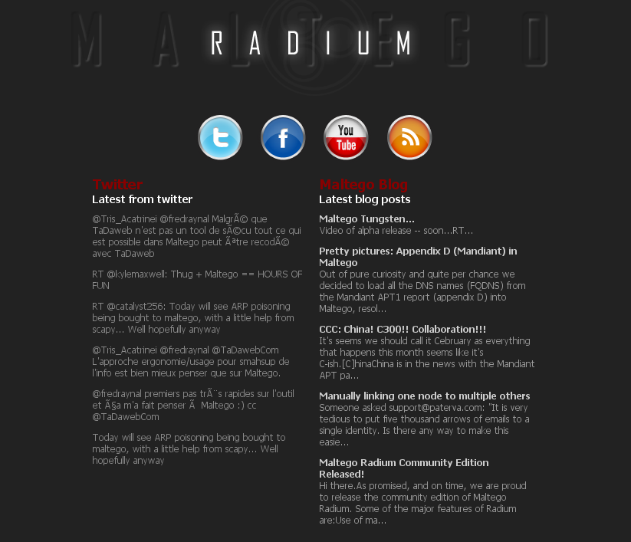
Maltego Radium™ on Social Media
Paterva on Twitter (@Paterva)
Maltego on Facebook
Paterva / Maltego on YouTube
RSS Feed

Slide 83
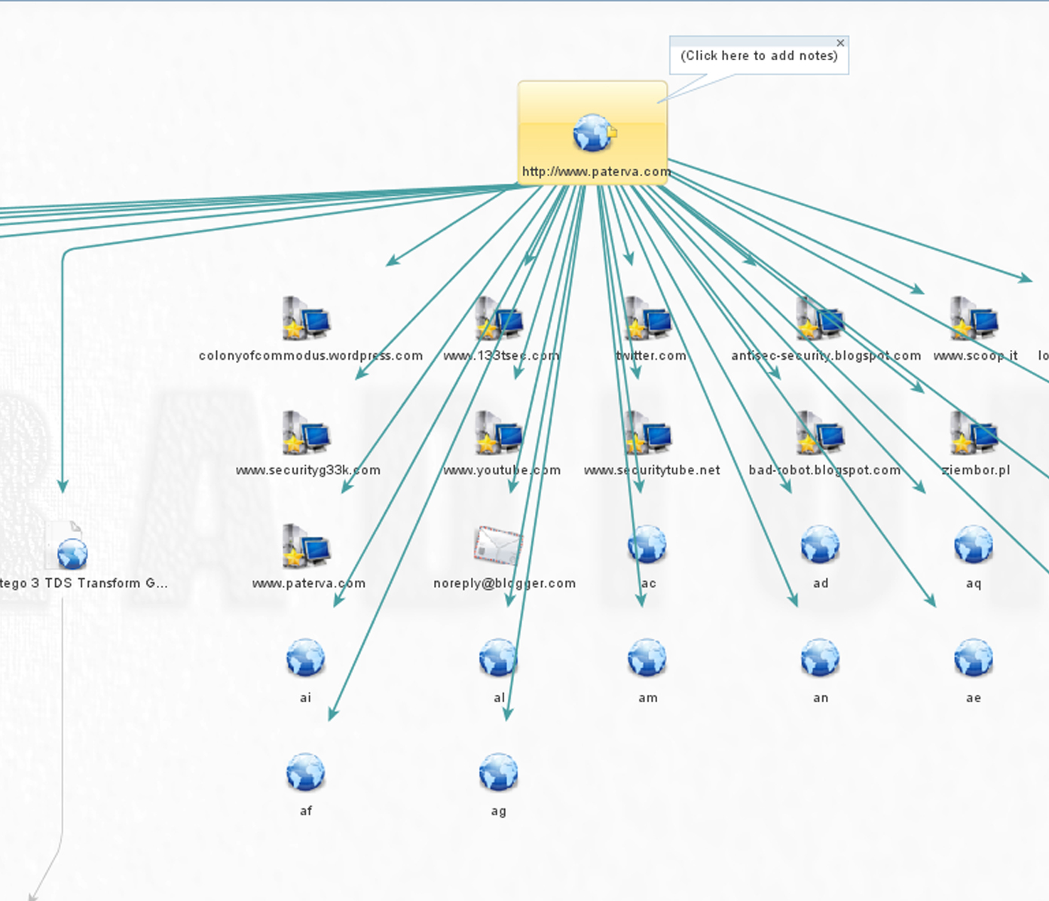
Who is Paterva?
Development Team for Maltego Radium: 5 individuals based out of Gauteng, S. Africa
Roelof Temmingh
44B Nelmapius Road Irene
Pretoria, Gauteng 0157
ZA
Phone: +27.27834486996
Email: roelof.temmingh@gmail.com
@roeloftemmingh on Twitter
A “company stalker” crawl of www.Paterva.com (to the right)
  Making the company “drink its own champagne” :P

Slide 84
Thanks!
“A Brief Overview of Social Network Analysis and NodeXL”
Thanks to Dr. Rebecca Gould, who encouraged my learning of Maltego Radium™ for (totally white-hat) higher education-based research.
Thanks to Phyllis Epps, who gave me permission to crawl her identity @peppslugs on Twitter, for this presentation.
Thanks to Anibal Pacheco, who gave me permission to crawl his electronic social networks for this demo. He asked me to share the following:
  Site: www.anibalpacheco.net
  Account: @anibalpachecoIT on Twitter
  YouTube channel: http://bit.ly/TM8CHP (Megabyte Wizards)
Thanks to CHECK for accepting this presentation and to the supportive audience!
The presenter has no tie to nor interests in Paterva.

Slide 85
Conclusion and Thin Ties Contact
Dr. Shalin Hai-Jew
Instructional Designer, iTAC
212 Hale Library
Kansas State University
785-532-5262
shalin@k-state.edu
Practically Speaking: No Anonymity
“We may not acknowledge that in an electronic medium, levels and kinds of anonymity mean, in an important sense, no anonymity. If there are domains in which we can be anonymous but those domains are part of a global communication infrastructure in which there is no anonymity at the entry point, then it will always be possible to trace someone’s identity.”
  Deborah G. Johnson and Keith Miller’s “Anonymity, Pseudonymity, or Inescapable Identity on the Net” (1998), Computers and Society

